Slide 1






THE PHYSICS OF MoEDAL : THE 7th LHC EXPERIMENT
NICK E. MAVROMATOS
KING’S COLLEGE LONDON & CERN-PH-TH
FOR THE MoEDAL COLLABORATION
March 25-26 2013
London Centre
for Terauniverse
Studies (LCTS)
AdV 267352
Valencia

Slide 2

LHCf
LHCb
MoEDAL
ATLAS
CMS
ALICE
TOTEM
…LHC Experiments, fighting to unveil the
mysteries of our world & discover New Physics

Slide 3
LHCf
LHCb
MoEDAL
ATLAS
CMS
ALICE
TOTEM
…LHC Experiments, fighting to unveil the
mysteries of our world & discover New Physics

Slide 4

OUTLINE*
DESCRIPTION OF THE MoEDAL EXPERIMENT:
Location, Institutional Structure
The principles of MoEDAL detection
Characteristic sensitivity vs other LHC Exps
THE PHYSICS PROGRAMME OF MoEDAL
Detection of highly ionising, long-lived massive particles
predicted in a plethora of BSM theories
Electroweak Monopoles rather than GUT monopoles with TeV
masses predicted recently (Cho et al. , 1212.3885 [hep-ph])
…falsifiable (in principle) at MoEDAL → boost from theory
* Many thanks to Jim Pinfold for providing material presented here

Slide 5
OUTLINE*
DESCRIPTION OF THE MoEDAL EXPERIMENT:
Location, Institutional Structure
The principles of MoEDAL detection
Characteristic sensitivity vs other LHC Exps
THE PHYSICS PROGRAMME OF MoEDAL
Detection of highly ionising, long-lived massive particles
predicted in a plethora of BSM theories
Electroweak Monopoles rather than GUT monopoles with TeV
masses predicted recently (Cho et al. , 1212.3885 [hep-ph])
…falsifiable (in principle) at MoEDAL → boost from theory
* Many thanks to Jim Pinfold for providing material presented here

Slide 6
OUTLINE*
DESCRIPTION OF THE MoEDAL EXPERIMENT:
Location, Institutional Structure
The principles of MoEDAL detection
Characteristic sensitivity vs other LHC Exps
THE PHYSICS PROGRAMME OF MoEDAL
Detection of highly ionising, long-lived massive particles
predicted in a plethora of BSM theories
Electroweak Monopoles rather than GUT monopoles with TeV
masses predicted recently (Cho et al. , 1212.3885 [hep-ph])
…falsifiable (in principle) at MoEDAL → boost from theory
IJMPA paper on the Physics of MoEDAL is under preparation
* Many thanks to Jim Pinfold for providing material presented here

Slide 7
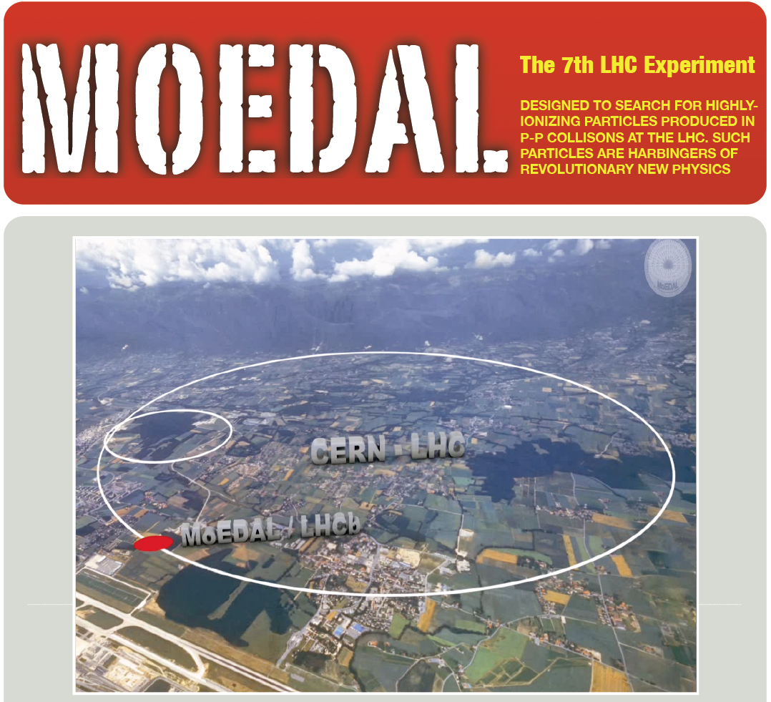











International Collaboration
42 Physicists from
17 Participating Institutions
UNIVERSITY OF ALBERTA
UNIVERSITY OF BOLOGNA
UNIVERSITY OF BRITISH
COLUMBIA
CERN
THE UNIVERSITY OF
CINCINNATI
CONCORDIA UNIVERSITY
CZECH TECHNICAL
UNIVERSITY IN PRAGUE
UNIVERSITÉ DE GENÈVE
DESY
IMPERIAL COLLEGE LONDON
KING'S COLLEGE LONDON
UNIVERSITY OF MÜNSTER
NORTHEASTERN UNIVERSITY
INSTITUTE FOR SPACE
SCIENCES, ROMANIA
TUFT'S UNIVERSITY
IFIC VALÈNCIA
YORK UNIVERSITY

Slide 8

Location of MoEDAL Experiment
MoEDAL shares intersection point 8 on the LHC ring with LHCb

Slide 9
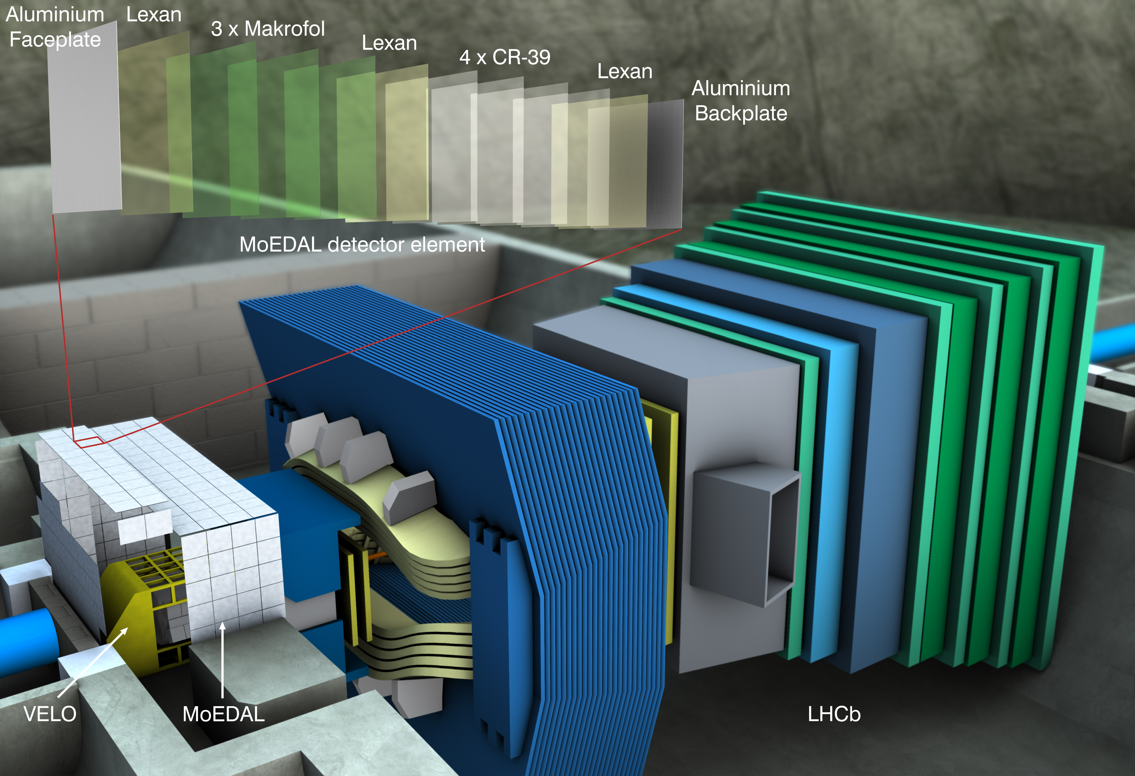
The MoEDAL Experiment Revealed

Slide 10
The MoEDAL Experiment Revealed

Slide 11
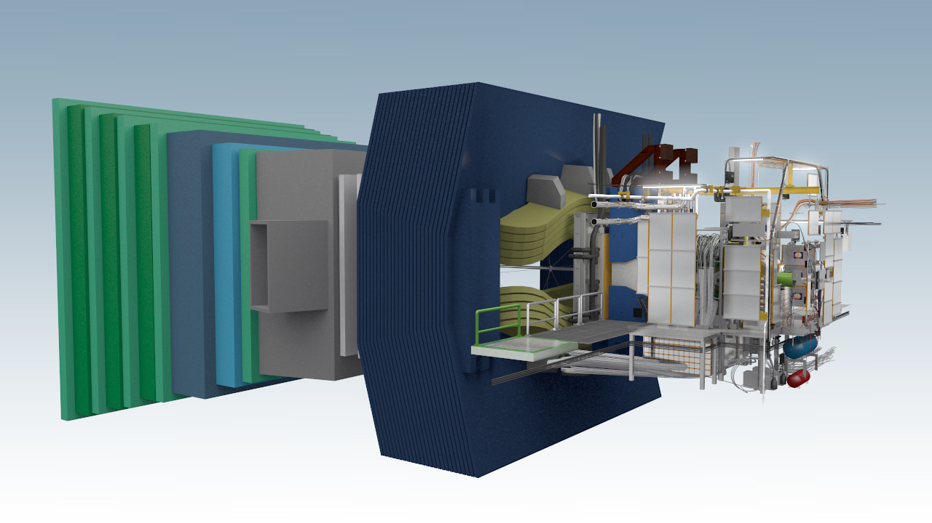
The MoEDAL Detector – a Tour
LHCb
MoEDAL
DETECTOR SYSTEMS
The TDR NTD array
(Z/β > ~5)
The Very High Charge Catcher NTD array (Z/β > ~50)
The Monopole Trapping detector
The TimePix radiation background monitor
MoEDAL is unlike any other LHC experiment:
The largest deployment of passive Nuclear Track Detectors (NTDs) at an accelerator
The 1st time trapping detectors will be deployed as a detector

Slide 12
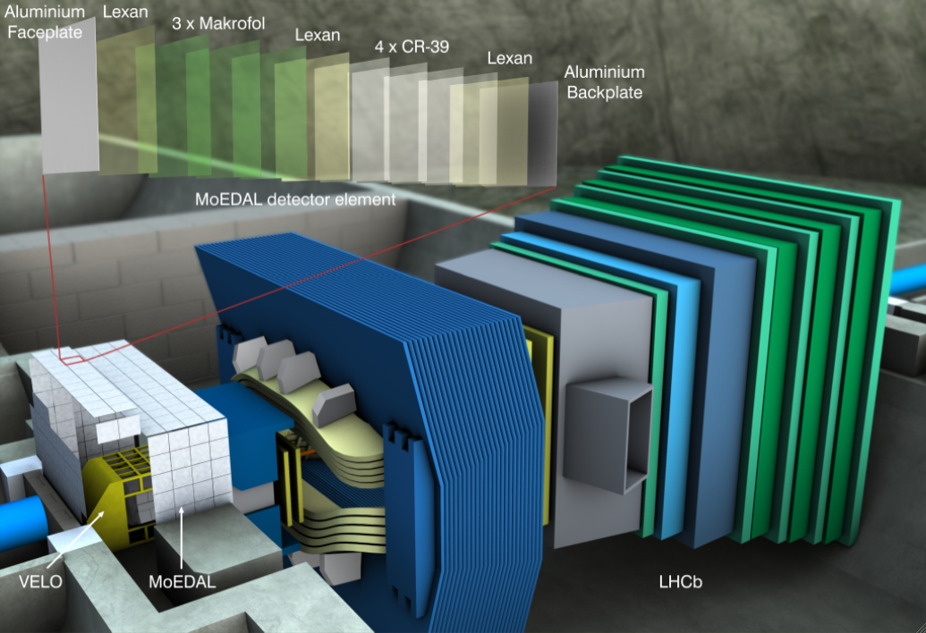
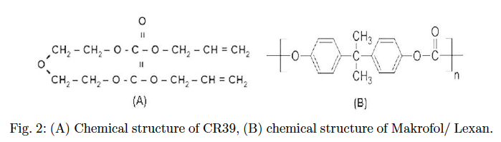
MoEDAL NTDs- What Are they?
CR39 density 1.32 g/cm³
Macrofol density: 1.29 g/cm³
NTDs utilized are of two types:
&

Slide 13
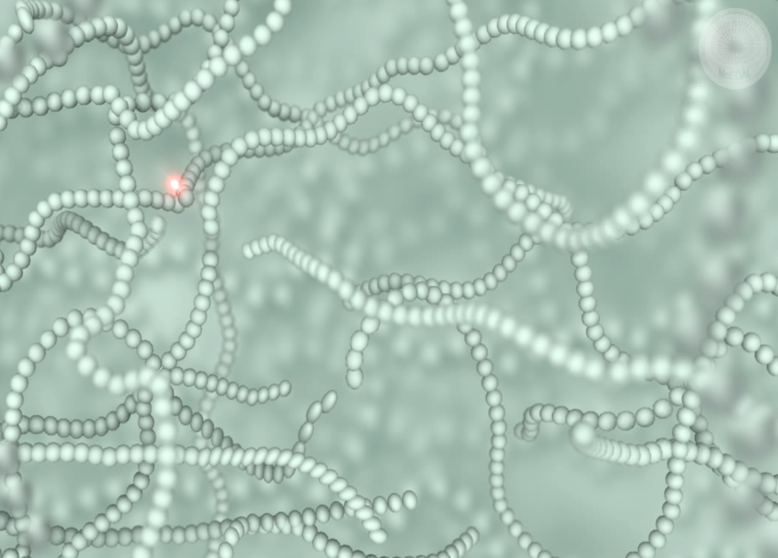
MoEDAL NTDs- How They Work
The highly ionizing particle leaves a cylindrical trail of damage in the plastic track etch detectors
Sufficient damage in plastic if cross section of ptcle-material

Slide 14
MoEDAL NTDs- How They Work
The highly ionizing particle leaves a cylindrical trail of damage in the plastic track etch detectors
NTDs are passive detectors that don’t need extensive support structures or HV, gas, electronic readout or trigger & are insensitive to relativistic SM particles

Slide 15
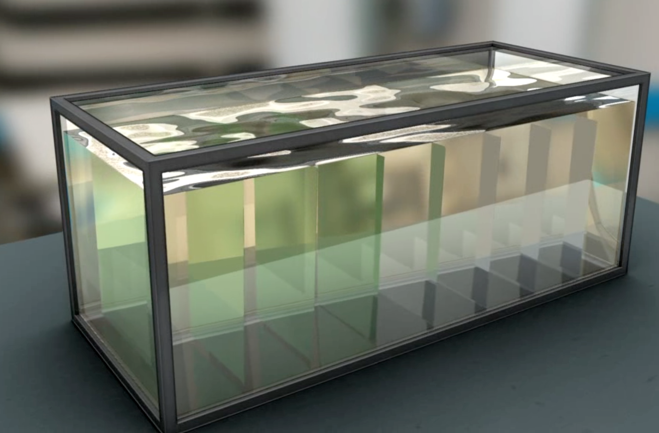

The Etching Process
Tracks are revealed as conical etch pits by controlled etching of the NTD with charge resolution ~0.05e and spatial resolution ~ 10 microns/pit – pointing to the IP

Slide 16
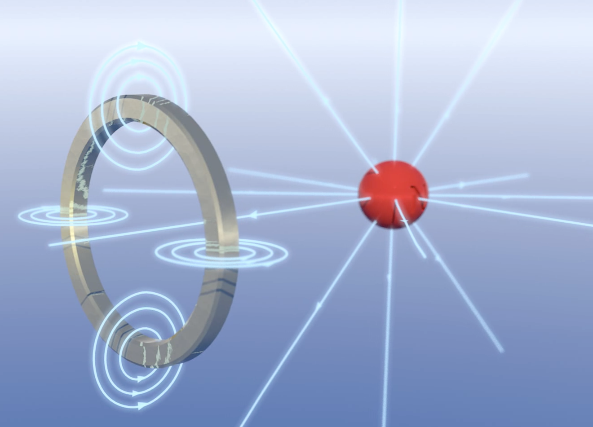
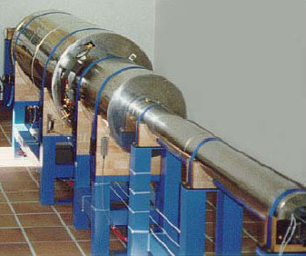
The Trapping Detector (MMT)
SQUID magnetometer (Southhampton)
We will deploy trapping volumes in the MoEDAL/VELO Cavern to trap highly ionizing particles
The binding energies of monopoles in nuclei with finite magnetic dipole moments are estimated to be hundreds of keV
After exposure the traps are removed and sent to:
The SQUID magnetometer at ETH Zurich for Monopole detection
SNOLAB (2km underground) to detect decays of MSPs

Slide 17
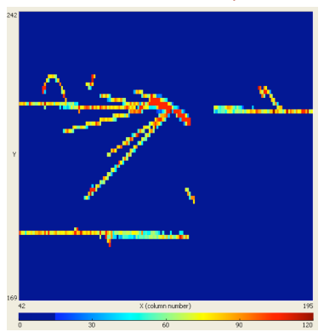
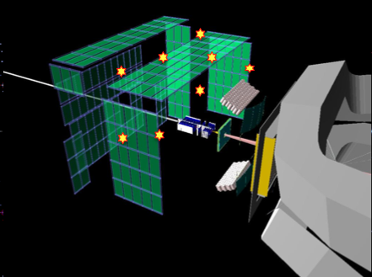
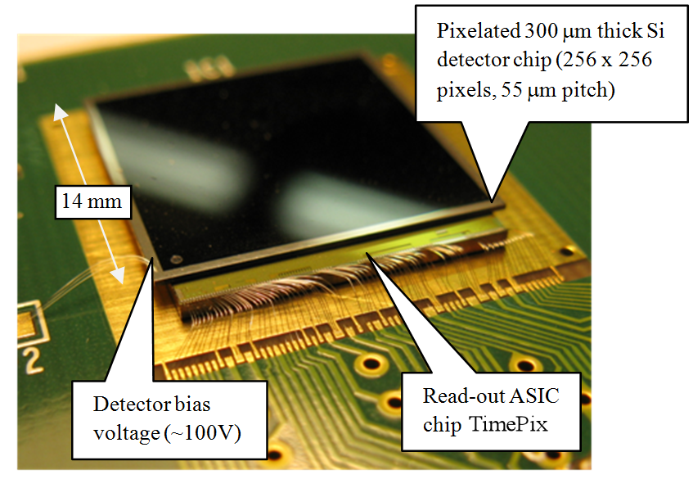
The TimePix Radiation Monitor
Timepix (MediPix) chips are used to measure online the radiation field + measure the spallation product background
The Timepix chip pixels are instrumented with an amplifier + comparator + counter + timer (allows TOT energy measurement)
The TimePix chip is essentially an electronic bubble chamber

Slide 18
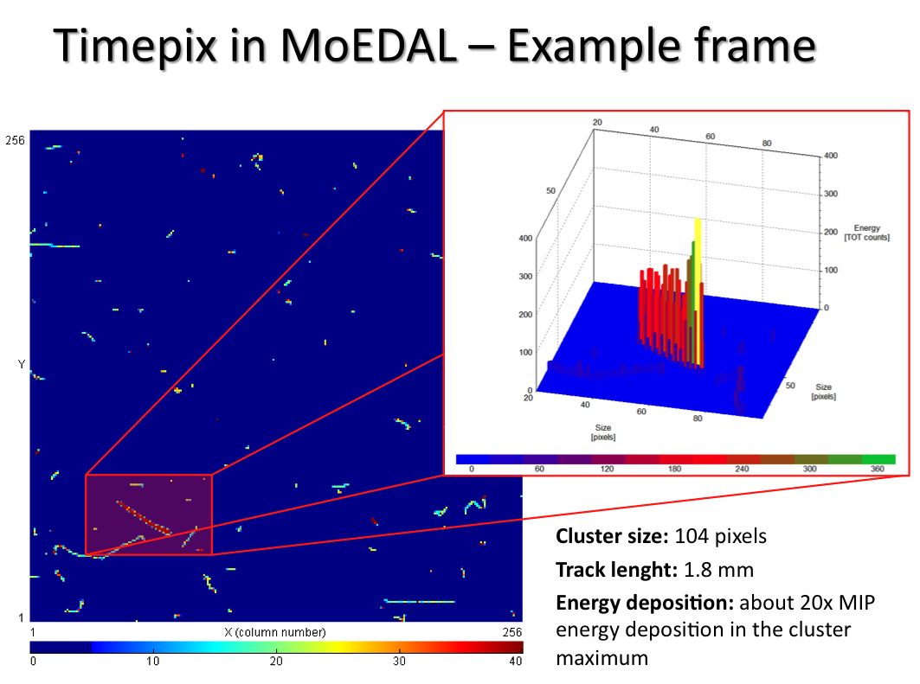
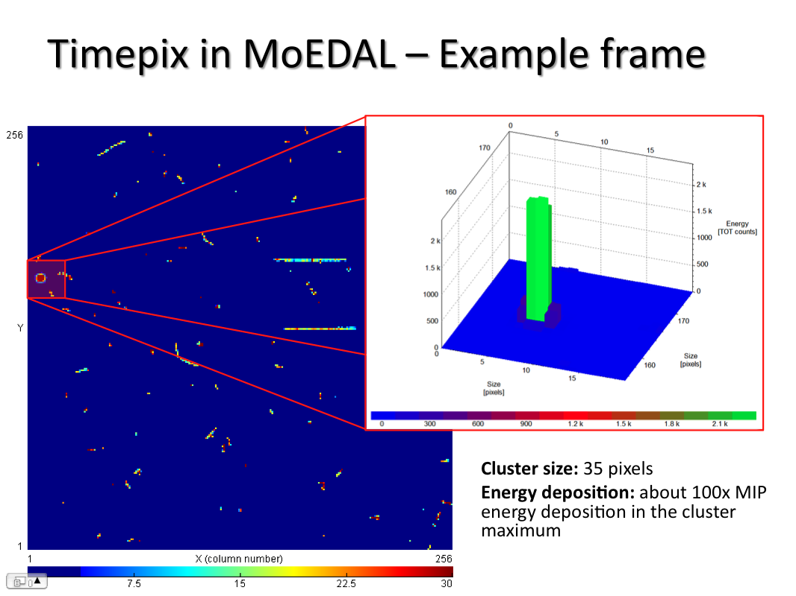
The TimePix Radiation Monitor
Interesting 1st results from the test TimePix chip deployment
Many interesting pictures of highly ionizing “blobs” & “tracks”
Scanning and calibration studies are in progress.

Slide 19
Complementarity of MoEDAL
ATLAS+CMS
MoEDAL
The main LHC detectors are optimized for the detection of singly (electrically) charged (or neutral) particles (Z/β~1) moving near to the speed of light (β > 0.5)
Typically a largish statistical sample is needed to establish a signal
MoEDAL is designed to detect charged particles, with effective or actual Z/β > 5.
As it has no trigger/ electronics slowly moving (β < ~5) particles are no problem
One candidate event is enough to establish the signal (no Standard Model backgrounds)
MoEDAL is complementary to the main LHC experiments and expands the physics reach of LHC

Slide 20
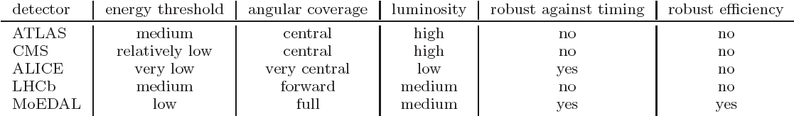
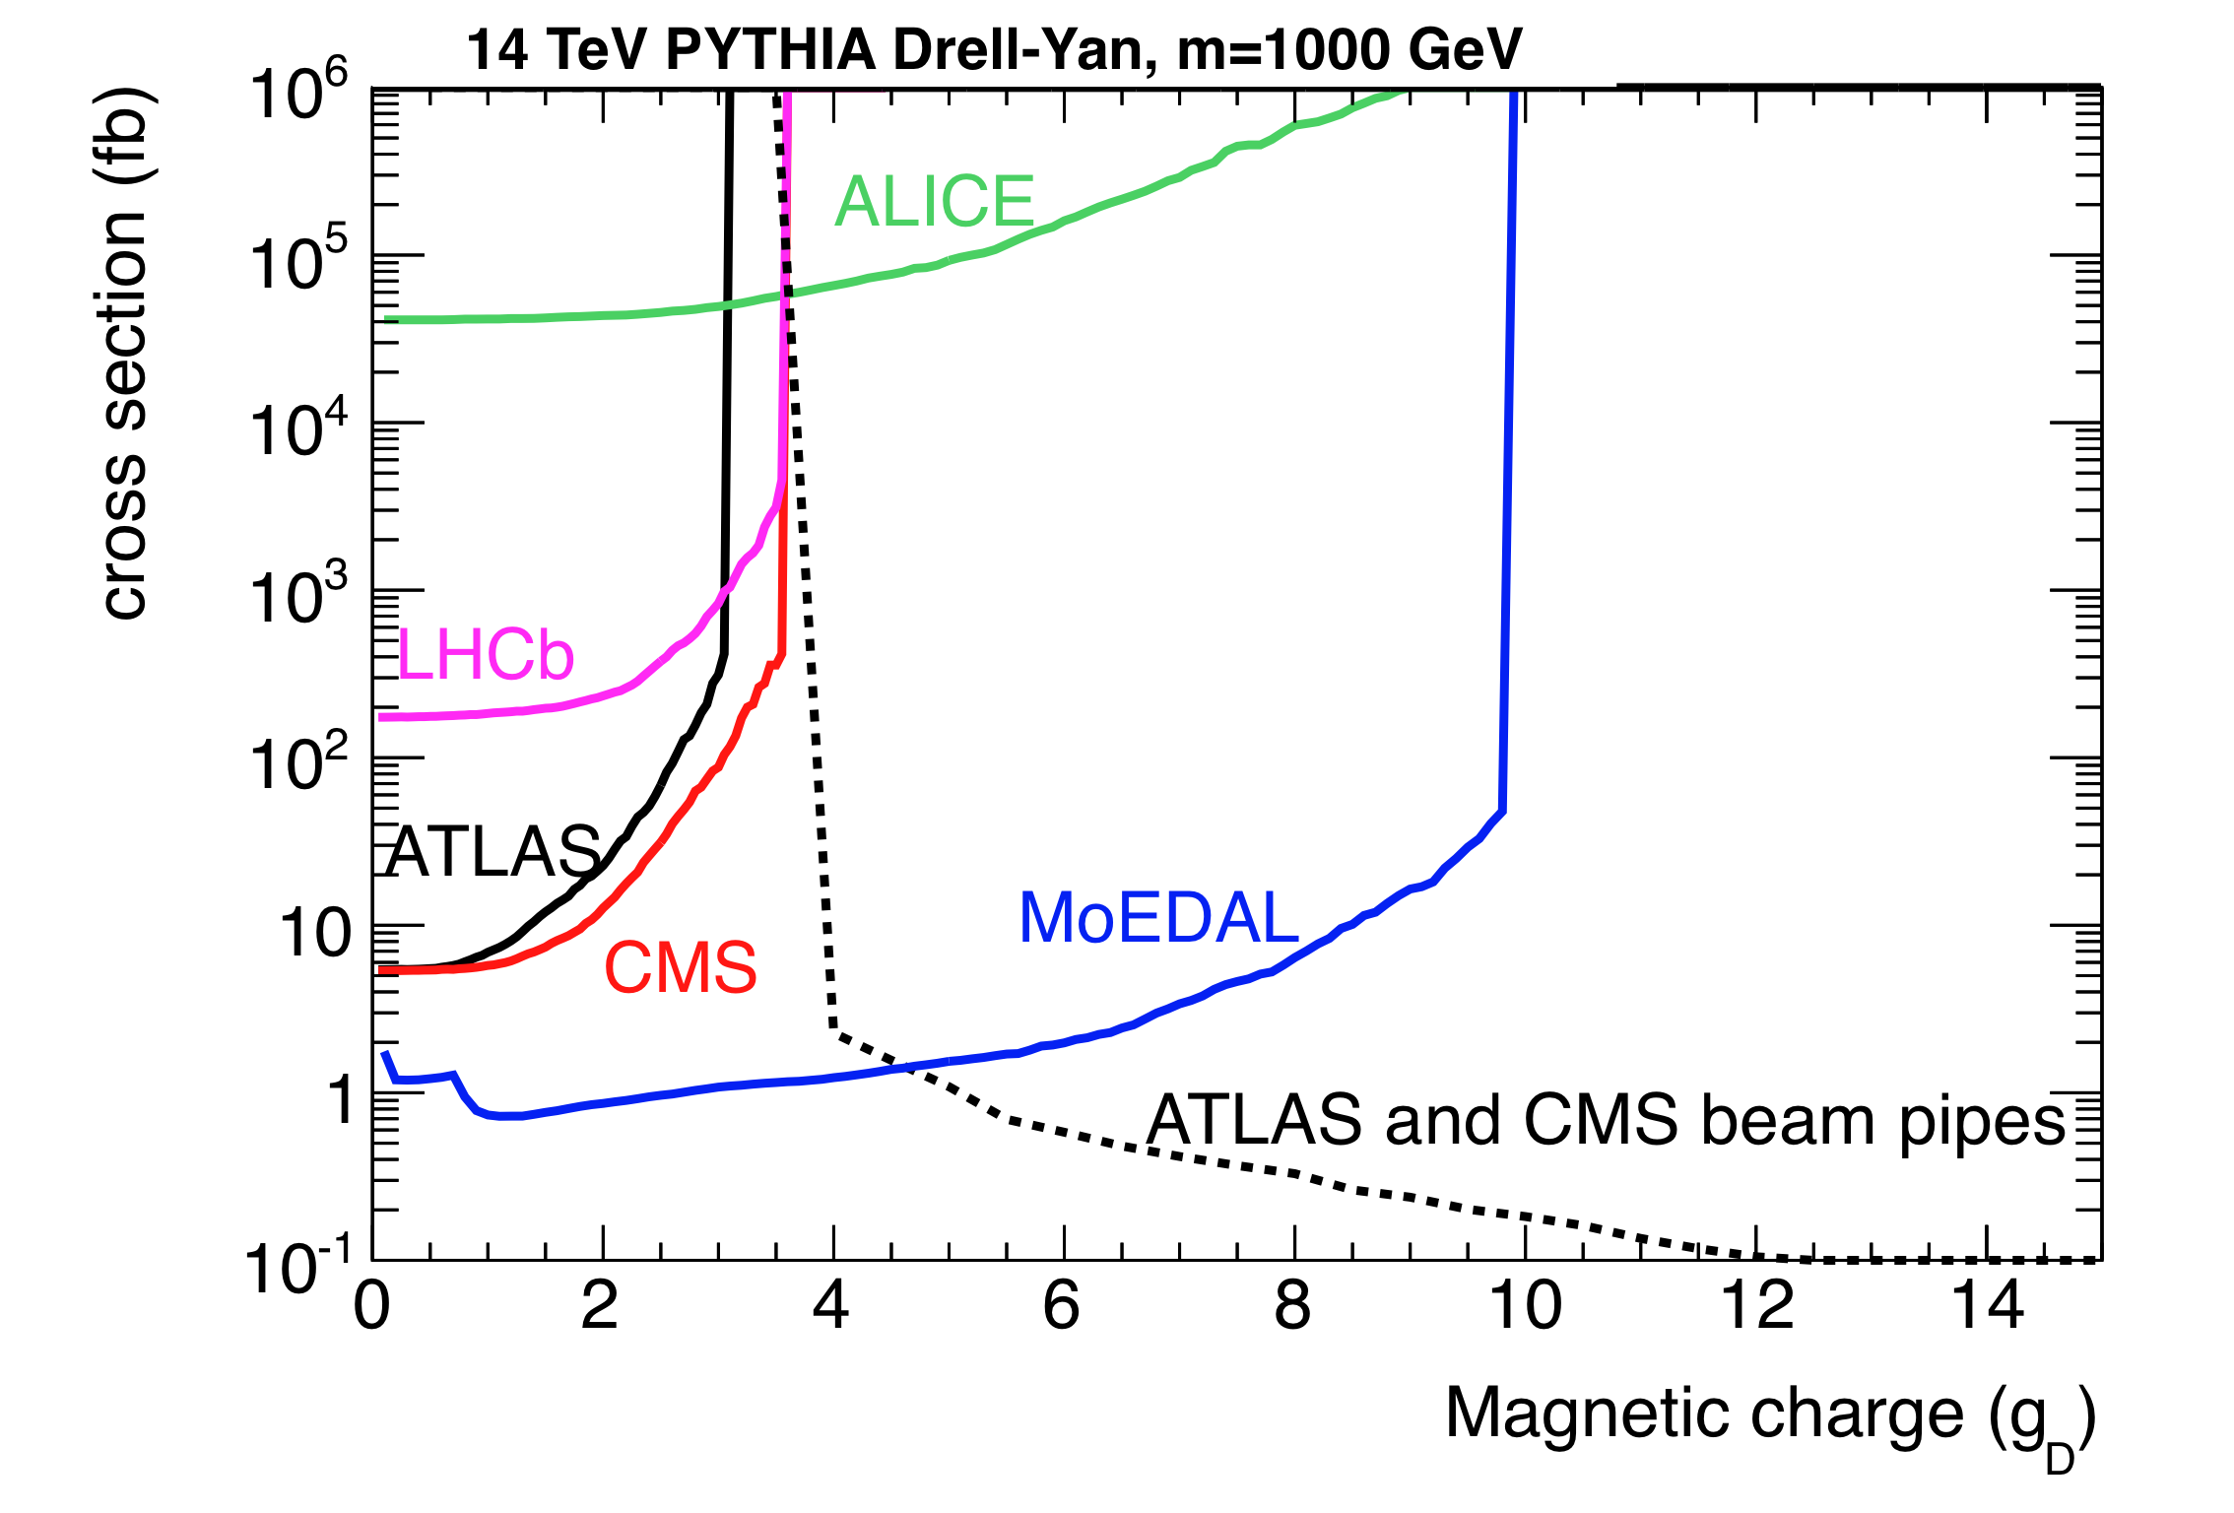
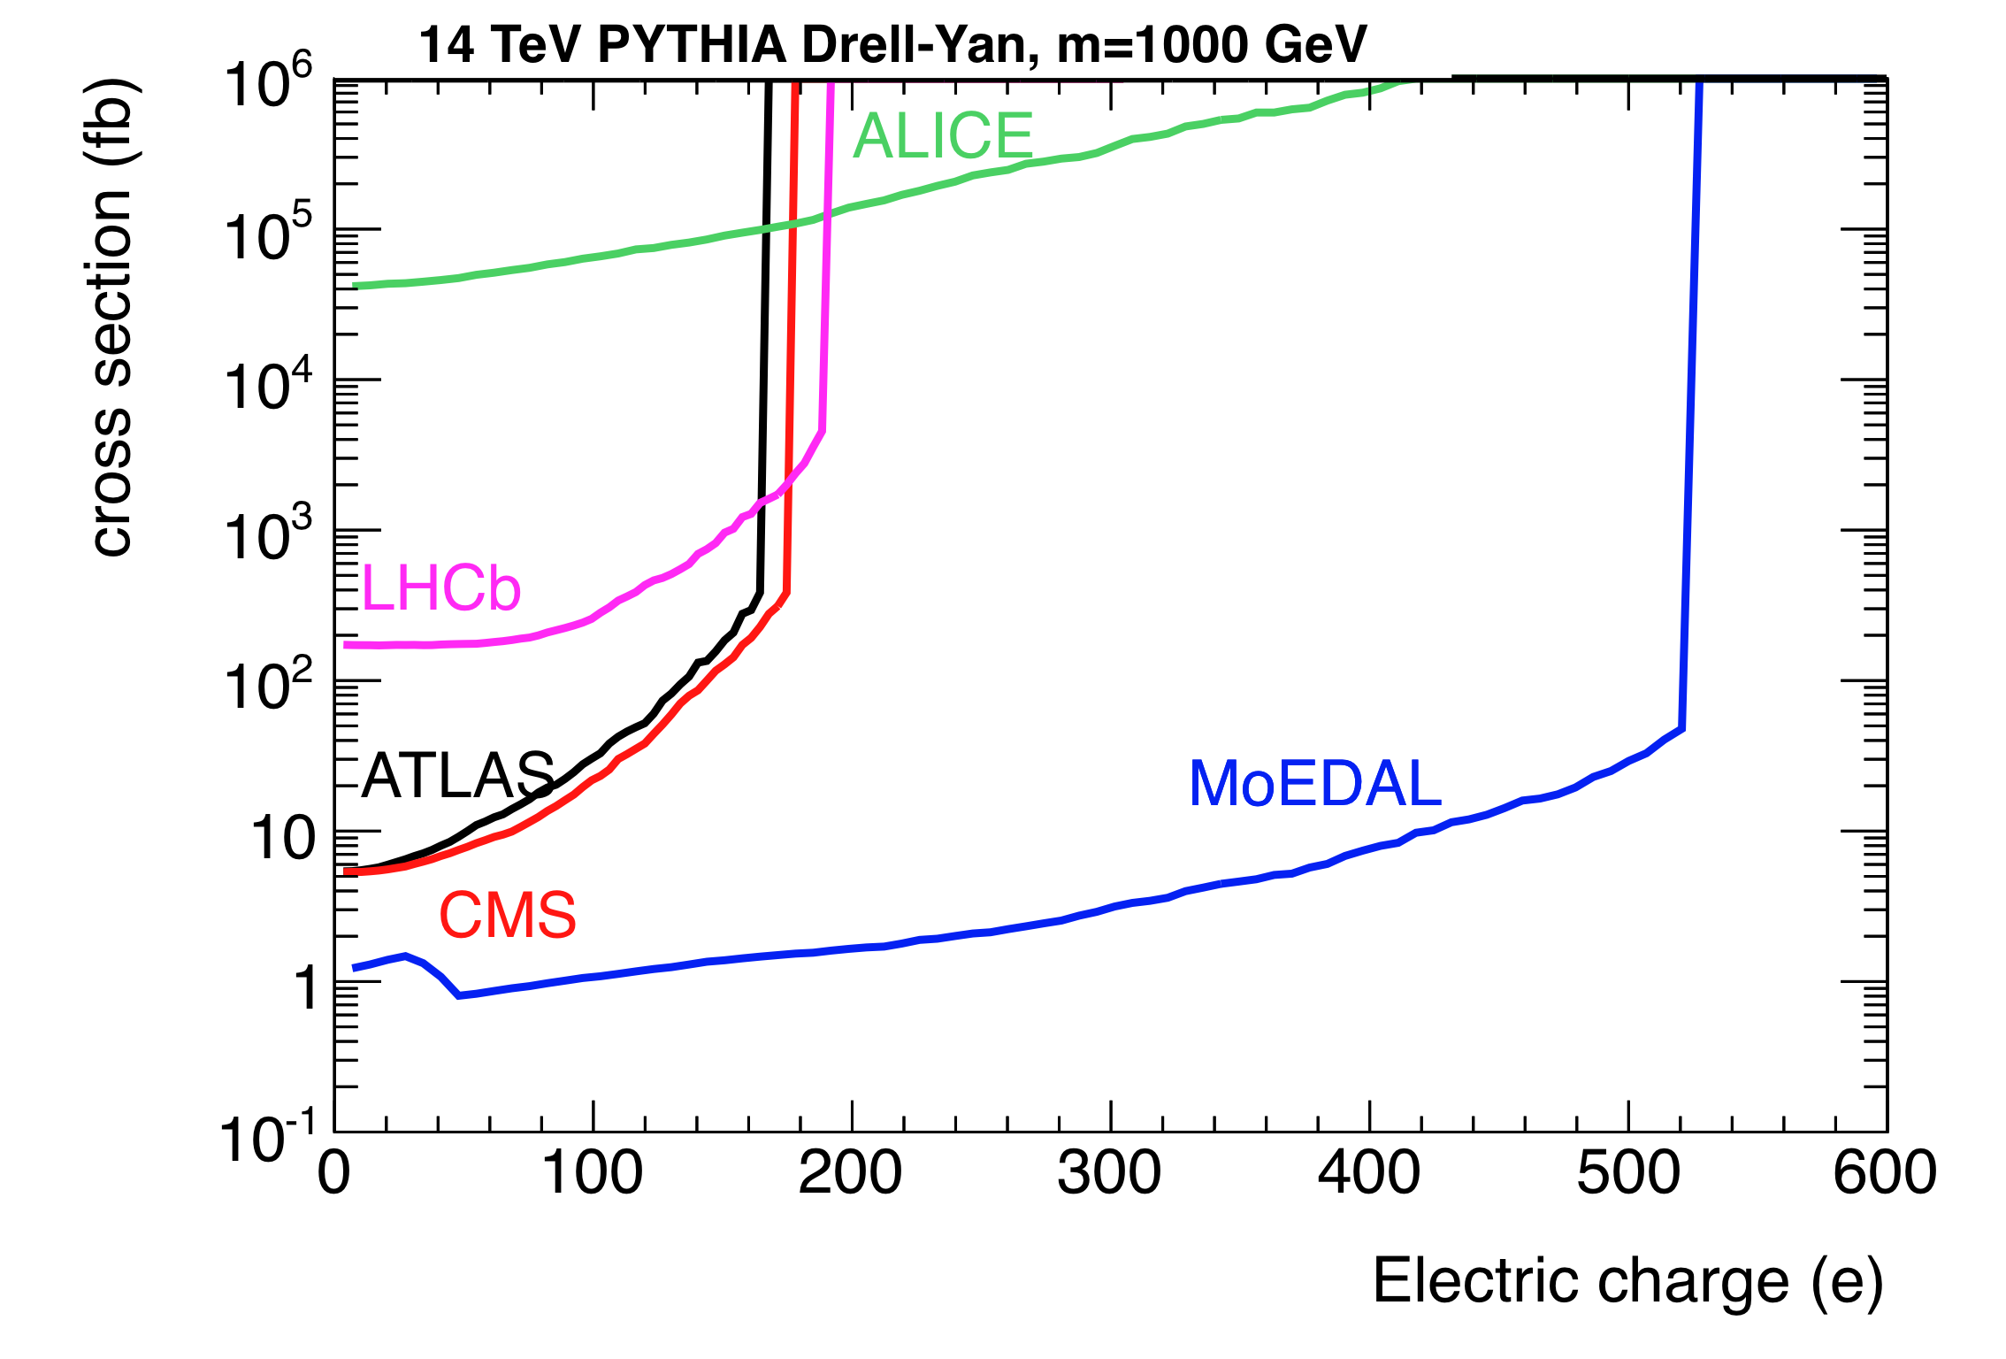
MoEDAL Sensitivity
✔
✔
✔
✔
✔
Cross-section limits for magnetic (L) and electric charge (R) (from arXiv:1112.2999V2 [hep-ph]) assuming:
Only one MoEDAL event is required for discovery and ~100 events in the other (active) LHC detectors
@ 20 fb⁻¹ (assumed)

Slide 21
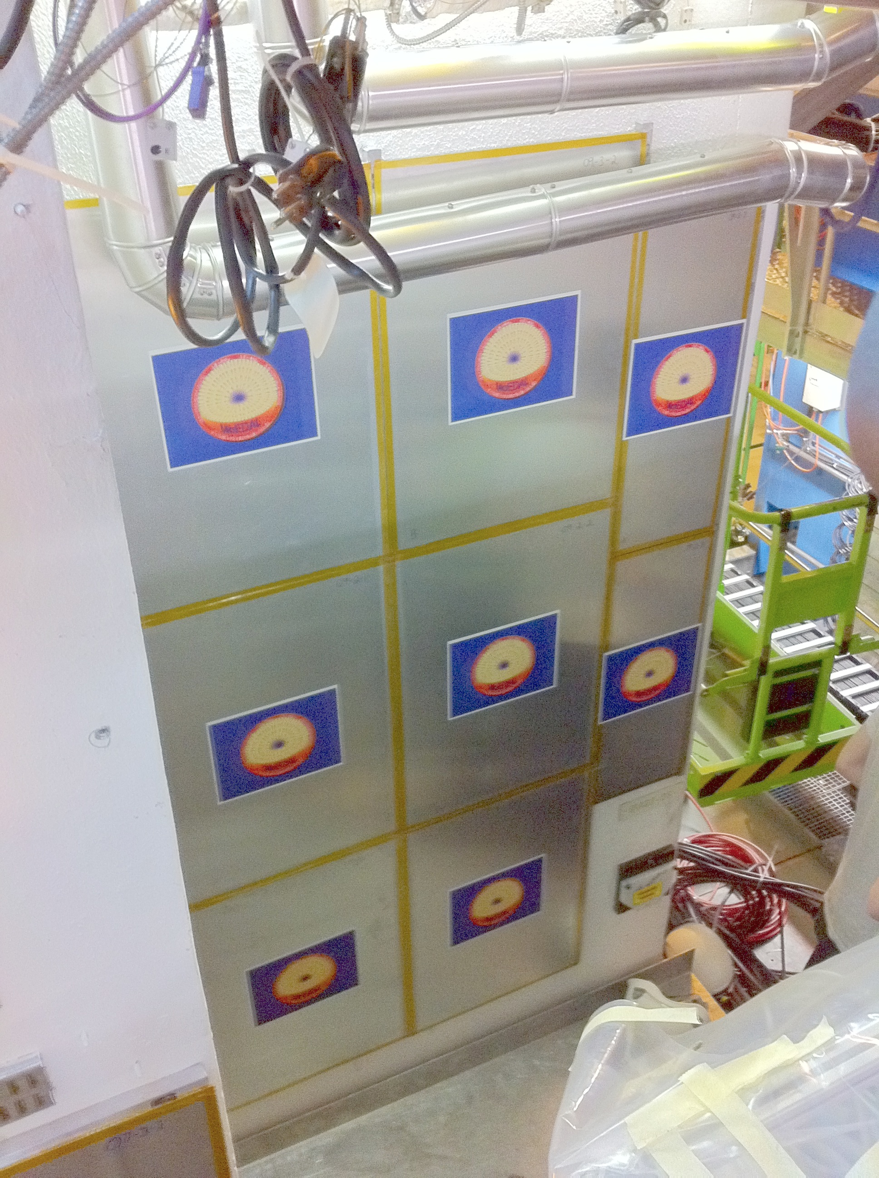
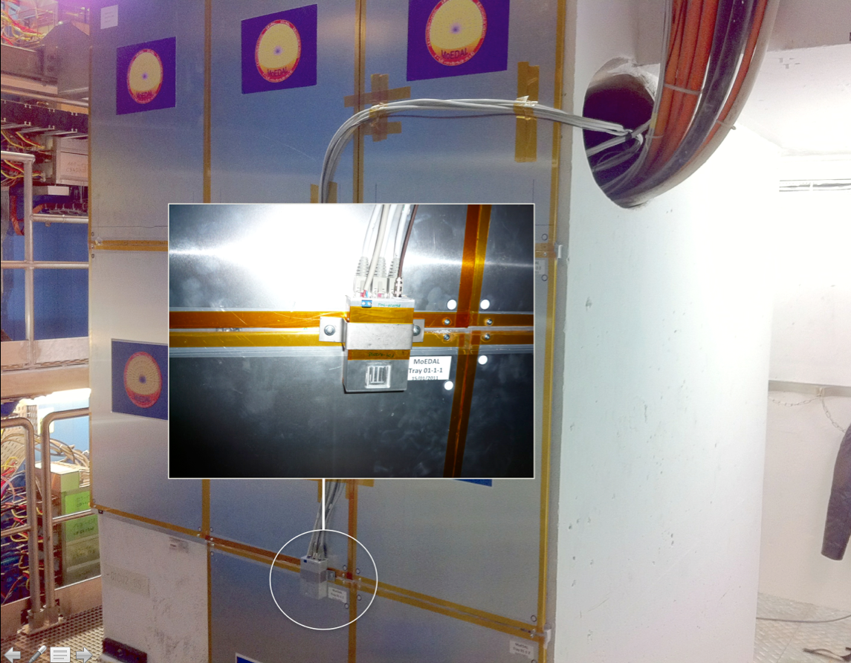
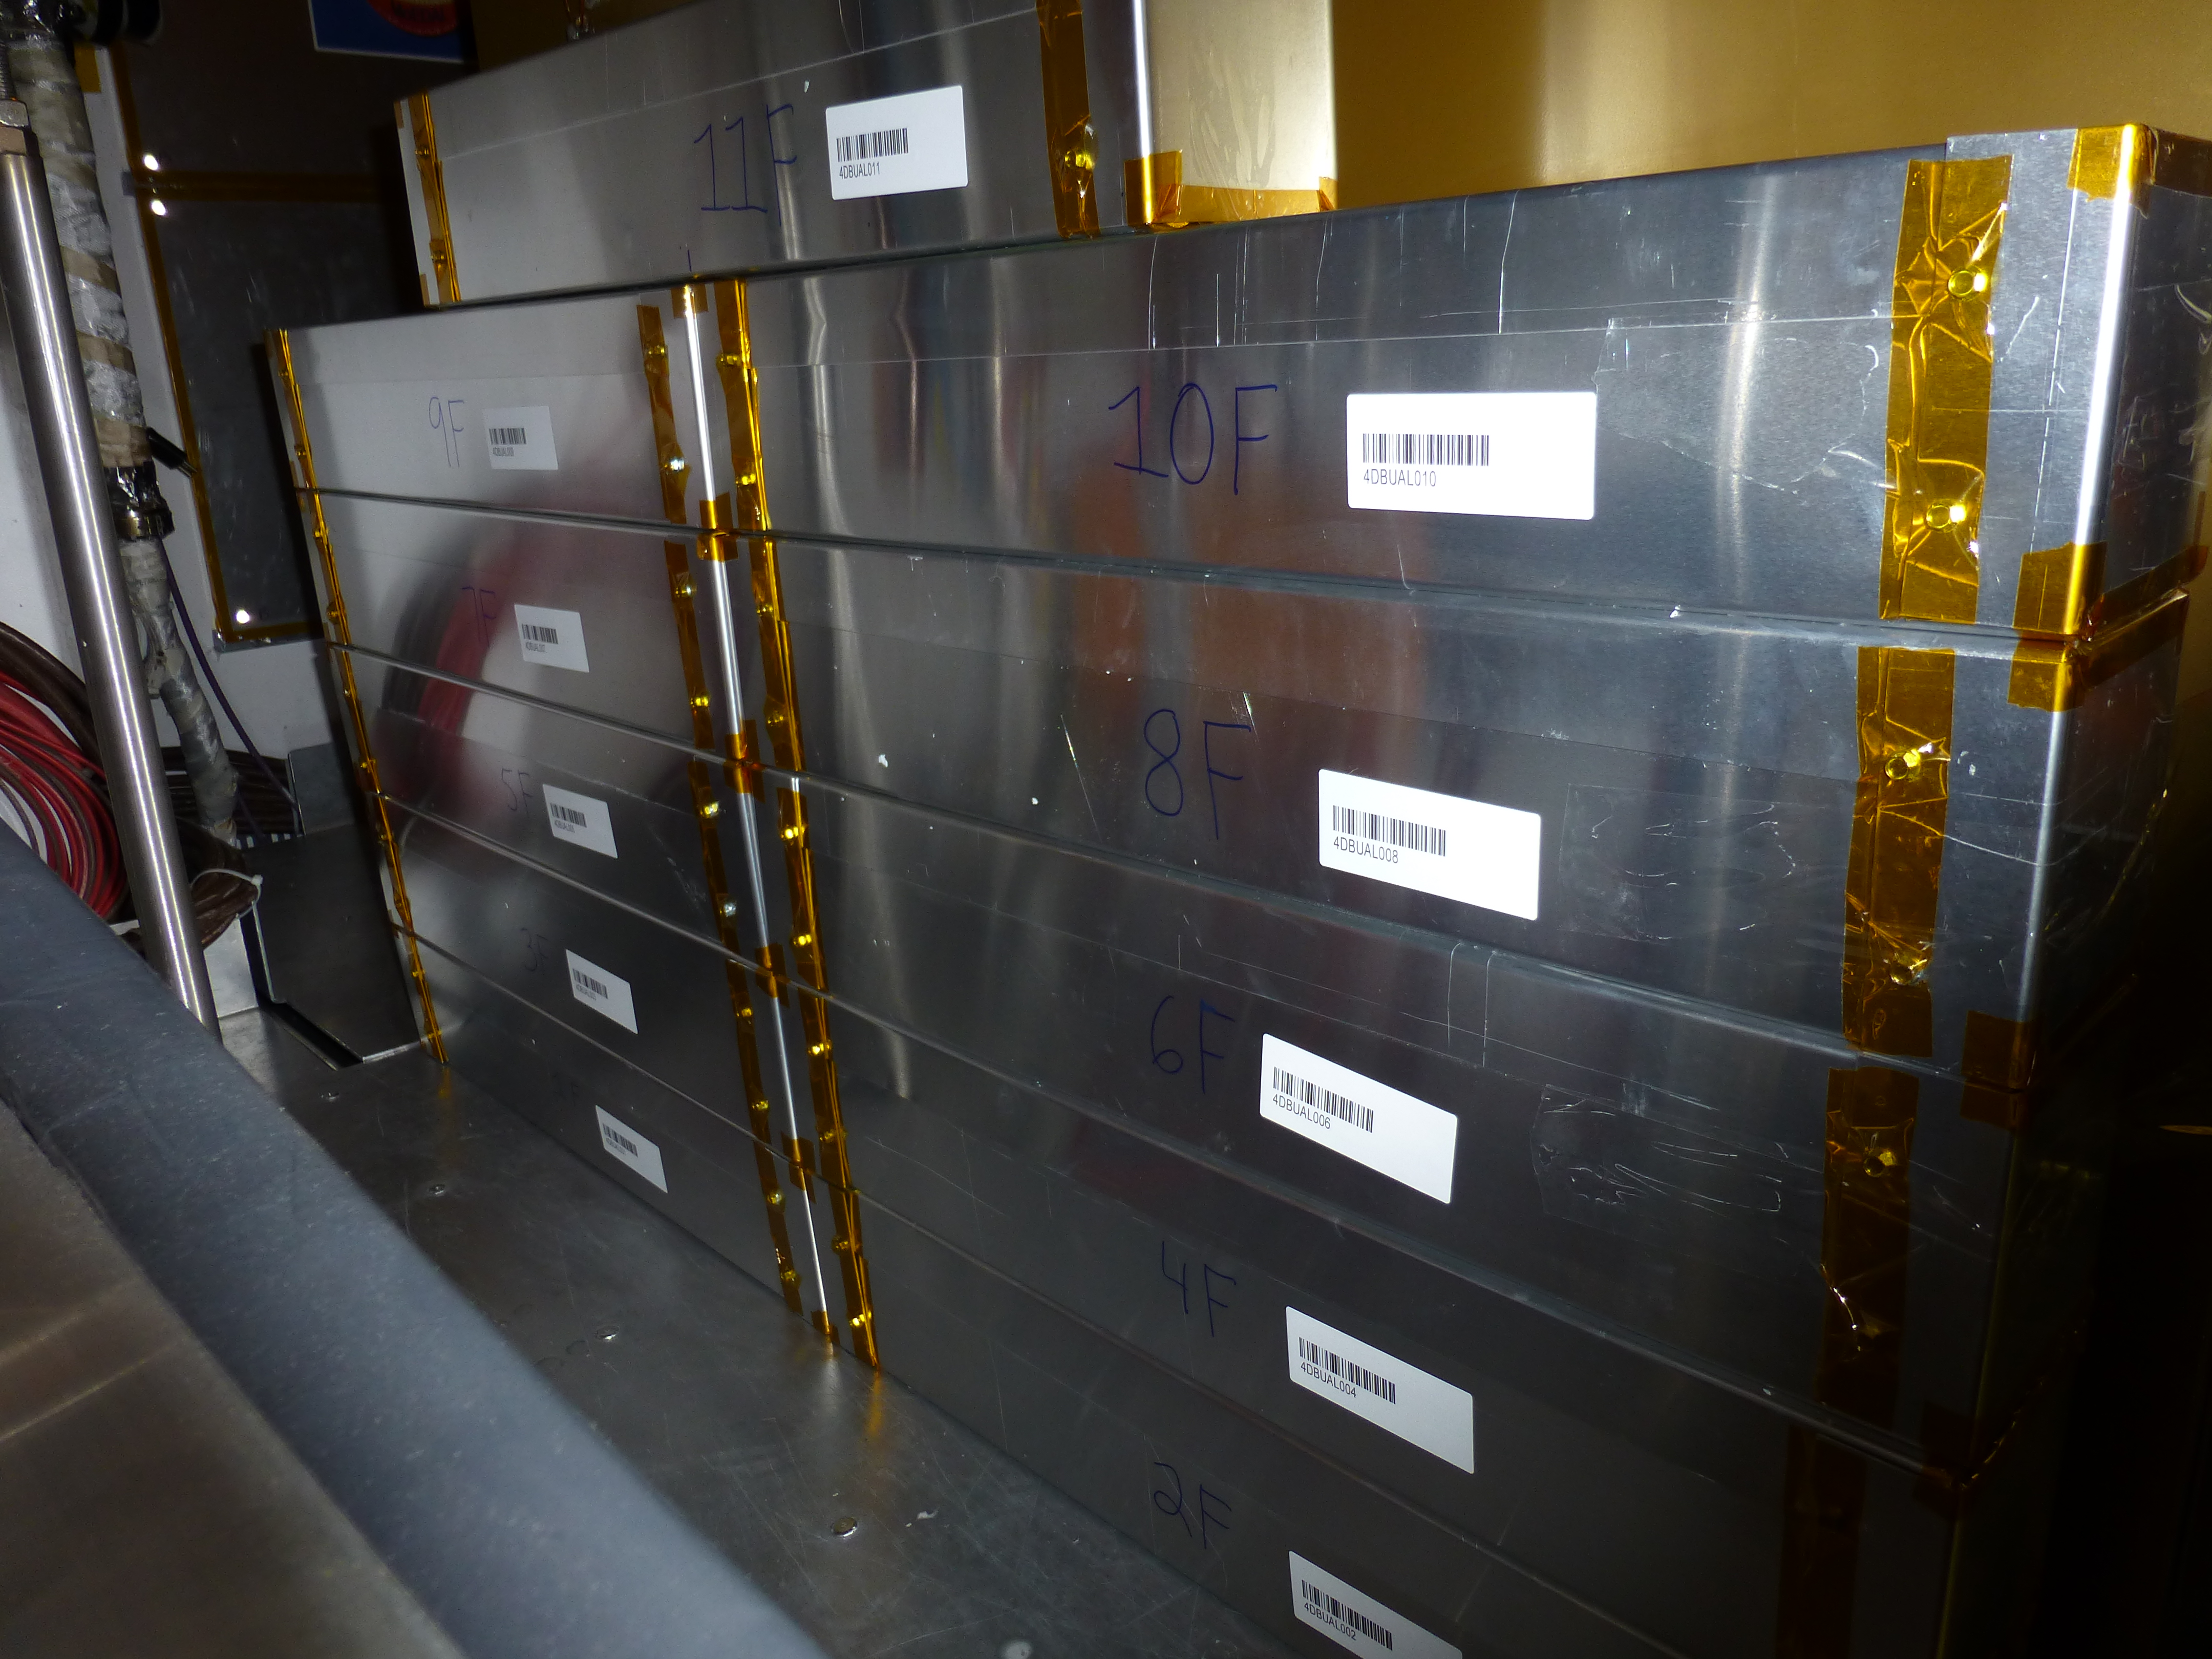
The MoEDAL Timescale
First detectors ( 10 sqm of plastic) deployed in Nov. 2009)
We deployed a larger area of plastic (~80 m²) in Jan. 2011
Test deployment of TimePix detectors in Feb. 2012
Test Deployment of MMT sub-detector in Sept. 2012
Full deployment is planned for the year long shutdown starting in 2013/2014.
In 2015 expect to have our first “official” run to be continued until we reach a ∫L of ≥ ~10 fb⁻¹ at 14 TeV.

Slide 22
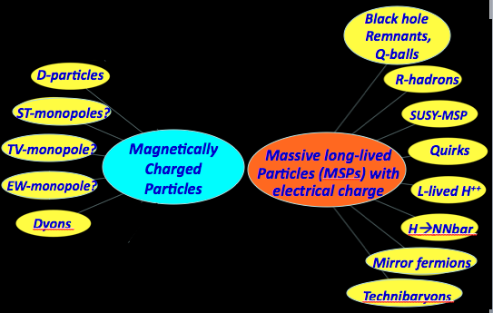
The MoEDAL Physics Program
Search for magnetic Monopole/Dyon with mass up to ~7 TeV & magnetic charge (ng) of n=8-9
Search for exotic, massive long-lived, single or multiply charged particles with Z/β ≥ 5 & mass up to 7 TeV & charge as high as ~400

Slide 23

Ways to get High Ionization
To get high ionization we need:
Magnetic charge (Monopoles, Dyons..) = ng = n x 68.5 x e - a singly charged relativistic monopole has ionization ~4700n times MIP!!
Multiple electric charge (H++, Q-balls, etc.) = n x e
Very low velocity & electric charge eg Stable (long-lived) Massive Particles – SMPs
Any combination of the above
MoEDAL TDR detectors have a threshold of Z/β ~ 5

Slide 24
Ways to get High Ionization
CHARGE
= z/β
VELOCITY: β =V/C
To get high ionization we need:
Magnetic charge (Monopoles, Dyons..) = ng = n x 68.5 x e - a singly charged relativistic monopole has ionization ~4700n times MIP!!
Multiple electric charge (H++, Q-balls, etc.) = n x e
Very low velocity & electric charge eg Stable (long-lived) Massive Particles – SMPs
Any combination of the above
MoEDAL TDR detectors have a threshold of Z/β ~ 5

Slide 25
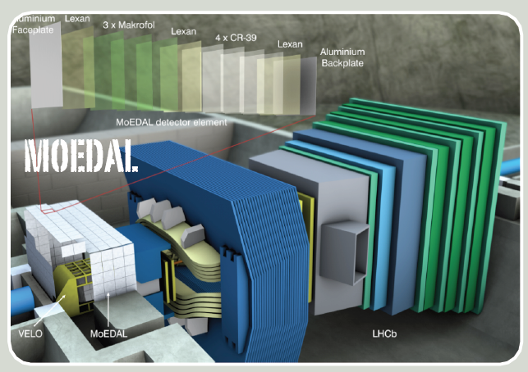
Ways to get High Ionization
Particle must be massive, long-lived & highly ionizing to be detected at MoEDAL
CHARGE
= z/β
VELOCITY: β =V/C
To get high ionization we need:
Magnetic charge (Monopoles, Dyons..) = ng = n x 68.5 x e - a singly charged relativistic monopole has ionization ~4700n times MIP!!
Multiple electric charge (H++, Q-balls, etc.) = n x e
Very low velocity & electric charge eg Stable (long-lived) Massive Particles – SMPs
Any combination of the above
MoEDAL TDR detectors have a threshold of Z/β ~ 5

Slide 26
The MoEDAL Physics Program
Search for magnetic Monopole/Dyon with mass up to ~7 TeV & magnetic charge (ng) of n=8-9
Search for exotic, massive long-lived, single or multiply charged particles with Z/β ≥ 5 & mass up to 7 TeV & charge as high as ~400

Slide 27
The MoEDAL Physics Program
Search for magnetic Monopole/Dyon with mass up to ~7 TeV & magnetic charge (ng) of n=8-9
Search for exotic, massive long-lived, single or multiply charged particles with Z/β ≥ 5 & mass up to 7 TeV & charge as high as ~400

Slide 28
MONO
POLES

Slide 29
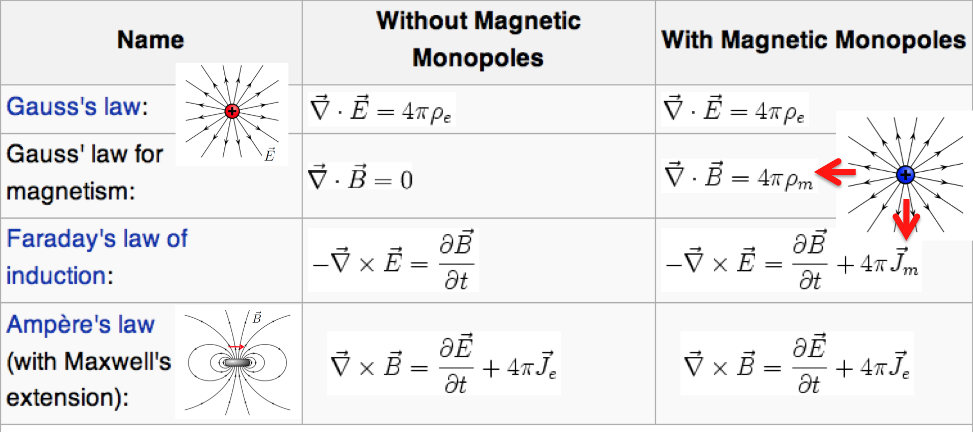
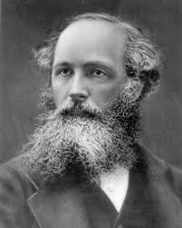
Maxwell’s Asymmetric Equations
Maxwell, in 1873 (@ KCL), makes the connection between electricity and magnetism - the first Grand Unified Theory!
As no magnetic monopole had ever been seen Maxwell cut isolated magnetic charges from his equations - making them asymmetric

Slide 30
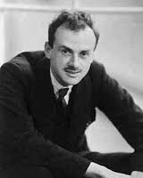
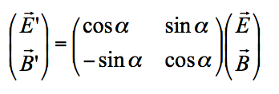
symMonopole symmetrizes Equations
DIRAC
Dirac, in 1931 postulates the existence of magnetic monopoles
DUALITY symmetric equations in the presence of monopoles
the distinction between electric and
magnetic charge is merely one of definition

Slide 31
symMonopole symmetrizes Equations
Dirac, in 1931 postulates the existence of magnetic monopoles

Slide 32
symMonopole symmetrizes Equations
Dirac, in 1931 postulates the existence of magnetic monopoles
DUALITY symmetric equations in the presence of monopoles
the distinction between electric and
magnetic charge is merely one of definition

Slide 33
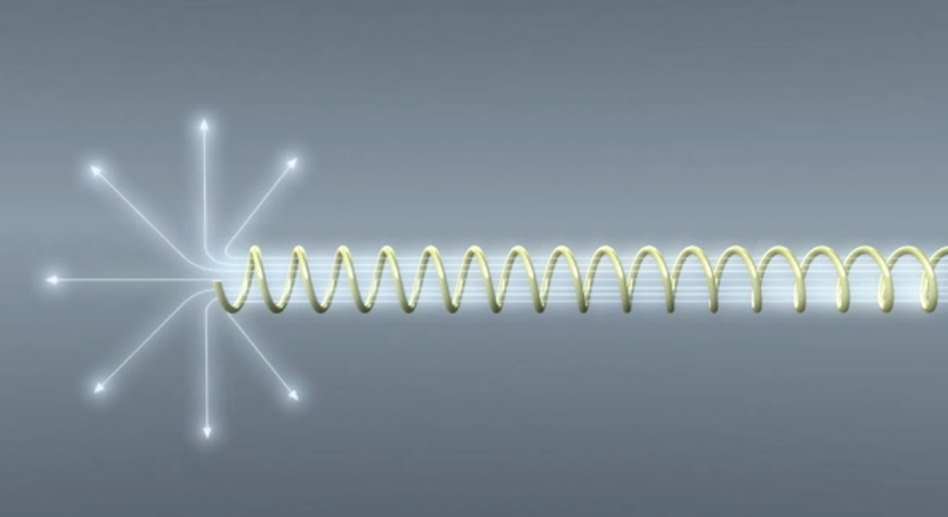
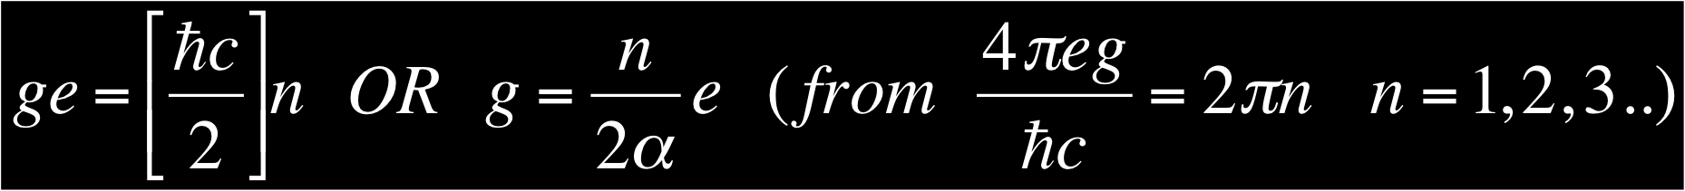
Dirac’s Monopole
In 1931 Dirac hypothesized that the Monopole exists as the end of an infinitely long and thin solenoid - the “Dirac String”
Requiring that the string is not seen gives us the Dirac Quantization Condition & explains the quantization of charge!

Slide 34
Magnetic Monopole Properties
Magnetic charge = ng = n68.5e HIGHLY IONIZING
Coupling constant = g/Ћc ~ 34. Spin ½?
Energy acquired in a magnetic field =2.06MeV/gauss.m = 2TeV in a 10m, 10T LHC magnet
The monopole mass is not predicted within the Dirac’s theory.

Slide 35


The ‘t Hooft-Polyakov Monopole
Alexander Polyakov
Gerard t’Hooft
In 1974 ‘t Hooft and Polyakov found that many (non-Abelian) Grand Unified gauge theories predict Monopoles
Such monopoles are topological solitons (stable, non dissipative, finite energy solutions) with a topological charge
The topology of the soliton’s field configuration gives stability EG a knot in a rope fixed at the ends (boundary conditions)
Produced in the early Universe at G.U.T. phase transition a GUM is a tiny replica of the Big Bang with mass ~ 0.02 μg

Slide 36
The ‘t Hooft-Polyakov Monopole
Alexander Polyakov
Gerard t’Hooft
In 1974 ‘t Hooft and Polyakov found that many (non-Abelian) Grand Unified gauge theories predict Monopoles
Such monopoles are topological solitons (stable, non dissipative, finite energy solutions) with a topological charge
The topology of the soliton’s field configuration gives stability EG a knot in a rope fixed at the ends (boundary conditions)
Produced in the early Universe at G.U.T. phase transition a GUM is a tiny replica of the Big Bang with mass ~ 0.02 μg

Slide 37
The ‘t Hooft-Polyakov Monopole
Alexander Polyakov
Gerard t’Hooft
In 1974 ‘t Hooft and Polyakov found that many (non-Abelian) Grand Unified gauge theories predict Monopoles
Such monopoles are topological solitons (stable, non dissipative, finite energy solutions) with a topological charge
The topology of the soliton’s field configuration gives stability EG a knot in a rope fixed at the ends (boundary conditions)
Produced in the early Universe at G.U.T. phase transition a GUM is a tiny replica of the Big Bang with mass ~ 0.02 μg
Equivalent to an energy of 10¹⁶ GeV (GUT scale)
i.e. inflation would wash them out cosmically
Moreover, cannot be produced at LHC energies
Hence out of prospects for experimental detection!

Slide 38
But… GUT monopoles not alone in market
Other monopole states predicted in
theories beyond the standard model,
like strings (Wen & Witten) may have sufficiently
low-masses (if string scale is low @ TeV)
to be falsifiable at LHC energies
One such state is the Cho-Maison monopole/dyon
in the Electroweak Standard Model
Its mass @ 4-7 TeV only recently predicted (12.12)

Slide 39

The Cho-Maison Magnetic Monopole
Y.M. Cho and D. Maison,
Phys. Lett. B391, 360 (1997).
Yongmin Cho
Cho – Maison produced a pioneering paper in 1997 in which they envisioned a new type of spherically symmetric Electroweak Standard Model Monopole or dyon, with:
Magnetic charge 2g_{D}
Mass in the range 4→7 GeV/c² → Cho et al. arXiv: 1212.3885 [hep-ph]
This monopole is a non-trivial hybrid between the abelian Dirac monopole and the non-abelian ‘t Hooft-Polyakov monopole
Cho-Maison monopole would be detected/falsified by MoEDAL if its mass lies in the predicted range

Slide 40
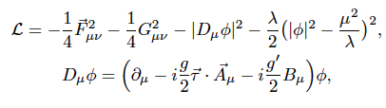
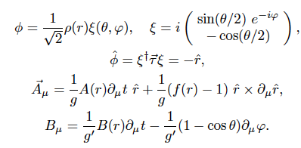
The Cho-Maison Magnetic Monopole
Y.M. Cho and D. Maison,
Phys. Lett. B391, 360 (1997).
The Standard Model provides naturally
the non-trivial topological framework
for the existence of a ``monopole-like’’ state
NB: incorrect conjectures
in the past that E/W model
does not have monopoles
SOLUTION
NB: apparent string-like
singularity in ξ, Β
is gauge artefact, can be
removed by making U(1)
non-trivial → e/w Dyon

Slide 41

The Cho-Maison Magnetic Monopole
Y.M. Cho and D. Maison,
Phys. Lett. B391, 360 (1997).
The Standard Model provides naturally
the non-trivial topological framework
for the existence of a ``monopole-like’’ state
NB: incorrect conjectures
in the past that E/W model
does not have monopoles
POINT-SINGULARITY OF CHO-MAISON MONOPOLE MAKES ESTIMATE OF MASS CLASSICALLY DIFFICULT
SOLUTION
NB: apparent string-like
singularity in ξ, Β
is gauge artefact, can be
removed by making U(1)
non-trivial → e/w Dyon

Slide 42
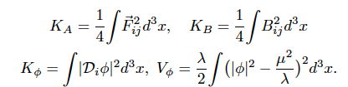



The E/w Monopole as Soliton
Cho, Kimm, Yoon , arXiv:12.12.3885
View the Cho-Maison Soliton as finite energy Soliton
and apply Derrick’s scaling arguments to static monopoles
Infinite
Soliton Energy
unless UV cutoff
imposed
➔∞
If finite energy, monopole stable
against Scale trnsf:
M_{W} = 80.4 GeV,
M_{H} = √2 μ = 125 GeV (LHC 2012),
sin²θ = 0.23
in terms of
physical fields

Slide 43


The E/w Monopole as Soliton
Cho, Kimm, Yoon , arXiv:12.12.3885
Finiteness is guaranteed if one invokes an UV cut-off →
this UV completion for SM ids not known and hence there
are theoretical ambiguities, one may embed it in more
complicated theories…
Moreover, quantum corrections in the (renormalizable) SM lead
to ``running’’ of couplings with energy and there are corrections
to Dyon energy E
Thus Cho_Maison e/w monopole mass estimated to lie between
M = 4 – 7 TeV
Experiment can falsify such ideas independently, important
to emphasize

Slide 44
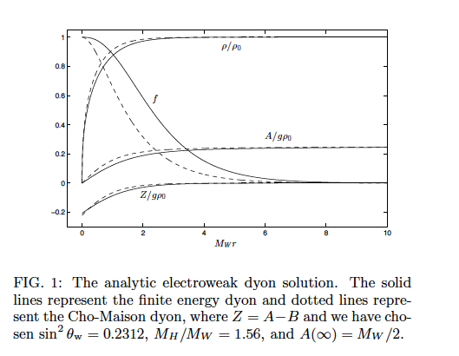
The E/w Monopole as Soliton
Cho, Kimm, Yoon , arXiv:12.12.3885
Agreement
between analytic
solution and
approximation
of Cho-Maison
Dyon as soliton
with finite energy

Slide 45
The E/w Monopole as Soliton
Cho, Kimm, Yoon , arXiv:12.12.3885
Finiteness is guaranteed if one invokes an UV cut-off →
this UV completion for SM ids not known and hence there
are theoretical ambiguities, one may embed it in more
complicated theories…
Moreover, quantum corrections in the (renormalizable) SM lead
to ``running’’ of couplings with energy and there are corrections
to Dyon energy E
Thus Cho_Maison e/w monopole mass estimated to lie between
M = 4 – 7 TeV
Experiment can falsify such ideas independently, important
to emphasize

Slide 46
The E/w Monopole as Soliton
Cho, Kimm, Yoon , arXiv:12.12.3885
Finiteness is guaranteed if one invokes an UV cut-off →
this UV completion for SM ids not known and hence there
are theoretical ambiguities, one may embed it in more
complicated theories…
Moreover, quantum corrections in the (renormalizable) SM lead
to ``running’’ of couplings with energy and there are corrections
to Dyon energy E
Thus Cho_Maison e/w monopole mass estimated to lie between
M = 4 – 7 TeV
Experiment can falsify such ideas independently, important
to emphasize
Thus can be produced
after inflation

Slide 47
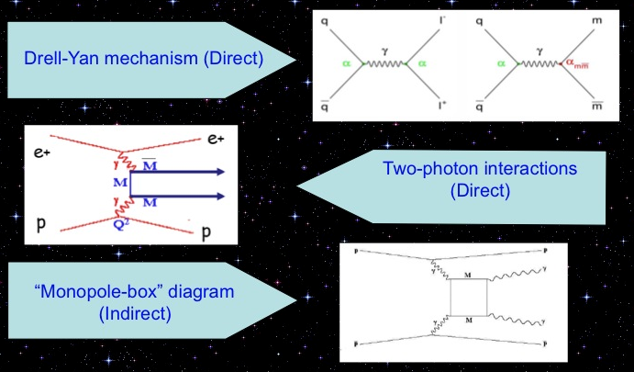
Monopole Production at Colliders
CDF excluded MM pair production at the 95% CL for cross-section < 0.2 pb and monopole masses 200 < m_{M}< 700 GeV/c²

Slide 48
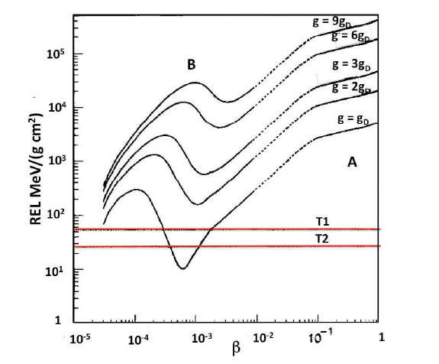
Monopole Energy Losses in NTDs
Detection
thresholds of CR39
used in MACRO Expt

Slide 49

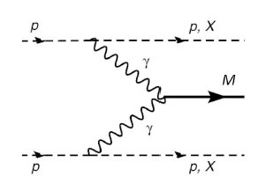

THE SEARCH FOR MONOPOLIA
Dirac or other monopoles
(e.g. Cho-Maison monopole)
may not be free states but
BOUND states → MONOPOLIUM
(MM) → produced at colliders?
M
Epele, Fanchiotti, Garcia-Canal,
Mitsou, Vento,
EPJPlus 127 (2012), 60

Slide 50
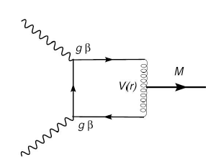
THE SEARCH FOR MONOPOLIA
Dirac or other monopoles
(e.g. Cho-Maison monopole)
may not be free states but
BOUND states → MONOPOLIUM
(MM) → produced at colliders?
M
Monopole-
antimonopole
binding
interaction
M
Epele, Fanchiotti, Garcia-Canal,
Mitsou, Vento,
EPJPlus 127 (2012), 60

Slide 51
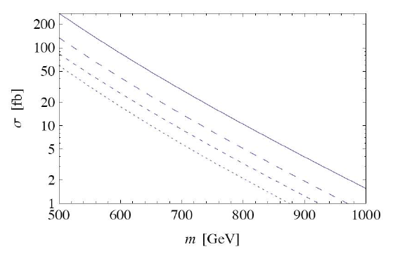
THE SEARCH FOR MONOPOLIA
Dirac or other monopoles
(e.g. Cho-Maison monopole)
may not be free states but
BOUND states → MONOPOLIUM
(MM) → produced at colliders?
Production cross
section @ LHC, 3.5 TeV
monopole mass
Binding energy fixed BE = 2m/15 , e.g.
for m=750 GeV, binding energy = 100 GeV
→ monopoloium mass M= 1400 geV
V. Vento in MoeDAL Phys. Review

Slide 52
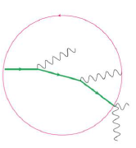
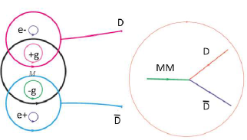

Relevance to MoEDAL
Monopolium is neutral in its ground state & thus if produced in such a state is
difficult, probably impossible, to detect in MoeDAL since damage to platics
from SM background could be higher
BUT…it may be produced in an excited state, which could be a magnetic multiple
→ highly ionizing.
Its decay via photon emission will produce a peculiar trajectory, if the decaying states are also magnetic multipoles,
the process will generate a peculiar trajectory in the medium.
Monopolium
might break up
in the medium
of MoEDAL into
highly-ionizing
Dyons
V. Vento
in MoeDAL Phys. Review
Moreover, In presence of magnetic fields huge polarizability

Slide 53
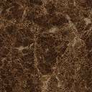


Is it worthy the effort?
We believe so !!! … especially in view of
modern developments on (theory arguments on)
the determination of the mass
of (hybrid) E/W monopoles @ O(10) TeV
(Cho, Kimm, Yoon 2012)
Such theoretical
arguments can be
falsified or verified
directly by Experimentt !!

Slide 54
Is it worthy the effort?
``I would be surprised if Nature had made no use of it [monopole]’’
P.A.M. DIRAC

Slide 55
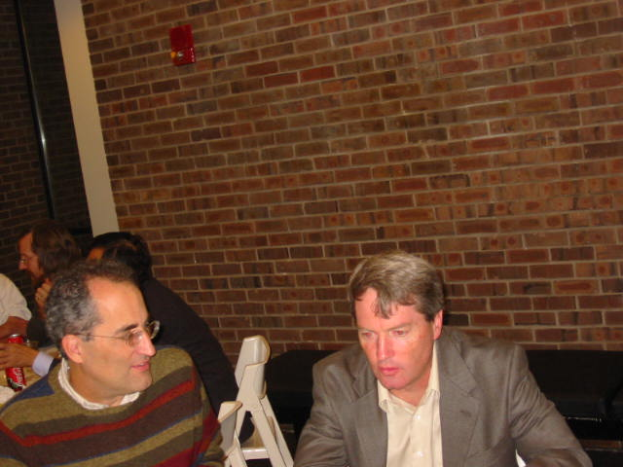
Is it worthy the effort?
Last Words From:
E. Witten* and J. Polchinski**
* (String Theorist, Field Medalist)
(**Discoverer of D-branes + a father of M-theory)
f
Ed Witten
Joseph Polchinski

Slide 56
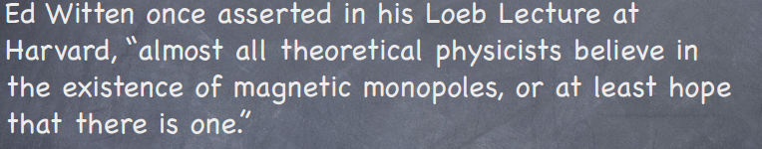
Is it worthy the effort?
Last Words From:
E. Witten* and J. Polchinski**
* (String Theorist, Field Medalist)
(**Discoverer of D-branes + a father of M-theory)
f
Ed Witten
Joseph Polchinski

Slide 57
I would like to express my strong support for the MoEDAL experiment. Although monopoles do not get as much press as dark energy and other hot topics, in fact they are the most certain prediction of theory beyond the Standard Model - more so than supersymmetry, strings, extra dimensions, modified gravity, or many other widely discussed ideas. As I have discussed in my Dirac Centenary Talk, their existence seems inevitable in any framework that explains the quantization of electric charge. Of course their mass scale and abundance are highly uncertain, but the same can be said for almost any other form of new physics
Last Words From J. Polchinski*
(*Discoverer of D-branes + a father of M-theory)
f
Ed Witten
Joseph Polchinski

Slide 58
Is it worthy the effort?...Yes!!!
f
Yongmin Cho
P.A.M. DIRAC
Ed Witten
Joseph Polchinski

Slide 59
The MoEDAL Physics Program
Search for magnetic Monopole/Dyon with mass up to ~7 TeV & magnetic charge (ng) of n=8-9
Search for exotic, massive long-lived, single or multiply charged particles with Z/β ≥ 5 & mass up to 7 TeV & charge as high as ~400

Slide 60
The MoEDAL Physics Program
Search for magnetic Monopole/Dyon with mass up to ~7 TeV & magnetic charge (ng) of n=8-9
Search for exotic, massive long-lived, single or multiply charged particles with Z/β ≥ 5 & mass up to 7 TeV & charge as high as ~400

Slide 61
LONG-LIVED
SUSY
MASSIVE
PARTICLES

Slide 62
Prospects for SUSY Models @ LHC
CMSSM used heavily in experimental studies
→ currently severely constrained
Few prospects for multiply-charged sparticles
Many prospects for long-lived singly-charged sparticles
Staus, stops, selectrons, …
Some would be produced with low velocities, hence highly-ionizing
Production rates within MoEDAL reach

Slide 63
Scenarios for Metastable Sparticles
Maybe R-parity not exact?
No stable sparticle
Next-to-lightest sparticle (NLSP) may be long-lived
Could be charged or neutral
Scenarios for long-lived NLSP:
Small mass difference from neutralino LSP
Gravitino LSP
Gluinos in split supersymmetry

Slide 64
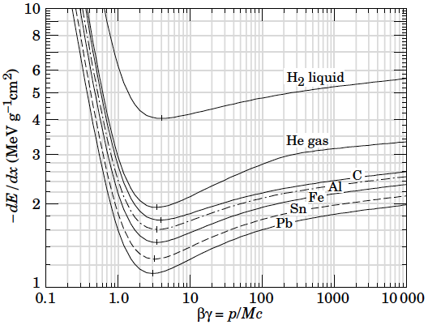
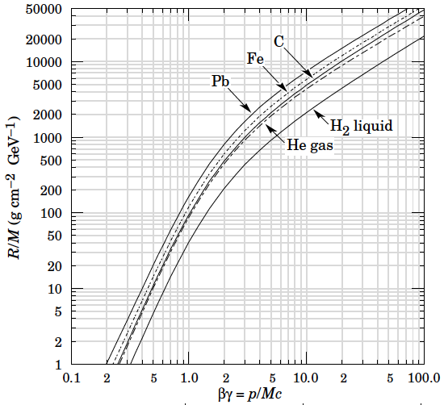
Energy Loss and Range
Singly-charged particles are
highly-ionizing if moving slowly
Small range in typical
Detector materials
J. Ellis talk in 1st MoEDAL Workshop, CERN June 2012

Slide 65
Next-to-Lightest Supersymmetric Particle (NLSP) ?
In neutralino dark matter scenarios:
Lighter stau?
Could be long-lived if m_{stau}–m_{LSP} small
In gravitino dark matter scenarios:
Lighter stau, selectron or sneutrino?
Lighter stop squark?
gluino, …?
Naturally long-lived
Decay interaction of gravitational strength

Slide 66

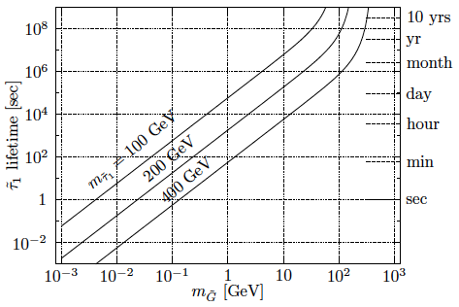
Stau Lifetime in Gravitino Dark Matter Scenarios
Gravitational-strength decay interaction
Naturally
long
lifetime
J. Ellis talk in 1st MoEDAL
Workshop, CERN June 2012
Hamaguchi, Nojiri, De Roeck: hep-ph/0612060

Slide 67

Gluinos in Split Supersymmetry
Long-lived because squarks heavy
Possible gluino hadrons:
Gluino-g, gluino-qqbar, gluino-qqq
Is there a metastable charged gluino hadron?
Gluino hadrons may flip charge as they pass through matter
Gluino mesons may change into baryons:
e.g., gluino-uubar + uud ➔gluino-uud + uubar
Hewitt, Lillie, Masip, Rizzo: hep-ph/0408248

Slide 68
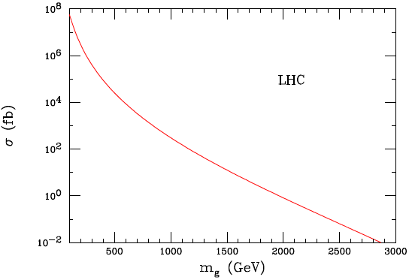
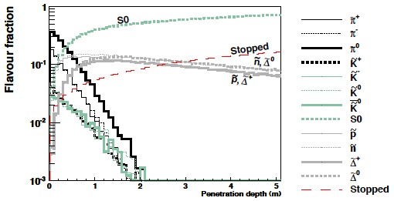
Gluino Production at the LHC
Hewitt, Lillie, Masip, Rizzo: hep-ph/0408248
Large cross section @ LHC
Significant fraction of charged particles emerge from the detector
Farrar, Mackeprang, Milstead, Roberts: arXiv:1011.2964

Slide 69
DOUBLY CHARGED
HIGGS

Slide 70
DOUBLY-CHARGED HIGGS
Extended Higgs sector in BSM models: SU_{L}(2) x SU_{R}(2) X U_{B-L}(1) P-violating model
Higgs triplet model with massive left-handed neutrinos but not right-handed ones
COMMON FEATURE: doubly charged Higgs bosons H±± as parts of a Higgs triplet
H_{L}±± : couple to Higgs, EW gauge bosons & left-handed charged leptons
H_{R}±± : couple to Higgs EW gauge bosons & right-handed charged leptons

Slide 71



Higgs Triplet Model (HTM) - details
Yukawa couplings
Higgs triplet
Realistic neutrino masses &
for
Triplet in 2 x 2 rep:

Slide 72
COLLIDER PRODUCTION OF H_{L,R}±±
Comparable
Cross sections
if m(H±±) ≈ m (H±)

Slide 73
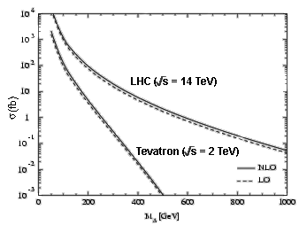
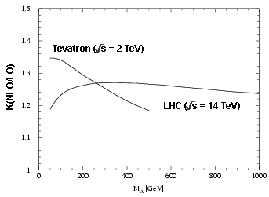
Collider Production of H± ±
Pair Production :
W-W Fusion :
_
_
q′
_
q′
H⁺⁺
H⁺⁺
q′
W
H
++
W
--
-
q
γ * /Ζ∗
H⁻⁻
q
W
+
W
q
Dominant Production mode
Small probability
Cross section independent of
Fermionic coupling
|ρ_{EW} - 1| Is small, experimentally observed
Doubly-charged Higgs
production cross section is enhanced substantially (~35%) due to NLO corrections.
R-handed H++ cross section is smaller by a factor of ~2 due to different value of coupling of these particles to Z bosons.
M. Spira & M. Mühlleitner, hep-ph/0305288

Slide 74
DECAYS OF H_{L,R}±±
DECAYS TO WW
LEPTONIC DECAY MODES :
DOMINANT FOR MASS RANGE:
LEPTON-FLAVOUR-VIOLATING DECAY MODES ALLOWED
-may be particular large, e.g. BR(H⁻⁻ ⁻⁻ → μ τ) ≈ 1/3

Slide 75
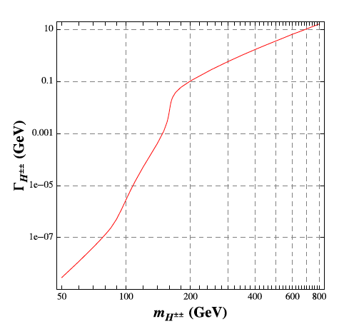



Life-Time of H±±
Depends on many
parameters : Yukawa h_{ij,}
mass of H±±, , v_{Δ} ,
QCD effects....
Chiang, Nomura, Tsumura, arXive 1202.2014

Slide 76


Life-Time of H±±
Depends on many
parameters : Yukawa h_{ij,}
mass of H±±, , v_{Δ} ,
QCD effects....
Essentially there are
no constraints on its
life time …
it can be
long (e.g. for h_{ij} < 10⁻⁸)
→ RELEVANT
FOR MoEDAL
Chiang, Nomura, Tsumura, arXive 1202.2014

Slide 77

Decaying H±± SEARCHES @ LHC
@ LHC:
Several Studies @ LHC in decay channel
(increased sensitivity of LHC vs Tevatron)
e.g. study of production
followed by a decay
Εxpected LHC exclusion limits assuming BR(H±± → μ± μ± ) = 100 %

Slide 78

Akeroyd, Chiang, Gaur, arXive:10092780

Slide 79

H±± SEARCHES @ LHC - Higgs Triplet Model
Three-Lepton decay signatures may offer significantly greater discovery potential
of H±± in Higgs triplet model vs four-lepton signatures
In such a case, production mechanism contributes to
the signal and has superior
sensitivity in the region of
m(H±±) > 200 GeV
(i.e. high invariant mass of charged
lepton pairs) for which
SM background is small

Slide 80


H±± SEARCHES @ LHC –HTM
Akeroyd, Sugiyama, arXive:1105.2209
Large branching ratios of in sizable regions of parameter space
From
→
pair production of H±± with cross section
comparable to standard H±± pair production
via
→ enhanced detection process in four lepton channel @ LHC
Additional decays from production of
neutral triplet scalars, lead to additional production of H± with additional production
(via H± decays) to H±±.

Slide 81

Connection with MoEDAL
H±± must be long-lived & highly ionizing in order to be detected at MoEDAL
To get high ionization we need:
Magnetic charge or multiple electric charge (Monopoles, Dyons, SMPs…)
Very low velocity & electric charge (Stable Massive Particles - SMPs)
Any combination of the above
MoEDAL has a threshold of Z/β ~ 5 5
VELOCITY: β =V/C

Slide 82
Long Lived Doubly Charged Higgs
No constraint on the lifetime of H±± , can be long
Search for particles with cτ > 3 m, no decay within the detector
They will behave like heavy stable particles, (muons but more ionising)
Main process of energy loss is ionization
, dE/dx ∝ (charge)²
Measurement of ionization – dE/dx measurement along the charged
particle track in tracker and calorimeter.
Background – Advantage is lack of Standard Model decays.
Events expected from highly ionizing particles.
Muons – data from cosmic rays (pure muon sample)
CDF strategy:
S Banerjee ICHEP2004
Electrons – W
e υ Monte Carlo sample
Hadronic decays for taus from Monte Carlo sample
QCD contribution calculated from experimental data

Slide 83
Long Lived Doubly Charged Higgs
No constraint on the lifetime of H±± , can be long, e.g. Yukawa h_{ij} < 10⁻⁸
Search for particles with cτ > 3 m, no decay within the detector
They will behave like heavy stable particles, (muons but more ionising)
Main process of energy loss is ionization
, dE/dx ∝ (charge)²
Measurement of ionization – dE/dx measurement along the charged
particle track in tracker and calorimeter.
Background – Advantage is lack of Standard Model decays.
Events expected from highly ionizing particles.
Muons – data from cosmic rays (pure muon sample)
CDF strategy:
S Banerjee ICHEP2004
Electrons – W
e υ Monte Carlo sample
Hadronic decays for taus from Monte Carlo sample
QCD contribution calculated from experimental data

Slide 84
Long Lived Doubly Charged Higgs
No constraint on the lifetime of H±± , can be long, e.g. Yukawa h_{ij} < 10⁻⁸
Search for particles with cτ > 3 m, no decay within the detector
They will behave like heavy stable particles, (muons but more ionising)
Main process of energy loss is ionization
, dE/dx ∝ (charge)²
Measurement of ionization – dE/dx measurement along the charged
particle track in tracker and calorimeter.
Background – Advantage is lack of Standard Model decays.
Events expected from highly ionizing particles.
Muons – data from cosmic rays (pure muon sample)
CDF strategy:
S Banerjee ICHEP2004
Electrons – W
e υ Monte Carlo sample
Hadronic decays for taus from Monte Carlo sample
QCD contribution calculated from experimental data

Slide 85

Mass Limit for Long Lived H±±
CDF strategy:
S Banerjee ICHEP2004
Bayesian upper limit on H±± crosssection
σ H±±
=
Upper Limit on No. of Signal Events at 95% C.L. for 0 Observed Events
Total H±± Acceptance x Integrated Luminosity
For a H±± mass of 130 GeV H±± cross section is 0.057 ± 0.0066 ± 0.0030
Mass Limit for Quasi-Stable Doubly charged Higgs is 134 GeV

Slide 86
Long Lived Doubly Charged Higgs & MoEDAL
For very small Yukawa couplings h_{ij} < 10⁻⁸ the doubly charged Higgs boson could be quasi-stable.
In this case very slow pseudo-stable Higgs could be detected in the MoEDAL NTDs. For example with CR39, one could detect doubly charged Higgs particles with a Z/β > 5 (15), where β ≤ 0.4 (0.13).
If such slow heavy particles are produced then one could have difficulty measuring them in ATLAS and CMS as their journey through the detector to the muon system would span more than one beam crossing.

Slide 87

Long Lived Doubly Charged Higgs & MoEDAL
For very small Yukawa couplings h_{ij} < 10⁻⁸ the doubly charged Higgs boson could be quasi-stable.
In this case very slow pseudo-stable Higgs could be detected in the MoEDAL NTDs. For example with CR39, one could detect doubly charged Higgs particles with a Z/β > 5 (15), where β ≤ 0.4 (0.13).
If such slow heavy particles are produced then one could have difficulty measuring them in ATLAS and CMS as their journey through the detector to the muon system would span more than one beam crossing.

Slide 88
QUIRKS

Slide 89


EXTENSION OF THE SM WITH NEW HEAVY FERMIONS (QUIRKS) CHARGED
UNDER BOTH A NEW UNBROKEN GAUGE GROUP & THE SM GAUGE GROUP
Kang, Lutty arXive: 0805.4642
NEW GAUGE GROUP (``INFRACOLOUR’’ (IC)) SU(N) WITH FERMIONS
(QUIRKS) IN FUNDAMENTAL REPRESENTATION BECOMES STRONG AT A SCALE
Λ << m , WHERE m IS THE QUIRK MASS ASSUMED TO BE IN THE
PHENOMENOLOGIVCALLY INTERESTING RANGE 100 GeV < m < TeV
COUPLING OF SM TO INFRACOLOUR SECTOR

Slide 90


EFFECTIVE OPERATOR MEDIATES INFRACOLOUR
GLUEBALL DECAY WITH RATE OF ORDER
INFRACOLOUR GLUEBALLS CAN DECAY INSIDE PARTICLE DETECTOR
FOR Λ > 50 GeV
FOR Λ < 50 MeV LIFE TIME BECOMES LONGER THAN AGE OF UNIVERSE
(METASTABLE STATE) → RELEVANCE FOR MoEDAL AS
QUIRKS CAN BE HIGHLY IONIZING

Slide 91

IN PARTICULAR:
BREAKING OF INFRACOLOUR STRING IS
EXPONENTIALLY SUPPRESSED FOR Λ << m
Life time :
(cf. Schwinger mechanism
for pair creation of charged
ptcles by weak Electric field )
Longer than Age of Universe for m > 100 GeV, Λ = 50 MeV

Slide 92

Kang, Lutty arXive: 0805.4642

Slide 93

IN PARTICULAR:
BREAKING OF INFRACOLOUR STRING IS
EXPONENTIALLY SUPPRESSED FOR Λ << m
QUIRK-ANTIQUIRK PAIR STAYS CONNECTED BY THE INFRACOLOUR STRING
LIKE A ``RUBBER BAND’’ THAT CAN STRETCH UP TO MACROSCOPIC LENGTHS
ASSUMING QUIRKS TO HAVE CHARGE e , no strong colour charge →
quirk-antiquirk pair is reconstructed in the detector as a highly-ionizing track
SIGNATURE: large ionization-energy loss rate dE/dx , a jet, from initial state
radiation, and missing transverse energy E_{T} aligned with the track
D0 Coll. arXive:1008.3547

Slide 94

QUIRK PRODUCTION
Kang, Lutty arXive: 0805.4642

Slide 95


D0 Coll. arXive:1008.3547
QUIRK SIGNAL

Slide 96
QUIRK IN MoEDAL…
QUIRK-ANTIQUIRK PAIR STAYS CONNECTED BY THE INFRACOLOUR STRING
LIKE A ``RUBBER BAND’’ THAT CAN STRETCH UP TO MACROSCOPIC LENGTHS
STRONG IONIZATION EFFECTS – MOST RELEVANT for MoEDAL detector for Λ < 10 keV
Two scenarios for quirk-antiquirk pair:
Move away from the LHCb detector towards
the plastic film as a slowly moving pair (decelerated by flux tube)
if produced close to threshold: One end moves towards LHCb detector & gets stuck, the other towards the plastic film
Quirks May be undetected if moving slowly although stuck in the detector.
LHCb much less dense medium for quirk motion → good candidates for MoeDAL

Slide 97
Q-BALLS

Slide 98






Q-balls
Non-topological soliton field configurations with a global charge Q
Coleman
Friedberg-Lee-Sirlin (multiple scalars)
Global U(1) (phase) symmetry
Spherical
Q-ball
φ = 0
(Potential Minimization)
Size R → Minimize:
φ = φ₁ ≠ 0

Slide 99




Single scalar field Q-balls of size R
φ rotates around the internal symmetry space SO(2) with frequency ω
Conserved charge:
Energy is minimised @ radius R, with energy
per unit charge at minimum
Stable Q-ball if
Many SUSY models have logarithmic one-loop corrections which allow such a condition
to be satisfied, but in most models Q-ball masses are much higher than
electroweak scale … so unlikely to be produced at LHC energies….
Q-balls may be important for Cosmology: can be produced abundantly
in early Universe & play a role in Baryon asymmetry and Dark Matter
Kusenko, Shaposhnikov, Tinyakov

Slide 100




…BUT ABOVE RESULTS FOR FLAT SPACE TIMES ---
Gravity affects Q-ball stability
Tamaki, Sakai arXive:1108.3902
Stable Q-balls with arbitrarily small charge exist in non-flat space-times in
contrast to Minkowski space-time cases for Affleck-Dine potentials …
…no matter how weak gravity is

Slide 101

Q-balls in MoEDAL
HENCE ….
Self-gravitating stable charged Q-balls
with relatively low masses may EXIST →
relevant for LHC energies,
can be highly ionizing
(mass is not relevant for ionization)
so relevant for MoEDAL

Slide 102
CHAMPS
Charged
massive
Particles

Slide 103
de Rujula, Glashow, Sarid (1990)
Dimopoulos, Eichler, Esmailzadeh, Starkman (1990)
Starkman, Gould, Esmailzadeh, Dimopoulos (1990)
WHAT ARE SIMPS?
(I) Charged Massive Particles (CHAMP) : if the whole of DM, as originally assumed
→ cosmological compatibilities require them to be heavy ( 20 teV < M_{Ch} < 1000 TeV)
if charge + 1: Superheavy remnants of H isotopes in the Universe,
particle-antiparticle symmetric → anti-CHAMP may bind with ⁴He nuclei after BBN
but mostly bind to protons to behave like superheavy stable neutrons
But, may be CHAMPS are a (small) part of DM: if neutral DM decays
(at late eras) to CHAMPs stringent bounds may be re-evaluated,
e.g. fraction of CHAMP in galactic halo
< 0.4 – 1.4 x 10⁻² (Sanchez-Salcedo et al. 1002.3145)
Also Galactic magnetic fields || disc, prevent CHAMPS from entering the disc
(non detection on Earth) if their charge q_{X} & mass are in the range:
Chuzhoy & Kolb 0809.0436

Slide 104
CHAMPS - REVISITED
Chuzhoy & Kolb 0809.0436
Also Galactic magnetic fields || disc, prevent CHAMPS from entering the disc
(non detection on Earth) if their charge q_{X} & mass are in the range:
DM density profiles:
these CHAMPS interact with ordinary matter via magnetic field mediation →
affect visible Universe → their density profiles depend on the Galaxy
→ : moderate effects in large elliptical galaxies and Milky way,
expulsion of CHAMPS with moderate charge (Coulomb Interactions
not important) from spherical Dwarf Galaxies → agreement with observations ?
DM Annihilation different from Cold Dark Matter (CDM) model:
attractive Coulomb potential between X⁺ , X⁻
increased annihilation cross section (relative to CDM models)
by a factor c/v (Sommerfield-Sakharov effect)
after CHAMP becomes non relativistic the annihilation rate
falls off slower than in CDM → kinetic energies scale as (1 + z) with redshift
present annihilation rate depends on fraction of X⁻ bound to baryons

Slide 105
CHAMPS - REVISITED
Langacker, Steigman
arXive:11073131
(II) Fractionally Charged Massive Particles (FCHAMP): Leptons with electroweak
interactions (charge U_{Y}(1)) but no strong interactions of mass m_{L} and charge Q_{L} e that
could be fractional.
Constraints from primordial nucleosynthesis & Cosmic Microwave Background
& invisible width of Z boson → Q_{L}-m_{L} relation:
Surviving FCHAMP abundance on Earth several orders of magnitude higher than
limits from terrestrial searches for fractionally charged particles → close window
for FCHAMP Q_{L} ≥ 0.01.
BUT… as Q approaches an integer |Q_{L} – n| ≤ 0.25 these searches are increasingly
insensitive → ``unconstrained islands ‘’ in Q_{L}-m_{L} planes to be explored by
searching for FCHAMPS in Cosmic Rays
& in MoEDAL detector via tracks in the plastics…
…If we can produce FCHAMPS @ LHC….

Slide 106


FCHAMPS ``ISLANDS’’
Langacker, Steigman
arXive:11073131

Slide 107
de Rujula, Glashow, Sarid (1990)
Dimopoulos, Eichler, Esmailzadeh, Starkman (1990)
Starkman, Gould, Esmailzadeh, Dimopoulos (1990)
WHAT ARE SIMPS?
(III) SIMP could be neutral (fermion)
Wandelt et al., astro-ph/0006344
Bai, Rajaraman, 1109.6009
e.g. behave like a neutron
so most of astrophysical & terrestrial
constraints can be avoided, especially
if light ….

Slide 108
CONSTRAINTS ON SIMPS/CHAMPS
Bai, Rajaraman, 1109.6009
(i) Direct Detection Searches:
ground exps (CDMS, XENON) → stringent bounds on low cross sections
High Cross sections : SIMP stopped in the atmosphere do not reach ground or
underground detectors -→ high-altitude expts (Baloon, satellite… X-ray Quantum
Calorimeters (XQC)) reach interactions above the atmosphere &
eliminate large portion of SIMP parameter space
(ii) Earth Heating:
SIMP captured gravitationally by Earth, accumulate at core,
→ self-annihilate into SM ptcles → thermalize/modify Earth’s heat flow,
(iii) Neutron Star core collection of scalar SIMP → collapse to black hole
(iv) Cosmic Rays:
protons-SIMP scattering → π⁰ → γγ (assume SIMP near Galaxy Center, uncertain)
(v) CMB, Large Scale Structure modified by strong SIMP - baryon interactions
(vi) Bound States SIMP-Nucleons: if formed -→ constraints exclude models →
avoid such bound states → repulsive forces between SIMPS and nucleons

Slide 109
CONSTRAINTS ON CHAMPS FROM PLASTIC COSMIC RAY DETECTOPS
Scattering of SIMPs off molecules in plastic causes sufficient damage by molecular
bond breaking provided energy deposition is such that:
This corresponds to cross sections
Minimum length of tracks required for tracks to be seen (e.g. 2.5 mm)

Slide 110


Wandelt et al., astro-ph/0006344
Bound States SIMP-Nucleons:
Avoid such bound states → repulsive forces between SIMPS and nucleons → fermion SIMP and scalar φ attractive mediator (for charge neutrality of the Universe), scalar force < two pion exchange
→ nucleon bound states do not form due to φ :
Bai, Rajaraman, 1109.6009
Toy (Instructive) Models
Extend SM by one massive particle m_{x}
Important information: nucleon-X
cross section σ_{xp}
Not modification of Galactic halo shape (e.g. Bullet Cluster) →

Slide 111

CONSTRAINTS ON SIMPS/CHAMPS
Bai, Rajaraman, 1109.6009
m_{X} < 1 GeV , σ_{xp} < 10⁻²⁵ cm⁻² ALLOWED !!

Slide 112

Wandelt et al., astro-ph/0006344

Slide 113
D-MATTER

Slide 114

SECOND VERSION OF STRING THEORY (BRANE-THEORY):
Our Universe
Lorentz Invariant
(Standard Model particles)

Slide 115

SECOND VERSION OF STRING THEORY (BRANE-THEORY):
Our Universe
Lorentz Invariant
(Standard Model particles)
(Gravitons)
Gravity Unified
with rest of Interactions

Slide 116
STRING/D-BRANE BASICS
p-branes:
have p longitudinal
dimensions
over which strings
have their ends
attached
String theory
p-brane types allowed
Heterotic Strings admit no p-branes

Slide 117
STRING/D-BRANE BASICS
String theory
p-brane types allowed
Phenomenologically
relevant
Heterotic Strings admit no p-branes

Slide 118
STRING/D-BRANE BASICS
String theory
p-brane types allowed
Wrap
3-branes
around
3 cycles
Effective
``point-like’’
localised on
higher
dimensional
brane worlds
Heterotic Strings admit no p-branes

Slide 119
STRING/D-BRANE BASICS
String theory
p-brane types allowed
Wrap
3-branes
around
3 cycles
Effective
``point-like’’
localised on
higher
dimensional
brane worlds
e.g. 5,7-branes
Heterotic Strings admit no p-branes

Slide 120
ANTOHER VERSION of BRANE WORLDS with D-PARTICLE
(POINT-LIKE BRANE) DEFECTS :
(Standard Model particles)
(Gravitons)
D-particle defect
J Ellis, NEM, M Westmuckett

Slide 121
ANTOHER VERSION of BRANE WORLDS with D-PARTICLE
(POINT-LIKE BRANE) DEFECTS :
(Standard Model particles)
(Gravitons)
D-particle defect
(effectively point-like,
wrapped up 3-brane
around 3 cycle)
J Ellis, NEM, M Westmuckett

Slide 122
ANTOHER VERSION of BRANE WORLDS with D-PARTICLE
(POINT-LIKE BRANE) DEFECTS :
Our Universe
NO LONGER
Lorentz Invariant
Recoil of defect
(Standard Model particles)
(Gravitons)
D-particle defect
J Ellis, NEM, M Westmuckett

Slide 123

D-matter
Such wrapped up p-branes branes
around p-cycles appear as localised objects
when embedded in higher-dimensional
p’ brane worlds (p’ > p)
Have small (string scale) compactification radii
Can be considered as effectively point-like ``localised’’
excitations from string vacuum
TERMED D-PARTICLES → form of D(efect)-matter
They have masses M_{D} = M_{s}/g_{s}
M_{S} = STRING MASS SCALE (≥ TeV phenomenologically)
g_{s} < 1 = (WEAK) STRING COUPLING
wrapped
up p-brane
p’ brane
G Shiu L-T Wang 2003
J Ellis, NEM, Wesmuckett 2004
Can play the role of a kind of
Dark matter/dark energy fluid

Slide 124

D-matter vs Monopoles

Slide 125
D-matter vs Monopoles
Symmetry Breaking scale

Slide 126
D-matter vs Monopoles
Symmetry Breaking scale
NON-PERTURBATIVE
PERTURBATIVE

Slide 127



D-matter/SM matter interactions
Via exchange of open strings
stretched between D-particle
and p’ (D-brane) world
D-matter Mass spectrum
Can be produced @ LHC
if M_{s} = O(10 TeV)
Lightest D-matter
(stable, play role of DM)
e.g.

Slide 128
D-matter/SM matter interactions
Via exchange of open strings
stretched between D-particle
and p’ (D-brane) world
D-matter Mass spectrum
Can be produced @ LHC
if M_{s} = O(10 TeV)
Lightest D-matter
(stable, play role of DM)
e.g.
Excited states can be electrically
(or magnetically) charged → can be
highly ionizing → relevant to MoEDAL

Slide 129
Black-Hole
Remnants in Large extra dimensions

Slide 130

Large Extra dimension models motivated by string theory
Arkani-Hamed
Dimopoulos, Dvali
(string models)
Randall Sundrum
(brane models)
Both relevant
for providing
resolution of
the hierarchy
problem
in field theory
Stringy effects @ low
scales (TeV ) possible

Slide 131

Large Extra dimension models motivated by string theory
Arkani-Hamed
Dimopoulos, Dvali
(string models)
Randall Sundrum
(brane models)
Both relevant
for providing
resolution of
the hierarchy
problem
in field theory
Stringy effects @ low
scales (TeV ) possible
Dimopoulos, Landsberg
Formation of TeV Black Holes (BH) by high energy SM particle Collisions

Slide 132

Large Extra dimension models motivated by string theory
Arkani-Hamed
Dimopoulos, Dvali
(string models)
Randall Sundrum
(brane models)
Both relevant
for providing
resolution of
the hierarchy
problem
in field theory
Stringy effects @ low
scales (TeV ) possible
Dimopoulos, Landsberg
Formation of TeV Black Holes (BH) by high energy SM particle Collisions
BH produced in proton-proton collisions can carry electric charge
Charged BH Hawking evaporate but not completely → certain fraction of final
BH remnants carry charge (BH±)

Slide 133
BH formed from proton-proton collisions are formed from interactions of
valence quarks (carry largest available momenta of partonic system) →
BH average charge 4/3 → after evaporation to stable remnants, some
accumulated net charge
Most of BH remnants carry charge zero or one (in units of electron charge)
smaller but non negligible fraction carry multiple charges → highly ionizing,
relevant to MoEDAL
Estimated number of BH remnants vs charge using PYTHIA event generator
& CHARIBDIS program for BH decay

Slide 134

TeV
remnant

Slide 135


Slide 136
Conclusions - Outlook
Topic of talk: Several Instances where highly ionizing massive particles can appear @ the LHC energy range in VARIOUS scenarios
Such charged (magnetically or electrically) massive particles vary from E/W SM monopoles and Q-balls to extra-dimensional TeV mass Black Hole remnants and D-matter
Can be relevant for MoEDAL Physics if long lived & slowly moving, highly ionizing → may be undetectable in ATLAS & CMS, good targets for MoEDAL?

Slide 137
Conclusions - Outlook
MOTIVATION: Several theories BSM predict extra highly-ionising matter…
Monopoles (electroweak for relevance to MoEDAL)
Stable (Long-Lived) Massive SUSY particles
DOUBLY-CHARGED HIGGS MODELS
QUIRKS
Q-BALLS
D-matter
CHAMPS
Charged TeV Black Hole remnants…
RELEVANCE TO MoEDAL
IF: MASSIVE, LONG-LIVED &
HIGHLY IONISING

Slide 138
Conclusions - Outlook
PROSPECTS LOOK GREAT FOR LHC Expts
HIGGS(like) Discovery in 2012, → more
measurements to come in the future to unveil
the nature of the Boson & possibly New Physics
FUTURE LOOKS BRIGHT FOR MoEDAL – ROLE AS A
PROBE OF THE TOPOLOGY OF THE SM ….
MAY DETECT NOT ONLY MONOPOLES BUT OTHER EXOTICS AS
WELL & probably exclusively …
SURPRISES MAY BE AROUND THE CORNER EVEN FOR THEORISTS…
…Carry on Searching …

Slide 139

Conclusions - Outlook

Slide 140
SPARES

