Slide 1





Status of AdSyncASTRO: Advanced acquisition and synchronization for Astrophysics
Diego Real Congreso ASFAE
(IFIC - CSIC / UV) Alicante: 04-03-2024
ASFAE/2022/023

Slide 2
OUTLINE
ASFAE/2022/014: Telescopios submarinos de neutrinos: nuevas perspectivas
Short Summary
ASFAE/2022/023 AdSyncASTRO: Advanced acquisition and synchronization for Astrophysics
Introduction
Low-resources TDCs
SiPMs for neutrino telescopes
Novel TDC architecture (416 ps resolution)
SiPM DCR filter
White Rabbit Expansion Board
High-Reliability White Rabbit Switch
Next steps ahead
Summary
D. Real - AdSyncAstro (4 - March - 2024)

Slide 3

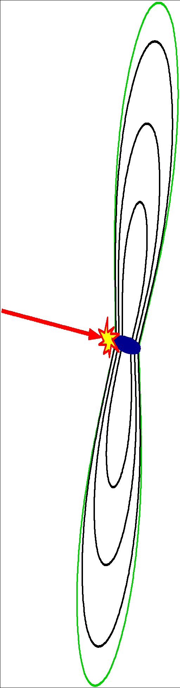
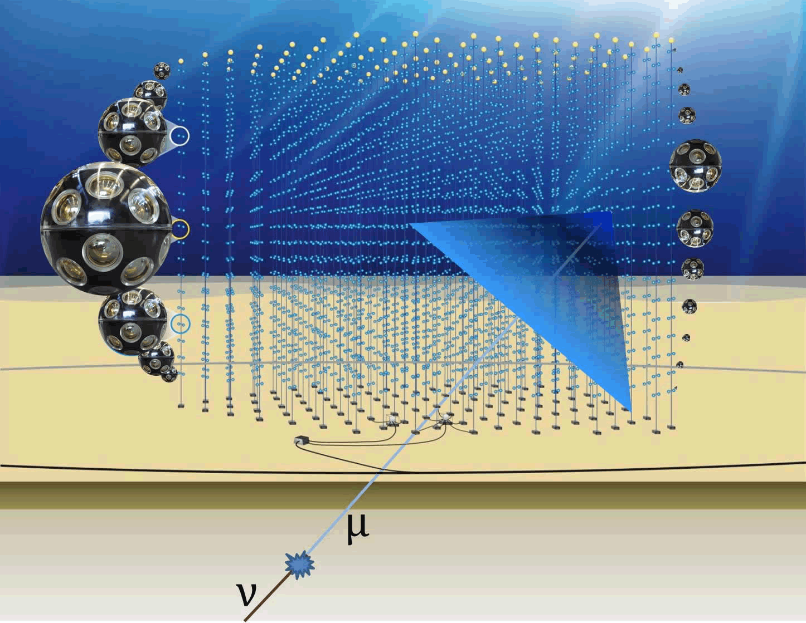
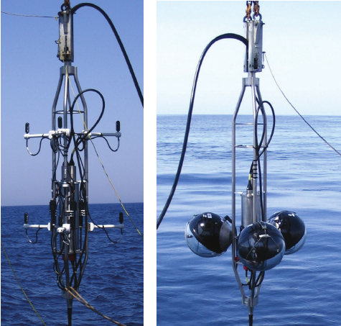
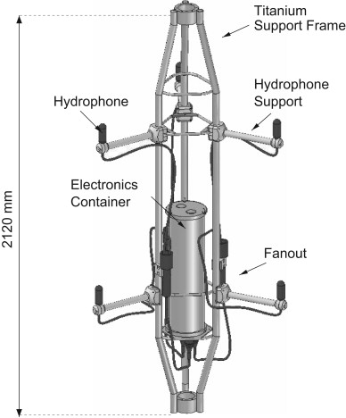
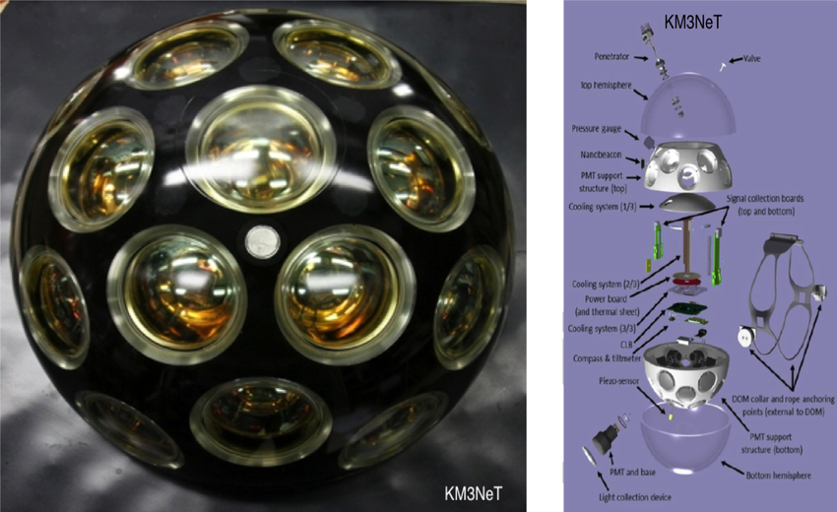
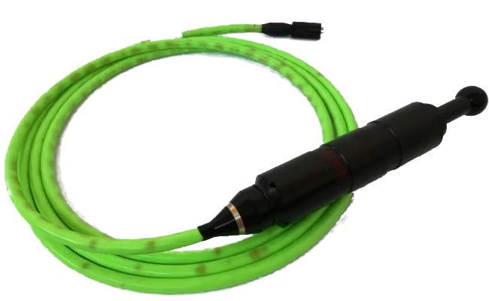

ASFAE/2022/014
Telescopios submarinos de neutrinos: nuevas perspectivas
Towards a hybrid optical-acoustic neutrino telescope:
Extension to the ultra-energetic range (>10¹⁶ eV): ~100 km³, possible through the acoustic signal given the lower attenuation
KM3NeT has already an acoustic monitoring system for positioning (hydrophones in the bases + Piezo in DOMs)
An acoustic antenna is being developed to complement the system and allow the acoustic detection of neutrinos
Implementation of an acoustic trigger in KM3NeT:
Ph. D. thesis of Dídac Diego-Tortosa
Publication being revised by KM3NeT Coll.
ν
The ASFAE’s research projects acknowledge the financial support from the MCIU with funding from the European Union NextGenerationEU and Generalitat Valenciana.

Slide 4
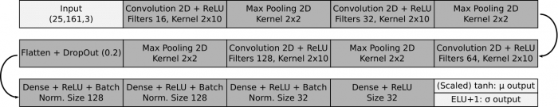
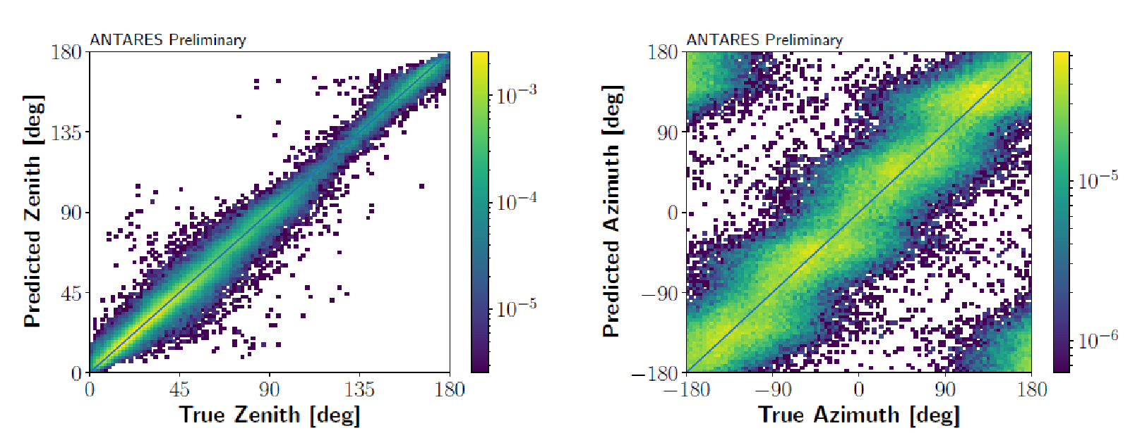
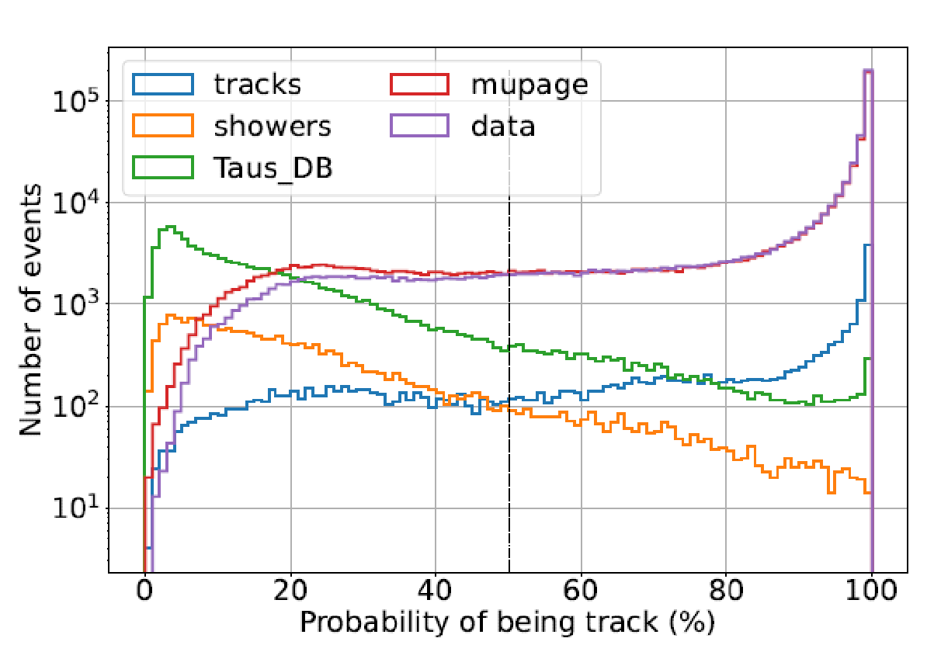
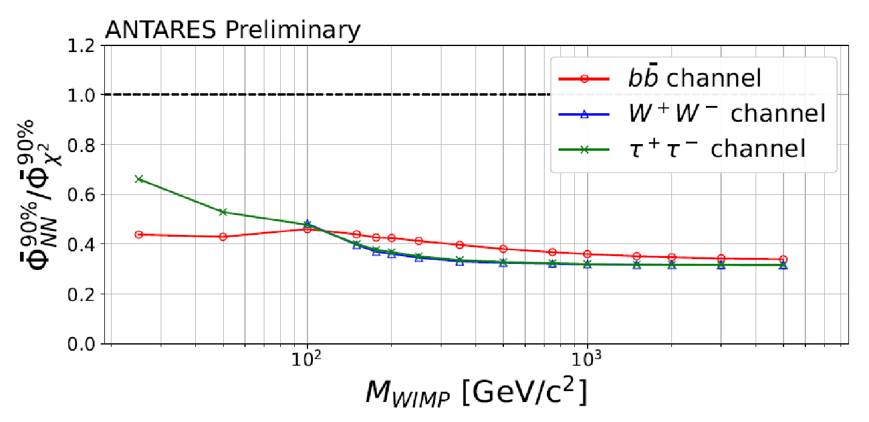
ASFAE/2022/014
Telescopios submarinos de neutrinos: nuevas perspectivas
Machine learning algorithms for ANTARES/KM3NeT
Convolutional neural network to determine direction/energy
Development of models to classify and reconstruct single-line events in ANTARES:
Direction of the incoming neutrino
Neutrino energy
Event type discrimination
Estimation of uncertainties (quality parameter)
Significant improvement at low energies, factor 2:
Searches for dark matter
Multi-messenger physics at low energies
Oscillations
Direction results
Classifier results
Algorithm development in KM3NeT:
Graph-based convolutional networks to improve spatio-temporal resolution (Graphnet)
Incorporate transformers into the models
~2 Better sensitivity
(low energy <~ 250 GeV)
PoS(ICRC2023)1443
The ASFAE’s research projects acknowledge the financial support from the MCIU with funding from the European Union NextGenerationEU and Generalitat Valenciana.

Slide 5
Introduction
AdSyncASTRO objective: To develop an advanced acquisition system capable of operating in a distributed manner with sub-nanosecond time synchronization to read signals from photomultiplier tubes (and SiPMs) with TDCs and ADCs using low resources
D. Real - AdSyncAstro (4 - March - 2024)

Slide 6
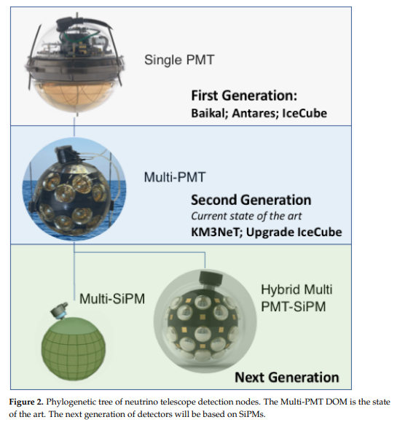
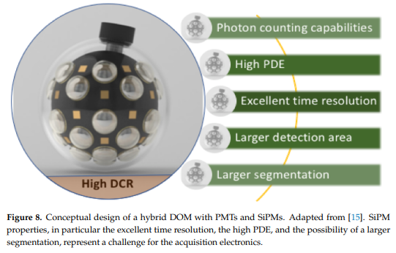
SiPMs for Neutrino Telescopes
Silicon Photomultipliers for Neutrino Telescopes. D. Real and D. Calvo. Universe 2023, 9(7), 326; https://doi.org/10.3390/universe9070326
D. Real - AdSyncAstro (4 - March - 2024)

Slide 7
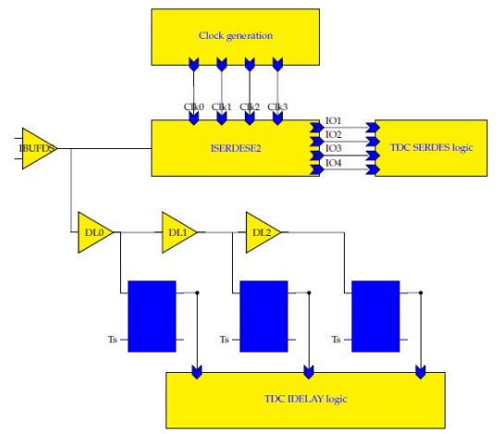
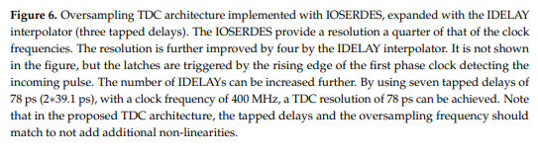
SiPMs for Neutrino Telescopes
Silicon Photomultipliers for Neutrino Telescopes. D. Real and D. Calvo. Universe 2023, 9(7), 326; https://doi.org/10.3390/universe9070326
Proposed a novel low-resource architecture of Time to Digital Converters
Low-resource electronics critical in neutrino telescopes due to the operation conditions
D. Real - AdSyncAstro (4 - March - 2024)

Slide 8
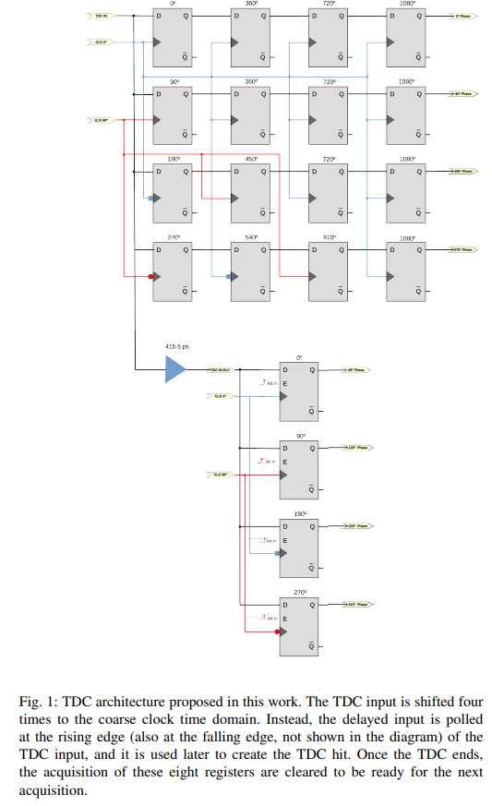
Novel TDC architecture (416 ps resolution)
Novel hybrid low-resource Field-Programmable-Gate-Array time-to-digital-converter architecture. D. Real et al. TechRxiv. February 27, 2024. DOI: 10.36227/techrxiv.170905916.61371080/v1. Submitted to IEEE Transactions on Instrumentation and Measurement
Proposed a novel low-resource architecture of Time to Digital Converters
Resolution: 415.85 ps (LSB)
Single-shot precision: 186 ps r.m.s
Differential Non-Linearity: 0.2 LSB
Integral Non-Linearity: 0.15 LSB
Low-resource use (213 FF/TDC channel)
Implemented in Artix-7 (Zed Board)
D. Real - AdSyncAstro (4 - March - 2024)

Slide 9
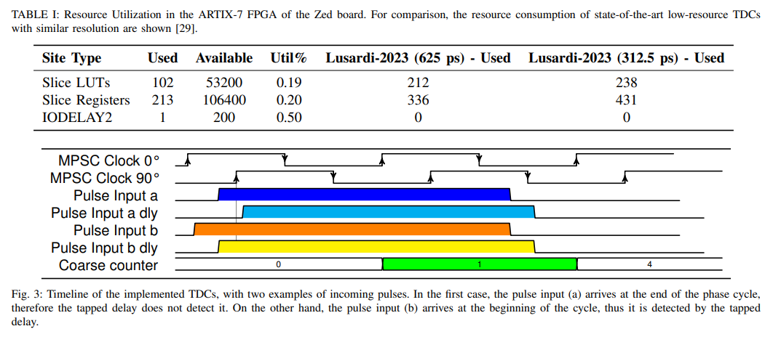
Novel TDC architecture (416 ps resolution)
Novel hybrid low-resource Field-Programmable-Gate-Array time-to-digital-converter architecture. D. Real et al. TechRxiv. February 27, 2024. DOI: 10.36227/techrxiv.170905916.61371080/v1. Submitted to IEEE Transactions on Instrumentation and Measurement
D. Real - AdSyncAstro (4 - March - 2024)

Slide 10
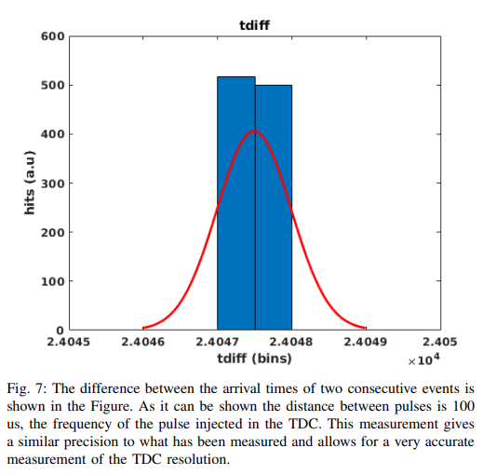
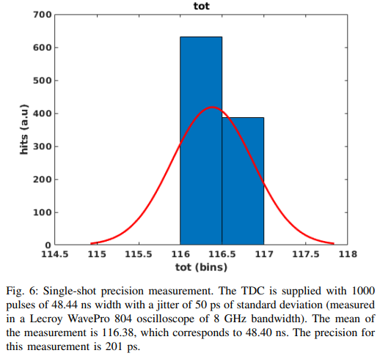
Novel TDC architecture (416 ps resolution)
Novel hybrid low-resource Field-Programmable-Gate-Array time-to-digital-converter architecture. D. Real et al. TechRxiv. February 27, 2024. DOI: 10.36227/techrxiv.170905916.61371080/v1. Submitted to IEEE Transactions on Instrumentation and Measurement
D. Real - AdSyncAstro (4 - March - 2024)

Slide 11
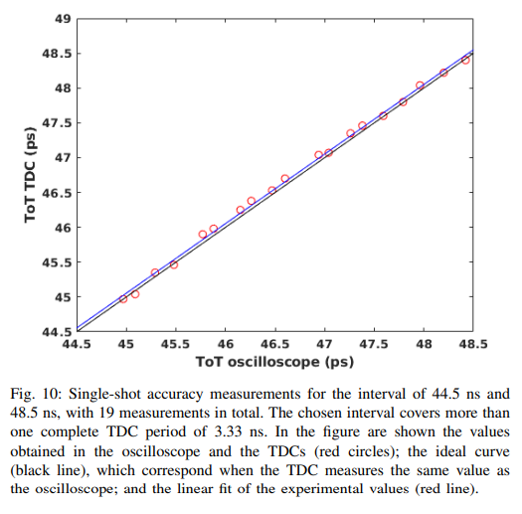
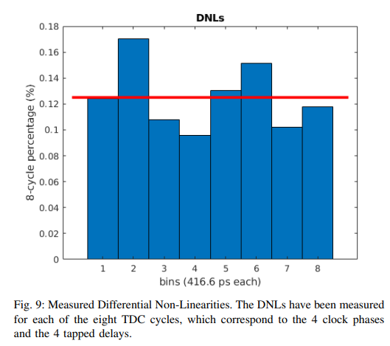
Novel TDC architecture (416 ps resolution)
Novel hybrid low-resource Field-Programmable-Gate-Array time-to-digital-converter architecture. D. Real et al. TechRxiv. February 27, 2024. DOI: 10.36227/techrxiv.170905916.61371080/v1. Submitted to IEEE Transactions on Instrumentation and Measurement
D. Real - AdSyncAstro (4 - March - 2024)

Slide 12
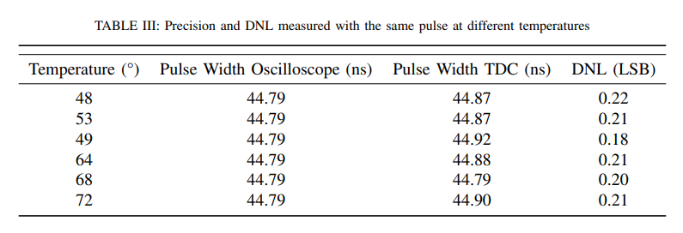
Novel TDC architecture (416 ps resolution)
Novel hybrid low-resource Field-Programmable-Gate-Array time-to-digital-converter architecture. D. Real et al. TechRxiv. February 27, 2024. DOI: 10.36227/techrxiv.170905916.61371080/v1. Submitted to IEEE Transactions on Instrumentation and Measurement
Next step: Migrating the architecture to Ultrascale+ to obtain a resolution 167 ps
D. Real - AdSyncAstro (4 - March - 2024)

Slide 13
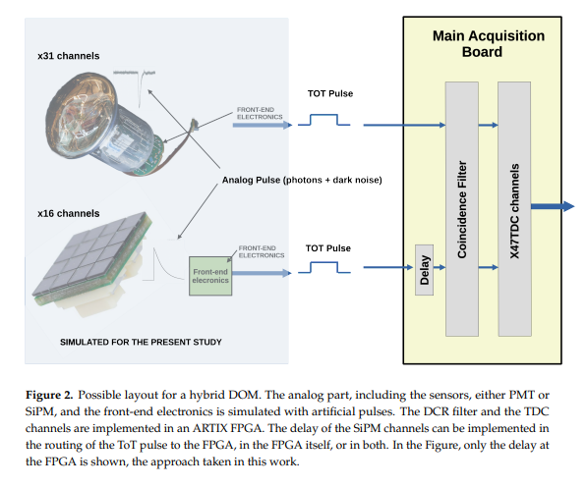
DCR Filter for SiPM
Fast Coincidence Filter for Silicon Photomultiplier Dark Count Rate Rejection. Real, D. et al. Preprints 2024, 2024021078. https://doi.org/10.20944/preprints202402.1078.v1. Submitted to Sensors
D. Real - AdSyncAstro (4 - March - 2024)

Slide 14
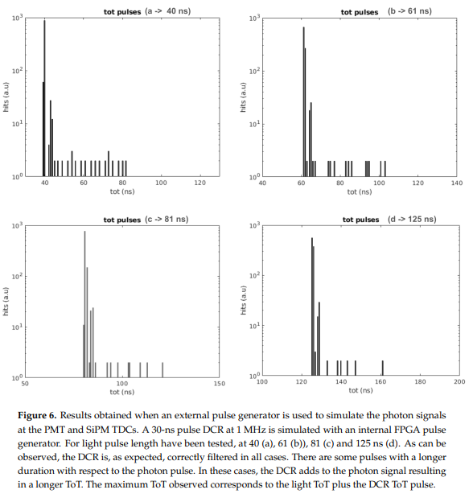
DCR Filter for SiPM
Fast Coincidence Filter for Silicon Photomultiplier Dark Count Rate Rejection. Real, D. et al. Preprints 2024, 2024021078. https://doi.org/10.20944/preprints202402.1078.v1 Submitted to Sensors
D. Real - AdSyncAstro (4 - March - 2024)

Slide 15
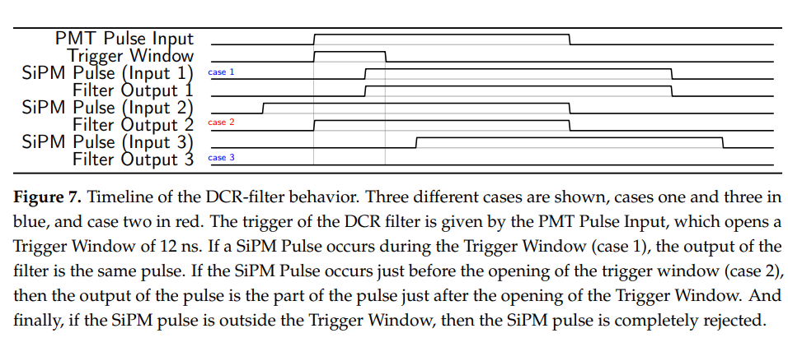
DCR Filter for SiPM
Fast Coincidence Filter for Silicon Photomultiplier Dark Count Rate Rejection. Real, D. et al. Preprints 2024, 2024021078. https://doi.org/10.20944/preprints202402.1078.v1 Submitted to Sensors
D. Real - AdSyncAstro (4 - March - 2024)

Slide 16
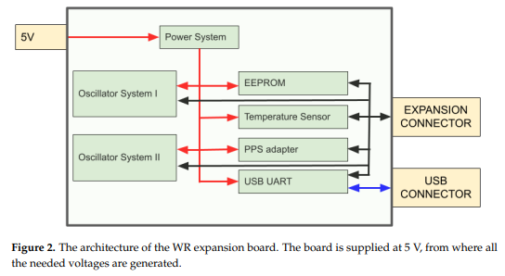
White Rabbit Expansion Board
White Rabbit Expansion Board: Design, Architecture, and Signal Integrity Simulations Electronics 2023, 12(16), 3394; https://doi.org/10.3390/electronics12163394
Provides White Rabbit Functionality to boards without the White Rabbit hardware
D. Real - AdSyncAstro (4 - March - 2024)

Slide 17
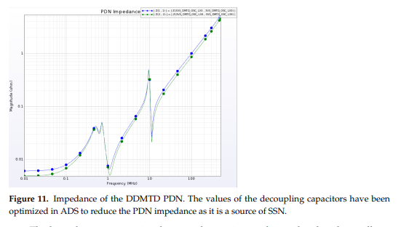
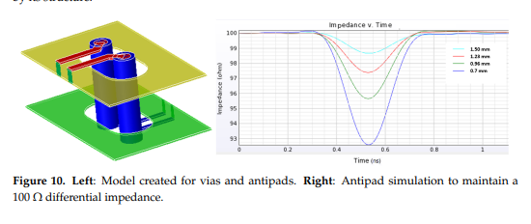
White Rabbit Expansion Board
White Rabbit Expansion Board: Design, Architecture, and Signal Integrity Simulations Electronics 2023, 12(16), 3394; https://doi.org/10.3390/electronics12163394
D. Real - AdSyncAstro (4 - March - 2024)

Slide 18
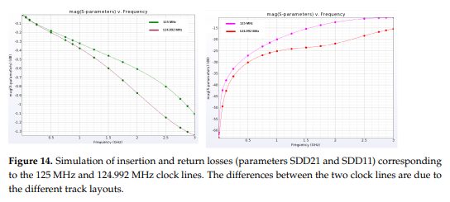
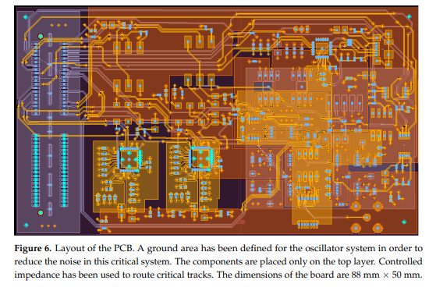
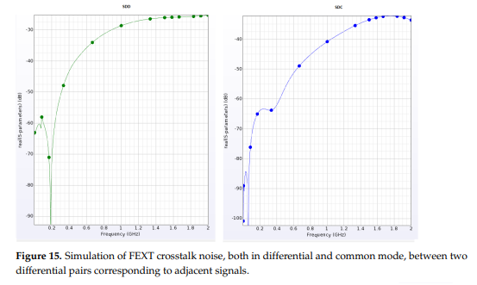
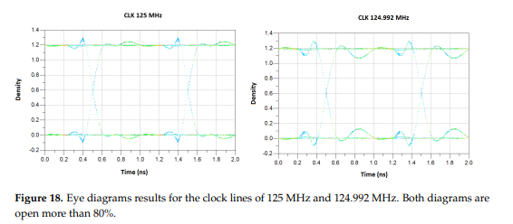
White Rabbit Expansion Board
White Rabbit Expansion Board: Design, Architecture, and Signal Integrity Simulations. D. Real et al. Electronics 2023, 12(16), 3394; https://doi.org/10.3390/electronics12163394
D. Real - AdSyncAstro (4 - March - 2024)

Slide 19
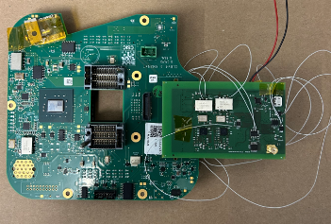
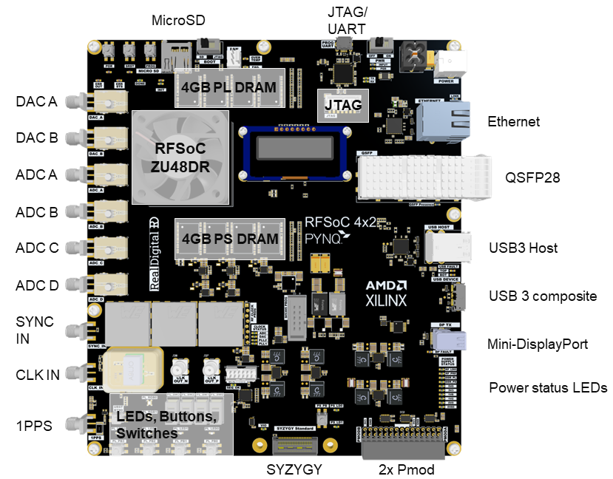
White Rabbit Expansion Board
Prototype already developed and first tests on-going in a KM3NeT CLB
Next Step: To provide White Rabbit functionality to a Xilinx RF SoC (14-bit 5 GSPS ADCs):
Use the expansion board
Implement WRPC with GTY Transceivers
In parallel: Developing an acquisition board based on the RFSoC ZU48DR (ASFAE Board) with the White Rabbit Hardware inside. Schematics already finalized
D. Real - AdSyncAstro (4 - March - 2024)

Slide 20
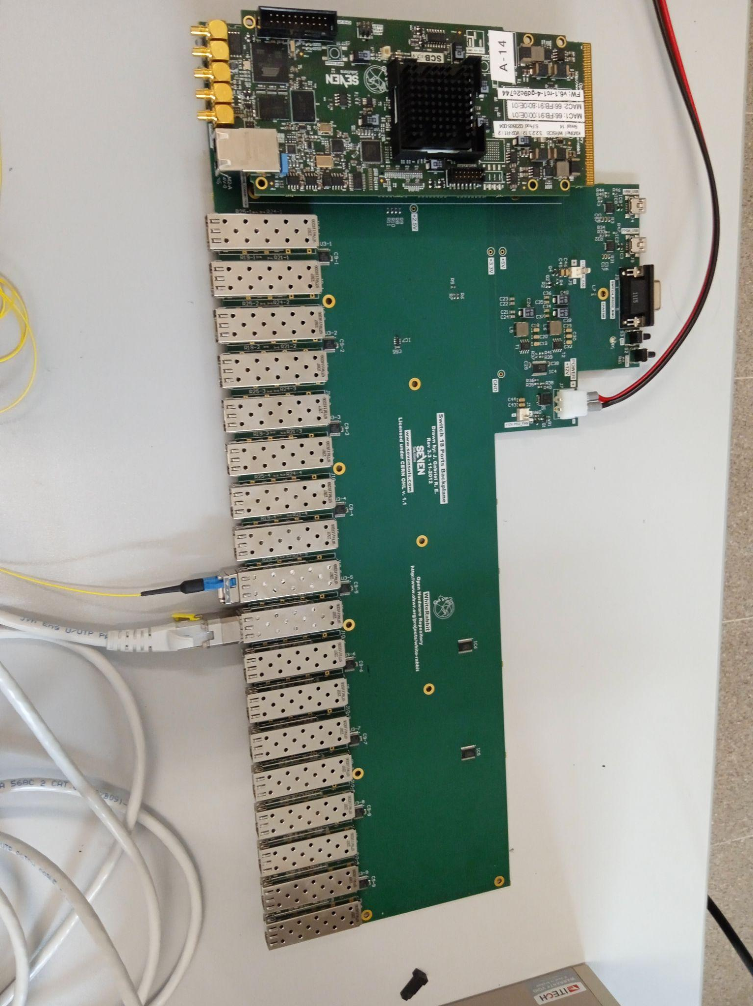
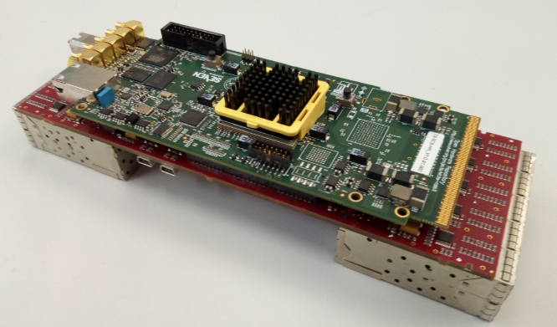
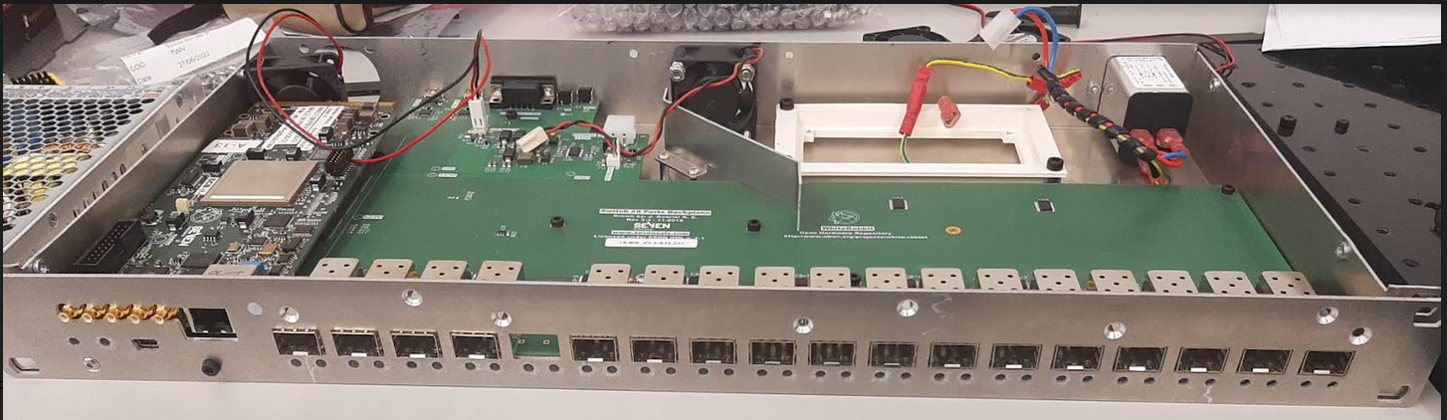
High-Reliability White Rabbit Switch
KM3NeT White Rabbit Switching Core Board (higher reliability than standard SCB)
+
Standard backplane
=
Higher reliability White Rabbit Switch
KM3NeT ASFAE
One prototype already built (with a KM3NeT SCB). Preparing to produce 10 more High-Reliability White Rabbit Switches
D. Real - AdSyncAstro (4 - March - 2024)

Slide 21
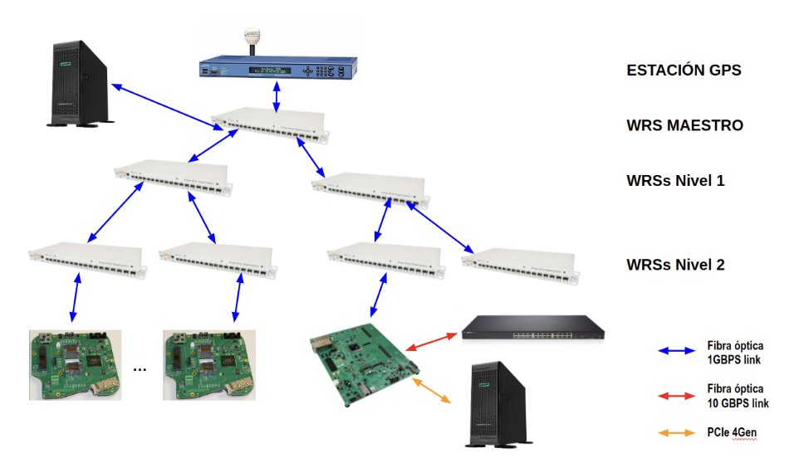
Next Steps Ahead
Finalize WR expansion board tests
Provide WR functionality to the RFSoC
Finalize the layout of the ASFAE board and produce it
Implement the TDCs in the RFSoC board
Produce 10 High-reliability WRS
Synchronization tests
D. Real - AdSyncAstro (4 - March - 2024)

Slide 22
Summary
Developed new architecture of low-resource TDCs. Implemented in Artix-7 @416 ps, in development in Ultrascale+ @167 ps -> Proposed for the use of SiPMs in neutrino telescopes
SiPM DCR Filter using as trigger PMT signal
White Rabbit expansion board under test
Migration of the WRPC to RFSoC ongoing
Finalise design and production of the ASFAE board
Produced one HR WRS. 10 more WRS ongoing
To perform final tests
D. Real - AdSyncAstro (4 - March - 2024)

Slide 23
THANKS!
D. Real - AdSyncAstro (4 - March - 2024)

