Slide 1
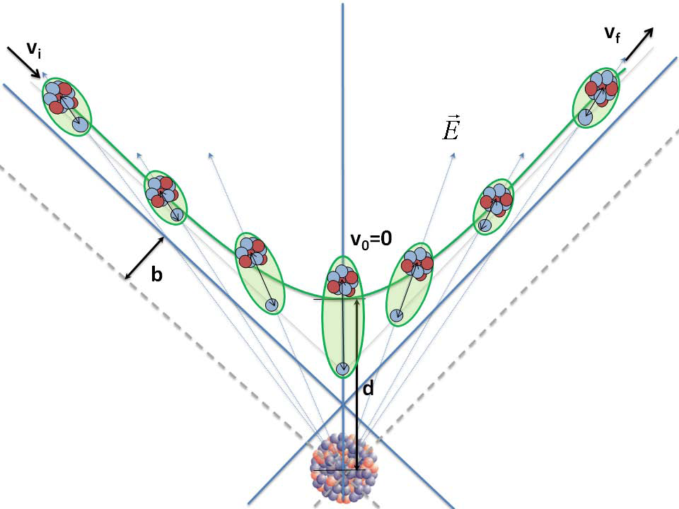
Máster Interuniversitario de FÍSICA NUCLEAR Curso 2023-2024
Scattering of Nuclei at low energies
Courtesy of M. Cubero

Slide 2
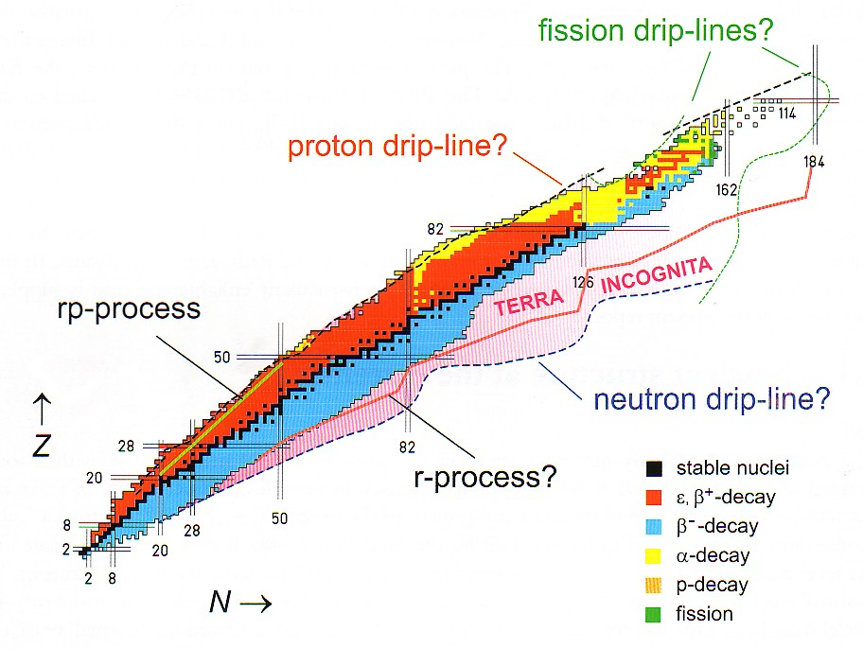
Situated far from the valley of Stability Very different N/Z compare to the stable one
Close to the drip lines : B_{n} =0, B_{p} =0 at the frontier of discovery
Exotic Nuclei

Slide 3
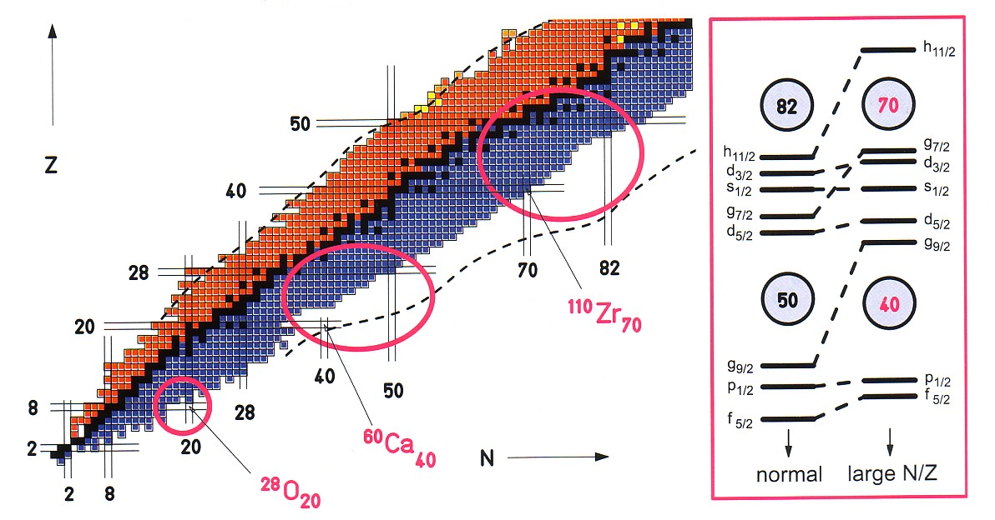
Why Study Exotic Nuclei?
Explore the different degrees of freedom of the system in
isospin, T,
in excitation energy, E_{x},
spin, J,
level density, ρ
Stringent test of Theoretical Models
Observation of new decay modes
Measurement of astrophysical interest
Halo structure
Evolution of shell structure

Slide 4
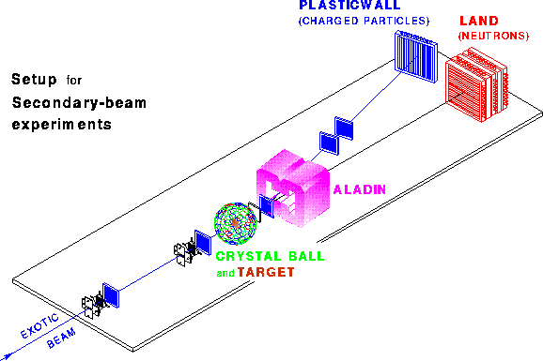
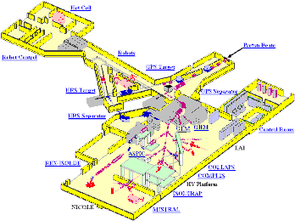
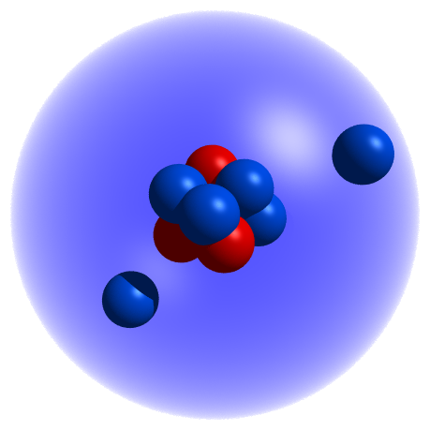
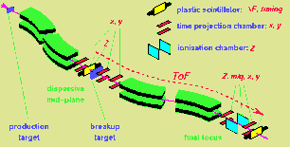
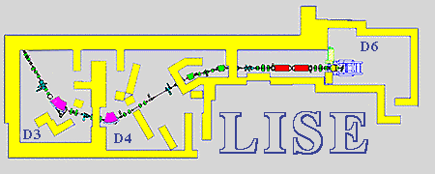
To explore a new phenomenon many different approaches are needed
Talks by D. Cortina A. Algora
GSI
Reacciones a E_{r}=700 MeV/u
Elastic
Scattering
Spins
Moments
ISOLDE
Desintegración beta E_{r}=0
Reaction
Cross Sections
Masses
Beta
Decay
Momentum
Distributions
GANIL
Reacciones a E_{r}=30-60 MeV/u
Unbound
Nuclei

Slide 5
Production Methods (see Talk by B. Rubio)
ISOL- Method
FAIR
GSI
RIKEN
GANIL
SPIRAL1
HIE –
ISOLDE
ISOL-(DE)
1 GeV/u
400MeV/u
345MeV/u
50MeV/u
10MeV/u
10MeV/u
0.06 MeV
meV -100MeV/u
Good beam
From ms to s
High Temp
Thick Target
Ion source
Mass
Separator
Post-
Accelerator
Light & Heavy Ions
Spallation
Fusion
Fission
Fragmentation
Experiments
Detectors
Spectrometer
Driver Accelerator
Reactor
Gas Cell
Heavy Ions
Fusion
Fragmentation
Fission
GeV
Microseg
Ev. Slow down
Fragment
Separator
Storage
Ring
Thin Target
In-Flight-method

Slide 6
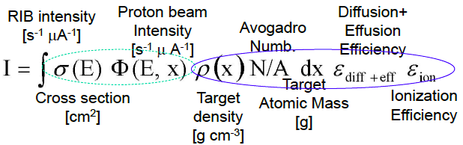
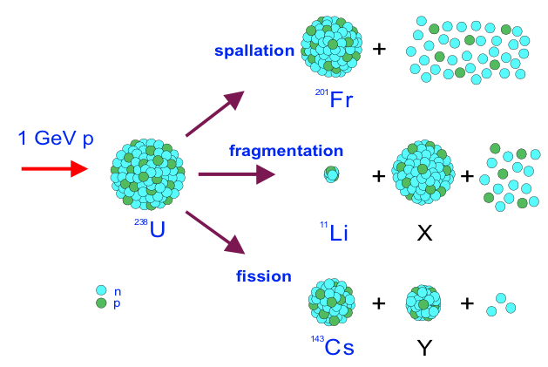
ISOL- Beams
The case of ISOLDE

Slide 7

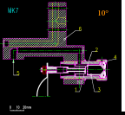
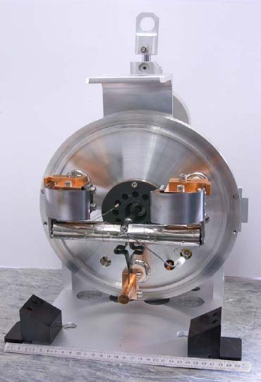
Produced Nuclei: ISOLDE > 50 y Experience
Over 20 target materials (carbides, oxides, solid metals, molten metals and molten salts) and ionizers, depending on beam of interest operated at high temperature
3 types of Ion-sources: Surface, Plasma, laser
> 1000 nuclides of over 70 chemical elements produced
Target
p+
p+
ISOLDE today offers the largest range of available isotopes of any ISOL facility worldwide.

Slide 8
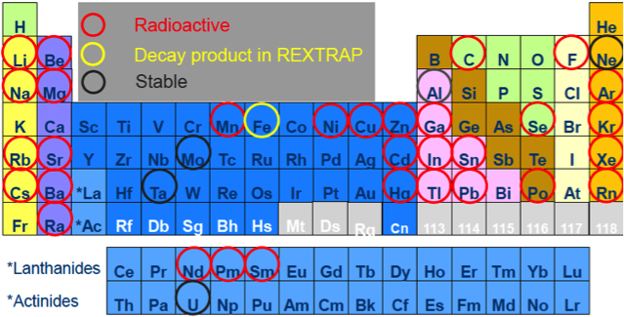
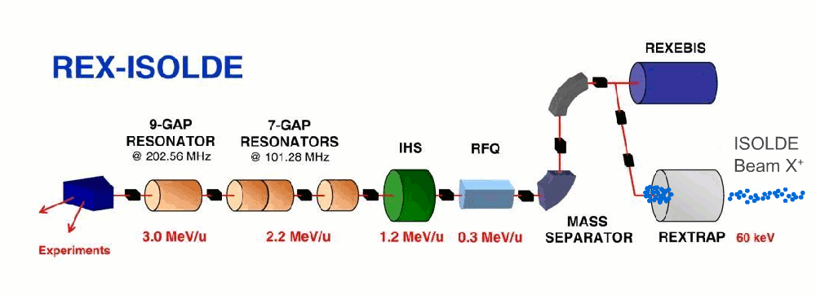
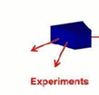
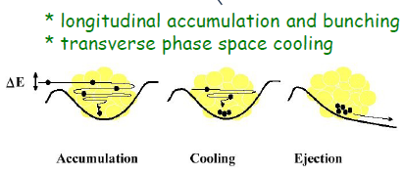
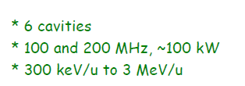
Post-accelerator: REX-ISOLDE
REX-ISOLDE started in 2001
Total efficiency : 1 -10 %
Charge Breeding
1⁺ to A/Q = 2 – 4.5
1⁺ to A/Q = 2 – 4.5
ISOLDE
1 Nature, 12 PRL, 6 PLB…..
Primary target
Protons
from PS
Heidelberg + GSI, Darmstadt
Stockholm
Mainz
Notes:
Ions are cold in the large aceptance rex-trap to effectively enter in the Electron beam ion source that produce a charge breeding between 3 al 4.5. last year the A/Q ratio 2 was successfully proved.
The 4-rod-RFQ is designed to accelerate radioactive ions with a charge-to-mass ratio larger than 1/4.5 from 5 keV/u to 300 keV/u . The RF Quadrupole field provides transverse focusing for the low energy ions while a modulation of the four rods performs a smooth bunching and acceleration of the injected 100 µs bunch.
The IH-Structure (IHS) [8] is a compact cavity containing separated regions of acceleration and focusing, including a triplet of quadrupoles and a section of drift tubes operating as a re-buncher, boosting the beam from 0.3 MeV/u to an energy value between 1.1 and 1.2 MeV/u, by providing an effective voltage of up to 4.2 MV. The whole structure has 20 gaps and a total length of 1.5 m.

Slide 9
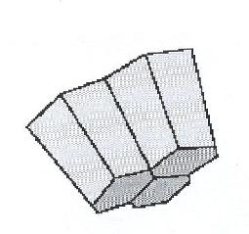
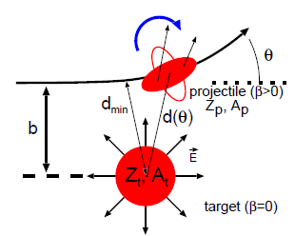
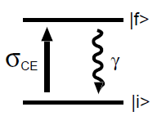
Coulomb excitation
Miniball setup: highly efficient gamma detectors and particle detector
Ge γ detectors
CD – detector
Double sided Si strip detector
ΔE-E detector
Beam dump
PPAC
detector
REX-
ISOLDE
E <3 MeV/u
target
Beam
Excitation of a projectile nucleus (radioactive) by the electromagnetic field of the target (made of stable nuclei)
Beam
impurities
Observables: Transition energies and intensities
Information: reduced transition matrix elements
=> Study collectivity and deformations

Slide 10
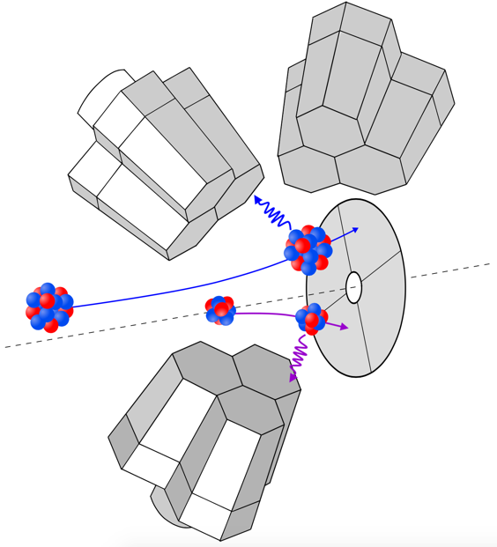
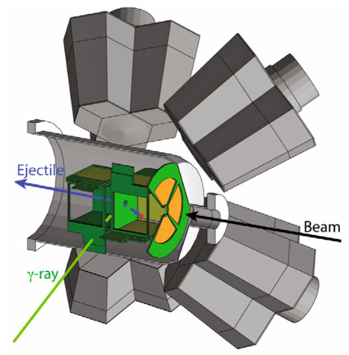
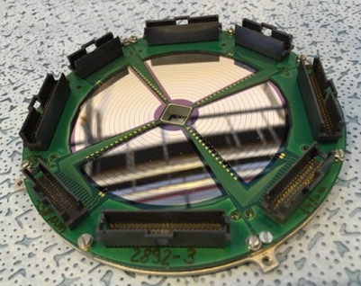


Miniball: Coulex or transfer
Array of HPGe of 8 x triple clusters
6-fold electronic segmentation
ε > 7% for 1.3 MeV γ-rays… Compact.
Event-by-event Doppler correction.
TREX
Particle ID in segmented Si detectors, telescope configuration.
Forward CD only; plunger possible.
Barrel configuration; large coverage.
Complementary to new ISS setup!
N. Warr et al., EPJ A 49 (2013)
V. Bildstein, et al., EPJ A 48, 85 (2012).

Slide 11
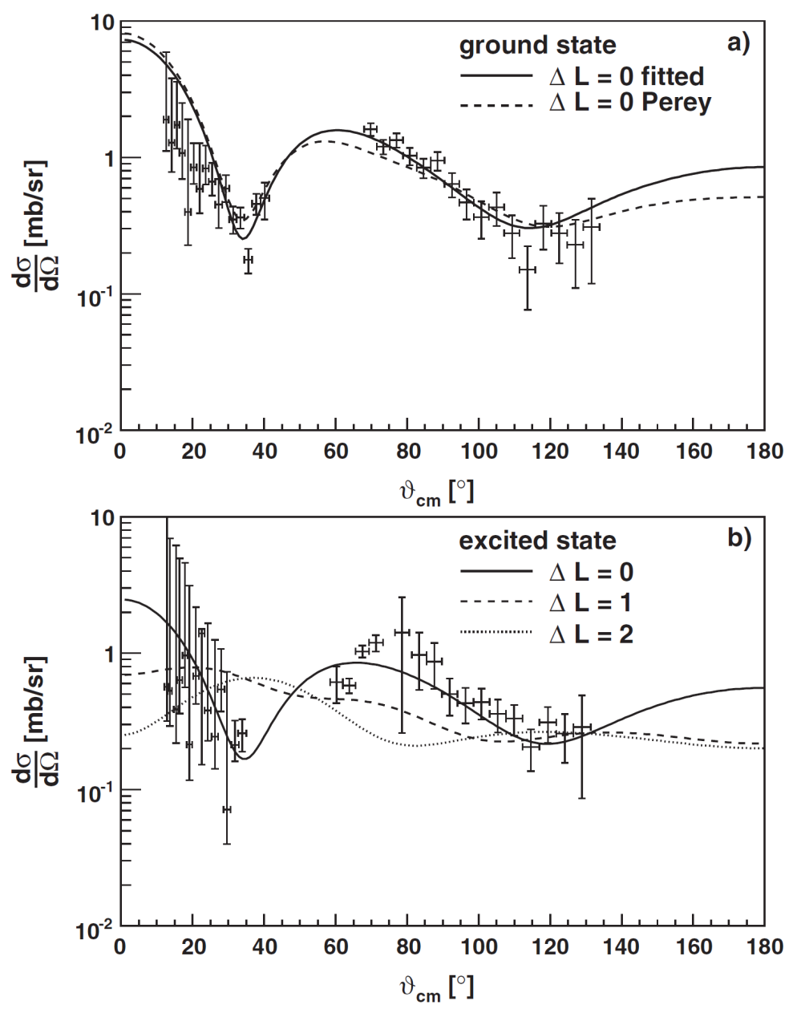
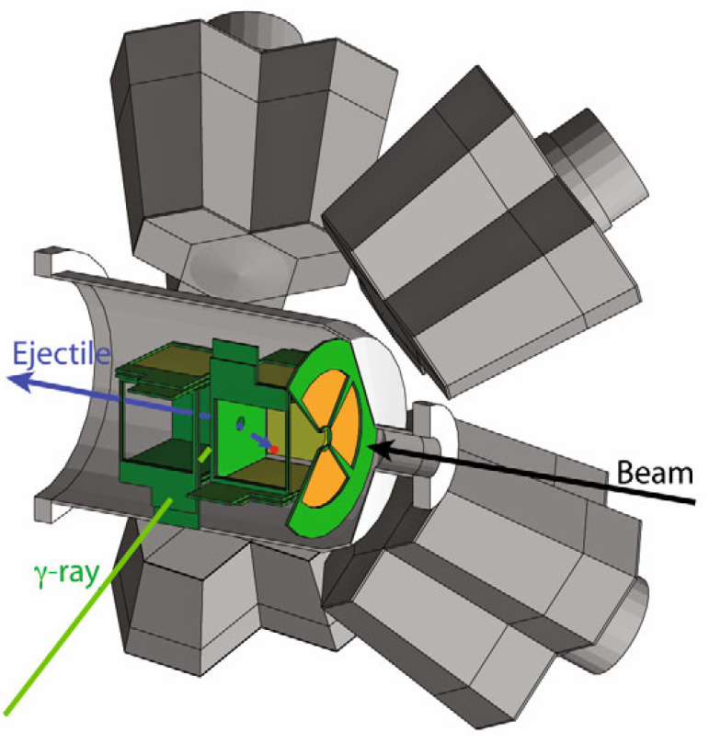
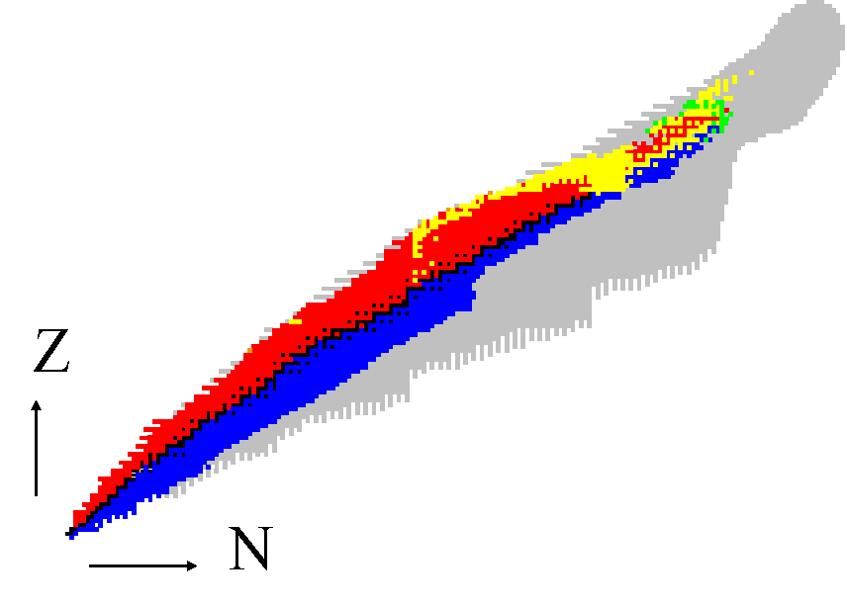
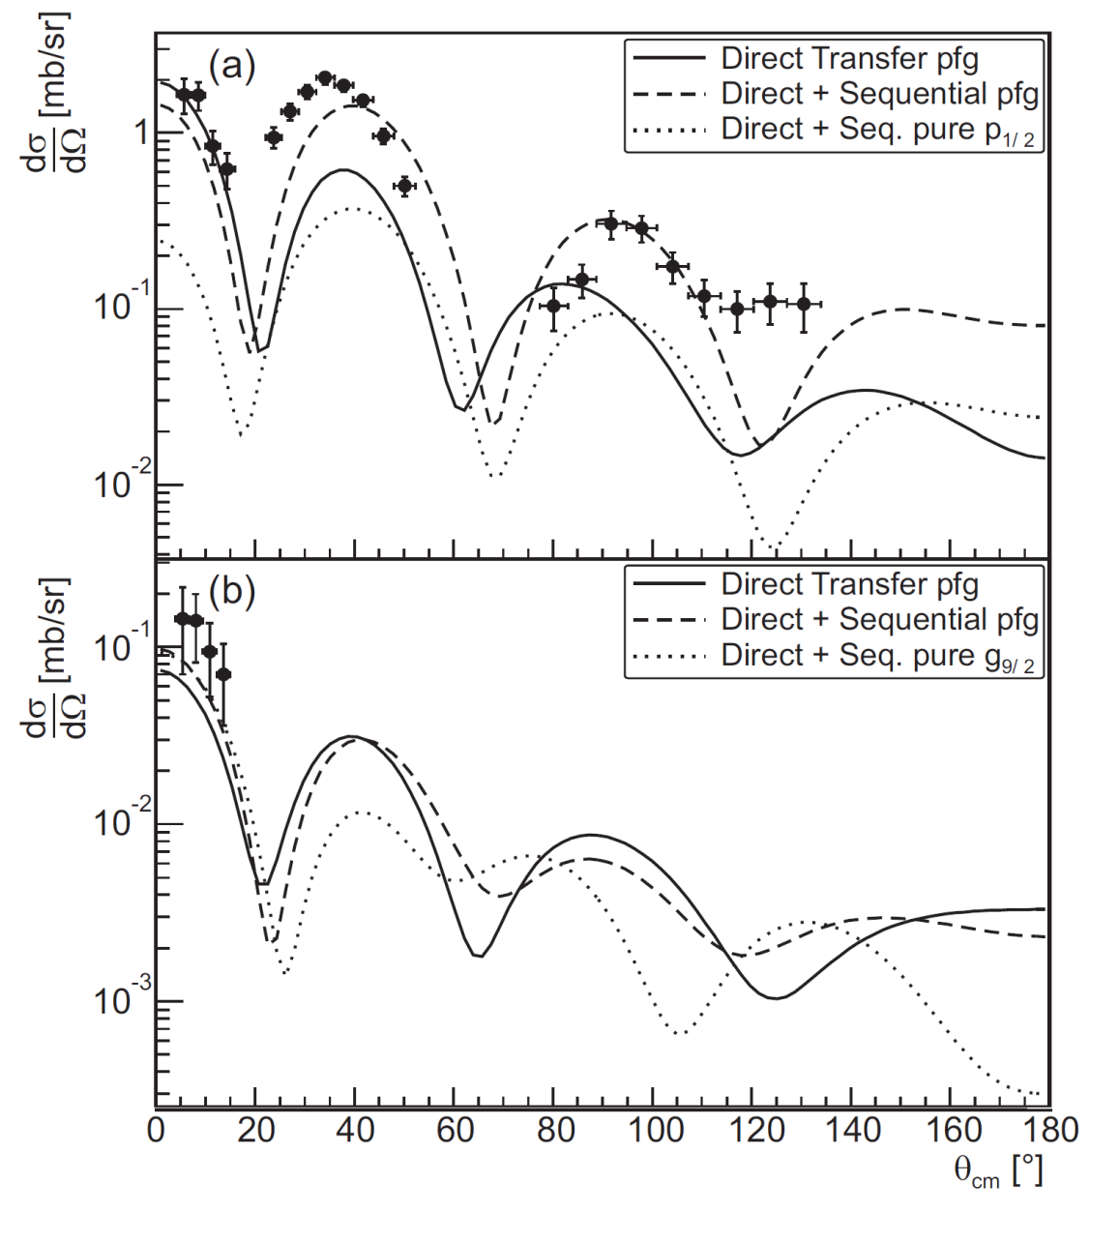
Coulex &Transfer Reactions @ REX
Coulomb excitation with Miniball:
collectivity versus individual nucleon behaviour
Few-nucleon transfer reaction studies:
single-particle properties
halo and cluster structures
³⁰Mg(t,p)³²Mg (N=20)
20
40
50
82
82
50
Need to go to 10 MeV/u
Transfer reaction studies
t(⁷²Zn,p)⁷³Zn Hellgartner
t(⁴⁴Ar,p)⁴⁶Ar Nowak
d(⁶⁶Ni,p)⁶⁷Ni Diriken
t(⁶⁶Ni,p) ⁶⁸Ni Elseviers
d(⁷⁸Zn,p)⁷⁹Zn Orlandi
28
d(³⁰Mg,p)³¹Mg, K. Wimmer, PRL 2010
Light nuclei, halos & clusters
d(⁸Li,p)⁹Li*; Tengborn PRC (2011) d(⁹Li,p)¹⁰Li
d(¹¹Be,p)¹²Be Johansen PRC (2013)
20

Slide 12
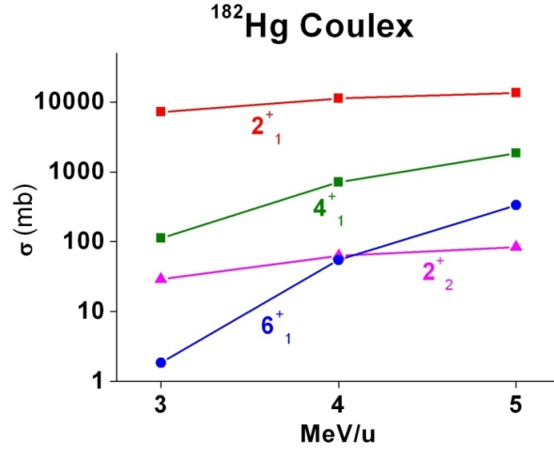
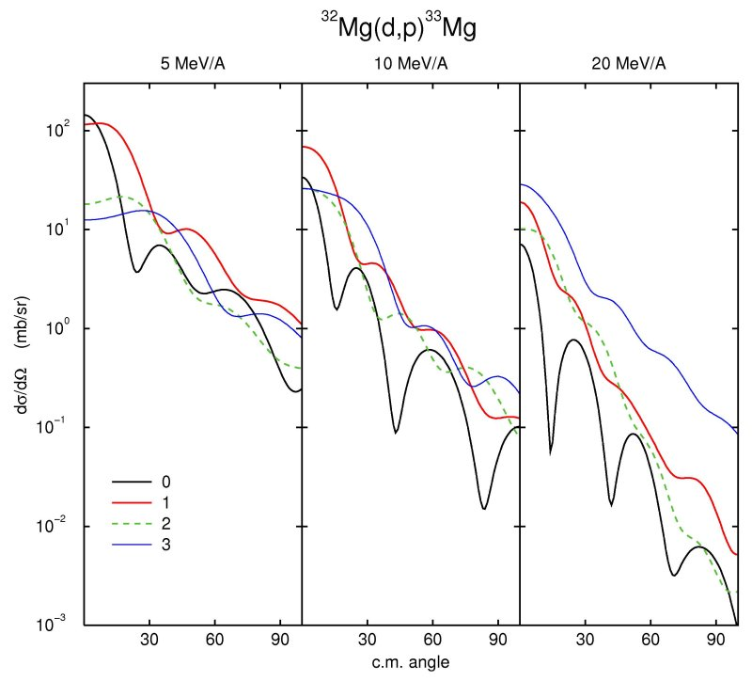
Intensity & Selectivity & Beam quality & Efficiency Energy upgrade to 5.5 MeV /A 10 MeV /A
Advantages of Going to High energies
³²Mg(d,p)³³Mg
Access to a wealth of spectroscopic information
From the absolutes intensities of 4⁺/2⁺ (multistep coulex)
⇒Access to the sign of deformation
θ_{cm}
Single particle information through the spectroscopic factors
High energy needed to learn about the “l” transfer

Slide 13
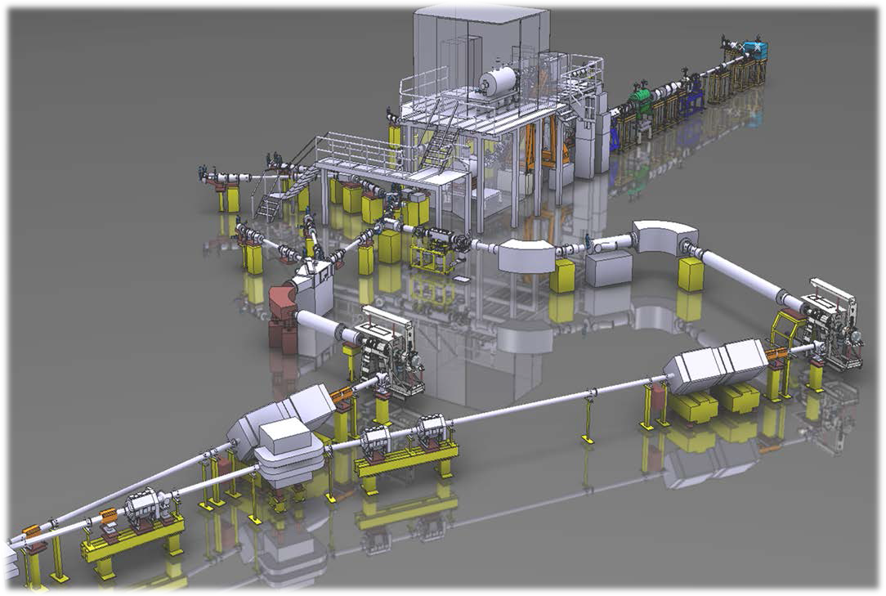
The HIE-ISOLDE project (2010- )
Energy: 4.5 – 10 MeV/u
Intensity: x10 in power
Beam Quality
Higher Energy
2015
Purity & Beam Quality
Higher Intensity
2020
ISOLDE
Notes:
The HIE-ISOLDE (High
Intensity and Energy) project will provide major improvements in energy
range, beam intensity and beam quality. A major element of the project will
be an increase of the final energy of the post-accelerated beams to 10 MeV/u
throughout the periodic table. The first stage will boost the energy of the
current REX LINAC to 5.5 MeV/u where the multistep Coulomb excitation
cross sections are strongly increased with respect to the previous 3 MeV/u
and many transfer reaction channels will be opened. The construction of
the Linac is underway and the full physics program with post accelerated
beams up to 5.5 MeV/u will start in 2016.

Slide 14
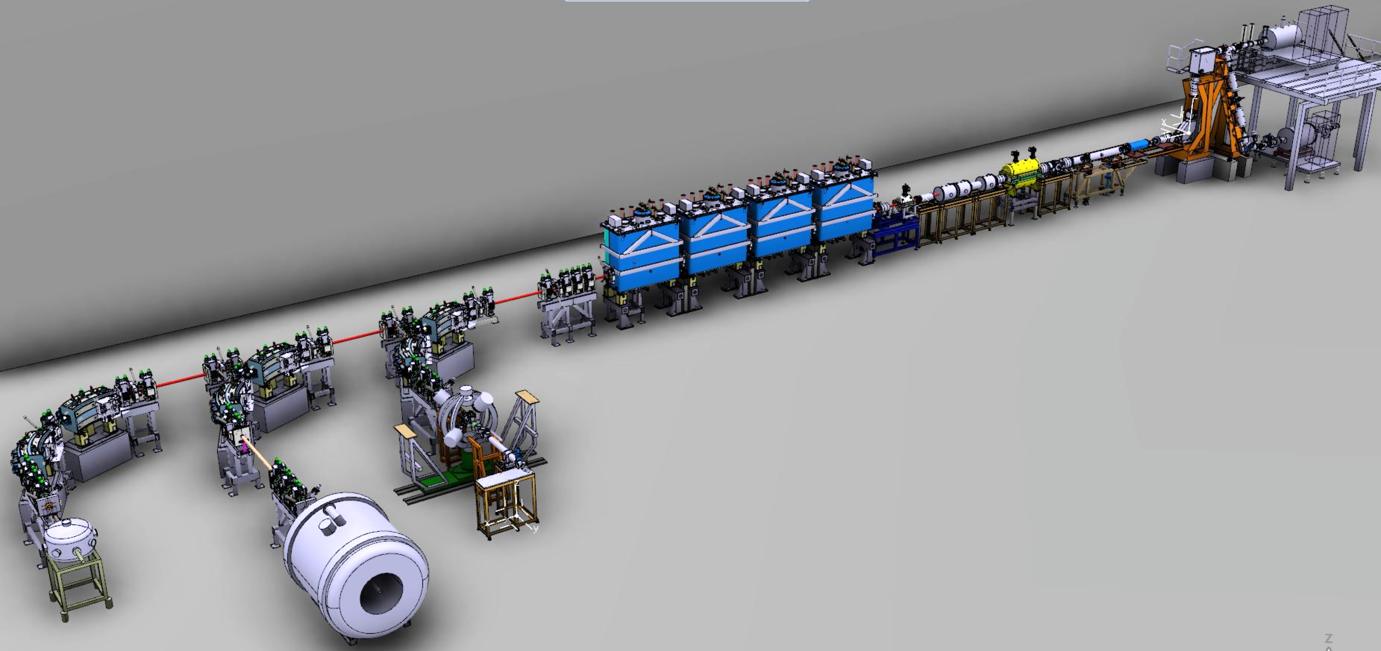

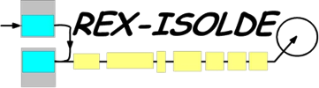

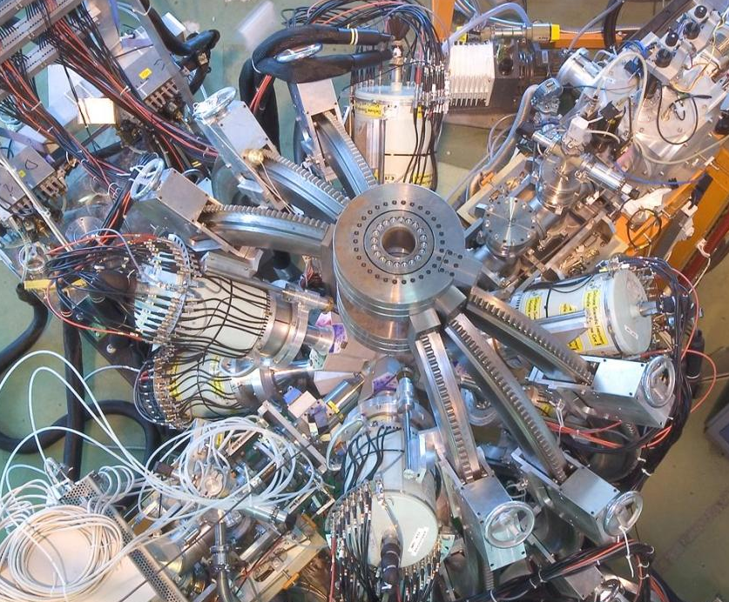

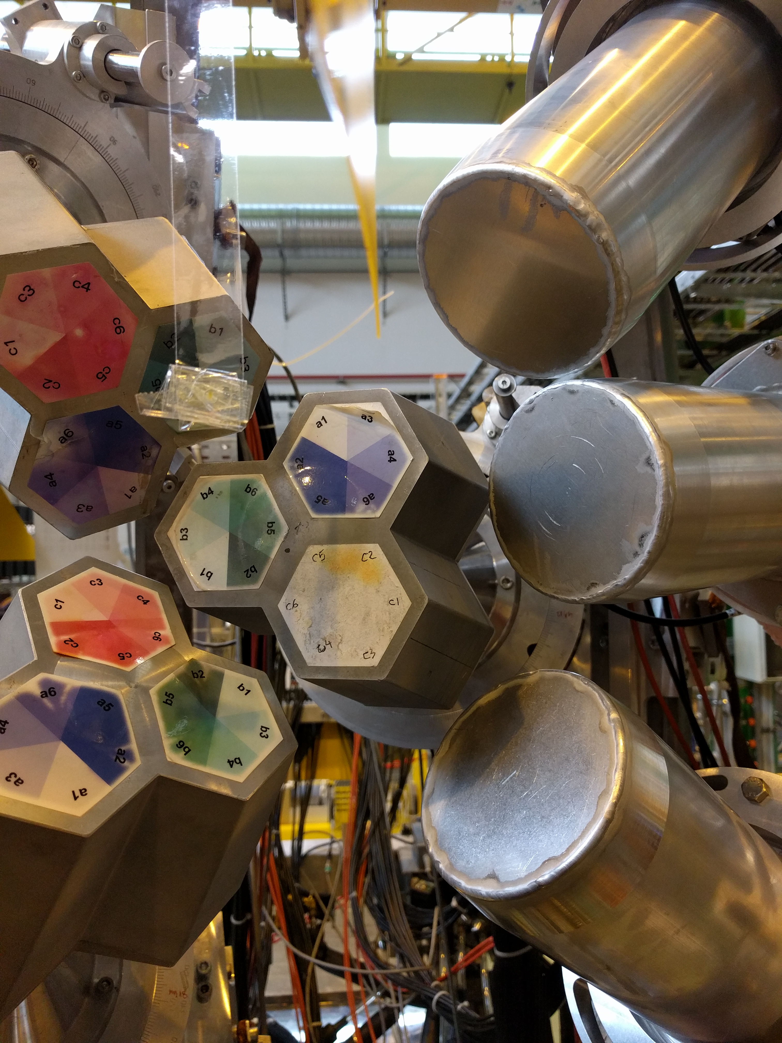
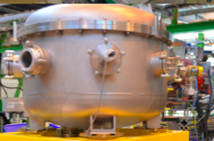
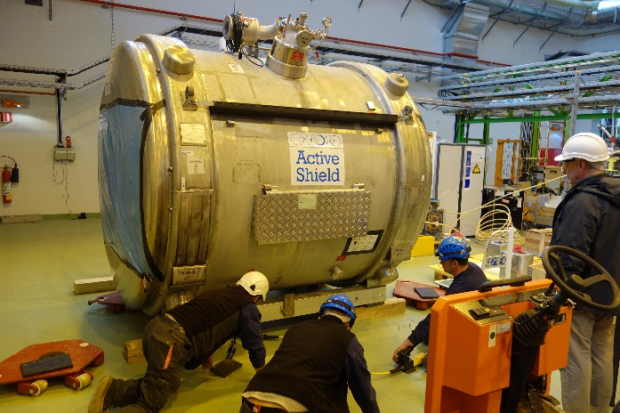
HIE-ISOLDE (2014-) @ 10 MeV/u ( A/q = 4.3)
>10 MeV/u
Nuclear reactions:
Inelastic scattering
Coulomb excitation
Few-nucleon transfer
Astrophysical processes
2.83 MeV/u
10.0 MeV/u
1⁺ RIB from ISOLDE
Miniball
CD-Si Detectors
Plunger
MINIBALL
ISS - ISOLDE Solenoidal
Spectrometer
Moveable Setups (SEC)
SEC

Slide 15
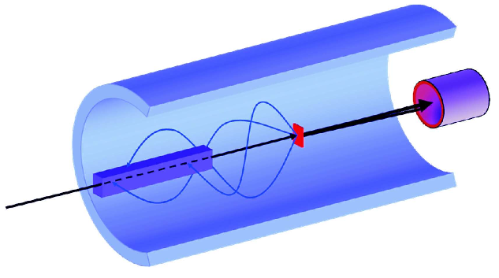

Solenoidal Spectrometers
Problem solved by using a solenoidal magnetic field (i.e. an MRI magnet!)
Protons after the reaction (d,p) follow cyclotron motion → return to axis.

Slide 16

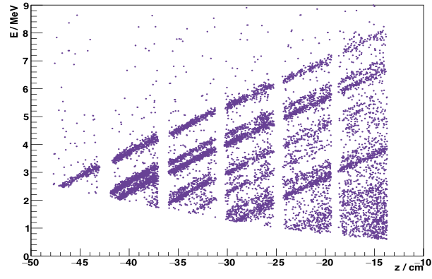
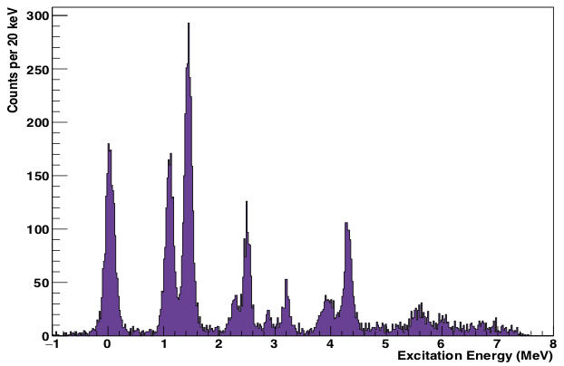
ISS – First results – ²⁸Mg(d,p)
Excitation energy resolution of ~140 keV.
Compared to DWBA calculations to make 𝓁 assignments.
2 days beam time with ~10^6 pps
David Sharp (Manchester)

Slide 17
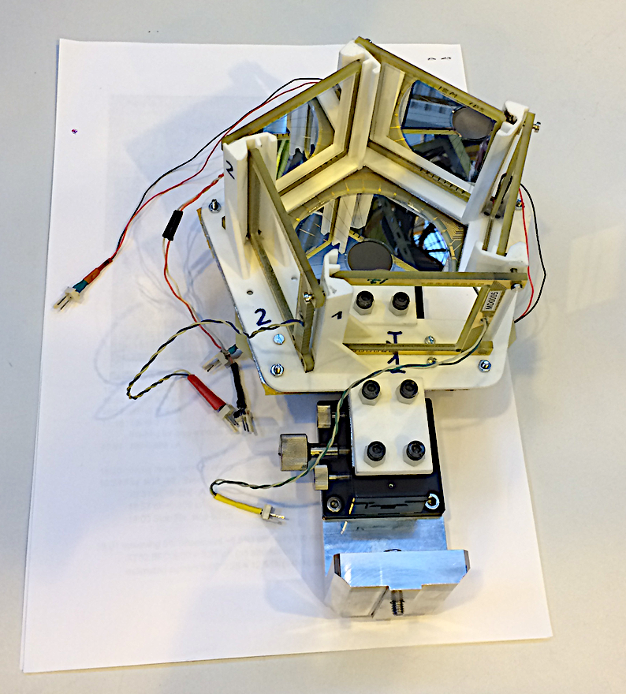
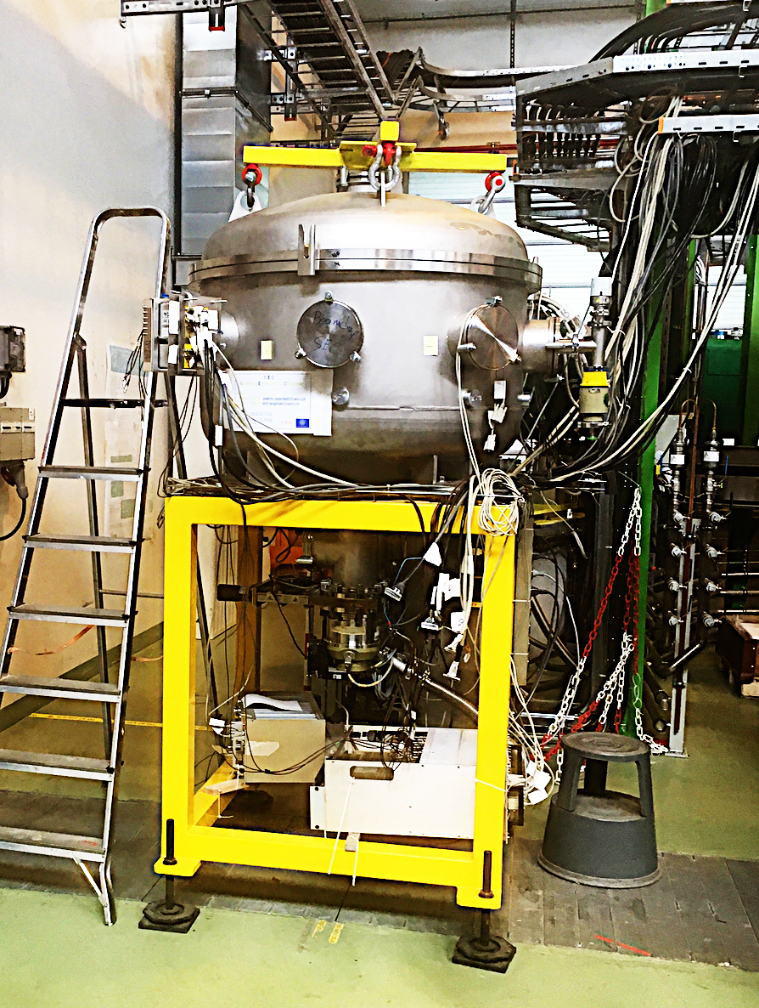
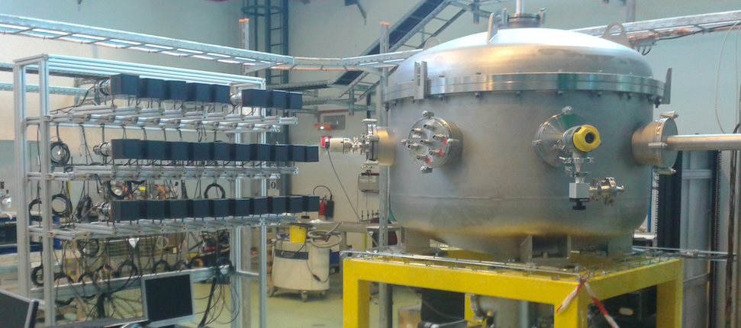
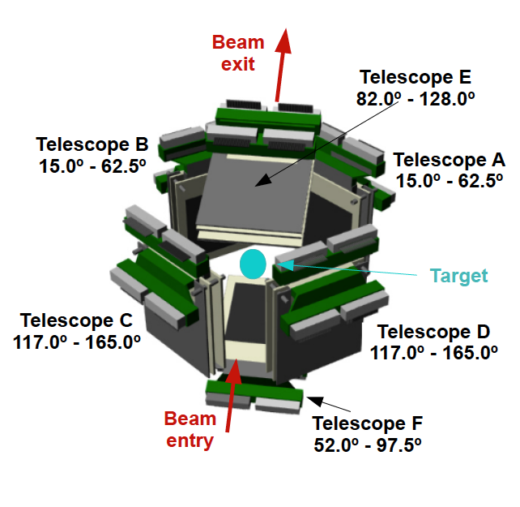
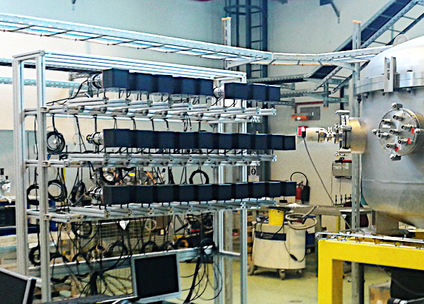
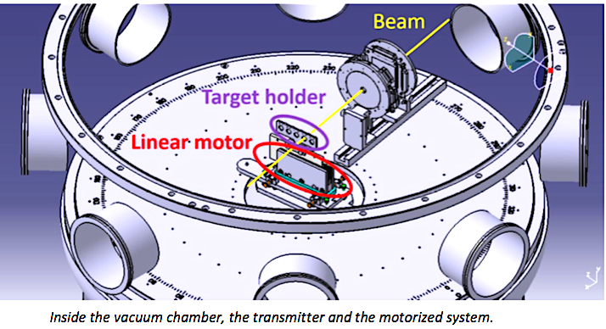
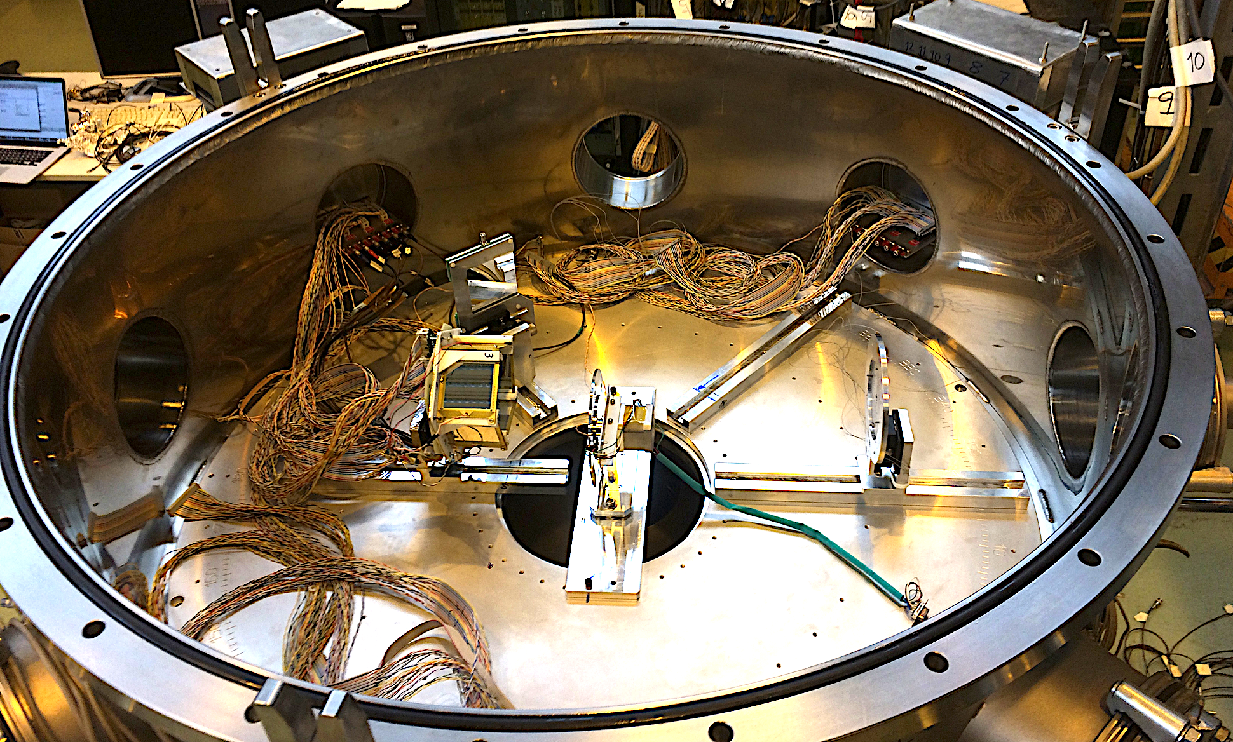
Scattering Experiments Chamber (SEC)
Flexible setups for scattering experiments:
Compact Pentagon Si array →
GLORIA for complete theta angles ↓
Coupled to ancillary devices.
Focus on light nuclei.
SAND n-Array
32x 10x10x10cm³ Plastic TPS-1000
PM tubes Photonis XP4312
Power supply CAEN SY1527
Slides from Ismael Martel (Huelva)

Slide 18
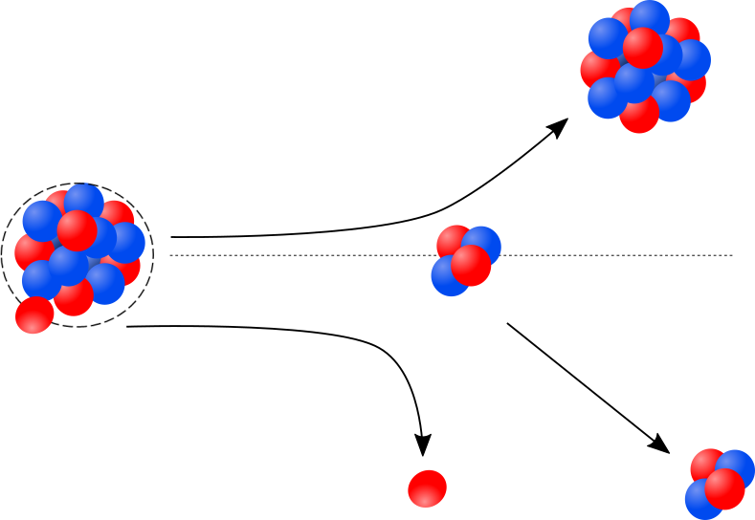
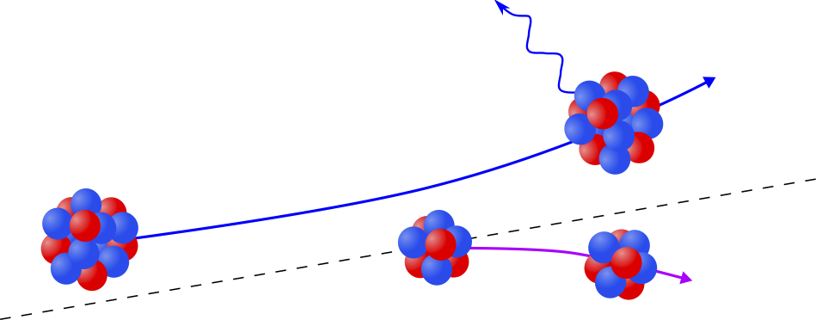
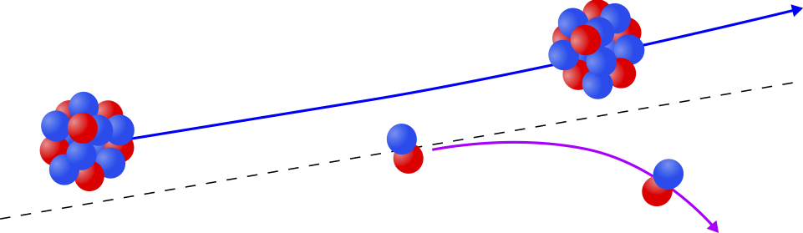
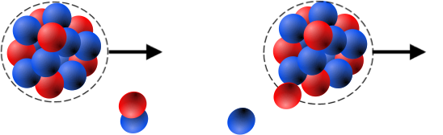
Nuclear reactions of choice
Coulomb excitation: 2 – 6 MeV/u → Miniball
Few-neutron transfer: 2 – 10 MeV/u → Miniball / ISS / SEC
Breakup / stripping: 4 – 6 MeV/u → SEC
Cluster transfer (t, α, ⁷Li): 4 – 8 MeV/u → Miniball / SEC
Elastic & Inelastic scattering: 4 – 10 MeV/u → ISS / SEC
Multi-nucleon transfer: 6 – 10 MeV/u → Miniball / SEC
Transfer-induced fission: 7 – 10 MeV/u → ISS / SEC
Breakup
Coulomb excitation
1-neutron transfer
Elastic & Inelastic scattering

Slide 19

Light Nuclei
Courtesy Kanada-En’yo
Light nuclei: a quantum mechanics laboratory
Quantum mechanics plays a role in creating peculiar structures in ground states of light nuclei: nuclear skins and/or nuclear halos, nuclear clusters, nuclear molecules, gas condensate ….
Theoretical understanding of the structure of light drip-line nuclei challenging → necessary to go beyond mean field approach → Ab Initio Calculations.
In order to handle new observables and exotic structures extension of theoretical models needs to be made also in the description of reaction dynamics

Slide 20




Nuclear Density & neutron-proton asymmetry
1-2n with very Low Binding Energy
Large neutron excess
Stable
Halos
Neutron Skins
Pygmy Resonance
Neutron stars
EOS
Notes:
Nucleon-nucleon correlations in nuclei as a function of neutron-proton asymmetry
Neutron Skin
phenomenon is expected in heavier systems, where the Xs of n’s results in development of a skin or mantle of n’s on outside of nuc.
End up with core of normal n+p plus a mantle of more loosely bound n’s
Can obviously, in principle, give rise to new collective modes between the skin and core.
Examples of normal n-p modes shown; -- Dipole and scissors
One obvious new one is soft dipole.
Look for possibilities of quad modes using U(6) algebra of IBM.

Slide 21


Nuclear halo
The nuclear halo is a threshold effect arising from the very weak binding energy (0.1-1 MeV) of the outer nucleon(s)
Nuclear halo appears when the weakly bound valence nucleon(s) are in s or p states, close to the particles emission threshold.
³⁷Mg (S_{n}=0.22 MeV) heaviest known halo nucleus
p-wave n-halo component (40%) in ground state
deformed contrary to the feature of s-wave halo nuclei
N. Kobayashi PRL 112, 242501 (2014)
Promising case (Hamamoto PRC95,044325(2017)) ⁵³Ar (Sn = 350# keV)
Notes:
37Mg lies near the edge of the “island of inversion” and has a sizable p-wave neutron halo component, the heaviest such system
identified to date.

Slide 22



Surprise at the neutron drip line: Halo
1985, First experiments with radioactive nuclear beams, Berkeley (USA)
Be, C and Al
Tanihata
¹¹Li
Hansen & Jonson
Europhys. Lett. 4 (1987) 287
Tanihata et al, PRL 55 2676(1985)
R_{m}(¹¹Li) = 3.30(24) fm
R_{c}(¹¹Li) = 2.47(4) fm
¿Why is the mass radius so large?
Energy threshold effect (S_{2n} = 378(5)keV)
Highlight by nuclear reactions
Effects in beta decay
⁶Li
⁷Li
⁸Li
⁹Li
¹¹Li

Slide 23

Beta decay of an exotic nuclei
Even a neutron rich- nuclei emit charged particles
⁶Li
⁷Li
⁸Li
⁹Li
¹⁰Li
¹¹Li
20.6
β⁻
3/2⁻
1996
T_{1/2} = 8 ms
17.916
1983
1966
15.721
⁹Li+d
⁹Li
⁸Li+t
10.59
1980
→p
8.82
1979
8.982
d
7.315
2α+3n
Q_{βd} = 3.007 – S_{2n} MeV
⁹Be+2n
0.320
½⁻
1974
γ
Energies (MeV)
0.320
0.504
¹⁰Be+n
¹¹Be
½⁺
¹¹Be
23

Slide 24


Beta decay of ¹¹Li(II)
¹¹Li
beta
320 keV
½⁻
γ
½⁺
¹¹Be
M.J.G. Borge et al., PRC55 (97) R8
N. Aoi et al., NPA616 (97) 181c
D. Morrisey et al., NPA627 (97) 222
Q = 20.62 MeV, T _{1/2}= 8.2 ms
b(320) = 6.3(6) %
log ft = 5.73
¹¹Li
N = 8
(1s_{1/2})²/(0p_{1/2})² ~1
Shell Model (UAM)

Slide 25



Halo wavefunction of ¹¹Li /Full kinematic Studies
Coulomb Excitation
Break-up Reaction
Set-up @GSI
Talk by D. Cortina tomorrow
Experiments
→ Momentum Distribution of neutron Halo
→ Composition of the wave function (s, p or d components)?
→ Spatial distribution of neutrons in the halo

Slide 26


Halo wavefunction of ¹¹Li
¹¹Li (264 MeV/u) + C ⁹Li + n @ GSI
¹⁰Li
s
⁹Li
p
n₂
n₁
l=0 0.409(22)
l=1 0.420(34)
l=2 0.171(49)
d
Simon, et al., Nucl. Phys. A 791 (2007) 267
Model Independent experimental confirmation, of the Beta Decay result

Slide 27


Halo nuclei & reactions
⁹Be
¹⁰Be
¹¹Be
¹²Be
⁶Li
⁷Li
⁸Li
⁹Li
¹⁰Li
¹¹Li
³He
⁴He
⁶He
⁸He
¹H
²H
Halo Nuclei: Common “Structural” properties
Rather inert core plus one or two barely unbound extra (1-2) neutrons or protons
Extended nucleon distribution,
large “radius”→ “halo”
Very few excited states –if any.
Unique exotic structure: Insight into slow degrees of freedom
n
Reaction properties at near-barrier energies:
→ Strong absorption in elastic channel
Large cross section for fragmentation
They are easily polarizable.
PDescouvemont. NPA 615 (1997) 261
Interplay between Nuclear Structure & Reaction Mechanism
27

Slide 28




Low energy reactions of Halo nuclei
Studies at Coulomb barrier energies are interesting to learn about the influence of the halo on the dynamics of the reaction
- Important correlation between relative motion and internal degrees of freedom.
-Low energy→ Collision time large enough for dynamic effects to play a significant role.
At the collision time τ = R/v ≈ 10⁻²¹s (B=0.5 MeV)
For B = 8 MeV t = 10⁻²³s
Weak binding & extended neutron distribution → large couplings effects between elastic channel and inelastic, transfer, breakup and fusion channels.
Coulomb Barrier
Elastic Cross Sections and reaction fragments →
→ Large yields at Coulomb barrier
→ Useful to get first information with low intensity RIBs
e²/4πε₀ = 1.44 MeV.fm
Test of theoretical description well developed using stable nuclei:
- Optical Model
- Coupled Channels Calculations (CC)
- Continuum Discretized Coupled Channels Calculations (CDCC).....

Slide 29
IEM-CSIC +U. Huelva + U. Sevilla launched 15 years ago a program to study the elastic scatering of halo nuclei at energies near the Coulomb barrier
Courtesy of M. Cubero

Slide 30








⁶He + ²⁰⁸Pb studies @ Louvain La Neuve
Most bound
2n-halo
skin
S_{2n} (⁶He) = 974.8(20) keV / S_{1n} (⁶He) = 1710.0(2) keV
I. Tanihata, et al. Phys. Lett., B289:261, 1992.
⁶He production around 10⁶ /s
A.M. Sánchez-Benítez, et al. NPA 803, 30 (2008)
L. Acosta et al., PRC 84(2011) 044604.
⁶He+²⁰⁸Pb
(b)
CD-DINEX
(c)
(d)

Slide 31

Scattering of halo Nuclei @ Coulomb Barrier

Slide 32





The case of ⁶He + ²⁰⁸Pb
Elastic data
Breakup data
First Setup
Second Setup
Breakup dominates at forward angles.
Transfer reactions => 2n transfer to neutron-unbound final states make the biggest contribution to the α-particle production cross section.
Scattering process dominated by:
- Dipole couplings (coulomb + nuclear)
- Coupling to continuum
θ_{LAB} (deg)
CDCC calculations:K. Rusek et al., PRC 72, 037603 (2005). F Full CDCC No continuum Dipole coupling
Acosta et al., PRC84 (2011)044604

Slide 33



Why ¹¹Li & ¹¹Be are interesting?
¹¹Li & ¹¹Be are the archetype of halo nuclei.
S_{2n} (¹¹Li)= 369.15(65) keV,
S_{n} (¹¹Be)= 501.6 keV
Huge E1 strength at low break-up energy
→ Dipole polarizability:
The elastic cross sections around the Coulomb barrier are sensitive to the B(E1) values close to the break-up threshold. A measurement of elastic scattering can confirm the presence of the large dipole polarizability.
Elastic Scattering & break-up effects should be described by means of scattering calculations that consider explicitly the coupling to the continuum
.
¹¹Be

Slide 34




¹¹Li @ TRIUMF
TRIUMF @ ISACII hall
Cyclotron.
Continuous beam accelerator.
ISOL method.
¹¹Li @ 23.07 MeV )
30º - 60º
10º - 40º
30º - 60º
¹¹Li beam up to 6000 pps on target
Beam | Energy (MeV/u) | Target Pb (mg/cm2) | Time (h)
⁹Li | 2.67 (24.0) | 1.45 | 11.75
 | 3.27 (29.4) | 1.45 | 7.63
 | 3.27 (29.4) | 1.9 | 9.95
 | 3.67 (33.0) | 1.9 | 31.05
¹¹Li | 2.2 (24.2) | 1.45 | 82.2
 | 2.7 (29.7) | 1.45 | 118.12
50º - 100º
⁹Li @ 23.09 MeV (CM)
90º - 140º
34

Slide 35











Raw Data: ¹¹Li on ²⁰⁸Pb @ 24.2 MeV
T 2
T 3
T 2
T 2
T 1
T 1
¹¹Li on ²⁰⁸Pb @ 24.2 MeV θ = 55(1)º
ΔΕ (keV)
ΔΕ + Ε (keV)

Slide 36
Theoretical Interpretation
Which is the mechanism responsible of the ¹¹Li scattering?
What can we learn of the ¹¹Li structure?
Comparison of the experimental data with theoretical calculations.
Semiclassical Calculations:
Include Coulomb coupling at first order
Continuum Discretised Coupled Channel (CDCC):
V[n-n-⁹Li] + V[n1-²⁰⁸Pb] + V[n2-²⁰⁸Pb] + V[⁹Li + ²⁰⁸Pb]
Reproduce the direct breakup of the projectile
Includes Coulomb and multipole nuclear couplings.
Continuum up to 5 MeV taken into account considering the binning procedure
Structure of ¹¹Li
Koning & Delaroche
From ⁹Li data

Slide 37


Elastic Scattering of ⁹Li used to tune the potential
Elastic scattering of ⁹Li on ²⁰⁸Pb @ 2.67 MeV/u follows Rutherford.
The real part of the potential is from double folding Sao Paolo Potential (SPP) and the imaginary part from a Wood Saxon.
It is possible to describe the data with fixed geometry, r_{i} = 1.35 fm , a_{i} = 0.51 fm
The fact that N < 1 => Attractive polatization effect
The contribution of 1st excited state in ⁹Li included in CC calculation
The OM and CC reproduce similarly well the data.
28.3 MeV (CM)
⁹Li
σ_{el} / σ_{R}
31.7 MeV (CM)
θ_{cm} (deg)
Notes:
In the following we show the elastic scatering of 9Li on lead for energies around the Coulomb barrier and well above. And for both types of targets.
Therefore the real part of the optical potential is describe using the double folding Sao Paolo Potential beased in the density distribution and a wood saxon for the imaginary part. The geometrical factor are kept constant and only the dept
Of the imaginary potential is change with energy. We see that we can describe the full set of data with the smae geometry parameters.

Slide 38
Elastic Scattering of ⁹Li, ¹¹Li around the Coulomb Barrier
The ⁹Li elastic scattering data follow the OM calculation as any other compact nuclei both below and around the Coulomb Barrier.
4body-CDCC (⁹Li (0⁺) +n+n) calculation uses the OM potential deduced from the ⁹Li data for energies above the barrier.
If no continuum states are included 4body-CDCC is unable to describe the ¹¹Li data.
The 4b-CDCC calculations reproduce better the data if a low energy resonance around 0.69 MeV is included.
E_{CM} = 23.1 MeV
E_{CM} = 28.3 MeV
M. Cubero et al., PRL109 (2012)262701

Slide 39




Theoretical approach to Breakup process
Direct Breakup
2n-Tranfer
J.P. Fernandez-Garcia et al., PRL110 (2013)142701
Direct breakup dominates the process due to dipole Coulomb int.
Dipole resonance at 0.69 MeV essential to reproduce the breakup data. Confimed by (p,p’), Tanaka
Energy depends of 3-body interaction.
The B(E1) distribution deduced from the direct breakup distribution assuming a linear dependence. It indicates a larger B(E1) at low excitation energy than measured.
Fdez-Garcia, PRL110 (2013)142701
In CDCC the breakup process is treated as an inelastic excitation of the projectile
Assume neutron transfer mechanism populating bound and unbound states of the target
Notes:
Good agreement with the continuous blue line 4b-CDCC, below the grazing angles ( 60º) → Direct Breakup
Above 60º n-transfer dominates

Slide 40
p-halo vs n-halo induced collisions
p in the halo feels Coulomb interaction, expected dynamics different from n-halo
(e.g. Kucuc&Moro PRC86,034601,(2012) or A.Bonaccorso et al.: PRC69,024615,(2004)).
Possible semiclassical picture
T
T
n
C
C
p
Due to a dynamic polarization effect, the valence proton is expected to be displaced behind the nuclear core and shielded from the target; this effect causes a reduction of break-up probability compared to first-order perturbation theory predictions

Slide 41





Proton halo
⁸B (Sp = 138 MeV) + ⁶⁴Zn @ 4.9 MeV/u Approx 1,5 V_{c}
A
⁸B + ⁶⁴Zn
(protón halo)
¹¹Be + ⁶⁴Zn
(neutrón halo)
R. Spartà et al, PLB 820 (2021) 136477

Slide 42



¹⁷Ne + ²⁰⁸Pb @ 8 MeV/u
20º-25º
68º-75º
6 telescopes: DSSSD (40 μm) + Pad
Coverage: 25% of 4
Angle_{LAB} = 15º − 165º
Abundance of breakup cannel at grazing angle (65º CM)
²²Ne
²⁰Ne
¹⁷Ne
Comparison with stable ²⁰⁻²²Ne indicates that all show absorption near the Coulomb barrier (6.8 MeV/u) , But in the case of ¹⁷Ne scattering the interference between the nuclear and Coulomb part vanishes
Tesis J. Diaz Ovejas, Dec 2021

Slide 43



Scattering Studies with different targets
Systematics of low energy ⁶He scattering: reaction cross sections
A systematic behavior can be found in reactions with several targets and energies by using scaling parameters for energy and radius
Radius scaling factor: (Ap^{1/3}+At^{1/3}) ~ size
Energy scaling factor: Zp Zt / (Ap^{1/3}+At^{1/3}) ~ Coulomb barrier → E_{reduced}
Cross section scaling factor: R² ~ (Ap^{1/3}+At^{1/3})2 → σ_{reduced}
Fit Data with Wong’s formula
Results
E.F. Aguilera et al., PRC 83, 021601(R) (2011)
Reaction cross sections for ⁶He and ⁴He at Several energies and targets:
Halo effects: increase reaction cross section
“Universal” function for ⁶He reactions

Slide 44
Summary
Light nuclei are fascinating quantum mechanical laboratories.
Crucial to study their structure and dynamics to better understand the nucleon-nucleon correlations and the role play by the continuum.
The scattering studies at low energies allow energies allows to study the interplay between the nuclear structure and the reaction dynamics.

Slide 45
EURO-LABS Hands On Schools
EURO-LABS is committed to improve the efficiency of use of RIs and to increase its human and institutional basis. To this aim, EURO-LABS organizes a system of training activities, at various levels, starting with annual Basic Training schools and Advanced Training schools.
EURO_LABS Webpage: https://web.infn.it/EURO-LABS
Basic training school of 2024: 18-28 of June 2024 in Warsaw, Poland
It will involve hands-on activities around the accelerators in Warsaw. The training will from vacuum and target technology, to detectors and detectors array, accelerators and DAQ. Announcement in February
Advanced training school of 2024 dedicated to Operation of Accelerators, June 3rd – 7th, 2024 to be organized at CERN, Geneva, Switzerland. It will involve hands-on activities in three facilities: CLEAR, ISOLDE and PSBooster. The training will cover an introduction to accelerators, control systems, beam characterization, steering algorithms, phasing SC cavities and other advanced topics .
To apply please register online at https://indico.cern.ch/event/1357293/ or write to mgb@cern.ch. Dealine : January 31st

Slide 46
Better handling of theory for ¹¹Be!!
Theoretically more simple:
1n halo vs 2n halo
Experimentally more complicated
Bound excited state
Mass difference between
¹¹Be and ¹⁰Be smaller.
1/11 compared to 2/11 in ¹¹Li
2/6 in ⁶He
¹¹Be

Slide 47



Previous Reaction Studies near Coulomb Barrier
^{10,11}Be + ⁶⁴Zn & ¹¹Be + ¹²⁰Sn
@ ISOLDE (2.7 MeV/u)
¹⁰Be+⁶⁴Zn
¹¹Be+⁶⁴Zn
Experimental quasi-elastic cross section, reproduced only if coupling to continuum via the Coulomb and nuclear interactions are included
Di Pietro et al. Phys. Rev. Lett. 105,022701(2010)
Di Pietro et al., PRC84(2013)064614

Slide 48


¹¹Be + ¹⁹⁷Au: CDCC
Convergence obtained when many n-core partial-waves and high excitation energy in the continuum are included → High order couplings are important.
The CDCC calculation is able to describe both the quasi-elastic and Coulomb breakup data
Transfer & non-elastic breakup responsible of the breakup at large angles?

Slide 49

¹¹Be on ¹⁹⁷Au: XCDCC
The XCDCC includes a non-spherical ¹⁰Be with deformation reproducing the B(E2) value.
Ι ¹¹Be(gs)> = αΙ¹⁰Be(gs) 2s_{1/2}> + βΙ¹⁰Be(2⁺) 1d_{5/2}> + γ Ι ¹⁰Be(2⁺) 1d_{3/2}>
J.A. Lay
Excited states of ¹¹Be in the continuum with J^{π} = ½±, 3/2±, 5/2±…....... 15/2±
Excitation energy up to 14 MeV
Elastic
Inelastic
Breakup
The XCDCC calculation is able to reproduce the elastic, inelastic and breakup channels
The simplistic approach of ¹⁰Be(gs) +n + ¹⁹⁷Au is not able to describe the differential cross sections
Target excitation and transfer are expected to be relevant in the breakup at large angles and high energy
Notes:
Deformation parametro beta = 0.67
Waves ½+, ½- y 3/2- relevant at low angle and the rest necessary for describing the data at higher angle.

Slide 50

HIE-ISOLDE Opportunities:
Reaction | Physics | Optimum energy
(d,p), (³He,α), (³He,d), (d,n),… transfer | Single-particle configurations, r- and rp-process for nucleosynthesis | 10 MeV/u
(³He,p), (d,α), (p,t), (t,p) | pairing | 5-10 MeV/u
Few-nucleon transfer | Structure of neutron-rich and proton-rich nuclei | 8 MeV/u
Unsafe Coulomb excitation | High-lying collective states | 6-8 MeV/u
Compound nucleus reactions | Exotic structure at drip line | 5 MeV/u
Coulomb excitation, g-factor measurements | Nuclear collectivity and single-particle aspects | 3-5 MeV/u
(p,p’γ), (p,α), … | nucleosynthesis | 2-5 MeV/u

