Slide 1




The synthesis of nuclei
Linea 6 Summary
A.Algora, A.Gadea (IFIC, CSIC-UVEG)
https://indico.ific.uv.es/event/7309
Topics:
Decay spectroscopy of the heaviest nuclei
Nuclear Structure and Nuclear Astrophysics with TAS
β-decay and fundamental physics
Neutron detection for nuclear astrophysics
New detectors and Nucleosynthesis of heavy elements at n-TOF
Seniority conservation in nuclei of astrophysical interest with AGATA
New instrumentation for astrophysics studies with RIBs and AGATA
Exotic excitations in nuclear matter
Notes:
Introduction
Overview of the system
Physics outcomes from this meeting important
define physics case
experimental constraints
range of experiments
key experiments demonstrator/full array
meeting
Key design parameters Before too late
120/180 decision

Slide 2
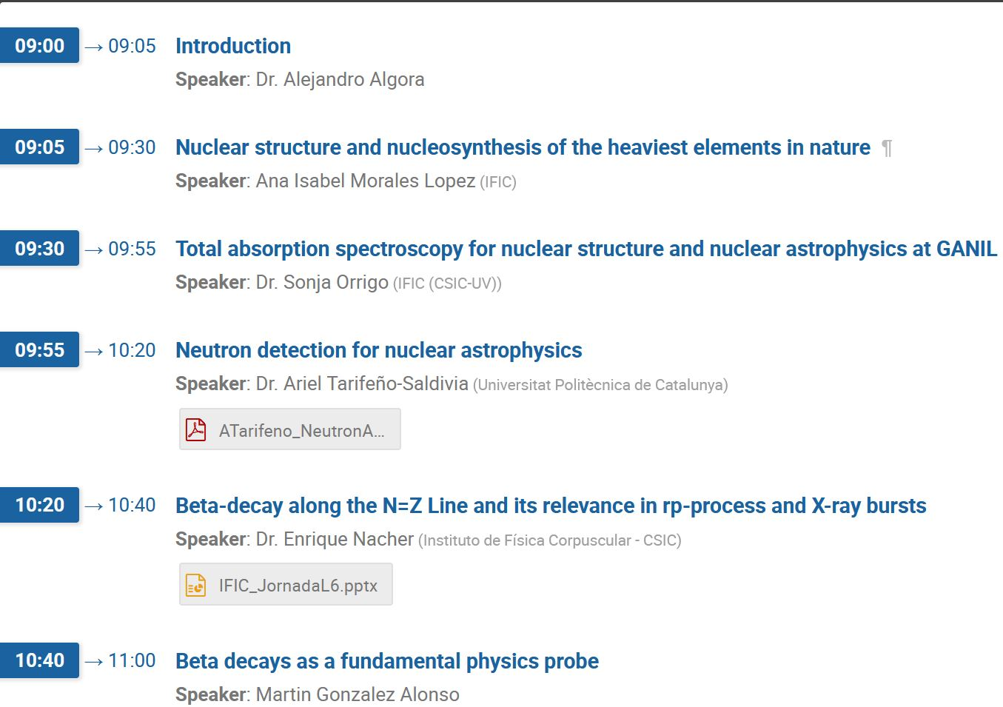
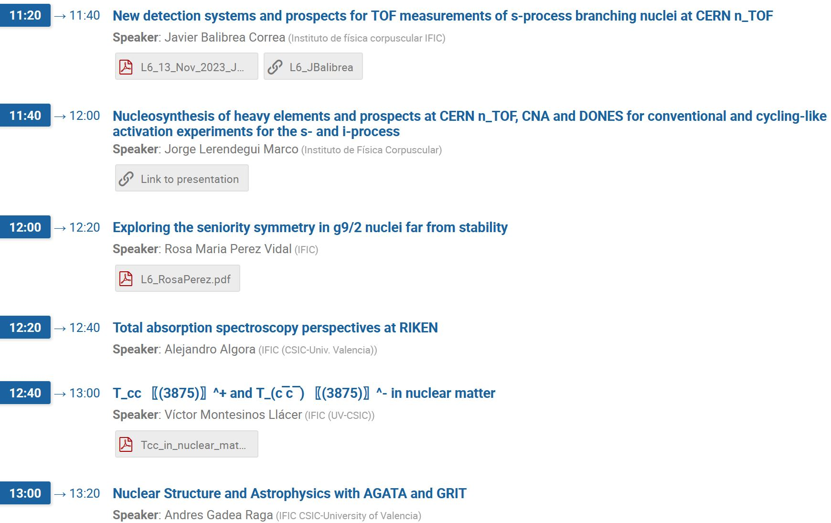
Notes:
Introduction
Overview of the system
Physics outcomes from this meeting important
define physics case
experimental constraints
range of experiments
key experiments demonstrator/full array
meeting
Key design parameters Before too late
120/180 decision

Slide 3
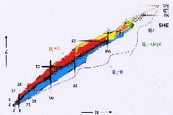
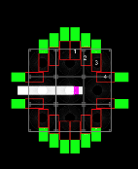
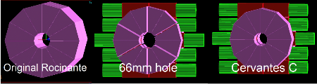
Total Absorption Spectroscopy for Nuclear Structure and Nuclear Astrophysics at GANIL (S.E.A. Orrigo)
Main goal: to improve our knowledge on the synthesis of nuclei by β-decay studies of exotic nuclei with the TAGS technique:
To overcome the Pandemonium systematic error affecting HPGe data
To provide information at high energy (complementary to HPGe)
To determine the β-strength, constraining nuclear models relevant for nucleosynthesis
Development of instrumentation: the new STARS spectrometer in the framework of the (NA)²STARS project
Upgrade of Rocinante and DTAS with 16 LaBr₃(Ce) modules
The 1st in the World combining large efficiency with excellent energy resolution and timing
Broad physics case: nuclear structure, nuclear astrophysics, applications
Notes:
The main goal is to perform β-decay studies of exotic nuclei with the TAGS technique. Another important goal is the development of new instrumentation: the 1st TAS in the World combining large efficiency with excellent energy resolution and timing, which will be used for a broad physics case.

Slide 4
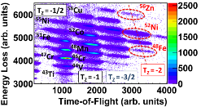
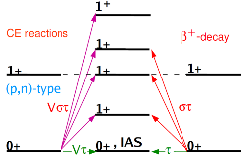
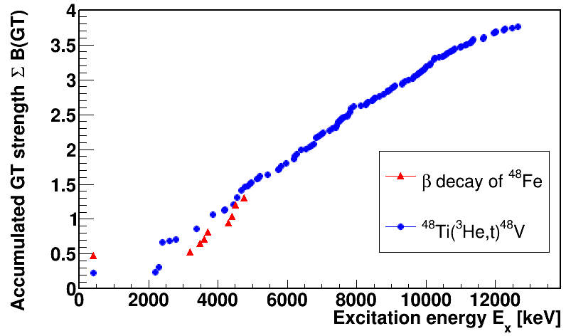
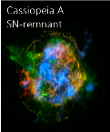
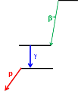
Total Absorption Spectroscopy for Nuclear Structure and Nuclear Astrophysics at GANIL (S.E.A. Orrigo)
1st experiment with the new STARS spectrometer at GANIL: β-decay of several proton-rich nuclei in the Cr-Zn region of great interest for:
Nuclear structure: selected T_{z}=-2 nuclei (⁴⁴Cr, ⁴⁸Fe, ⁵²Ni, ⁵⁶Zn)
To study isospin symmetry by comparing with mirror charge-exchange reactions
Additional validation of the TAGS technique at high energy
Nuclear astrophysics: ⁴⁶Mn, ⁴⁸Mn
To constrain reaction rates of interest for ⁴⁴Ti nucleosynthesis in type II supernovae
Gamma-rays above S_{p}; β-delayed gamma/proton competition
Status:
Experiment E891_23 defended at GANIL PAC on 14/11/2023
Approved: 10 days of beam-time granted
New DSSSD bought by GANIL & already 8 LaBr₃ crystals
Orrigo+, PRC 93, 044336 (2016)
☺
Notes:
The first experiment with the new TAS spectrometer will study the β-decay of several proton-rich nuclei at GANIL [region shown in the picture] of great interest for both nuclear structure and nuclear astrophysics.
[Interests: isospin symmetry by comparing with mirror charge-exchange reactions (schematic example shown + figure with comparison of accumulated B(GT) for beta-decay of 48Fe and mirror CE); validation of the TAGS technique at high energy; constraining reaction rates of interest for the 44Ti nucleosynthesis (supernova remnant where 44Ti has been detected is shown); study of gammas and gamma/proton competition above Sp (a sketch is shown)].
Status: the experiment has been defended at GANIL PAC and approved with 10 days of beam-time granted (which is a lot!), a new DSSSD has been bought by GANIL and we already own 8 LaBr3 crystals.

Slide 5
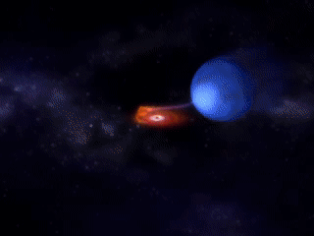
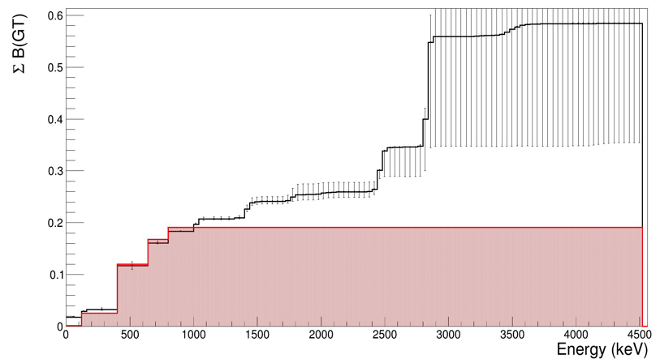
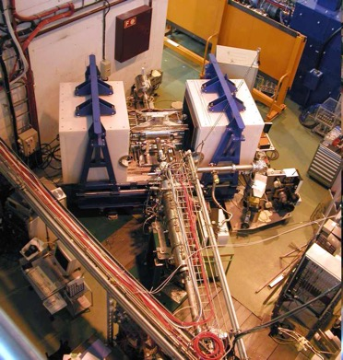
Nuclear astrophysics at ISOLDE (E.Nacher)
Introduction
X-ray burst conditions --> not terrestrial conditions: decay from excited states, electron capture from the continuum… --> effective T_{1/2} and Q_{EC}
Need for experimental B(GT) distributions in terrestrial conditions to constrain and validate calculations in stellar conditions
Status
⁶⁴Ge decay
PRELIMINARY
new TAS data
- ⁶⁴Ge is the bottleneck of the rp-process
- Beta decay measured with the TAS at CERN-ISOLDE
PRELIMINARY
PRELIMINARY
PRELIMINARY
PRELIMINARY
PRELIMINARY
ENSDF data
S. Parra, E. Nácher et al.
Preliminary, to be published soon
Notes:
ADD some coments what you think it is essential to mention

Slide 6
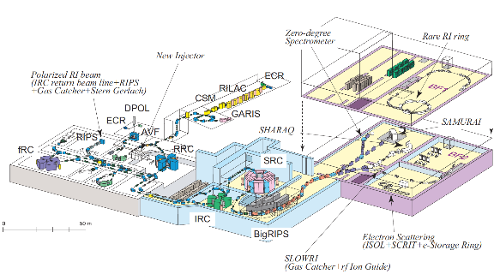
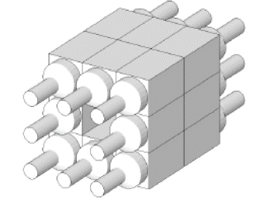
Total absorption spectroscopy studies at RIKEN (A.Algora)
Main goal: exploit the total absorption spectrometer DTAS
developed by the Gamma and Neutron Spectroscopy Group
at RIKEN in the study of very exotic nuclei.
Three approved DTAS experiments with nuclear structure and astrophysics goals
Notes:
The main goal is to exploit the combination of the DTAS spectrometer with the oportuniny of high beam intensities at RIKEN

Slide 7
Approved proposals led by the
Gamma and Neutron Spectroscopy Group
NP2112-RIBF210 – Study of the beta decay of 100Sn with a total absorption spectrometer (TAS). Spokespersons: Algora, Rubio, Nishimura)
Main goal: fix the energy of the 1+ state populated in the decay of 100Sn, determine the beta strength of the decay of 100Sn, improve the knowledge of the quenching of gA
NP212-RIBF217 - Beta-strength function and nuclear deformation of exotic rare-earth isotopes (^{152,154}Ce,¹⁵⁵⁻¹⁵⁸Pr,^{156,158,160}Nd,¹⁵⁹⁻¹⁶²Pm,¹⁶²⁻¹⁶⁴Sm,^{165,166}Eu). Spokespersons: Kiss, Algora, Davidson
Main goal: study the beta decay of important decays for the r-process in this region of particular interest
Notes:
These are important experimental lines for the future of the field.
Two experiments are led by the gamma and neutron spectroscopy group.
The first aim to exploit the high gamma detection efficiency of the DTAS to fix the energy of the 1+ state in 100Sn. This could provide a better understanding of the quenching of the
gA constant in the nuclear medium. This decay is the one with the largest BGT of the full nuclide chart. This is a region also of astrophysical interest.
The present level scheme is based on theoretical calculations

Slide 8
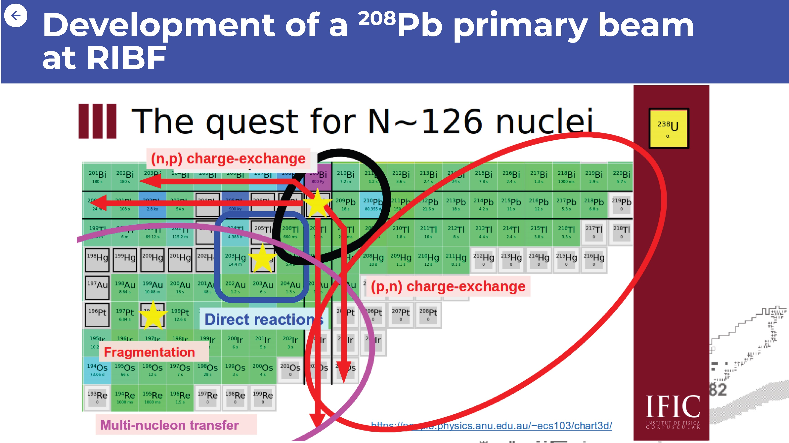
Nuclear structure and nucleosynthesis in N~126 at RIBF and FAIR (A.I.Morales)
Notes:
ADD some coments what you think it is essential to mention

Slide 9
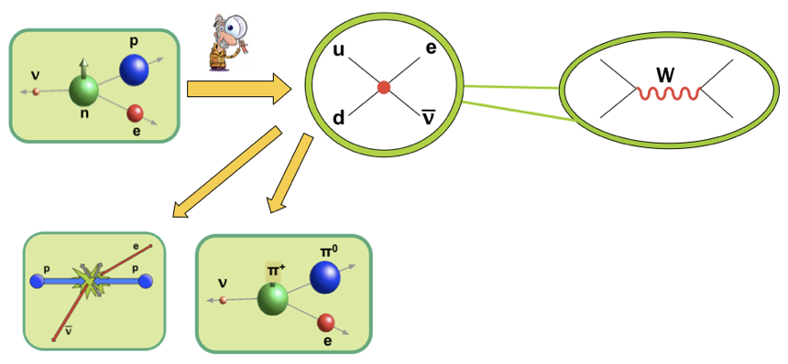
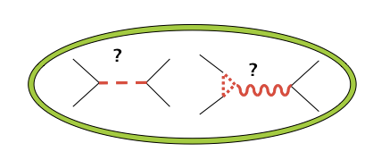
Beta decay as a fundamental physics probe
(M.Gonzalez)
Main research lines:
Analysis of precision measurements in beta decays as probes of nuclear, hadronic and particle physics.
Effective Field Theory (EFT) methods to have model-independent results (within & beyond the SM).
Study of the interplay with LHC, flavor physics, etc.
Implications for neutrino physics (neutrino production & detection, EFT approach)
Notes:
ADD some coments what you think it is essential to mention

Slide 10

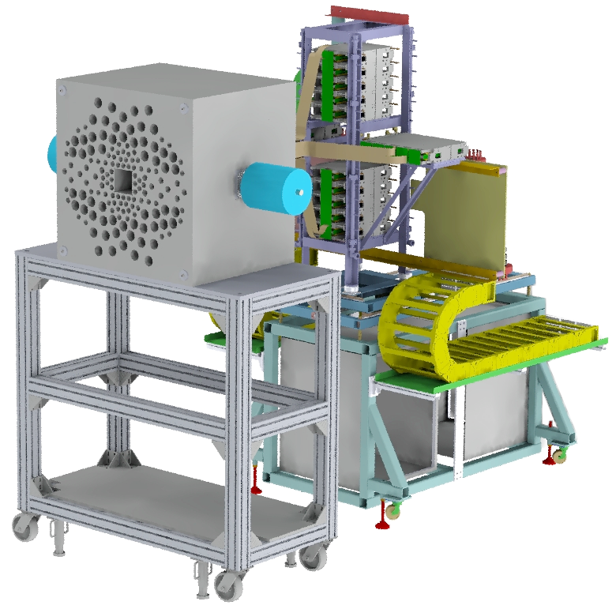
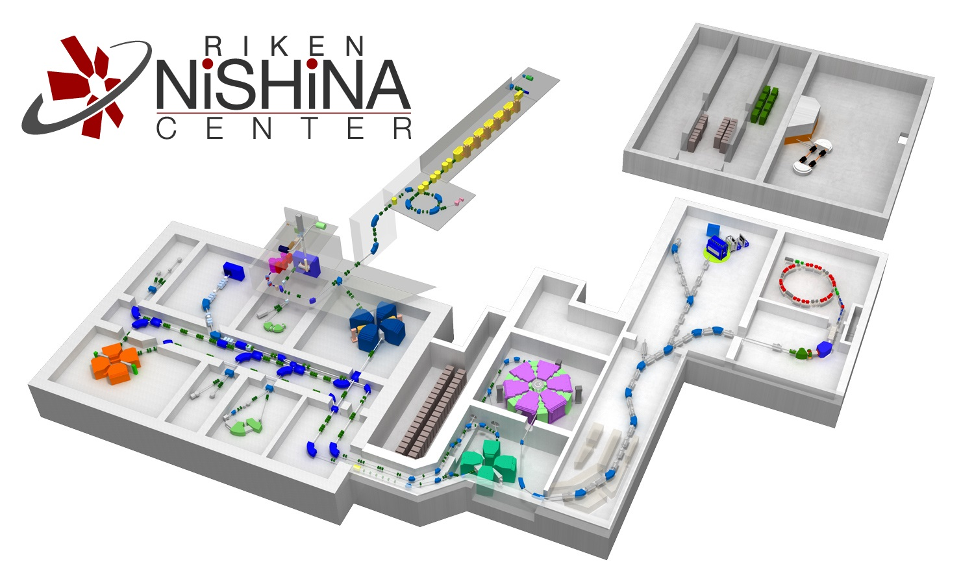

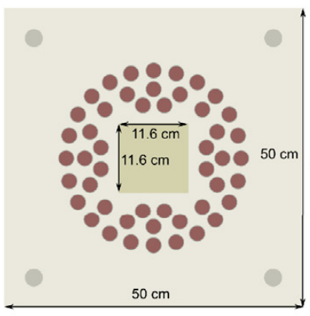
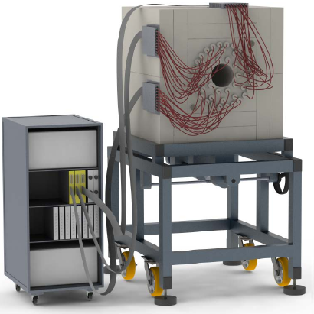
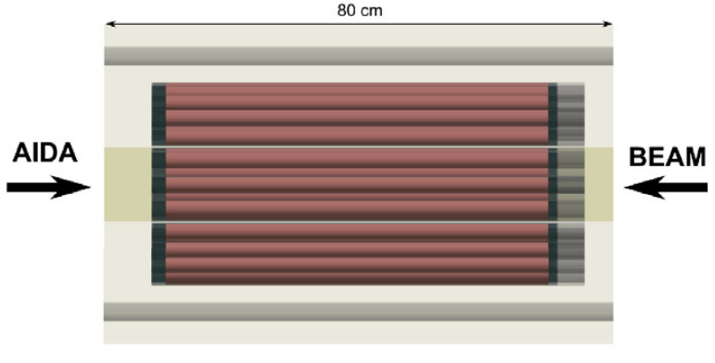
Neutron detection for nuclear astrophysics: status and perspectives (A.Tarifeño)
Goal: Obtain nuclear data crucial for comprehending the nucleosynthesis of elements, including the r-process, s-process, and alpha-process.
Present (2-3y)
Measurement of beta-delayed neutrons: BRIKEN project
BRIKEN detector is the world largest neutron counter for beta-delayed neutrons.
Project involve 20 institutions, 50 participants
Scope: 5 experiments (2016-2021), data analysis (-2024), publications (-2025)
Up to now: 12 papers (WOS) + ~ 4 in preparation
6 PhD thesis + 2 on-going
BRIKEN expected scientific outcome (new data): 235 P_{1n}, 90 P_{2n}, 115 T_{1/2}
Mid-term future (~5y)
Measurement of beta-delayed neutrons: BELEN-48 at FAIR
Physics case: P_{n} and T_{1/2} for N~126 with BELEN-48 & AIDA detectors
BELEN-48 is the beta delayed neutron counter for FAIR
Based on 48 3He-filled neutron counters.
Two detector designs optimized for energy-independent efficiency up to 500 keV and 1 MeV, respectively.
Notes:
ADD some coments what you think it is essential to mention

Slide 11
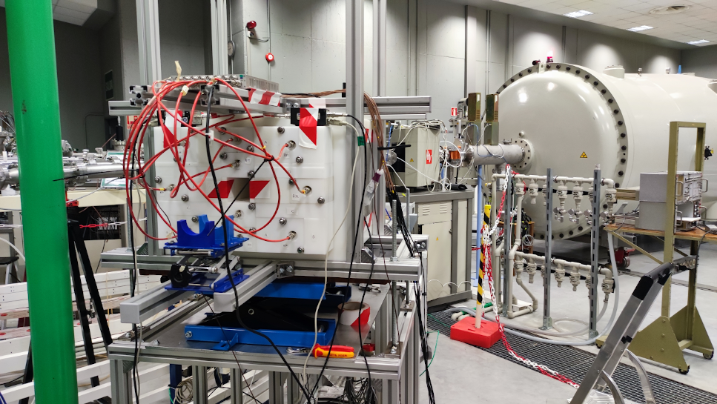

Neutron detection for nuclear astrophysics: status and perspectives
Mid-term future (~5-10y)
Beta-delayed neutrons with spectrometric capabilities: BELEN-62
Physics case: Beta-delayed neutron spectrum is needed to complete the “beta strength function” when the decay populates neutron-unbound states
BELEN-62 is an upgrade to BELEN-48 introducing spectrometric capabilities. Efficiency > 50% up to 4 MeV. Nearly flat response up to 4 MeV!
Expected to be implemented for demonstration by 2025.
BELEN-62 will allow research in different european facilities, for instance: ISOLDE, JYFL, GANIL, FAIR
Mid-term future (~5y)
Study of (alpha,n) reactions at national
ICTS: MANY project
(alpha,n) reactions play an important role in nuclear astrophysics, astroparticle physics and nuclear technologies.
MiniBELEN-10A is a modular neutron counter for (alpha,n) reactions, flat efficiency (7%) up to 8MeV.
MANY project aims to conduct measurements using alpha beams produced at CMAM (Madrid) and CNA (Sevilla).
Long-term future (~5-15y)
A free-neutron target for storage rings: NSTAR
Combination of storage rings with a free-neutron target may provide a unique tool for direct measurements of (n,g) CS in neutron-rich nuclei.
This concept has been already proposed using nuclear reactors and spallation sources.
NSTAR concept: alternative implementation of the neutron target based compact sources and thermal/cold neutron technology.
ERC Synergy Grant Proposal in preparation:
- C. Domingo-Pardo & A. Tarifeno-Saldivia (IFIC)
- I. Dillmann (TRIUMF)
- Y. A. Litvinov (GSI)
miniBELEN-10A @ CMAM

Slide 12

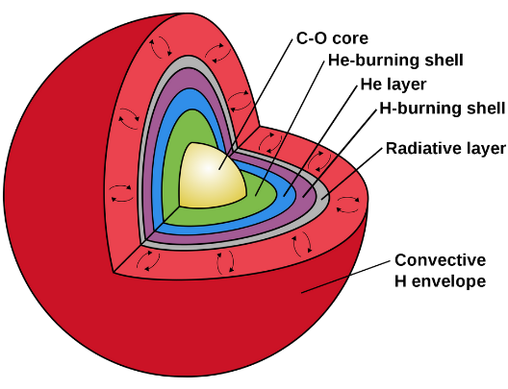
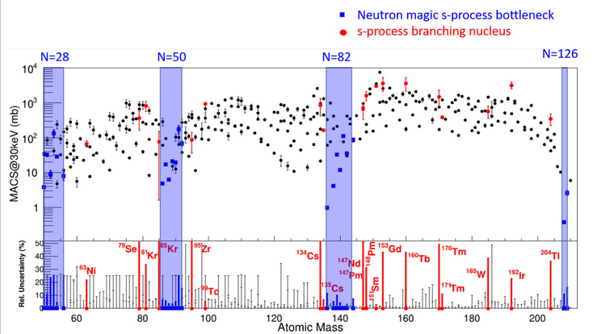



New detection systems and prospects for TOF measurements of s-process (J.Balibrea)
s-process is responsible of 50% of isotopic abundances A>57. This process takes place in Asymptotic Giant Branch stars during He-flashes
There are several isotopes acting as branching points and other many as a bottlenecks conditioning isotopic production
Very challenging (n,γ) measurements due to Small cross sections Highly radioactive (Non-existing)
(n,γ) ToF measurements require further developments to adapts for those key cases:
High luminosity facilities with good time resolution → n_TOF EAR2
High sensitivity (n,γ) detection setups : i-TED, sTED, STAR
Notes:
ADD some coments what you think it is essential to mention

Slide 13
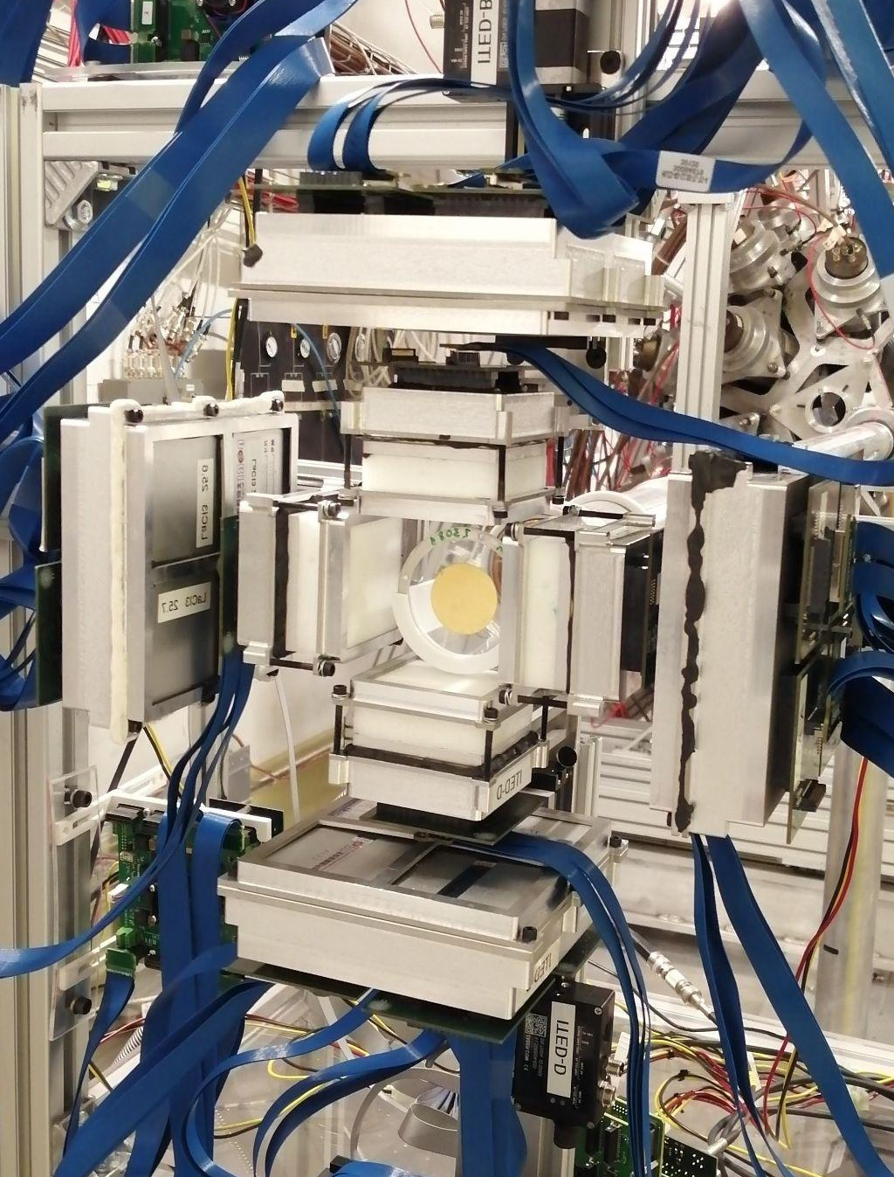
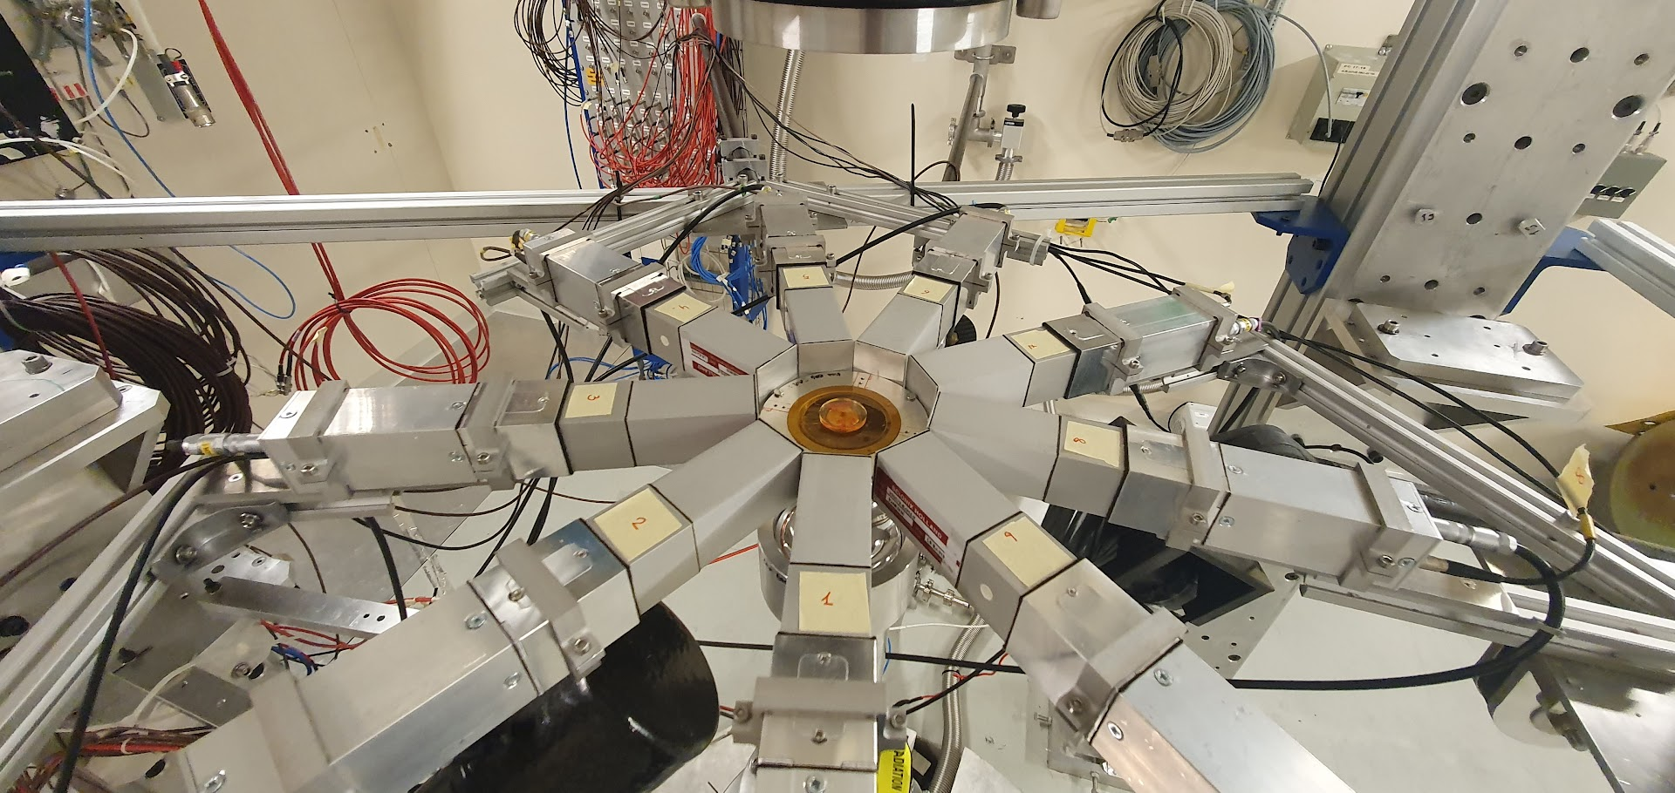
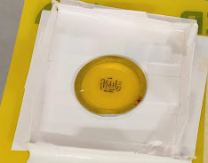
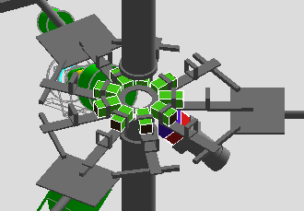


New detection systems and prospects for TOF measurements of s-process
Background suppression using Compton imaging
High sensitivity neutron capture setup
⁹⁴Nb(n,γ) in a 3/304mg of ⁹³Nb wires!
J. Balibrea-Correa, EPJ Web of Conferences 279, 06004 (2023)
ASFAE/2022/027
⁷⁹Se(n,γ) in a 3mg/3.9g of ²⁰⁸Pb⁷⁸Se!!
Lerendegui-Marco, J. et al., EPJ Web Conf. 279, 13001 (2023).
STAR (Stilbene-d12 deTector ARray) detection system for (n,ɣ):
Unique detection array made of solid Stilbene-d12 / Improved s/b ratio (↑↑𝜀 ↓↓b)/ New reading systems (SiPM, Fast PMT..)
Notes:
ADD some coments what you think it is essential to mention

Slide 14
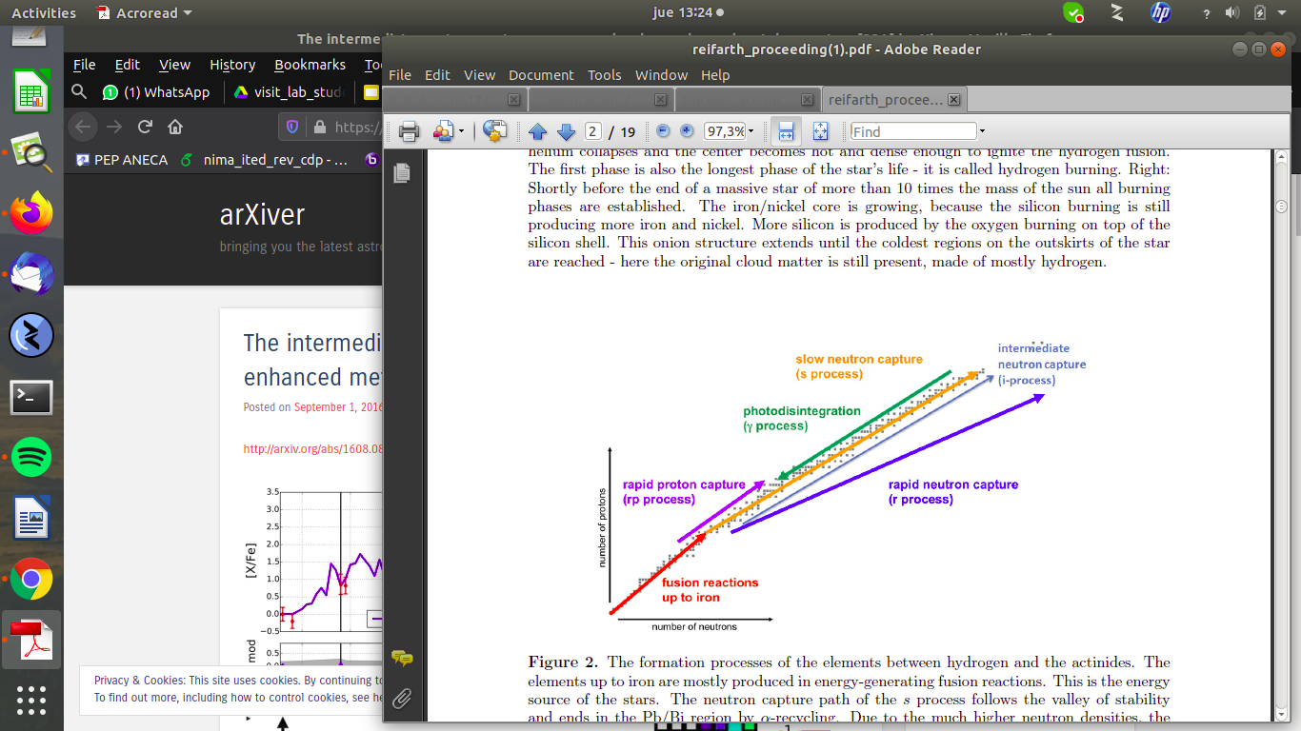
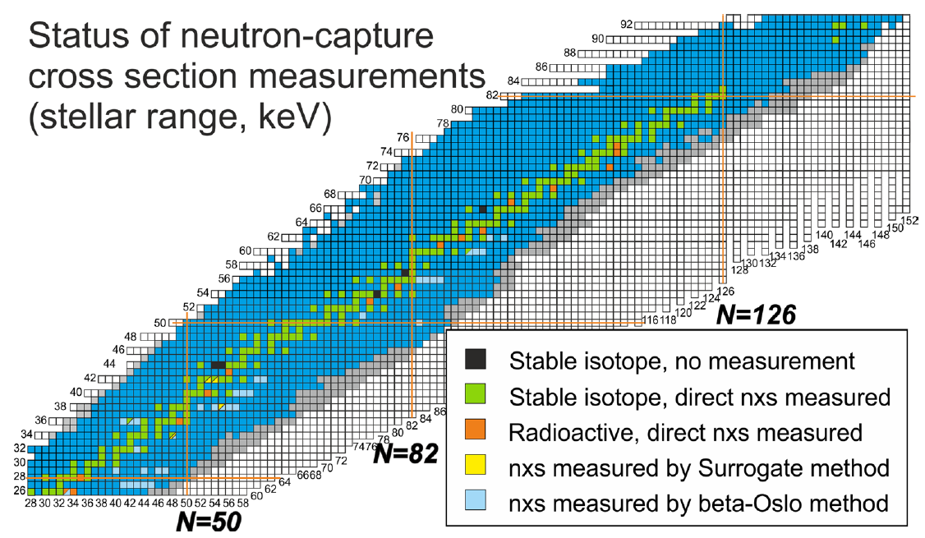
Neutron capture reactions and stellar nucleosynthesis (J.Lerendegui)
Neutrons capture reactions (n,g) play a key role in the synthesis of heavy elements
s-process: responsible for the synthesis of about ½ of the elements heavier than iron
s-process
N_{n} = 10⁶-10¹² cm⁻³
(n,g) for s-process: high accuracy is aimed
Still lack of accurate (n,g) stellar rates.
In particular for s-process branchings (unstable isotopes). Most: direct (n,g) never measured
i-process
N_{n} ~ 10¹⁵ cm⁻³
I. Dillmann et al., Eur. Phys. J. A 59, 105 (2023).
Stellar (n,g) rate: MACS
i-process: New nucleosynthesis process is required to reproduce experimental abundance pattern in AGB stars with low metallicity
(n,g) for i-process: involves n-rich nuclei
Short half-lives (minutes-days)
New facilities & experimental techniques are needed
Time-of-flight (n,g):
> 5e17 atoms currently. Not feasible for many unstable isotopes
MACS via activation in “stellar neutron beam”:
Complementary technique with higher sensitivity
Notes:
Los puntos más importantes a mencionar son:
que las reacciones de captura neutrónica juegan un papel clave para entender la síntesis de los elementos pesado en el universo.
Nuestra línea de investigación se centra en el proceso-s, en el que todavía quedan muchos rates (n,g) estelares (MACS=Maxwellian Averaged cross-section) por medir con precisión, en especial los isótopos inestables que actuan con branching points.
Más recientemente, con la aparición en la literatura del proceso-i, que se caracteriza por densidades de neutrones intermedias, también ha surgido el interés por hacer medidas
(n,g) de núcleos más n-rich relevantes en este proceso.
A modo de motivación para mi charla, centrada en medidas de activación, es importante mencionar que la sensibilidad actual de la técnica TOF, de la que habla Javi, está limitada para casos de targets inestables en los que es dificil conseguir suficiente masa y una posible técnica complementaria más sensible es medir directamente las MACS por activación utilizando
haces de neutrones estelares (i.e. cuya distribución en energía se aproxima al espectro estelar en el que se produce la nucleosíntesis),

Slide 15
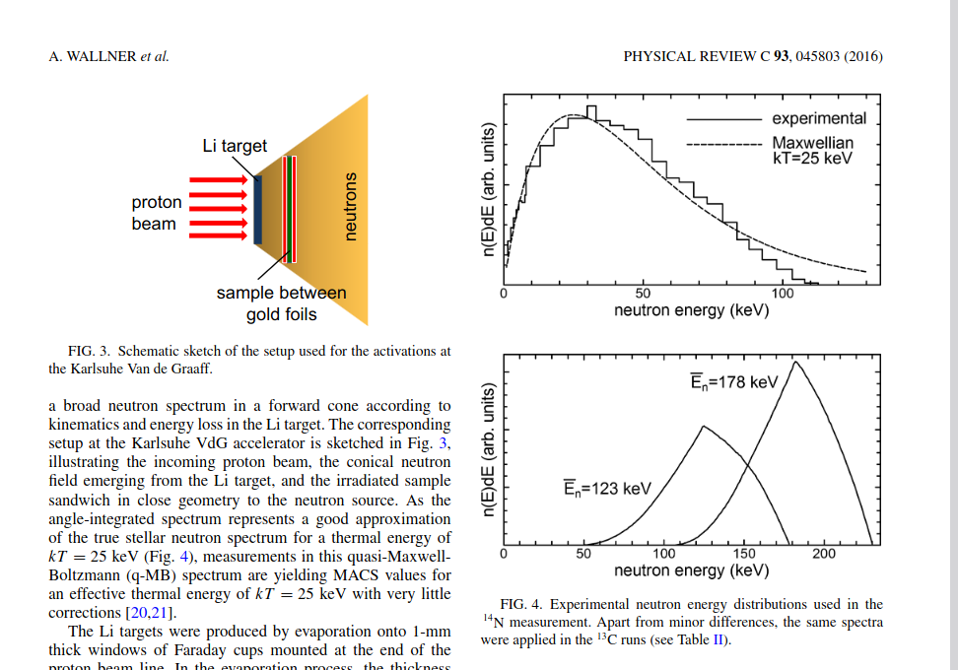
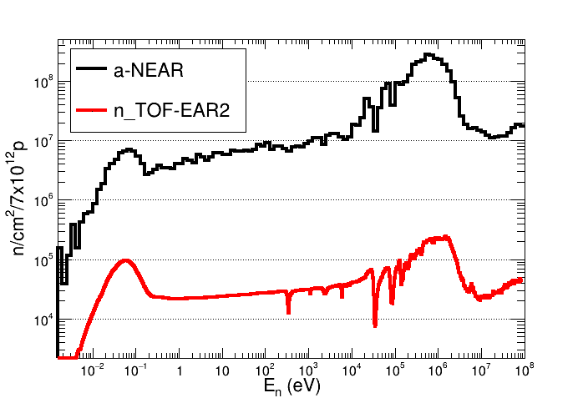
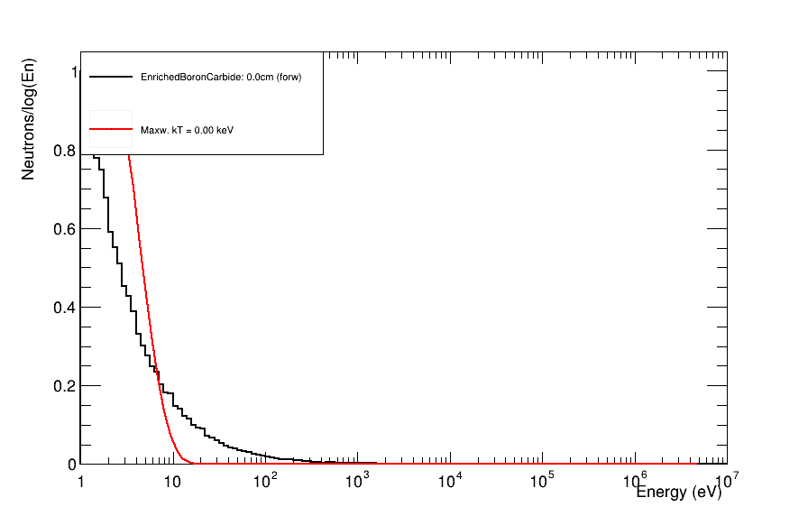




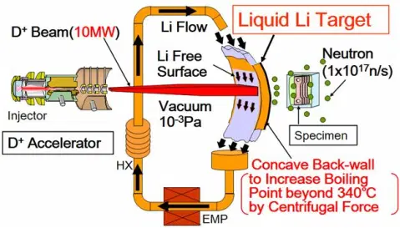

Neutron capture reactions:
Activation in stellar neutron beams
Low E (MeV) proton accelerators
Med/High energy accelerator (~10MeV - ~GeV)
N-spectra @
different stellar temperatures
⁷Li (p,n)⁷Be
Quasi-maxwellian @ 25 keV
Target + moderator
White neutron beam
Ep=1912 keV
+ Neutron Filtering
On-going activities and future plans
n_TOF-NEAR: High flux facility for activation at only 3~m from the spallation target
CYCLING @ n_TOF-NEAR: CYCLIc activation for (N,G) measurements to access short lived isotopes
Synergy ISOLDE + NEAR: shorter-lived isotopes with sufficient yields would be accessible 135Cs (s-process) , Cs-137, Ce-144 (i-process)
Future stellar activations @ IFMIF DONES?
J. Lerendegui, M. Bacak CERN-INTC-2022-018 ; INTC-I-241.
C. Domingo-Pardo, et al., Eur. Phys. J. A 59, 8 (2023)
J. Lerendegui, S. Carollo et al., CERN-INTC-2022-040; INTC-P-641
VERY HIGH FLUX (10¹³n/cm²/s) MeV NEUTRONS
UNIQUE FACILITY IN SPAIN
Filtered flux @ Dones: 1-4e9 n/cm2/s→ x~200 n_TOF NEAR
→ x~100-400 HISPANoS-CNA (1912 keV)
Notes:
Puntos importantes:
Que trabajamos o colaboramos en dos tipos de instalaciones que permiten hacer haces con un espectro estelar:
Aceleradores de baja energía (protones 1900 keV) + reación Li-7(p,n) que producen un espectro a una temperatura de estelar kT = 25 keV (HISPANoS)
Aceleradores de media alta energía (DONES, PS-CERN) con los que se puede producir neutrones de alta energía (MeV-GeV), moderarlos y filtrarlos para conformar la distribución aprox. Estelar.
En cuanto a las líneas en desarrollo y planes de futuro, hay que destacar
Nuestra implicación en la nueva instalación de alto flujo de neutrones para activación en CERN: n_TOF-NEAR
Y en concreto en el estudio de viabilidad y desarrollo de una estación cíclica que permita acceder a reacciones con productos de reacción (n,g) de vida media corta, fundamental para medir targets radioactivos.
Además, trabajamos en establecer una sinergia para producir targets inestables de interés astrofísico en ISOLDE, el año que vienen produciremos Cs-135, para luego medir (n,g) en n_TOF NEAR.
Por último, en el contexto del trabajo de FNUC en DONES, estamos trabajando en los cálculos de una estación similar a n_TOF-NEAR en DONES, que permitiría tener un flujo de 2 ordenes de magnitud mayor tanto que NEAR como que la instalación existente en España HiSPANoS-CNA

Slide 16
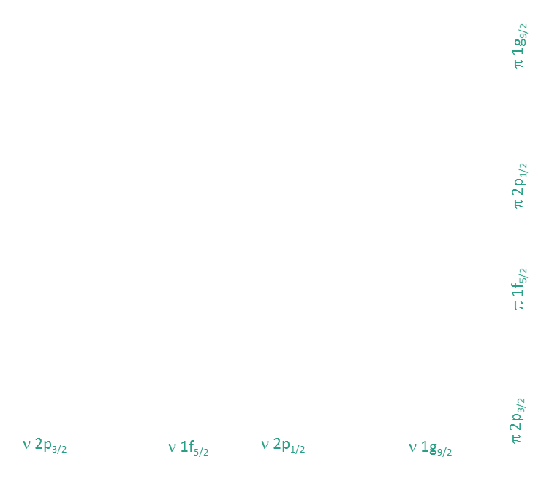
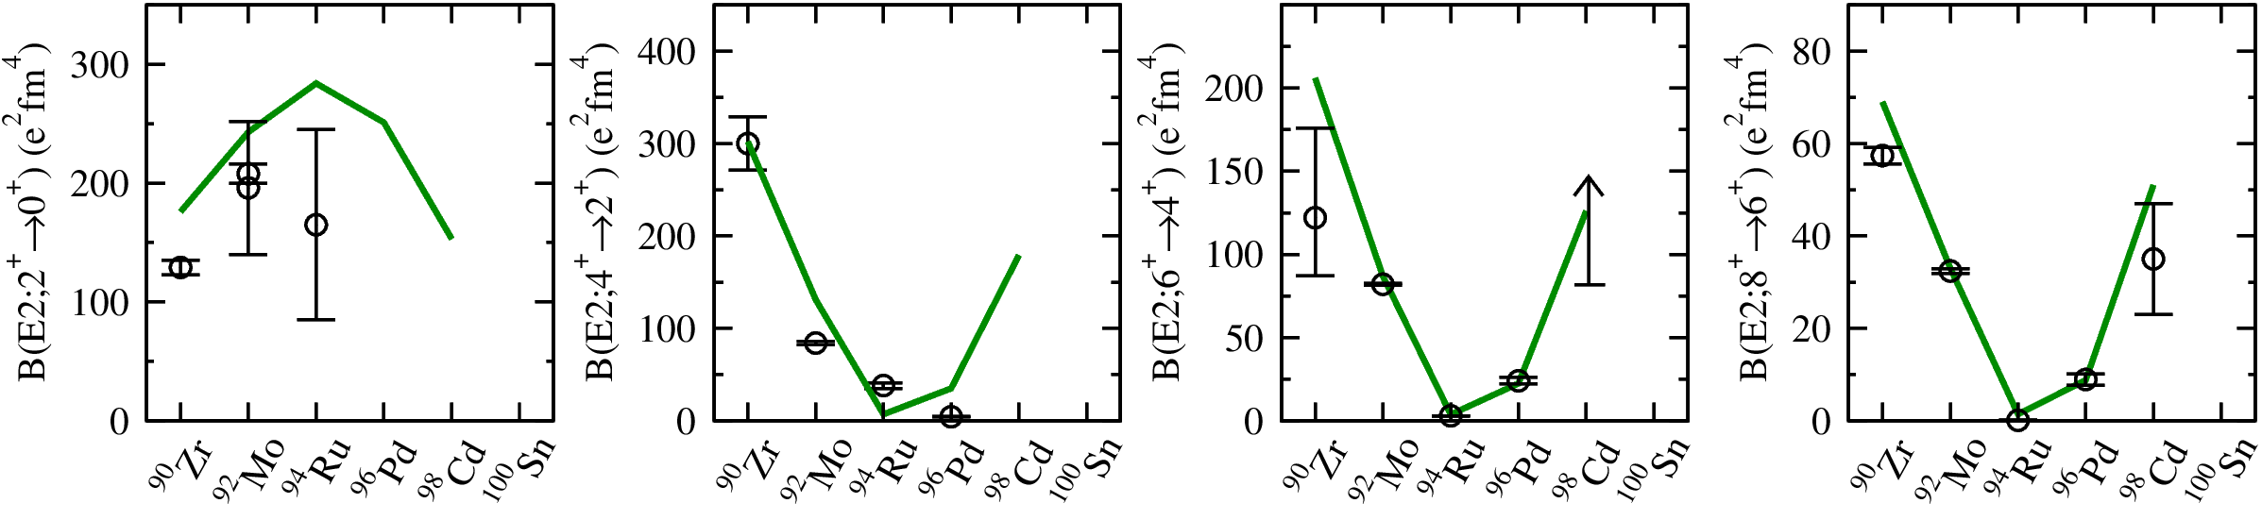
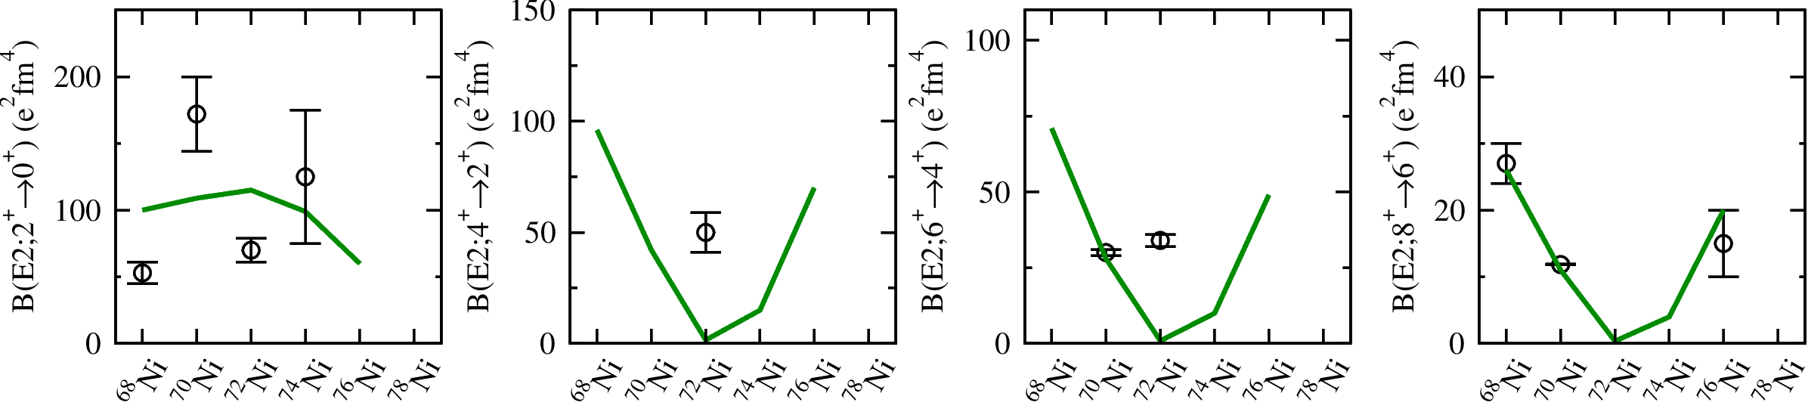
Exploring the seniority symmetry in
g_{9/2} nuclei far from stability (R.M.Perez)
N=50
N=50 isotones R.M. Pérez-Vidal et al. PRL 2022
Z=28 isotopes T. Marchi et al PRL 2014, K. Kolos et al PRL 2016, C.J. Chiara et al PRC 2015, A.I. Morales et al. PRL 2018, M. Sawicka et al PRC 2003, A.I. Morales et al. PRC 2016
¹⁰⁰Sn
N=50
⁹⁹In
Seniority, 𝝊, is a quantum number introduced to classify the jj-coupling of nucleons in a single j shell
g_{9/2} is the first shell in which seniority might not be conserved [1], but it can be preserved for a subset of solvable eigenstates (partial dynamical symmetry) [2]
Effective two-body interaction is different in the g_{9/2} near ¹⁰⁰Sn and ⁷⁸Ni [3].
In particular for nuclei far from the stability relevant for the nucleosynthesis, calculations using a simple single-shell g_{9/2} model suggest that seniority is not conserved [2]
Combination of extensive lifetimes information and shell model calculations, using a realistic interaction in a large model space, is needed to understand the extent of the seniority conservation in real nuclei.
⁹⁸Cd
Shell model calculations for the Z=28 isotopes (N=50 isotones) performed in the 0f5/2, 1p3/2, 1p1/2, and 0g9/2 neutron (proton) model space and with the neutron (proton) effective charge derived from microscopic calculations. A. Gargano and G. di Gregorio Private communication
⁹⁷Ag
⁹⁶Pd
2⁺→0⁺
4⁺→2⁺
6⁺→4⁺
8⁺→6⁺
⁹⁵Rh
N=50
⁹⁴Ru
Δ𝝊≈0
Δ𝝊≈0
Δ𝝊≈0
⁹³Tc
⁹²Mo
Δ𝝊≈2
⁹¹Nb
⁹⁰Zr
⁸⁹Y
Valence Mirror Symmetry Partners
⁸⁸Sr
⁸⁷Rb
Z=28
Δ𝝊≈ 2
Δ𝝊≈0,2?
Δ𝝊≈0,2?
Δ𝝊≈0
⁸⁶Kr
⁸⁵Br
⁸⁴Se
⁸³As
⁸²Ge
⁸¹Ga
[1] A. Escuderos and L. Zamick. Phys. Rev. C, 73(044302), 2006
[2] P. Van Isacker, Int. Jour. Mod. Phys. E 20 (2012) 191
⁸⁰Zn
Z=28
⁷⁹Cu
⁵⁶Ni
⁵⁷Ni
⁵⁸Ni
⁵⁹Ni
⁶⁰Ni
⁶¹Ni
⁶²Ni
⁶³Ni
⁶⁴Ni
⁶⁵Ni
⁶⁶Ni
⁶⁷Ni
⁶⁸Ni
⁶⁹Ni
⁷⁰Ni
⁷¹Ni
⁷²Ni
⁷³Ni
⁷⁴Ni
⁷⁵Ni
⁷⁶Ni
⁷⁷Ni
⁷⁸Ni
Notes:
Introduction to seniority: Text on the left
Image on the right:
summary of the experimental information available so far on reduced transition probabilities along N=50 isotones (top panels) and the Ni isotopes (bottom panels) compared versus the expected trend (based on calculations using realistic effective interactions )
The experimental data on the N=50 isotones have been interpreted on the basis of realistic shell-model calculations in the fppg proton valence space concluding that seniority is largely conserved in the first proton g9/2 orbital. Although the for the Ni isotopes the experimental data es very limited (as shown here) using the results of N=50 isotones as testing ground for the residual interaction in the valence-mirror symmetry partners, the shell model calculations have in the fppg neutron valence space, show the same trend toward the fill-up of the g9/2 orbital: a maximum for the 2+ → 0+ transitions and a minimum for the other transitions towards the middle of the filling of the orbital, predicting the seniority conservation for Ni isotopes, in contradiction with the previous calculations mentioned.
Limited experimental information for the Z=28 isotopes, experimental studies on going:
Lifetime measurements:
^{68,70}Ni (4+): Multinucleon transfer reaction at LNL
Benchmark for the collectivity in the region to shed light on the seniority scheme validity in the neutron g_{9/2} configurations.
^{70,72,74}Ni (4+): Fragmentation at RIBF in RIKEN
Validity of the seniority scheme in the neutron g_{9/2} configurations.
⁹⁴Ru,⁹⁶Pd,⁹⁸Cd(2+): Fragmentation at RIBF in RIKEN
Experimental determination for the reduced transition probabilities for the 2+→0+ yrast transitions in 96Pd and 98Cd, which are only 4 and 2 valence protons below the doubly magic 100Sn, to improve the knowledge of the wave functions in the upper g9/2 shell

Slide 17
Exploring the seniority symmetry in
g_{9/2} nuclei far from stability
N=50
N=50 isotones R.M. Pérez-Vidal et al. PRL 2022
Z=28 isotopes T. Marchi et al PRL 2014, K. Kolos et al PRL 2016, C.J. Chiara et al PRC 2015, A.I. Morales et al. PRL 2018, M. Sawicka et al PRC 2003, A.I. Morales et al. PRC 2016
¹⁰⁰Sn
N=50
⁹⁹In
Seniority, 𝝊, is a quantum number introduced to classify the jj-coupling of nucleons in a single j shell
g_{9/2} is the first shell in which seniority might not be conserved [1], but it can be preserved for a subset of solvable eigenstates (partial dynamical symmetry) [2]
Effective two-body interaction is different in the g_{9/2} near ¹⁰⁰Sn and ⁷⁸Ni [3].
In particular for nuclei far from the stability relevant for the nucleosynthesis, calculations using a simple single-shell g_{9/2} model suggest that seniority is not conserved [2]
Combination of extensive lifetimes information and shell model calculations, using a realistic interaction in a large model space, is needed to understand the extent of the seniority conservation in real nuclei.
⁹⁸Cd
Shell model calculations for the Z=28 isotopes (N=50 isotones) performed in the 0f5/2, 1p3/2, 1p1/2, and 0g9/2 neutron (proton) model space and with the neutron (proton) effective charge derived from microscopic calculations. A. Gargano and G. di Gregorio Private communication
⁹⁷Ag
⁹⁶Pd
2⁺→0⁺
4⁺→2⁺
6⁺→4⁺
8⁺→6⁺
⁹⁵Rh
N=50
⁹⁴Ru
Δ𝝊≈0
Δ𝝊≈0
Δ𝝊≈0
⁹³Tc
⁹²Mo
Δ𝝊≈2
⁹¹Nb
⁹⁰Zr
⁸⁹Y
Valence Mirror Symmetry Partners
⁸⁸Sr
⁸⁷Rb
Z=28
Δ𝝊≈ 2
Δ𝝊≈0,2?
Δ𝝊≈0,2?
Δ𝝊≈0
⁸⁶Kr
⁸⁵Br
⁸⁴Se
⁸³As
⁸²Ge
⁸¹Ga
[1] A. Escuderos and L. Zamick. Phys. Rev. C, 73(044302), 2006
[2] P. Van Isacker, Int. Jour. Mod. Phys. E 20 (2012) 191
⁸⁰Zn
Z=28
⁷⁹Cu
⁵⁶Ni
⁵⁷Ni
⁵⁸Ni
⁵⁹Ni
⁶⁰Ni
⁶¹Ni
⁶²Ni
⁶³Ni
⁶⁴Ni
⁶⁵Ni
⁶⁶Ni
⁶⁷Ni
⁶⁸Ni
⁶⁹Ni
⁷⁰Ni
⁷¹Ni
⁷²Ni
⁷³Ni
⁷⁴Ni
⁷⁵Ni
⁷⁶Ni
⁷⁷Ni
⁷⁸Ni
Notes:
Introduction to seniority: Text on the left
Image on the right:
summary of the experimental information available so far on reduced transition probabilities along N=50 isotones (top panels) and the Ni isotopes (bottom panels) compared versus the expected trend (based on calculations using realistic effective interactions )
The experimental data on the N=50 isotones have been interpreted on the basis of realistic shell-model calculations in the fppg proton valence space concluding that seniority is largely conserved in the first proton g9/2 orbital. Although the for the Ni isotopes the experimental data es very limited (as shown here) using the results of N=50 isotones as testing ground for the residual interaction in the valence-mirror symmetry partners, the shell model calculations have in the fppg neutron valence space, show the same trend toward the fill-up of the g9/2 orbital: a maximum for the 2+ → 0+ transitions and a minimum for the other transitions towards the middle of the filling of the orbital, predicting the seniority conservation for Ni isotopes, in contradiction with the previous calculations mentioned.
Limited experimental information for the Z=28 isotopes, experimental studies on going:
Lifetime measurements:
^{68,70}Ni (4+): Multinucleon transfer reaction at LNL
Benchmark for the collectivity in the region to shed light on the seniority scheme validity in the neutron g_{9/2} configurations.
^{70,72,74}Ni (4+): Fragmentation at RIBF in RIKEN
Validity of the seniority scheme in the neutron g_{9/2} configurations.
⁹⁴Ru,⁹⁶Pd,⁹⁸Cd(2+): Fragmentation at RIBF in RIKEN
Experimental determination for the reduced transition probabilities for the 2+→0+ yrast transitions in 96Pd and 98Cd, which are only 4 and 2 valence protons below the doubly magic 100Sn, to improve the knowledge of the wave functions in the upper g9/2 shell

Slide 18
Exploring the seniority symmetry in
g_{9/2} nuclei far from stability
N=50
Overview to explore the seniority symmetry in the g_{9/2} nuclei far from stability
Seniority conservation studied in the πg_{9/2} shell at N = 50 used as a ground for the comparison with the valence mirror symmetry partners Z=28 isotopes towards ⁷⁸Ni
Investigation of the seniority conservation in the νg_{9/2} shell via lifetime measurements of the yrast 4⁺ states in ^{68,70,72,74}Ni
LNL AGATA+PRISMA+Plunger (Proposal approved A 2022. Experiment to be performed 2024)
RIKEN BigRIPS+ZDS+HICARI (Proposal approved B 2019)
Investigation of the structure evolution towards ¹⁰⁰Sn via lifetimes measurements of the yrast 2⁺ states in ⁹⁴Ru, ⁹⁶Pd and ⁹⁸Cd (reference for the residual interaction in the Valence-Mirror symmetry partners Z=28 isotopes towards ⁷⁸Ni)
RIKEN BigRIPS+ZDS+DALI2+ (Proposal defended december 2023)
Notes:
Limited experimental information for the Z=28 isotopes, experimental studies on going:
Lifetime measurements:
^{68,70}Ni (4+): Multinucleon transfer reaction at LNL
Benchmark for the collectivity in the region to shed light on the seniority scheme validity in the neutron g_{9/2} configurations.
^{70,72,74}Ni (4+): Fragmentation at RIBF in RIKEN
Validity of the seniority scheme in the neutron g_{9/2} configurations.
⁹⁴Ru,⁹⁶Pd,⁹⁸Cd(2+): Fragmentation at RIBF in RIKEN
Experimental determination for the reduced transition probabilities for the 2+→0+ yrast transitions in 96Pd and 98Cd, which are only 4 and 2 valence protons below the doubly magic 100Sn, to improve the knowledge of the wave functions in the upper g9/2 shell

Slide 19

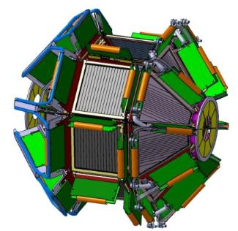
Instrumentation for Direct Reactions in Inverse Kinematics
High efficiency for light charged particles and High granularity with particle identification capability with ΔE/E and PSA. To be coupled with AGATA for studies with direct reactions in inverse kinematics with Radioactive Ion Beams (INFN Italy, CNRS France, Spain)
GRIT: High granularity
4π LCP detector array.
Low γ-ray absorption
Nuclear Measurements of Astrophysical Interest for AGATA+GRIT
Clusterisation phenomena in near threshold states
Studying if higher-order terms of the in-media nuclear Interaction (three body forces, etc.)
Electromagnetic decays from unbound states/resonances
Direct or surrogate cross section measurements
Contribution of the excited states to the reactions of astrophysical interest.
MCIN PRTR-C17.I01, Generalitat Valenciana ASFAE/2022/031, NextGenerationEU

Slide 20
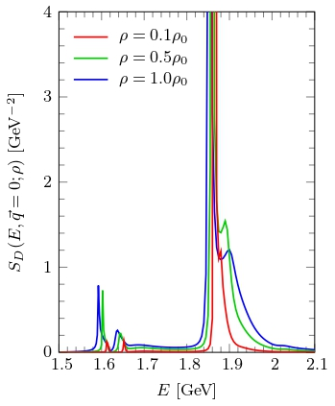
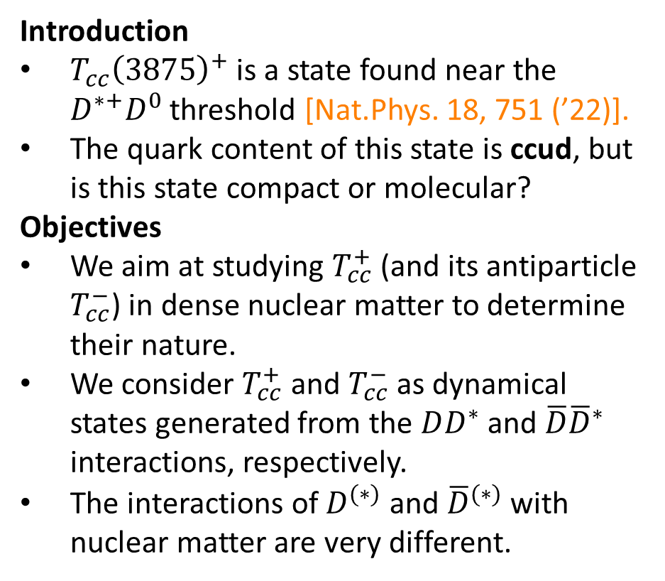
Tcc(3875)⁺ AND Tcc(3875)⁻ IN NUCLEAR MATTER
(V.Montesinos)
Introduction
$T_{cc}{\left(3875\right)}^{+}$ is a state found near the $D^{∗+}D^{0}$ threshold [Nat.Phys. 18, 751 (’22)].
The quark content of this state is ccud, but is this state compact or molecular?
Objectives
We aim at studying $T_{cc}^{+}$ (and its antiparticle $T_{cc}^{−}$) in dense nuclear matter to determine their nature.
We consider $T_{cc}^{+}$ and $T_{cc}^{−}$ as dynamical states generated from the $DD^{∗}$ and $\overline{D}{\overline{D}}^{∗}$ interactions, respectively.
The interactions of $D^{(∗)}$ and ${\overline{D}}^{(∗)}$ with nuclear matter are very different.
Figure 1: D⁰D⁰π⁺ spectrum showing the Tcc⁺ signal from LHCb.
Victor Montesinos, Miguel Albaladejo, Juan Nieves and Laura Tolos. PRC 108 (2023) 3, 035205.
Notes:
ADD some coments what you think it is essential to mention

Slide 21
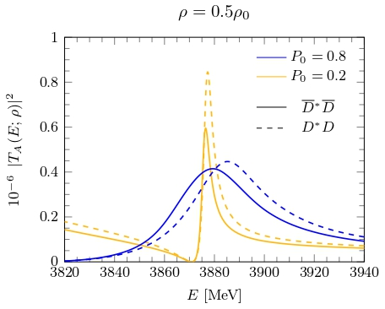
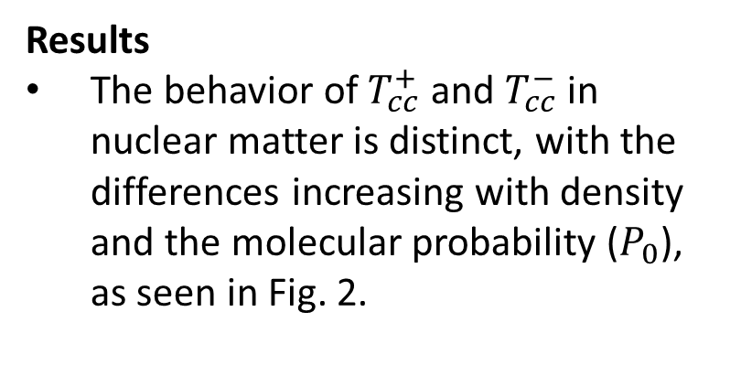
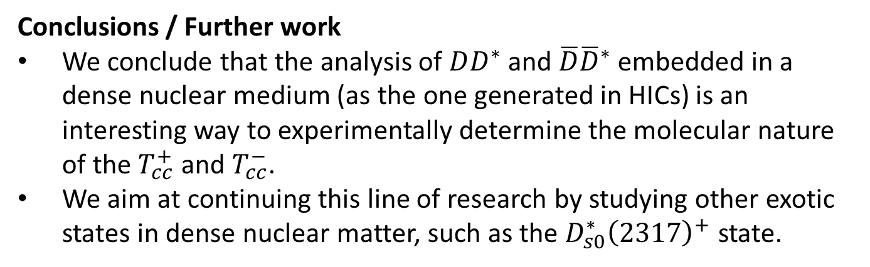
Tcc(3875)⁺ AND Tcc(3875)⁻ IN NUCLEAR MATTER
Results
The behavior of $T_{cc}^{+}$ and $T_{cc}^{−}$ in nuclear matter is distinct, with the differences increasing with density and the molecular probability ($P_{0}$), as seen in Fig. 2.
Figure 2: D*D vs D*D amplitude for different values of P0 and ρ.
Conclusions / Further work
We conclude that the analysis of $DD^{∗}$ and $\overline{D}{\overline{D}}^{∗}$ embedded in a dense nuclear medium (as the one generated in HICs) is an interesting way to experimentally determine the molecular nature of the $T_{cc}^{+}$ and $T_{cc}^{−}$.
We aim at continuing this line of research by studying other exotic states in dense nuclear matter, such as the $D_{s0}^{∗}{\left(2317\right)}^{+}$ state.
Victor Montesinos, Miguel Albaladejo, Juan Nieves and Laura Tolos. PRC 108 (2023) 3, 035205.
Notes:
ADD some coments what you think it is essential to mention

Slide 22
Summary and Outlook
Linea 6 is covering research aspects in nuclear Astrophysics, nuclear structure of interest for Astrophysics as well as fundamental research and exotic excitation in nuclear matter.
There is a broad variety of techniques and combination of decay, in-beam and reaction measurements. That are competitive in world – class facilities for nuclear physics research
The programme of the L6 groups covers physics cases in the relevant present and future facilities in Europe and in the world.

