Slide 1
TAU status

Slide 2
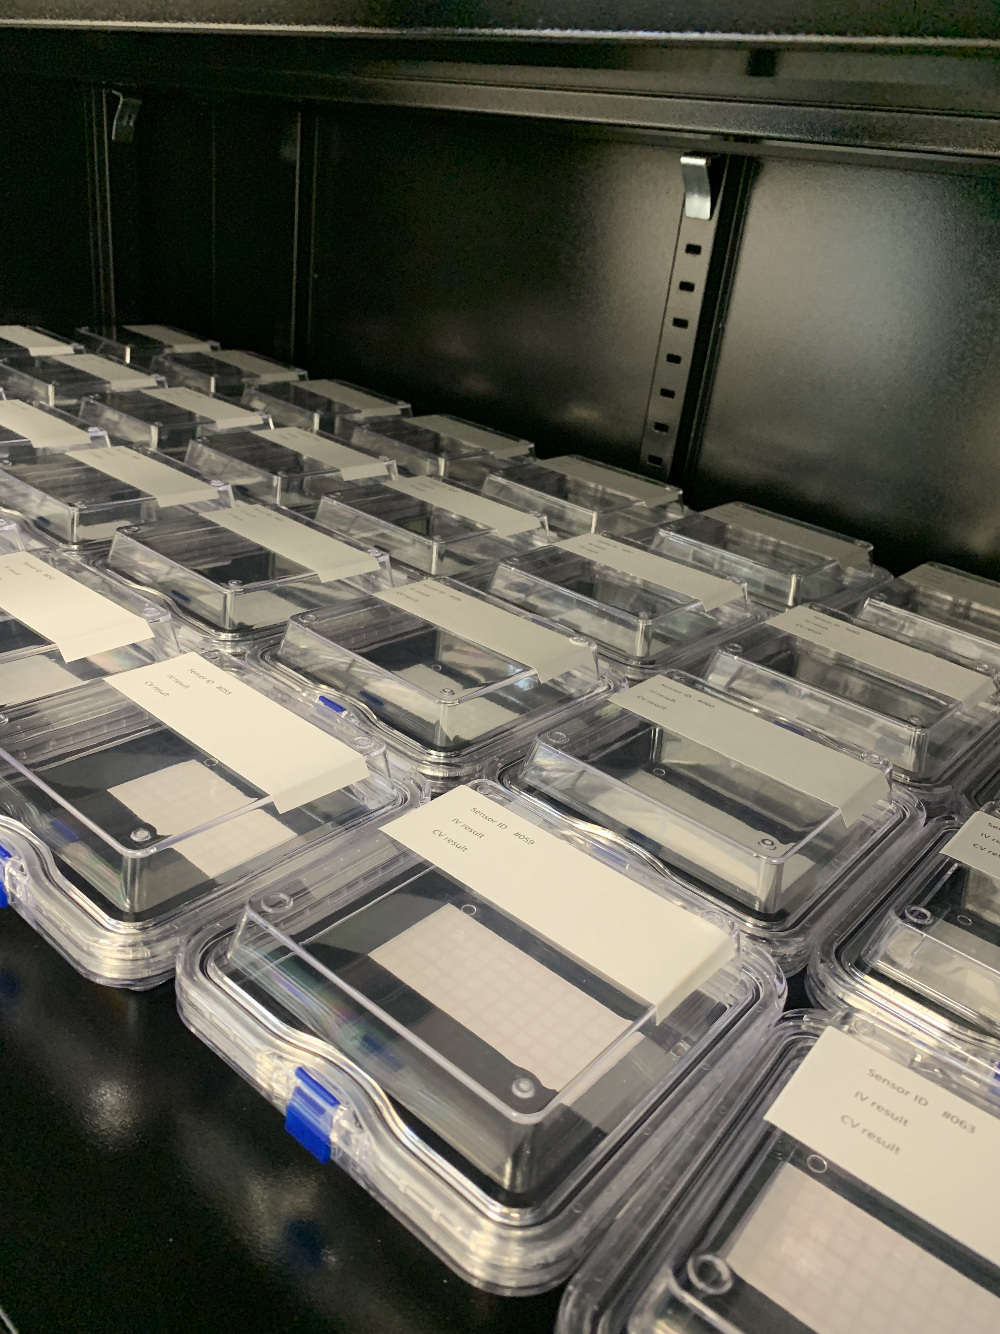
Sensors
All sensors (90) arrived
Labeled, stored in dry cabinet with membrane box

Slide 3
Probe station
LUMICAL probe card arrived
Probe station updated to accept the new probe card. Cooling, gas, pump cleaned and working
Software updated for the new probe card (configuration files)

Slide 4
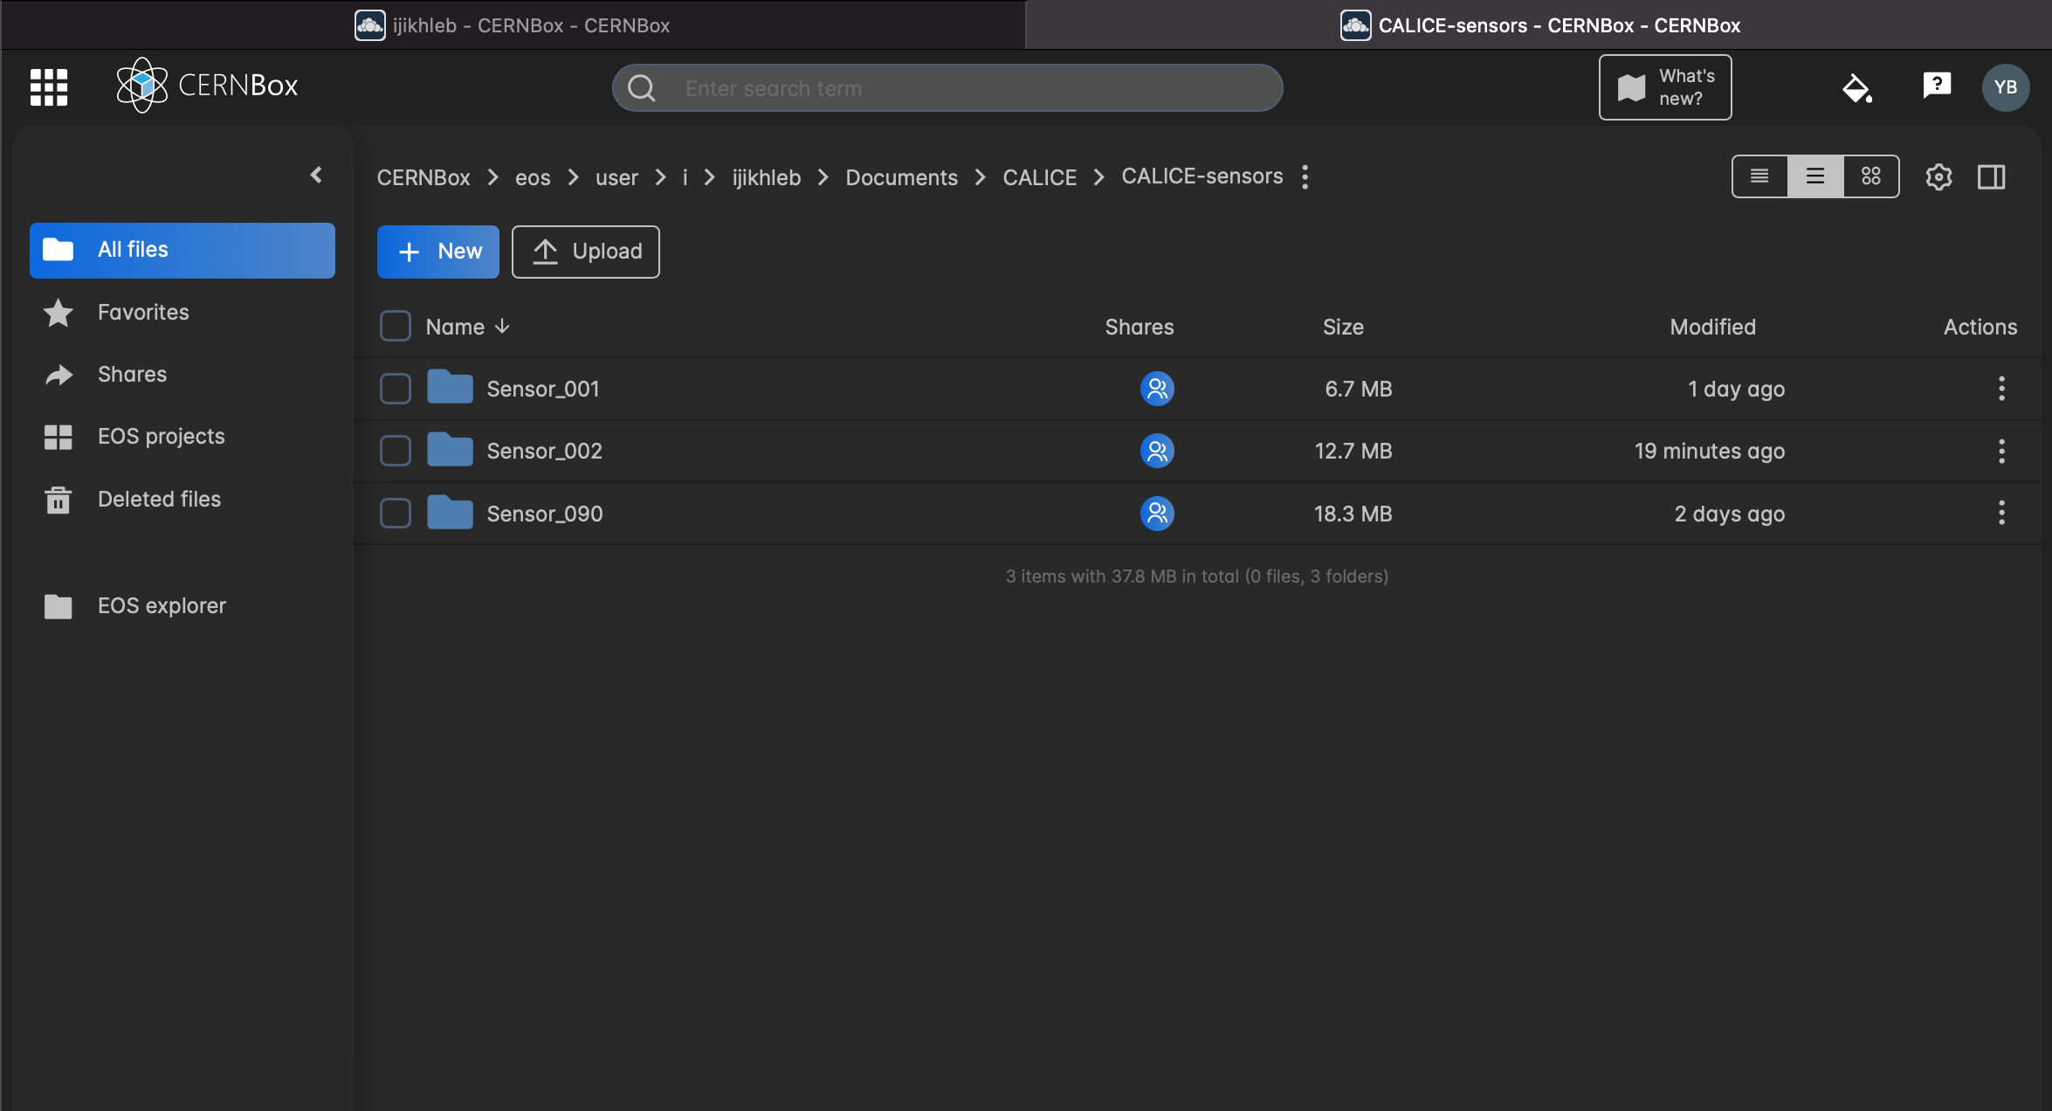
sensor Data
Data from the probe station are saved on the local computer
Then transferred to the CERN cloud (CERNBOX accessible by the collaboration)
Analyzed by python soft to produce plots and alarm if needed
For each sensor, one excel file produced with 256 sheets containing plots (CV,IV) for each pads. The excel file is uploaded to the CERN cloud.

Slide 5
Data taking
1st step : contact test to be sure all the pads are touching the probe pins. Takes few minutes
2nd step IV test. Takes 3 hours.
3rd step CV test. Takes 2 hours.
4th step CV test without sensor. Takes few minutes (no need to wait)
We are adding the following steps :
Rotation of the sensors
Contact test
IV and CV for the missing pins

Slide 6
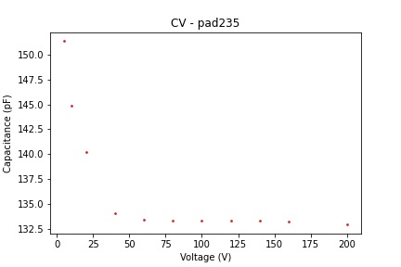
CV measurement
C (pF)
100 CV measurement on the same pad to check the repeatability
Measurement of the system every 10 CV measurements (to be subtracted)
measurement
C (pF)

Slide 7
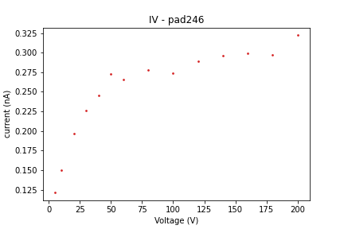
IV measurement
Checking the influence of different parameters: delay between measurements, delay between voltage change,…
Making tests to check the repeatability

Slide 8
Still in learning phase
We are checking all the small details to be sure we understand all the results
The probe is leaving some marks on the detector : need to be checked
We can test one/two sensors a day

Slide 9
Tungsten planes
After some paperwork, we understood how to proceed to order and deliver the three planes to Poland
We are waiting for a new quote from China

Slide 10
Thank you!

