Slide 1




IFIC

Slide 2

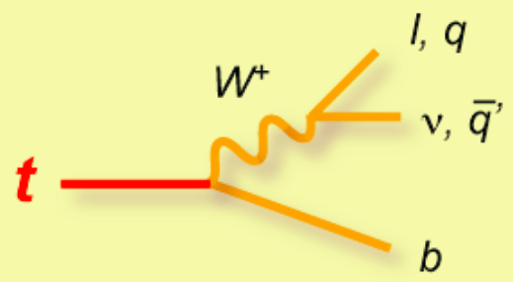
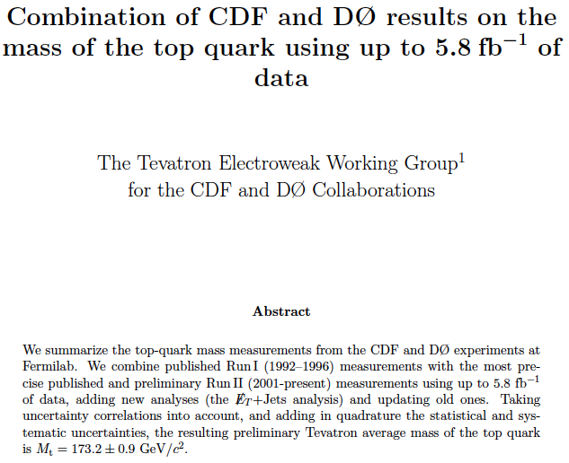

Why are we interested in the top quark?
● Heaviest known quark (plays an important role in EWSB in many models)
● Important for quantum effects affecting precision observables
● Very unstable, decays “before hadronization”
0.5% precision !
How should we theorists judge this error?
What is the theoretical error in this mass determination?
What mass is it?

Slide 3
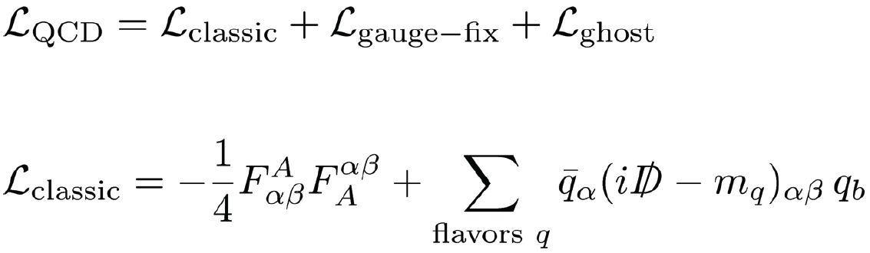
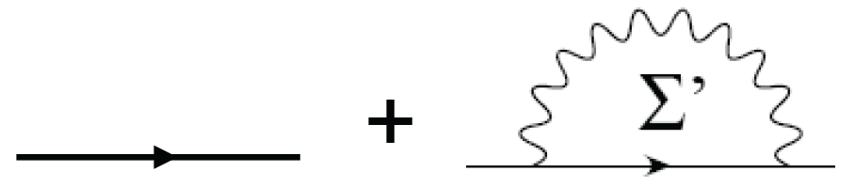
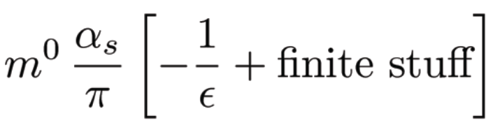




Concept of a Quark mass
Quantum Field Theory
Particles: Field-valued operators made from
creation and annihilation operators
Classic action: m is the rest mass, no other
mass concept exists at the classic level
Beyond LO QCD predictions, the top-quark mass value depends on the renormalization scheme
Renormalization
Common mass renormalization schemes
Unphysical due to confinement !
ambiguous by

Slide 4
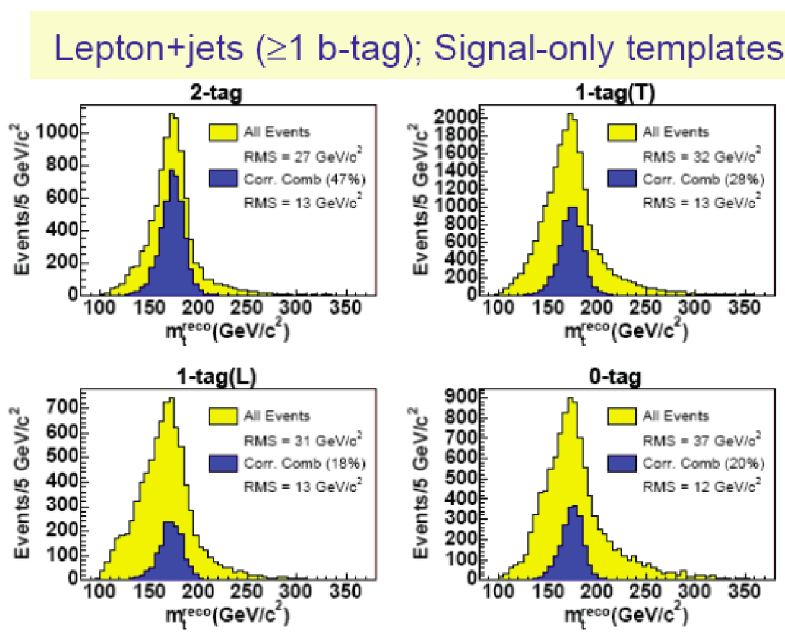
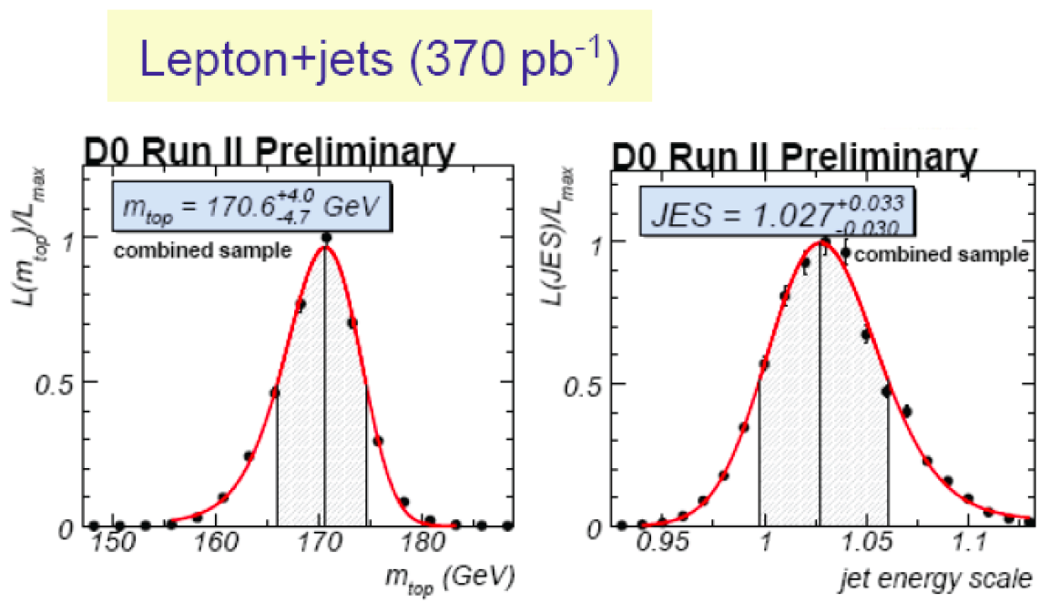
Direct measurements of the top mass @ Tevatron and LHC
Two main approaches to directly measure the top mass from the reconstruction of the final states in decays of top-antitop pairs
Template Method
Matrix Element Method
Monte Carlo templates of reconstructed mass distributions are fit to data
The top mass is extracted from the reconstructuction of the final states in the data using a calibration curve obtained from the Monte Carlo simulation

Slide 5
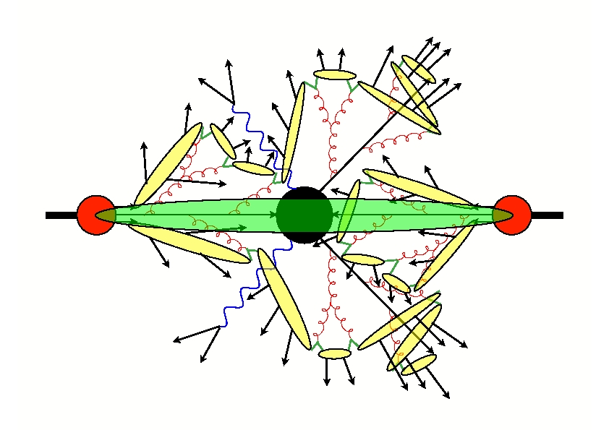
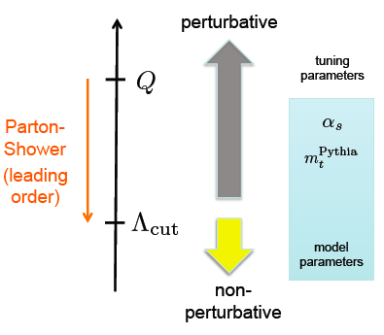
Parton shower Monte Carlo event generators
Computer program designed to simulate hadronic final states
Parton shower: leading-log approximation
Classic approximation
No quantum interference between production and decay
Infrared regularization scheme is not specified

Slide 6




Direct measurements of the top mass @ Tevatron and LHC
Two main approaches to directly measure the top mass from the reconstruction of the final states in decays of top-antitop pairs
What mass is measured? The top quark mass scheme used in the MC simulation
What is ? Not the pole mass!
It is not possible to establish a connection between and any other mass scheme without knowledge (at least) of parton showers
at NLL accuracy
To make a statement on a top quark mass value extracted from data, compare the measurement of a quantity depending on the top mass with a calculation using a consistent scheme
Matrix Element Method
Template Method
Monte Carlo templates of reconstructed mass distributions are fit to data
The top mass is extracted from the reconstructuction of the final states in the data using a calibration curve obtained from the Monte Carlo simulation

Slide 7
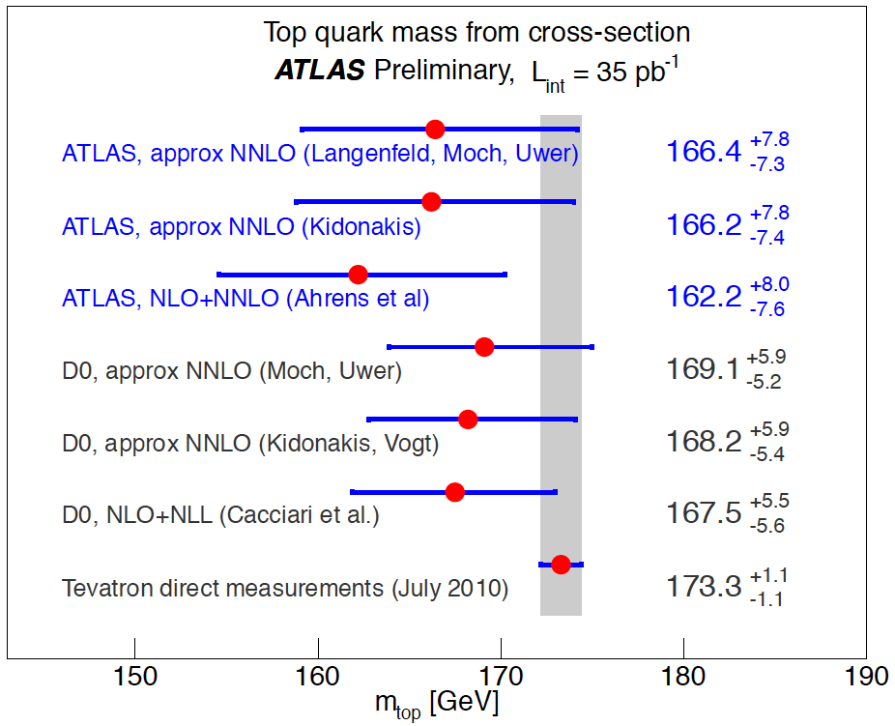
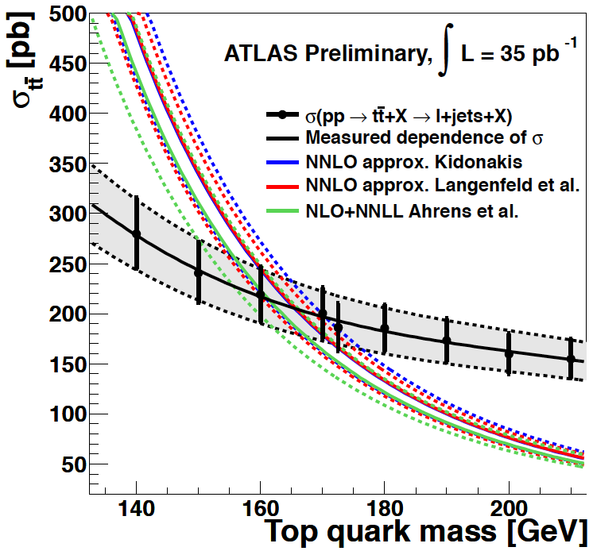
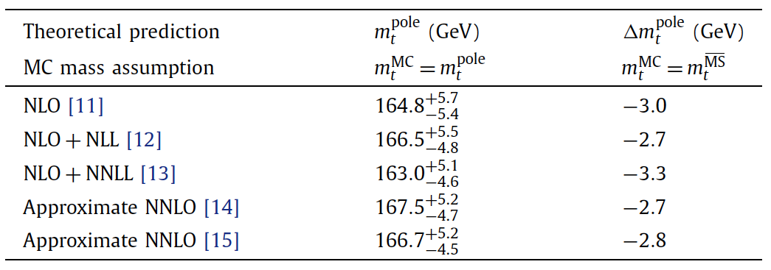

Top mass extraction from the measured cross section
Selection of t-tbar candidates in the cross section measurement introduces a dependence on
Significant improvement of this measurement questionable due to syst. (theoretical) uncertainties
We need better precision !

Slide 8



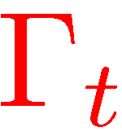
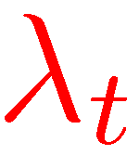
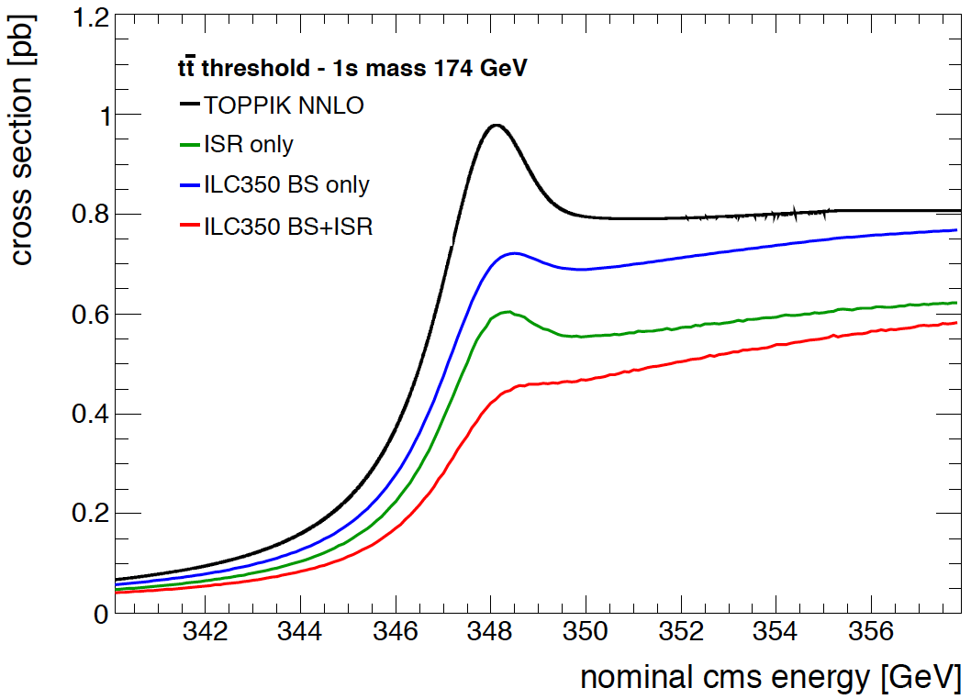
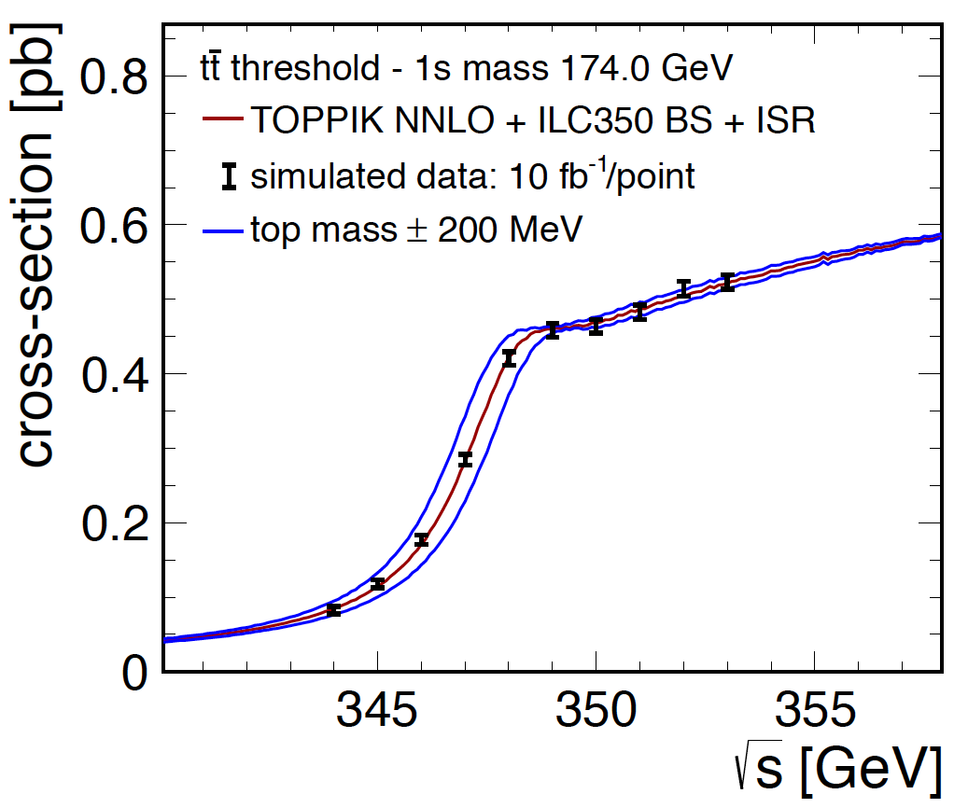
Top mass at the ILC
Threshold scan
Precise determination of the top mass , the width and the Yukawa coupling (one order of magnitude improvement with respect hadron colliders)

Slide 9
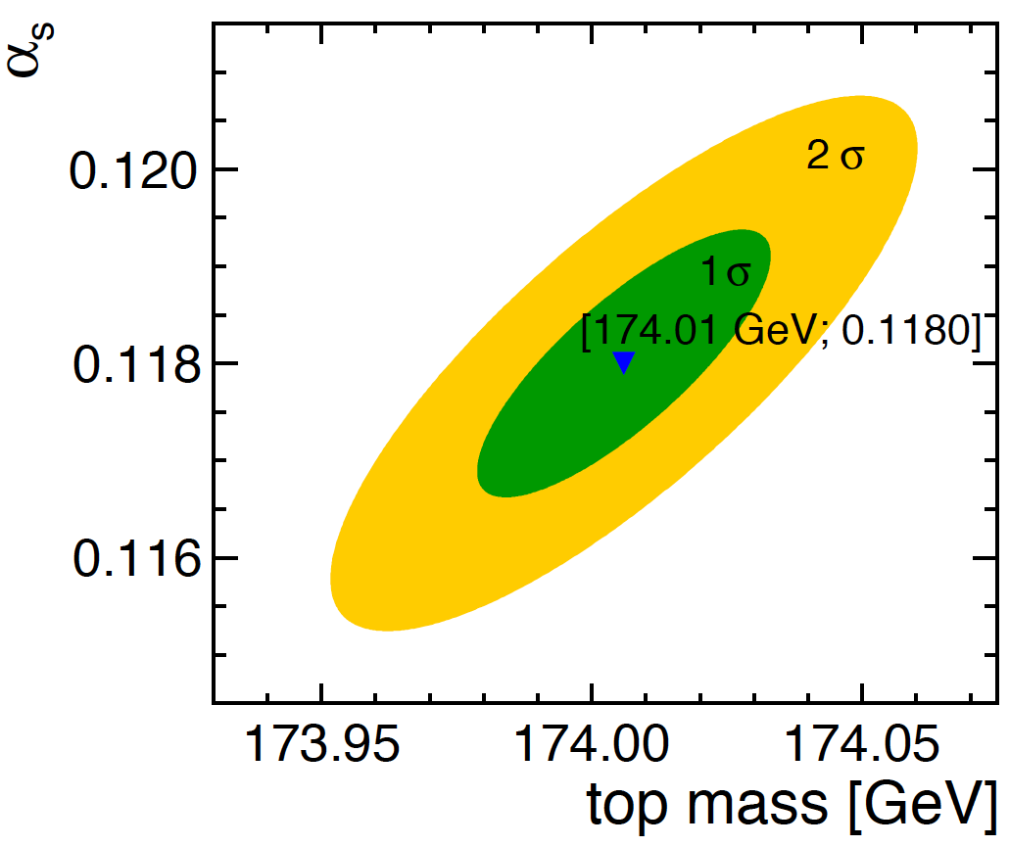
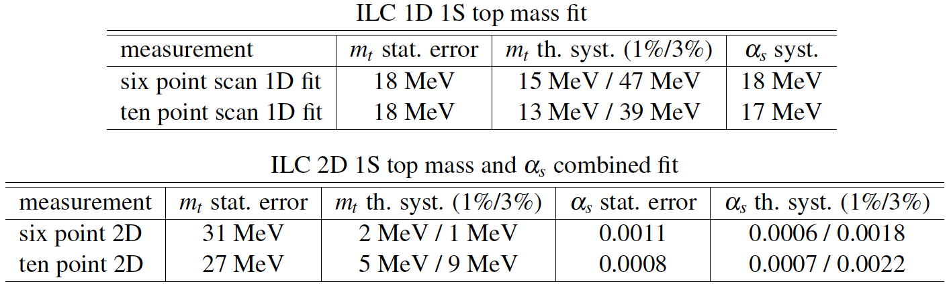
Prospects for the top mass measurement at the ILC
includes up to NNLO QCD corrections (no EW)

Slide 10
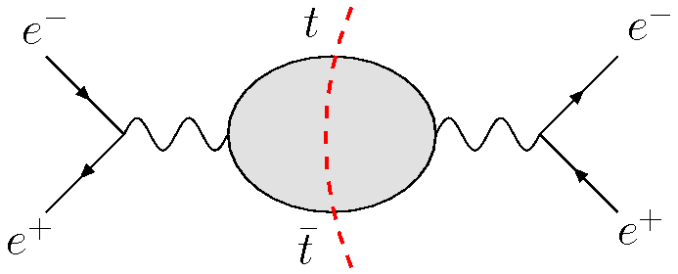
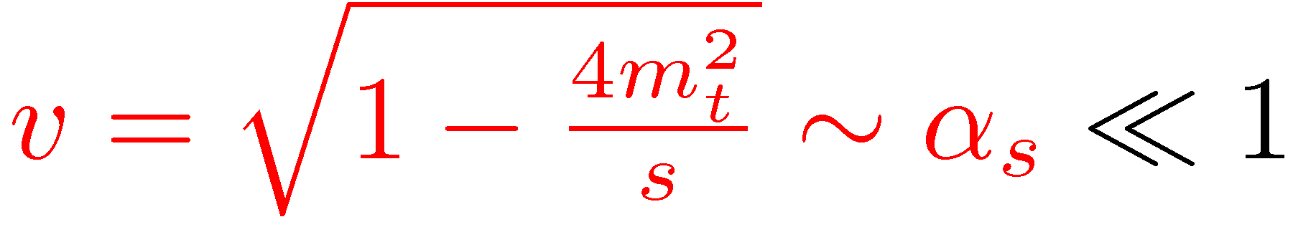
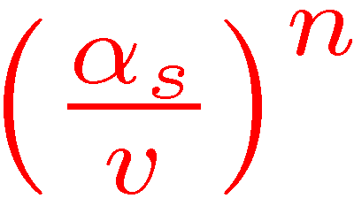
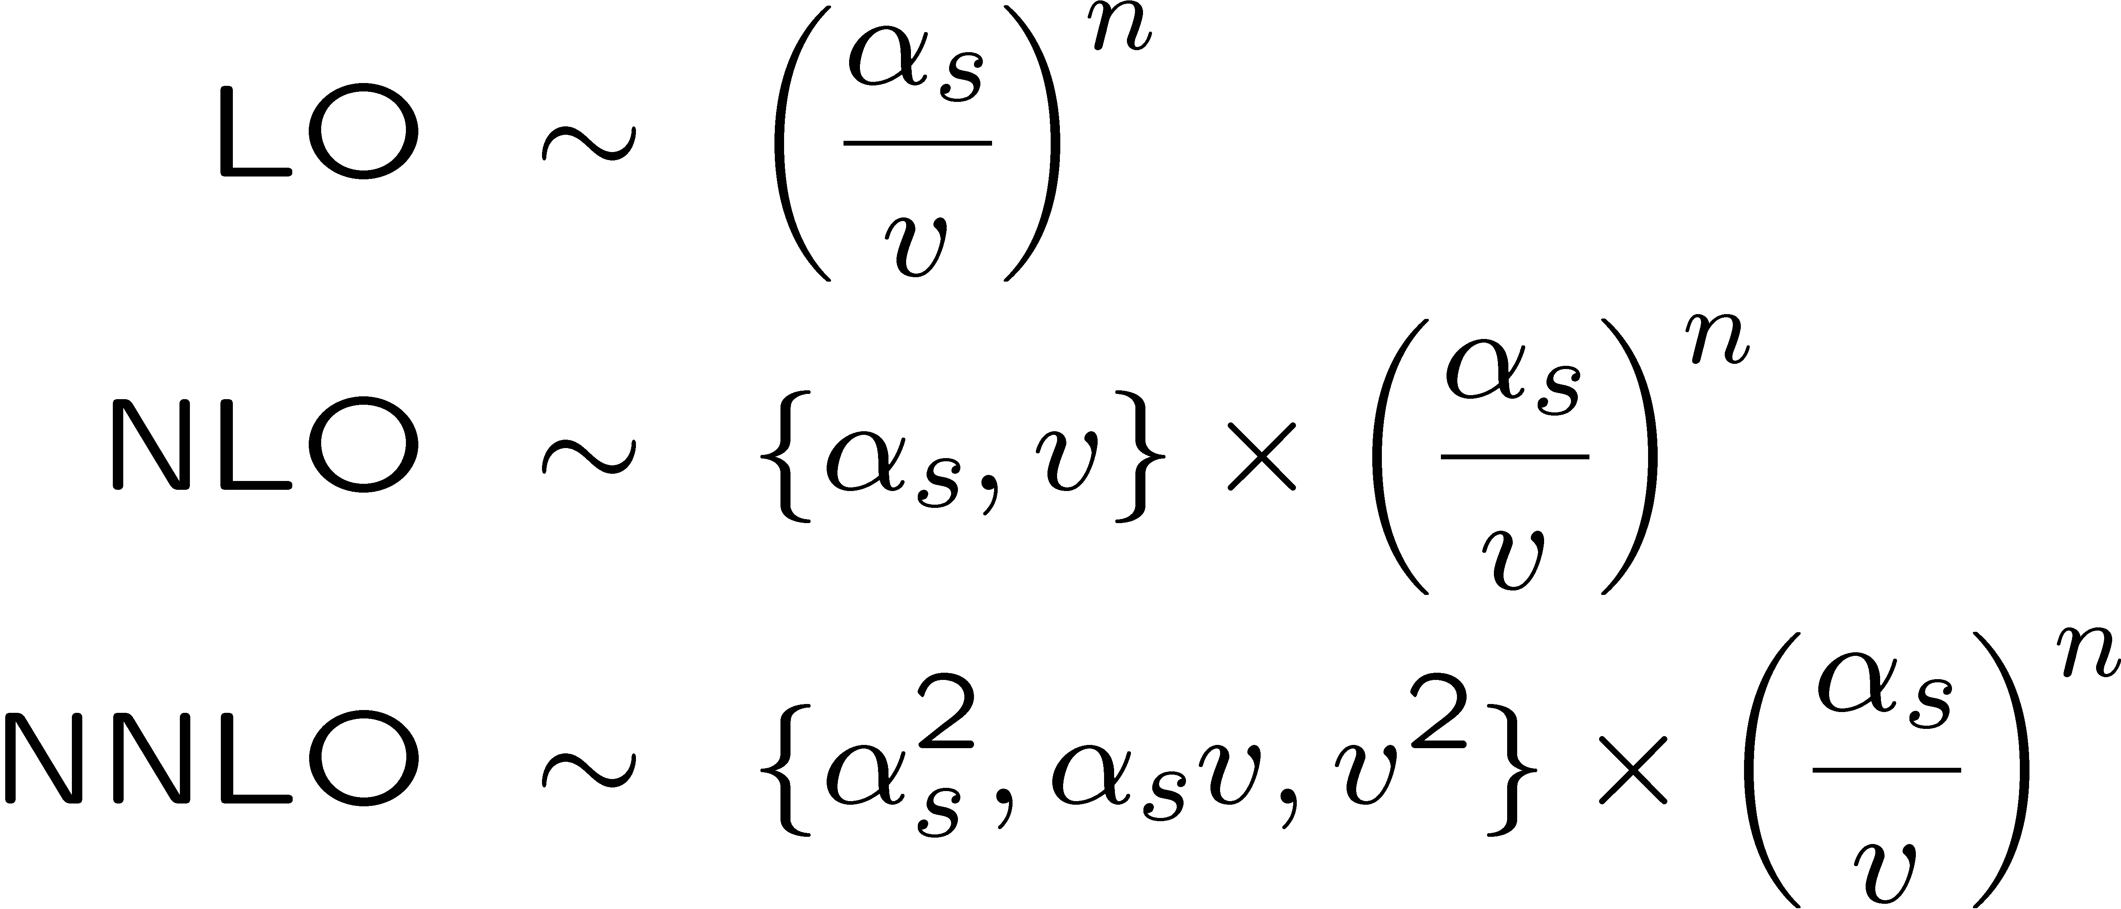
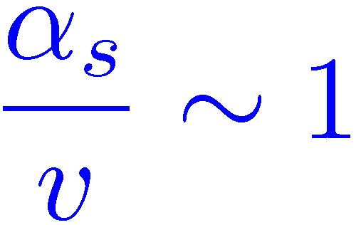
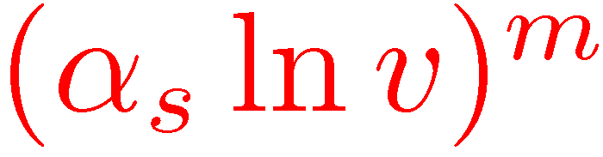
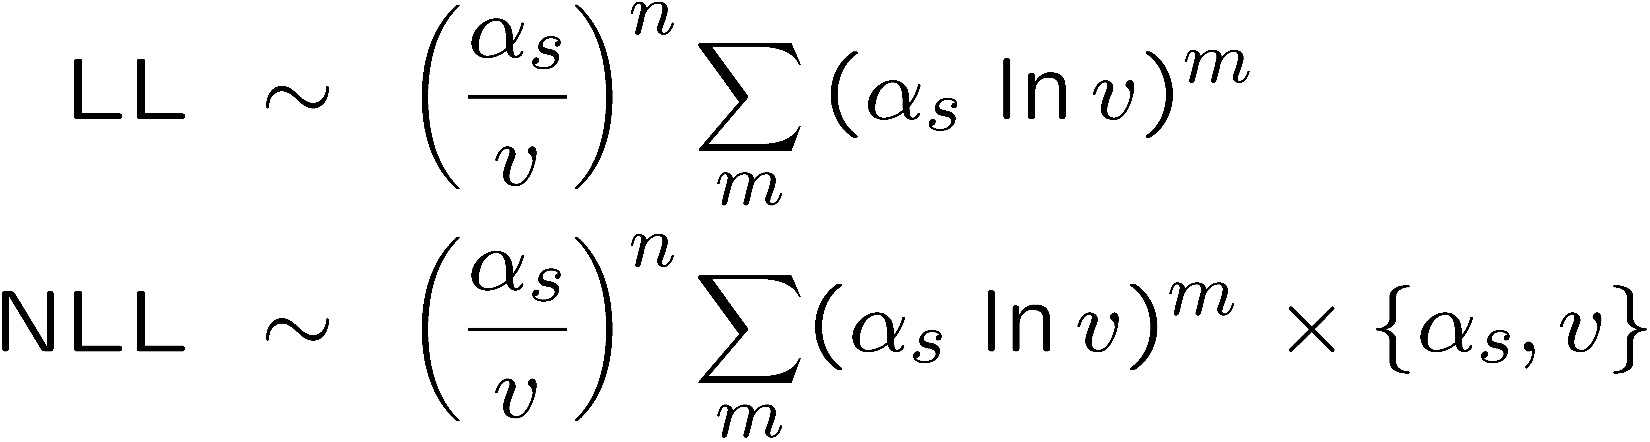
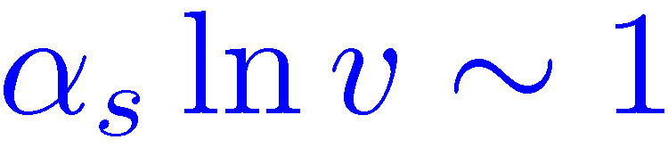
Status of QCD corrections
Top and antitop close to mass shell, use Non-Relat. EFT
Top quarks move slowly near threshold:
sum from “Coulomb gluons” to all orders
fixed-order approach: all N³LO pieces known (compilation of all contributions to check convergence of perturbative series
still pending)
Beneke, Kiyo, Schuller '05-08
Further RG improvement by summing also : LL, NLL, ...
RG improved calculation: NNLL almost complete (missing NNLL piece small)
Hoang, Manohar, Stewart, Teubner '00-01;
Hoang ´03; Pineda, Signer '06;
Hoang, Stahlhofen '06-11

Slide 11
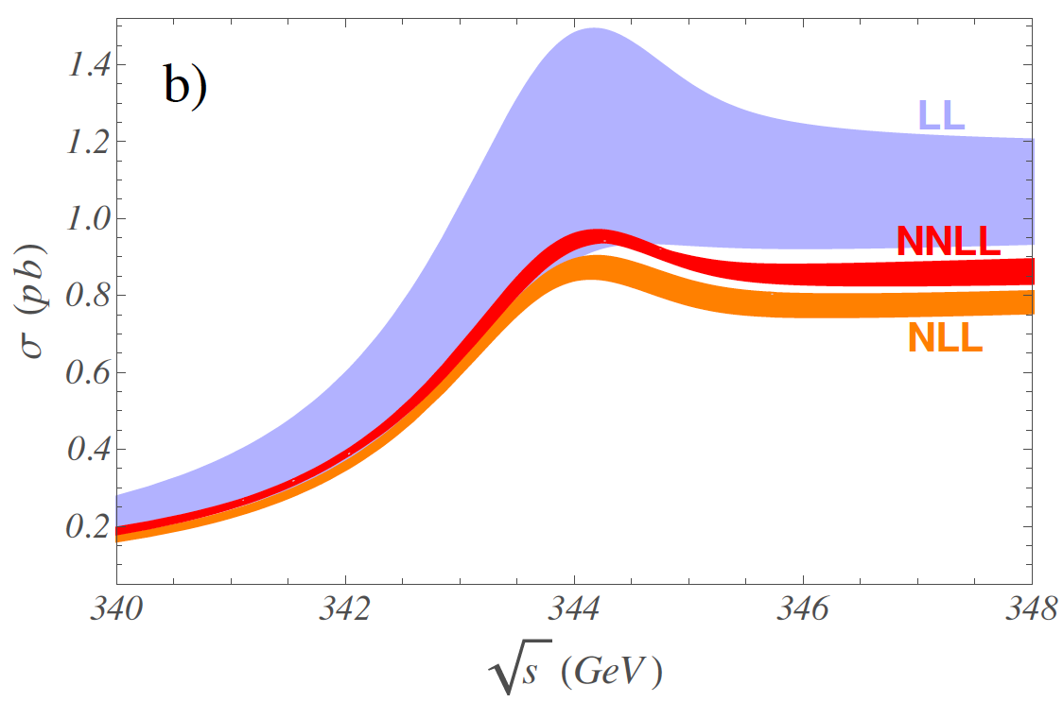
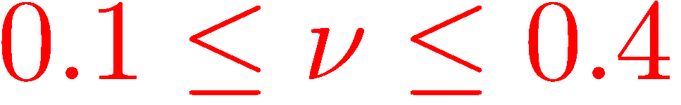
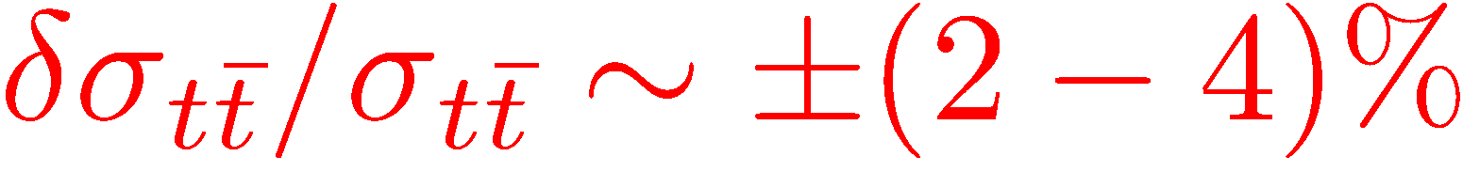
Status of QCD corrections (cont.)
Hoang, Stahlhofen (2011)
“threshold masses”
● missing QCD soft NNLL contributions small
● EW effects beyond LO and non-resonant effects not included

Slide 12

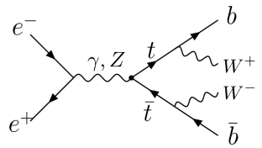
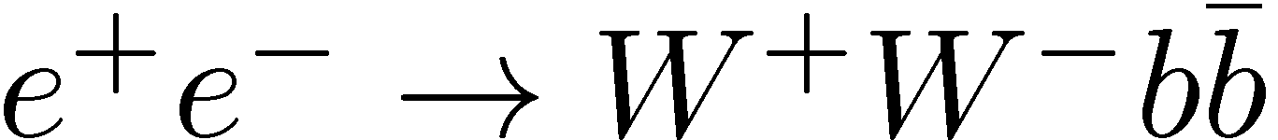
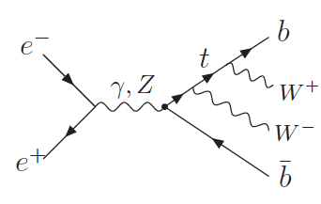
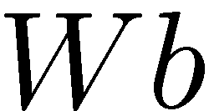
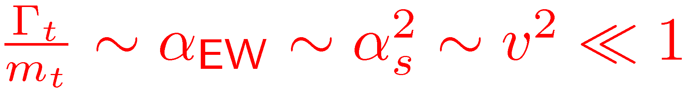
Effects from top-quark instability beyond LO
Note: once EW effects are turned on, the physical final state is
resonant contributions: top and antitop close to mass-shell
● Non-resonant (hard) corrections to
which account for the production of the pairs by
highly virtual tops or with only one or no top
Effective field theory (EFT) for pair production of unstable particles near threshold, based on separation of resonant and nonresonant fluctuations
Hoang, Reisser '05
Beneke, Chapovsky, Khoze, Signer, Zanderighi '01-04;
Actis, Beneke, Falgari, Schwinn, Signer, Zanderighi '07-08
● power counting for finite width effects:

Slide 13
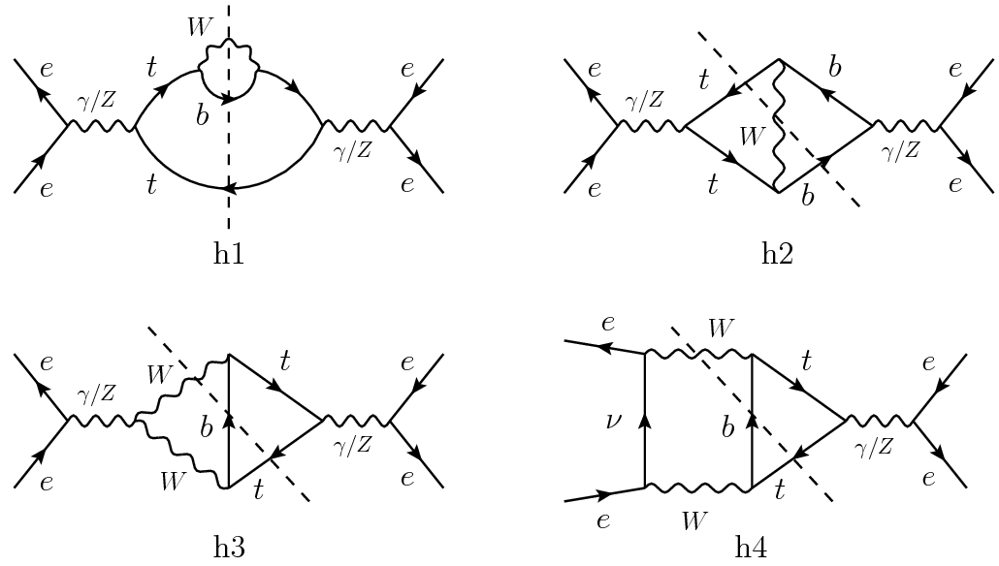
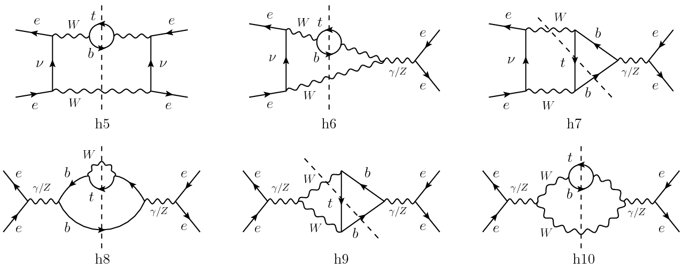
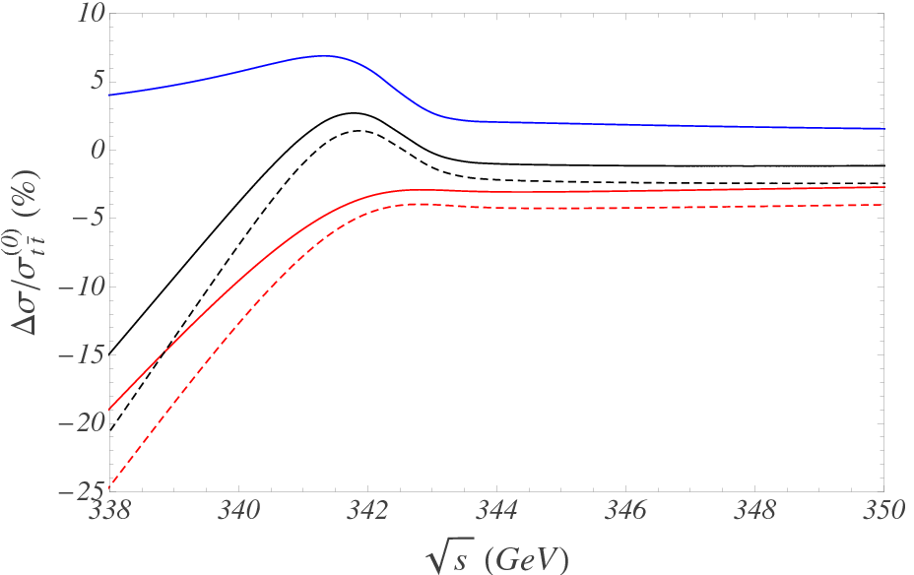
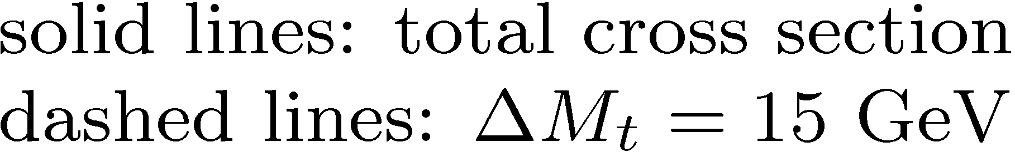
Non-resonant corrections
✔ computed at NLO for the total cross section and with top invariant-mass cuts
Beneke, Jantzen , RF (2010)
Relative sizes of EW NLO corrections w.r.t. LO
QED resonant correction (“Coulomb photons”)
Combined EW NLO corrections
Non-resonant NLO correction
~ -30 fb (-3% above and
up to -20% below threshold)
needed to meet the experimental
precision at the ILC

Slide 14

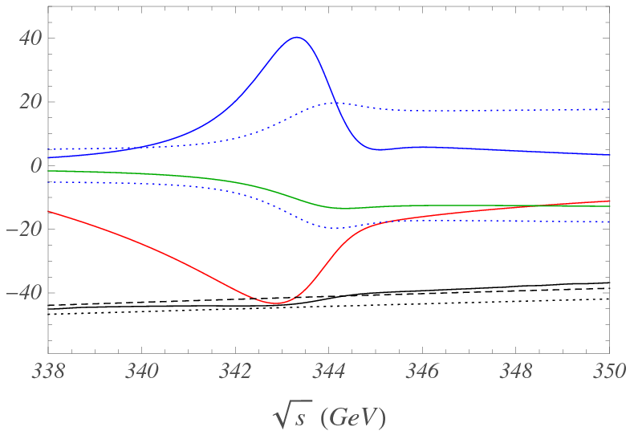
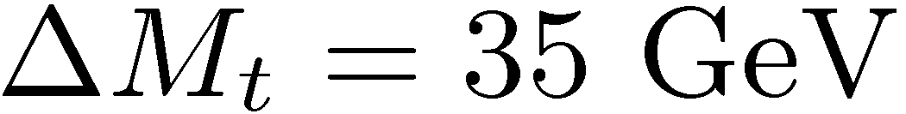
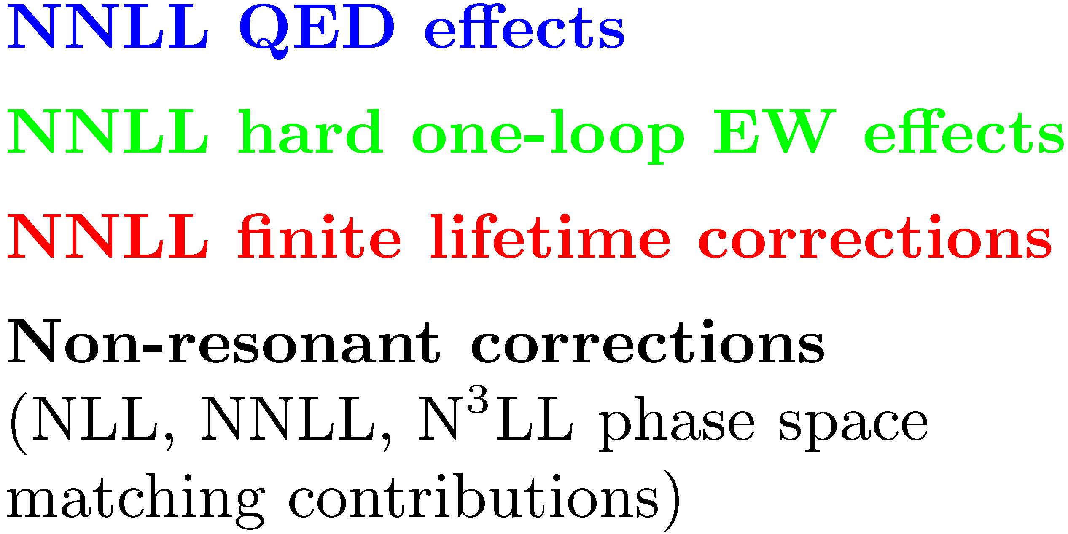
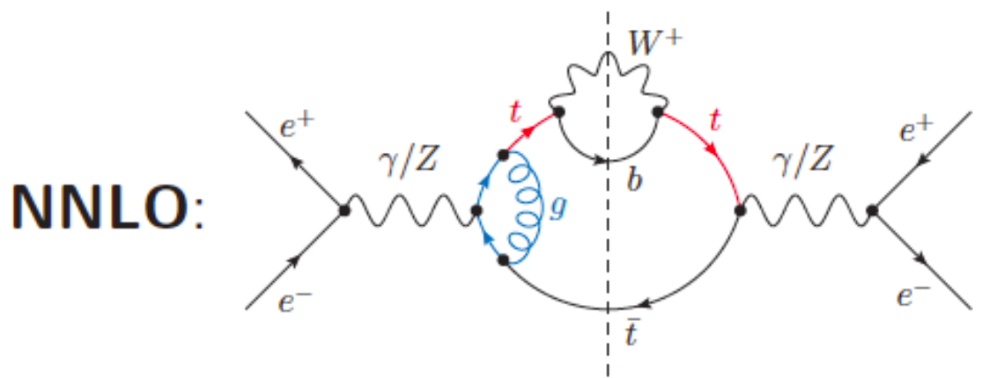
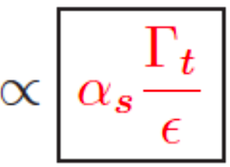
Non-resonant corrections at NNLO
✔ Beyond NLO: dominant NNLO and NNNLO terms computed within the
phase space matching approach with top invariant-mass cuts:
Hoang, Reisser, RF (2010)
8 full set of NNLO non-resonant corrections
for the total cross section currently unknown
✔ Extraction of NNLO end-point divergences almost complete
(Jantzen, RF)
8 Finite parts: overlapping of end-point and IR singularities calls for a modified
subtraction method (work in progress...)

Slide 15
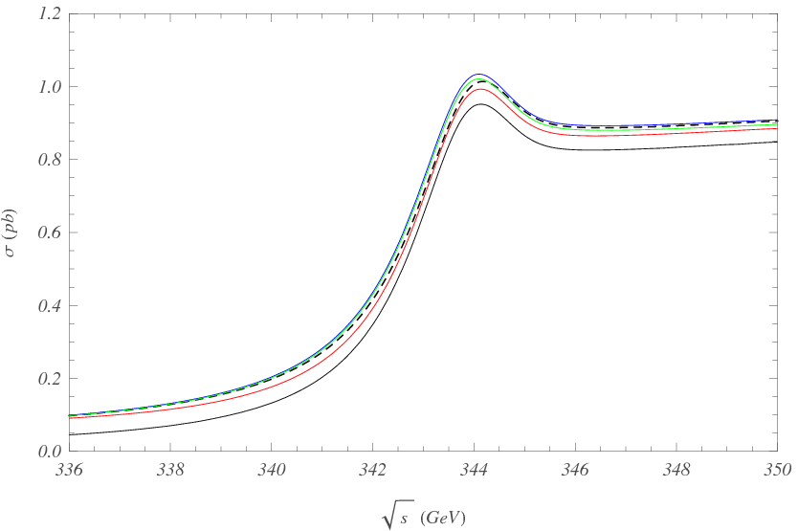
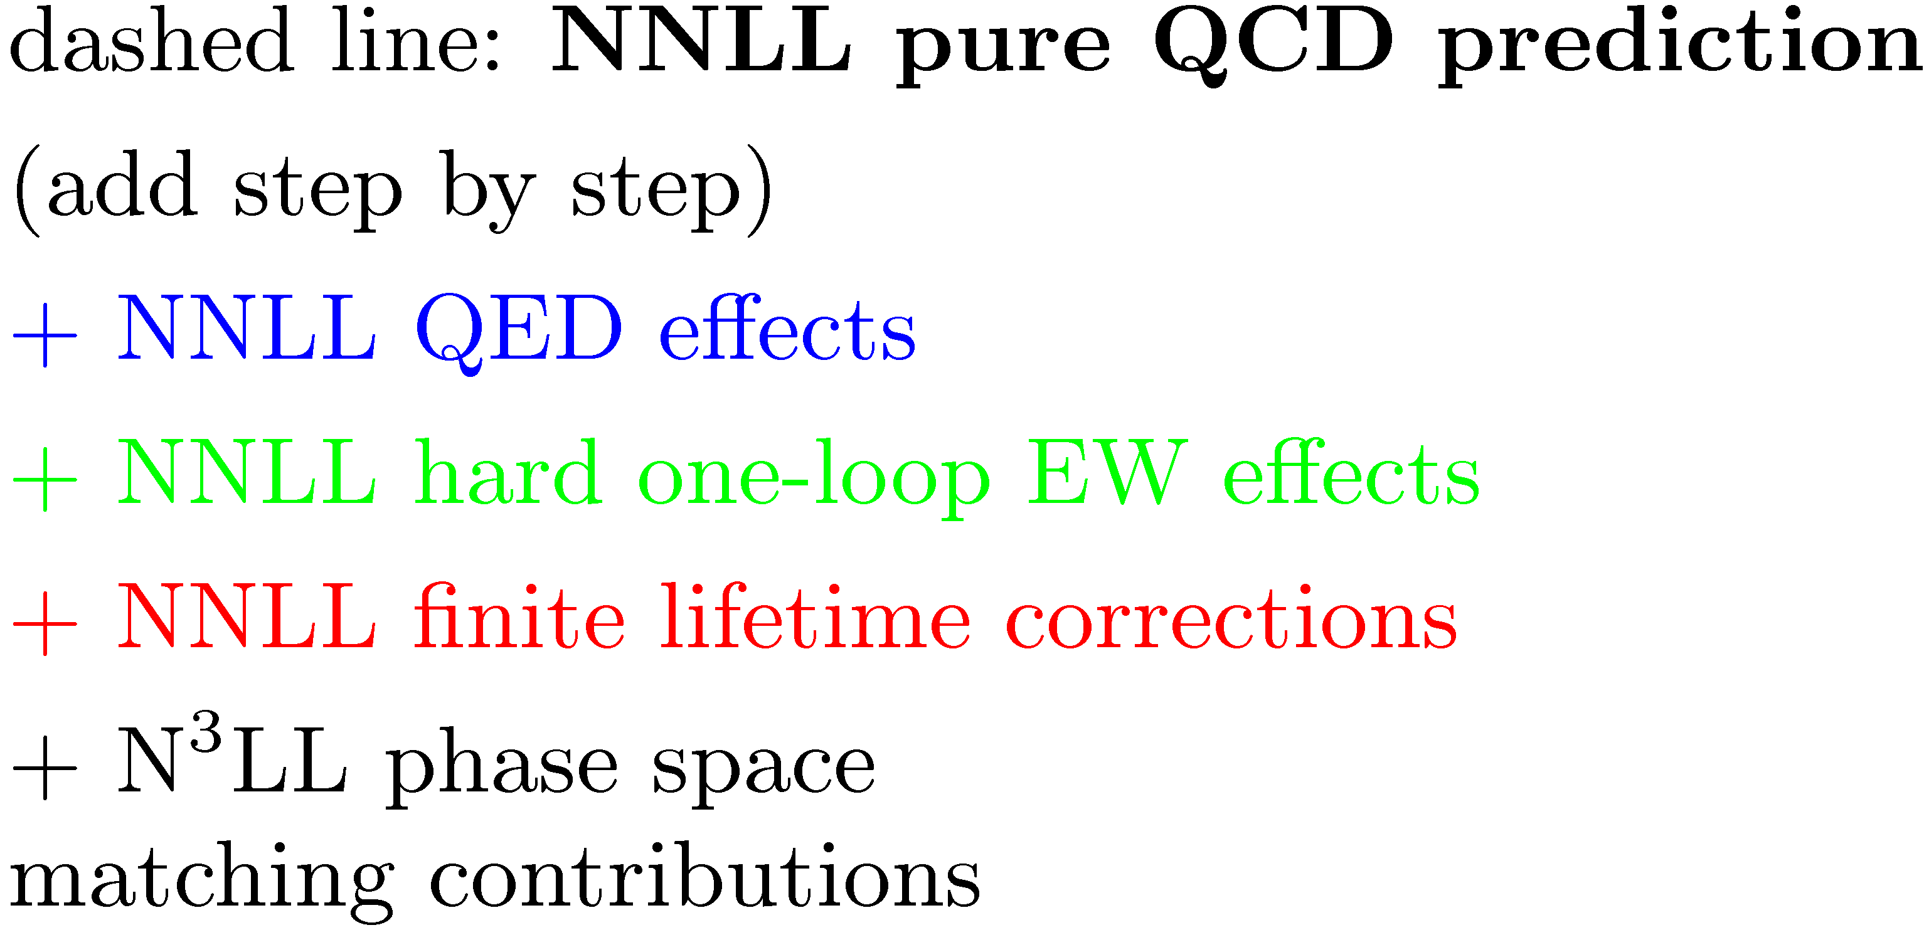
Top-pair production cross section

Slide 16
Summary: theoretical status of ttbar production cross section
Resonant corrections (top and antitop close to mass shell)
● QCD contributions:
fixed-order approach: all N³LO pieces known (compilation of all contributions
shall appear soon...)
RG improved calculation: NNLL almost complete (missing NNLL piece small)
● Electroweak contributions known to NNLL accuracy
8 Detailed error analysis of theoretical uncertainties in preparation...
3% theoretical uncertainty on the total cross section here seems realistic...
Non-resonant corrections (bW pairs from virtual tops or with only one or no top)
✔ computed at NLO for the total cross section and with top invariant-mass cuts
✔ Beyond: dominant NNLO and NNNLO terms known only when top invariant
mass are included
8 In progress: finite parts at NNLO, we expect the size to be small (few percent at most), but can become very important below the peak region
include non-resonant corrections in future ILC top-quark mass
measurement study

