Slide 1
The International Linear Collider - a Higgs Factory -
Hitoshi Yamamoto, IFIC / Tohoku University
IFIC, May 2, 2022

Slide 2

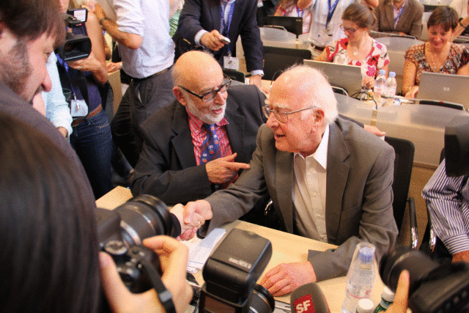
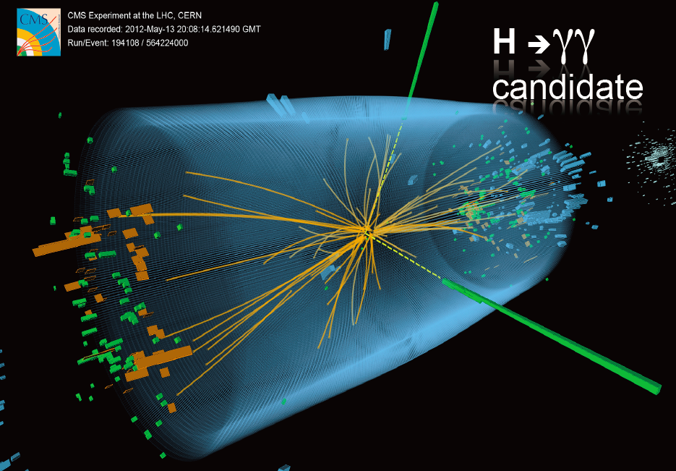
Discovery of Higgs
July 4, 2012
The ‘God particle’ was found!
Higgs:
The last to be found of the SM particles
No charge, no spin
→ It can mimic the vacuum
Fill the Universe (and we feel nothing)
Source of mass for all the SM particles

Slide 3
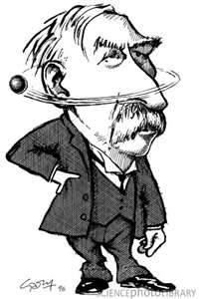
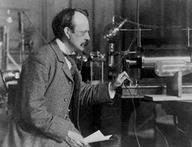
Higgs has been found, but,,,
Problem with Standard Model
E. Rutherford
No candidate for Dark Matter
Cannot explain the origin of EW symmetry breaking
Cannot explain the matter dominance of Universe
Higgs mass correction: quadratic divergence fine-tuning problem – unless multiverse?
…
They indicate New Physics beyond SM
Higgs is the probe for BSM
J. J. Thomson
New era of particle physics has begun!
Can be compared to the discoveries of nucleus (Ratherford) and electron (J.J. Thomson) opening new era of particle physics
Need to study Higgs in detail → Higgs Factory!

Slide 4


Global Strategies for Particle Physics
Europe
European Strategy for Particle Physics
(2020 update)
‘An electron-positron Higgs factory is the highest-priority next collider.’
US
DOE High-Energy Physics Advisory Panel,
P5 Report (Particle Physics Projects Prioritization Panel)
(2014 – updated discussion is now underway)
‘An electron-positron Higgs factory is the highest-priority next collider.’

Slide 5
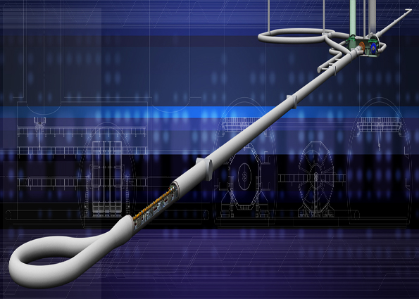
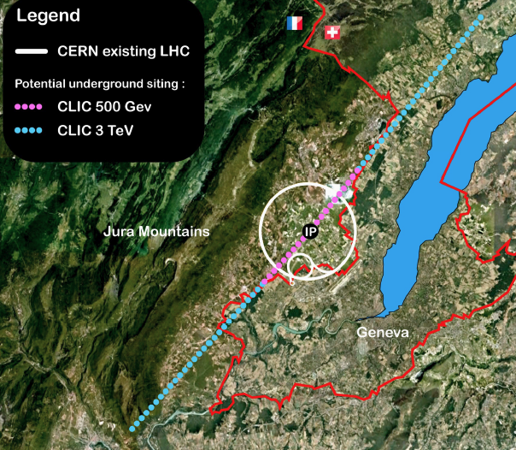
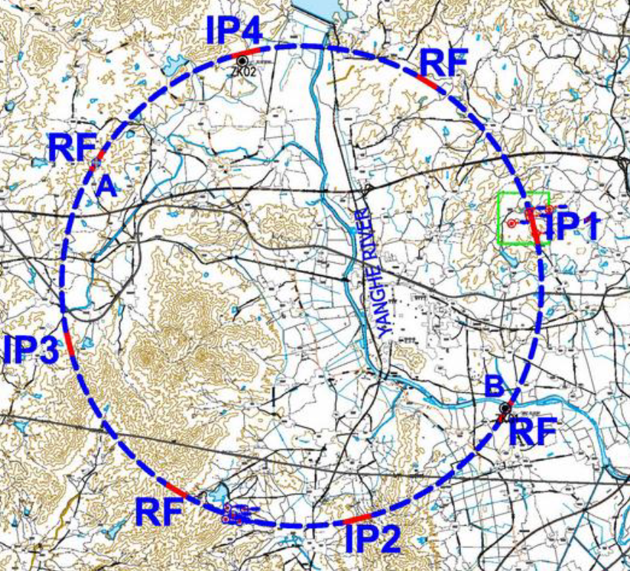
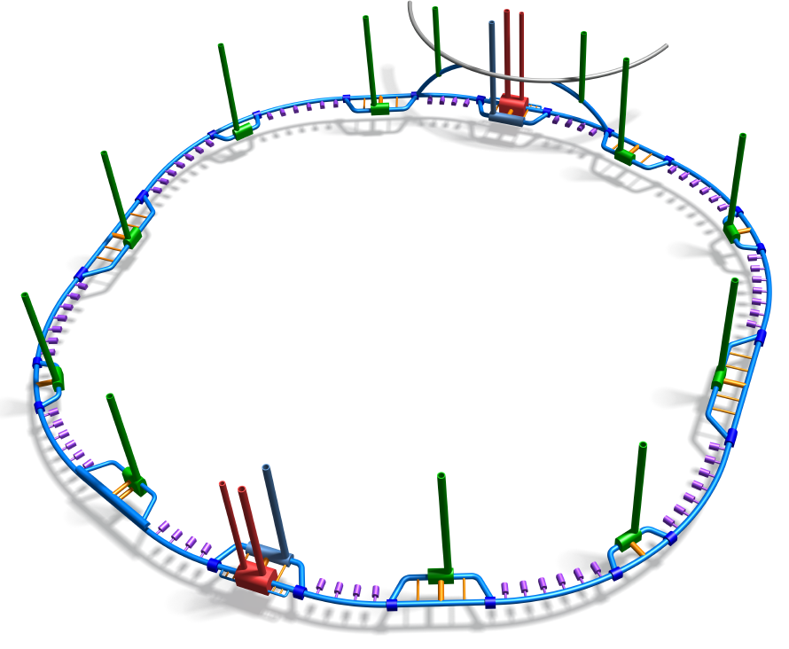
4 Candidates for e+e- Higgs Factory
International Linear Collider (ILC) – US, Europe, Japan +
Linear: 20 km long
Superconducting RF acceleration
Energy upgrade up to 1 TeV
CDR 2007, TDR 2012
Compact Linear Collider (CLIC) – CERN +
Linear: 13 km long
Two beam acceleration
Energy upgrade up to 3 TeV
CDR 2012
Circular Electron Positron Collider (CEPC) – China +
Circular: 100 km circumference
The same tunnel -> pp collider
CDR 2015
Future Circular Collider-ee (FCCee) – CERN +
Circular: 100 km circumference
The same tunnel -> pp collider
CDR 2018-19

Slide 6
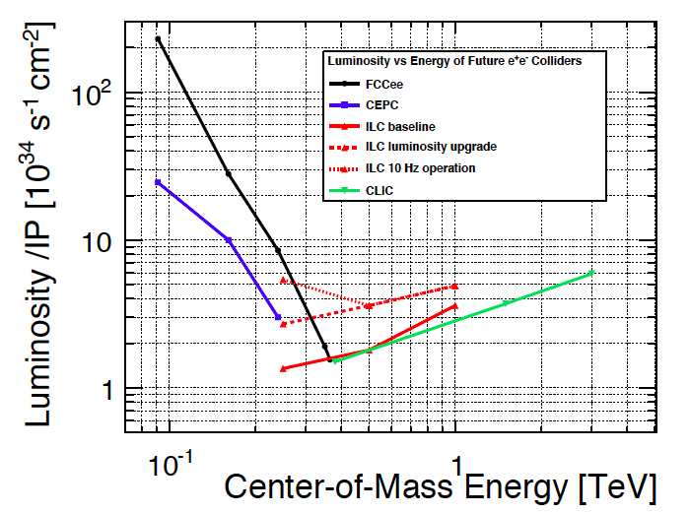
Luminosity vs Energy
(Inputs to ESU)
250 GeV Higgs Factories
FCCee/CEPC points are for 1 IP (their CDR have 2 IPs)
LC Higgs Factory numbers do not include effective x〜2.5 by polarization
(polarization effect discussed later)
ILC 10 Hz collision requires ~ILC500

Slide 7
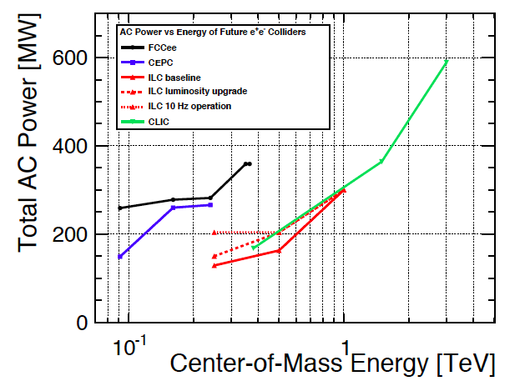
Site AC Power vs Energy

Slide 8

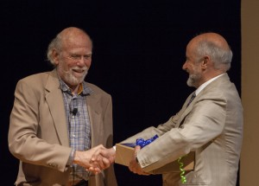
ILC TDR Completed Ceremony: June 12, 2013
Tokyo
CERN
Fermilab
TDR 5 volumes
Culmination of many years of R&Ds
ILC is in principle ready to go technically
(apart from some loose ends, cost reductions, etc.)

Slide 9
ILC Hardware Overview

Slide 10
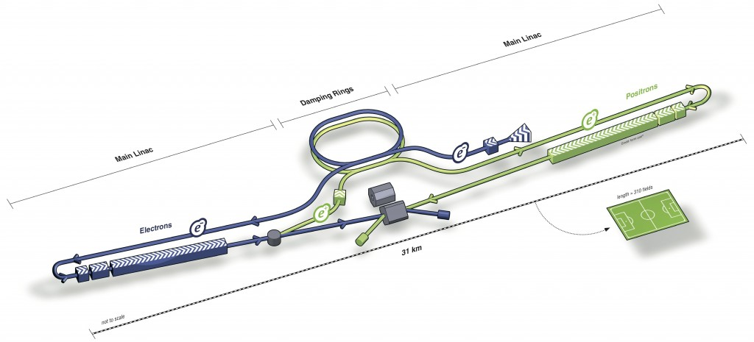
ILC
Main linac
Damping ring
Positron beam
Main linac
31 km
electron
TDR ‘Baseline’:
Ecm = 500 GeV
Polarization (e+/e-) = ±0.3/±0.8
2x10¹⁰ particles/bunch, 1312 bunch/train, train: 5 Hz
Wall plug power = 163 MW

Slide 11
Higgs Factory
250 GeV: the optimal energy to produce Higgs in a controlled environment
Higgsstrahlung: gold-plated mode
Precise measurement of HZZ coupling by production
Recoil mass of Z ≡ Higgs reconstruction
No explicit reconstruction of Higgs (Higgs tagging)
Powerful for invisible Higgs decays

Slide 12
Proposal for ILC250 Higgs Factory
At LCWS 2016 Morioka, it was proposed that the first stage at 250 GeV
will be a Higgs Factory.
Subsequently approved by the Linear Collider Board (LCB) and the International Committee for Future Accelerators (ICFA).
12

Slide 13
ILC Running Scenario
Up to Dec. 2016 LCWS2018
500 GeV start (‘H20’ scenario)
After Dec. 2016
ILC 250
Higgs Factory

Slide 14
ILC 250 Luminosity: smaller σ_{x}
The TDR value was a result of simple scaling from the 500 GeV parameters assuming the same horizontal IP beam size.
The horizontal beam size at 500 GeV was limited by the pair background.
The pair background is less at lower collision energies thereby allowing a smaller horizontal beam size at 250 GeV
Smaller horizontal beam size (by ) wrt TDR due to smaller horizontal emittance (by ½) - geometrical luminosity up by + pinching effect → x 1.65 lum. increase.
→ New baseline for 250 GeV

Slide 15
Luminosity Upgrade by N_{bunch}x2
250 GeV and 500 GeV: luminosity can be doubled by doubling the number of bunches per pulse (N_{bunch})
Requires ~50% more klystrons and modulators
May or may not require the 2nd positron ring in DR (electron cloud effect)
Construction cost increase is 6% for 500 GeV (TDR study)
No similar estimate for 250 GeV, but expected < 10%
These estimates include the 2nd positron ring
AC power for Nbunchx2
@500 GeV: 163 MW → 204 MW (TDR)
@250 GeV: expected to be less than 25 % increase

Slide 16
Luminosity Upgrade by 5Hz→10Hz
250 GeV: luminosity can be doubled by doubling the collision rep. rate (pulse rate) 5Hz→10Hz
Requires cryogenic system equivalent to ILC 500
Cost ~ ILC 500 (with the same N_{bunch})
AC power ~ ILC 500 (with the same N_{bunch})
Namely, ~ 204 MW

Slide 17
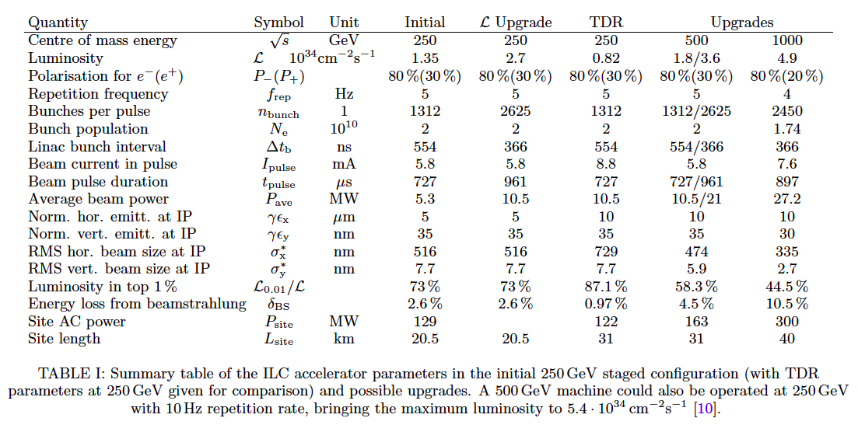
ILC 250 Machine Parameters
https://arxiv.org/abs/1903.01629
‘Long document’
ILC250 Higgs Factory

Slide 18
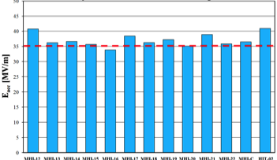
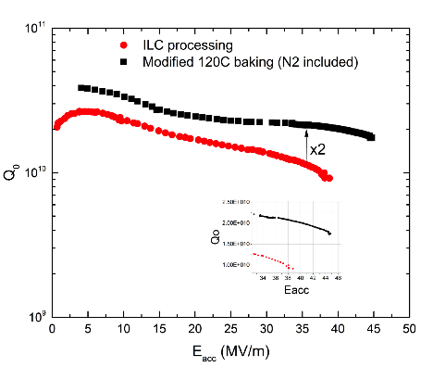
Accelerating Beams
Superconducting RF cavities
Cavity spec:
35 MV/m ±20% (‘vertical test’)
Corresponds to~ 31.5 MV/m operation
90% yield achieved
Still improving (9 yrs from TDR)
e.g. N2 doping
Higher gradient
35 MV/m operation realistic
(TDR: 31.5 MV/m)
→ Fewer cavities
Higher Q
Less cryogenic power

Slide 19
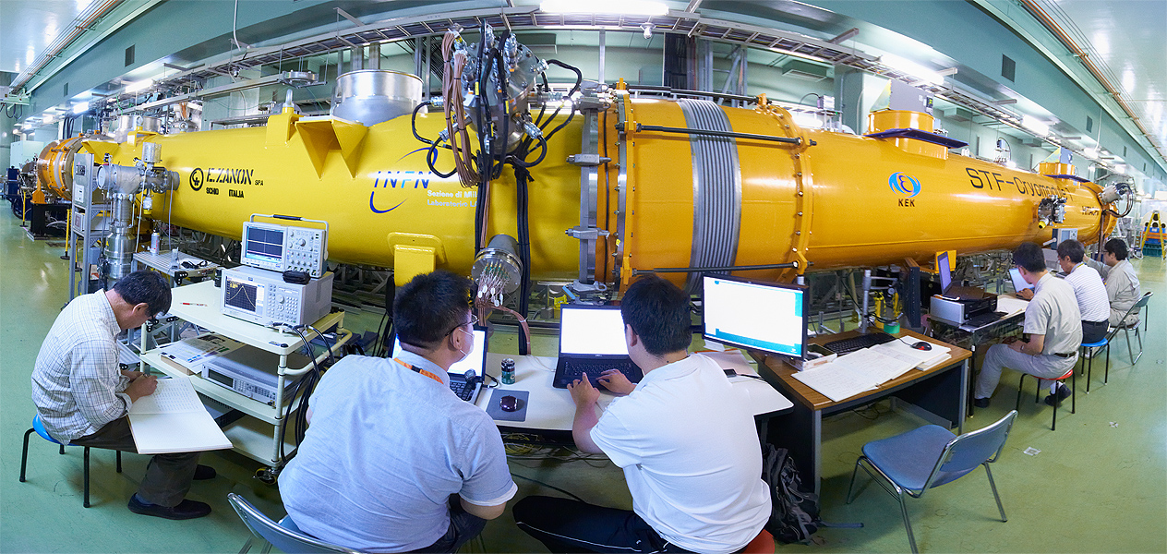
Assembling the Cryomodule
Cryomodule assembly
Combine cavities from all over the world
Designs are not identical
Can they be assembled to one accelerator without degrading performance?
‘Plug-compatibility’ design
KEK ‘S1-global’ project successful

Slide 20
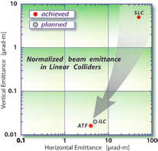
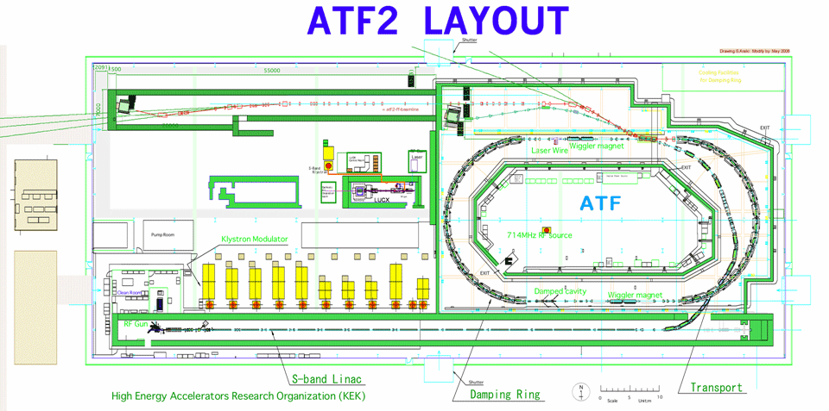
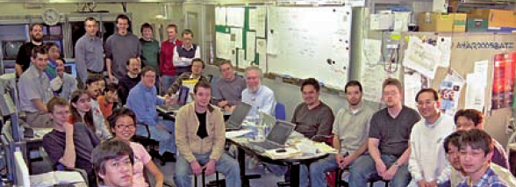
Making Beams Smaller 1
ATF (Accelerator Test Facility), KEK
ILC needs super low emittance:
ILC goal achieved
International collaboration

Slide 21
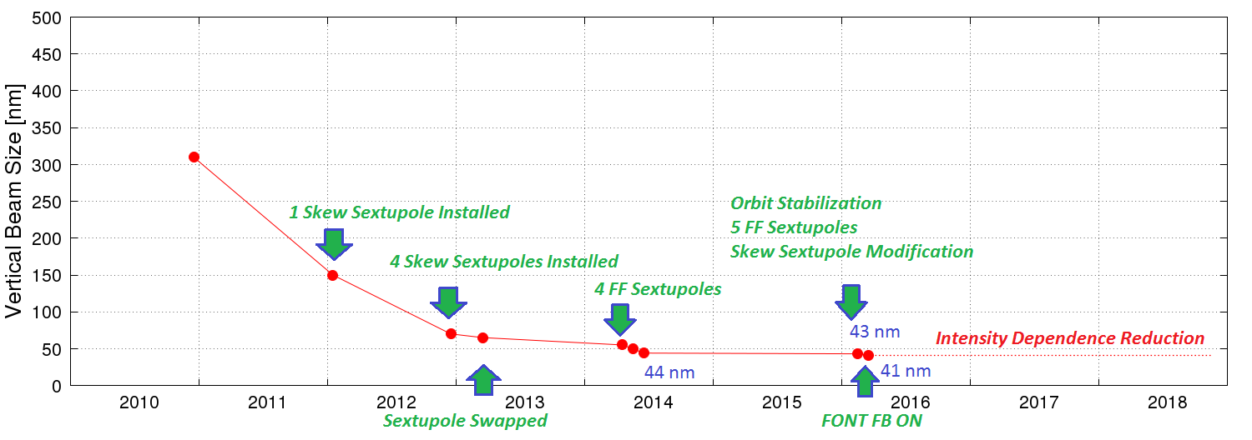
Making Beams Smaller 2
ATF2, KEK
Goals
Beam size 37 nm: 41 nm achieved: ~OK
Keep it stable by feedback system (FONT) : achieved

Slide 22
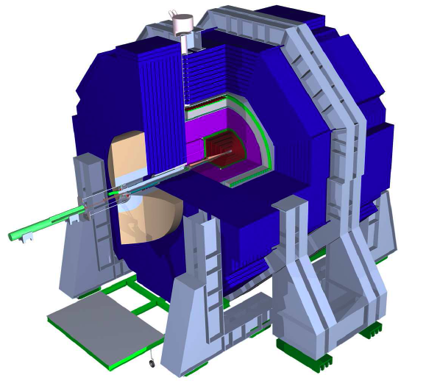
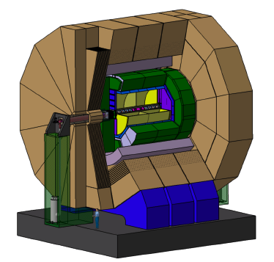
Two Detector Groups
SiD
High B field (5 Tesla)
Small ECAL ID
Small calorimeter volume
Finer ECAL granularity
Silicon main tracker
ILD
Medium B field (3.5 Tesla)
Large ECAL ID
Particle separation
TPC for main tracker
Based on PFA idea

Slide 23
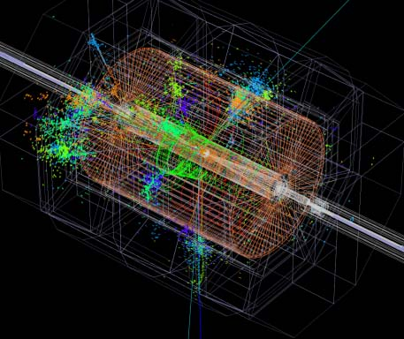
PFA
(Particle Flow Algorithm)
Jet Energy Measurement:
Charged particles
Use trackers
Neutral particles
Use calorimeters
Remove double-counting of charged showers
Requires high granularity
ILD
#ch | ECAL | HCAL
ILC (ILD) | 100M | 10M
LHC | 76K(CMS) | 10K(ATLAS)
X10³ for ILC
Need new technologies !
(Si pads, GEM, RPC, etc.)
Jet energy resolution ~ ½ of LHC

Slide 24
Precision Higgs Measurements

Slide 25
Model Discrimination by Higgs Couplings
Pattern of deviation from SM prediction
→ Model identification
Minimal Super-Symmetric Model
Minimal Composite Higgs Model

Slide 26
Higgs Coupling Measurements
‘κ framework’
Assume the same interaction as SM. Vary the size of the coupling constants (‘traditional’ framework).
Only observables: Higgs partial decay rates
Explicitly ignores beam polarizations
EFT (Effective Field Theory) approach (now standard)
Assume that deviations from SM are small.
Assume SU(2)XU(1) gauge symmetry of SM.
Take all possible terms up to dim-6
Radiative corrections calculable
Takes into account beam polarizations

Slide 27
EFT Approach for Higgs Couplings
(Before EW symmetry breaking)
After EW symmetry breaking:
a: vacuum exp. val.
χ: physical Higgs
20-parameter fit (all possible terms up to dim-6 assuming SU(2)xU(1))
Br(H→ZZ, γΖ, μμ)/Br(H→γγ) from HL-LHC included
e+e- → WW (@250 GeV) included
Electroweak precision measurements included
(e.g. A_{LR}(m_{Z}): can be measured well at 250 GeV by ISR)

Slide 28
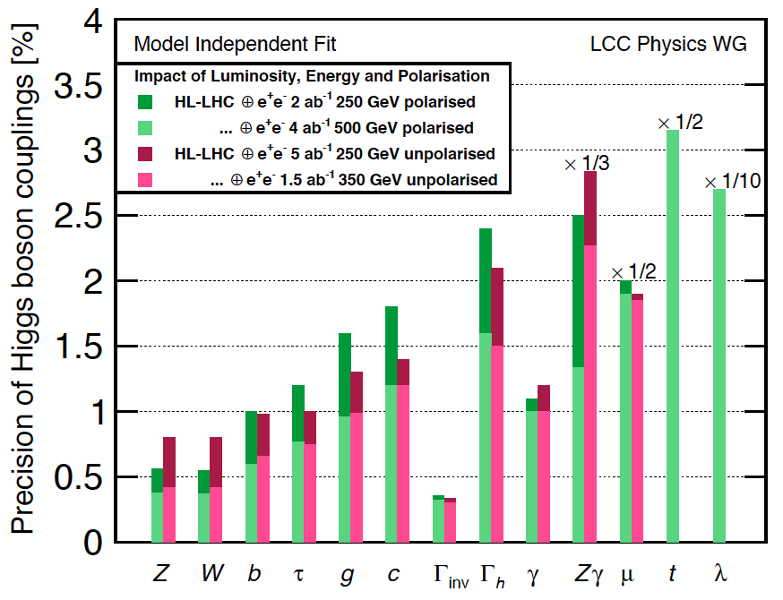
Power of Polarization
HL-LHC plus
ILC (polarized or
unpolarized)
ILC Polarization:
(e- e+) = (±0.8 ±0.3)
(−+, +−, ++, −−) =
(45%, 45%, 5%, 5%)
2 ab-1 at 250 GeV (polarized) is ‘roughly’ equivalent to 5 ab-1 at 250 GeV (unpolarized)
Effective luminosity 〜 x 2.5 by polarization

Slide 29
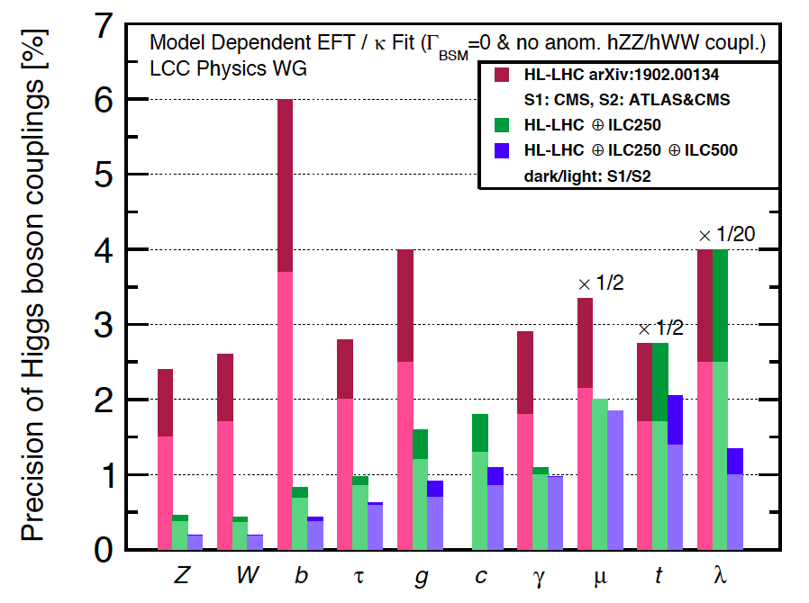
Comparison with HL-LHC
Common assumptions used: No Higgs decay modes other than SM
Higgs to Z/W are the same form as SM
Dark: S1 = current understanding of systematics
Light: S2 = with improvements in systematics

Slide 30
Model Discrimination
ILC250
Separation among models in ＃sigma
(for 9 models unlikely to be rejected by HL-LHC, with
at least one coupling deviate from SM by >5 %.)
ILC250 can identify the correct model more or less by pinpointing
The precision of ILC250 is necessary!

Slide 31
Dark Matter Searches at ILC
Highlights:
ISR mono photon events (e+e- → χχγ)
‘NLSP’ pair productions
Higgs invisible decays

Slide 32
Mono photon events (e+e- → χχγ)
χ: dark matter
escapes the detector
Main background processes
Radiative neutrino pair
Radiative Bhabha
(T channel also)

Slide 33
Mono photon events (e+e- → χχγ)
Exclusion limits for Λ
EFT approach: Vector-like fermion WIMP
+ ILC250
+ ILC250
K. Fujii et al
P_{RL} = 22.5%
P_{RL} = 40%
P_{RL}: fraction of data with e-(R) e+(L)
ILC 250 sensitive to a few TeV

Slide 34
NLSP Pair Production
Typical signal: soft particles and nothing else
Challenging backgound: two photon processes
(Good hermeticity to reject hard e+- close to beamline)
Eμ
Eτjet
End points of lepton energies
→ Simultaneous determination of M_{NLSP} and M_{LSP} to per mil

Slide 35
NLSP Pair Production
‘Smuon’ pair prodution
Discovery: 5σ
Exclusion: 95%
Signal: soft muon pair
500 fb-1 at Ecm = 500 GeV
Sensitivity nearly up to the kinematic limit
Possibility to find a new particle at ILC 250 also

Slide 36
NLSP Pair Production at Threshold
‘Smuon’ pair prodution
The threshold excitation curve gives information on the spin-parity of ‘smuon’ and its mass

Slide 37
Higgsino Pair + ISR
Charged Higgsino Pair + ISR
Signal: 1 hard γ(ISR) and (π or lepton,2 total) and nothing else
Recoil mass of γ(ISR)
1 hard photon required: Two photon backgrounds are not too serious
Minimum recoil mass → Higgsino mass to percent level

Slide 38
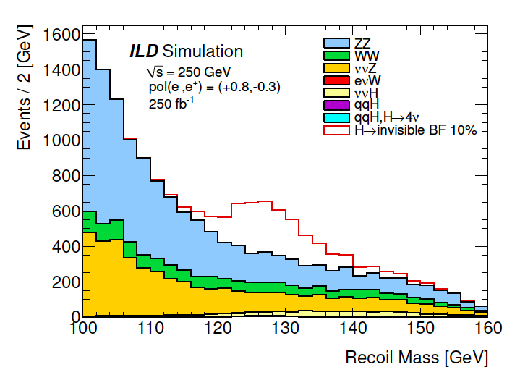
Exotic Higgs Decays by Higgs tagging
e+e- → ZH, H → invisible (e.g. 𝜒 𝜒)
Recoil mass reconstruction
2-jet
measured
e+
Z
e-
H
invisible
250 fb-1 at Ecm = 250 GeV
Including Z → l+l- and scaling to 1500 fb-1
Br (H → invisible) < 0.4%

Slide 39
Cosmological Connection

Slide 40
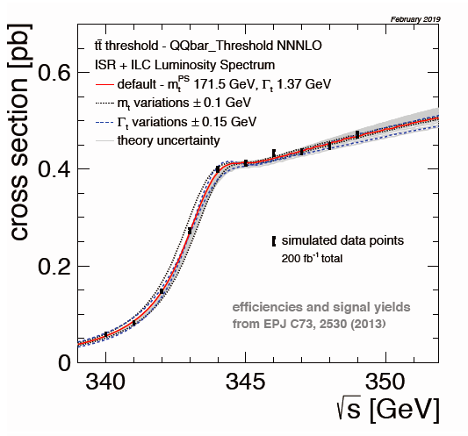
Top Mass Measurement
Δmtop (pole) = 14 MeV (stat), 40 MeV (incl. sys)
Pole mass is closely related to msbar mass

Slide 41
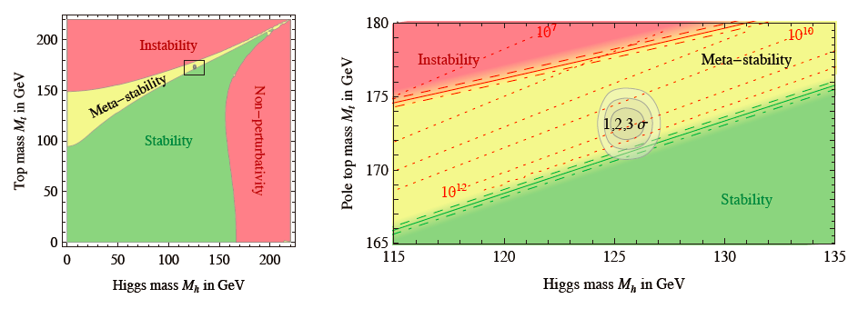
Vacuum Stability in SM
Degrassi et.al. 2013
ILC precisions for dM_{top} ~40 MeV and dM_{Higgs} ~40 MeV are more than enough

Slide 42
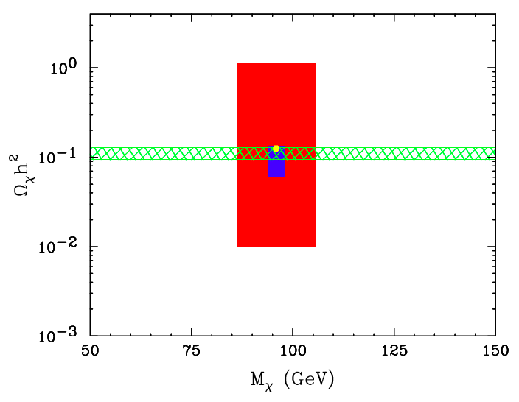
SUSY Parameter Determination and Prediction of Relic DM Density
(ILC TDR)
Model: “ B’ ” low masses and large mass splittings (good case for LHC)
Red: LHC hundred’s of fb-1
Blue: ILC (~H20)
Green band: from cosmology
(WMAP)
Birkedal et.al.

Slide 43
Political Status of ILC

Slide 44
International Supports for ILC
Europe
European Strategy for Particle Physics (2020)
‘The timely realisation of the electron-positron International Linear Collider (ILC) in Japan would be compatible with this strategy and, in that case, the European particle physics community would wish to collaborate’
US
US Department of Energy High-Energy Physics Advisory Panel, P5 Report (2014)
On the scientific case for the ILC
‘we emphasize most strongly that the scientific justification for the project is compelling’
On the US participation
‘As the physics case is extremely strong, all Scenarios include ILC support at some level through a decision point within the next 5 years’.
If scenario C (‘unconstrained’)：’Play a world-leading role in the ILC experimental program and provide critical expertise and components to the accelerator, should this exciting scientific opportunity be realized in Japan.’
Still valid now (to be updated later this year 2022)

Slide 45

US State Department on ILC
Address at LCWS2019 by Melinda M. Pavek :
Embassy of the USA, Economic and Scientific Affairs,
Director, Science, Innovation and Development Unit.
‘Today, I come before this distinguished body to tell you that,
the U.S. Department of State has done our initial due diligence,
and we are ready to assist our partner agencies in moving forward
with the next major particle physics facility in Japan—the International
Linear Collider, also known as the ILC. To be clear, the United States is
not looking for an immediate decision on building, or hosting, the ILC.
Instead, the United States is looking for Japan to signal an intent to
explore hosting the ILC’.

Slide 46

From Key-note Speeches at LCWS2019
On what is happening within Japanese government and legislative body:
’In parallel with the administrative process by the government, we,
as politicians in the legislative branch, will make actions in earnest
toward implementing the preparatory budget and discussing the
financial resources for the construction.’
http://epx.phys.tohoku.ac.jp/LCWS2019/keynote.html
Address at LCWS2019 by Hon. Shionoya:
The Director-General of the Federation of Diet Members supporting the ILC
and ex-MEXT minister

Slide 47
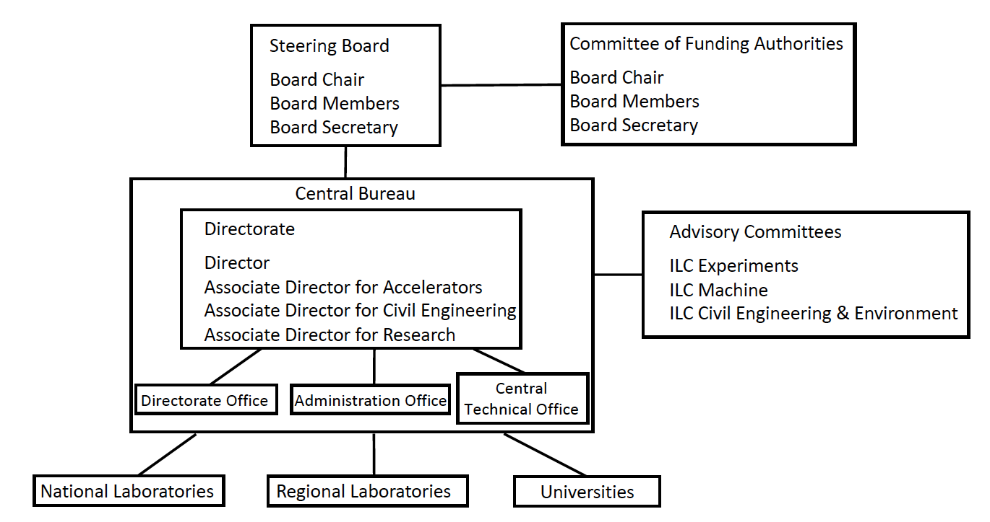
International Development Team (IDT)
Created by the International Committee for Future Accelerators (ICFA) in Aug. 2020.
Charge:
prepare for the creation of the Pre-lab as a preparatory phase for the ILC
Produced a proposal for the Pre-lab June 1, 2021.
Members are regional, national, and university laboratories
Material cost ~125 M$, human resources ~700 FTE*yr over several years

Slide 48
MEXT Committee on ILC (2nd Phase)
Apr 2022
'it is not currently possible to support a transition to the ILC Preparatory Laboratory
phase on the premise that Japanese government will express an interest in hosting
the ILC in Japan and on the proposed scale'
'Having said the above ... the Second Phase Advisory Panel would like to add:
'the significance of the precise measurement of the Higgs boson…will be unchanged'
'it is time to reconsider how to proceed with the ILC Project... the research
organizations of the countries concerned should work out the technical issues that
will be strategically important for development of next-generation accelerators
through reinforced collaboration’
'for the ILC Project...the hosting issue...should be temporarily decoupled'
'important for the community of researchers to build steady efforts for maintaining
trust among the people involved and deepening mutual understanding through
two-way communication in order to expand support by various stakeholders in Japan
and overseas ... As for building a relationship with stakeholders, we look forward to
future activities of ILC Japan, which was newly established last year'

Slide 49
Statement by International Committee for Future Accelerators (ICFA)
Apr 2022
ICFA reconfirms the international consensus on the importance of a Higgs
Factory as the highest priority for realizing the scientific goals of particle physics.
ICFA reaffirms its position that the concept for the ILC is technically robust and has reached a level of maturity which supports its moving forward with the engineering design study toward its timely realization.
ICFA commits to continuing efforts within the International Development Team (IDT) over the next year to coordinate the global research community’s activities toward further developing and realizing the ILC in Japan.
ICFA continues to encourage inter-governmental discussion between Japan and potential partner nations … toward realization of an ILC.

Slide 50
ILC Japan
Established by the Japan Association of High Energy Physicists (JAHEP) in July 2021. Its detailed structure is now being formed.
Acts as the face of the ILC community in Japan and works in tandem with KEK.
Headed by Shoji Asai
Director International Center for Elementary Particle Physics U. of Tokyo
Leader of ATLAS-Japan group
Chair, Japan Association of Elementary Particle Physics
Playing critical roles in communicating with the MEXT committee, negotiating the ILC budget, etc.
What Next?

Slide 51
Backups

Slide 52
Scientific Significance of ILC and Proposal of its Early Realization in light of the Outcomes of LHC Run 2
Japan Association of High Energy Physicists, July 22, 2017
…As discussed above, the scientific significance and importance of ILC has been further clarified considering the current LHC outcomes. ILC250 should play an essential role in precision measurement of the Higgs boson and, with HL-LHC and SuperKEKB, in determining the future path of new physics. Based on ILC250’s outcomes, a future plan of energy upgrade will be determined so that the facility can provide the optimum experimental environment by considering requirements in particle physics and by taking advantage of the advancement of accelerator technologies. It is expected that ILC will lead particle physics well into the 22nd century.
To conclude, in light of the recent outcomes of LHC Run 2, JAHEP proposes to promptly construct ILC as a Higgs factory with the center-of-mass energy of 250 GeV in Japan.

Slide 53
Linear Collider Board (LCB)
Conclusions on the 250 GeV ILC as a Higgs Factory proposed
by the Japanese HEP community
8 Nov 2017
…The cost of such a machine is estimated to be lower by up to 40% compared to the originally proposed ILC at 500 GeV [3]. …
The acceleration technology of the ILC is now well established…
One of the unique features of a linear collider is the capability to increase the operating energy by improving the acceleration technology and/or extending the tunnel length. For these reasons, the Linear Collider Board strongly supports the JAHEP proposal [4] to construct the ILC at 250 GeV in Japan and encourages the Japanese government to give the proposal serious consideration for a timely decision….

Slide 54
International Committee for Future Accelerators (ICFA)
Statement on the ILC Operating at 250 GeV as a Higgs Boson Factory
Nov 2017
…ICFA considers the ILC a key science project complementary to the LHC and its upgrade.
ICFA welcomes the efforts by the Linear Collider Collaboration on cost reductions for the ILC, which indicate that up to 40% cost reduction relative to the 2013 Technical Design Report (500 GeV ILC) is possible for a 250 GeV collider.
ICFA emphasizes the extendibility of the ILC to higher energies and notes that there is large discovery potential with important additional measurements accessible at energies beyond 250 GeV. ICFA thus supports the conclusions of the Linear Collider Board (LCB) in their report presented at this meeting and very strongly encourages Japan to realize the ILC in a timely fashion as a Higgs boson factory with a center-of-mass energy of 250 GeV as an international project, led by Japanese initiative.

Slide 55
Staging Options
Improvement by N2 doping
Options A, B, C : Assume 31.5 MV/m (TDR)
Options A’, B’, C’ : Assume 35 MV/m
Now realistic, e.g.

Slide 56
Cost Reduction
ILC500（TDR） → ILC250
Up to 40% cost reduction compared to ILC500 (TDR)

