Slide 1
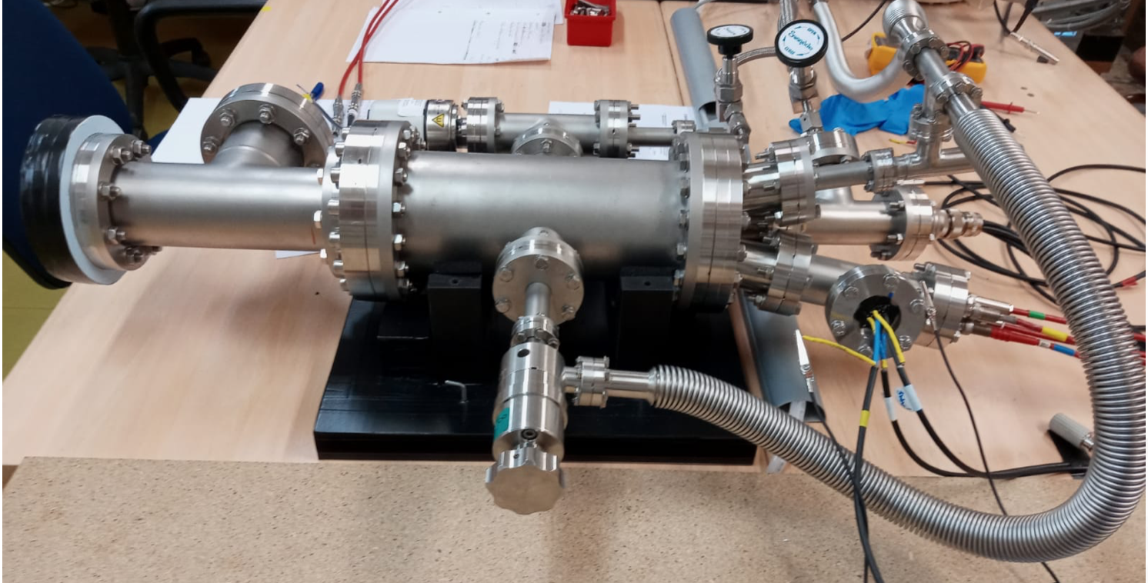
Preliminary gain measurements in weakly-quenched Ar-based mixtures

Slide 2
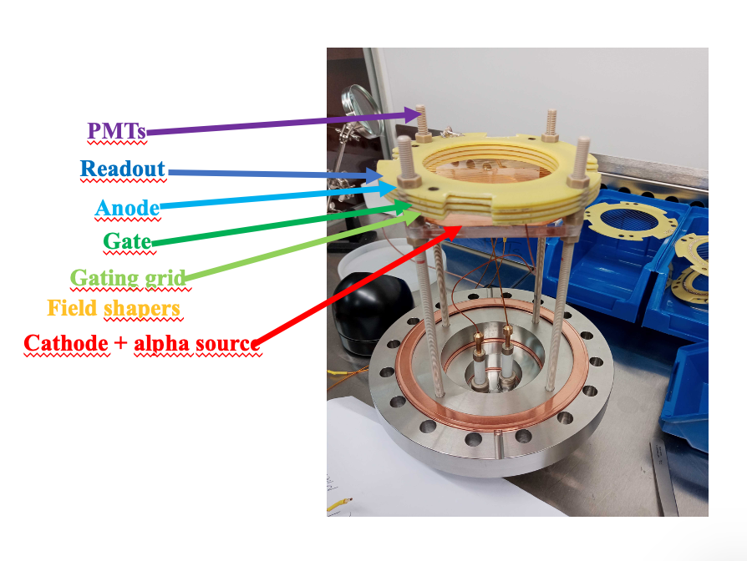
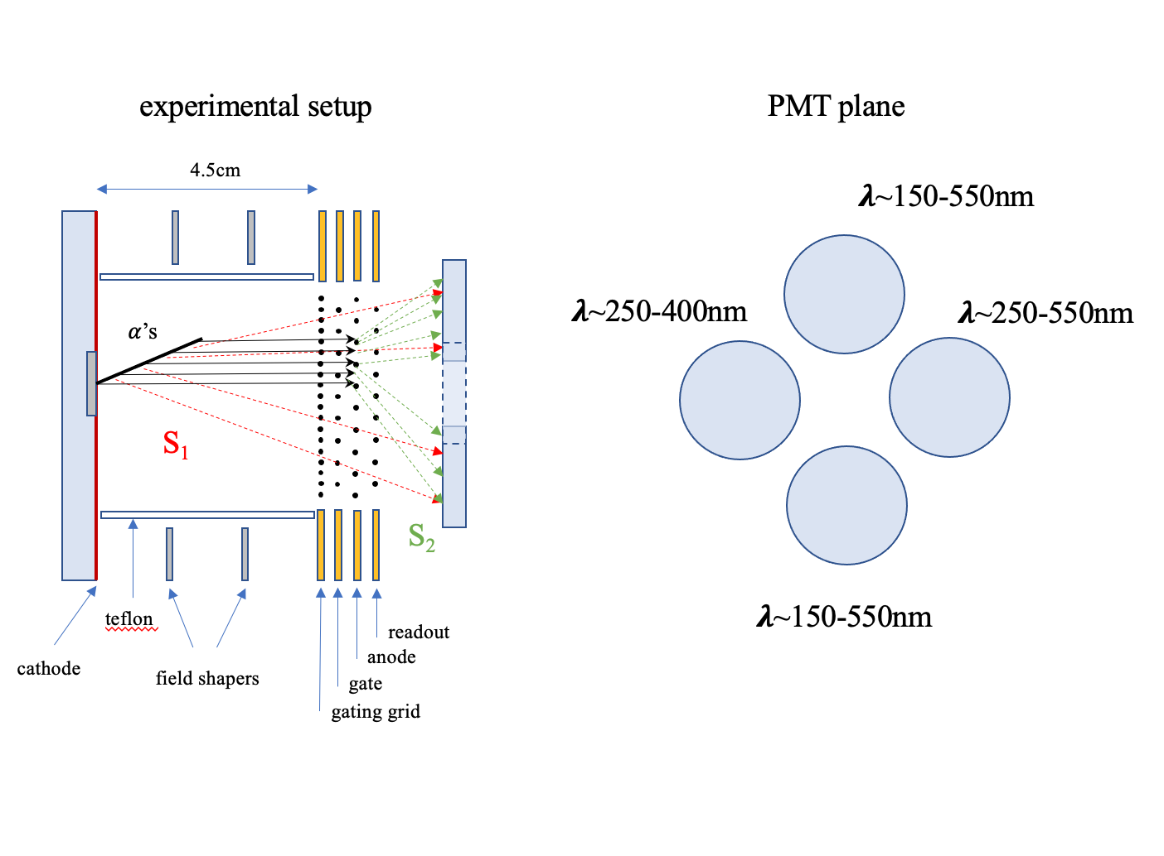
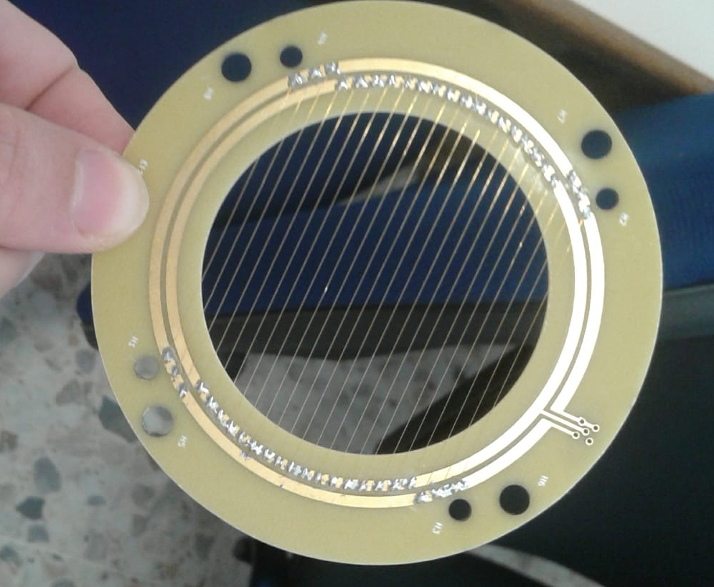
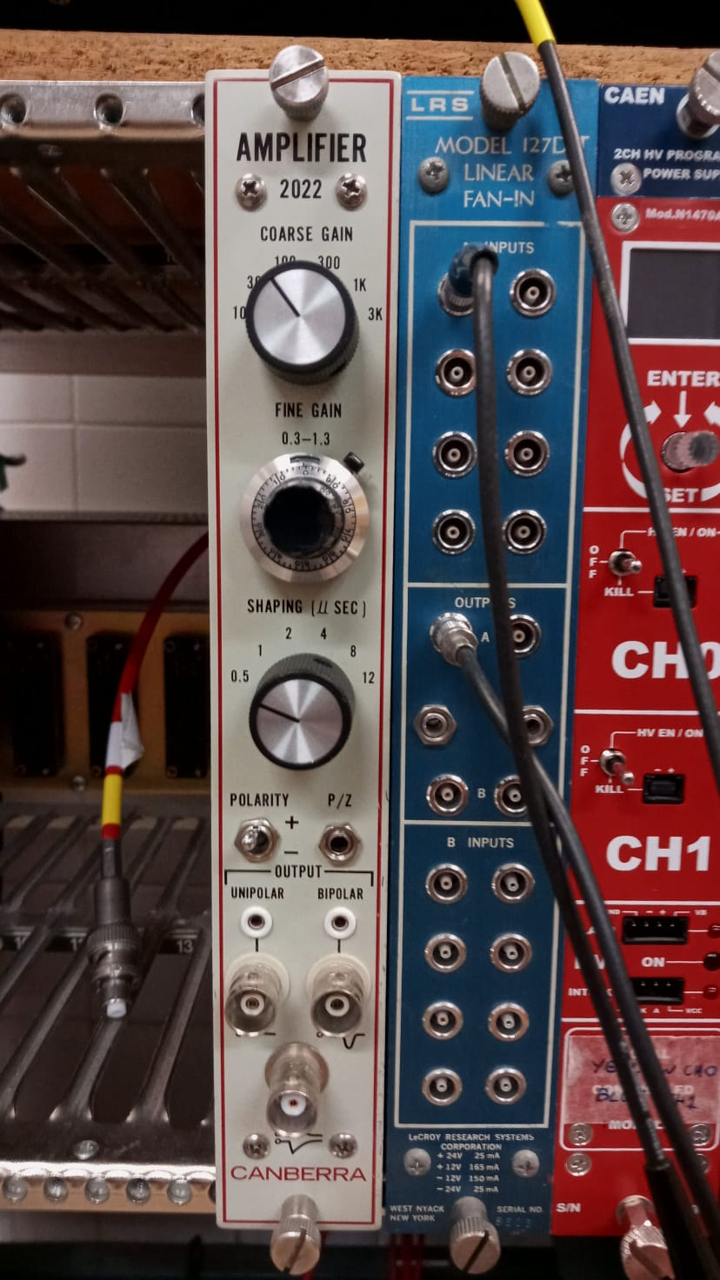
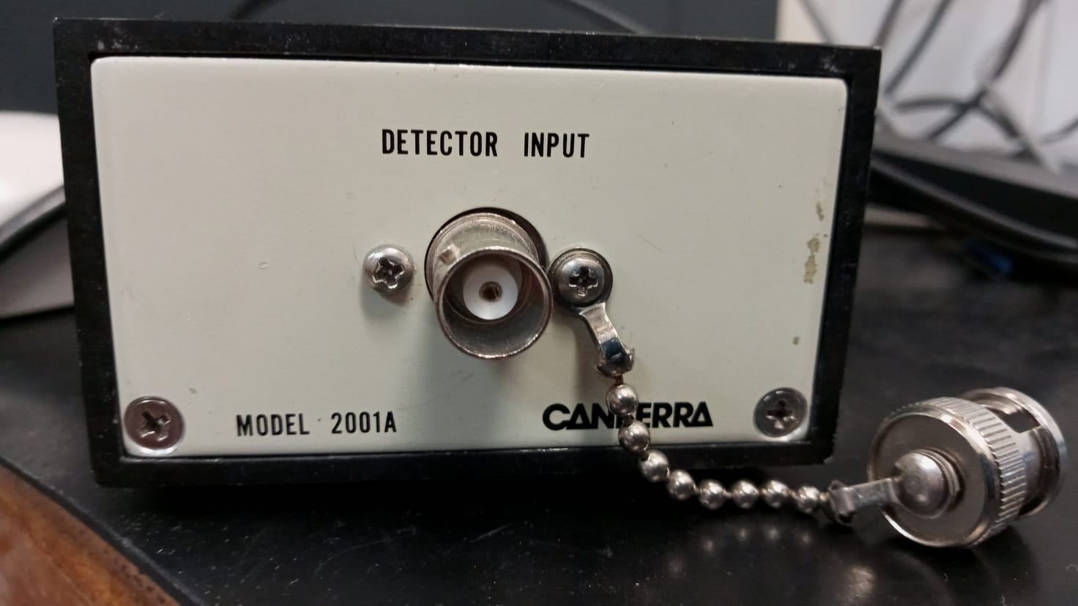
Our setup

Slide 3
Optical and charge gain in Ar/CF₄ at 10 bar (wire chamber stability)
optical gain
just a first look!-> measurements for different structures and gases scheduled for summer
charge gain
x3.5
preliminary calibration indicates that the maximum gain is around x100
Induced
signals

Slide 4
Conclusions and future plans
We were able to operate the wire chambers and measure gain in different gas mixtures
Charge gain in wire chambers is only about x3-4 lower than CH₄-based mixtures (P2)

Slide 5
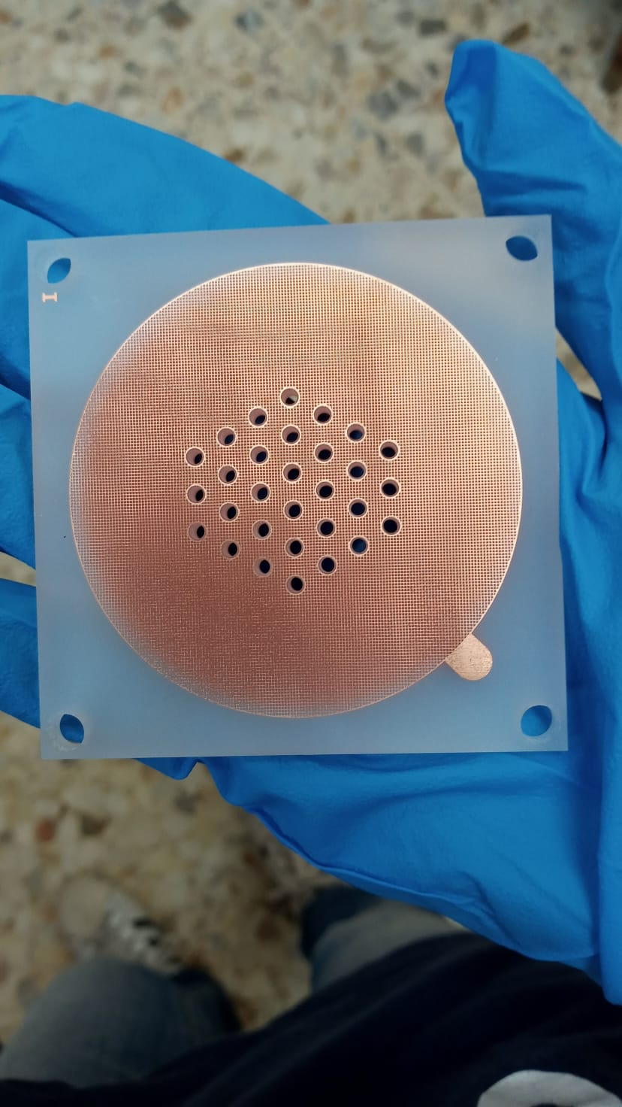
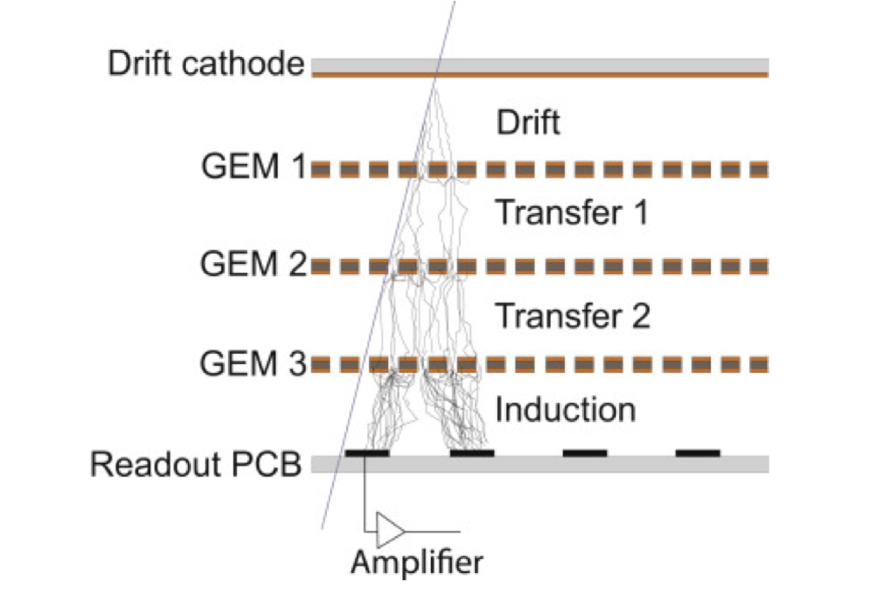
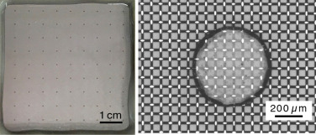
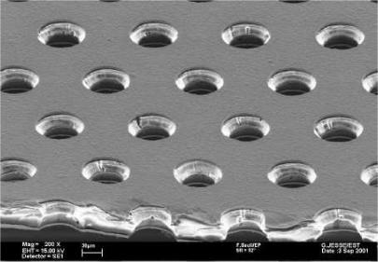
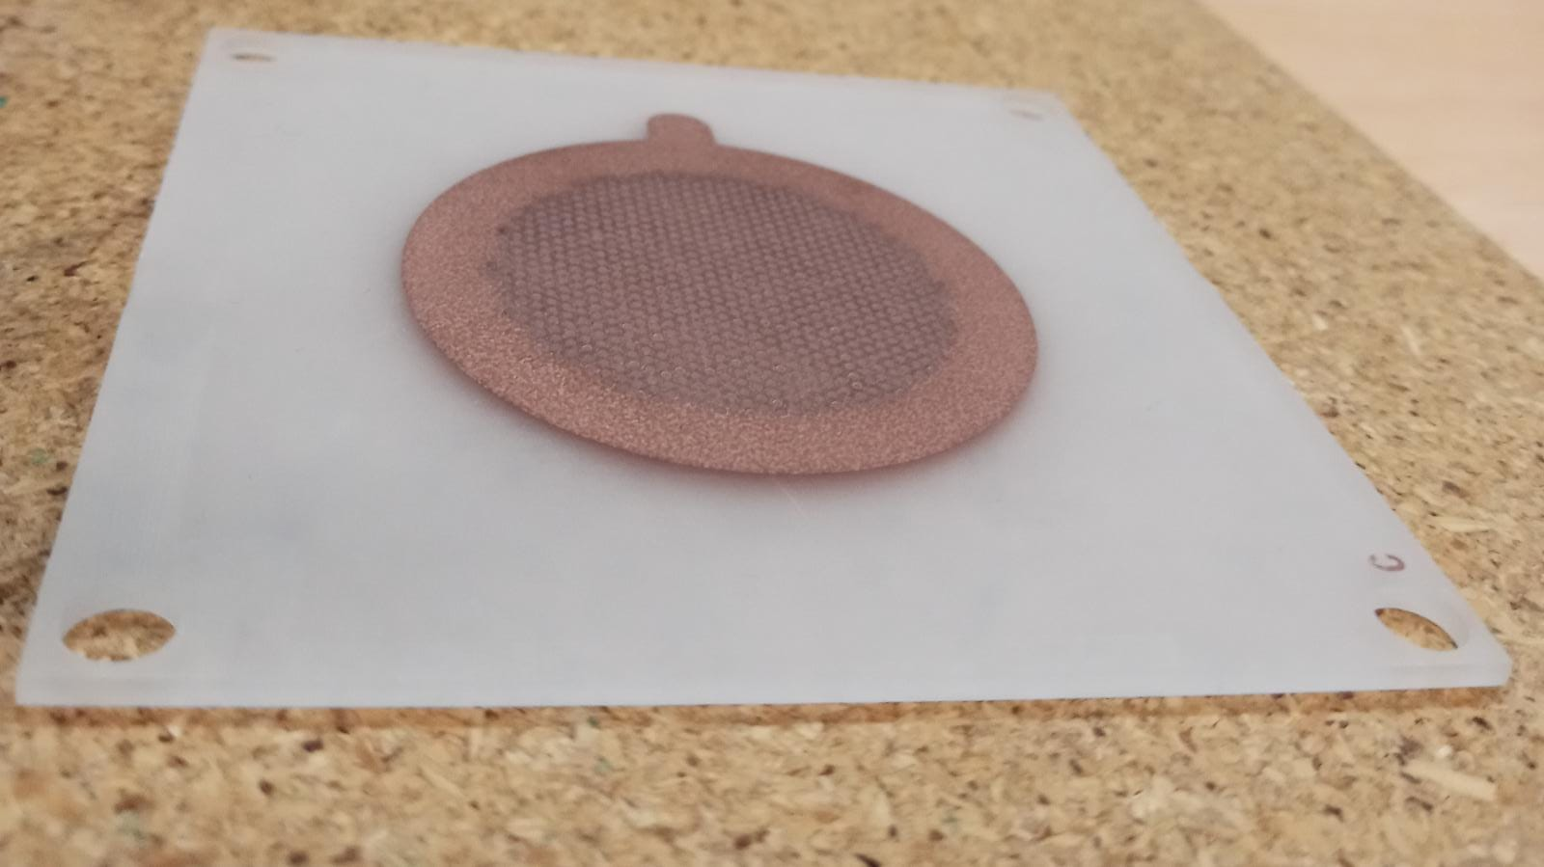
Conclusions and future plans
In the next future we will...
Measure the gain with different structures: glass MicroMegas, GEMs, TH-GEMs, FAT-GEMs
TH-GEMs and FAT-GEMs already available, MMs and GEMs soon made at CERN
In house
MMs
(images from CERN)
TH-GEMs
GEMs
Brunbauer et al., Nucl. Instrum. Methods 2020, 955, 163320.
Technical discussions ongoing
Ordered
FAT-GEMs

Slide 6
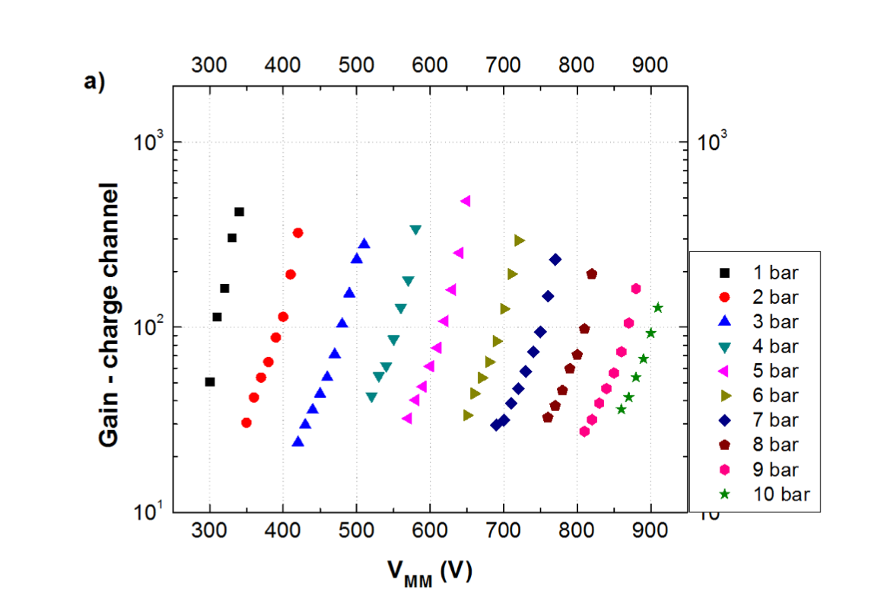
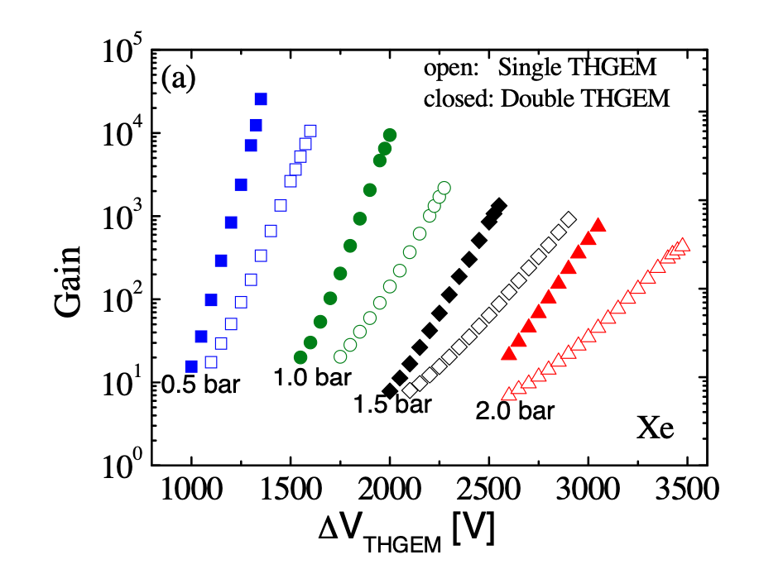
What to expect?
MicroMegas have a small decrease of gain with pressure (“Micromegas operation in high pressure xenon: charge and scintillation readout”, Balan et al., 2011, JINST 6 P02006)
THGEMs and GEMs gain decreases faster with pressure (see for example “Operation of a Thick Gas Electron Multiplier (THGEM) in Ar, Xe and Ar-Xe” , Alon et al., 2008, JINST 3 P01005)
)
Alon
MMs
TH-GEMs

Slide 7
THANKS FOR YOUR ATTENTION!

