Slide 1


Status report
Search for time correlations in atmospheric muon arrival times in the ANTARES Telescope
Laboratoire de Physique, Radiation et Matière
LPRM, Oujda
CERN, 28 Juin 2012
Y. Tayalati, A. Moussa, A. Rrhioua & M. Hamal

Slide 2
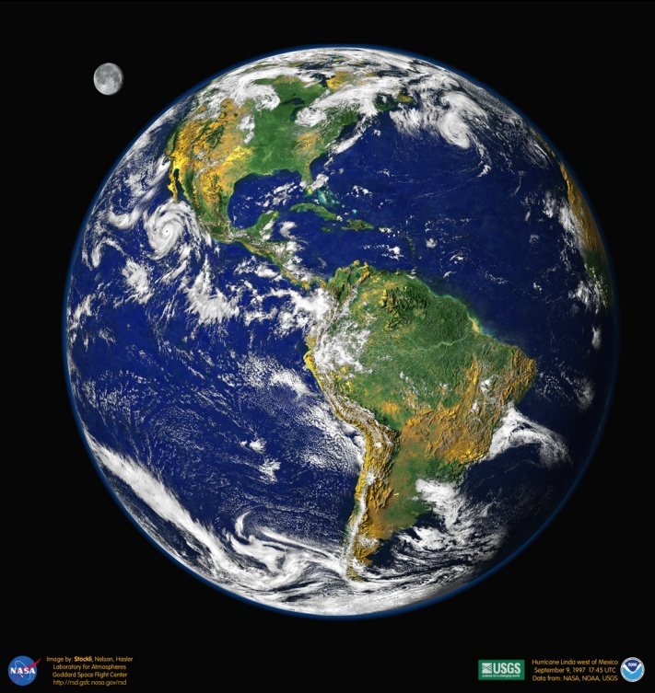
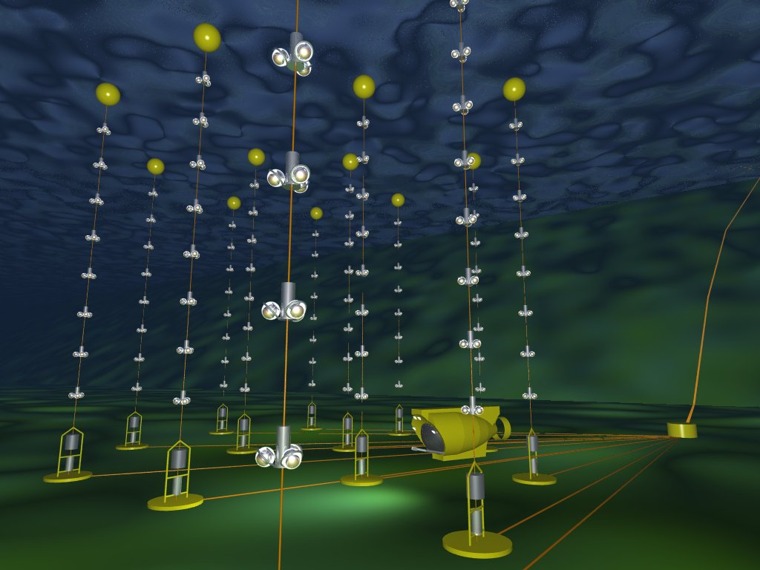
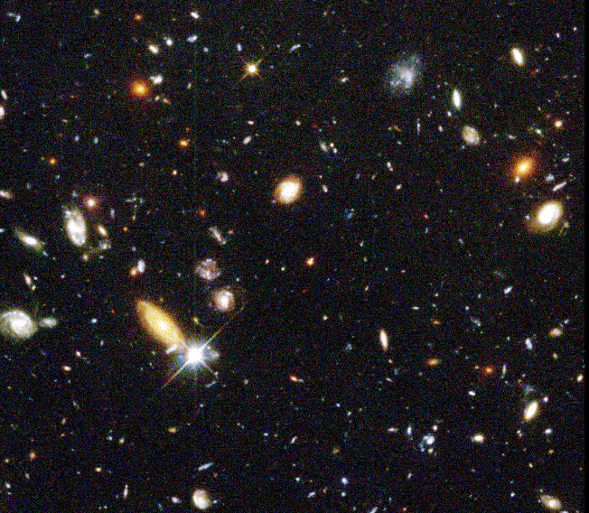
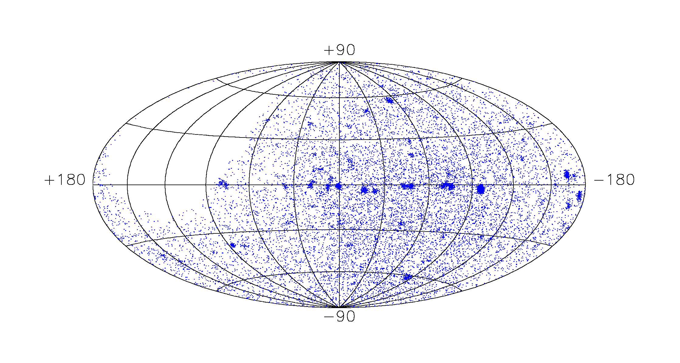
ANTARES
μ
ν
Neutrinos de haute
énergie émis par des
accélérateurs cosmiques

Slide 3
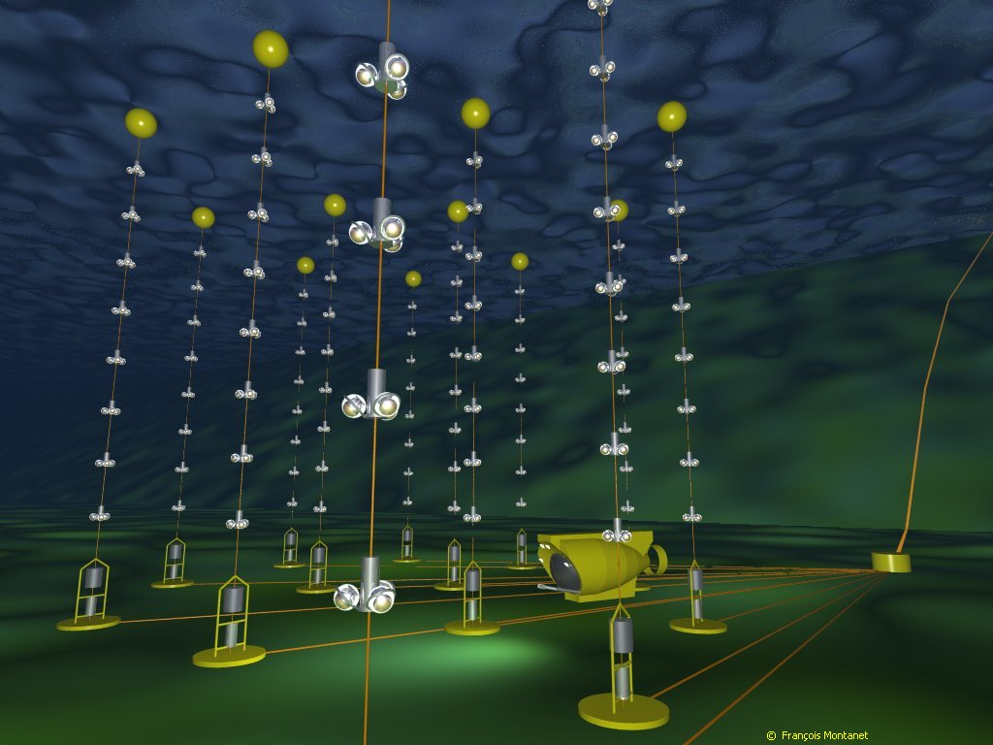
ANTARES
900 Modules Optiques (OM)
12 lignes
25 étages/ligne
3 OM/étage

Slide 4
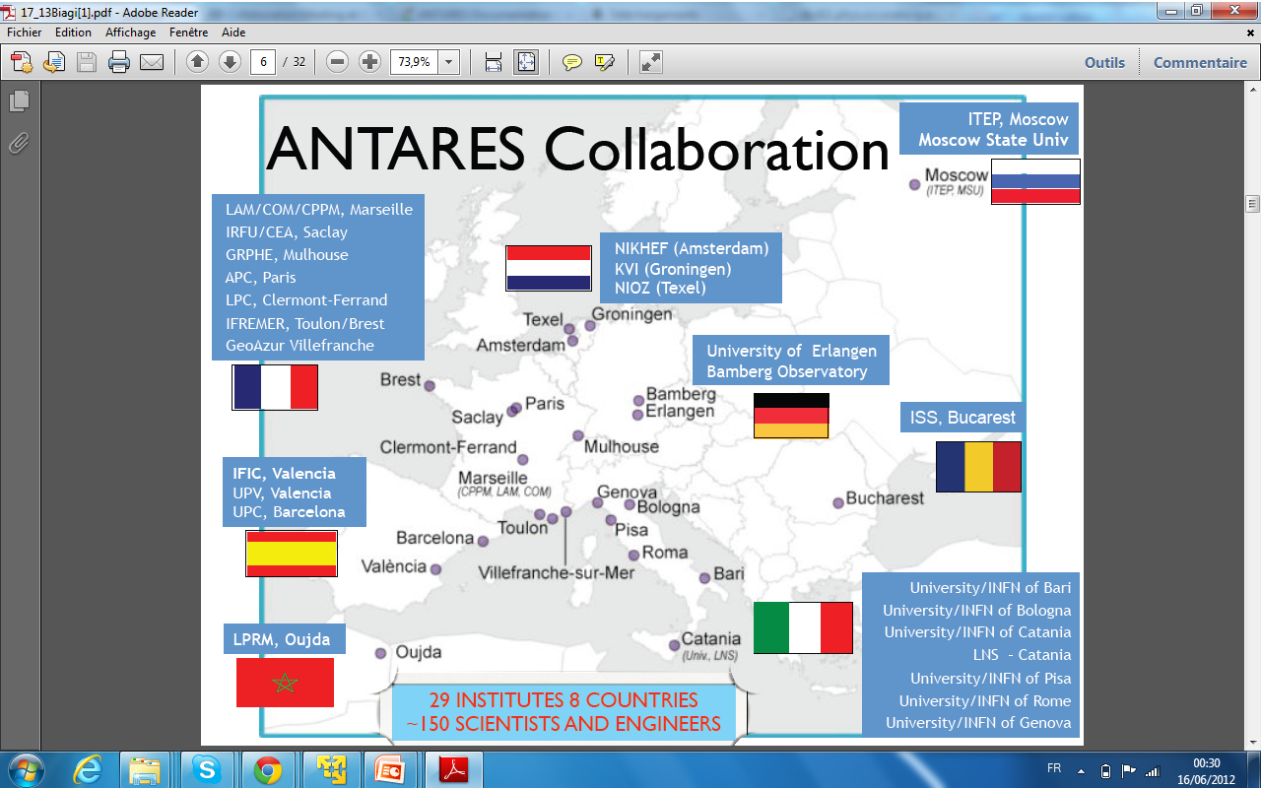
ANTARES

Slide 5
ANTARES
http://www.pi1.physik.uni-erlangen.de/antares/online-display/online-display.php

Slide 6
Recherche des corrélation temporelle
It is generally assumed that galactic cosmic rays have a random arrival time.
They could be some mechanisms which may introduce some modulations
on this distribution.
higher precision measurements did not report any effect
- S.P. Ahlen et al., Nucl. Phys. B 370 (1992) 432;
- C. Morello et al., Nuovo Cimento 7C (1984) 682;
N. Ochi et al., Proc. 28th ICRC 1 (2003) 195.

Slide 7
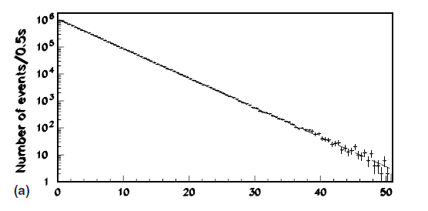
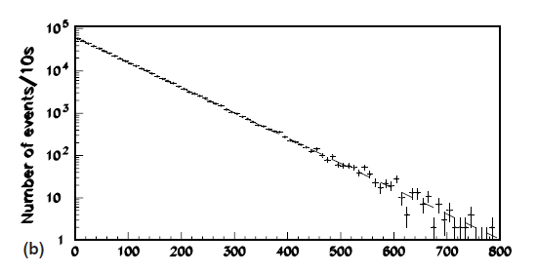
MACRO
Astroparticle Physics 23 (2005) 341–348
The results of their analyses with high statistics confirm a random arrival time distribution of high energy cosmic rays.
Distribution of the time separation of single muons,
Distribution of the time separation of double muons

Slide 8
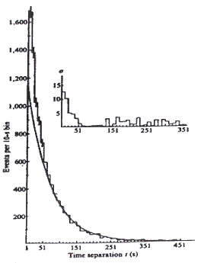
They have been studying1 the distribution of the arrival times of atmospheric Cerenkov light pulses, initiated by cosmic rays of energy ≥10^14 eV.
They detected a nonrandom component for time separations <40 s, and they discussed the possibility that it has a point-source origin.
- C. L. Bhat et al., Nature 288 (1980) 146.
- G. Badino et al., Nuovo Cimento 28 (1980) 93

Slide 9

DATA
/hpss/in2p3.fr/group/antares/user/schussl/data/SeaTray/prod_2011-05/
AntDST/v1r2p3_FullAntDST
e3D_SCANa Triggers
AntDST/v1r2p4/NtuplesProd: to processe Ttrees for the time study
ana_time, ana_scan:
- VO: Magrid : “ www.magrid.ma”

Slide 10
CutFlow
muon_ttheta <Pi/2. (only down going muons)
theAntDST.GetStrategy(thisStrategy).GetRecQuality()>-6.
To improve (after a comparison with MC!).
Cuts on:
Nlines, nhits, livetime, angError …

Slide 11
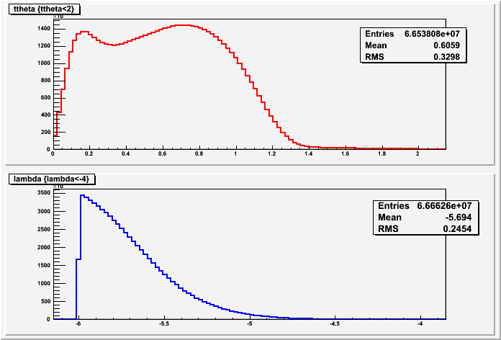
CutFlow

Slide 12
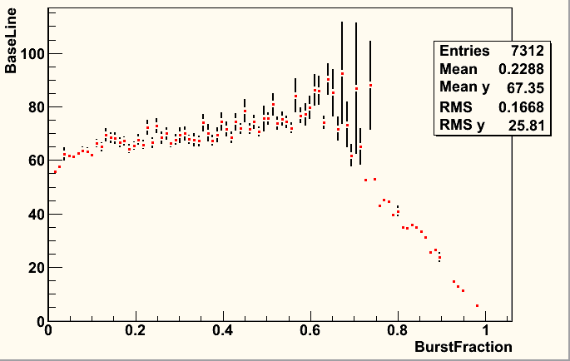
CutFlow

Slide 13
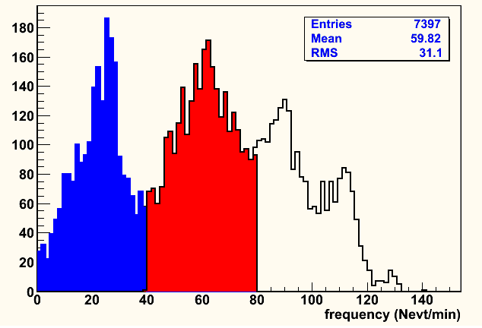
CutFlow

Slide 14
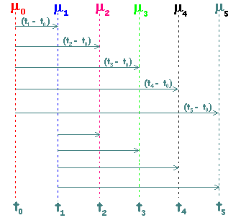
Time correlation analyses
For each muon arriving at t_0, we study the time difference with
the next five following muons :

Slide 15
Time correlation analyses
For random arrivals, the time distribution may be fitted to the Gamma function of order M
For M = 1 the equation reduces to an exponential

Slide 16
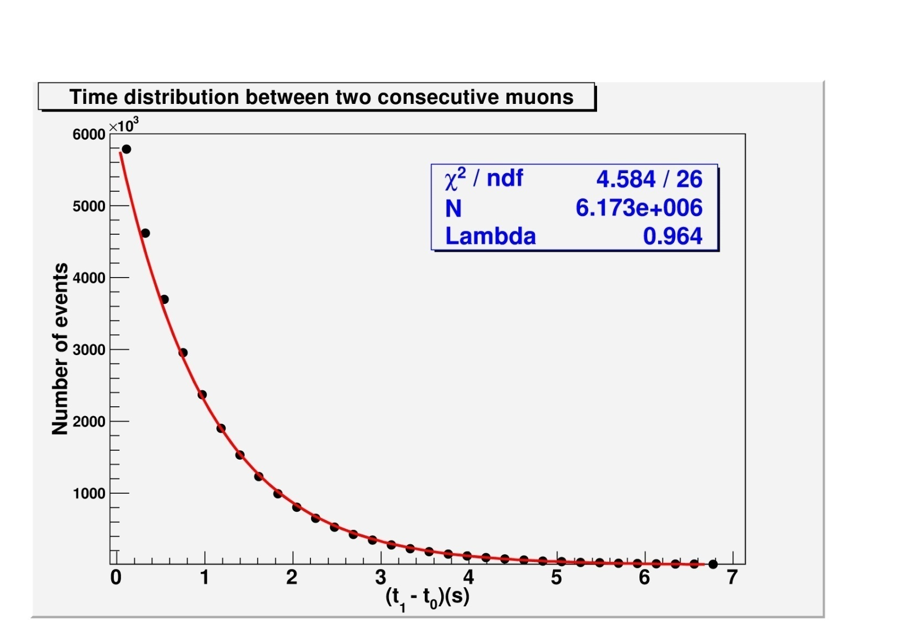
Time correlation analyses
Distribution of the time between two consecutive muons. Medium Frequency range.

Slide 17
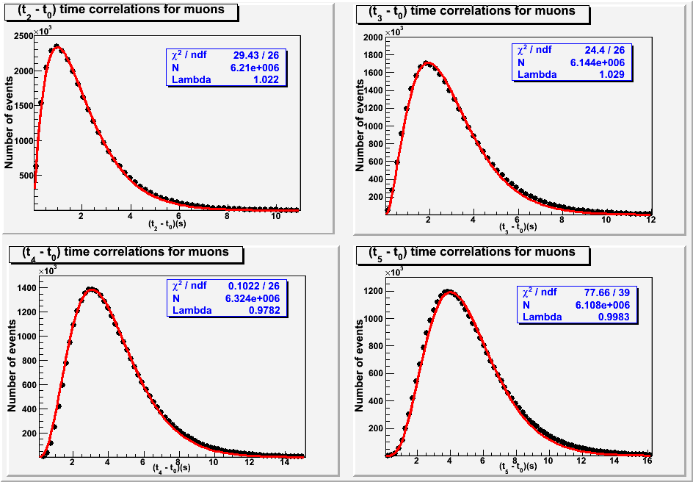
higher order
Time correlation analyses

Slide 18
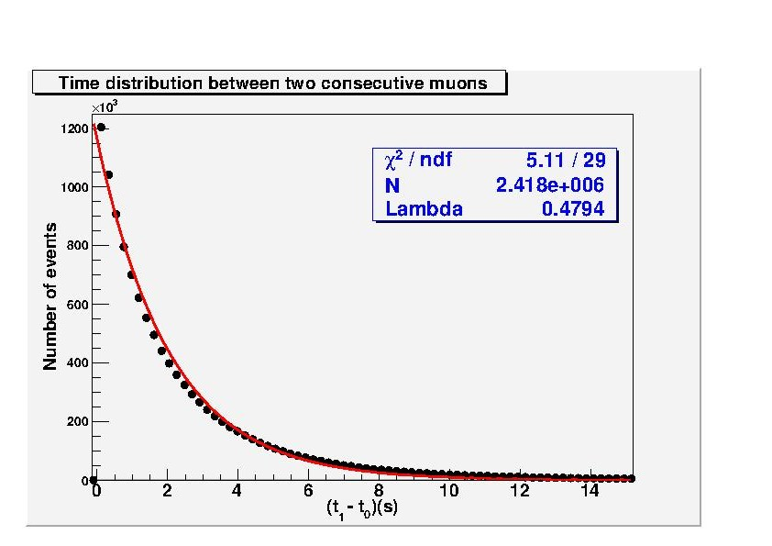
Time correlation analyses
Distribution of the time between two consecutive muons. Medium Frequency range.

Slide 19
Burst search
new analysis on muon time series in order to find isolated clusters of events.
If we consider an interval Δ≡ [A,B] of a continuous variable x and a Poisson process with density λ.
We call scan statistics (SS) the largest number of events found in any subinterval of [A,B] of length ω

Slide 20

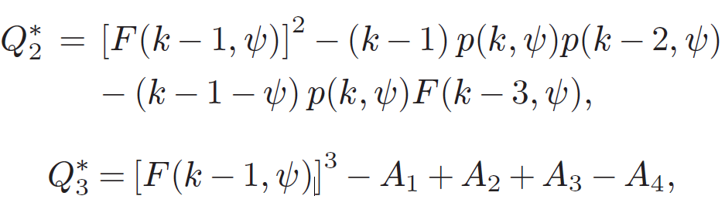
Burst search
Terranova F., Nucl. Instrum.Methods A, 519 (2004) 659.
The probability P that a statistical fluctuation would produce a burst of events as large as k can be approximated by

Slide 21
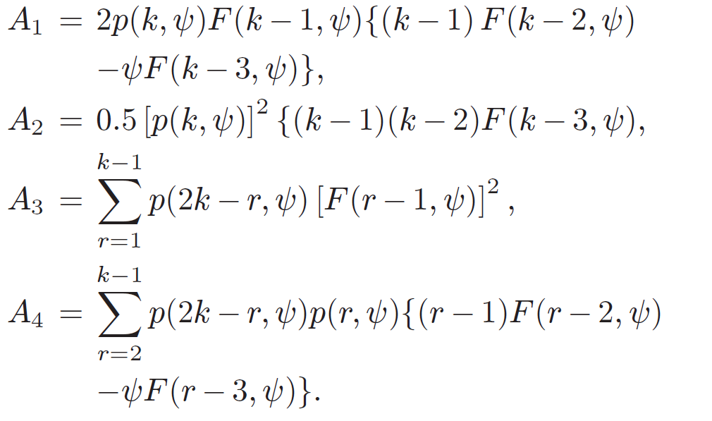
Burst search
Terranova F., Nucl. Instrum.Methods A, 519 (2004) 659.

Slide 22
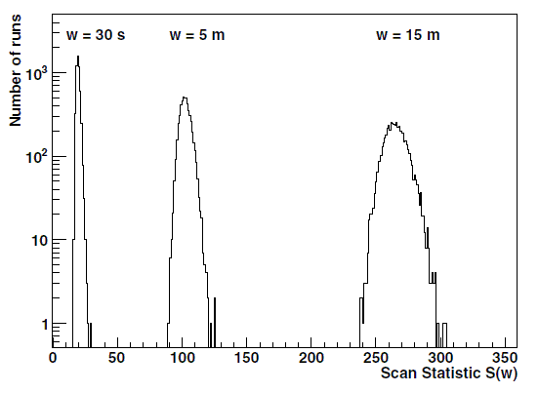
Burst search(MACRO)
EPL, 87 (2009) 39001
Distribution of the S(w) Scan Statistic variable for the windows w =30 s; w =5 min and w =30 min

Slide 23
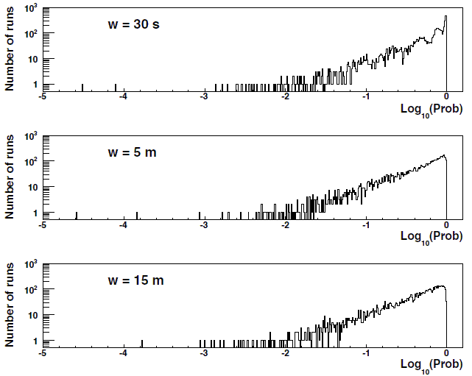
Burst search(MACRO)
Scan Statistic probability distributions for the windows w =30 s; w =5 min and w =30 min

Slide 24
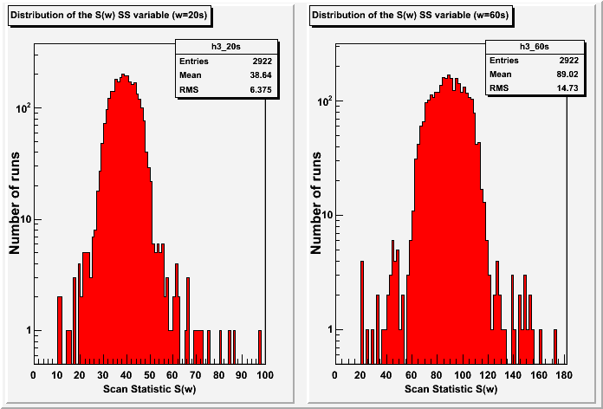
Burst search(ANTARES)
Distribution of the S(w) SS variable for the windows w = 20s (left panel) and
w = 60s (right panel).

Slide 25
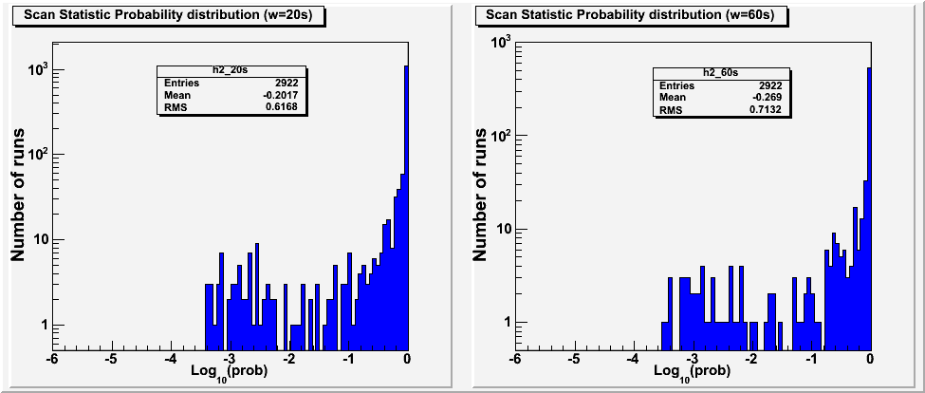
Burst search(ANTARES)
Scan Statistic probability distributions for the windows, used in this work,
w = 20s (left panel) and w = 60s (right panel).

Slide 26
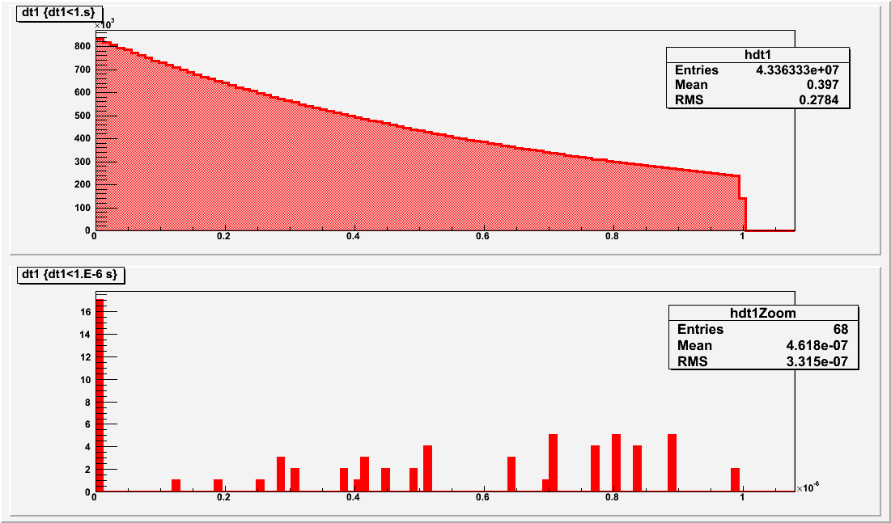
On NEMO results !

Slide 27
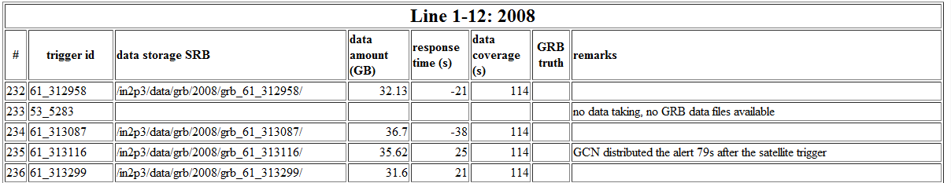
Etude des GRB.
http://antares.in2p3.fr/users/bouwhuis/internal/grb_data_archive.html
GCN alert messages received by Antares DAQ
53 (INTEGRAL), 61, 97 and 98 (Swift),
110 (Fermi, in very rare cases packet_id 111)

Slide 28
Data
The normal way to process the L0_data is :
1- Decode the GCN Alert
2- Filter the data
3- Reconstruct the Data

Slide 29
Perspective
The results of our analyses confirm with high statistics a random
arrival time distribution of high energy cosmic rays.
Search for bursts using the SS method show No significant deviations from the null hypothesis was found.
- spectrum analyses
- Analyses in narrow cones
- Kolmogorov–Smirnov test

