Slide 1
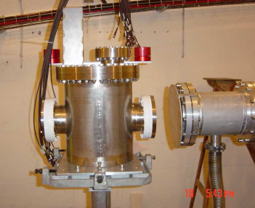
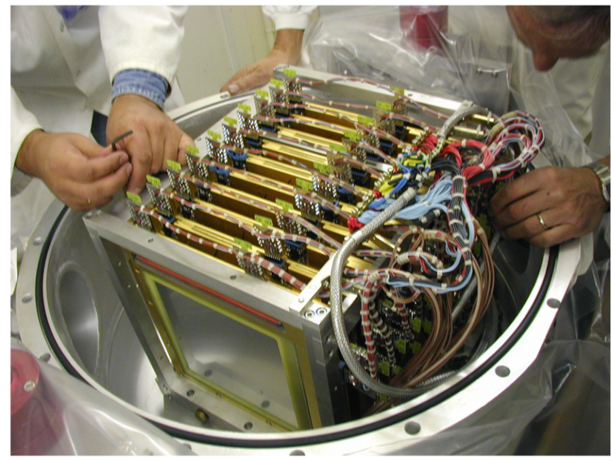
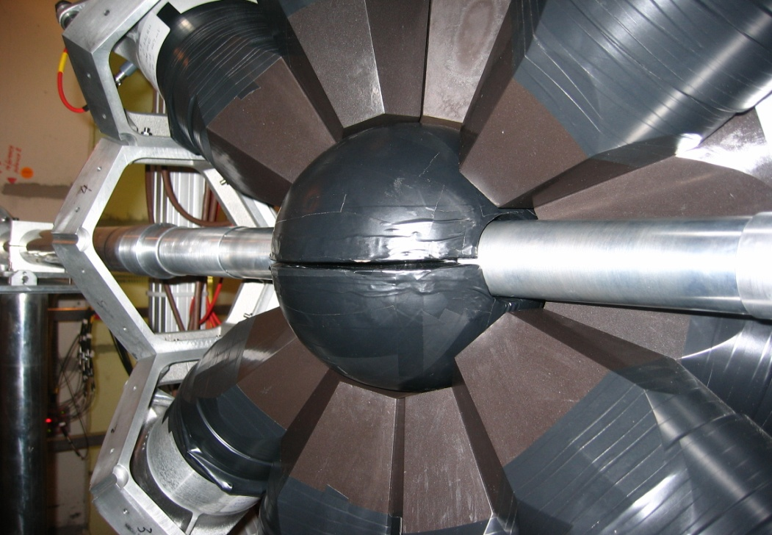
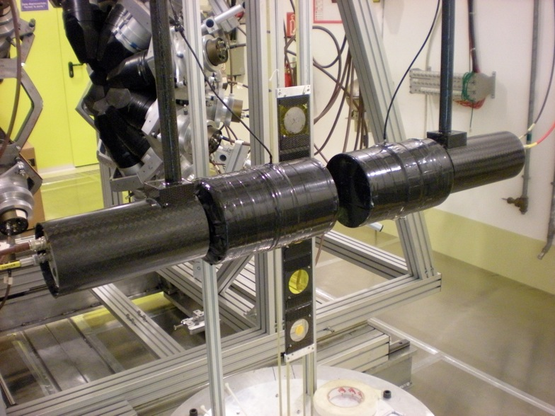
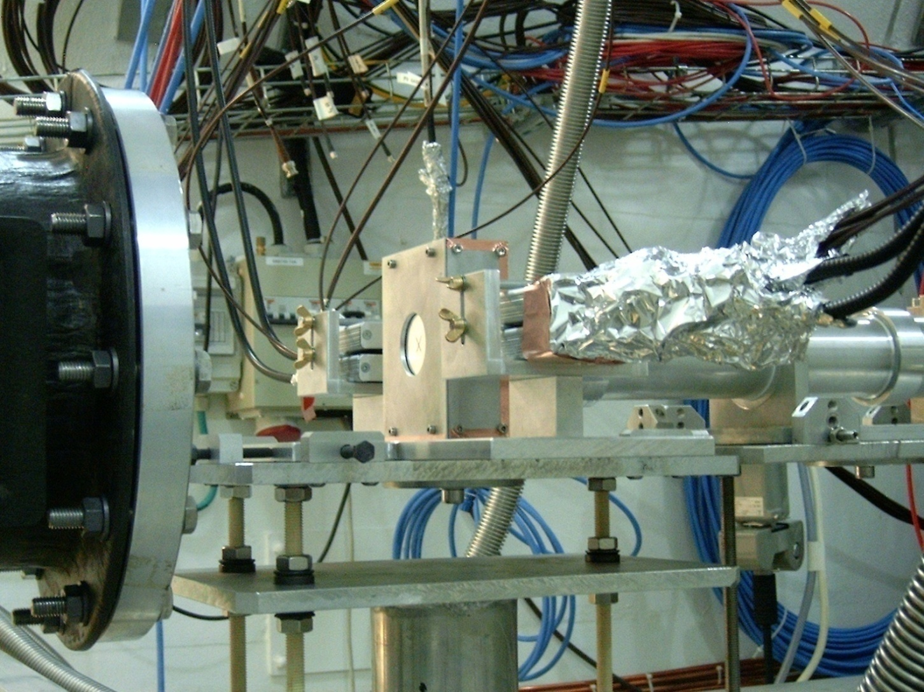
Candidate “Juan de la Cierva 2012” (U. Sevilla)
Experiments with neutron beams:
nuclear technology, astrophysics, basic and medical physics
Carlos GUERRERO
CERN Fellow, Physics Department
carlos.guerrero@cern.ch

Slide 2
Scientific career
1998-2003 Bachelor in Physics by the Universidad de Granada UGR (Spain)
2001-2002 Undergraduate in Physics at the University of California UCSB (USA)
2005 Master/DEA in Nuclear Physics by Universidad Complutense de Madrid UCM (Spain)
2008 PhD in Physics by Universidad Complutense de Madrid UCM (Spain)
2003 Introduction to Research Grants
UGR: Simulacion de emision gamma en explosiones de Supernova
Instituto de Astrofisica de Andalucia (CSIC): Estudio de la dinamica de colas de cometas
2004-2007 PhD Grant FPI-CIEMAT (Nuclear Innovation Unit)
PhD in Physics by UCM (Supervisor: Daniel Cano-Ott): “Measurements of the neutron capture cross sections of ²³⁷Np and ²⁴⁰Pu at the CERN n_TOF facility”
2007-2009 Research contract at CIEMAT (Nuclear Innovation Unit)
Nuclear data for science and technology within NTOF3FAIR and EUROTRANS
2009-2010 n_TOF Project Associate en el CERN
Commissioning of the CERN n_TOF-Phase2 facility: new spallation target and detectors
2010-2013 CERN Applied Physics Fellow in the Physics Department
n_TOF/CERN Physics coordinator and Analysis coordinator
Solicitante de un contrato Juan de la Cierva 2012 en la Universidad de Sevilla
(Tutor: J. M. Quesada)

Slide 3
Physics with neutron beams

Slide 4
My field of research: experimental nuclear (neutron) physics
Nuclear Tech.
(criticality, heat, waste product.)
Astrophysics
(sr-process)
Neutron beams
Detector tech.
Neutron production tech.
Basic Nucl. Phys.
(g strength funct., level densities, fiss. dynamics)
Medical Phys.
(NCT)

Slide 5
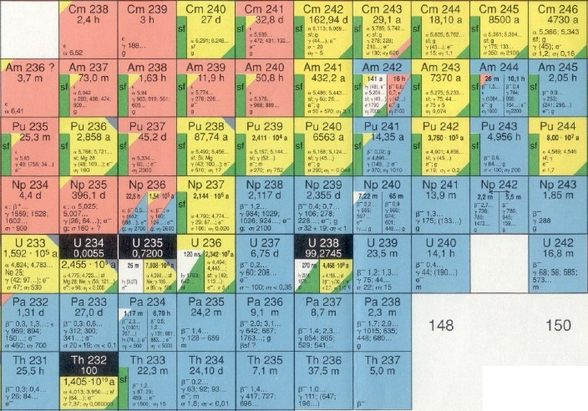
Neutrons and production of nuclear energy (& radioactive waste)
^{244, 245}Cm
1.5 Kg/yr
Figura Nucleosintesi (frecce che si muovono)
Foto FIC
²⁴¹Am:11.6 Kg/yr
²⁴³Am: 4.8 Kg/yr
²³⁹Pu: 125 Kg/yr
²³⁷Np: 16 Kg/yr
+Energy
LLFP
76.2 Kg/yr
LLFP
Quantities refer to yearly production in 1 GW_{e} LW reactor

Slide 6
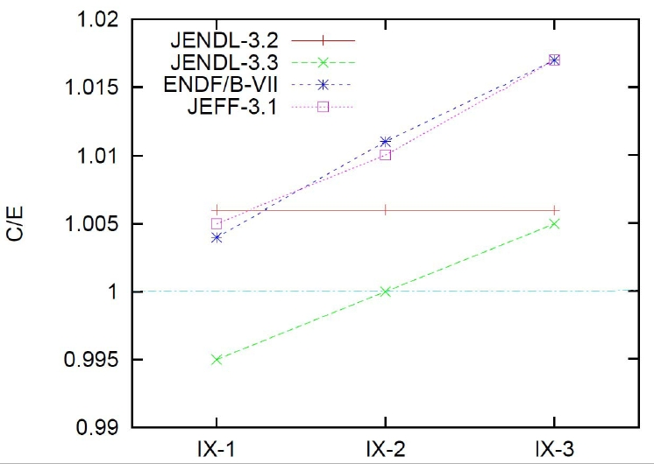
Neutrons and production of nuclear energy (& radioactive waste)
New reactor devices will use different fuel (with Pu and Minor actinides) in a fast neutron spectrum (MeV vs. meV) to profit from spent fuel, fresh U, and minimize radioactive waste
The criticality of currents and fast reactors must be known within 0.3% for operation.
Differences up to 2% in the measured and calculated criticality values for FCA (JAERI, Japan) assemblies with different hardness are due to ²³⁵U (n,γ) cross sections below 2.5 keV.
Faster neutron spectrum
n_TOF campaign to measure the cross section of ²³⁵U(n,γ) [and other fissile actinides]

Slide 7
Neutrons and production of isotopes in stars: The s-process
s-only
Zr
⁸⁰Br, t_{1/2}=17 min, 92 % (β⁻), 8 % (β⁺)
Y
p-process
Sr
(n,γ)
Rb
Kr
Br
(β⁻)
proton number
Se
(β⁺)
As
⁸⁵Kr, t_{1/2}=11 a
Ge
Ga
⁷⁹Se, t_{1/2}=65 ka
Zn
r-process
Cu
Ni
Co
⁶⁴Cu, t_{1/2}=12 h, 40 % (β⁻), 60 % (β⁺)
Fe
⁶³Ni, t_{1/2}=100 a
neutron number

Slide 8
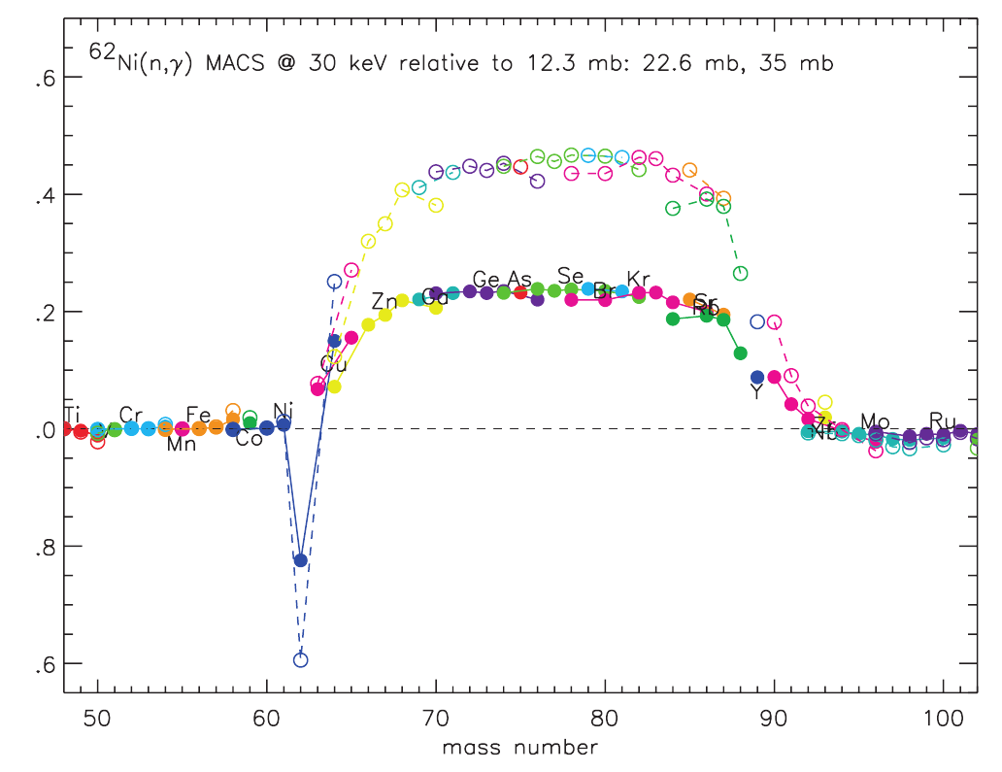
Neutrons and production of isotopes in stars: The s-process
In the weak s-process region the abundances of isotopes from Fe to Zr are highly affected by the knowledge of the cross section of every single isotopes:
Conclusions can be drawn only when ALL cross sections are known!
n_TOF campaign to measure all the available isotopes of Fe & Ni plus ⁵⁹Ni(n,α) and ⁶³Ni(n,γ)
Examples of basic and medical physics are given later.

Slide 9
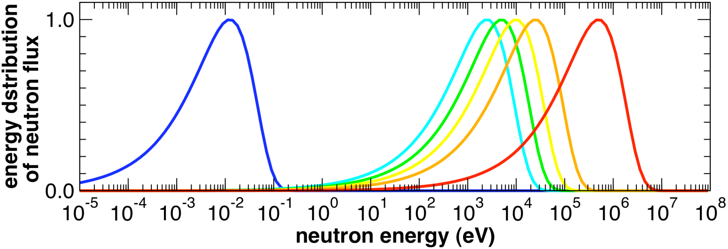
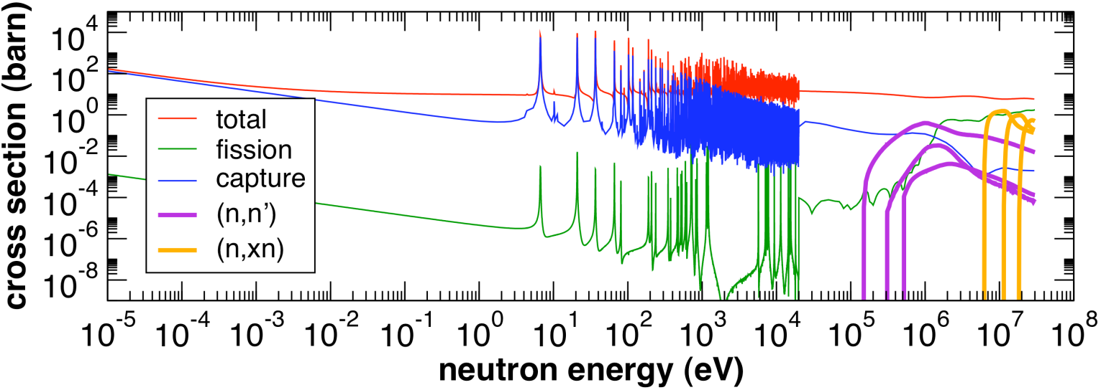
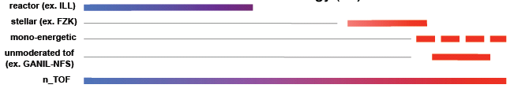
Neutrons and cross sections: energy distributions
Water moderated
Stellar spectra
BNCT (medical)
Fission & Fusion
Gen-IV
ADS
LWR reactors

Slide 10
Example of a pulsed neutron beam:
The n_TOF facility at CERN

Slide 11
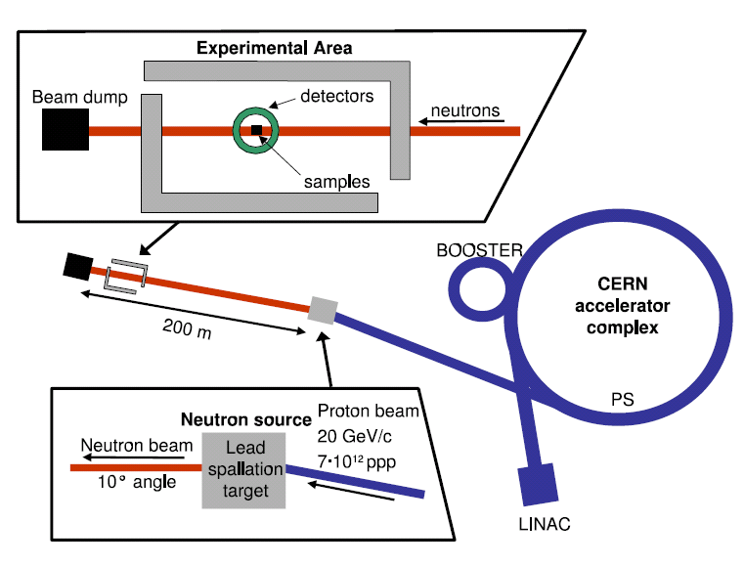
The n_TOF Facility at CERN

Slide 12
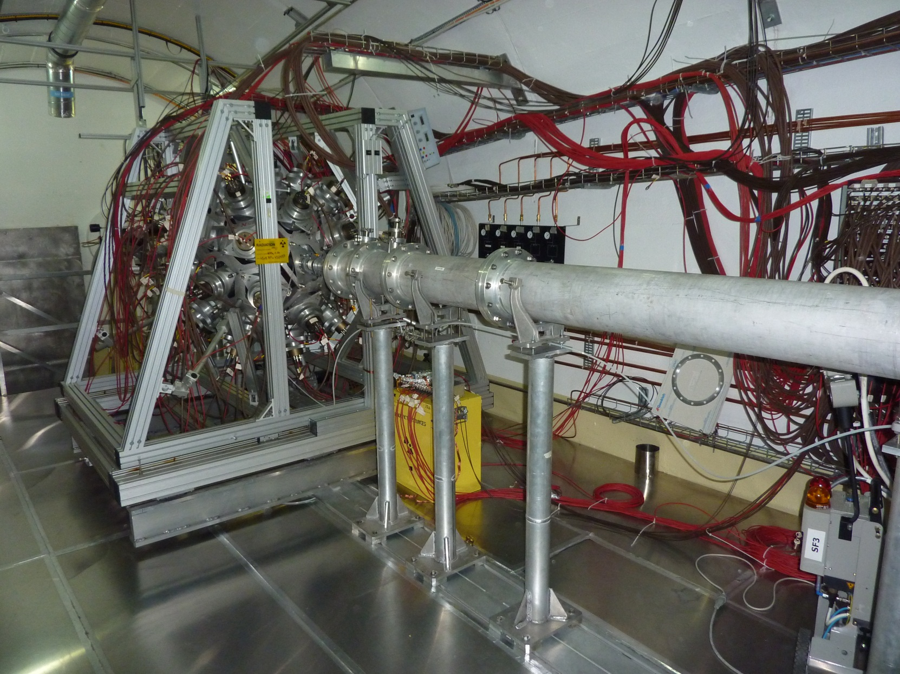
The n_TOF Facility at CERN
Work Sector Type A:
use of non-encapsulated radioactive samples allowed since 2010!!!

Slide 13
PhD research at CIEMAT (2004-2007)
Supervisor: Daniel Cano-Ott

Slide 14
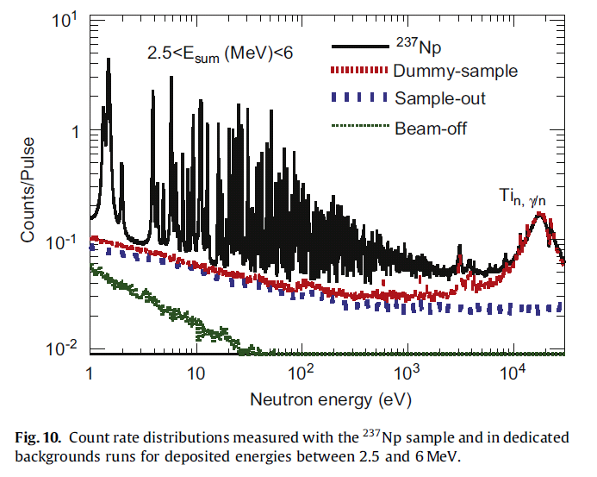
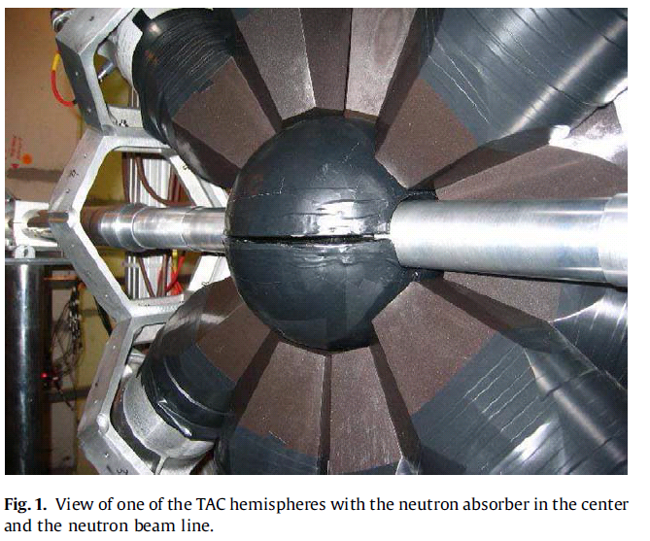
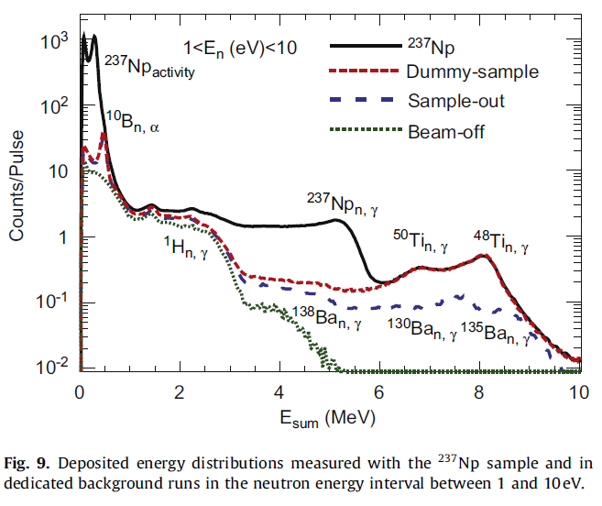
PhD research at CIEMAT (2004-2007)
“Measurements of the neutron capture cross sections of ²³⁷Np and ²⁴⁰Pu at CERN n_TOF ”
1. Experimental campaign at CERN n_TOF between May and October 2004
2. Mounting and commissioning of the new 40 BaF₂ Total Absorption Calorimeter (TAC)
C. Guerrero et al., The n_TOF Total Absorption Calorimeter for neutron capture measurements at CERN, Nucl. Instr. Meth. A 608 (2009) 424-433

Slide 15
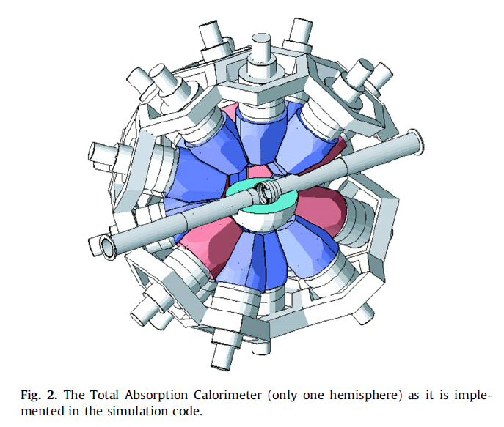
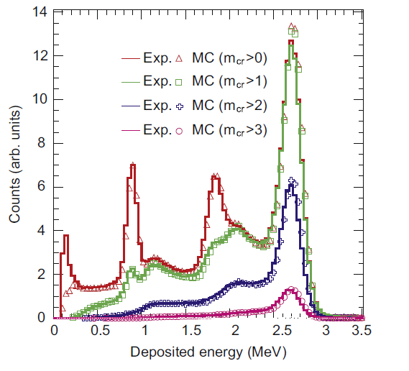
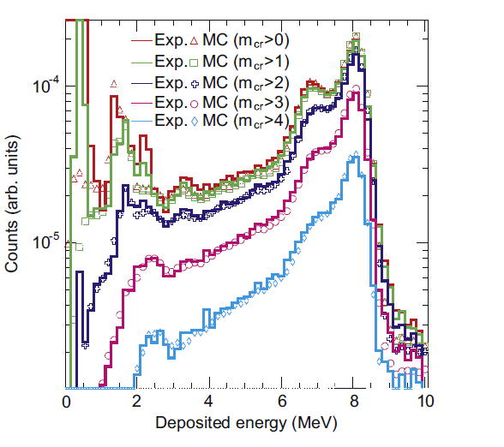
PhD research at CIEMAT (2004-2007)
“Measurements of the neutron capture cross sections of ²³⁷Np and ²⁴⁰Pu at CERN n_TOF ”
1. Experimental campaign at CERN n_TOF between May and October 2004
2. Mounting and commissioning of the new 40 BaF₂ Total Absorption Calorimeter (TAC)
3. Monte Carlo simulations of the TAC (calculation of efficiencies, pile-up, etc.)
C. Guerrero et al., Monte Carlo simulations of the n_TOF Total Absorption Calorimeter, Nucl. Instr. Meth. A 671 (2012) 108-117

Slide 16
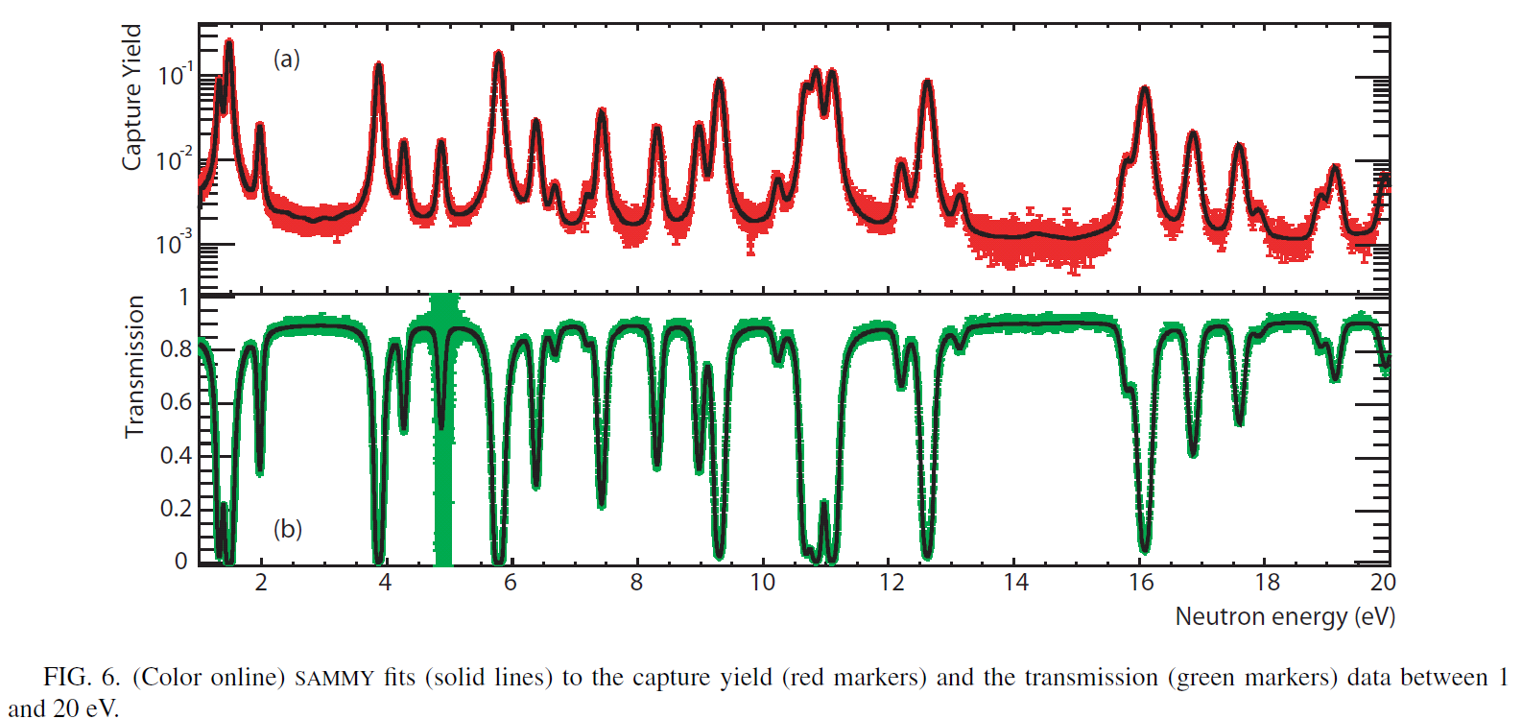
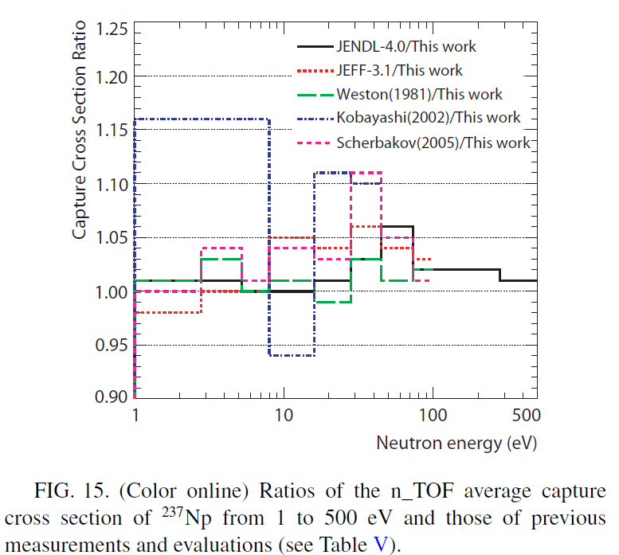
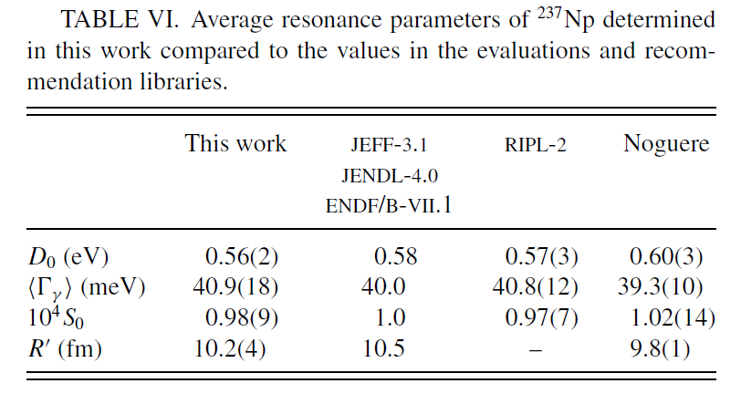
PhD research at CIEMAT (2004-2007)
“Measurements of the neutron capture cross sections of ²³⁷Np and ²⁴⁰Pu at CERN n_TOF ”
1. Experimental campaign at CERN n_TOF between May and October 2004
2. Mounting and comissioning of the new 40 BaF₂ Total Absorption Calorimeter (TAC)
3. Monte Carlo simulations of the TAC
4. Neutron capture cross sections analysis
C. Guerrero et al., Measurements and resonance analysis of the ²³⁷Np neutron capture cross section, Phys. Rev. C 85 (2012) 044616
First measurement of the σ(n,γ) of a Minor Actinide at n_TOF

Slide 17
Research contract at CIEMAT (2007-2009)

Slide 18
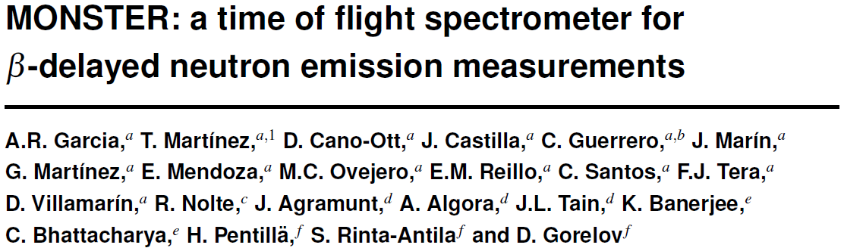
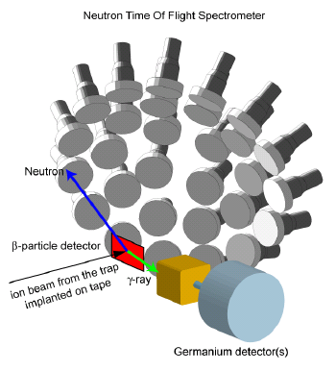
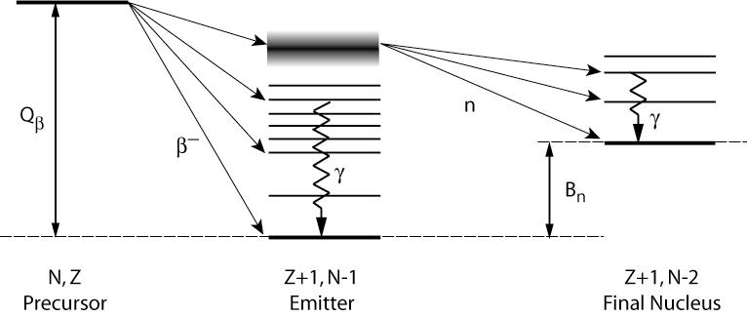
Research contract at CIEMAT (2007-2009)
Participation in the research activities of the CIEMAT Nuclear Innovation Unit related to Nuclear Data for Science and Technology: mostly within nTOF3FAIR and EUROTRANS
1. Mounting and testing of g-ray and neutron detectors (BC501A, LaCl₃, BF₃)
2. Digital Pulse Shape Analysis (PSA) algorithms
3. Neutron beam monitoring for ADS applications @GENEPI and @YALINA
MONSTER @DESPEC/FAIR
Measurement of β-delayed neutron emission probabilities in coincidence with γ-rays in neutron rich nuclei important for basic physics, astrophysics (r-process) and nuclear tech. (reactor dynamic)
JINST 7 C05012

Slide 19
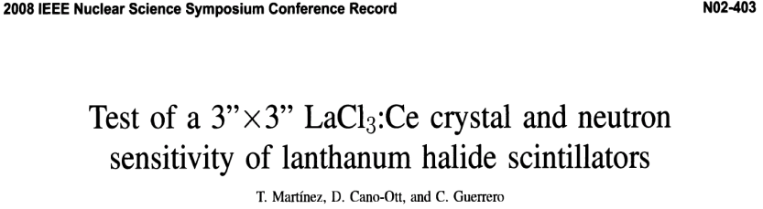
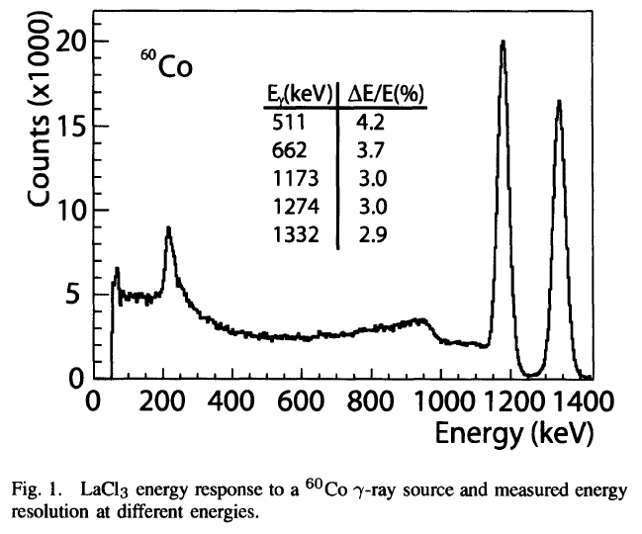
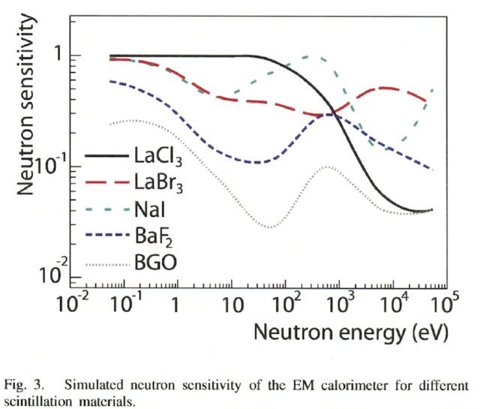
Research contract at CIEMAT (2007-2009)
Participation in the research activities of the CIEMAT Nuclear Innovation Unit related to Nuclear Data for Science and Technology: mostly within nTOF3FAIR and EUROTRANS
1. Mounting and testing of g-ray and neutron detectors (BC501A, LaCl₃, BF₃)
2. Digital Pulse Shape Analysis (PSA) algorithms
3. Neutron beam monitoring for ADS applications @GENEPI and @YALINA
October 2012: tests for using LaBr₃ & LaCl₃ for inelastic reactions!

Slide 20
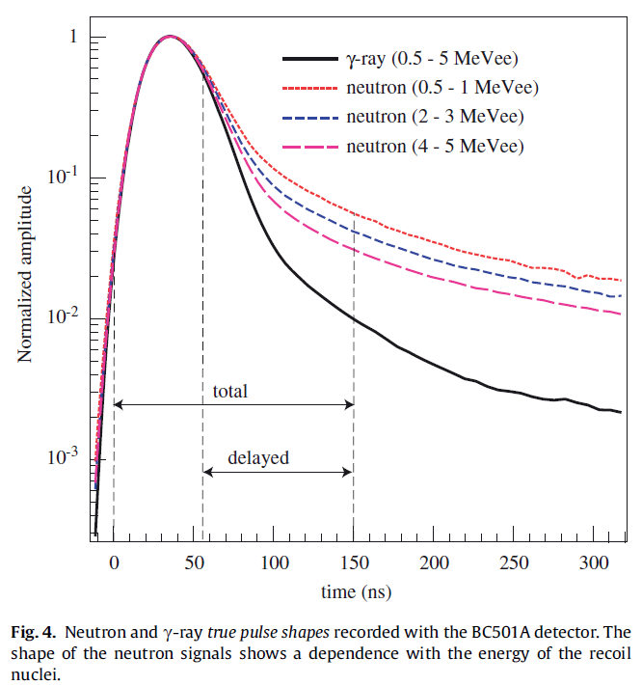
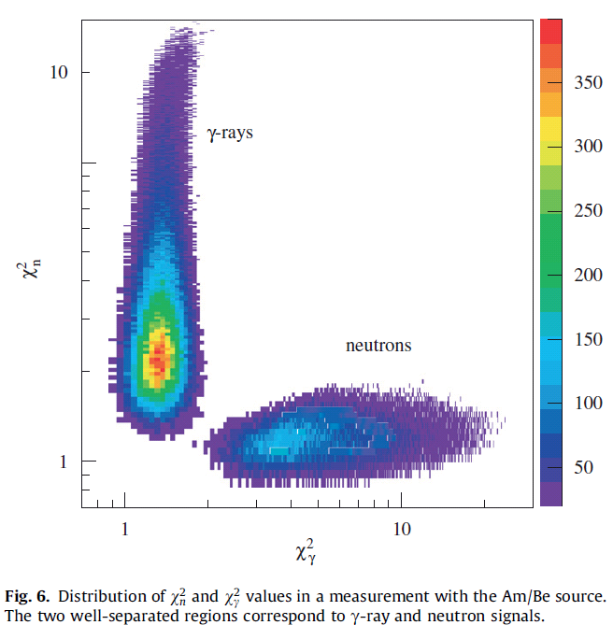
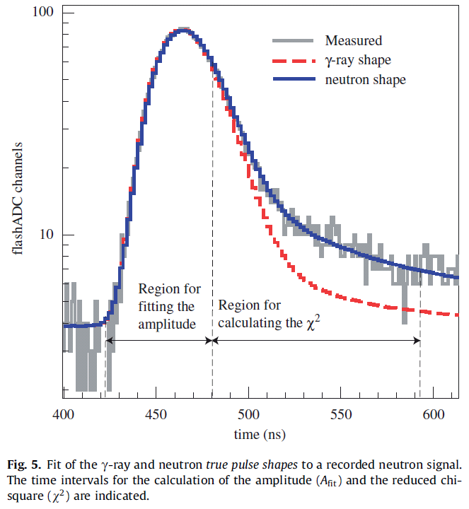
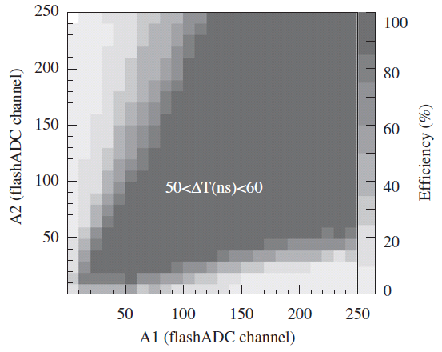
Research contract at CIEMAT (2007-2009)
Participation in the research activities of the CIEMAT Nuclear Innovation Unit related to Nuclear Data for Science and Technology: mostly within nTOF3FAIR and EUROTRANS
1. Mounting and testing of g-ray and neutron detectors (BC501A, LaCl₃, BF₃)
2. Digital Pulse Shape Analysis (PSA) algorithms
3. Neutron beam monitoring for ADS applications @GENEPI and @YALINA
C. Guerrero et al., Analysis of the BC501A neutron detector signals using the true pulse shape, Nucl. Instr. Meth. A 597 (2008) 212-218

Slide 21
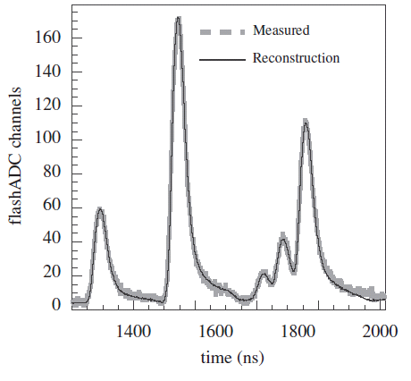
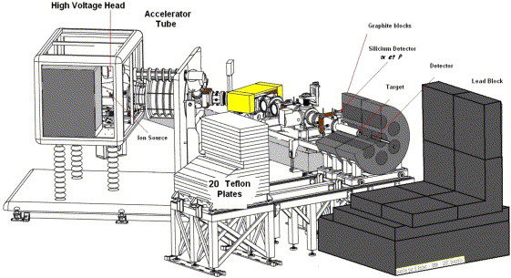
Research contract at CIEMAT (2007-2009)
Participation in the research activities of the CIEMAT Nuclear Innovation Unit related to Nuclear Data for Science and Technology: mostly within nTOF3FAIR and EUROTRANS
1. Mounting and testing of g-ray and neutron detectors (BC501A, LaCl₃, BF₃)
2. Digital Pulse Shape Analysis (PSA) algorithms
3. Neutron beam monitoring for ADS applications @GENEPI and @YALINA
GENEPI D-T source in LPSC Grenoble

Slide 22
Project Associate at CERN (2009-2010)

Slide 23
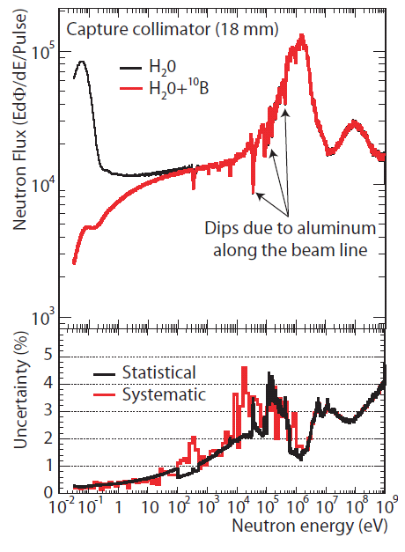
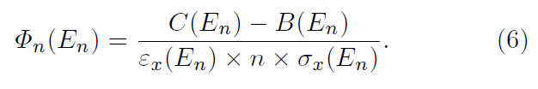
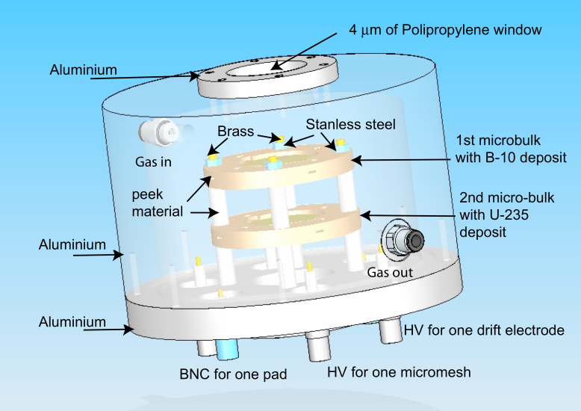
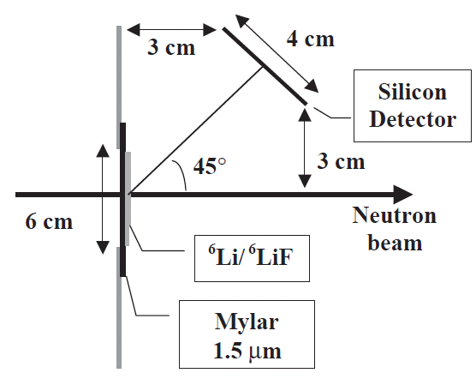
Project Associate at CERN (2009-2010)
Following a 4 years halt, the CERN n_TOF facility resumed operation in 2008 after a major upgrade of the spallation target and the experimental area.
I was responsible of the commissioning of the facility and Physics Coordinator
C. Guerrero et al., Characterization of the n_TOF neutron beam: fluence, profile and resolution, JKPS 59 (2010) 1624-1627
C. Guerrero et al., Performance of the neutron time-of-flight facility n_TOF at CERN, submitted to Eur. Phys. J. A (November 2012)
²³⁵U(n,f)
²³⁵U(n,f) & ¹⁰B(n,α)
⁶Li(n,t)α

Slide 24
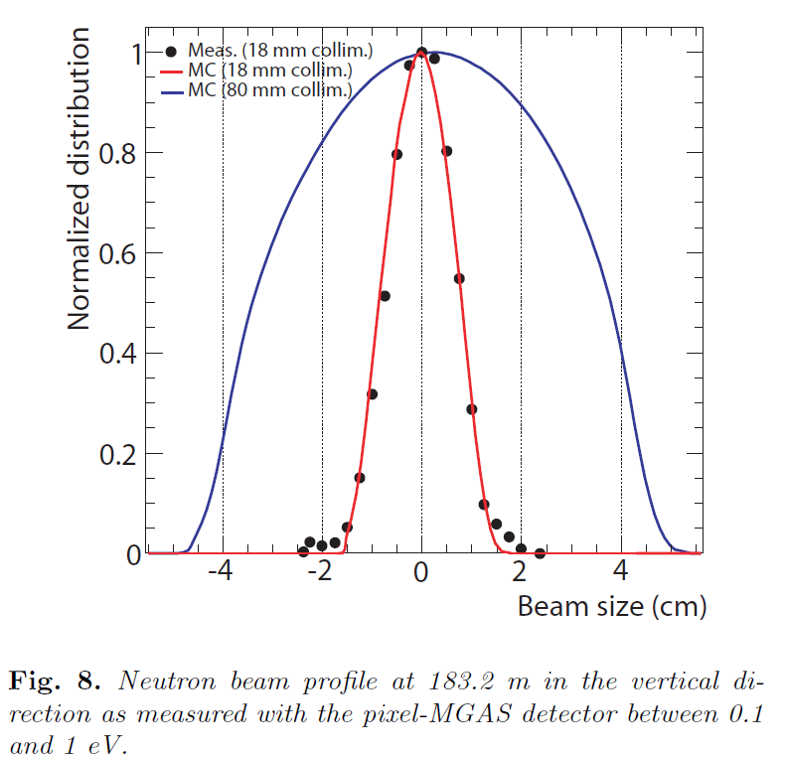
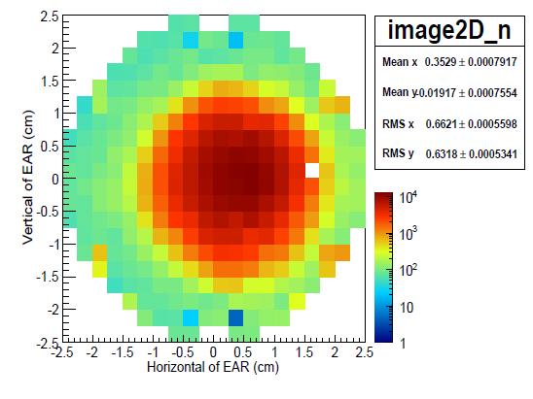
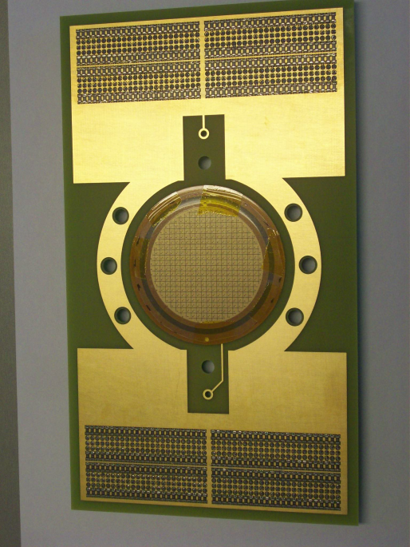
Project Associate at CERN (2009-2010)
Following a 4 years halt, the CERN n_TOF facility resumed operation in 2008 after a major upgrade of the spallation target and the experimental area.
I was responsible of the commissioning of the facility and Physics Coordinator
C. Guerrero et al., Characterization of the n_TOF neutron beam: fluence, profile and resolution, JKPS 59 (2010) 1624-1627
C. Guerrero et al., Performance of the neutron time-of-flight facility n_TOF at CERN, submitted to Eur. Phys. J. A (November 2012)
Pixel-MGAS

Slide 25
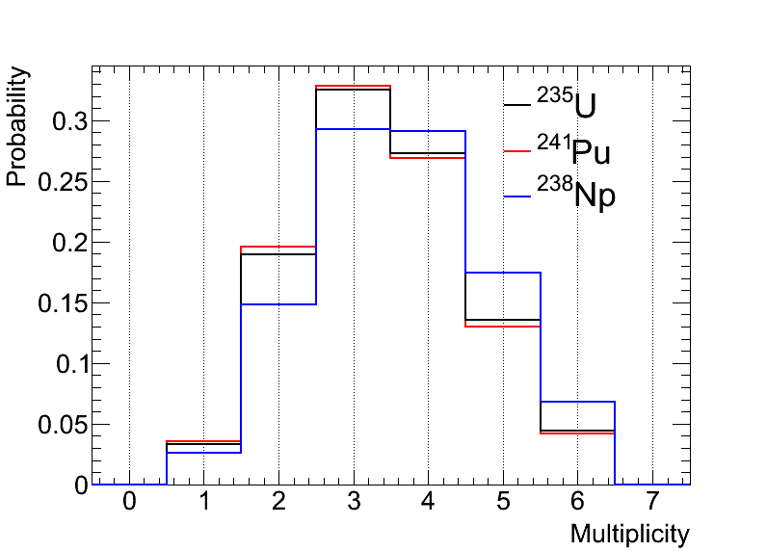
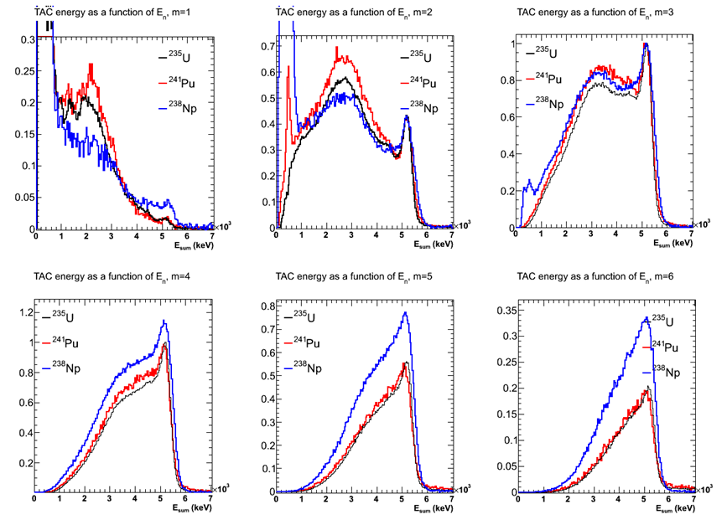
Study of Photon Strength Functions on Actinides (TAC)
Detection of the capture cascades from ²³⁴U, ²³⁷Np and ²⁴⁰Pu with the TAC provide information regarding the corresponding compound nuclei.
m_{cr}=1
m_{cr}=2
m_{cr}=3
m_{cr}=6
 | Known levels | Capture level | Ground state
²³⁵U | 28 (E<610 keV) | 1/2+ | 7/2-
²³⁸Np | 40 (E<460 keV) | 2+,3+ | 2+
²⁴¹Pu | 9 (E<560 keV) | 1/2+ | 5/2+
m_{cr}=4
m_{cr}=5

Slide 26
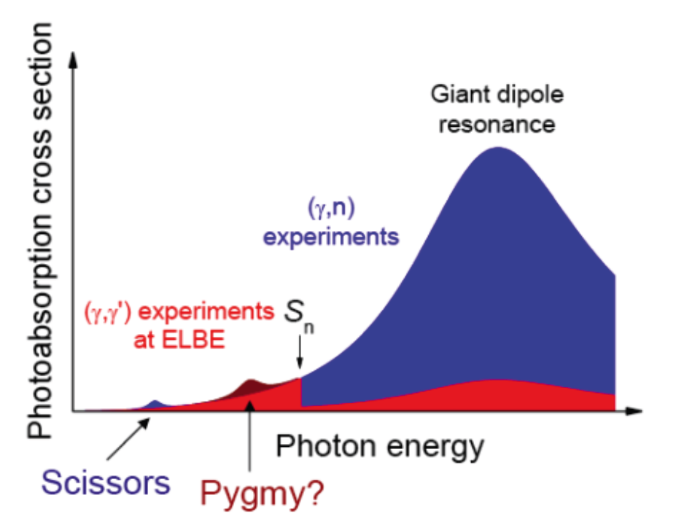
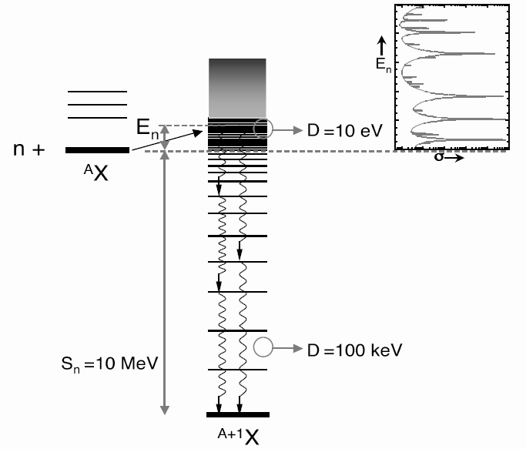
Study of Photon Strength Functions on Actinides (TAC)
Detection of the capture cascades from ²³⁴U, ²³⁷Np and ²⁴⁰Pu with the TAC provide information regarding the corresponding compound nuclei.
(n,γ) TAC
?

Slide 27
Study of Photon Strength Functions on Actinides (TAC)
DECAY GENerator (DECAYGEN) [IFIC]
Known level scheme
Level density
Photon Strength Functions (E1,M1,E2)
Capture Cascades: E_{γ}^{i=1,mγ}
Geant4 MC simulation of the TAC
Detailed detector geometry
Geant4 Standard EM physics
Realistic event reconstruction
Assumption on PSF
Comparison
Experimental TAC response
(E_{sum}, m_{cr})
Simulated TAC response
(E_{sum}, m_{cr})

Slide 28
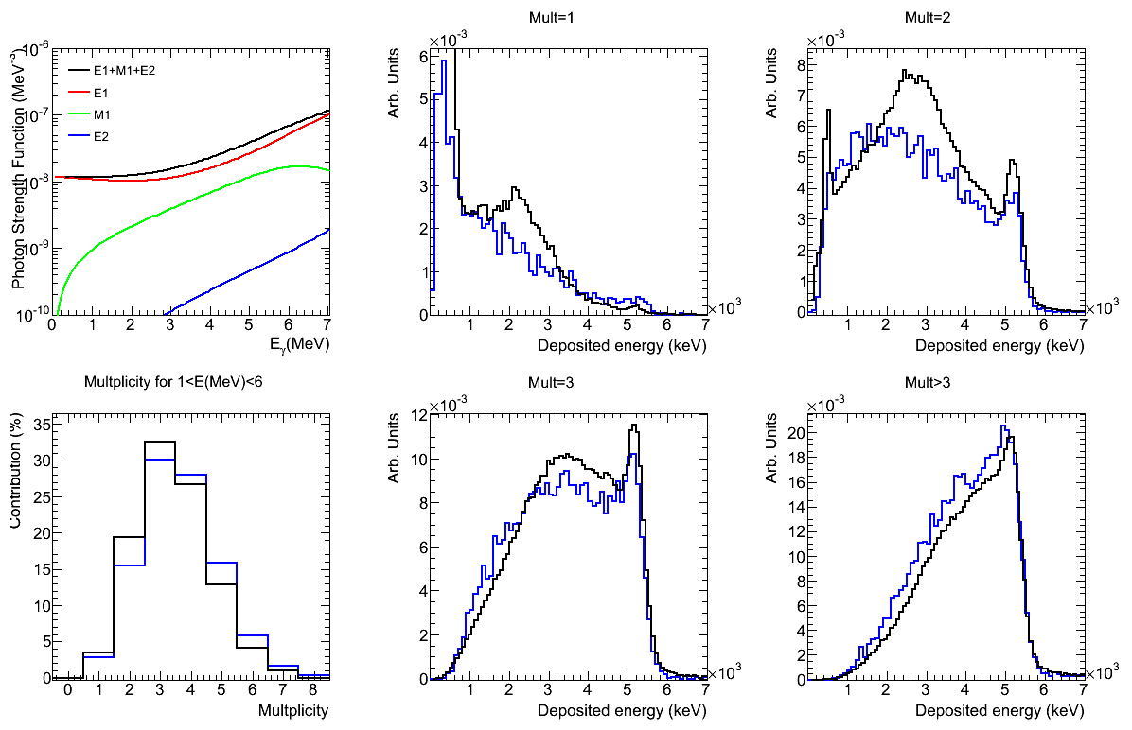
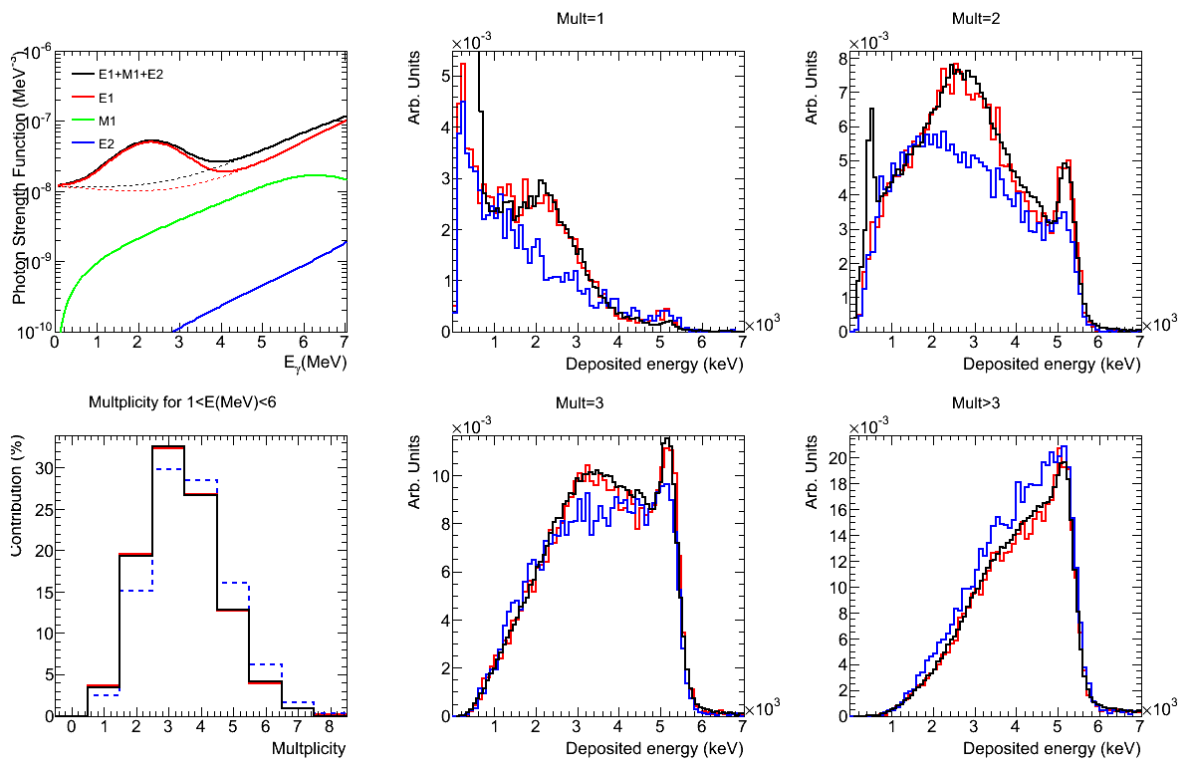
Study of Photon Strength Functions on Actinides (TAC)
²⁴¹Pu
Pygmy (or spin-flip) mode associated to oscillations/vibrations neutron vs. protons
PSF from RIPL-2
PSF from RIPL-2
Tuned PSF
PSF from RIPL-2
PSF from RIPL-2
Tuned PSF
C. Guerrero et al., Study of Photon Strength Function of Actinides: the case of ²³⁵U, ²³⁸Np and ²⁴¹Pu, JKPS 59 (2011) 1510-1513. [Phys. Rev. Lett. in preparation]
PSF from RIPL-2
PSF from RIPL-2
PSF from RIPL-2
Tuned PSF
PSF from RIPL-2
Tuned PSF
PSF from RIPL-2
PSF from RIPL-2
Tuned PSF

Slide 29
CERN Fellow in Applied Physics (2010-2013)

Slide 30
CERN Fellow in Applied Physics (2010-2013)
Physics coordinator:
  Collaboration with the spokespersons of each experiment
  Coordination of the teams responsible for the different detection systems
  Plan the experiment schedule
Analysis Coordinator
  Organization of analysis meetings every three months
  Coordination between the PhD students (16) and postdocs
  Maintenance of the common analysis software
  As University of Manchester Visiting Research Fellow:
    main supervisor of PhD student T. Wright. (J. Billowes)
  As University of York Honorary Visiting Fellow:
    main supervisor of PhD student M. Vermeulen (D. Jenkins)
  Co-supervisor of TU Wien PhD student C. Weiss (H. Leeb and E. Griesmayer)

Slide 31
CERN Fellow in Applied Physics (2010-2013)
Spokesperson of the following experiments at n_TOF:
  Irradiation of FBG optical sensors in the n_TOF dump area
  Measurements of neutron-induced capture and fission reactions on ²³⁵U: cross sections and alpha ratios, photon strength functions and prompt fission γ-rays
  Micromegas detector for ³³S(n,α) cross section measurement at n_TOF
  The (n,α) reaction in the s-process branching point ⁵⁹Ni
  Validation of simultaneous measurement of capture and fission reactions at n_TOF
  Participation in experiments outside n_TOF:
  β-delayed neutron emission measurements around the third r-process abundance peak, C. Domingo-Pardo et al. (S410 GSI-FRS, 2011)
  Shape effects in the vicinity of the Z=82 line: study of the beta decay of ^{182,184,186}Hg, A. Algora et al. (IS539 CERN, Isolde, 2012)
  Reactor g-ray heating studies at EXOGAM@ILL: prompt g-ray emission from fission and capture in U and Pu, C. Guerrero et al. (EXOGAM@ILL, 2012/13)

Slide 32
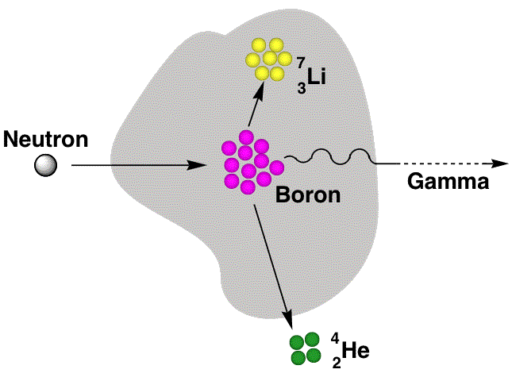
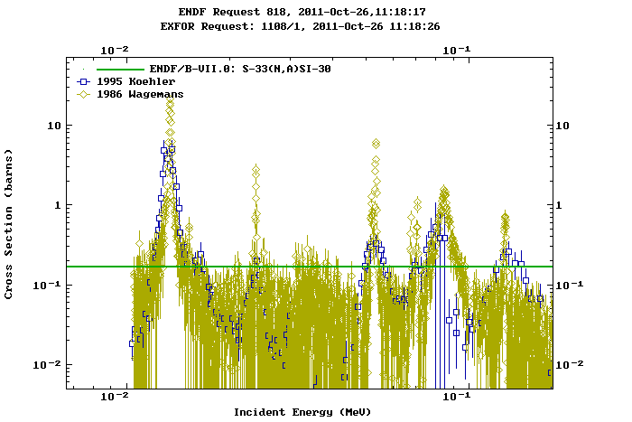
Measurement of (n,α) cross sections for Medical Applications (NCT)
I. Porras, Phys. Med. Biol. 53 (2008) L1-L9
“Enhancement of the neutron radiation dose by the addition of ³³S atoms”,
High (n,α) cross section in the keV region
Low (n,γ) cross section.
No production of radioactive residuals.
Stable and present in nature.
Chemical compounds easy to deliver to tumors.
Low toxicity.
  J. Praena, J.M. Quesada and C. Guerrero, Micromegas detector for ³³S(n,α) cross section measurement at n_TOF

Slide 33
Measurement of (n,α) reactions for astrophysics
C. Weiss and C. Guerrero,
The (n, α) reaction in the s-process branching point ⁵⁹Ni, CERN-INTC-2012-011
⁵⁸Ni | ⁵⁹Ni | ⁶⁰Ni | ⁶¹Ni | ⁶²Ni
⁵⁷Co | ⁵⁸Co | ⁵⁹Co | ⁶⁰Co | ⁶¹Co
⁵⁶Fe | ⁵⁷Fe | ⁵⁸Fe | ⁵⁹Fe | ⁶⁰Fe
⁵⁹Ni(n,*) competitive channels [first branching point!]
⁵⁹Ni β-decay
⁵⁹Ni(n,γ)
⁵⁹Ni(n,α) [usually a threshold reaction] feedback to ⁵⁶Fe

Slide 34
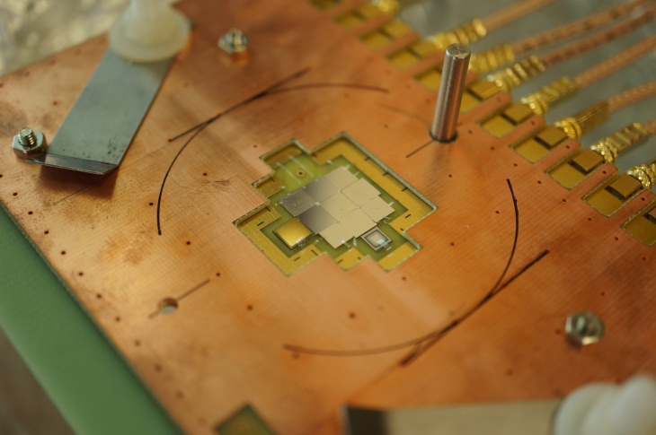


Measurement of (n,α) reactions for astrophysics
C. Weiss and C. Guerrero,
The (n, α) reaction in the s-process branching point ⁵⁹Ni, CERN-INTC-2012-011
Diamond mosaic – detector:
  9 sCVD diamonds of 150 μm thickness
Dedicated electronics
Measurement under vacuum
  => High resolution spectroscopic measurement
Spectroscopic amplifiers
Sample:
180 μg metallic Ni (95% ⁵⁹Ni)
205 μg LiF (95% ⁶Li)
Neutron flux + ⁵⁹Ni σ(n,α)
Neutrons
Vacuum Chamber
Sponsored by CIVIDEC Instrumentation GmbH

Slide 35
Measurement of (n,α) reactions for astrophysics
Spectroscopic measurement:
Charged particles can be distinguished
in pulse height spectra
Neutron Fluence Measurement
Cross section measurement
Amplitude cuts for
  Tritons from ⁶Li(n, α)t
  Alphas from ⁵⁹Ni(n, α)⁵⁶Fe
6

Slide 36
Simultaneous measurements of (n,γ)&(n,f) [TAC+MGAS]
New reactor devices will use different fuel (with Pu and Minor actinides) in a fast neutron spectrum (MeV vs. meV) to profit from spent fuel, fresh U, and minimize radioactive waste
The criticality of currents and fast reactors must be known within 0.3% for operation and 0.5% for safety.
Differences up to 2% in the measured and calculated criticality values for FCA (JAERI, Japan) assemblies with different hardness are due to ²³⁵U (n,γ) cross sections below 2.5 keV.
Faster neutron spectrum
n_TOF campaign to measure the cross section of ²³⁵U(n,γ) and other fissile actinides

Slide 37

Simultaneous measurements of (n,γ)&(n,f) [TAC+MGAS]
The one week test experiment was carried out in September 2010:
  3 ²³⁵U samples of 1 mg and 2 cm diameter each
  MGAS running with He+isobutane at 1 atm
  The TAC and MGAS signals digitized at 250 MS/s and 100 MS/s, respectively.
BaF₂ module
neutrons
MGAS with 3 ²³⁵U samples
MGAS signals

Slide 38


Simultaneous measurements of (n,g)&(n,f) [TAC+MGAS]
Deposited energy (m_{cr}>2) and multiplicity (E_{sum}>3)distributions corresponding to resonances:
Total – fission
Background
Fission
Total - fission-backg.
Fission
- 33% of fission events fall above E_{sum}>7.5 MeV
- 100% of capture events fall below E_{sum}<7.5 MeV
- 32% of fission events fall above m_{cr}>9
- 98% of capture events fall below m_{cr}<9

Slide 39



Simultaneous measurements of (n,g)&(n,f) [TAC+MGAS]
Frontcover Eur. Phys. J. A 48 (2012)
EPJ website Highlight
(most downloaded article April-May 2012)
Highlight EurophysicsNews 43 No.3 (2012)
Three proposals out of this work:
  ²³⁵U(n,g/f) in the keV region (n_TOF)
  Prompt fission g-rays for reactor heating (ILL)
  ^{239,241}Pu(n,g/f) at n_TOF-EAR2

Slide 40
A hint on some future plans…
Within the Basic Nuclear Physics Group of U. Sevilla from the end of 2013 (JdC):
Experiments at EU neutron beam facilities
⁷⁹Se(n,γ) for s-process (with C. Domingo-Pardo, IFIC) [n_TOF-EAR2]
σ(n,γ)/σ(n,f) of ^{239,241}Pu isotopes (with D. Cano-Ott, CIEMAT) [n_TOF-EAR2]
Prompt fission g-ray studies for reactor applications (with O. Litaize, CEA) [EXOGAM@ILL ]
Exploitation of neutron beam lines at CNA (with J. Praena)
VdG: Astrophysics through Li(p,n) [NIM-A 601 (2009) 333-338]
Cyclotron: High E_{n} neutron beam through D-D(T) fusion reactions
Proposal of a neutron beam line at LRF (Huelva): use of intense beam intended for NCT, irradiation of materials, cross sections, etc.
Within the framework of a Marie Curie Career Integration Grant (CIG) [2013-2017]

Slide 41
Thank you for you attention!!
Nuclear Tech.
(criticality, heat, waste product.)
Astrophysics
(sr-process)
Neutron beams
Detector tech.
Neutron production tech.
Basic Nucl. Phys.
(g strength funct., level densities, fiss. dynamics)
Medical Phys.
(NCT)

