Slide 1

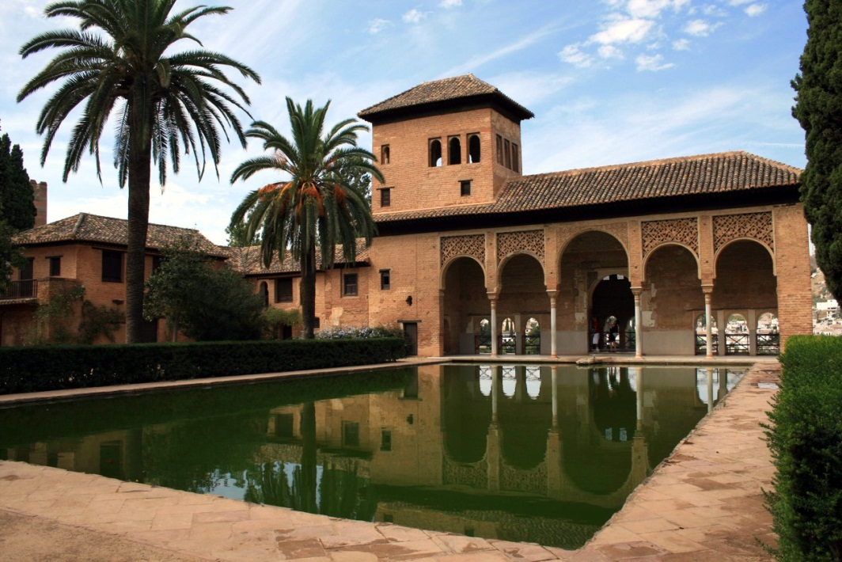

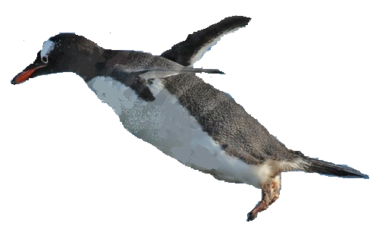


LHCb status and results
Hugo Ruiz
Institut de Ciències del Cosmos

Slide 2
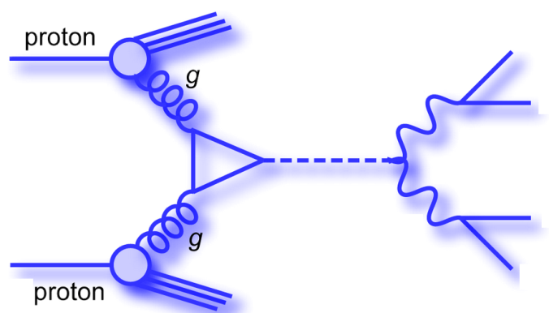

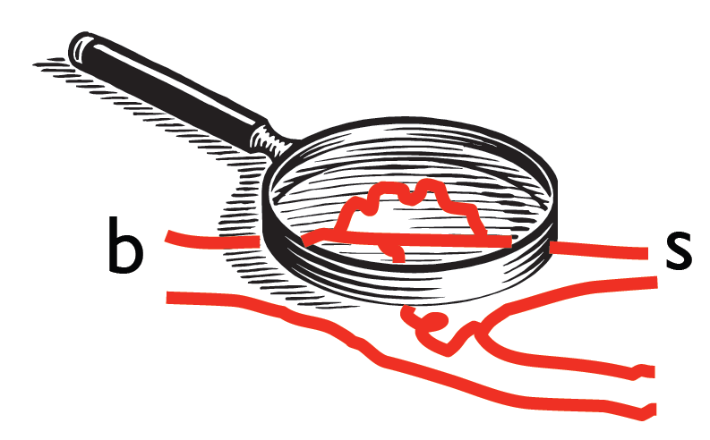
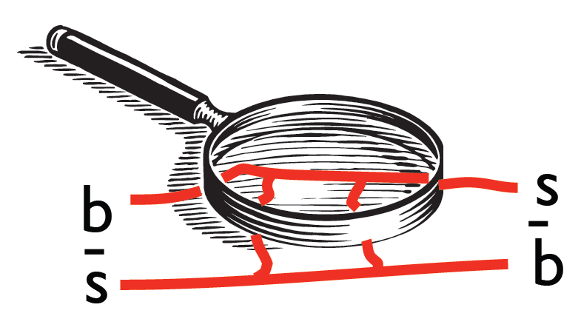
The LHCb physics scope (1): flavor physics
ATLAS, CMS: direct search
LHCb: look for effect of new massive particles in lower energy observables
  The SM is ≈ right ⇒ NP will probably show up in loop processes
  Need observables with QCD corrections under control ⇒ B mesons
New particles would distort the SM (CKM) picture of B decays by modifying:
  Phases CP violation
  Amplitudes ⇒ Branching ratios
  Lorentz Structure Angular distributions
Flavor-related open issues: number of generations, hierarchy of masses and CKM elements, the excess of matter over antimatter…

Slide 3
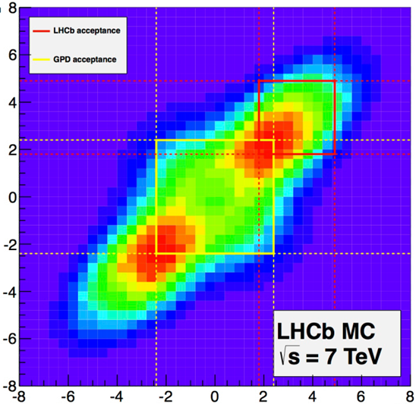



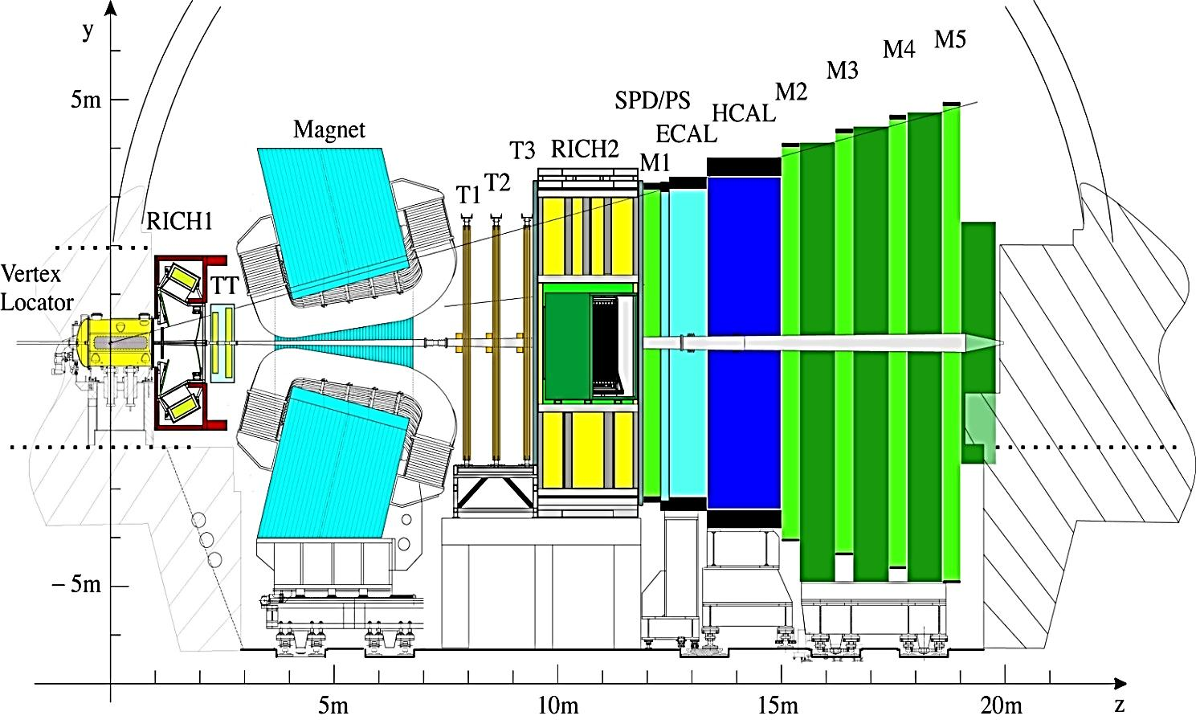
LHCb
η_{B2}
<L> ~ 1cm
LHCb
B
IP
CMS
η_{B1}

Slide 4
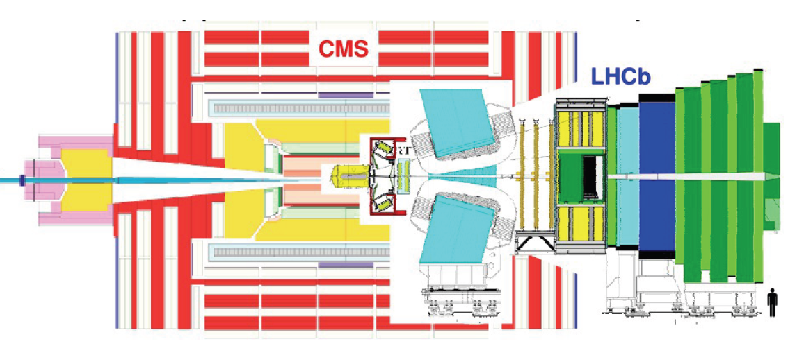
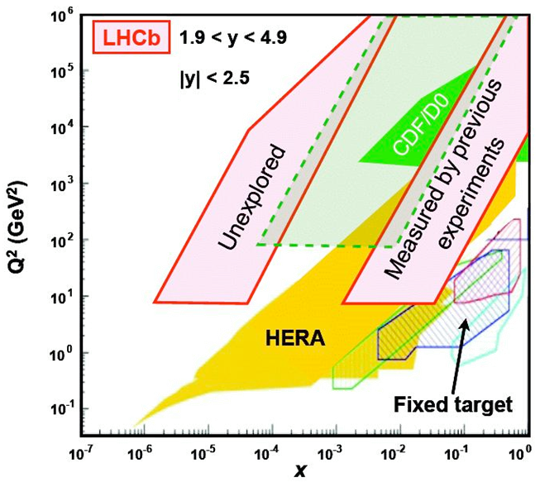
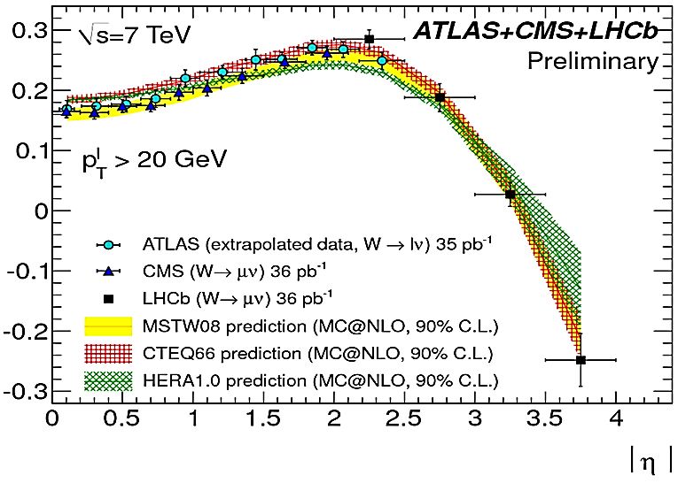
LHCb physics scope (2): forward physics
Quarkonium studies
  Even in p-Pb collisions
Electroweak physics
Soft QCD physics, parton PDFs
Example : [N(W⁺)-N(W⁻)]/N(W^{+/-})
ATLAS CMS
[N(W⁺)-N(W⁻)]/N(W^{+/-})
x: fract. of p_{beam} carried by colliding parton
Q²: squared p transfer in partonic collision
JHEP 6 (2012), 58

Slide 5
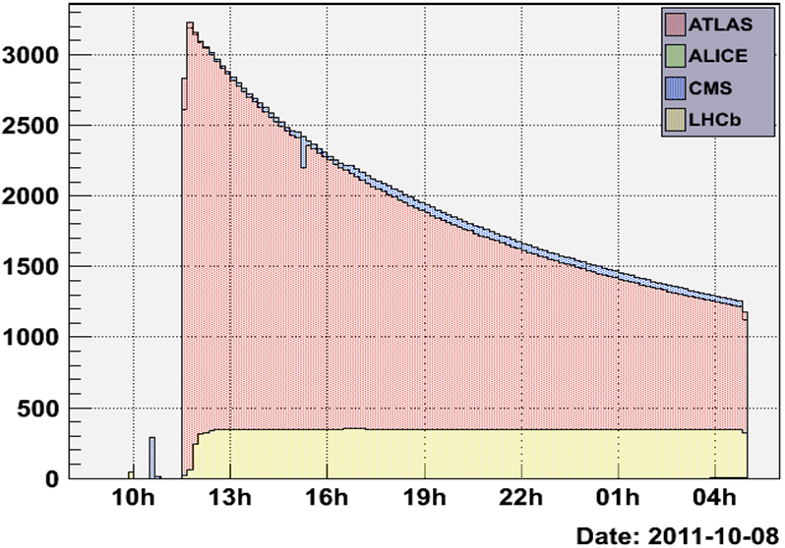
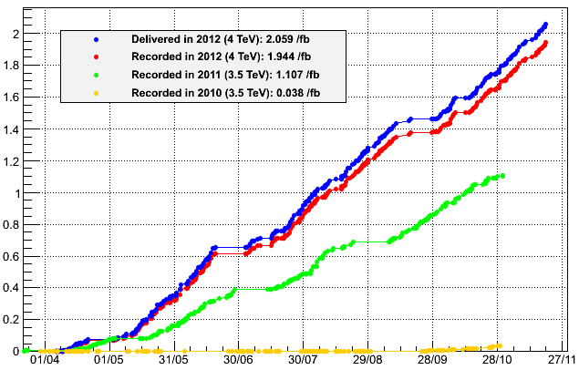
Data taking
Need “clean” events ⇒ luminosity leveling by vertical beam displacements
  ∫Ldt in 2012: 10x smaller than @ ATLAS/CMS
  All subdetectors > 98% active channels
σ_{bb} = 284±53μb (√s=7TeV), ~ 10⁵ bb pairs/s (10⁴ x B factories)
  All species (B⁰, B⁺, B_{s}, B_{c}…)
  Charm: x 20
Typical fill
2012
L (μb⁻¹s⁻¹)
∫Ldt (fb⁻¹)
4·10³²=2 x design
2011
PLB 694 209
CONF-2010-013
Most results today from 1fb⁻¹ in 2011 @√s=7 TeV

Slide 6
Oscillations

Slide 7
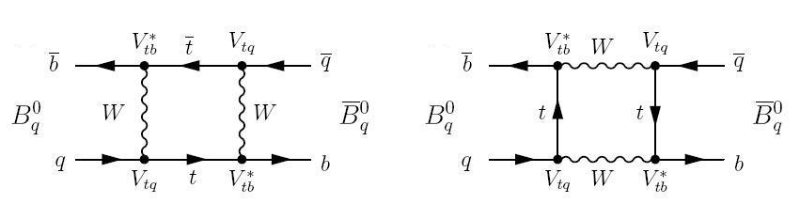
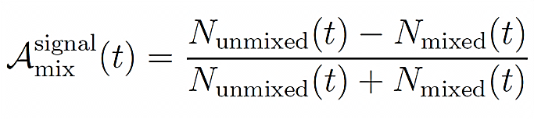


Oscillations
Periods (∝Δm) are stringent tests of SM
Choose a flavor-specific final state, count:
Flavor tagging:
K±, π± from fragmentation or B** decay
Same side (SS)
Signal B
PV
D_{x}
Tagging B
kaon (K±)
Opposite side (OS)
lepton (μ±, e±)
Effective tagging efficiency ~ 2-3%

Slide 8

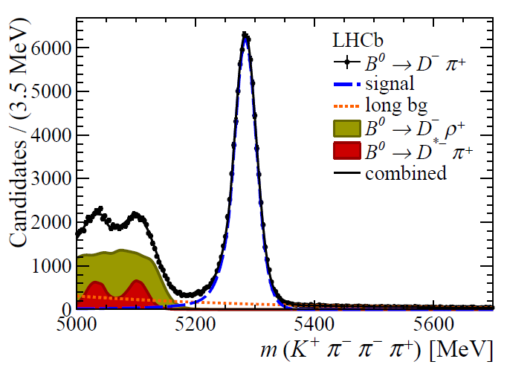
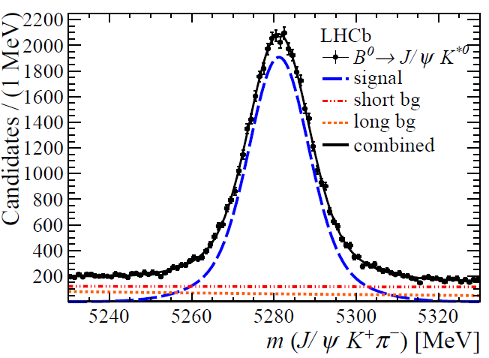
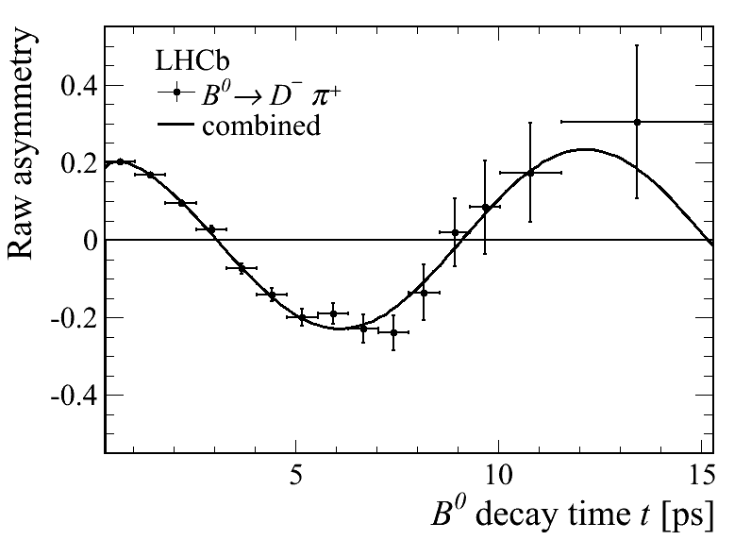
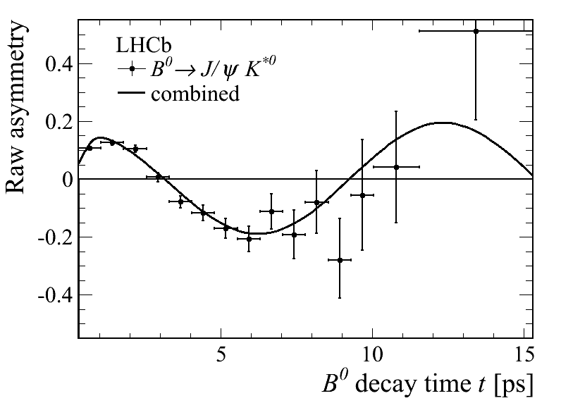
Oscillations: B_{d}
Most precise result to date
Δm_{d} = 0.5156 ± 0.0051 ± 0.0033 ps⁻¹
arXiv:1210.6750,
LHCB-PAPER-2012-032 Subm. PLB

Slide 9
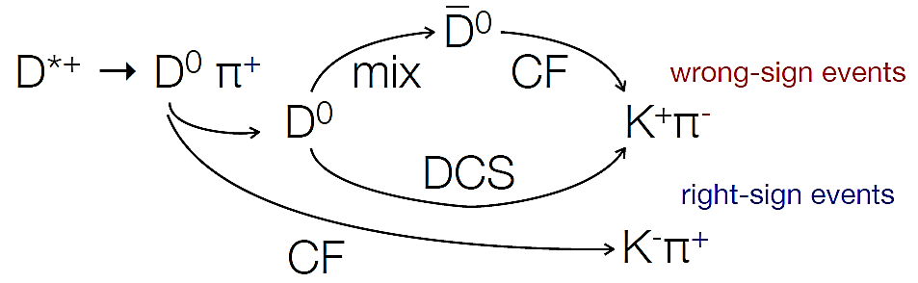
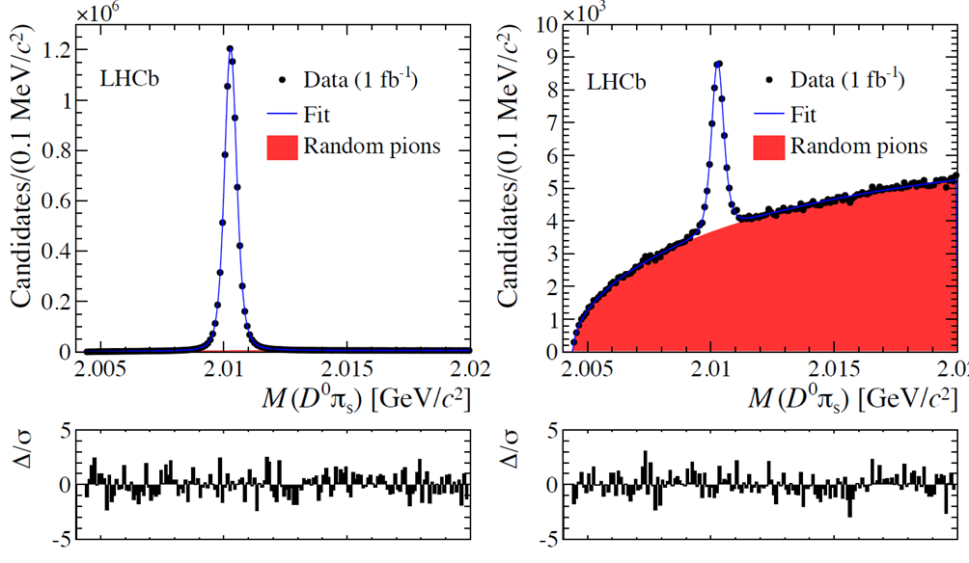
Oscillations: D⁰
Probes NP which couples to up-type quarks
D⁰ oscillation period > 100·τ_{D0} ⇒ full oscillation period cannot be observed
So far 5σ only if results from BaBar, Belle and CDF are combined
Classify events according to:
RS:
~8.4M
WS:
~36k

Slide 10
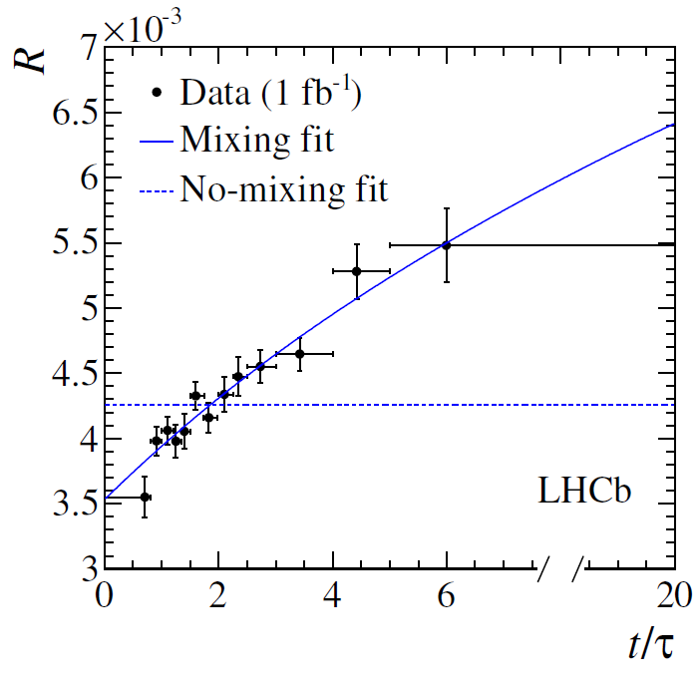

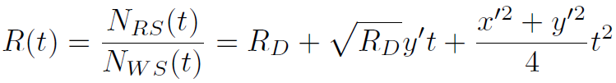


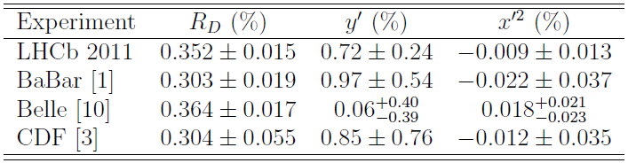
Oscillations (3): D⁰
  Assuming |x| , |y| << 1 , and no CPV:
No mixing hypothesis is excluded at 9.1σ
⇒ First observation in a single experiment
; x= Δm/Γ y=Δ Γ/2Γ
arXiv:1211.1230, LHCB-PAPER-2012-038
Subm. PRL

Slide 11
CP violation

Slide 12
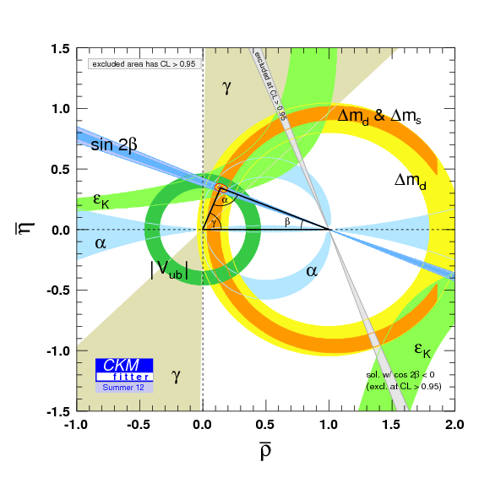
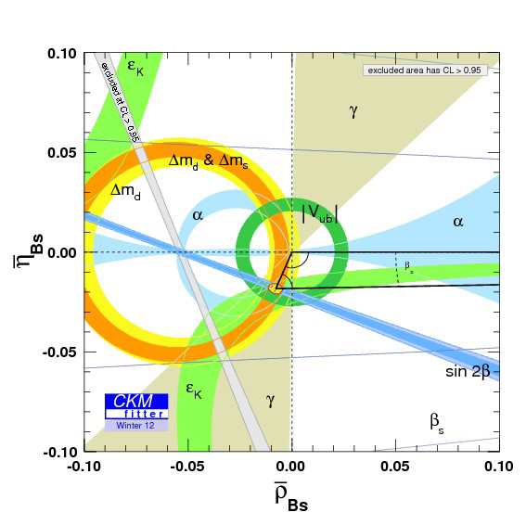
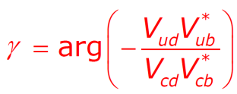
CP violation in the SM
CPV caused by interference ⇒ appears in processes with >1 contributing amplitudes
SM: CPV arises from single phase in CKM matrix. Unitarity of CKM expressed as triangles
Reasonable consistency so far, including many B_{d} observables @ B factories
However:
  There is indeed matter in the Universe
  Lacking a direct measurement of
  B_{s} sector quite unexplored!

Slide 13
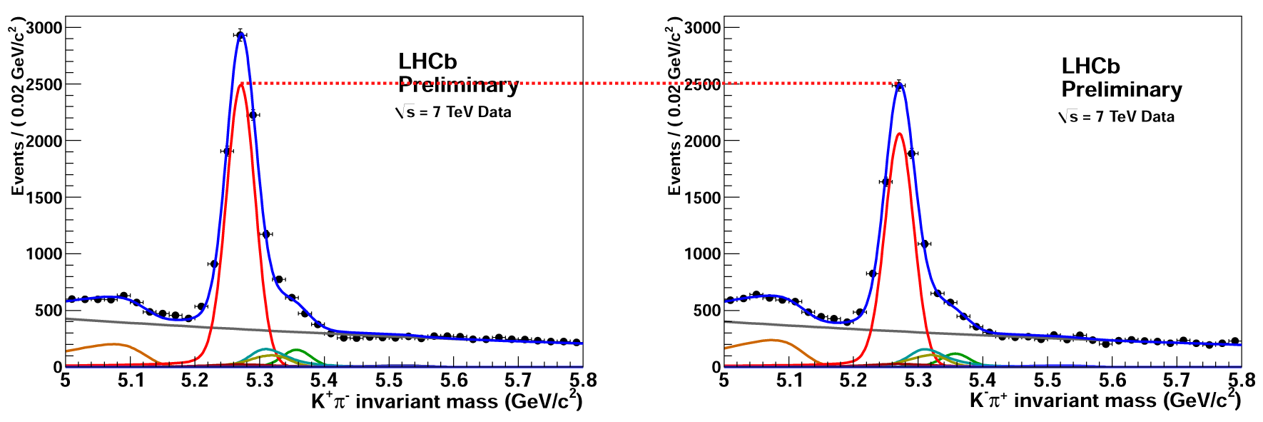
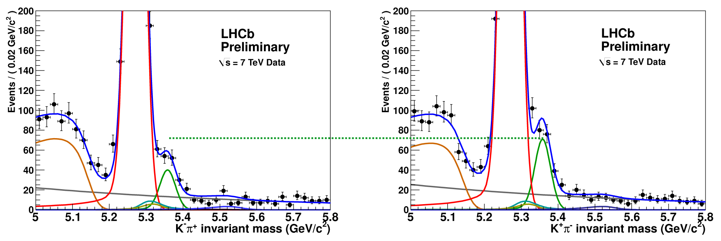
CPV in the decay: B→K⁺π⁻ (0.35 fb⁻¹)
B_{d}→K⁺π⁻
B_{d}→K⁻π⁺
Most precise single measurement! HFAG: -0.098 ± 0.013
B_{s}
B_{s}
PRL 108 (2012) 201601
First 3σ evidence of CP asymmetry in B_{s} decays!

Slide 14
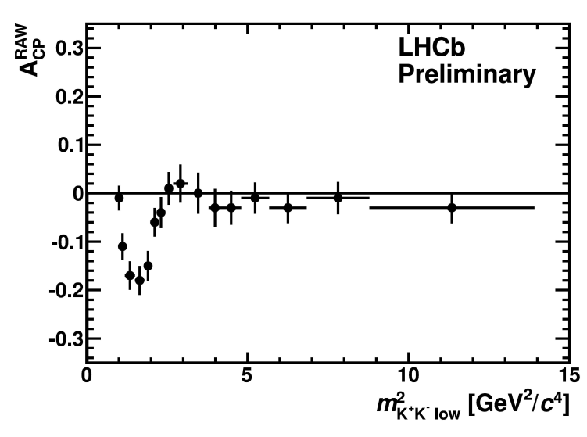
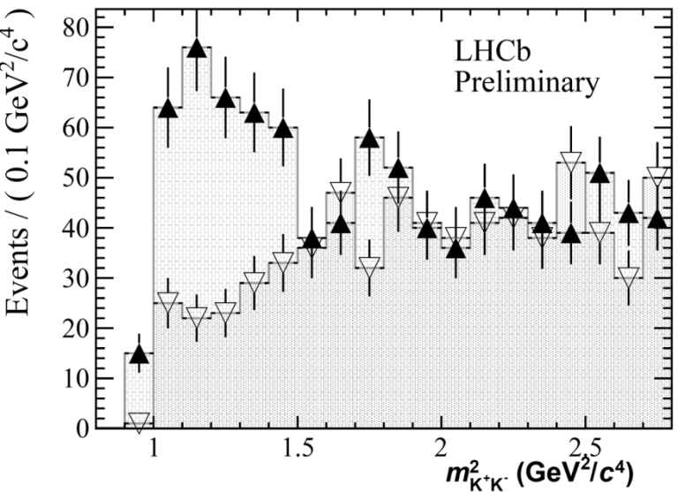
CPV in the decay: charmless 3 body
Collected 10x decays than B-factories ⇒ 1st evidence of CP violation in these decays
Very large in regions of phase-space not clearly associated with resonances
Telling us about the strong dynamics that is generating the strong, CP-conserving, phase difference, necessary for CPV to arise
A_{CP}(B±→K±π⁺π⁻) = +0.034 ± 0.009 ± 0.004 ± 0.007 (2.8σ)
A_{CP}(B±→K±K⁺K⁻) = -0.046 ± 0.009 ± 0.005 ± 0.007 (3.7σ)
A_{CP}(B± → π±π⁺π⁻) = +0.120 ± 0.020 ± 0.019 ± 0.007 (4.2σ)
A_{CP}(B±→π±K⁺K⁻) = -0.153 ± 0.046 ± 0.019 ± 0.007 (3.0σ)
LHCb-CONF-2012-018
rarer
LHCb-CONF-2012-028
B⁺→π⁺K⁺K⁻
A_{CP}^{RAW}(B±→K±K⁺K⁻)
B⁻→π⁻K⁺K⁻

Slide 15
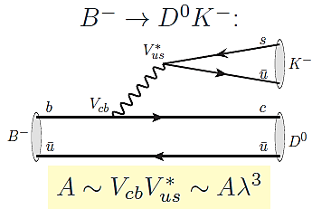
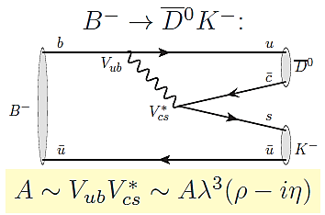
CPV in the decay: γ from trees: B±→D⁰K±
Tree diagrams ⇒ no NP expected
Sensitivity to γ from interference between the 2 diagrams
  D⁰ and D⁰ must decay to the same final state
Challenge: low BR in suppressed modes
_
Method | D decay | LHCb publication
Gronau-London- Wyler (GLW) PLB 265, 172 (1991) | CP eigenstates (D⁰→K⁺K⁻, π⁺π⁻) | PLB 712 (2012) , 203
Attwood-Dunietz-Sony (ADS) PRL 78, 3257 (1997) | Cabibbo allowed D⁰→K⁻π⁺ & double Cabibbo suppr. D⁰→K⁺π⁻ + D⁰→K⁺π⁻π⁺π⁻ | LHCb-CONF-2012-030
Giri-Grossmann-Soffer-Zupan (GGSZ, Dalitz) PRD 68, 054018 (2003) | 3-body D⁰→K_{s} π⁺π⁻ | LHCb-CONF-2012-027

Slide 16
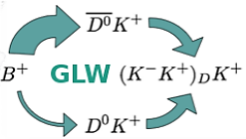
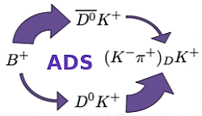
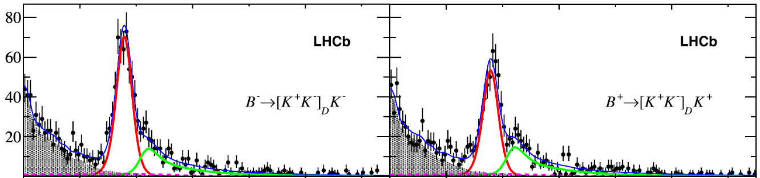
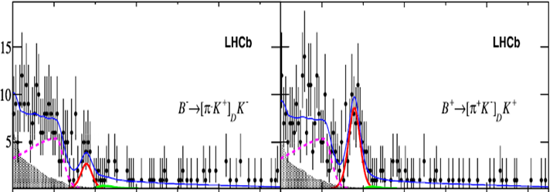
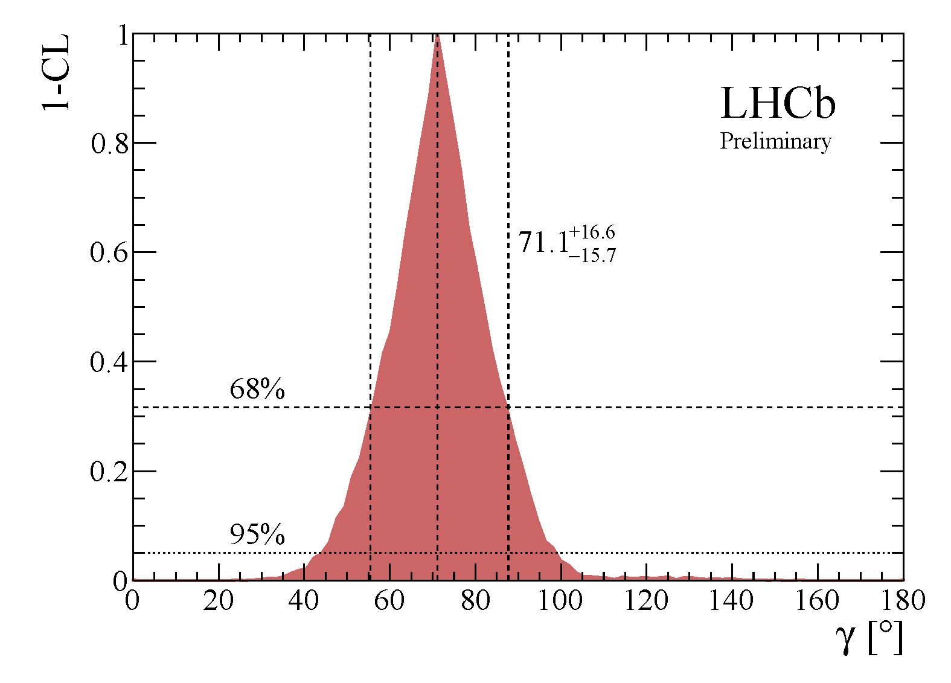
γ from trees: B±→D⁰K± (2)
2 examples:
Result:
4.5σ
4.0σ
γ = (71.1^{+16.6}_{-15.7})°
from B±→DK ±, D→KK, ππ, K⁰_{S}ππ, K⁰_{S}KK or Kπππ
Previous World average:
γ = (66 ±12)º CKMFitter 2012
Soon:
measure γ from loops, like time-dependent A_{CP} in B→h⁺h⁻
Measure γ-2β_{s} from time-dep B_{s} → D_{s}K
B±→DK ±
LHCb-CONF-2012-032

Slide 17
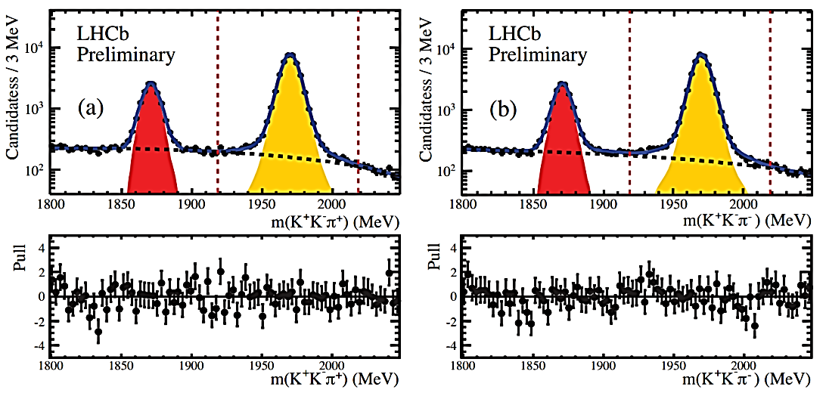


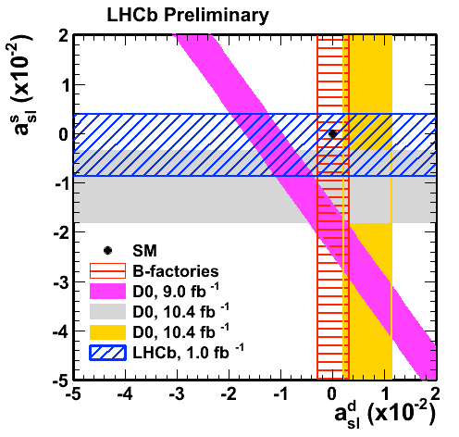
Flavor-specific CPV in B⁰_{s}→μ±νD±_{s}
D_{s}⁺
D_{s}⁻
Use the exclusive
B⁰_{s}→μ∓ν D±_{s}(→ π± φ(→ K⁺ K⁻) )
Production asymmetry diluted by fast B_{s} oscillation
LHCb result:
Interest raised by di-μ charge asymmetry by Dzero, which is @ 3.2σ from SM
a^{s}_{sl} = (-0.24 ± 0.54 ± 0.33)%
World-best measurement
LHCb-CONF-2012-022

Slide 18
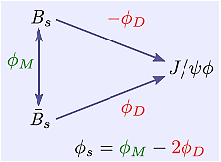
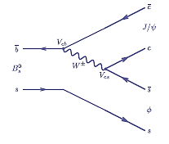
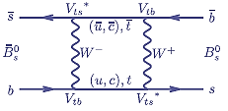
The B_{s} mixing phase with B_{s}→ J/ψφ
Time-dependent CPV from interference mixing-decay. Two amplitudes:
In the SM the phases are:
ɸ_{D} from a tree, robust against NP, but ɸ_{M} can be affected (box)…
ɸ_{s} → ɸ_{s}SM + ɸ^{NP}?
B_{s}→J/ψ(→μ⁺μ⁻)φ(→K⁺K⁻)
ɸ_{M} = 2arg(V_{ts}V_{tb}*) ≈ -2β_{s}
ɸ_{D} = arg(V_{cs}V_{cb}*) ≈ 0
ɸ_{s} = ɸ_{M} - 2ɸ_{D}≈ -2β_{s}-0 ≈ -0.04 (SM)
PRD 84, 033005 (2011)

Slide 19
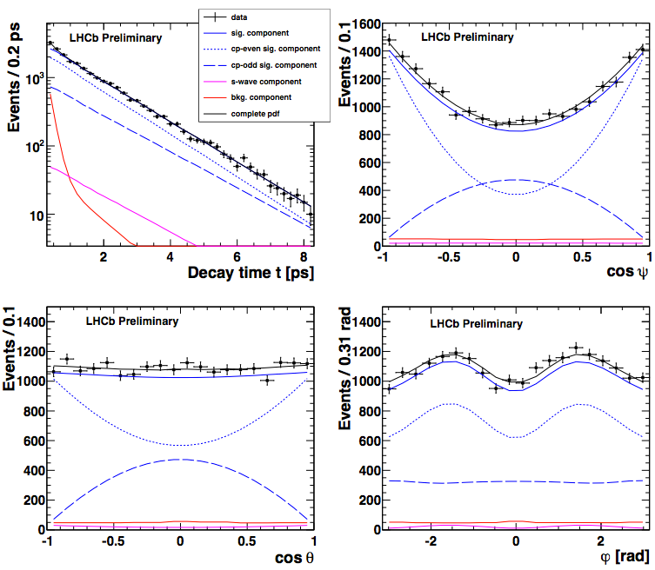
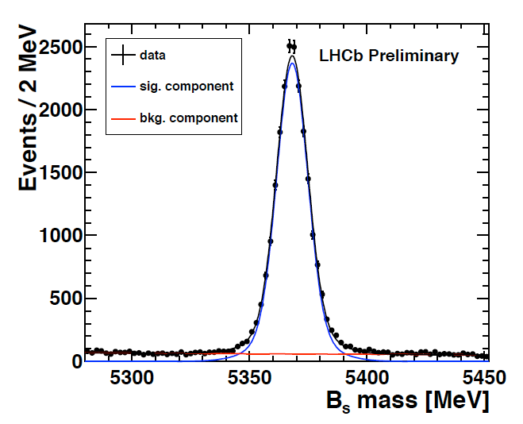
φ_{s} with B_{s}→ J/ψφ
Final state combines CP even-odd ⇒ need to disentangle polarization amplitudes ⇒ angular time-dependent analysis
Effective tagging power ~ 2.3%
World largest sample, high purity

Slide 20
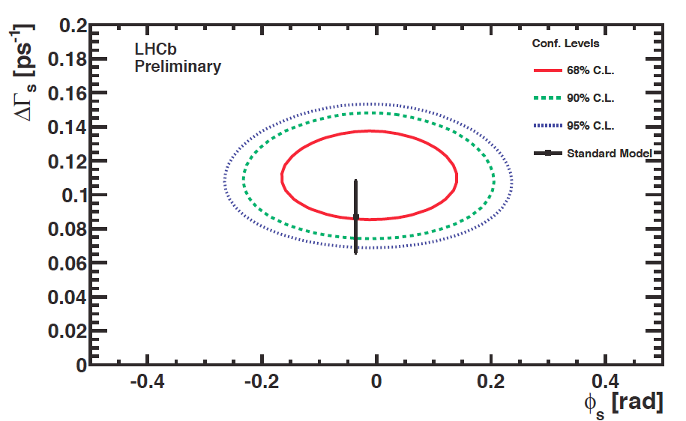
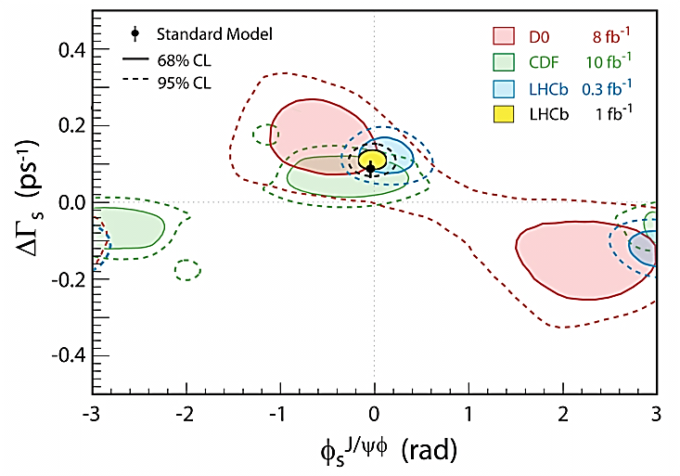
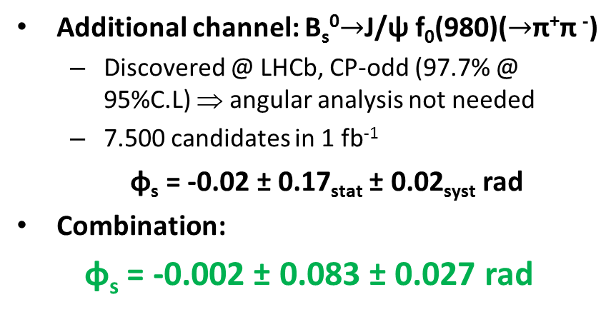
φ_{s} with B_{s}→ J/ψφ: results
LHCb-CONF-2012-002
ɸ_{s} = -0.001 ± 0.101_{stat} ± 0.027_{syst} rad
ΔΓs = 0.116 ± 0.018_{stat} ± 0.006_{syst} ps⁻¹ first observation (> 5σ) of ΔΓs ≠ 0
sign(ΔΓs) resolved in LHCb analysis of strong phase variation vs m(KK)
PRL 108, 241801 (2012)
LHCb-PAPER-2012-005
Additional channel: B_{s}⁰$→$J/ψ f₀(980)($→$π⁺π ⁻)
  Discovered @ LHCb, CP-odd (97.7% @ 95%C.L) ⇒ angular analysis not needed
  7.500 candidates in 1 fb⁻¹
ɸ_{s} = -0.02 ± 0.17_{stat} ± 0.02_{syst} rad
Combination:
φ_{s} = -0.002 ± 0.083 ± 0.027 rad
PLB 707 (2012) 497–505

Slide 21
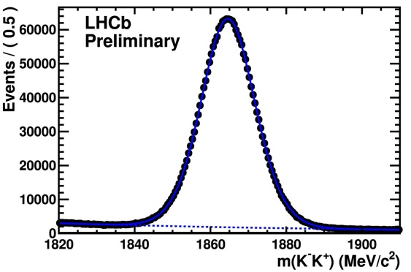
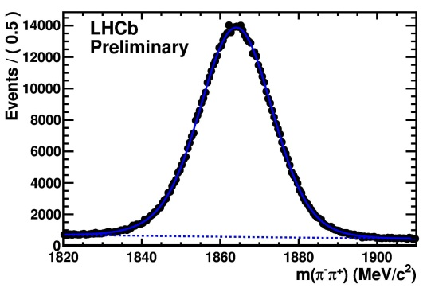
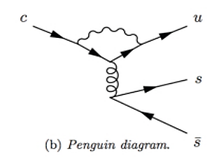


CPV in charm decays
CPV in charm not yet seen experimentally. In SM:
  Mixing and interference: very small and universal amongst CP eigenstates
  In decay: small, O(10⁻³-10⁻⁴) can vary depending on final state
Used D*⁺→π⁺D⁰(→K⁺K⁻, π⁺π⁻ )
To reduce systematics, measure:
K⁺K⁻
π⁺π⁻
ΔA_{CP} = (-0.82 ± 0.21 ± 0.11)%, 3.5σ
But charm theoretical predictions notoriously difficult…

Slide 22
Rare B decays

Slide 23




B⁰/B_{s}→μ⁺μ⁻, 2fb⁻¹
See Paula Alvarez’s talk @ Red de Física del Sabor, Xabier Cid’s talk @ Red Temática LHC
Double suppression: FCNC & helicity
Precise SM prediction:
B_{s}→μ⁺μ⁻ = (3.54±0.30)×10⁻⁹
B⁰→μ⁺μ⁻ = (0.107±0.01)×10⁻⁹
  Buras, Isidori: arXiv:1208.0934
Sensitive to NP in scalar/pseudo-scalar sector: MSSM, large tanβ approximation
  BR(B_{s,d}→μ⁺μ⁻ ) ∝ tan⁶β/M⁴_{A}
Analysis: soft selection + Boosted Decision Tree combining geometrical and kinematic information
  Use the copious B _{(s)} → h⁺h⁻ as calibration
BR extracted from a simultaneous ﬁt to different BDT bins.
B_{s}
B⁰

Slide 24
B⁰/B_{s}→μ⁺μ⁻, 2fb⁻¹
LHCb-PAPER-2012-043
arXiv:1211.2674, Subm PRL
The fit to all BDT bins yields:
BR(B_{s}→μ⁺μ⁻) = (3.17 +1.45 (stat.) ± 0.23 (syst.) ) · 10⁻⁹
  Probability of background-only fluctuation: 5 x 10⁻⁴ ⇔ 3.5 σ
  The result clearly disfavors constrained SUSY at high tan β (F. Mahmoudi et. al. arXiv:1205.3099)
  BR(B⁰→μ⁺μ⁻) < 9.4 x 10⁻¹⁰ @ 95%C.L
      Probability of background-only fluctuation: 11% ⇔ 1.2 σ.
Similar analyses:
  BR(K⁰_{S}→μ⁺μ⁻) < 9x10⁻⁹ at 90% CL
    SM 5·10⁻¹², approaching predictions of NP models
    X 30 improvement wrt previous result (from 1973!)
  BR(D⁰→μ⁺μ⁻ ) < 1.3 × 10⁻⁸ at 95% CL
    Order of magnitude improvement wrt previous results
_{-1.18}
arXiv:1209.4029, subm JHEP
See Xabier Cid’s talk @ Red Temática LHC
LHCb-CONF-2012-005

Slide 25




B⁰→ K*μ⁺μ⁻
BR ∼ 10⁻⁶, many observables sensitive to new operators from NP
Example:
All 2011 data
Last year’s summer
LHCB-CONF-2012-008
In the SM, A_{FB}(q²) flips sign at a well predicted value of q², measured to be 4.9^{+1.1}_{-1.3} GeV² at LHCb

Slide 26


Isospin asymmetry in B⁽⁺⁾→K^{(*)(+)} μ⁺μ⁻
Isospin asymmetry A_{I} , between B⁰→K⁰(K*⁰)μ⁺μ– and B⁺→K⁺(K*⁺)μ⁺μ–
SM prediction: A_{I} ≈ -1% for decays into K*.
Measurements:
Kμμ: Integrating over q²: 4.4σ from 0 seen for B → Kμ+μ– decays. NP? SM?
  Consistent with “hints” from CDF, BaBar (3.9σ), Belle
JHEP 07 (2012) 133

Slide 27








Radiative decays
Published two measurements to date:
1)
  By using World average of BR(B→K*γ), obtained:
BR(B_{s}→φγ to date: BR(B→K*γ), = ( 3.9 ± 0.5 ) 10⁻⁵
2)
SM: (-0.61±0.43)%, some NP models up to -15%!
SM: 1.0±0.2
most precise to date
PRD 85, 112013 (2012)
NPB 867 (2013) 1‐18
See R. Vázquez and V. Rives talks @ Red Temática LHC

Slide 28


Constraints on SUSY
Based on Straub, DM, arXiv:1107.0266

Slide 29
LHCb upgrade

Slide 30


Aim
LHCb: 5 fb⁻¹ in coming 5 years. Upgrade: 50 fb⁻¹
Aim: forward physics + match ~ theory precision in key observables:
How:
  CPU-trigger, upgrade all detectors for read-out @40 MHz
  Increase inst. lumi. x 2.5 to 10³³ (25ns bunch spacing)
Yield increase: x 10 (20) in channels with (out) muons
* Statistical sensitivities, assume measured (or SM) central values

Slide 31
What needs to be upgraded
Replace. 2 options: strips or pixel
Santiago:
Pixel: thinning, slim edges, rad had, tile construction
Micro-strip: sensor design, prototyping and testing
High-speed radiation hard cooper link (5Gbs)
Replace. Outer straw tubes
Inner: strips or fibers. Barcelona:
input stage, shaper for FE ASIC
Decrease PMT gain → lower noise tolerance in R/O electronics. Barcelona: preamp and integrator for FE ASIC
HPD → MaPMT

Slide 32

Conclusions
LHCb obtained many exciting results, most not covered in this talk
  76 papers
  ~100 conference contributions http://cdsweb.cern.ch/collection/LHCb%20Papers?ln=en
LHCb is now the frontier in flavor physics
    BR(B_{s}→μμ)
    B⁰→K*μμ
    γ
    Φ_{s}
    ….
Stay tuned, as we approach the capitulation of the SM
The Capitulation of Granada by F. Padilla: Muhammad XII before Ferdinand and Isabella

Slide 33
Back-up

Slide 34

LHCb Trigger

Slide 35




Performance
Mass resolution Vertexing
σ_{mJ/ψ}= 13 MeV
VELO: @1cm from beam!
σ_{mY}= 47 MeV
Performance ~ MC
B_{s}→J/ψφ (σ_{Bs}= 7 MeV)
σ_{p}/p ~ 0.4 – 0.6 %
p scale ~ 2·10⁻⁴ MeV
σ_{τB} ~ 50 fs
period B_{d}(B_{s}) ~12500(350) fs
Produced World-best b-hadron masses
PLB 708 (2012) 241-248

Slide 36





Performance: particle identification
Κ_{s}→π⁺π⁻
Λ→p⁺π⁻
D→Κ⁺π⁻ from D*
φ→Κ⁺Κ⁻
Probl aerogel?

Slide 37
Upgrade schedule
2012 LHCb data taking (8 TeV)
2013-14 Long Shutd. 1 / LHCb maintenance, first infrastructures for upgrade
2015-17 LHCb data taking (13-14 TeV), double σ_{bb}, σ_{cc}
2018-19 Long Shutd. 2 / LHCb upgrade installation [ Atlas/Cms upgrades phase 1]
2019-21 LHCb data taking (14 TeV) @ 2·10³³
≥ 2022 HL-LHC [ Atlas/Cms upgrades phase 2]
Preparation:
2012-13 R&D, technological choices, preparation of subsystems TDRs
2014 Requests for approval/Funding/Procurements
2015-19 Construction & installation

Slide 38


Search for Mayorana neutrinos
Decays B⁺→h ⁻μ ⁺μ ⁺ are (ΔL=2) strictly forbidden in SM
They can happen through sterile Majorana ν of mass O(1GeV)
LHCb search for a wide range of such decay modes :
No signals found

Slide 39

LFV decays (1)

Slide 40


LVF decays (2)
In addition:

Slide 41

The rarest B decay ever observed (until 11/12)
BR(B⁺ → π⁺μ⁺μ⁻) ~ 2·10⁻⁸
  Partially reconstructed decays (red dotted)
  Misidentified K⁺μ⁺μ⁻ (black dashed)
  Total (blue solid line)
Candidates for which the μ⁺μ⁻ pair is consistent with coming from a J/ψ or ψ(2S) decay have been excluded

Slide 42



Forward Physics
JHEP 6 (2012), 58
Main syst: lumi

Slide 43

b fragmentation functions

Slide 44



Constraints on SUSY
F. Mahmoudi et. al. [arXiv:1205.3099]
Global fit to flavor and high energy observables
  Includes Higgs and SUSY direct searches and flavor measurements
Done for constrained SUSY models, here CMSSM (NUHM1 similar)
What is A0?
all scalar particles mass m₀
gauginos (partners of gauge bosons) same mass m_{1/2}
all trilinear couplings the same: A₀
tan β is the ratio of the vacuum expectation values of the Higgs doublet.
B_{s}→μ⁺μ⁻ disfavors constrained SUSY at high tanβ

