Slide 1






Slide 2
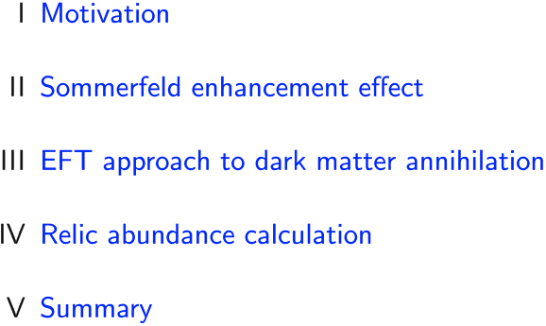
Outline

Slide 3
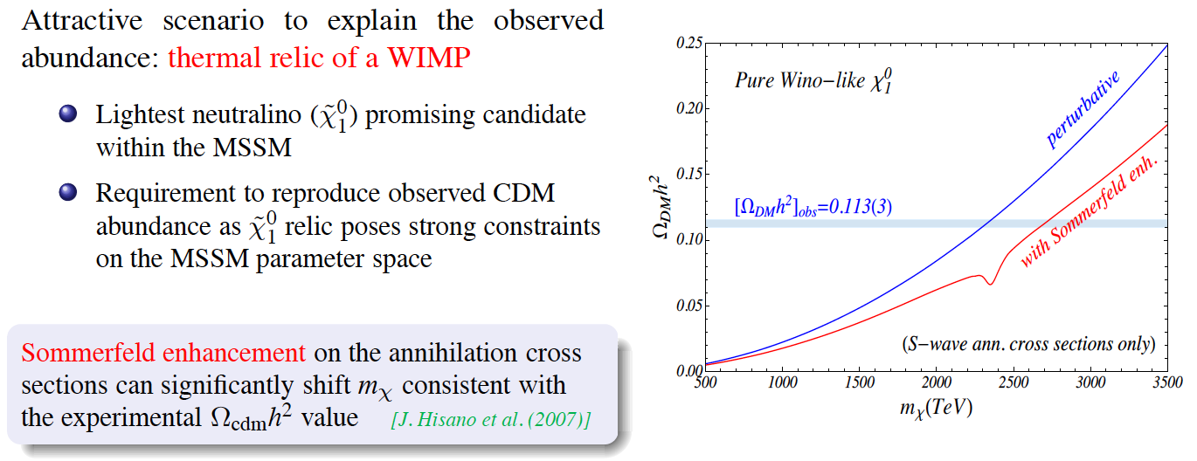

Motivation

Slide 4
II. Sommerfeld enhancement
effect

Slide 5



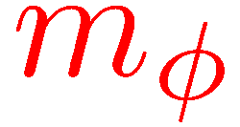

Sommerfeld enhancement for neutralinos in the MSSM (I)

Slide 6





Sommerfeld enhancement for neutralinos in the MSSM (II)

Slide 7
III. EFT approach to dark matter annihilations

Slide 8



Non-relativistic effective theory approach: NRMSSM

Slide 9


Four-fermion operators – MSSM matching calculation

Slide 10






Born-level annihilation cross section: EFT vs MadGraph

Slide 11

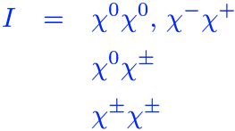


Long-range potential interactions: Sommerfeld factor

Slide 12


Annihilation cross section including long-range interactions

Slide 13
IV. Relic abundance calculation

Slide 14
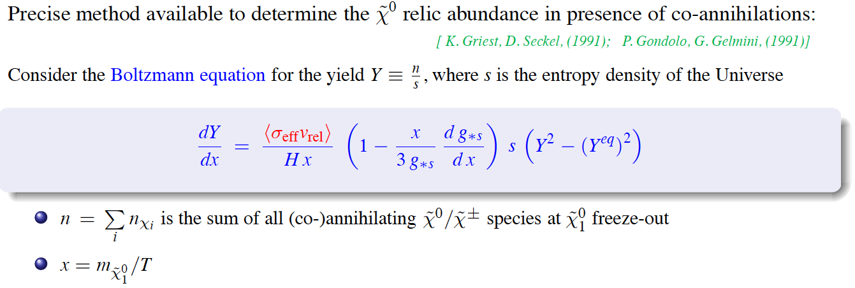

Relic abundance calculation, standard framework

Slide 15











Results for a wino-like neutralino LSP (I)

Slide 16




Results for a wino-like neutralino LSP (II)

Slide 17


Summary

Slide 18
Backup slides

Slide 19
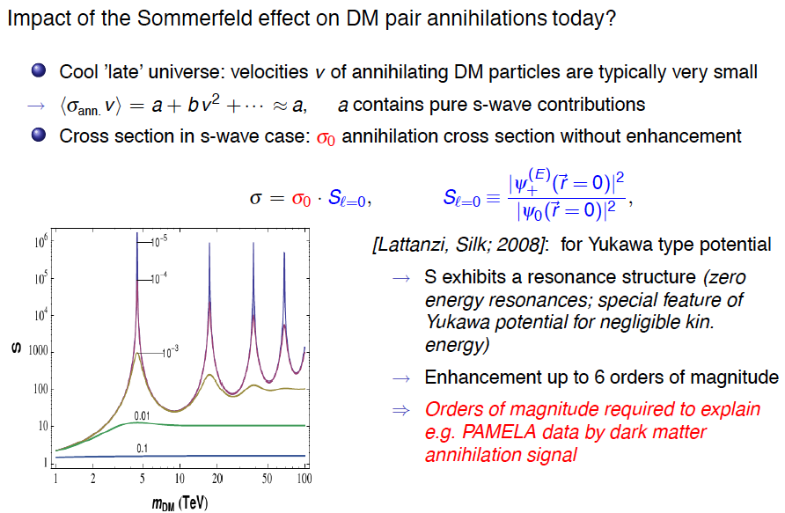
Sommerfeld enhancement in today’s universe

