Slide 1


Measuring top quarks couplings to γ and Z at ee colliders

Slide 2
Introduction
Generally speaking a LC can measure top electroweak couplings at the % level but these measurements are entangled, meaning that photon and Z couplings are not separated
In contrast LHC will measure ttγ and ttZ separately but with poor precision for ttZ
The purpose of this presentation is to indicate a possible way to extract separetely these couplings in a LC

Slide 3

Reminder from Snowmass 2005

Slide 4
Comments
These figures, from the Snowmass study, assume that only one coupling is varied at a time (entanglement is ignored)
In the work of P. Doublet for ILD, it was assumed that only ttZ receives contributions from BSM physics
Measuring ALR and AFBt one can access to the axial and vector couplings of the Z
This was justified under the assumption that only Z would mix with Kaluza Klein particles but this assumption is model dependent

Slide 5

An other observable
In the rest system of the top quark the lepton angular distribution is given by:
where λt=1 for tR and -1 for tL
The angle θ_{hel} is measured in the rest frame of the top quark with the z axis defined by the direction of motion of the top quark in the laboratory
It is easy to reconstruct θ_{hel} at a LC
Only the lepton has the full power analysis

Slide 6
Proposed Method
For each beam polarization, one measures the production cross section which gives access to σ_{L} and σ_{R}
For each polarization, one measures the angular asymmetry of the cosθ_{hel} distribution to extract the fraction of tR and tL
This fraction is simply related to AFB_{hel} which is measured for the two beam polarisations
This provides 4 independent observables needed to extract independently the 4 couplings

Slide 7
Estimate of the accuracies
One assumes the usual standards for ILC: 500fb-1 at 500 GeV with half of the data taken with eR and the other half with eL
Instead of using axial and vector couplings one can use left and right handed couplings which is more natural since one is using longitudinal polarisation of the incident beam
Reconstruction efficiency and purity are almost perfect for total cross section measurements
For semi-leptonic events, used to measure the helicity asymmetry, the efficiency is ~20%
For simplicity one assumes P=100% and β_{t}=1

Slide 8
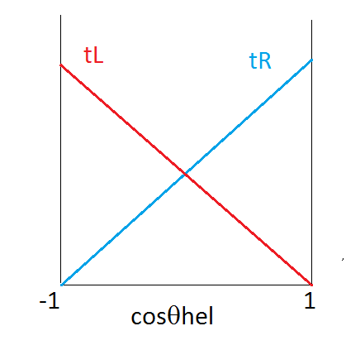
AFB_{hel}
Define F_{R} the fraction of tR in a sample
F_{R}~1 with eR (polarized beams needed !)
AFB_{hel}=F_{R} − 1/2
Defining the 4 helicity combinaisons LeLt, RR, LR, RL and working with polarized beams, one has:
F_{R}=RR/(RR+RL) for eR
F_{L}=LL/(LL+LR) for eL

Slide 9
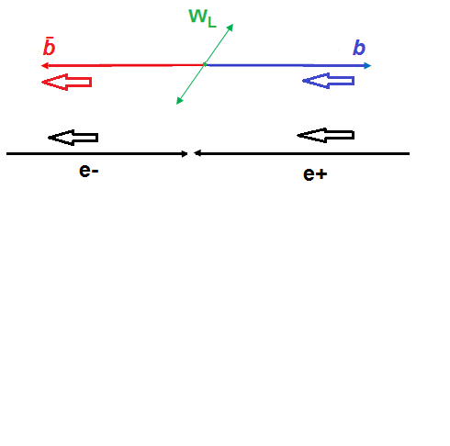
Ambiguity ?
Even with a perfect PFLOW there remain ambiguities for the typical tL configuration
This configuration gives rise to a wrong sign AFB_{t}
This will also change the helicity angle (wrong boost) but not the sign of cosθ_{hel} which remains negative with a soft electron seen in the laboratory frame
Hence the sign of ABF_{hel} will be preserved

Slide 10


Extraction of couplings
Explicitly one can write the four amplitudes LL, RR, LR, RL as the sum of a photon and Z contributions:
AeAt=QeQt+ZeZt where Qe=-1 Qt=2/3 Z=(I3-Qs²w)/swcw I3eL=-1/2 I3tL=1/2
σ_{L}=A(LL²+LR²) σ_{R}=A(RL²+RR²) for the cross sections with P=-1 and P=1
E_{L}= LR²/(LL²+LR²) E_{R}=RL²/(RR²+RL²) (E_{R}=1-F_{R}) for the fraction of tL and tR measures with P=-1 and P=1
AFB_{hel} provides E_{R} and E_{L}
Largest errors comes from AFB_{hel}

Slide 11
Results
Without γ/Z separation one can use the two cross sections, resulting in: dLtZ/LtZ =0.7% and dRtZ/RtZ =1.6%
Degradation by 4 on tL and 3 on tR

Slide 12
Conclusions
It is possible to extract independently the photon and Z couplings at the expense of a limited degradation of the accuracies
The helicity asymmetry observables seem more promising than AFBt since they will suffer less from the eL ambiguities
Realistic studies are needed to assess these statement
I am writing a note on this method

Slide 13
BACK UPS

Slide 14
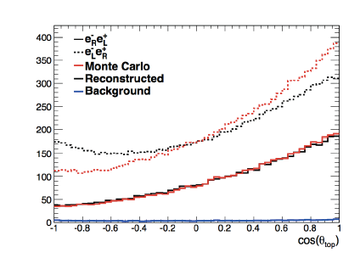
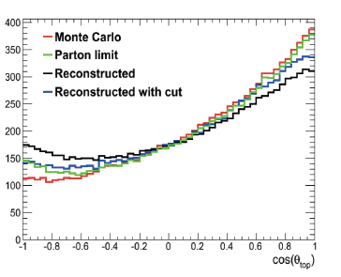
Ambiguities
Philippe Doublet et al. Feb 2012. e-Print: arXiv:1202.6659 [hep-ex]
eL

Slide 15
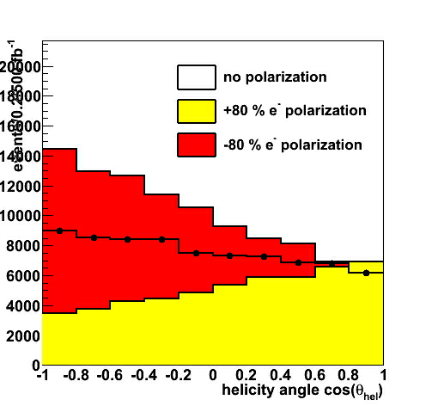
Impact of Polarisation
Marcel Vos

Slide 16
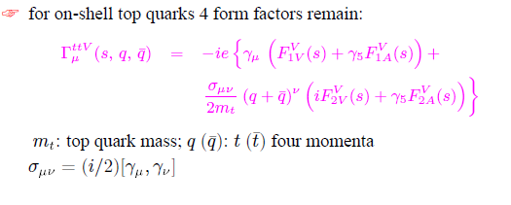
More form factors
G-2 terms
Dipole moments CPV Im and Re

Slide 17
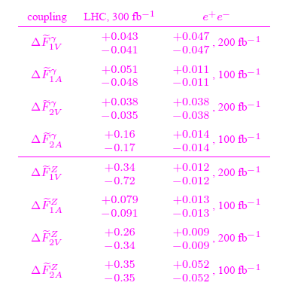
Snowmass 2005

