Slide 1
GIE-ETSI Sevilla Group
Activities 2020 1st Semester
F.R.Palomo, F.Muñoz, R. Carvajal, F.Márquez , E.López-Morillo, R.Millán, J.M.Hinojo, R.Girona
fpalomo@us.es
Departamento Ingeniería Electrónica, Escuela Superior de Ingenieros
Universidad de Sevilla, Spain

Slide 2
2020 First Semester Summary
Covid-19 Impact
  During 5 months, all permissions for travelling abroad cancelled, now opened again
  The group have been working in remote mode, laboratories closed under lockdown and during the preparations for
  biological security
  In mid September the laboratories and facilities were available again
  Our centre, the Sevilla’s School of Engineering is now opened, full of biological security procedures to ensure the
  safety of students and workers, a new set of technologies now fully operational for remote online teaching.
  Today the laboratories and facilities are fully operational, all work-teams back to activity
  If forced by biological security we are ready to go back to full remote operations

Slide 3

¿Where is GIE?
Hybrid Detector Array:
Pixel Detector Matrix bump bonded
Over a Read Out Chip
Data Acquisition System Detail:
FPGA (Virtex) on Semicustom PCB connected
to a PCB bearing the Hybrid detector array
A Detector System is comprised esentially of four subsystems:
  The main detector, in our case a silicon diode array
  The Read Out Chip responsable of processing electrical signals from the detector array and to transform into digital messages
  A Data Acquisition System, tipically implemented with a semicustom PCB with a digital design inside a
  An Electrical Power Unit, with appropriate robustness, reliability and free of electromagnetic interference

Slide 4
Activities First Semester 2020
Grupo de Ingeniería Electrónica (GIE) Strategy:
To get the excelence in two areas of microelectronic design and electronic system integration, useful for High Energy Physics:
  1. Design and Integration of DAQ systems for monitoring and control of ROC chips:
    Work initiated with the ROC4Sens chip
    Hybrid FPGA technology (they combine a logic fabric with arrays of microcontrollers)
Project DERAD (funded, ongoing, with an associated student, 2 years)
  To finish the DAQ RoC4Sens Board
  Different Irradiation campaigns for IP blocks under development

Slide 5
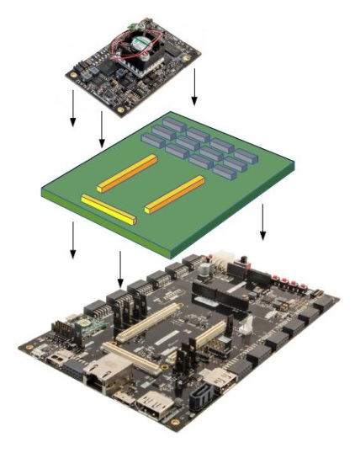
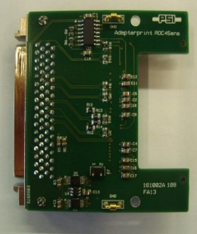
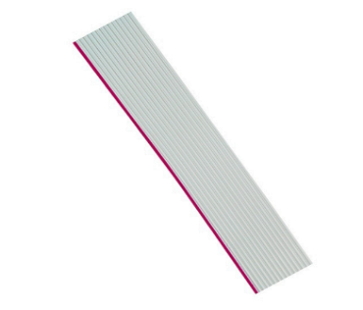
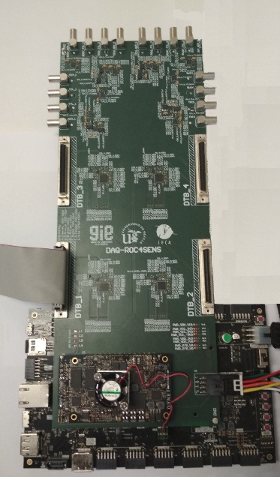
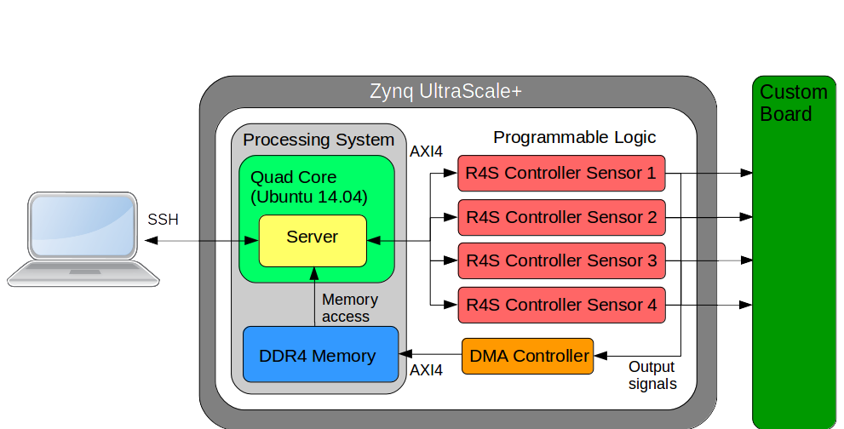
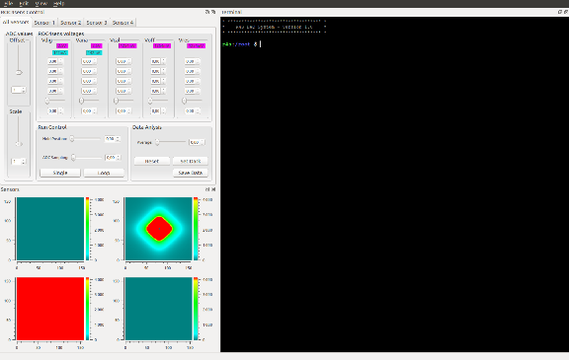
RD50 Roc4Sens DAQ
CUSTOM BOARD
A 10-layer board has been designed
  Instability when linux starts. Sometimes linux is frozen at the first attempt
  High power consumption due to ADCs
Hardware design (VHDL) has been simulated. Only I2C signals have been tested succesfully
Interface
CUSTOM BOARD - DTB ADAPTER
Interface
CUSTOM BOARD - TLU
MAIN IDEAS OF THE PROJECT
Increase the operation frequency
Improving data processing
Simultaneous control up to 4 sensors
Managing TLU with NIM or TTL levels
Use of the current DTB ADPATER
ADCs have been moved from DTB ADAPTER to the CUSTOM BOARD

Slide 6
Activities First Semester 2020
Grupo de Ingeniería Electrónica (GIE) Strategy:
To get the excelence in two áreas of microelectronic design and electronic system integration, useful for High Energy Physics:
  2. Analog and Digital design for Monolithic and Hybrid Read Out Chips (ROC) Híbridos y Monolíticos
    Spin-Off from the cumulated experience in collaboration RD53 (Hybrid ROC for ATLAS and CMS, 2022)
    Design in HVCMOS, working group inside the RD50 collaboration for development of a Monolithic ROC chip (detector and microelectronics in the same die)
Project nanoMAPS (granted, a doctoral student, 4 years)
  Development of full blocks (pixel frontend, pixel backend, integrated logic) in the framework of RD50 collaboration
  IP and components irradiation, radiation hardness simulation and design for the sensor and the electronics

Slide 7
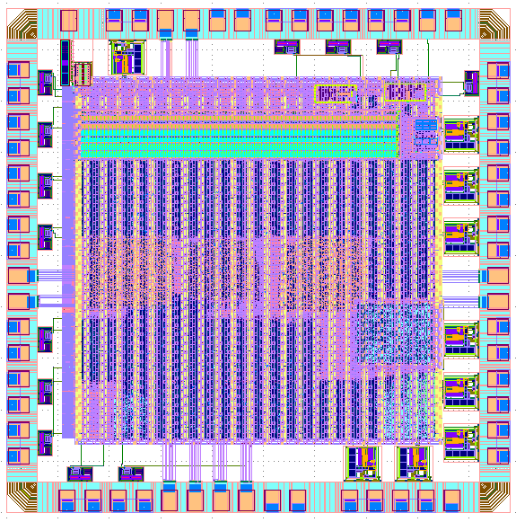
RD53 IP Blocks (Power On Reset, Command Reset)
RD53B has 2 resets: one for Power down, as in
RD53A and an new one for Clock Signal Down
(Clock signal generated from external data flow)
Low Level Command Reset active only (low level)
If detected 20 or less clock pulses. The general reset
in RD53B is a reduction in the CDR/PLL activity due
to a reduced external dataflow. Power On Reset is now
reserved only for Power Down-Up state.
SEU Chip (TSMC 65 nm)
A mini@asic built for testing radiation hardened registers and the reset system for RD53B

Slide 8
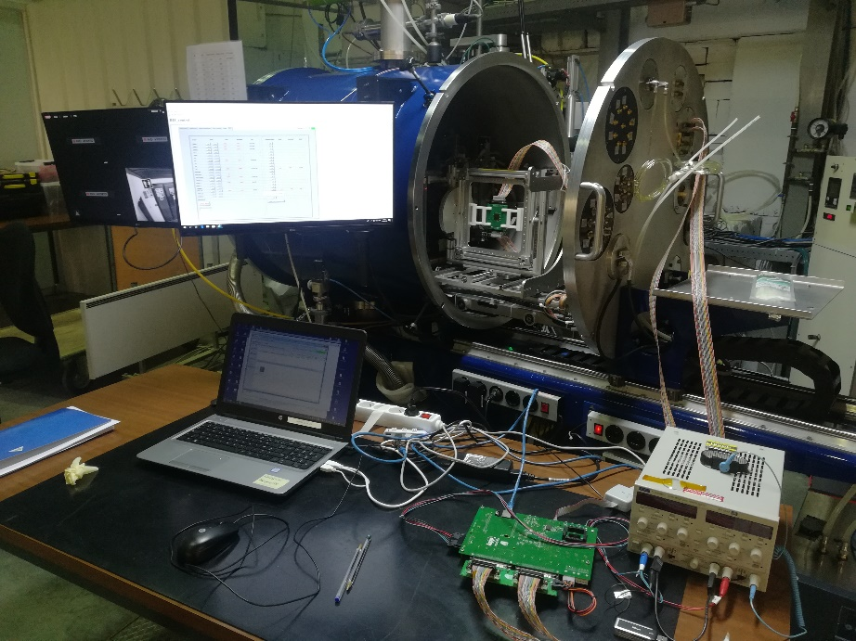
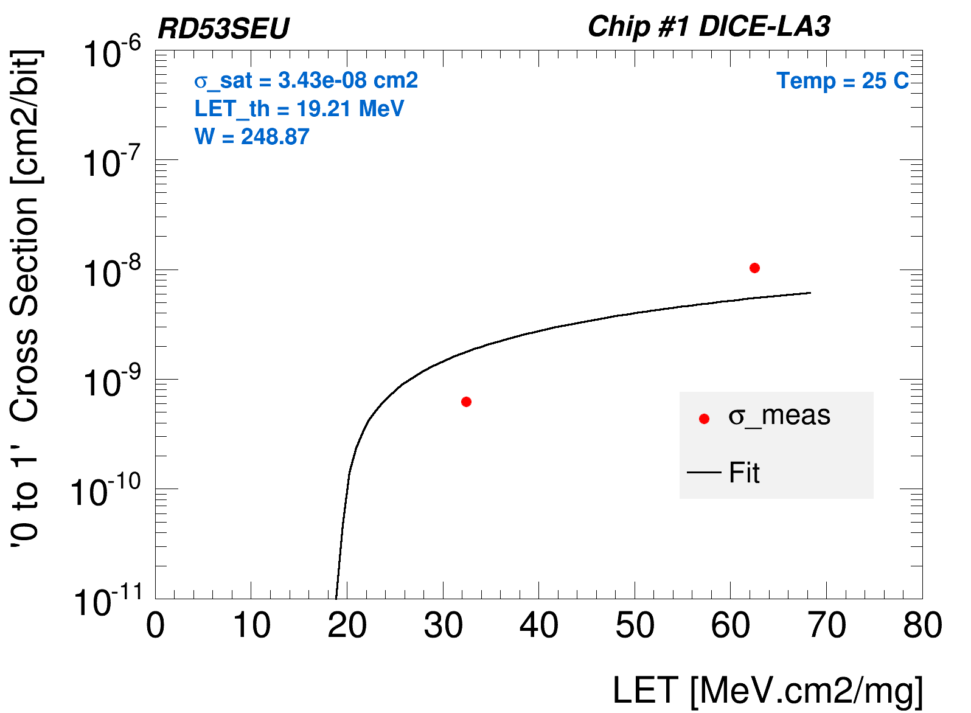
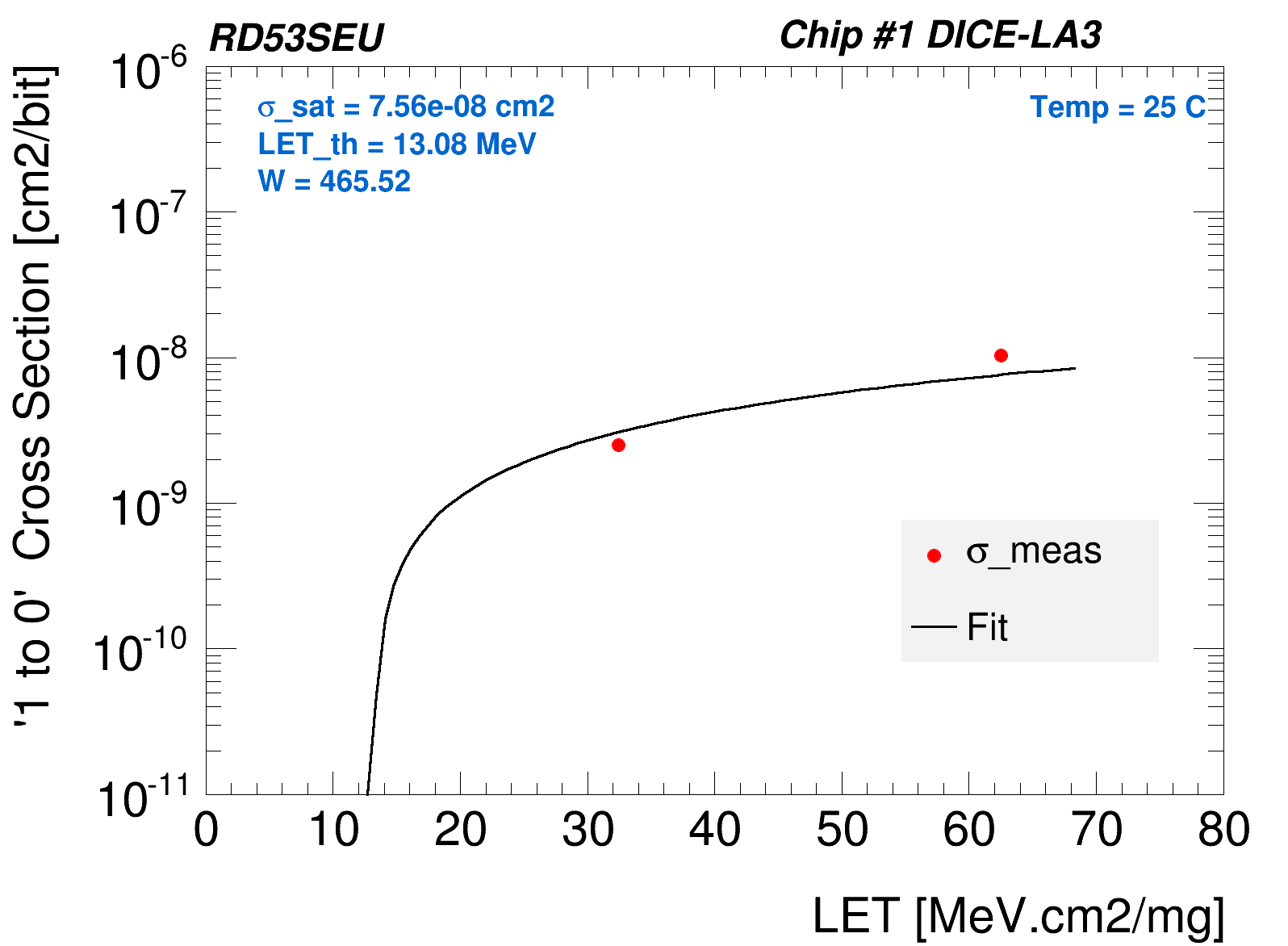
RD53 Irradiations (SEU Chip Louvain)
The CYClotron of LOuvain la NEuve (CYCLONE)
A new DICE design proposed by GIE
Error only detected at High Energies (well beyond the expected 15 MeV-cm²/mg limit expected at LHC)
LET Threshold over the limit
It is an improvement over the conventional DICE register

Slide 9
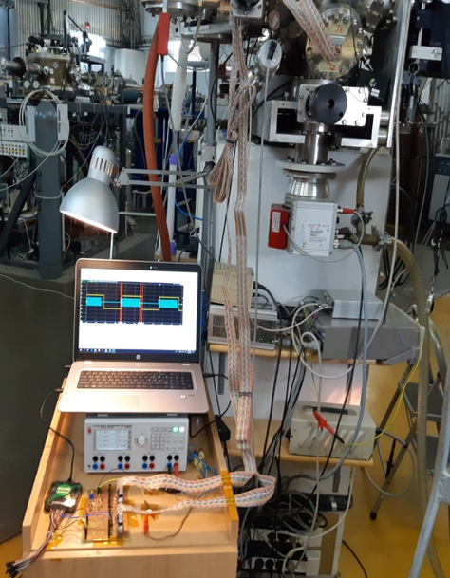
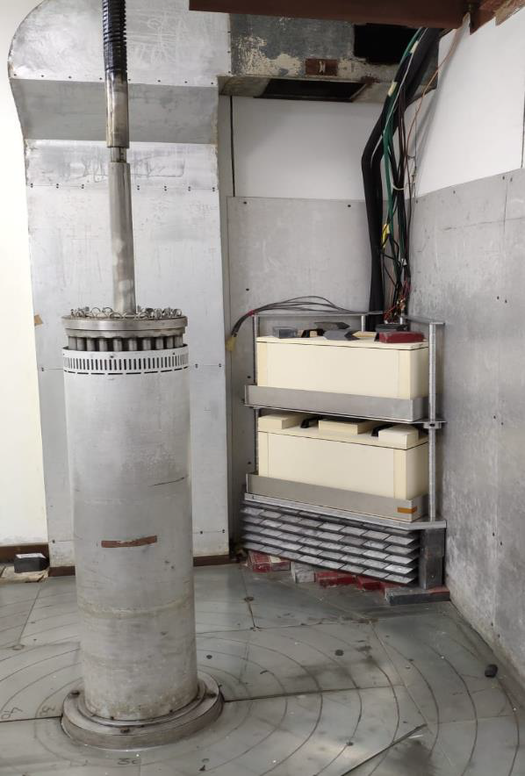
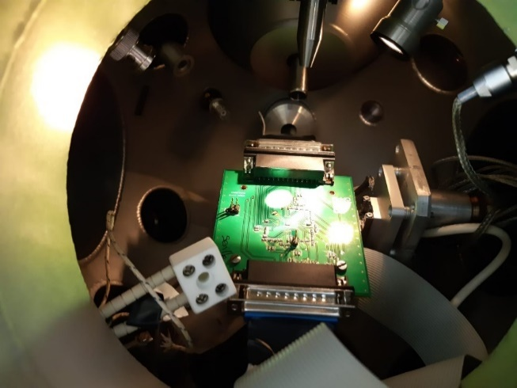
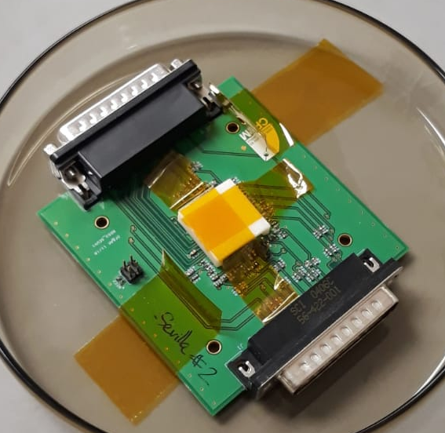
RD53 Irradiations (SEU Chip Zagreb)
Ion Beam from RBI Zagreb Microbeam
Beam over PoR, CMDRst y subblocks (Schmitt-Trigger)
Li9MeV, C14.6MeV
No SETs in PoR-> Qualified
No SETs in CMDRst but we found electrical unstabilities (redesigned)
Gamma Irradiation at the RBI Zagreb Co60 facility (60 days, 6.5 Gy/s)
up to 650 Mrad without errors, well over the 500 Mrad qualification

Slide 10
RD53 DICE latches analysis
RD53 Clock tree study
Final loads (FFs)
L4
Complete new version of the DICE block in SEU chip was laid out, with separate input inverters and a new version of interleaved layout, with some different W/L values in six different “flavours”:
  COL1: Reference design (previous versión; shared input)
  COL2: Separate inverters with Wp=400, Wn= 200, L=60nm
  COL3: Separate inverters with Wp=400, Wn= 200, L=400nm
  COL4: Separate inverters with Wp=500, Wn= 250, L=500nm
  COL5: Separate inverters with Wp=400, Wn= 200, L=400nm
  and modified interleaved layout v1
  COL6: Separate inverters with Wp=400, Wn= 200, L=400nm
  and modified interleaved layout v2 (differ. inverters placement)
  New DICE cell proposed (Sevilla’s Design)
L3
SET sensitivity study to basic clock schemes for:
Different driver strenght (x4, x8, x16)
Inverter/buffer based topologies
Study of redundancy at firts stages
Study of shorted outputs configuration
End
routing
load
L2
L1
Root
Fan-out
routing
load
Fan-out
routing
load
Fan-out
routing
load

Slide 11
RD53 CDR/PLL study
RD53 LVDS TX/RX study
  LVDS Opamp critical transistors affect the amplitude with minor influence.
  Most sensitive TX block: CMFB Opamp
      Impacts in transistors with recovery times of 2 us (for Qinj=0.5 pC)
      This effects can affect the receiver block during similar times.
  A topology modification to the transceiver block, based on analogue redundancy, was proposed and implemented by Univ. Bergamo to increase the robustness.
SET/SEU effects were found, determining critical values of charge and recovery times and most critical blocks.
Suggestions to Univ. Bonn were made to optimize the design that were included in the final chip:
  Introducing triple redundancy to the XOR gate
  Use of larger transistors for the voters
  Size increase (W) in the MUX of the DIV8 output chain.
  In PFD, PD and FD blocks, the analysis revealed some SETs and one-cycle or permanent SEUs could be generated. A testbench for designers was provided to evaluate their influence when running the PLL.
  Permanent SEUs in the tests → limited to one cycle when the loop is active.
  SETs with max. recovery time of 0.4 ns.

Slide 12
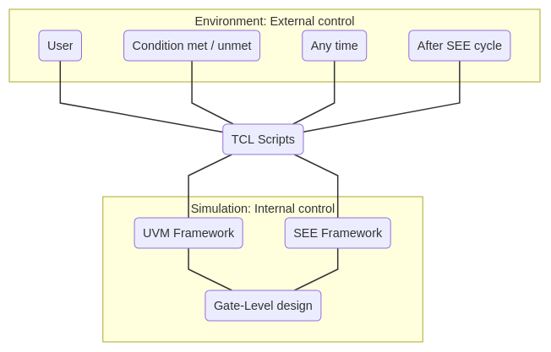
RD53 SEE Software. External Control by a TCL Interface
Definition of blocks to verify and elaboration of design+SEE
  By construction, only one production: less time consuming
Default Initial SEE state off
  Simulation with and without SEE has to be the same
TCL Bidirectional Internal communication with:
  Testbench: To enable/disable SEE
  Generator: Enable/Disable block injection
  Injectors: Enable/Disable a block SEE strategy
  UVM layers: To control the emulated chip and to generate
  a command sequence
External bidirectional TCL communication:
  At moment’s notice
  Tras cada After each complete cycle of injection strategy
  When a condition happens
  In user’s real time, without stopping the simulation

Slide 13
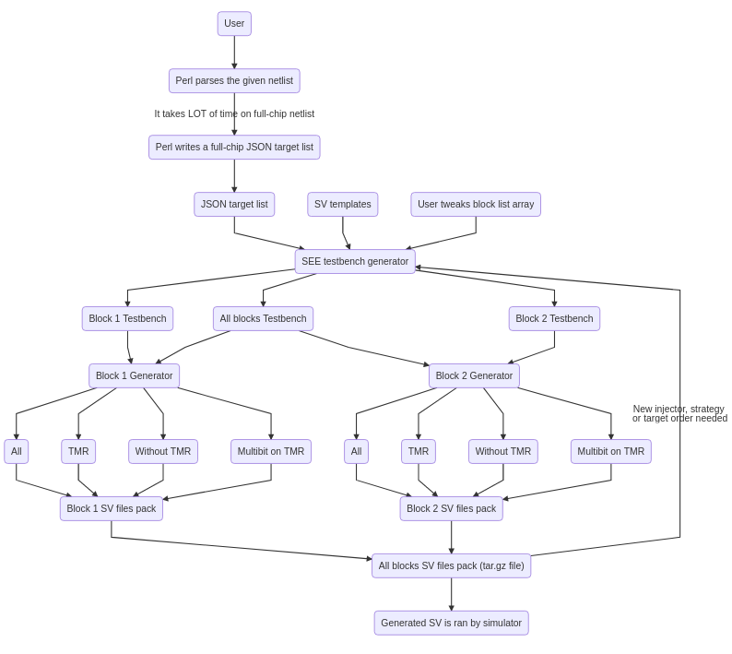
RD53 Verification: SET Injection by blocks
Every possible netlist is now processed only one time, less time consuming
  Previous model was one injector for each netlist
The register available for injection now registered in JSON standard
  A very popular standard
  Third party tools now able to read the register list
The software define the blocks of interest and generates the SEE structure
  Testbenches, toplevel, generator access unified
  Generators, one for each block, injector access unified
  Injectors, one for each strategy
    TMR: Injecting in Tripled elements, one by one
    Validates the triplication strategy
    NO TMR: For non tripled elements
    Validates if tripilication is needed
    Multibit: Injection in pairs of elements
    Validates triplication necessity in case of double hits
    Full Elements: Injection one by one
    Useful for a system global view in final state

Slide 14
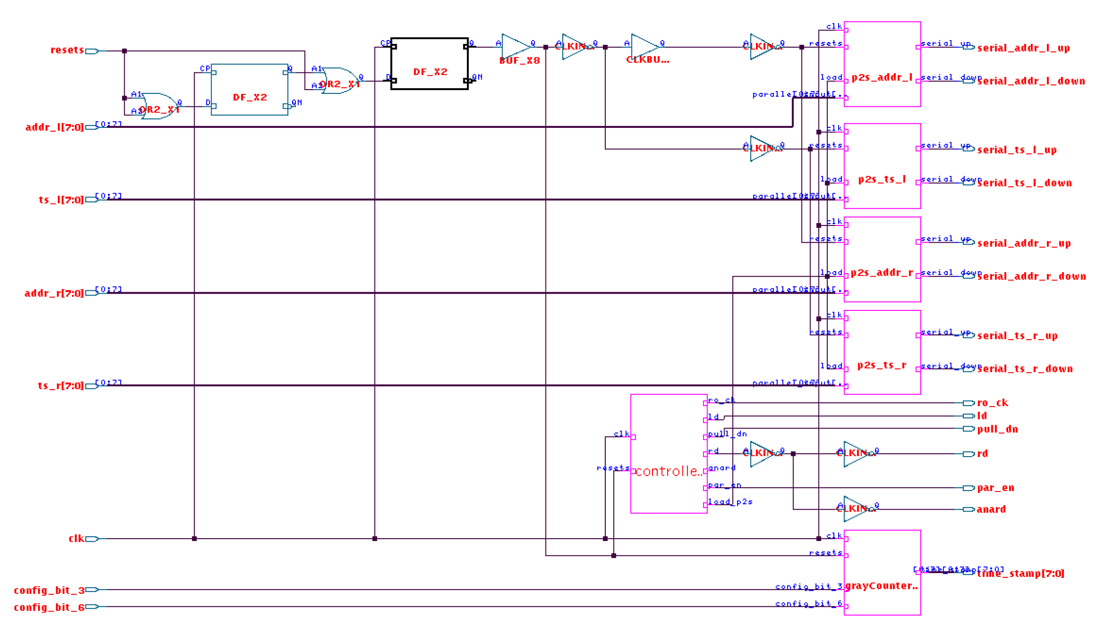
RD50 HVCMOS. Control Unit
Block to process 4800 pixeles
  Organized in 300 columns with 16 elements each
New design for increased versatility
  Operation frequency increased to 200 MHz
  ASIC Clock distribution and generation simplified
  Transmission Rate increased
    4 new serial-parallel registers for transmission of
      Pixel Address
      TimeStamp

Slide 15
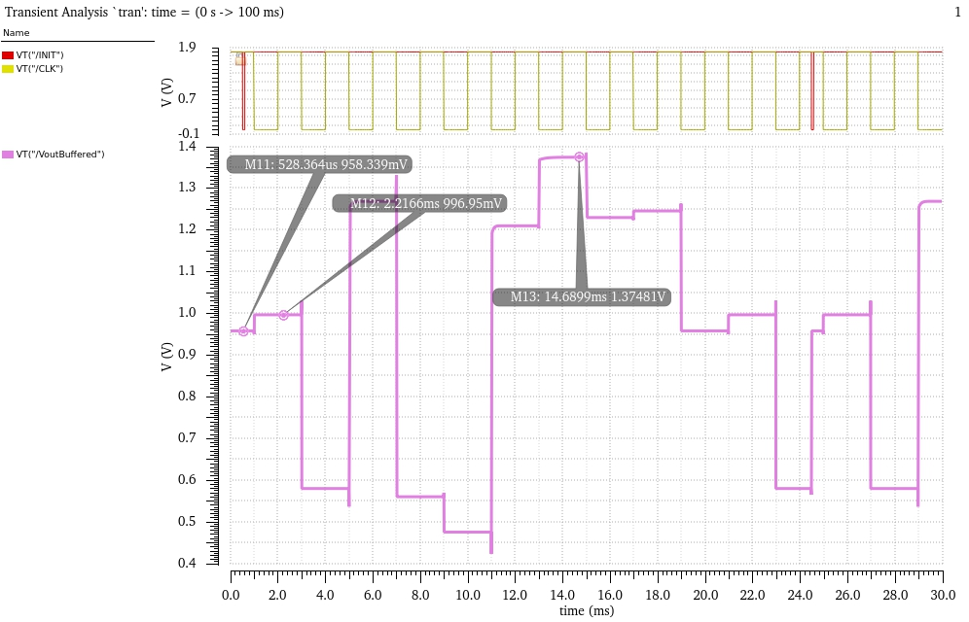
RD50 HVCMOS. Analog Buffer
Characterization of an analog voltage buffer
  Power Consumption
  Gain
  Dynamic Range
Proposal of a measuring system for up to 10 polarization voltages
  Design of an analog multiplexer
  Shift register solution to minimize the number of necessary pads
    Reset, the initial shift register state
    Enable, a left shift for every clock leading edge
    Voltage to measure

Slide 16

Thanks for your attention
fpalomo@us.es

