Slide 1




Instrumentation Activities for Future Accelerators at IMB-CNM / IFCA / ITAinnova
Red Futuros Aceleradores
IFT, Oct 6th 2020
F Arteche, S. Hidalgo and I. Vila

Slide 2
Outline
R&D activities update since the last meeting.
Caveat: Selected highlights, not comprehensive review.

Slide 3





R&D Topics (Spanish stakeholders)
Small-size cell 3D pixels
Radiation tolerance
Cell form factor
Low Gain Avalanche Detectors
Radiation tolerance
Two-Photon-Absorption TCT
Top-bench fiber-based femtosecond laser commissioning
SPIN OFF 1:
RD50 Radiation tolerance of
DMAPS project
100% fill factor, small pixel size (4D timing)
Manufacturing and interconnection yield,
Inner Tracker and Endcap Timing Layer Module design & assembly
Infrastructure commissioning: assembly robot, wedge bonders, Q&A testing
SPIN-OFF2:
Silicon Defect spectroscopy/light DM direct detection
Manufacturing yield and uniformity
Validation of integration procedures (ITK, ETL)
EMC and RD53 Simulations

Slide 4
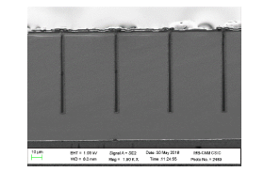
Update on R&D on 3D pixel sensors
This year’s characterization milestone:
  to demonstrate the radiation tolerance of RD53A + IMB-CNM assemblies up to 2e16 n_eq/cm2
  35 bare assemblies with different geometries prepared.
  Still waiting for test beam characterization of irradiated samples (difficult access to the test beam facility due to pandemic constrains).
Technology milestones:
  First production on CMS ROC first prototype (CROC) by Q2 2021
  Technological improvements: yield, reverse current, bowing.
System-wise milestones:
  Assessment of vertexing performance using a the CMS detector full simulation including a specific description of 3D sensors.

Slide 5
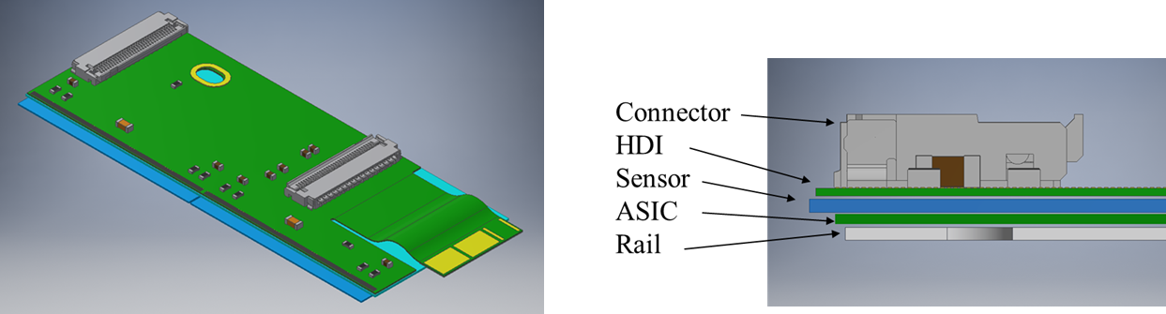
Update on (IT and ETL) module design & assembly
Extension of IFCA clean room completed (now about 60m2 ISO 7)
Completed the wedge bonder installation and programing of robotic gantry for automatic module assembly (Inner tracker and Endcap Timing Layer Modules).
Major contribution to the RD and production of the “IT 1X2 Module” (inner layer/disk building block)
IFCA: RD on 3D sensors and module integration.
IMB-CNM: RD on 3D sensors and 3D sensor production.
ITAINNOVA: RD on HDI, serial powering and EM noise suppression (also members of the ASIC collaboration RD53)

Slide 6
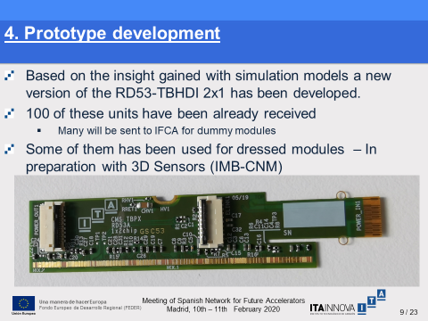
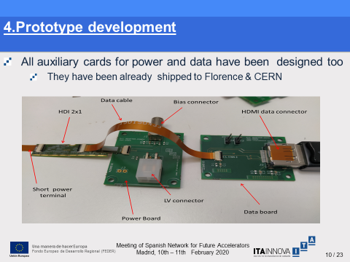
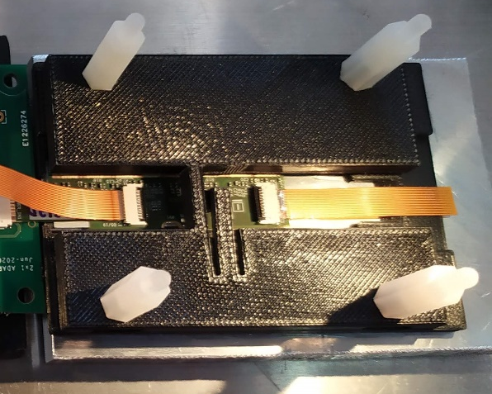

Update on (IT and ETL) module design & assembly (2)
    They have been already shipped to Florence, ETH & CERN
First 2x1 module equipped with 3D sensors

Slide 7
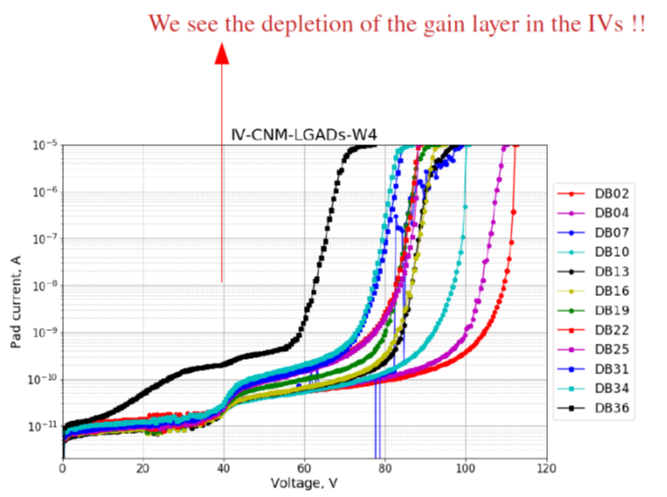
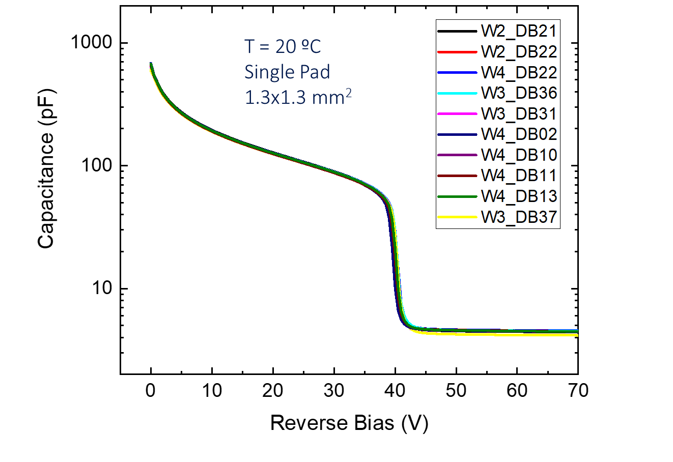
R&D on LGAD
Current milestone:
  New LGAD production with lower inverse current. Initial irradiation completed (testing to start soon).
  Focus on improving gain uniformity.
Medium/short term plans (getting ready for LGAD Market Survey) dedicate production with final sensor layouts.
V_{GL} ∼39-40 Volts

Slide 8
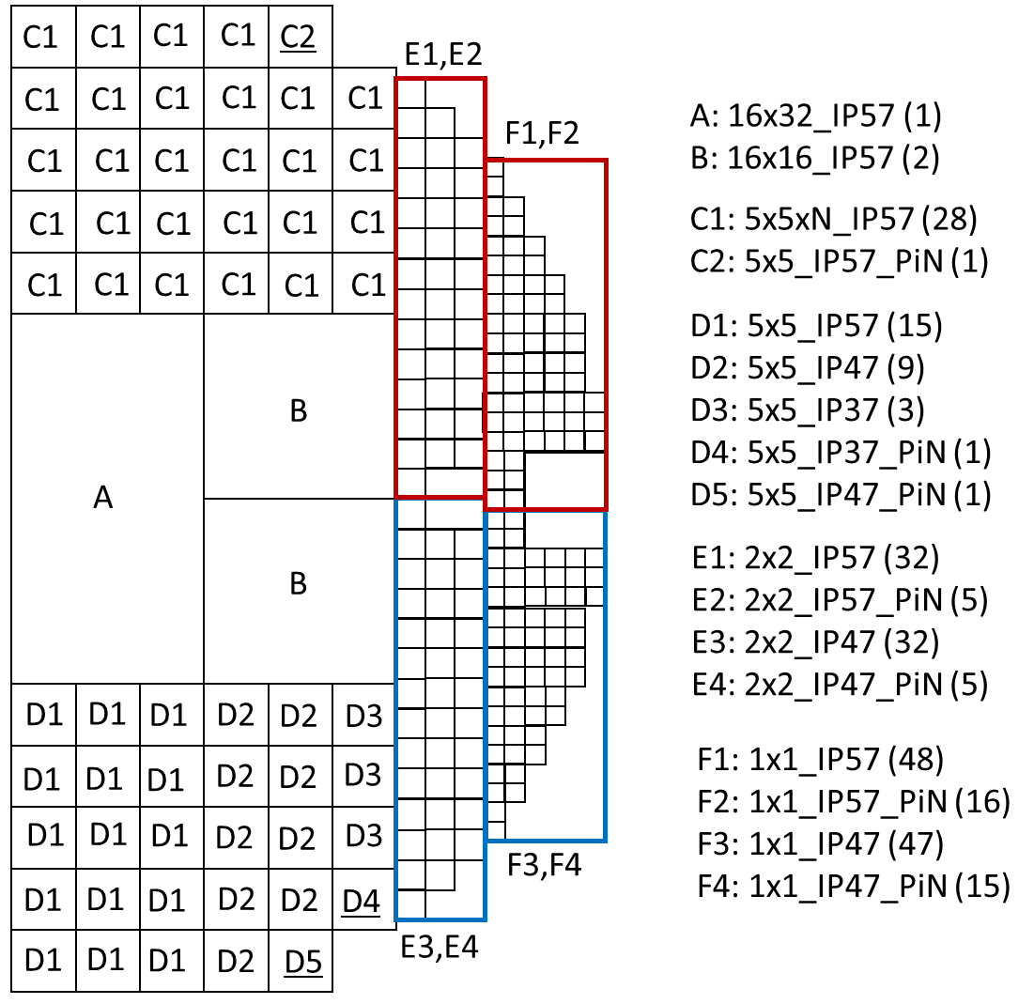
R&D on LGAD (2) – MS run (LGAD 6LG3)
50um active thickness.
6” wafers: Epi, SiSi and SoI wafers
Slim Edge to 500 µm (SE5)
3 Inter-Pad Gaps: 37, 47, 57 µm (IP37, IP47, IP57)
Run on Epi wafer started two weeks ago.
5 months turnaround time.

Slide 9
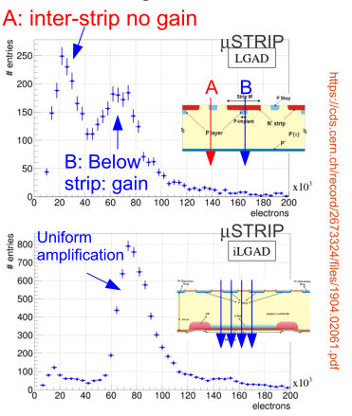
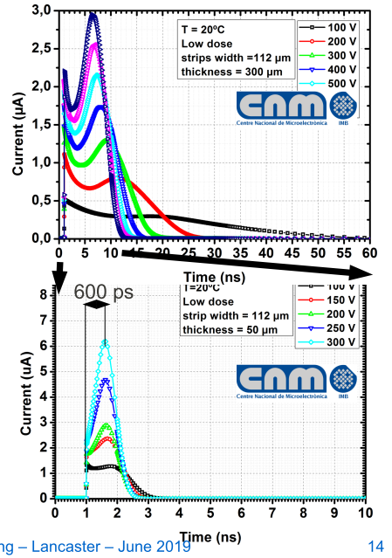
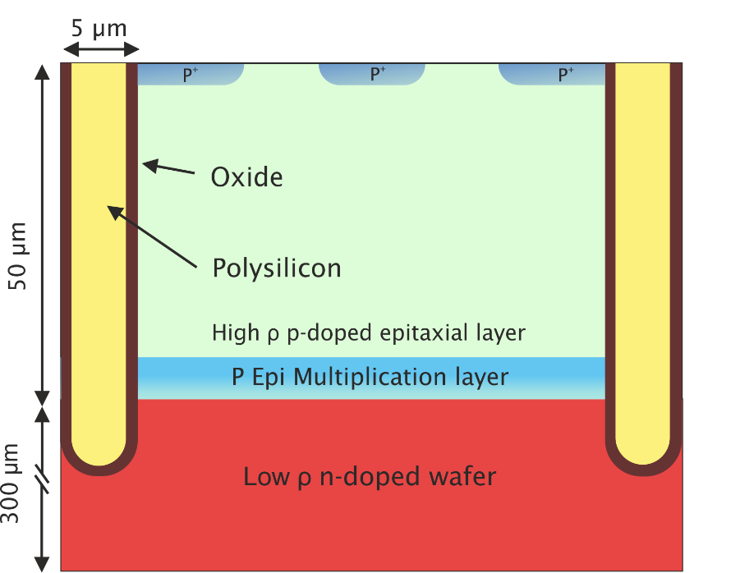
R&D LGAD(3) ILGAD towards 100% fill factor
RD50 Project on thin I-LGAD in progress, to achive both high-precission timing and tracking

Slide 10
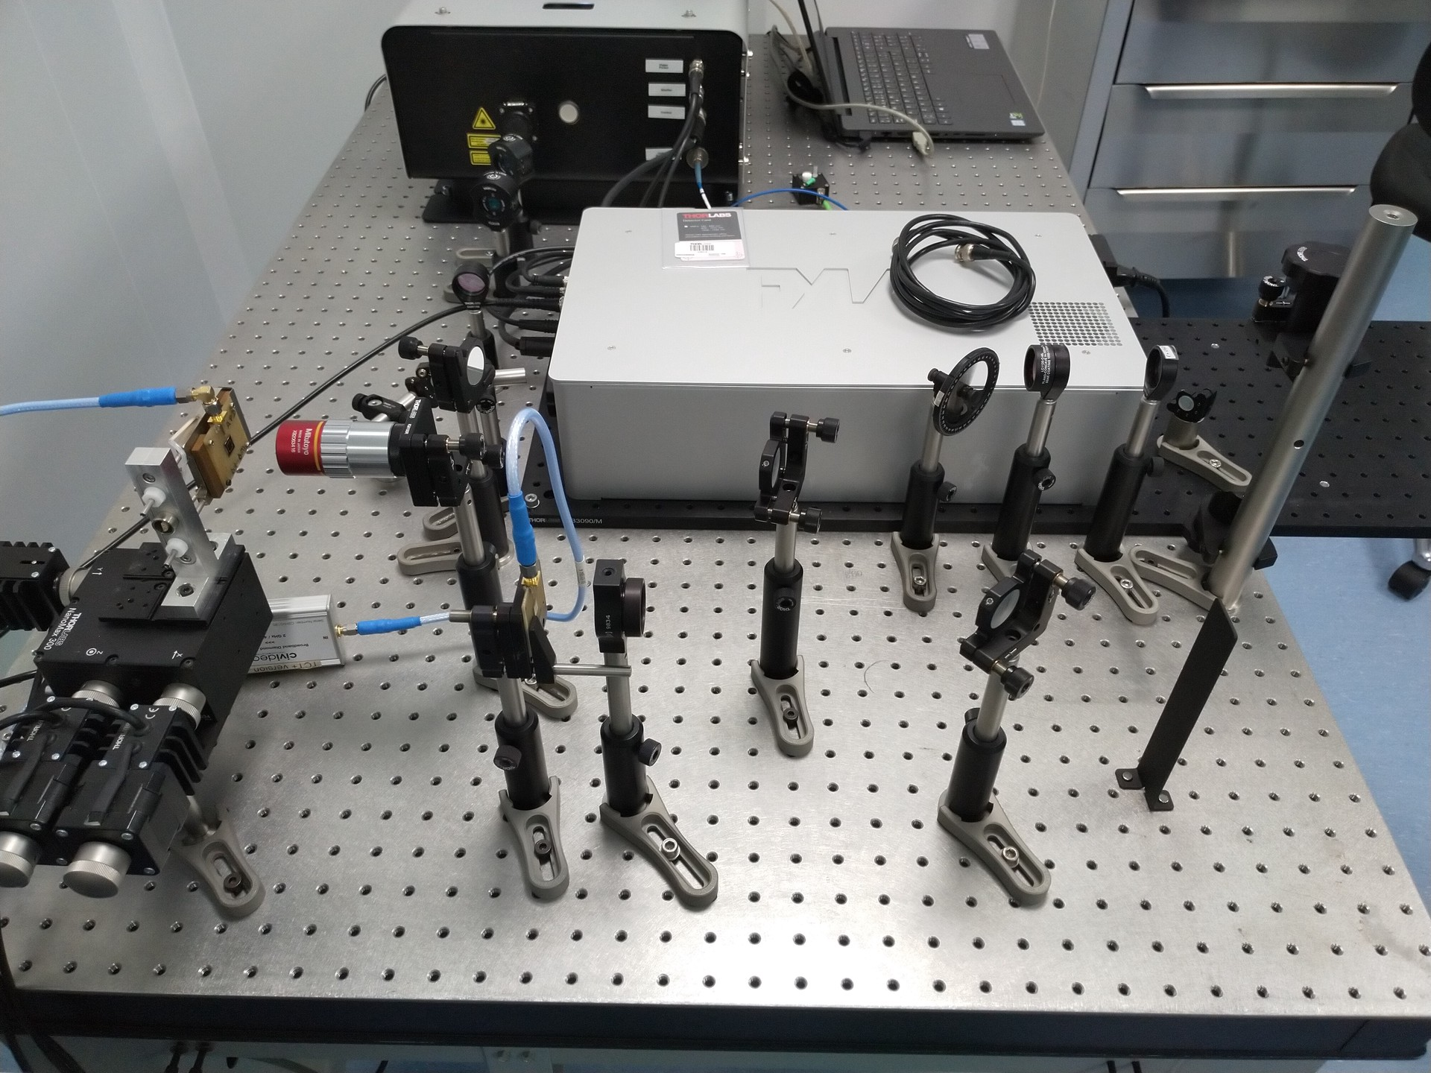
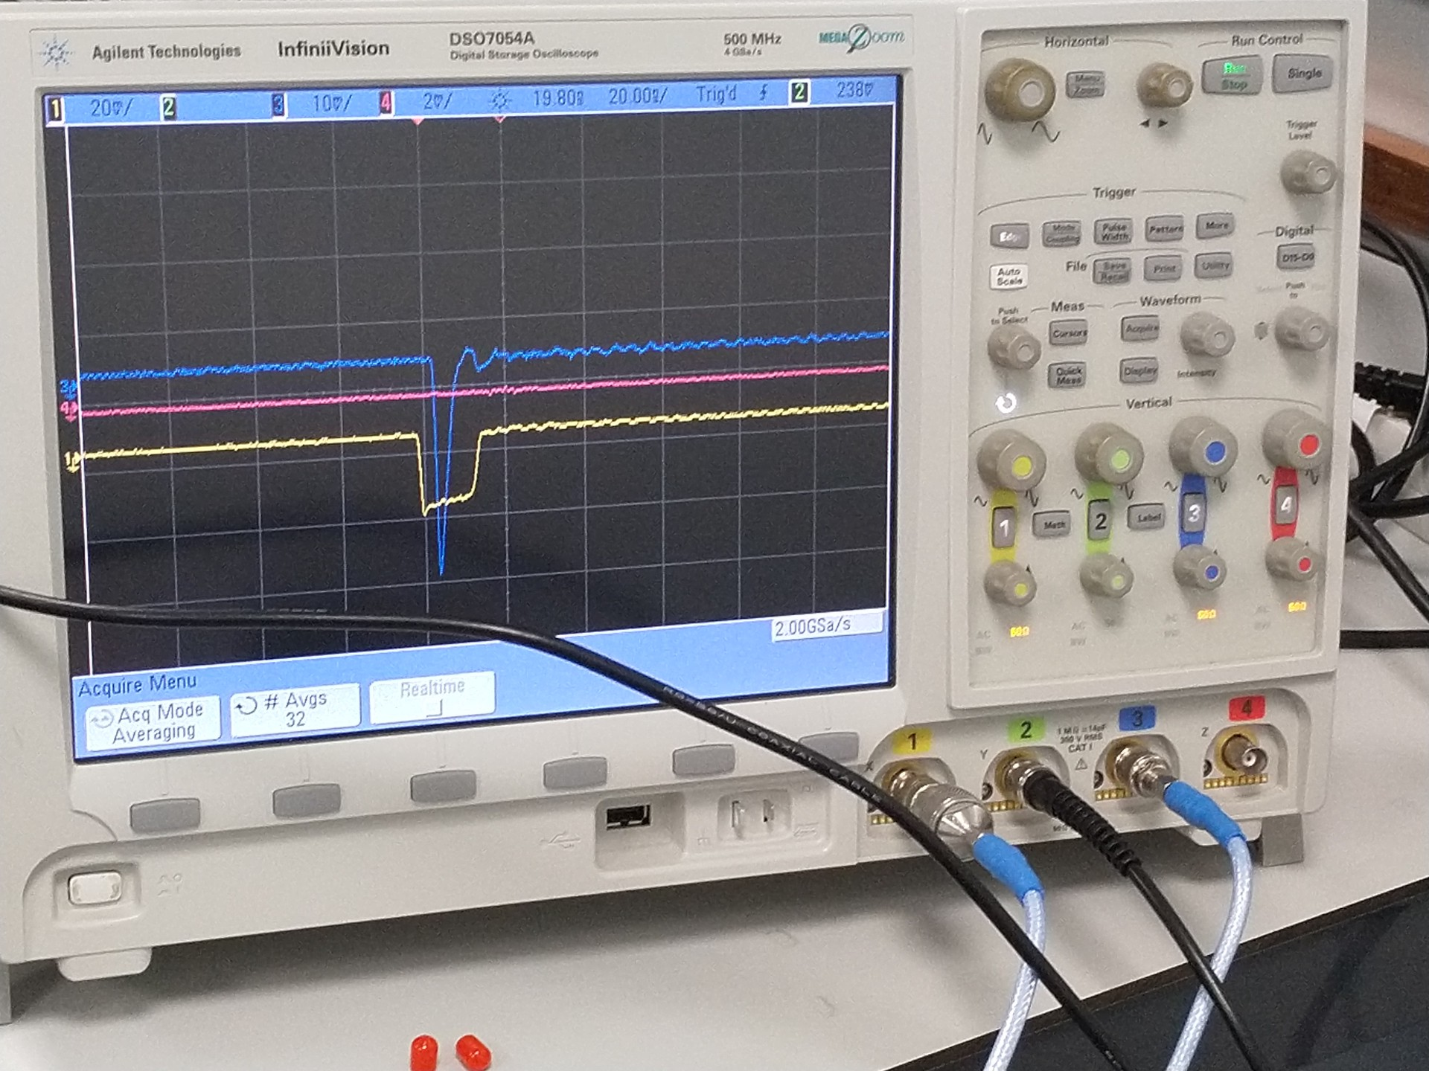
TPA-TCT
Installation and commissioning of top-bench femtolaser at IFCA

Slide 11
Outlook
Lab activities during the pandemic are limited and complex.
In 2020 still the main share of the activity on CMS IT and ETL.
  Completing the RD on sensors (3D and LGADs) by 2021
  Maintain the RD on serial powering for the IT.
  Moving to:
    assembly infrastructure commissioning (IT & ETL)
    sensor market survey and pre-production (IT & ETL).
Exploratory RD for future experiments:
  ILGAD project progressing (defining the device layouts)
  Commissioning of the new TPA-TCT setup at IFCA (DMAPS and light DM direct detection)

Slide 12
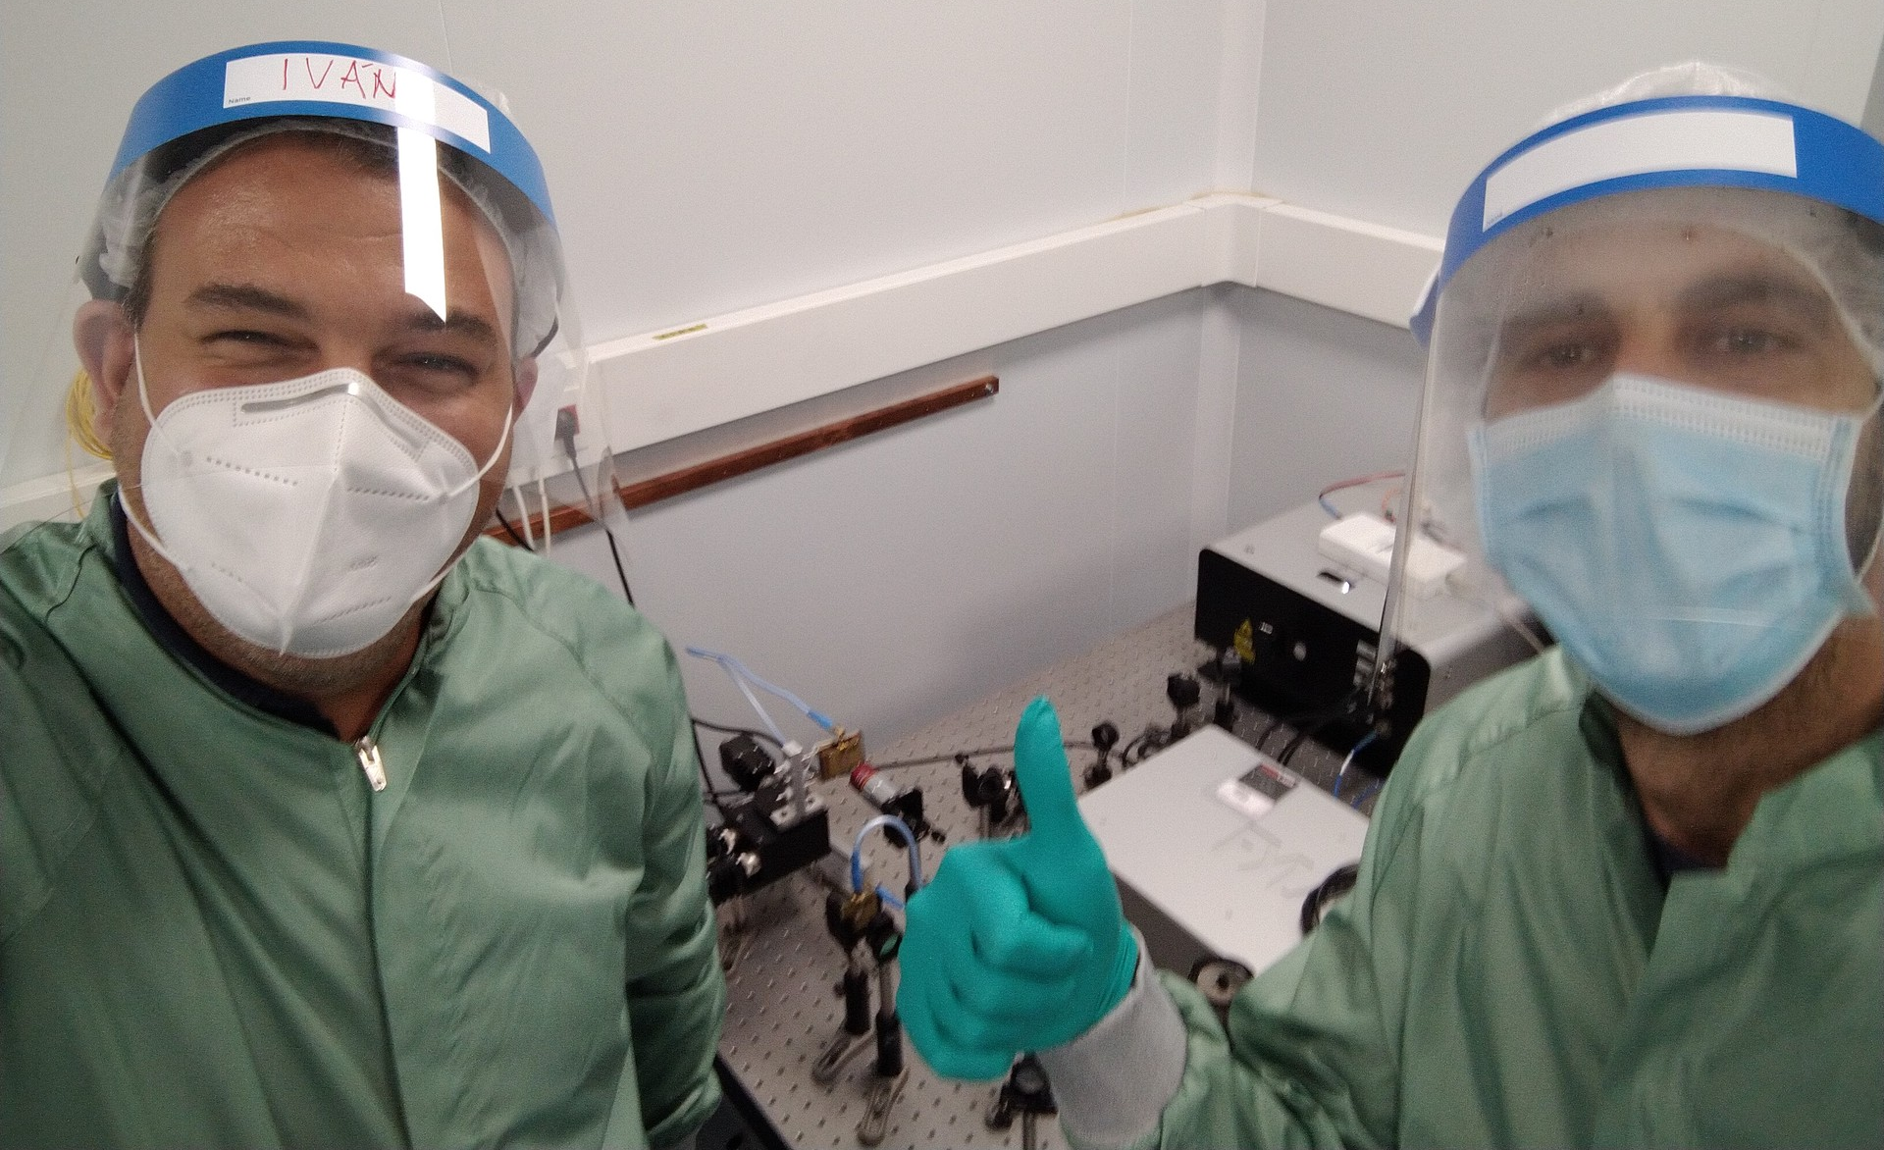
Thanks and stay safe!

