Slide 1
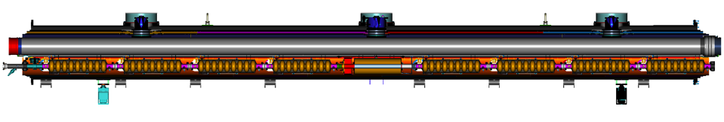



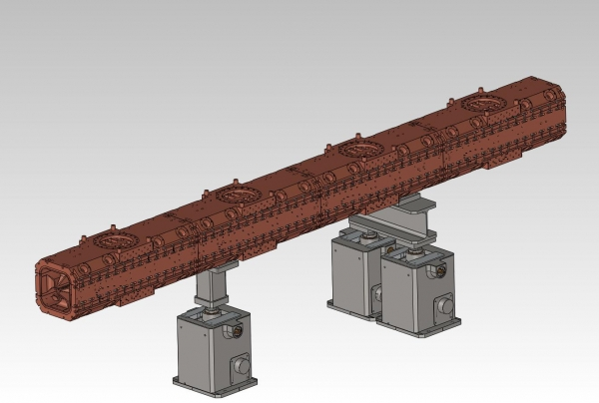
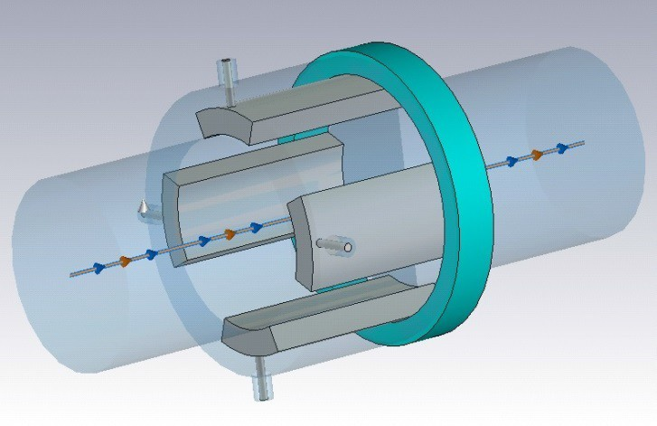
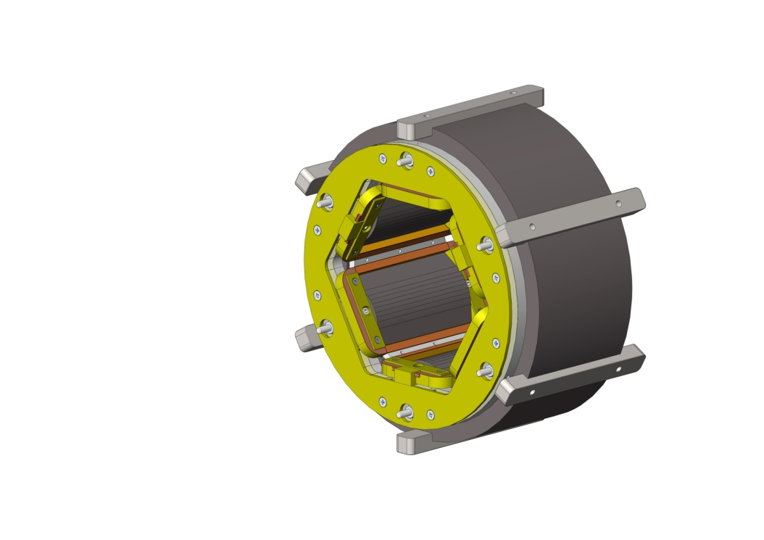
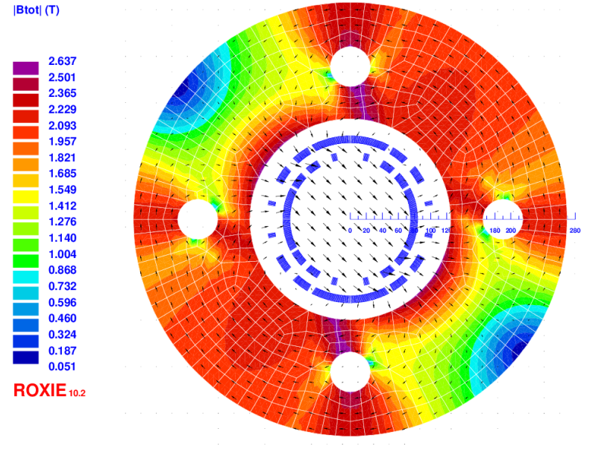
Luis García-Tabarés
CIEMAT
Daniel Esperante
IFIC
Benito Gimeno
U. VALENCIA
THE CIEMAT & IFIC CONTRIBUTION PROPOSAL TO THE ILC FACILITY

Slide 2
The CIEMAT/IFIC Preliminary Proposal for ILC Contribution (1)
CIEMAT & IFIC Contribution to the ILC LINAC
1.- SCOPE OF THE CONTRIBUTION
The splittable, conduction cooled superconducting magnets allocated in the Main Linac Cryomodules to focus and steer the beam.
The contribution includes the Magnet Power Supply and the Beam Position Monitor.
REFERENCE MAGNET Splittable magnet for LCLS-II
 | ILC Cryomodule Magnet |  | E-XFEL Cryomodule Magnet
Type: Combined | QUADRUPOLE | DIPOLE (2 H&V) | QUADRUPOLE | DIPOLE (2 H&V)
Overall Nº of Magnets | <315 | <630 | 103 | 206
Integrated Field | 36 T | 0. 075 Tm | 5.97 T | 0.00075 Tm
Peak Field | 3.3 T |  | 2,48 T | 1.59 T
Magnetic Length | 680 mm |  | 169.6 mm | 203.7 mm
Inner Diameter | 78 mm |  | 94.4 mm | 83.6 mm
Op. Current | 100 A |  | 50 A
Baseline Technology | Splittable NbTii Conduction Cooled |  | NbTi, He Bath Cooled in Vacuum Vessel
Alternative Technology | Splittable MgB₂ Conduction Cooled
ILC MAGNET S vs E-XFEL MAGNET SPECS
Notes:
2

Slide 3
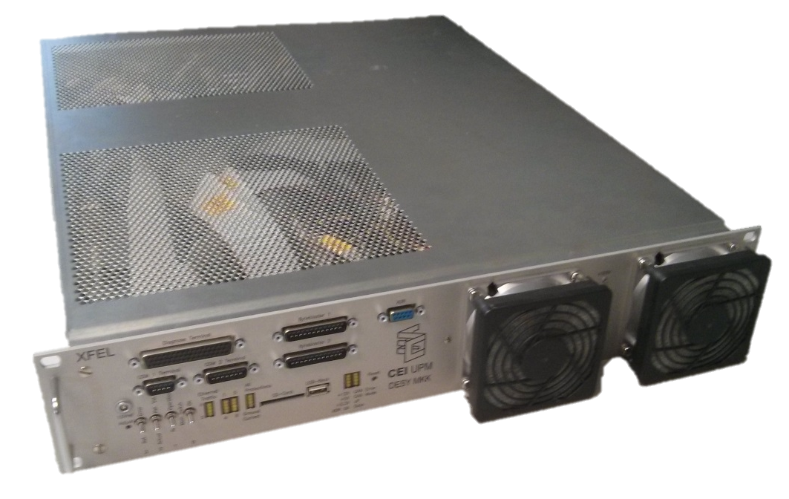
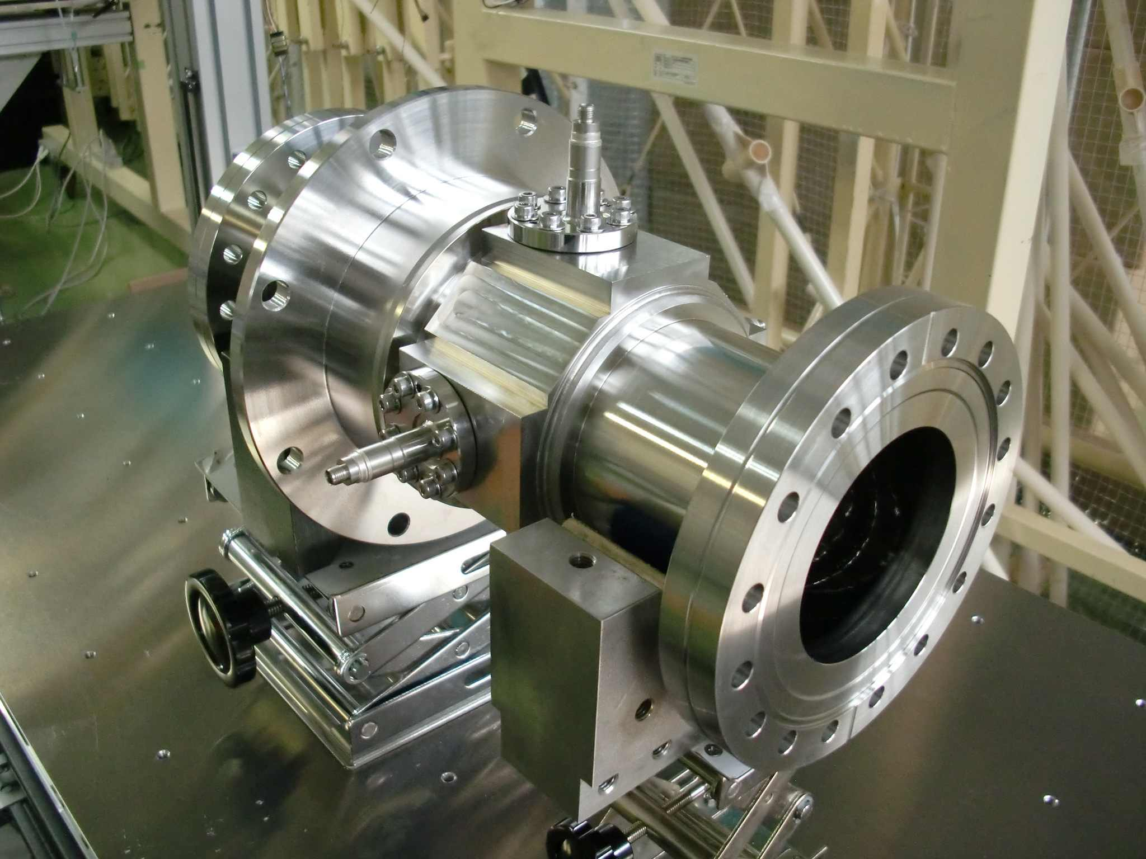
The CIEMAT/IFIC Preliminary Proposal for ILC Contribution (2)
CIEMAT & IFIC Contribution to the ILC LINAC
ILC MAGNET S vs E-XFEL MAGNET SPECS
 | ILC Magnet Power Supply | E-XFEL Magnet Power Supply
Type | TBD | Bipolar Power Supply
Nº of Units | TBD | 240
Output voltage | TBD | ± 10 V
Output Current | ± 100 A | ± 50 A
Admissible Ripple | TBD | ¿?
Technology | TBD | Switch-Mode MOSFET-based Converters @ variable commutation frequency
ILC BPMs SPECS
 | ILC Beam Position Monitor
Type | L-Band Re-entrant Cavity
Nº of Units | TBD
Op. Frequency | 2.04 GHz
Beam Resolution | <300 nm
Overall Length | 320 mm
Inner Diameter | 78 mm
Notes:
3

Slide 4
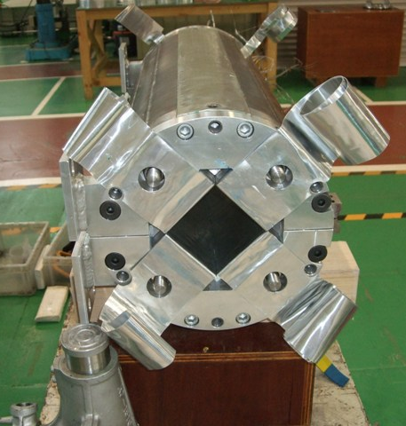
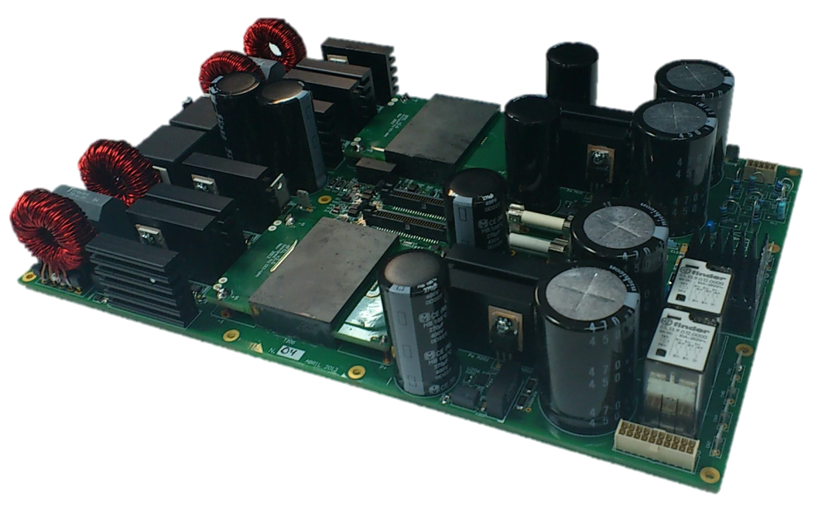
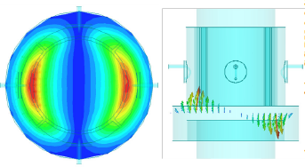
The CIEMAT/IFIC Preliminary Proposal for ILC Contribution (3)
CIEMAT & IFIC Contribution to the ILC LINAC
2.- BUDGET ESTIMATE
MAGNET = 40-60 k€/UNIT
Based on E-XFEL 2005 Prices (20k€/Unit) scaled up by length factor and cost of life and scaled down by the absence of vacuum vessel
POWER SUPPLY = 10 k€/UNIT
Based on E-XFEL 2005 Prices (6k€/Unit) scaled up by current factor, absence of control system and cost of life
BPM = 15 k€/UNIT Including Electronics
10 k€/UNIT for the cavity & 5 k€/UNIT for the electronics.
Based on prices for IFMIF BPM, scaled down by a series production factor
Notes:
4

Slide 5
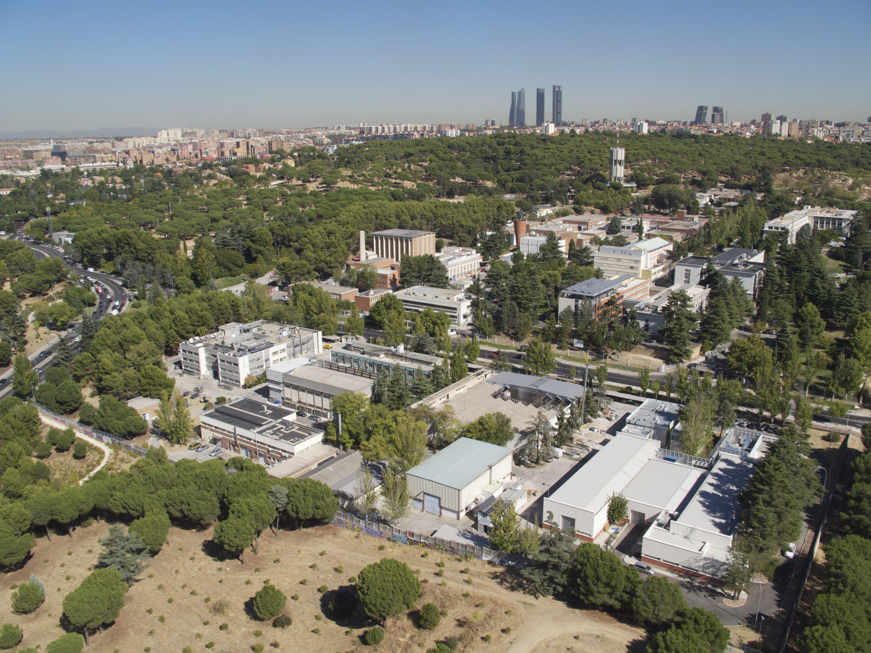
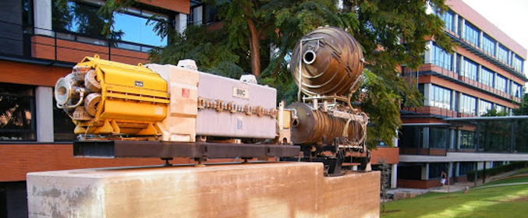
The CIEMAT/IFIC Preliminary Proposal for ILC Contribution (4)
CIEMAT & IFIC Contribution to the ILC LINAC
3.- INVOLVED PUBLIC RESEARCH INSTITUTES
CIEMAT (Madrid)
Is a Governmental Laboratory (Research Public Institution of the Ministry of Science, Innovation & Universities). 1300 engineers, researchers and staff &100 M€ annual budget. More than 30 years of experience in superconducting magnets for Particle Accelerators
IFIC – GAP (Valencia)
IFIC is a joint Institution (CSIC & Valencia University) devoted to Nuclear Physics, Particles & Astroparticles and its applications
The GAP is devoted to Particle Accelerator Technologies, specifically beam instrumentation, kicker magnets and RF Systems
Notes:
5

Slide 6
The CIEMAT/IFIC Preliminary Proposal for ILC Contribution (5)
CIEMAT & IFIC Contribution to the ILC LINAC
4.- MOTIVATION FOR THIS CONTRIBUTION
To profit from the previous and broad experience in the E-XFEL collaboration which was conceptually very similar to this one.
To participate in the development of a new technology in superconductivity, based on MgB₂, which has a potential interest in energy transportation and generation as well as in low and medium field magnets.
To increase our knowledge in cryogenic instrumentation, particularly in BPMs for future colliders and also for medical accelerators.
To promote a variety of Spanish industrial participation in ILC with a wide range of activities spanning from digital electronics to superconductivity, power converters, precision machining, etc.
Notes:
6

Slide 7
The CIEMAT/IFIC Preliminary Proposal for ILC Contribution (6)
CIEMAT & IFIC Contribution to the ILC LINAC
5.- COLLABORATION STRUCTURE
COMPONENT | COORDINATION | PROTOTYPING | POTENTIAL INVOLVED COMPANIES
Magnet | CIEMAT | CIEMAT | Elytt Energy Antec Magnets
Magnet Power Supply | CIEMAT | Industry | Elytt Energy Btesa Jema Green Power
BPM Mechanics | IFIC | IFIC+CIEMAT+ Industry | AVS Ramen Cadinox
BPM Electronics | IFIC | Industry | Seven Solutions
Notes:
7

