Slide 1
The IDEA detector at the FCC-ee
Franco Bedeschi
Spanish network for future colliders
October 7, 2020
Sommario
Status and timelines
Detector requirements
IDEA design
Current R&D
Final remarks

Slide 2
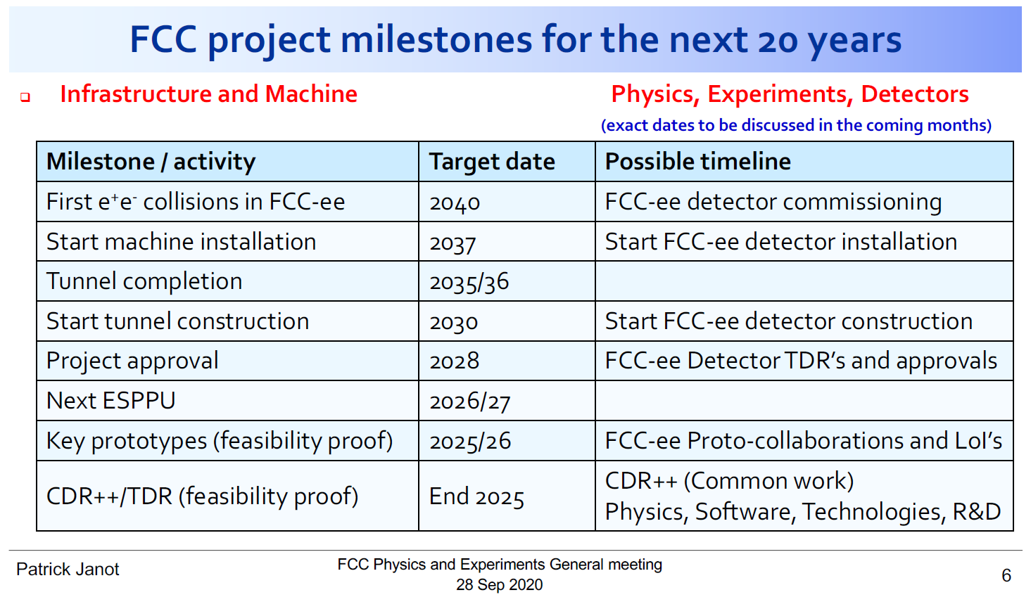
Status and timelines
ESU approved by CERN council
«An electron-positron Higgs factory is the highest-priority next collider………. a feasibility study of the colliders and related infrastructure should be …. completed on the timescale of the next Strategy update.»
Implications on timing for detector R&D:
Experiment LoI’s by EU strategy 2025/26
R&D completed – CDR++
FCCee detector TDR 2028
Detailed detector design

Slide 3
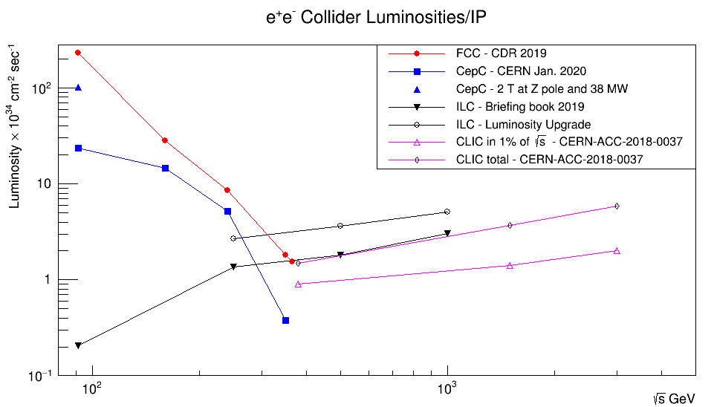

Physics at FCC-ee
Higgs factory
10⁶ e+e- → HZ
EW & Top factory
3x10¹² e+e- → Z
10⁸ e+e- → W+W- ;
10⁶ e+e- → tt
Flavor factory
5x10¹² e+e- → bb, cc
10¹¹ e+e- → 𝛕+𝛕-
Potential discovery of NP
ALPs, RH ν’s, …
FCCee
Z
WW
ZH
CEPC
ILC upgrade
t$\overline{t}$
CLIC
~100 kHz of physics data at the Z pole
Physics plan still under discussion – Order may change
ILC TDR

Slide 4
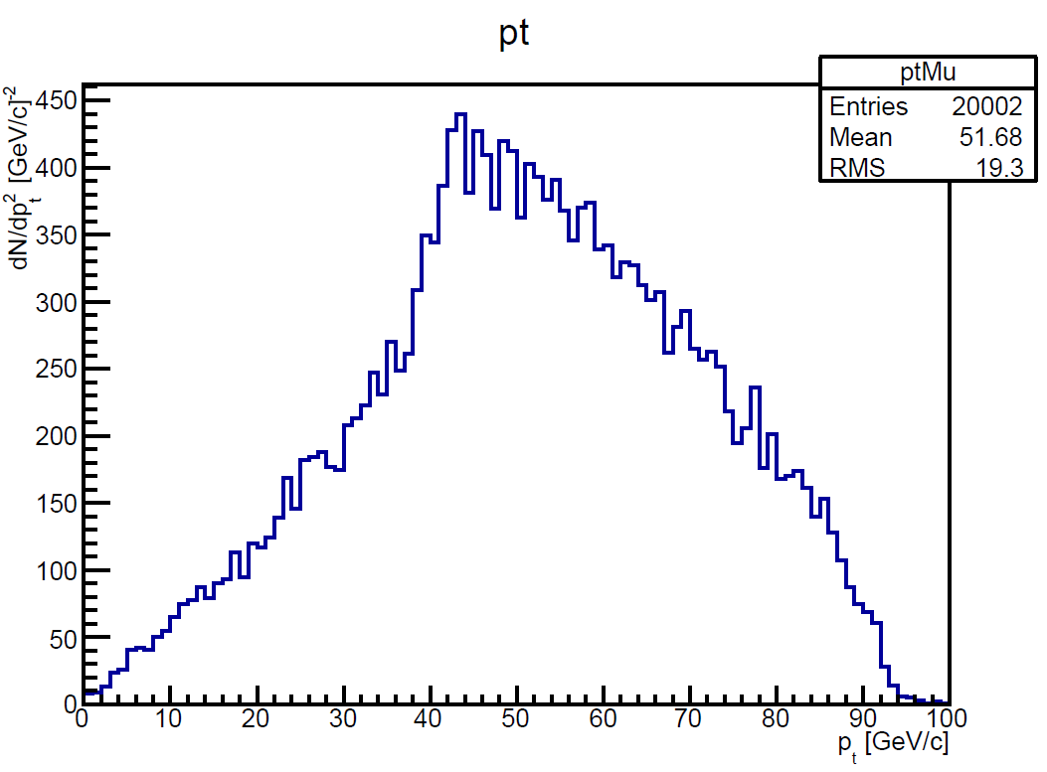
Requirements for Higgs physics
Tracking:
Momentum resolution for Z recoil (and H→μμ)
Comparatively low momenta involved → transparency is important
Vertex resolution/transparency to separate g, c, b, τ final states
Calorimetry:
Jet-jet invariant mass resolution to separate W, Z, H in 2 jets
Good π⁰ ID for τ and HF reconstruction
ZH (H→μμ)
Muon pt
ZH (Z→μμ)
Muon pt

Slide 5
Requirements for EWK/HF physics
EWK:
Extreme definition of detector acceptance
Extreme EM resolution (crystals) under study
Improved π⁰ reconstruction
Physics with radiative return
HF:
PID to accurately classify final states and flavor tagging
Other requirements highly overlap with Higgs req.

Slide 6
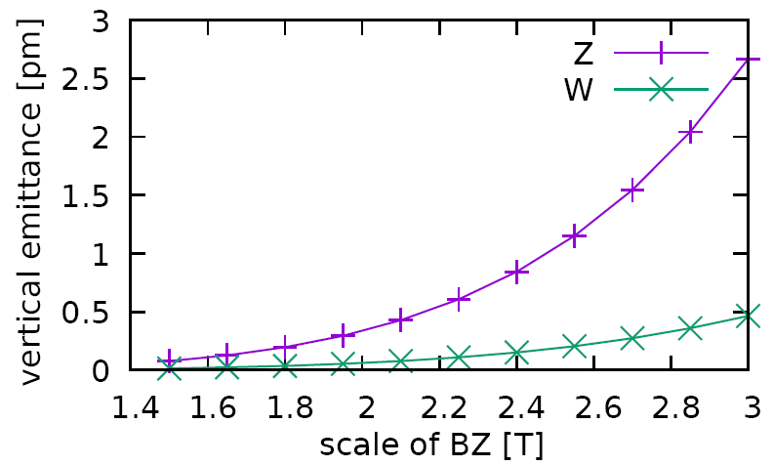
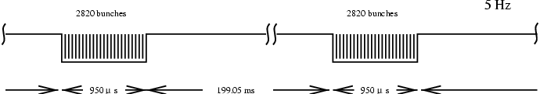
Circular vs. Linear
Low field detector solenoid to maximize luminosity
Optimized at 2 T
Large tracking volume → calorimeter outside → very thin coil
Beam time structure:
Short bunch spacing (~ 20-30 ns Z, ~ 1 μs H)
No large time gap
Cooling issues for PF calorimeter and vertex detector
TPC ion backflow
ILC

Slide 7
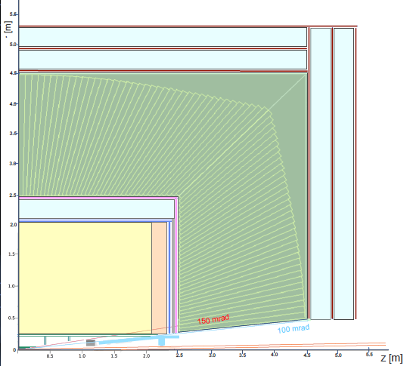
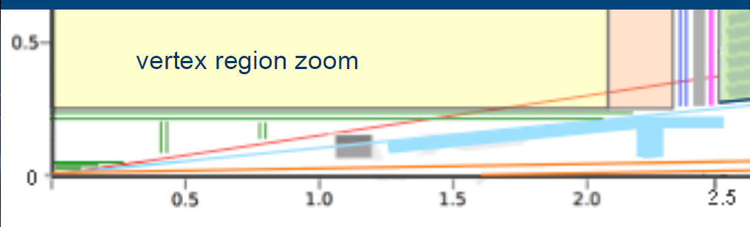
IDEA layout
Small magnet
Small yoke
Yoke/μ chambers
Calorimeter
Yoke/μ chambers
Solenoid
Tracking → 150 mrad
No material in front of luminometer
Calorimetry → 100 mrad
DCH

Slide 8
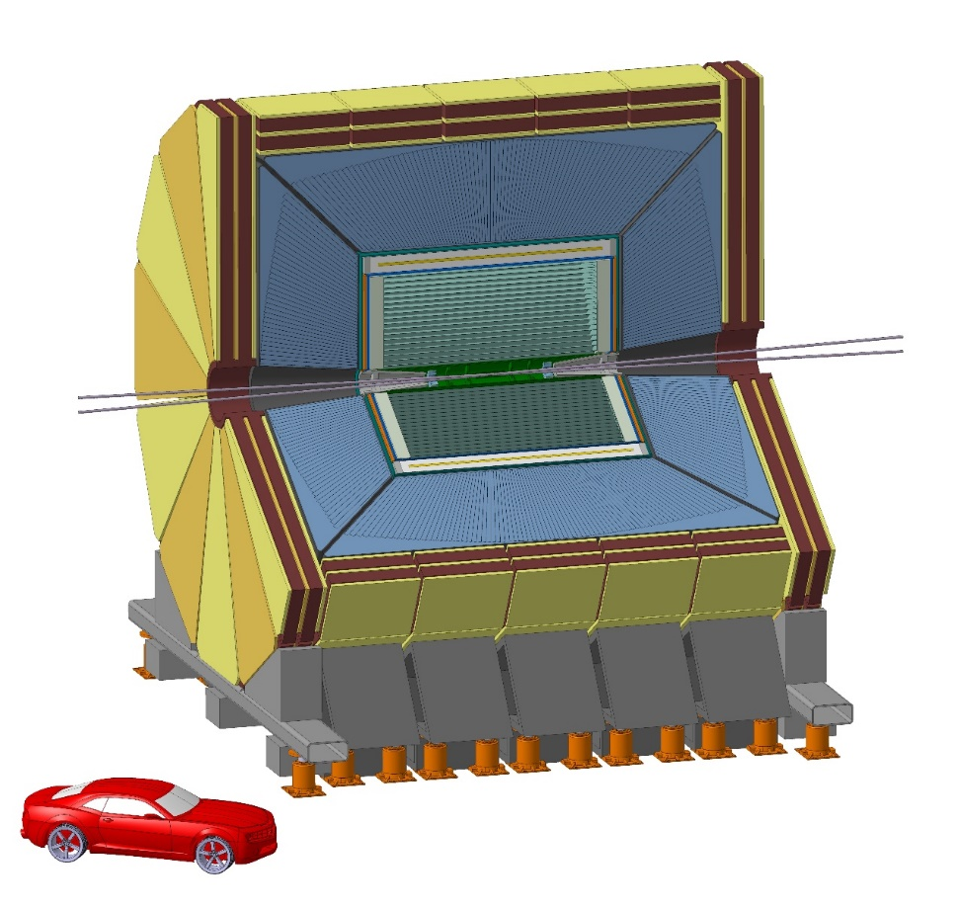
Detectors & R&D
IDEA concept
Innovative Detector for E+e- Accelerator

Slide 9
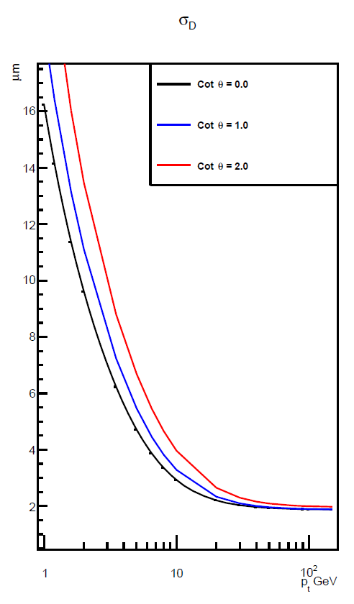
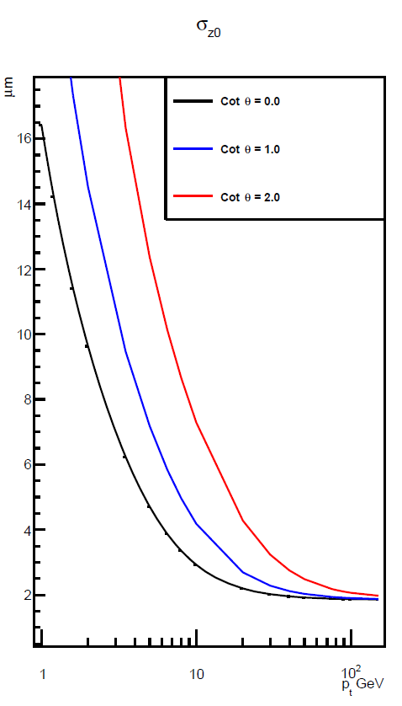
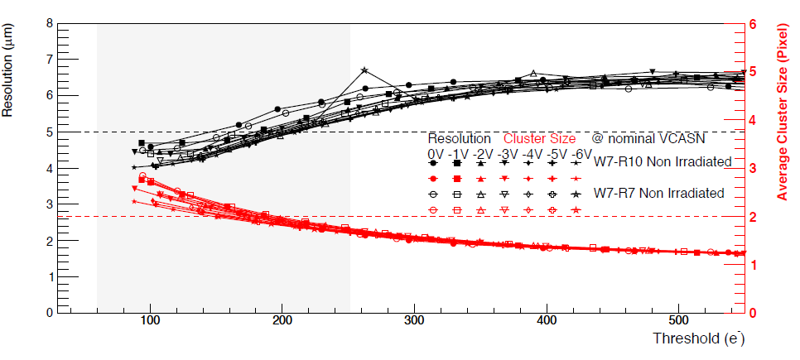
Vertex detector
Transparency:
Low power (< 20 mW/cm²) to allow air cooling
Resolution:
5 μm shown by ALICE ITS (30 μm pixels)
Aim at ~20 μm pixels for ~ 3 μm point resolution
Courtesy of ALICE J.W. van Hoorne

Slide 10
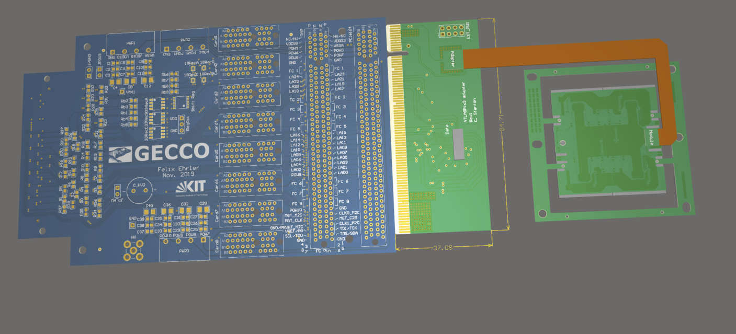
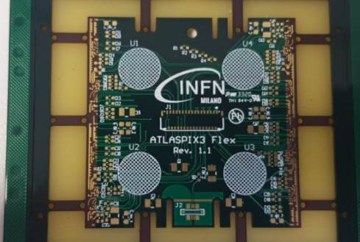
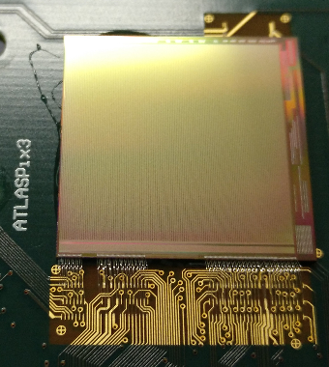
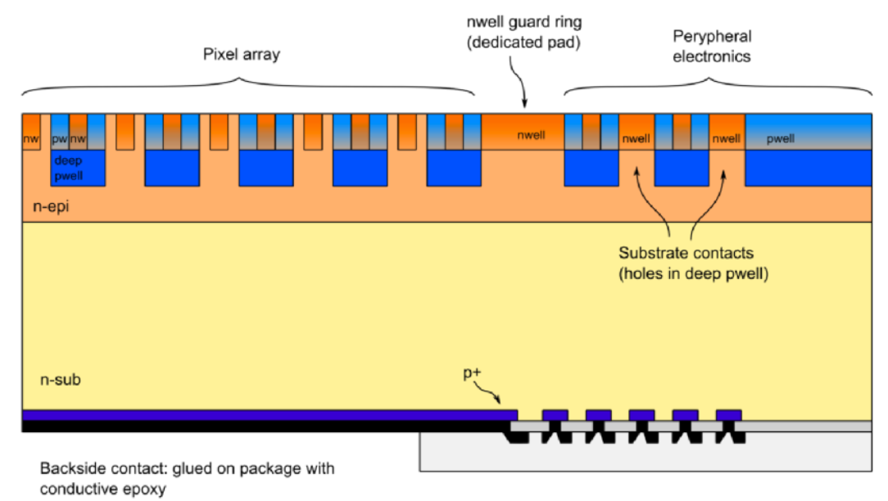
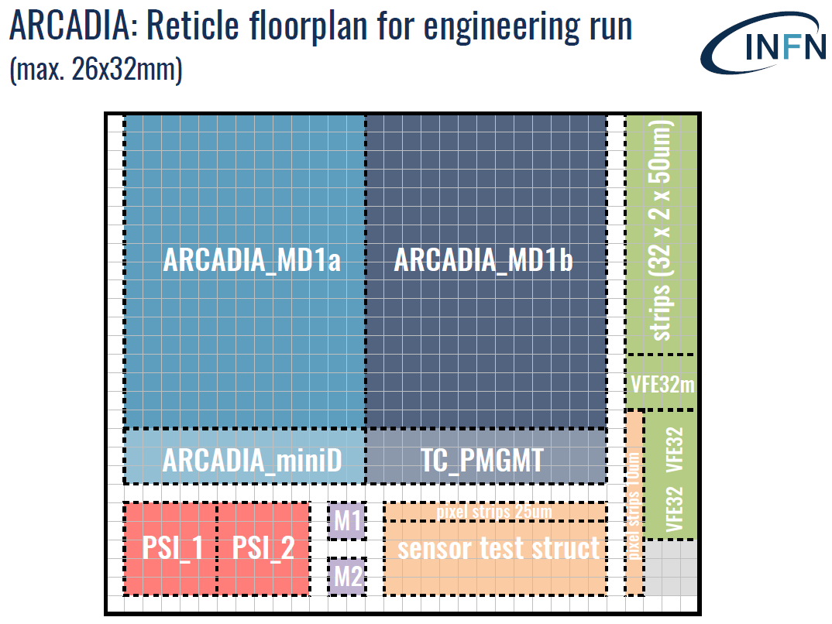
Silicon detector R&D
Two paths with some overlap:
DMAPS pixel detector (ARCADIA/LFoundry)
Test beam with staves by ~ 2023
INFN-CSN5 call – 2019-2021 (~ 1 M€)
Additional funds secured also beyond 2021
MoU in progress with industry and other international labs
Large area silicon (Pixels and strips)
First demonstrators use AtlasPix3 → modules for mini-staves
Full system test beam by 2022/23
New pixel development FCEPCPix1 in AMS
Passive CMOS micro-strips at Lfoundry
Large international collaboration:
China: Harbin, IHEP, NWPU, Shandong, SJTU, Tsingua, UTSTC; Germany: KIT; Italy: Milano, Pisa, Torino; UK: Bristol, Daresbury, Edinburgh, Lancaster, Liverpool, RAL, Sheffield, Warwick

Slide 11
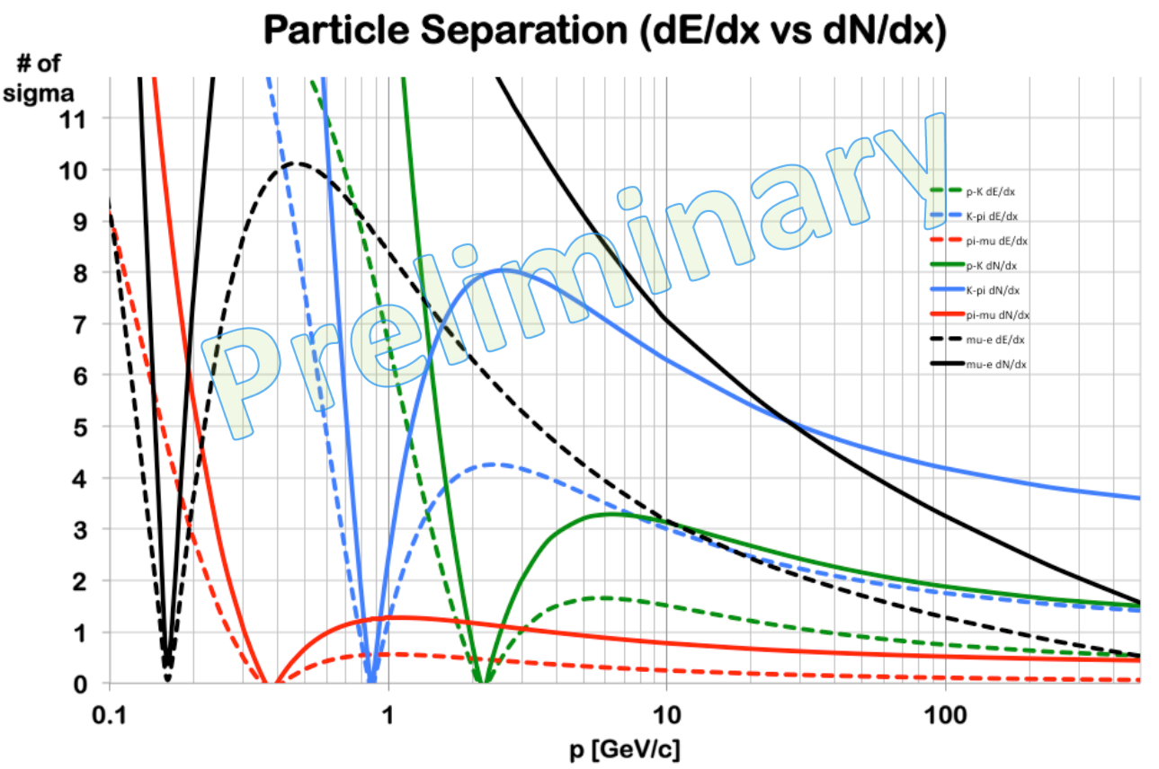
Drift chamber
High transparency and fast (max drift ~ 400 nsec)
Cluster counting in DCH for good PID resolution
Excellent K/π separation except 0.75<p<1.05 GeV (blue lines)
Could recover with timing layer
MS only
K/π dN/dx
3σ
K/π dE/dx
GeV
Nσ K/π separation with TOF over 2 meters
IDEA
90 degree

Slide 12
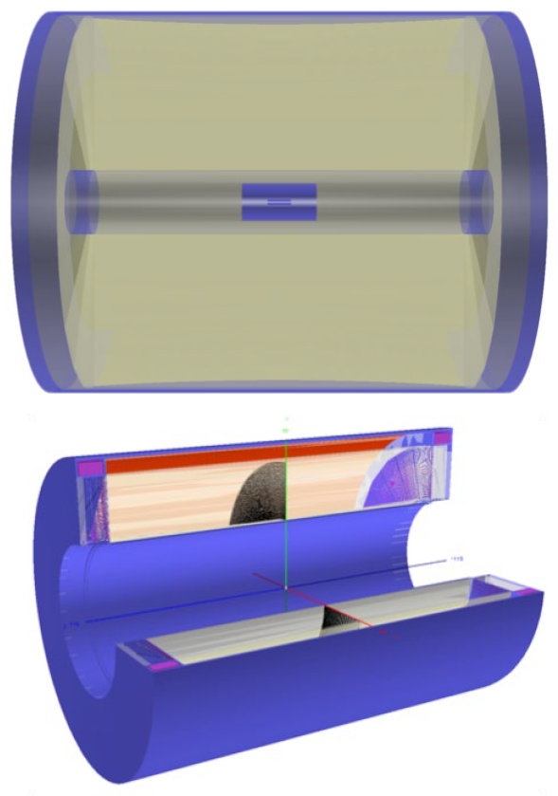
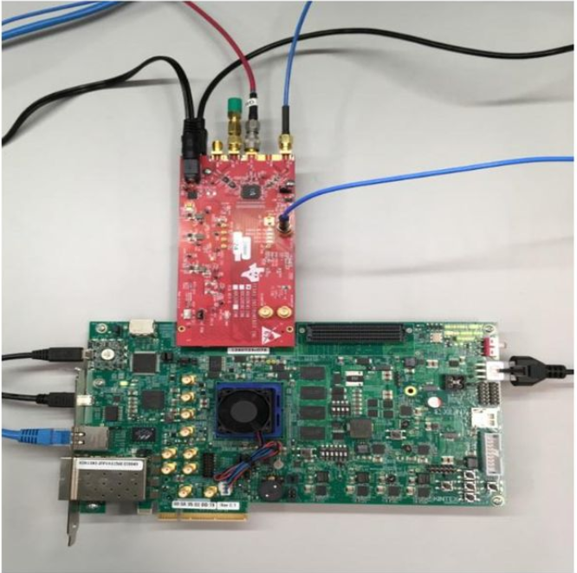
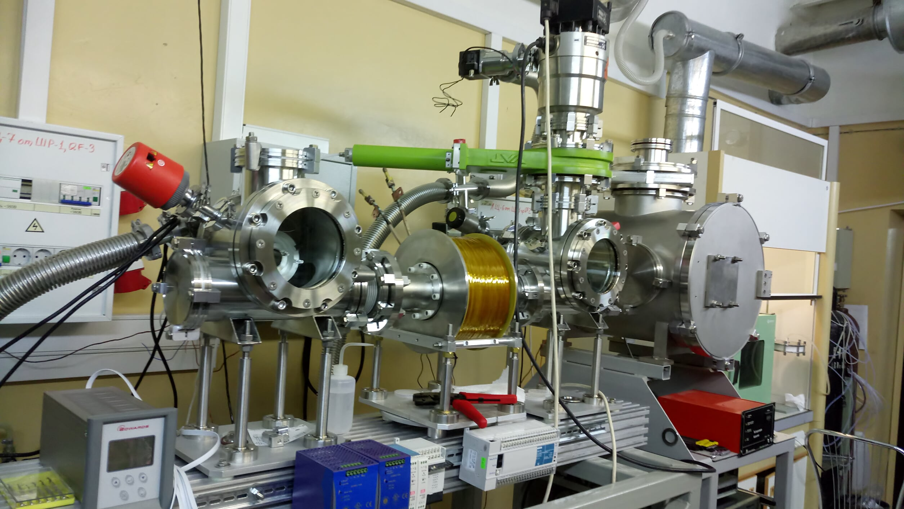
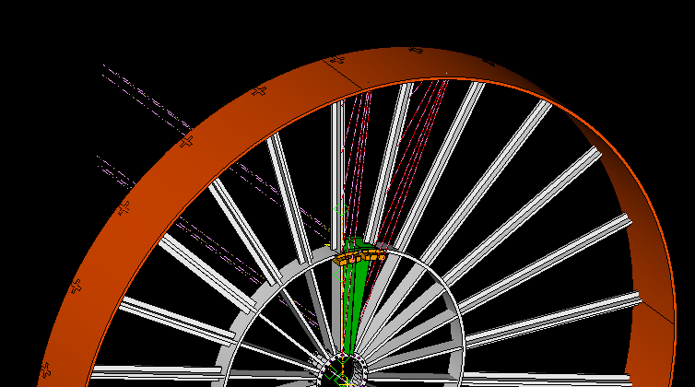
Drift Chamber R&D
Synergic with MEG2/PSI and CMD3 & STC factory/BINP
Good support from Cremlin+ (2020-2023)
Activities:
New wire development (eg. C-fiber)
Low mass mechanics
Cluster counting electronics
Simulation and reconstruction SW
Magnetron

Slide 13
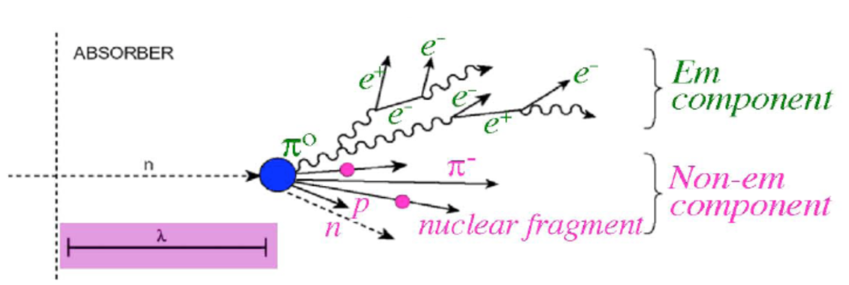
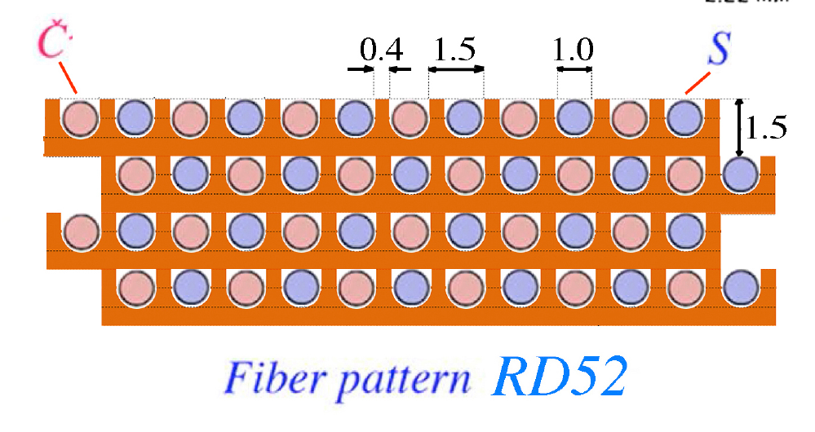
Dual Readout calorimeter
Event by event correction for EM-had fluctuations
Principle demonstrated by DREAM/RD-52
EM and hadron calorimeter in a single package
All electronics in back easy to cool and access
NEW: mechanics, SiPM readout, readout electronics
Alternating scintillating and clear fibers in metal matrix

Slide 14
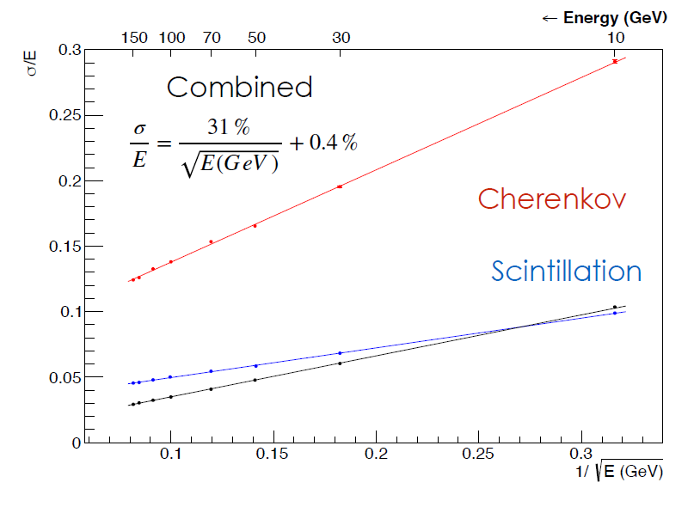
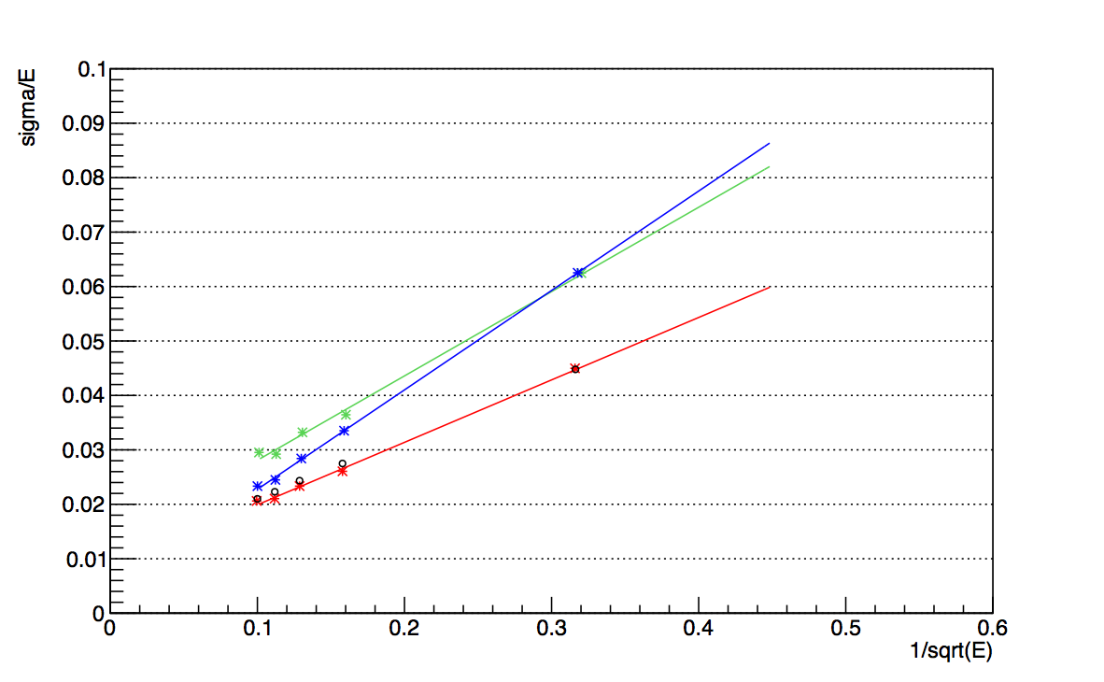
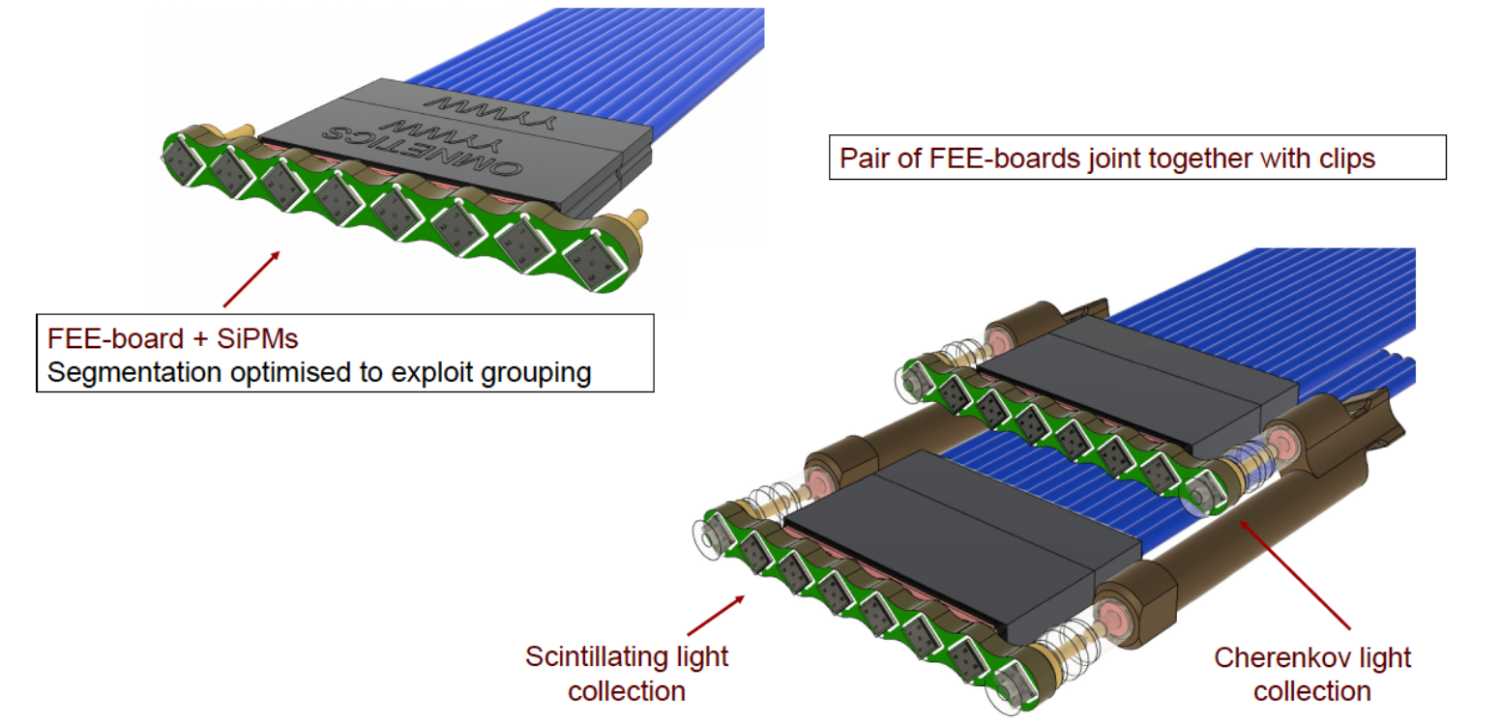
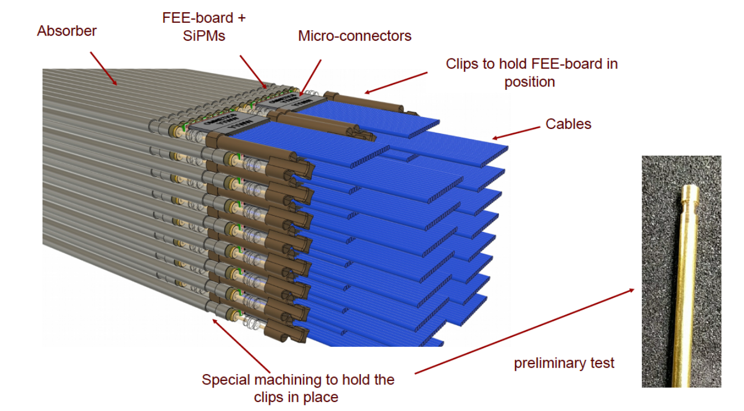
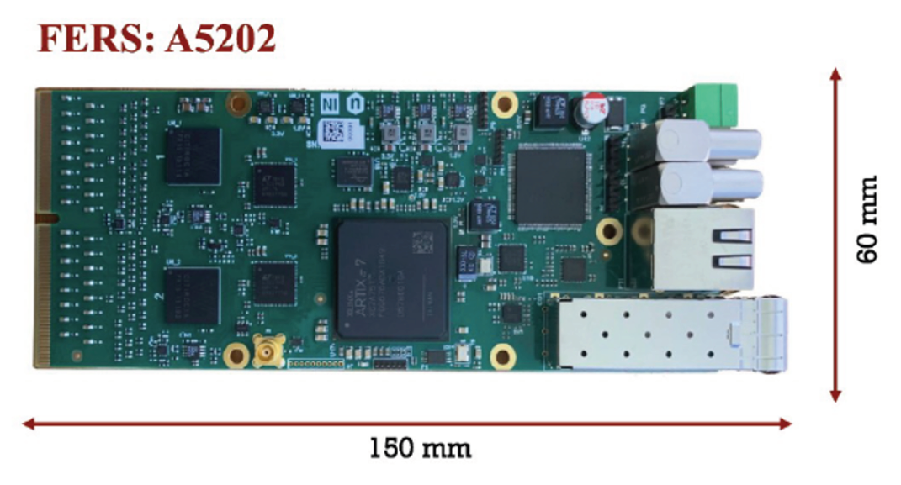
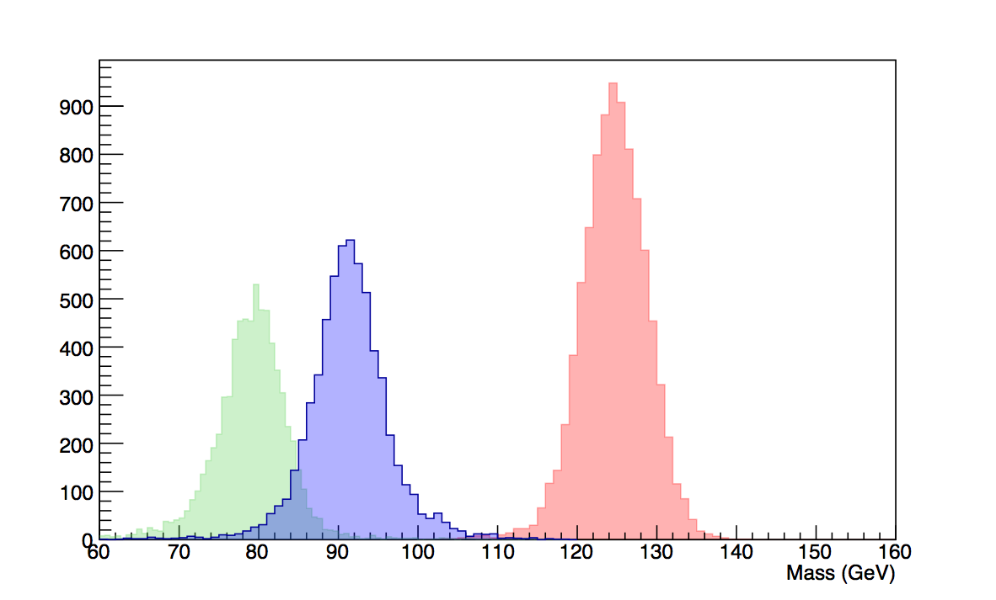







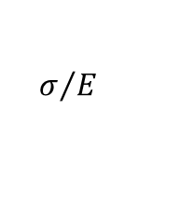

Dual Readout calorimeter R&D
EM resolution
Collaboration:
INFN (Italy), RBI (Croatia), Sussex (UK), Korea – (2 M$/5 yr)
Princeton, Maryland (USA) for potential crystal EM addition
Activities:
Scalable mechanics
Scalable SiPM readout
Performance demonstration with dedicated prototypes
EM 2021, HAD ~ 2024
Simulation and reconstruaction SW
IDEA Preliminary
$$σ/E$$
$$e^{+}e^{−}→HZ→{\overset{˜}{χ}}^{0}{\overset{˜}{χ}}^{0}jj$$
$$\frac{σ}{E}=\frac{11.0\%}{\sqrt{E}}+0.8\%$$
$$e^{+}e^{−}→WW→ν_{μ}μjj$$
Hadrons
C
$$e^{+}e^{−}→HZ→bbνν$$
S
S+C
$$\frac{1}{\sqrt{E}}$$

Slide 15
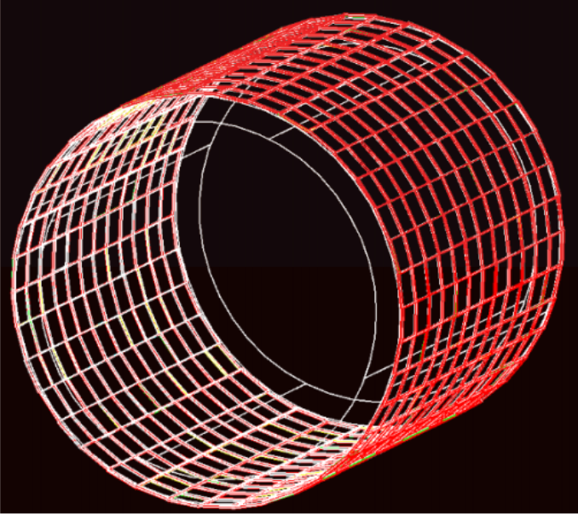
Pre-shower/Muon
Synergy with LHCb upgrade
Partner companies ELTOS (Italy), TECHTRA (Poland)
Activities:
Development and industrialization of μRwell chambers
Optimization in progress for IDEA
Resistivity and pitch
Simulation and reconstruction SW

Slide 16
Software
Significant SW R&D and studies in progress
Worldwide development of Key4HEP guided by CERN
DD4HEP, EDM4HEP, ….. for the serious SW developer
Lot of infrastructure for IDEA:
DELPHES card available
Full GEANT simulation in progress
FCCee physics groups restructured to tackle several “case studies”
Physics Performance Coordinators recently appointed
P. Azzi (INFN), E. Perez (CERN)

Slide 17
Final comments
Summary of main features:
High precision vertex detector
High transparency and momentum resolution
Good integrated PID with cluster counting → even better with timing layer
Excellent calorimetry → FANTASTIC with crystals
Light solenoid and minimal yoke
Tracking muon system
Excellent performance at all energies: Z, WW, ZH, tt
Based on achievable technologies, but need R&D/SW simulation to finalize, optimize, reduce costs and engineer full detector
Much R&D work in progress supported by several funding sources
Collaboration on all these R&D’s is growing internationally, but there is still ample space for additional contributions

Slide 18
Additional material

Slide 19
Special funding (1)
Programs active in 2021:
ARCADIA (CSN5) - Pixel DMAPS
Cremlin + (EU) - Drift Chamber/cylindrical μRwell
FEST (EU) - CEPC: Software/Physics
FCC-IS - FCC accelerator R&D
Programs seeking approval in 2021:
HiDRa (CSN5) - Dual Readout calorimetry
ITN SPIRAL-NET - e+e- collider performance studies

Slide 20
Special funding (2)
Programs seeking approval in 2021
AIDAinnova (EU)
WP 5 – Pixel MAPS – tasks: 5.2.1/ 5.2.2
ARCADIA/Belle2
WP 7 – Gas Detectors – tasks: 7.3.2/ 7.4.1
μRwell chambers/drift chamber readout
WP 8 – Calorimetria – tasks: 8.4.2
Dual readout calorimeter
WP 10 – Cooling per VTX – tasks: 10.2
Cooling substrates/microcooling
WP 11 – Microelettronica – tasks: 11.3
ASICS per μRwell
WP 12 – Software – tasks: 12.2.1 /12.4.2/ 12.5.2
Key4HEP/MPGD simulation/Particle flow for Dual readout cal.

Slide 21
FCC-IS Design Study – just approved by EU-H2020
NEW!
FCC-IS (Innovation Study) is a design study project: 3M€ for 4 years
Kick-off: 9-10 November 2020
Goal of the FCC-IS study: Carry out the technical design study for a 100 km long luminosity frontier circular collider infrastructure at CERN that will extend Europe’s leadership in the domain of fundamental physics research until the end of the 21st century.
The study focuses on the high priority topics to prepare the ground for a construction project by 2026.
First priority: optimisation of the particle collider design.
It includes both design and prototyping.
INFN-LNF participates to FCCIS (Scientific Responsible for INFN: M. Boscolo)
MDI is included in the proposal as well as instabilities and impedance studies
There is usually strong competition for Design Studies. Proposals come from every field of science, including social sciences and humanities. At the last call (November 2019) the success rate was only 18% (10 project approved out of 60 submitted, only 1 for physics selected: FCC-IS).
Examples: at the moment, for accelerators 2 DS have just completed (EuPraxia for a compact plasma-based FEL and EuroCirCol for FCC), ESSnuSB for a neutrino superbeam at ESS is ongoing, FCC-IS, for FCC-ee, has been just approved.
Back

Slide 22
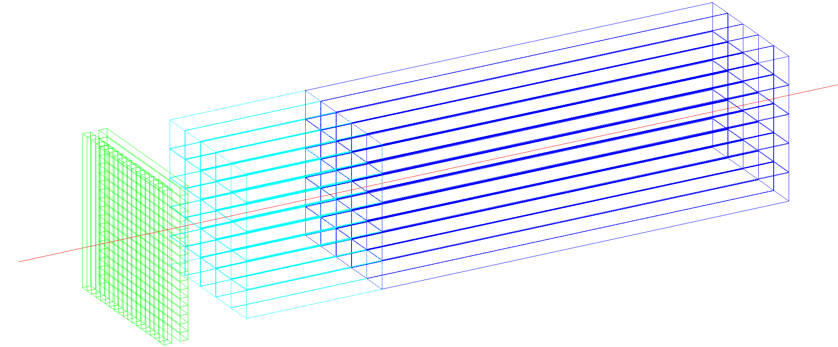
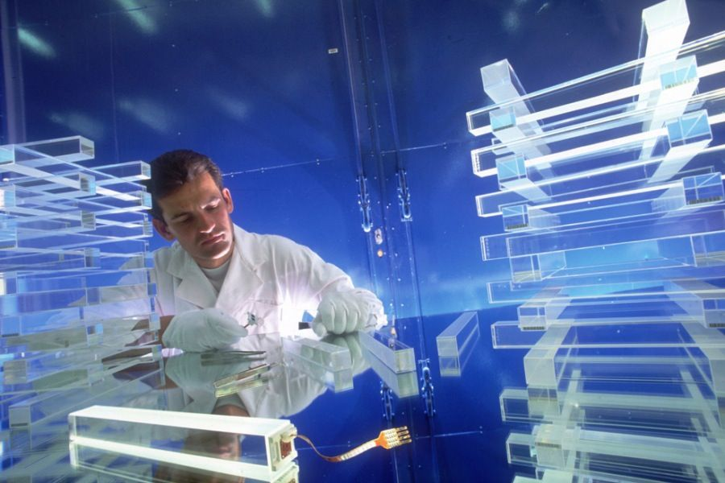

Crystal option
~20 cm PbWO₄
3%/$\sqrt{E}$
DR w. filters
Timing layer
Lyso 20-30 ps
ECAL layer:
PbWO crystals
front segment 5 cm (~5.4X₀)
rear segment for core shower
(15 cm ~16.3X₀)
10x10x200 mm³ of crystal
5x5 mm² SiPMs (10-15 um)
1x1x5cm³
PbWO
1x1x15cm³
PbWO

