Slide 1

R&D activities for future linear colliders
at USC
Abraham Gallas (USC-IGFAE)

Slide 2
Outline
Sensor developments:
Pixels:
Sensors production: thinning, bump bonding. Tile design and fabrication (CNN).
Assembly construction with Timepix & Medipix3 at Santiago (wedge bonding, gluing…)
Characterization in the lab, test-beams (2010/2011), irradiations and CVD diamond cooling.
Silicon micro-strip fine pitch:
Prototypes: new sensors (Hamamatsu), n-on-p, 200 & 150 µm, 30 µm minimum pitch:
Sensor design
Quality Assurance
Construction of detector prototypes
Assemblies with D0 sensor (320 µm thick, 60 µm pitch with 30 µm intermediate strips)
Pitch Adapter design and fabrication.
PR01 detector prototype construction
Characterization in lab and test-beams (2010/2011)
Preparations for APD irradiation at USC
Complementary developments:
High-speed readout copper link
Timepix Telescope Trigger Logic Unit (AIDA EU project)

Slide 3
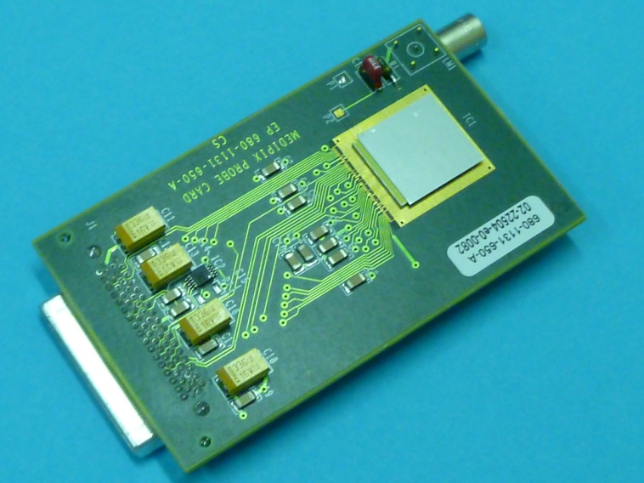
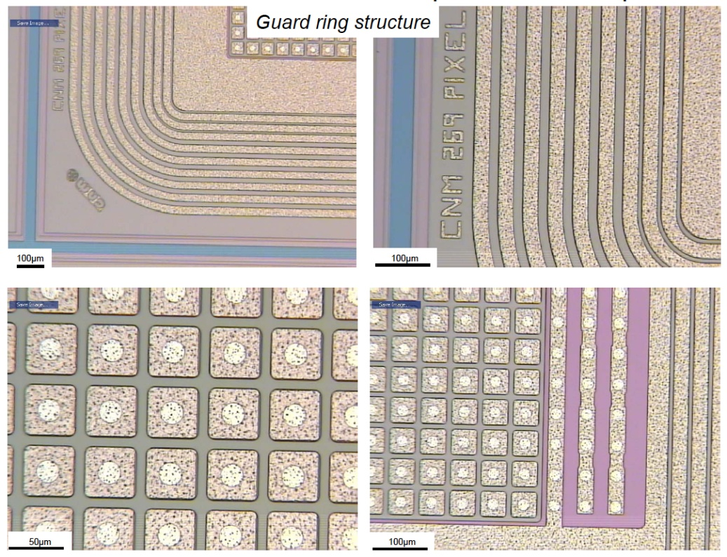
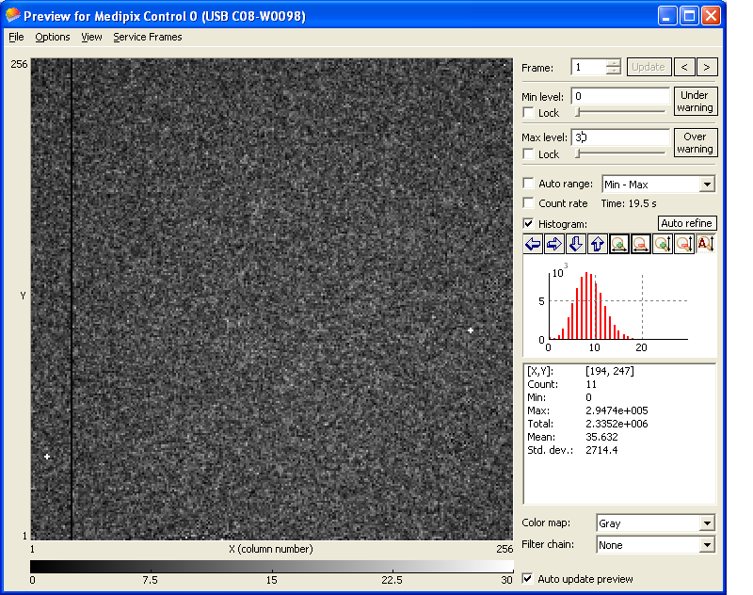
Pixel sensors
Collaboration with CNM to thin 2D-pixel (55x55 μm) sensor from 300 down to 200, 150, 100 μm, p-on-n & n-on-p sensors produced and bump bonded on Timepix and Medipix3 ASIC (radiation hardness studies)
Goal: measure the resolution, efficiency, rad-hardness of a thin sensor...
Thickness down to 150μm
Built and tested in 2010 Test-beam
⁵⁵Fe Pixel Map

Slide 4
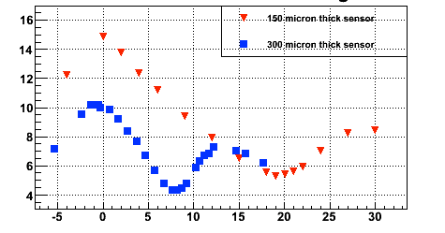
2010 Test beam results
σ(μm)
Sensor Angle (deg)
Thin sensors: Direct comparison of 300 and 150 μm thick sensors in identical conditions

Slide 5
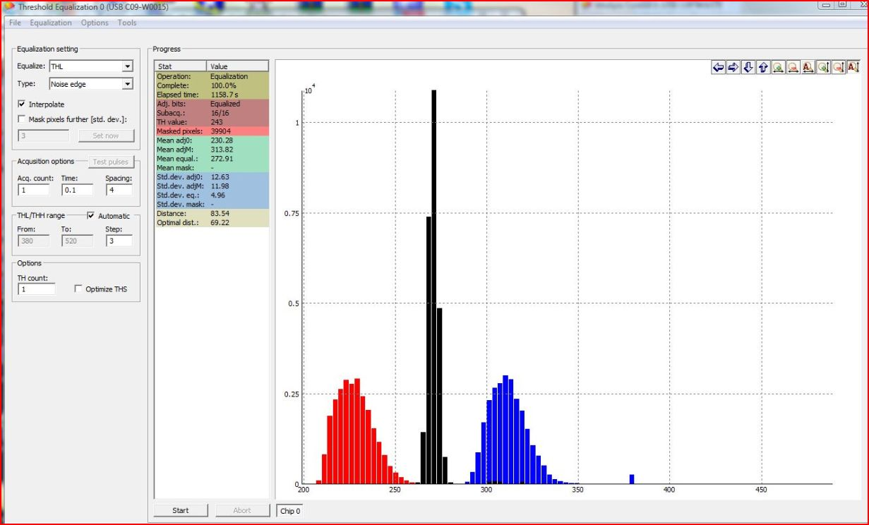
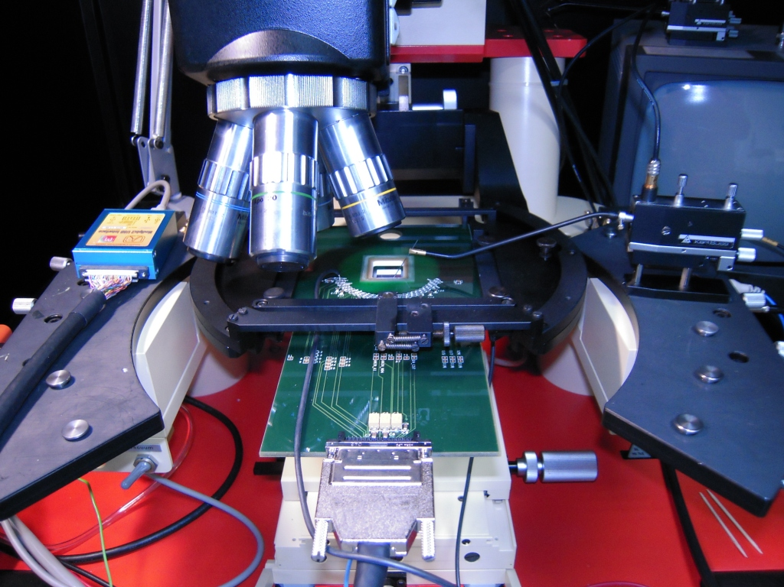
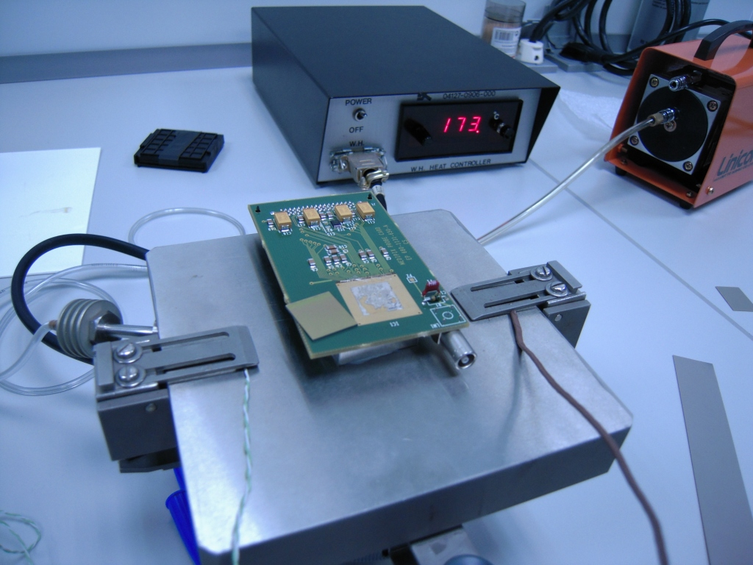
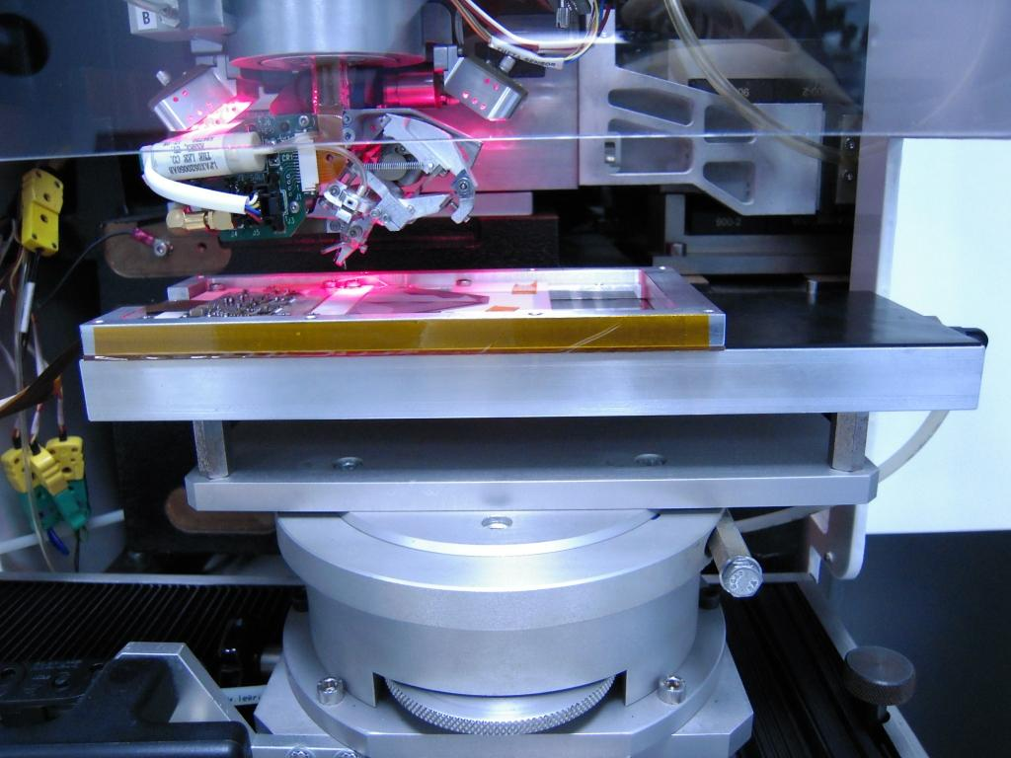
Construction & testing infrastructure at Santiago
Testing
Probe station with Timepix and Medipix3 probe cards & USB RO
Gluing and PCB mounting
Wedge bonding

Slide 6
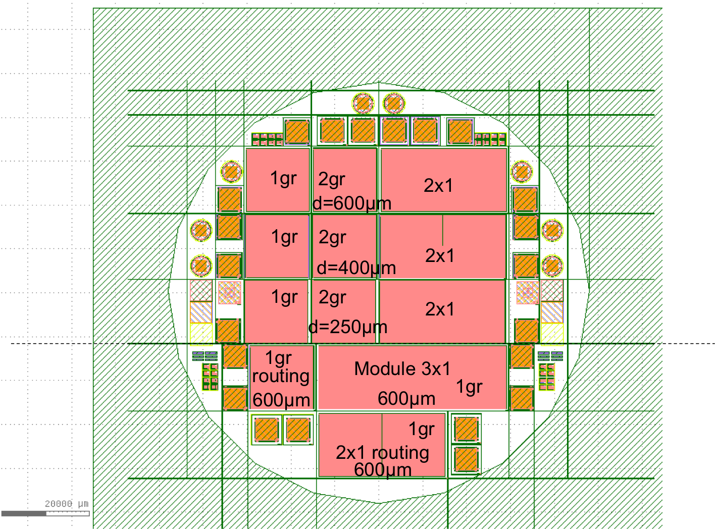
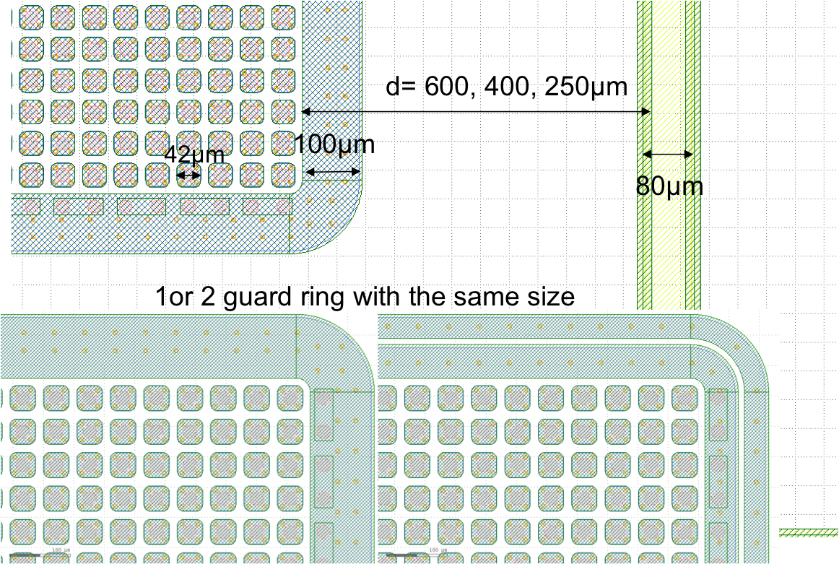
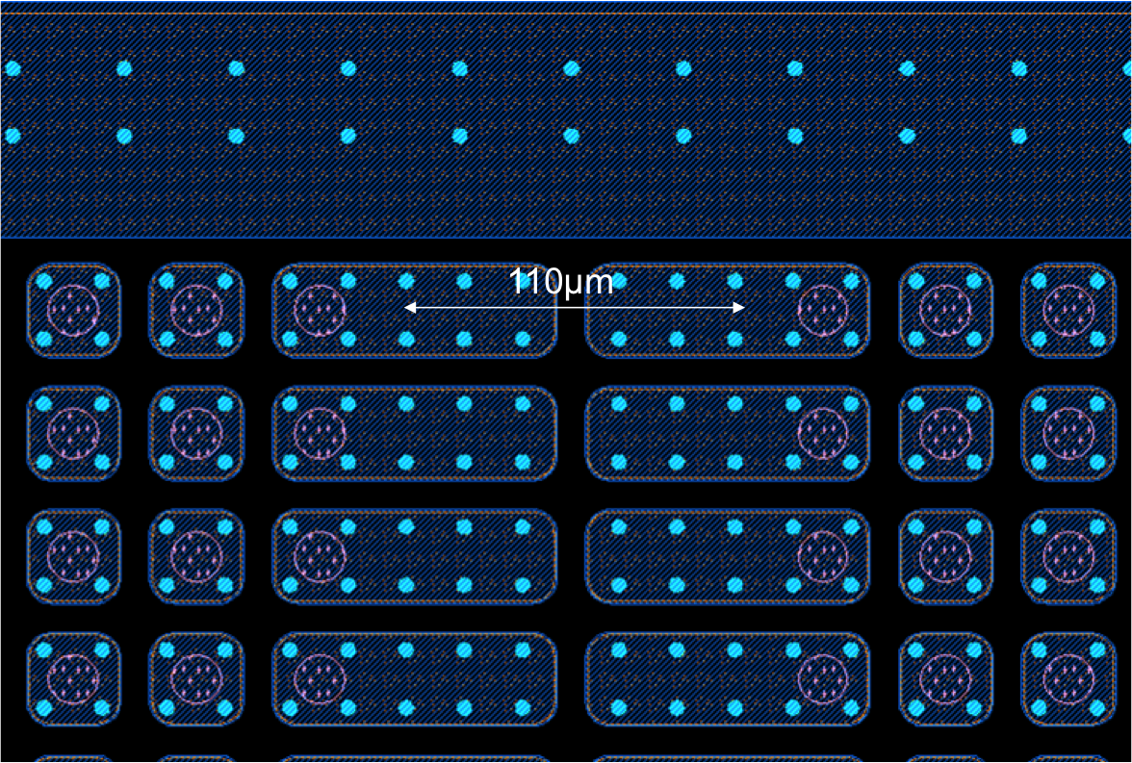
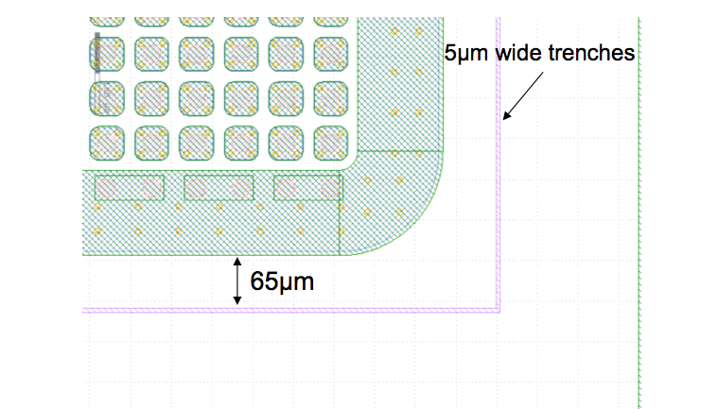
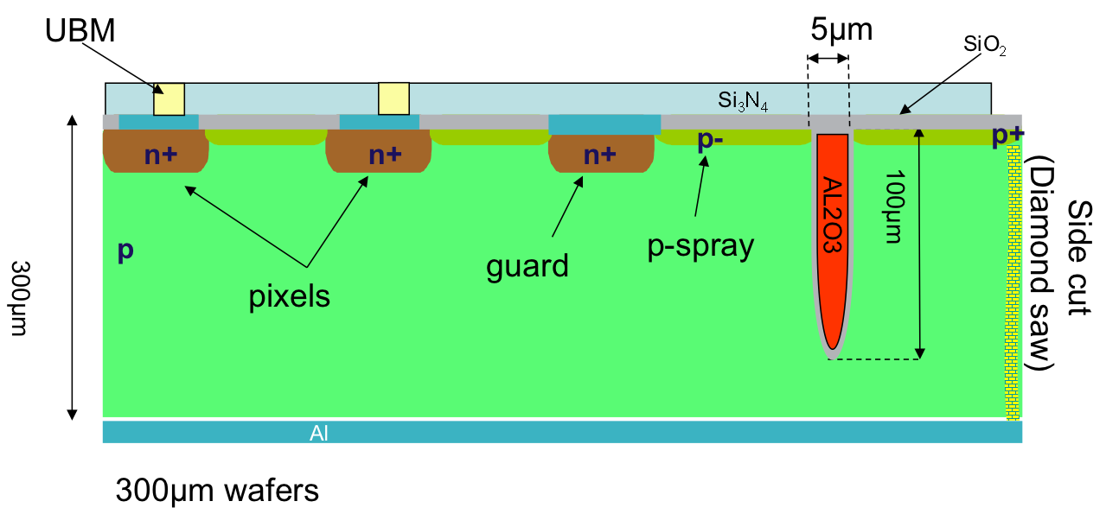
Pixel sensors: 3x1 Tiles
Mask designed by G. Pellegrini at CNM. Built at Photronics.
First run started, completion Dec11/Jan12
Several thickness will be produced (300-200-150μm, n-on-p & p-on-p)
R&D on:
Multi-ASIC bump-bonding on thin sensors
Minimal guard ring design, slim edges: trenches, sidewall Al₂O₃
Minimization of dead areas inter ASICs: elongated pixels, routing
Many test structures to optimize guard-ring design (rad-hard) and for QA of sensor prior bump-bonding

Slide 7
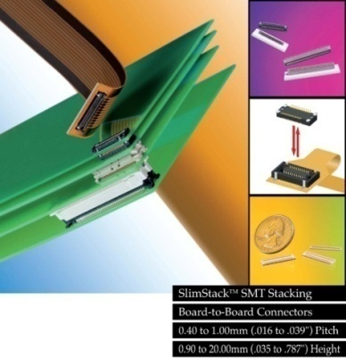
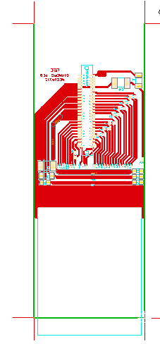
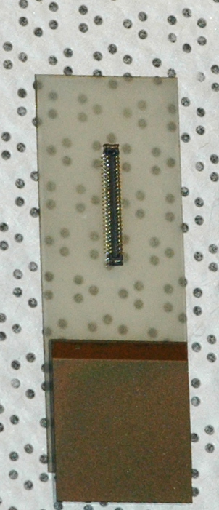
IRRADIATIONS & CVD diamond cooling
Irradiate assembly with rad-hard Medipix3 + n-on-p sensor up to ~ 5x10¹⁵ 1 MeV n_{eq} cm⁻²
At the moment 2x200 μm and 1x150 μm detectors built
Heat dissipation is an issue:
Research CVD diamond support with lithography.
PCB metallization layout done at Santiago.
Molex slimstack connector
1mm mated height

Slide 8
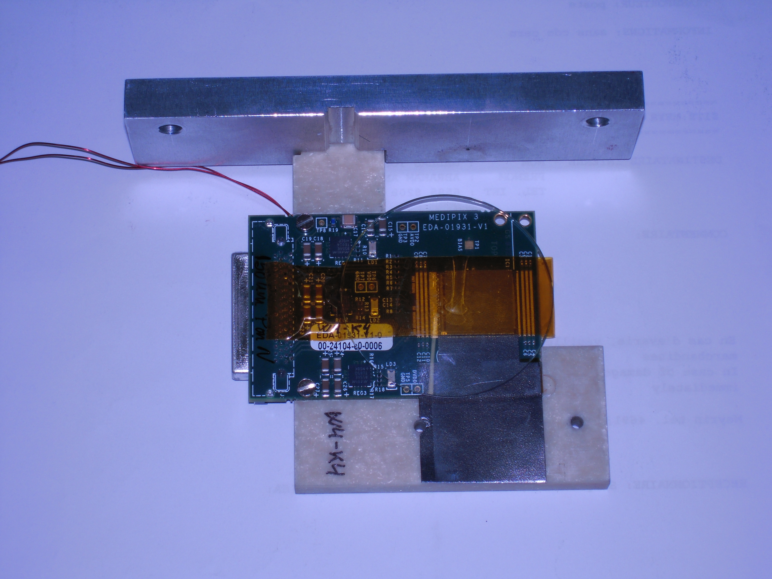
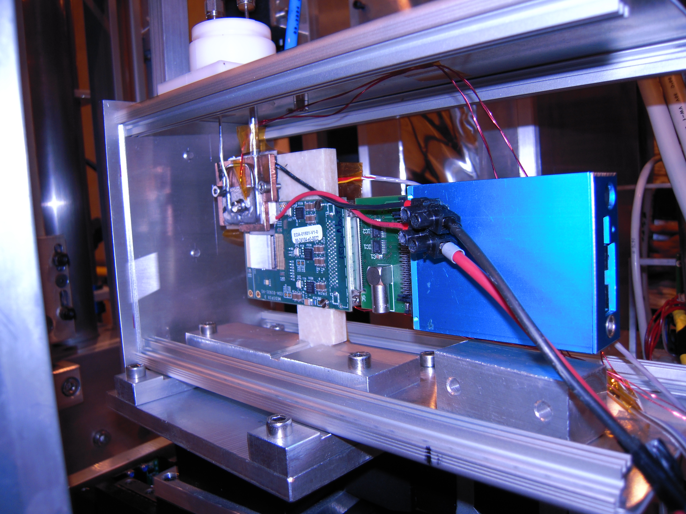
TPG cooling @ 2011 Test-beam
Non-irradiated Medipix3
TPG cooling foil spine
Two stage cooling system
Peltier
Evaporative CO₂

Slide 9
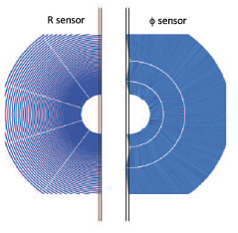
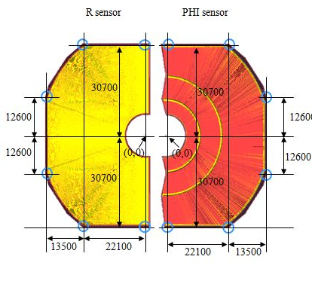
R-Φ prototype strip sensors (Hamamatsu)
Both sensors
Minimum pitch 30 μm
~ 2560 strips
p-type material, 200 μm and 150 μm thicknesses
Sensitive region starts at 7.5 mm, with 500 μm guard ring
R sensor
Curved strips (for now), 5 sectors
Φ sensor
3 sectors

Slide 10
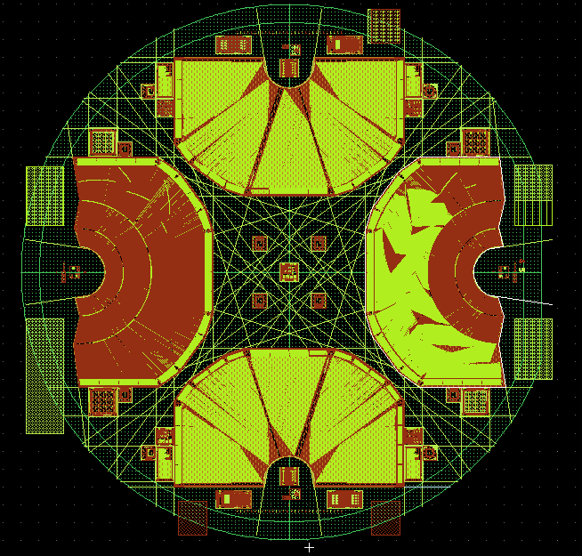
Design status I
Verification expected for this week and first sensors this year
All design requests have been respected
4 sensors per wafer

Slide 11
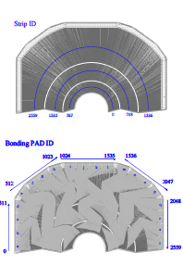


Design status II
Double Metal is complex, but feasible

Slide 12
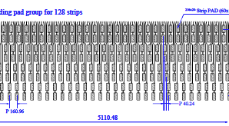
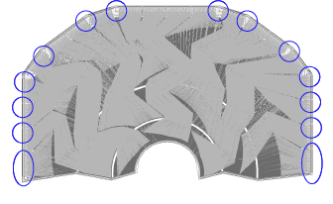
Design status III
Bond pad scheme compatible with Beetle1.5 for ease of testing. Regular grounding pads requested
A fraction of strips have DC pads to the implants for testing purposes
A very complete set of test structures also supplied
pads, minis, bonding pads, alignment marks, bias resistors, aluminum snakes….

Slide 13
Silicon micro-strip fine pitch QA (I)
Quality Assurance and electrical tests will be performed in the 25 m² class 100000 (ISO 8) clean room:
Sensors stored in inert N₂ atmosphere with humidity and temperature control.
Optical inspection (photographic + DB record):
scratches, defects, chipped edges
pads bondability, strip metallization, polysilicon resistors.
backplane
Metrology:
Overall dimensions, alignment marks positioning, distances between marks.
Thickness measurement, warp.
Electrical tests:
IV & CV curves for the whole sensor
Long term biasing tests to check stability
Inter-strip capacitance and inter-strip resistance for considerable number of strips.
Punch-through measurements.
Polysilicon resistor measurement.
First approximation: 11 man-hours per module (2 h Optical inspection + 3 h Metrology + 6 h electrical tests)

Slide 14
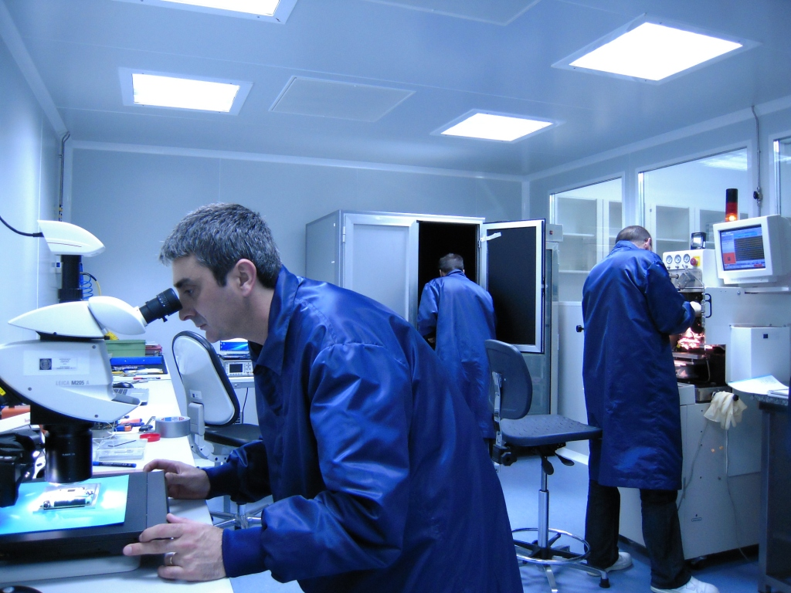
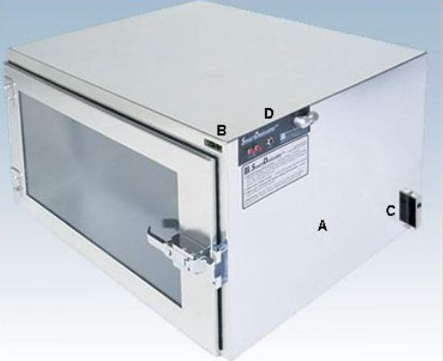
Silicon micro-strip fine pitch QA (II)
25 m² class 100000 (ISO 8) clean room:
Bonding machine, Kulicke & Soffa 8060
Precision Pull-tester, Dage 3000
Probe station: KarlSuss PM5 equipped with a Mitutoyo microscope, a CCD camera and 7 probes (2 of them up to 1 KV measurements).
1060nm & 660nm (1 mW) Lasers
Motorized Leica M205A microscope with digital cameras (Kit DFC 420)
Storage under N₂:
Smart system that monitors humidity inside the box flushing fresh N₂ as needed
Reduce N₂ consumption and increase the autonomy.
Being set up at the moment.

Slide 15
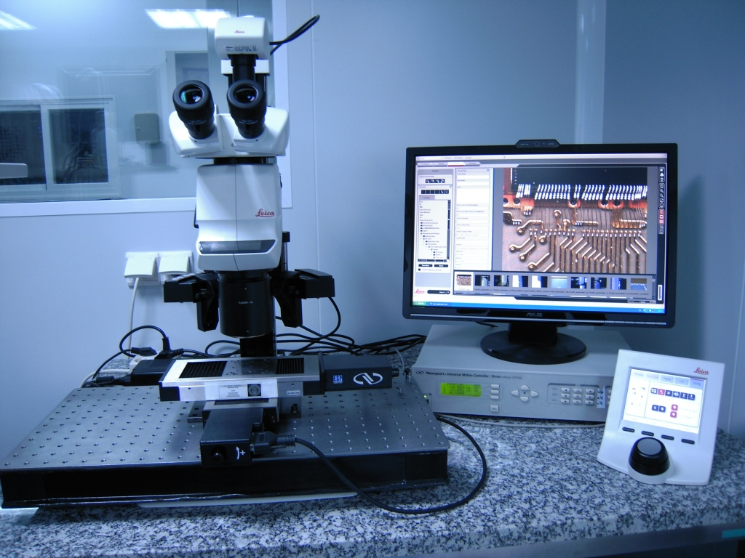
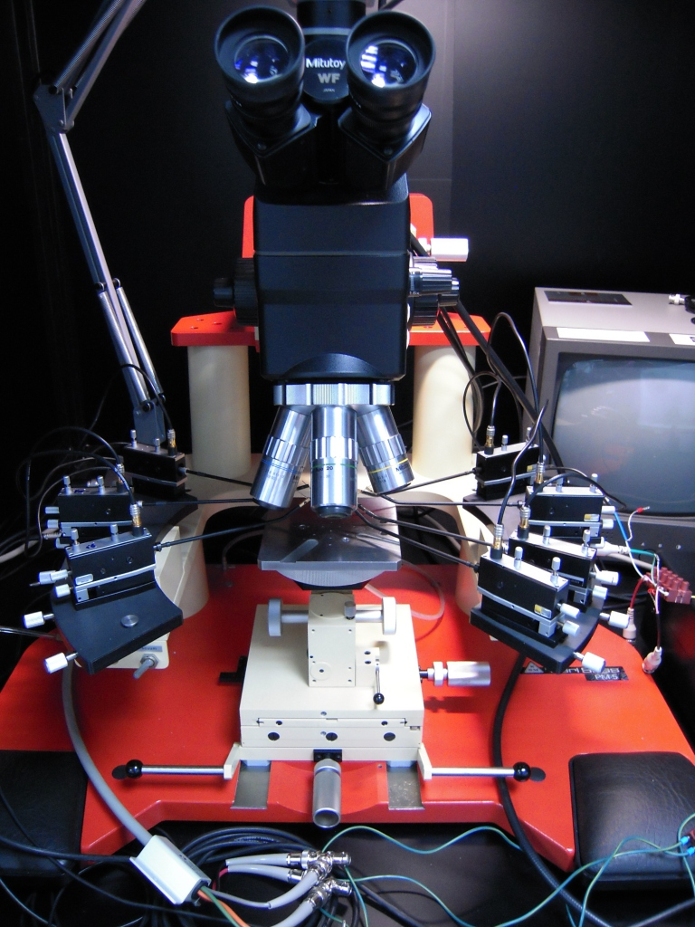
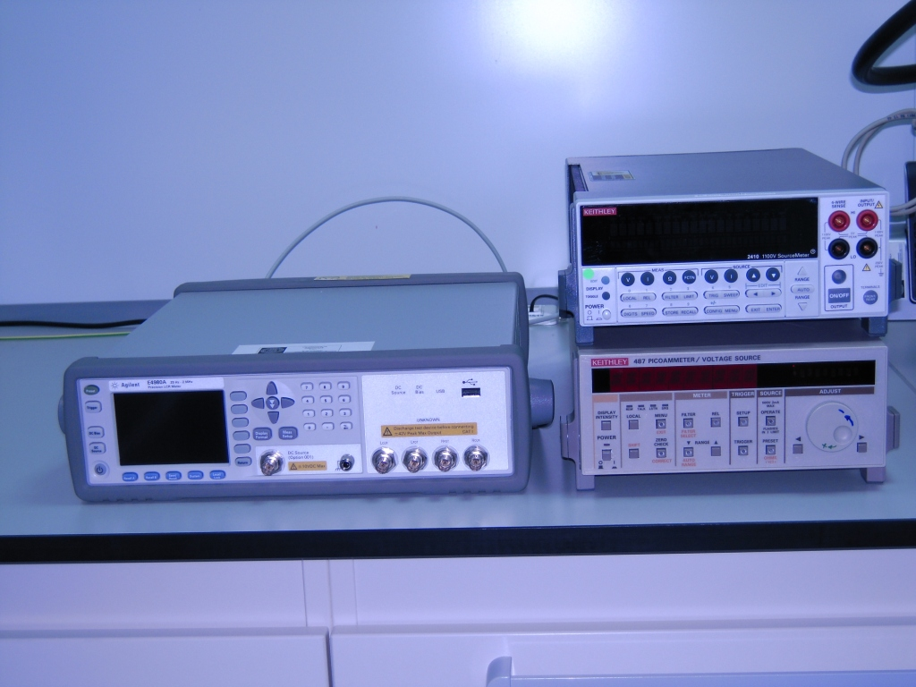
Silicon micro-strip fine pitch QA (III)
Metrology with a motorized Leica M205A microscope with digital cameras on XY motorized table:
XY resolution of 0.01µm
Z resolution ~0.1 µm
Electrical characterization:
Probe station: Mitutoyo microscope, CCD camera and 7 probes(2 of them up to 1 KV measurements).
LCR + Keithleys.

Slide 16
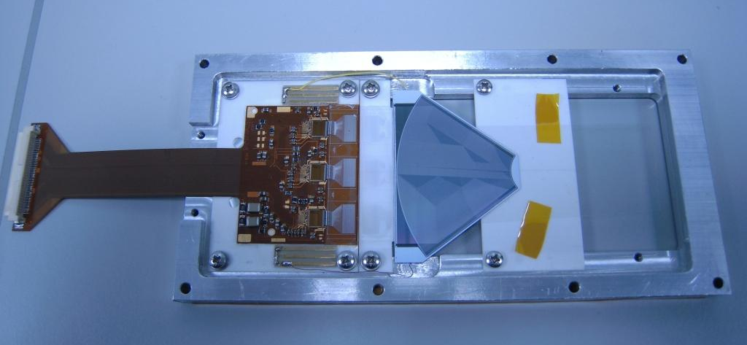
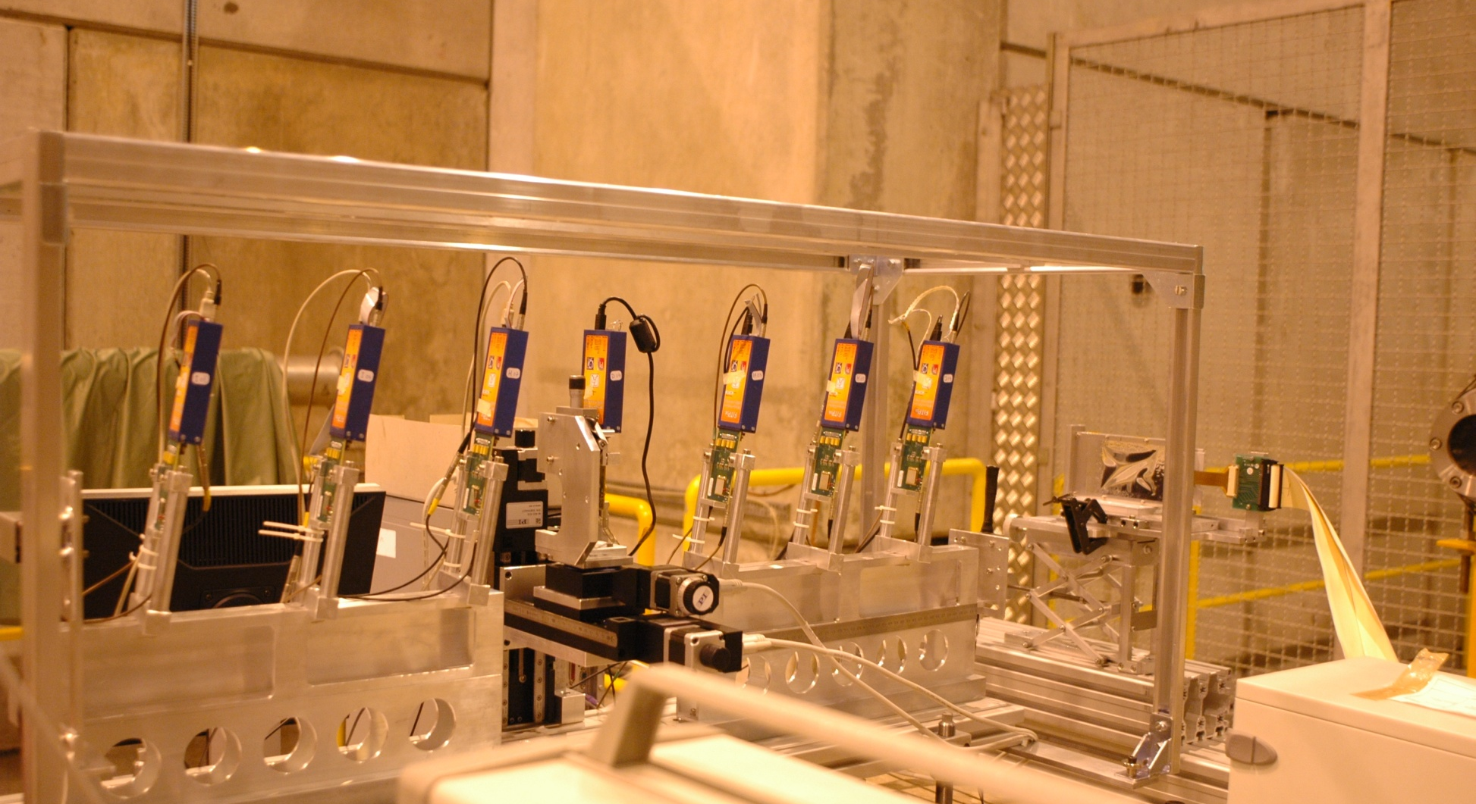
Silicon micro-strip fine pitch prototypes : PR01
Hamamatsu R-sensor:
(n⁺n) sensor p-stop
300 μm thickness
40μm minimum pitch
We have instrumented with an IT-hybrid (3 Beetle chips)
We have also setup the need readout and trigger electronics and software as well as worked in the development of the Timepix telescope
The aim is to measure eta and resolution for fine pitch with fast electronics, tested in test beam May 2010. Re-tested October 2011 test beam

Slide 17
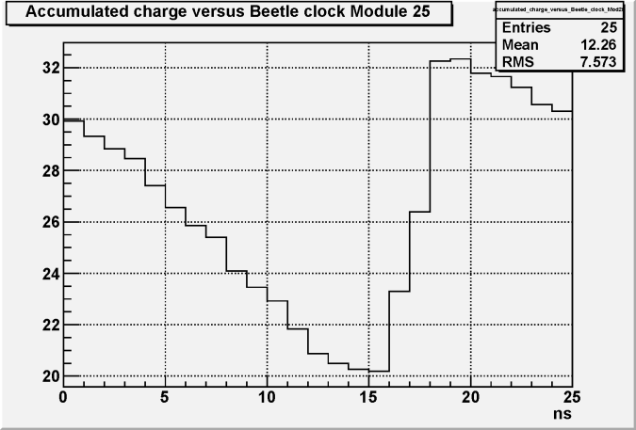
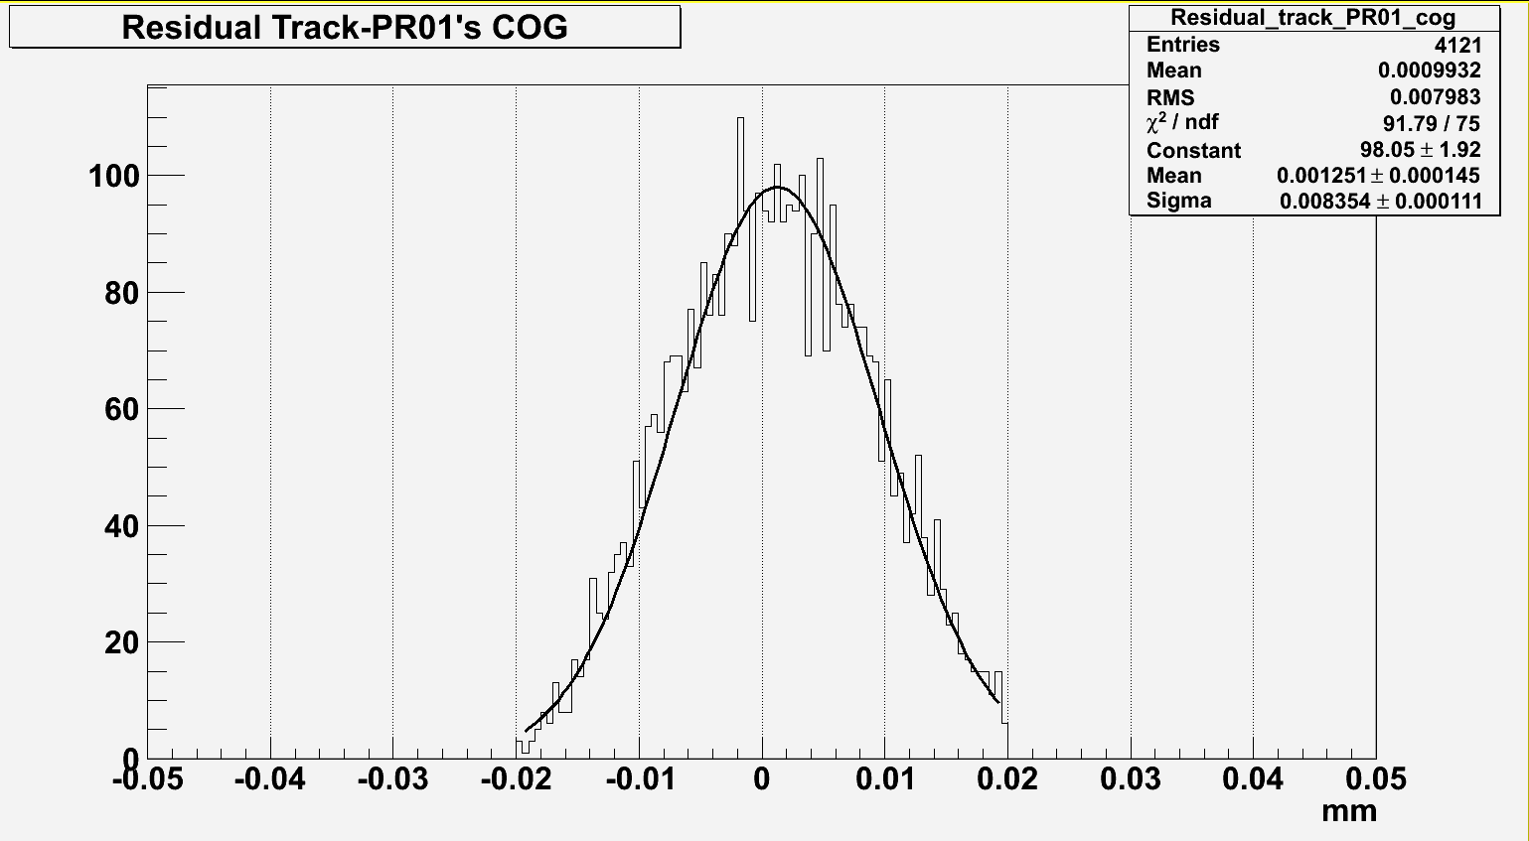
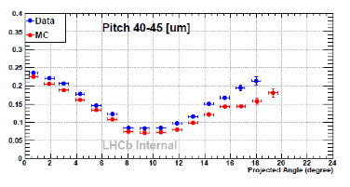
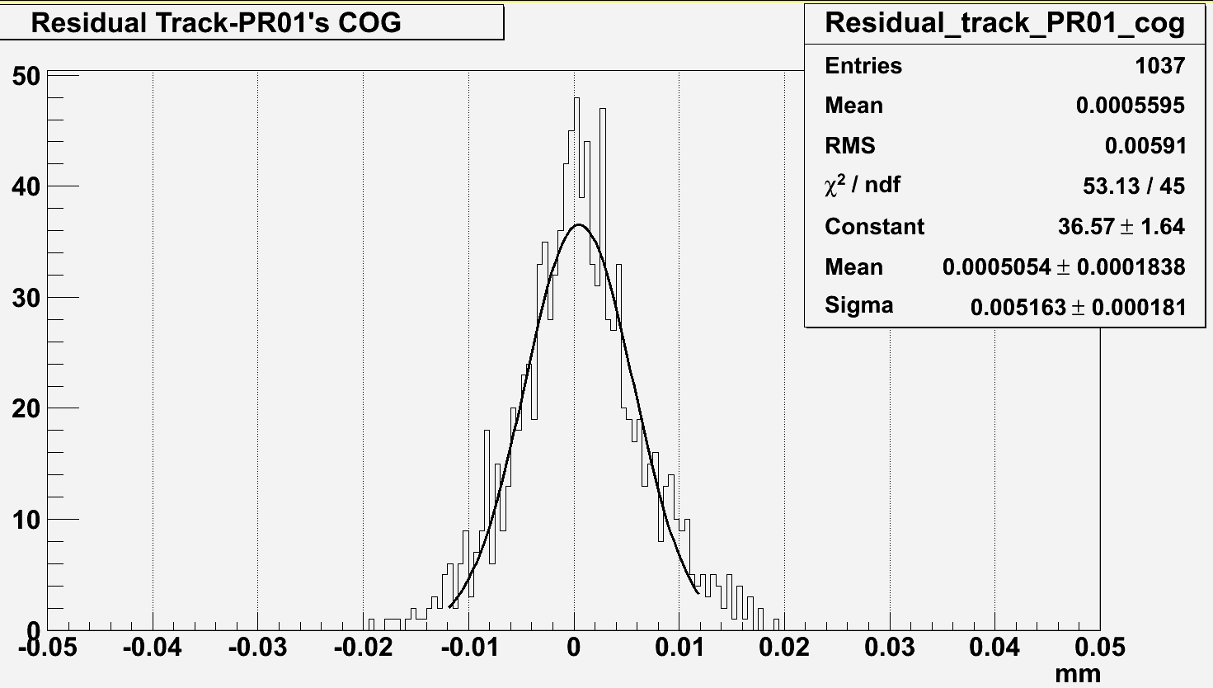
Silicon micro-strip fine pitch: PR01 (II)
Pulseshape, 25ns window
2010 test-beam results:
At 0º it seems that we get a resolution a bit better than expected (8.3 = 0.207*(pitch))
At 7.6º , is slightly worse, but we know that this is due to a lack of charge that we observe in the pulse shape
We re-measured it in 2011. Analysis ongoing
Angle: 0 º
Resolution/pitch
Angle: 7.6 º
Projected Angle (degree)

Slide 18
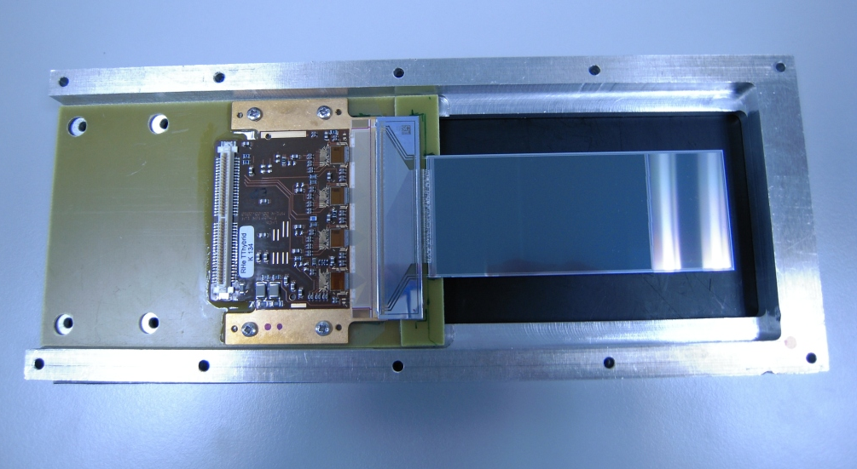
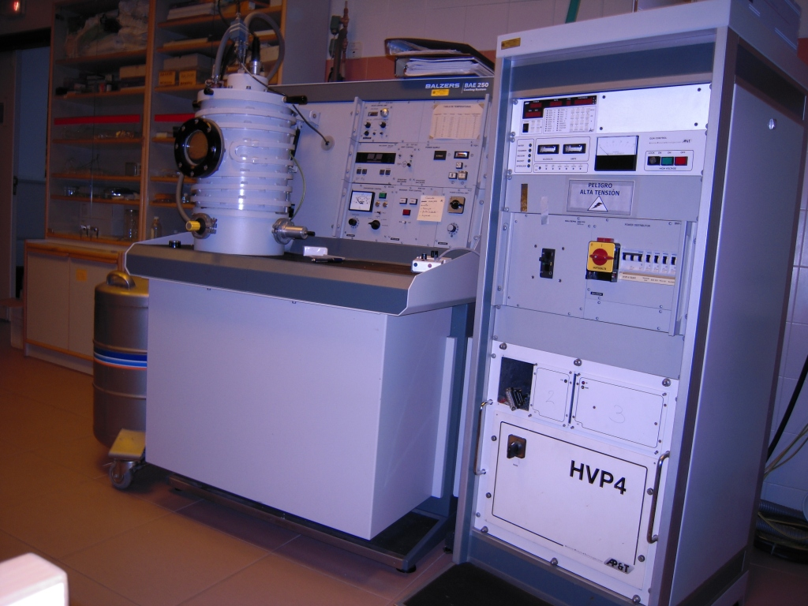
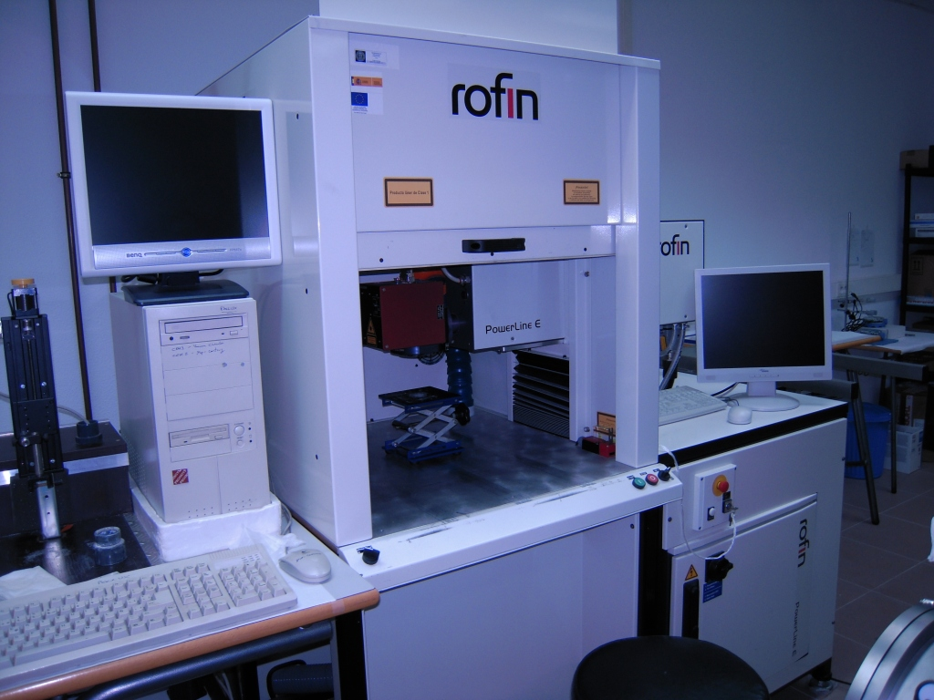
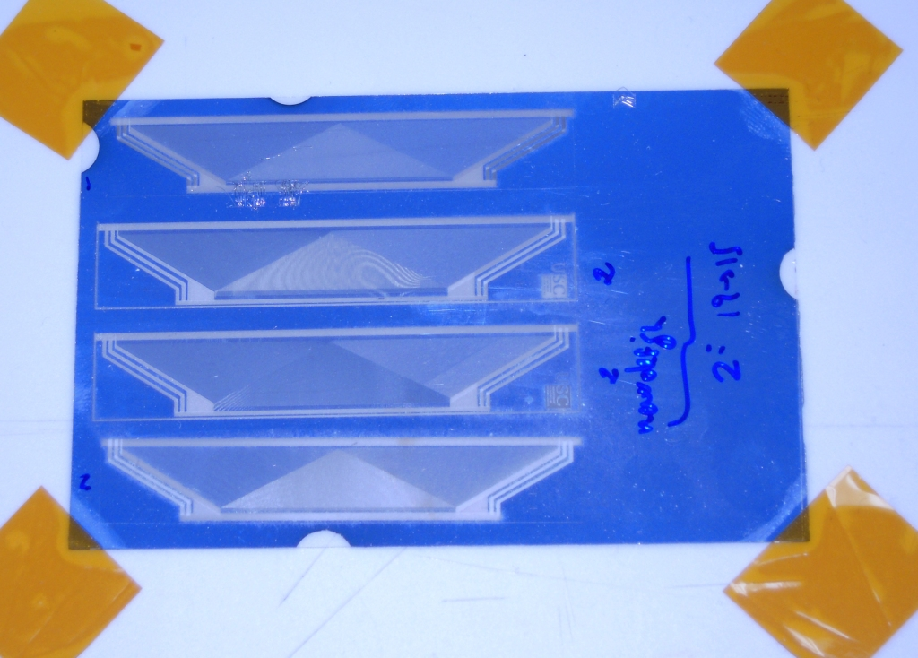
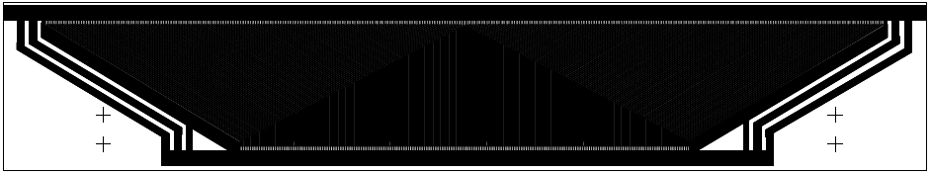
Silicon micro-strip fine pitch prototypes : D0
D0 sensor (Hamamatsu):
TT hybrid, 4 Beetle chips
Sensors: p-on-n, 320 µm thick, 60 µm pitch with 30 µm intermediate strips
Tests in lab and test beam October 2011
Pitch-Adapter:
Design & built at Santiago’s University
DESAG 263T 300 µm substrate
Evaporation 0.2 µm Cr + 1µm Al (sintering at 200°C 2h)
112 μm in hybrid's side to 60 μm in sensor's side (pads in a single row in hybrid’s side and in double row in sensor side)
Two technologies tried:
Laser ablation (Nd:YVO₄ 20W)
Photolithography (failed QA)

Slide 19
Preparations for APD irradiation at USC (I)
Dose accumulated:
At ILC 100 kRad/year → 100 kRad x 10 years x 2 (safety factor) = 2 MRad.
Staged irradiation:
100 kRad, 200 kRad, 300 kRad, 600 kRad, 900 kRad , 1 MRad, 1.5MRad, 2 MRad
8 steps → N+1= 9 samples of each device
Devices:
1 diode ST, STI
1 diode ST, well
1 diode AMS
1 pixel AMS
1 array 3x3 digital
1 pixel ST

Slide 20
Preparations for APD irradiation at USC (II)
Maximum dose rate of the source: 7 kRad/h
Plan to change soon to a new source of 6000 Ci (date not confirmed yet)
Radiation field uniformity (less than 5% variation):
10x10 cm² just below the source
2x2 m² at the maximum distance from the source.
Rate of irradiation?:
28 rad/h ---------- 7 kRad/h
Are devices ON/OFF during irradiation?
DAQ Software: LabView programs for IV scans and data logging are ready.
Availability: January 2012

Slide 21
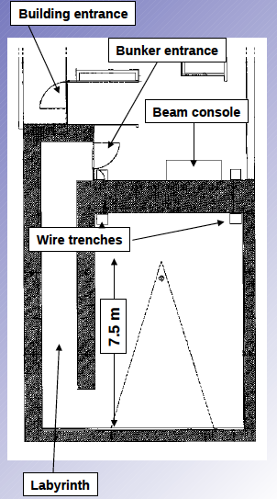
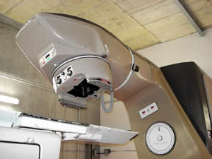
Bunker floor plan layout
12 m long cables

Slide 22
High-speed readout copper link
Readout speed is a concern in current high-density pixel detectors since effective data Tx rate goes above Gbits. Typical issues:
Zero suppression needed in the chip
Local copper interface to a high speed optical link
Problems to face:
Skin effect in conductor and dielectric losses
Control the cable mechanical parameters to achieve the desired electrical performance
Signal compensation needed if distances above several tens of cm
USC activity:
Prototype cable to asses the performance of a high-speed flex cable 'Pyralux® AP-PLUS’ from DuPont
Characterize radiation hardness and high frequency behavior of different configurations:
With network analyzer
FPGA high speed custom system
h
w
gnd
Sig+
gnd
Sig-
t
h
w
gnd
Eye diagramme for R₀, L=65 cm and 5Gbit/s.
Skin effect only.
ns
Step response L=65 cm and LCP:
Blue = skin-effect only.
Red = including dielectric loss.
(*) For details on status see Pablo Vázquez’s talk

Slide 23
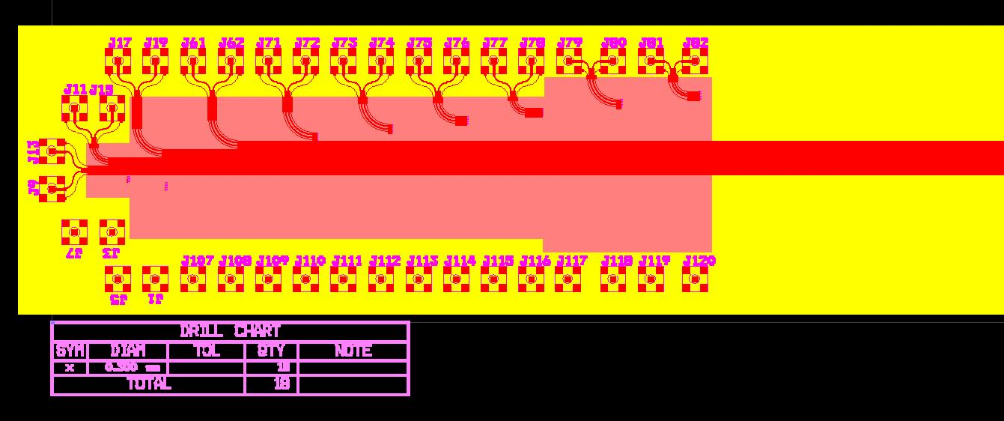
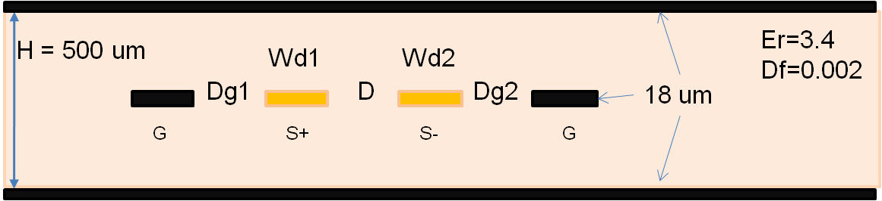
High-speed readout copper link (II)
Cable assembly:
Male-female
miniature connectors
Cut-out lines
Area 3
Area 2
Area 1
SMC connectors
SMC connectors
Area1: to study parameters of coupled differential lines
Area2: to study parameters of decoupled strip-lines
Area3: to place a miniature fine pitch connector and test a Tx line with the connector. This area is cut-off in two pieces out of the rest of the assembly.
Layout development:
Parameters to scan:

Slide 24
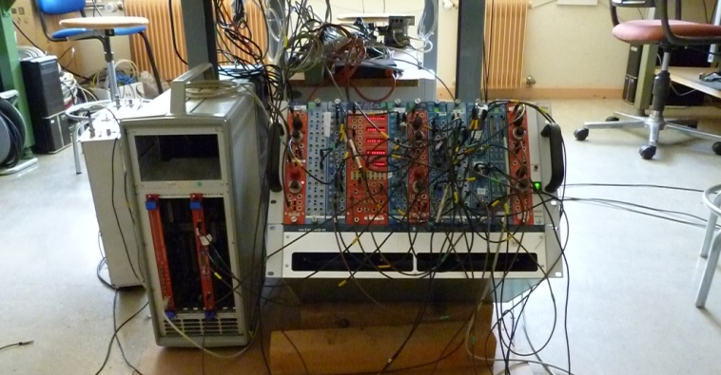
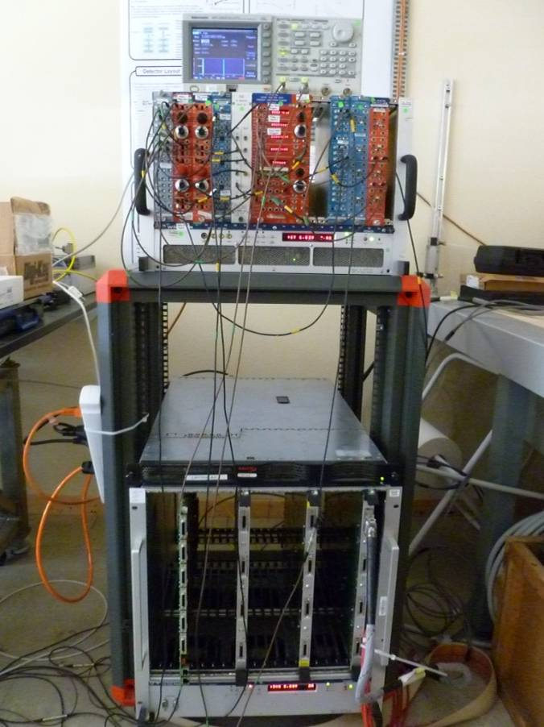
Trigger Logic Unit (TLU)
A Timepix Telescope arm is an AIDA deliverable
Trigger Logic Unit: currently we use 2 NIM crates and a VME TDC to perform timing tasks
Controlling the Shutter – e.g. selecting X particles per frame
Providing triggers to external systems
Measuring the phase between synchronized and unsynchronized triggers
The development of a trigger logic unit common to the EUDET and Timepix telescope under consideration. Already got in touch with David Cussans (developer of previous EUDET TLU) to build a portable based TLU replacement
TDC
NIM 1
NIM 2
TELL1 RO

Slide 25
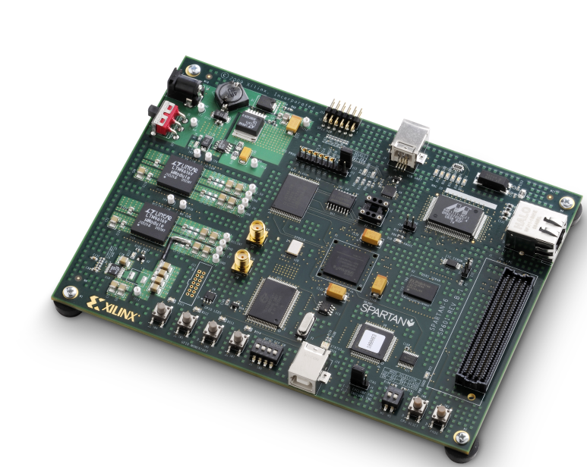
Trigger Logic Unit(II)
The first idea was to build a TLU only for the Timepix telescope design based on VHDL and Altera (Stratix II) development board:
Embedded system, remote configurable, GBE data output, several on-chip TDCs…
A solution was presented to the collaboration
But, finally, the idea to converge to a common TLU has prevailed:
Moved to Xilinx SPARTAN-6 FPGA development board, the same as the future EUDET TLU
Currently studying how to integrate both systems

