Slide 1


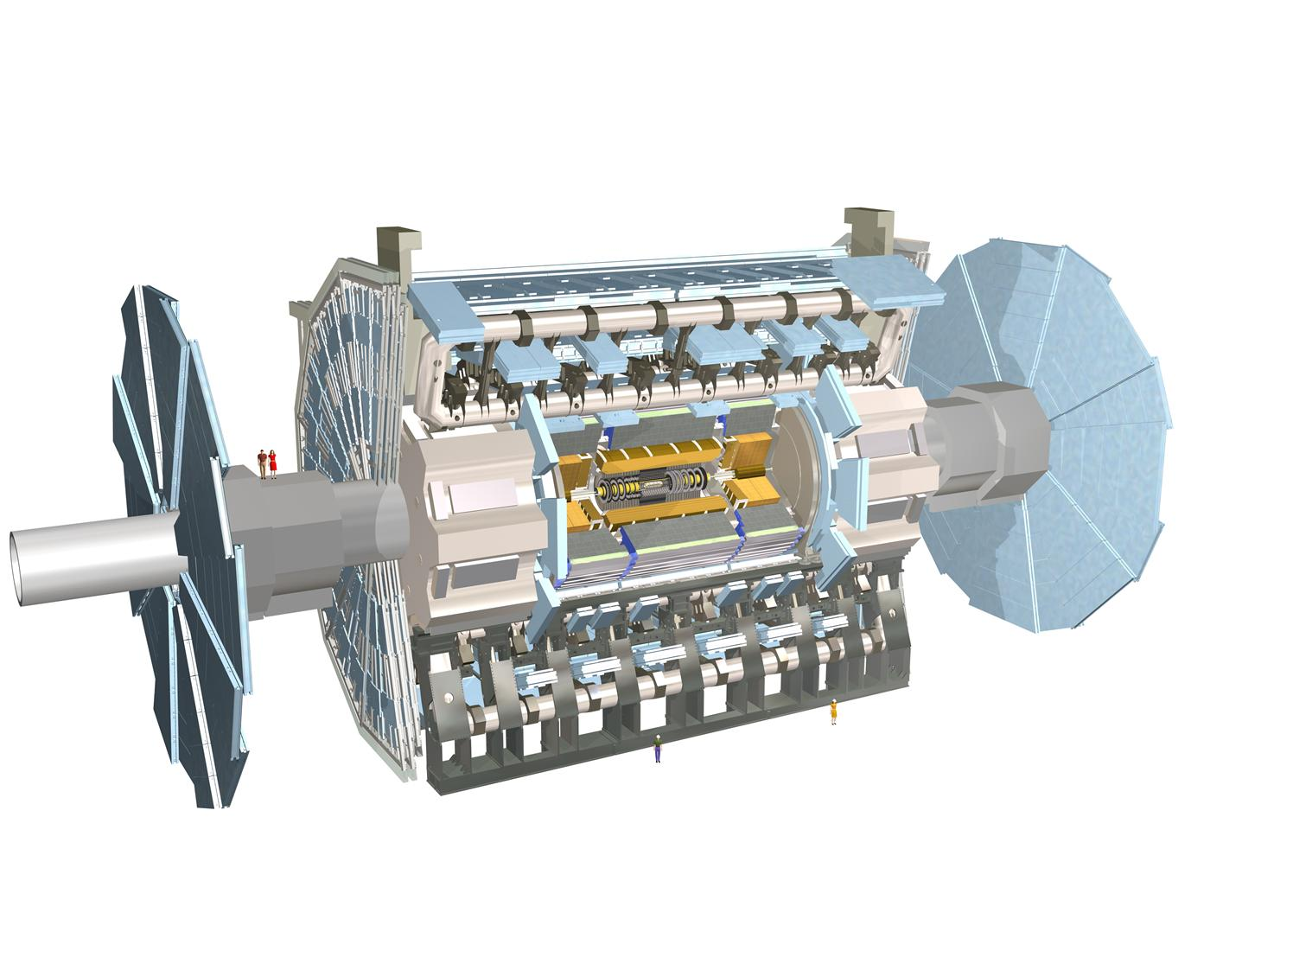

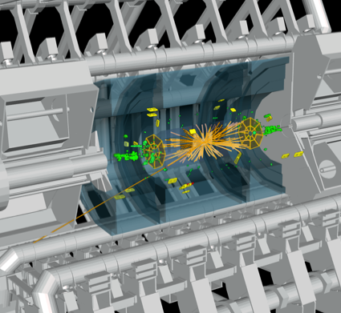
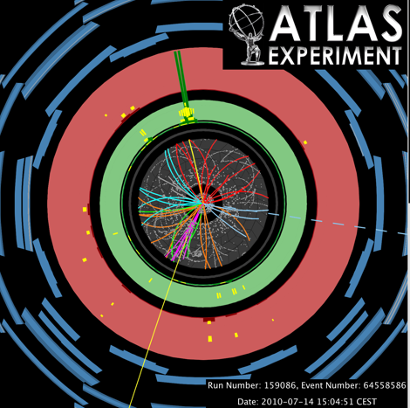
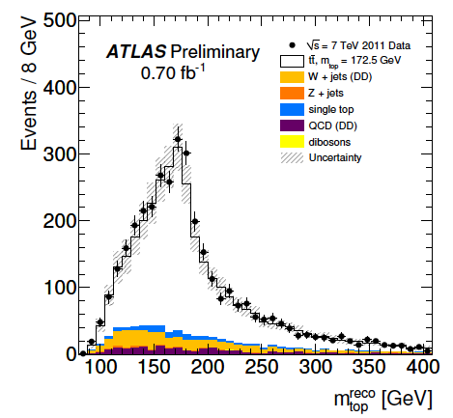
Top Quark Physics in ATLAS Detector On behalf of the ATLAS Collaboration
Regina Moles-Valls
IFIC – Universitat de València

Slide 2
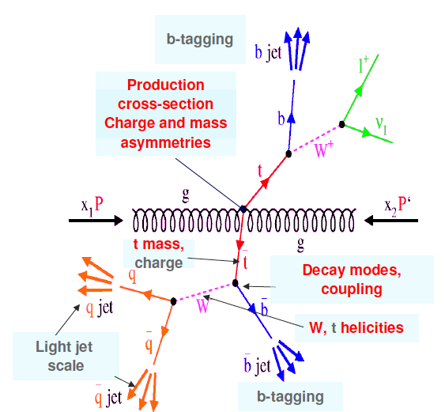

Top Physics Outline
ATLAS Top Physics results presented in this talk:
Top production:
Top quark pair cross section
Single top quark cross section
Top Properties:
Top quark Mass
Top quark charge asymmetry
W polarization
Spin correlation
New physics in top sector
Flavour Changing Neutral Current
ttbar resonances
Exotics heavy quark searches
…
Studies on event and object reconstruction:
bJES , jet shapes, τ trigger, jet structure,…

Slide 3



Top Physics Outline
ATLAS Top Physics results presented in this talk:
Top production:
Top quark pair cross section
Single top quark cross section
Top Properties:
Top quark Mass
Top quark charge asymmetry
W polarization
Spin correlation
New physics in top sector
Flavour Changing Neutral Current
ttbar resonances
Exotics heavy quark searches
…
Studies on event and object reconstruction:
bJES , jet shapes, τ trigger, jet structure,…
M.Bosman, P.Casado, C.Conidi, L.Fiorini, D.Gerbaudo, C.Helsens, A.Juste, M.LL.Mir, J.Montejo, J.Nadal, I.Riu, F.Rubbo, A.Succurro, V.Vorwerk
S.Cabrera, M.J.Costa(*), F.Fassi, J.Fuster, C.García, A.Irles, S.Martí, R.Moles, M.Moreno-Llàcer, S.González, E.Oliver, S.Pedraza, T.Pérez, E.Ros, J.Salt, V.Sánchez, E.Valladolid, M.Villaplana, M.Vos, A.Wildauer (*) Top Group Convener
J. A. Aguilar-Saavedra

Slide 4
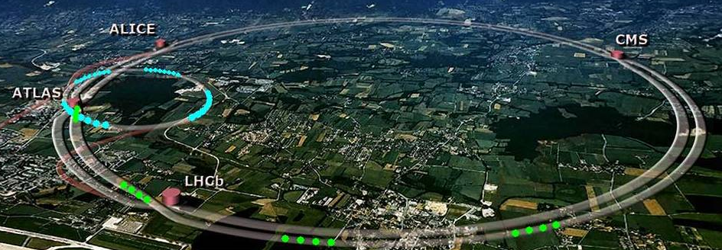
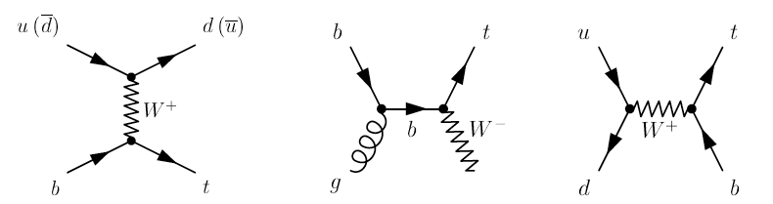
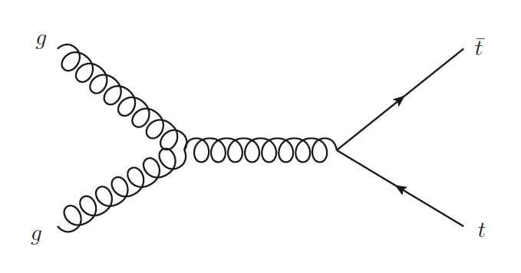
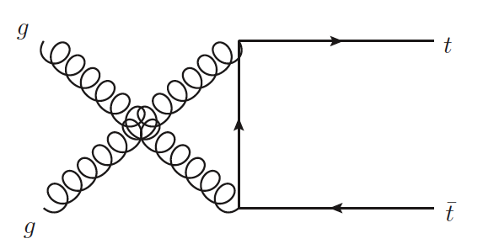
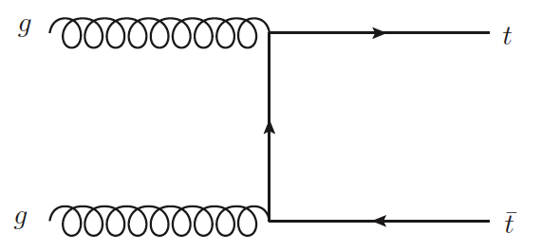
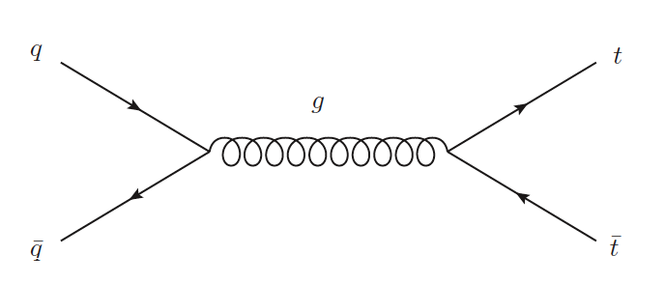
Top quark physics at LHC
Top pair production
Strong interaction
Single top production
Weak interaction
Gluon fusion 85%
t-channel
~65pb
Wt
production
~16pb
Quark scattering 15%
σ_{top} (7TeV)= 165⁺¹¹₋₁₆ pb (theoretical NLO+NNLO)
s-channel
~5pb
σ_{top} (7TeV)≈ 84 pb (theoretical NLO+NNLO)

Slide 5



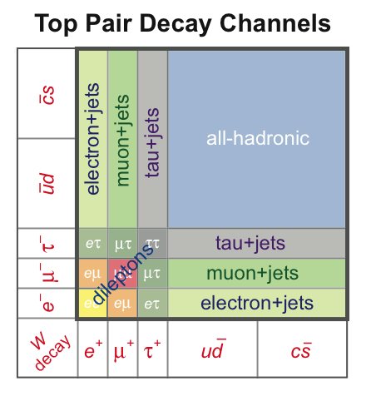
Top quark Physics in ATLAS Detector
Top quark decays take place almost exclusively:
t W+b
ttbar
Channel | Full Hadronic (45%) | Semi-leptonic (30%) | Di-leptonic (11%)
Products | 6 jets | l+MET+4jets l=(e,μ) | 2l+MET+2jet l=(e,μ,τ)
Background
Single top
Channel | t-channel | Wt production | s-channel
Products | 1,2 l+MET+2,3 jets
Background

Slide 6
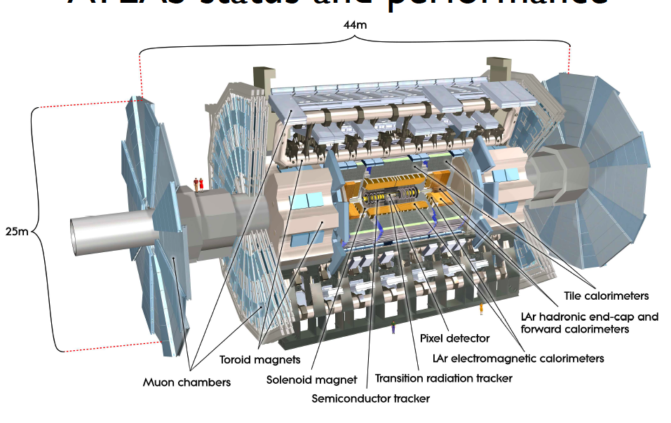
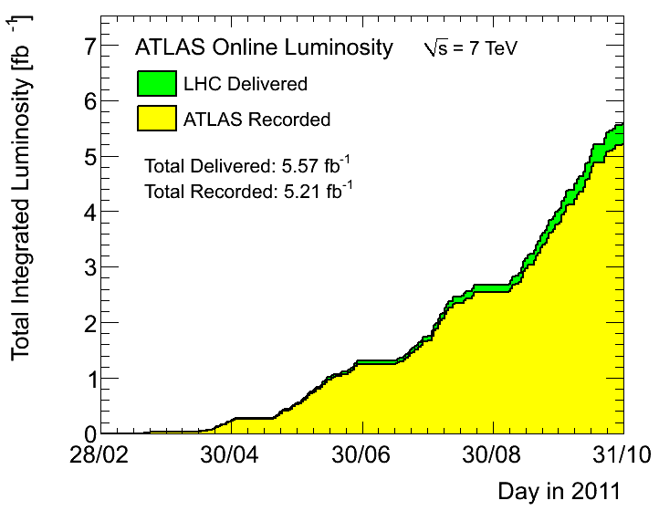
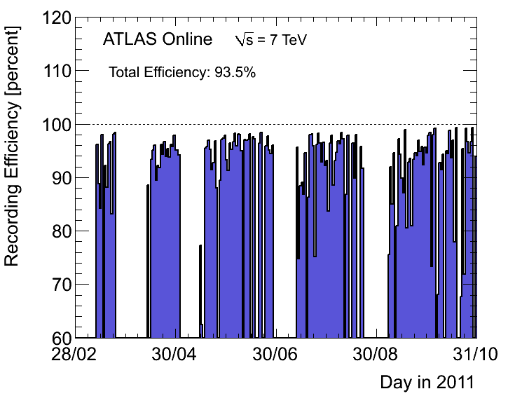
ATLAS Performance for Top Physics
Collecting useful data:
≈1fb⁻¹:σ_{tt}^{μ+τ}, resonances
0.7fb⁻¹: mass, single top production,
charge asymmetry, spin correlation,
W polarization,…
200pb⁻¹: resonances
35pb⁻¹: FCNC

Slide 7
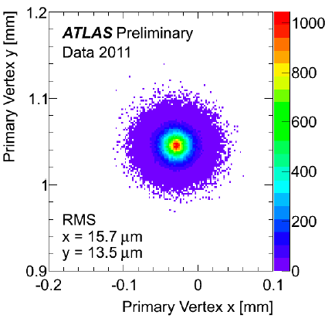
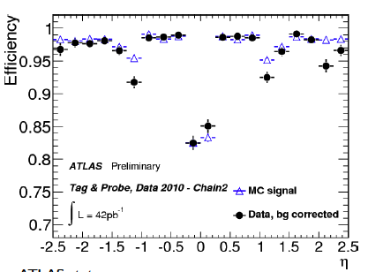
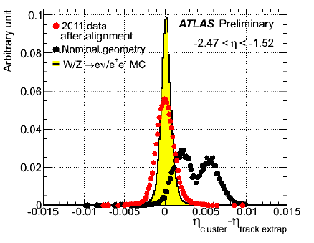
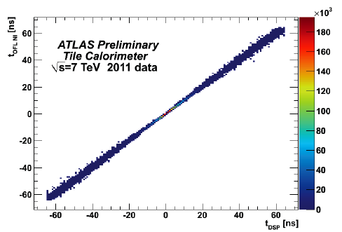
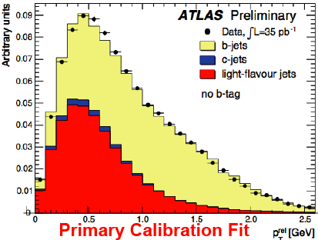
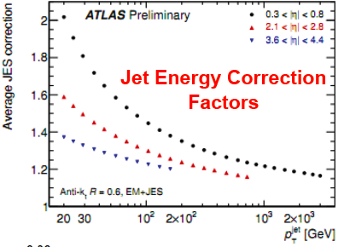
ATLAS Performance for Top Physics
Electron: Energy deposits in EM calorimeter with associated well reconstructed track in the ID
Muon: Track segments in different layers of muon chambers are combined and matched with ID track
Jets: Anti-kt4 algorithm is used starting from energy cluster of adjacent calorimeters jets. Calibration is done using EM+HAD calorimeter information
b-tagging: Based on impact parameter. It requires a good ID tracking performance
Trigger: Trigger is based on signatures of e, μ and jets, as well as missing transverse energy
B-jet
Top quark in ATLAS needs:
Efficient e,μ,τ reconstruction
Good Jet reconstruction
b-jet tagging capability
E_{T}^{miss}
Top physics Full detector working!!!
Muon

Slide 8
Top production:
Top quark pair cross section
Single top quark cross section
Top Properties:
Top quark Mass
Top quark charge asymmetry
W polarization
Spin correlation
New physics in top sector
Flavour Changing Neutral Current
ttbar resonances
Exotics heavy quark searches
…

Slide 9
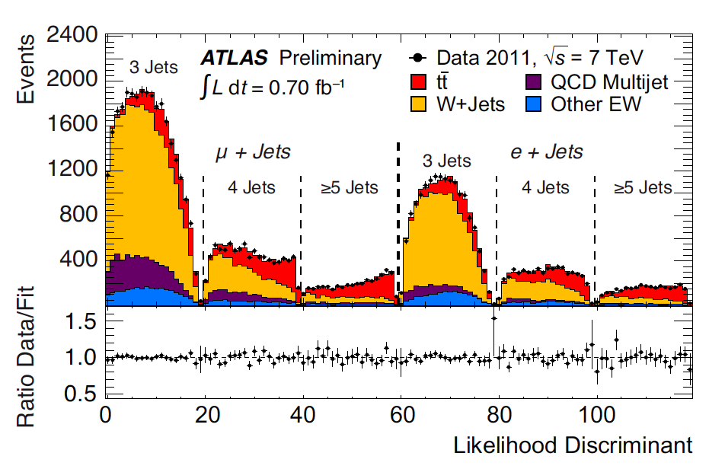
Measurement of ttbar cross section
Precise measurements of cross-section allow precision tests of perturvative QCD
Validation of the SM at high energies: σ_{tt}SM=165⁺¹¹₋₁₆ pb
Some of these measurements open new windows to new physics
ttbar sample important background in searches for physics BSM
σ(tt) in lepton+jets final states
ATLAS-CONF-2011-121
Signature: lepton (e/μ), E_{T}^{miss}, at least 3 jets
Multivariate Analysis:
η_{l}, p_{T}^{leading jet}, aplanarity and H_{T3}
Uncertainty systematically dominated
Challenging theoretical uncertainty:
Δσ/σ = 6.6%
σ_{t}(tt)=179 ±3.9(stat)±9.9(syst)±6.6(lumi) pb

Slide 10
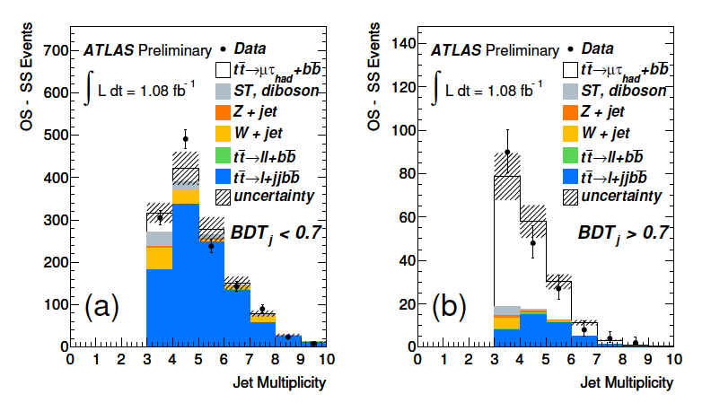
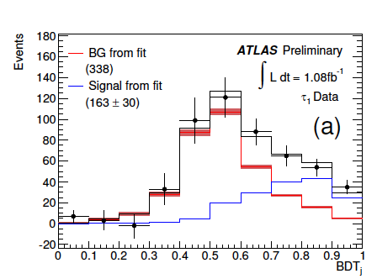
Measurement of ttbar cross section
ttbar cross-section in μ+τ final states
IFIC : ATLAS-CONF-2010-119
IFAE+IFIC: Analysis update in progress
Signature: μ and τ leptons, E_{t}^{miss}, 2 or more jets(1b^{tag})
Identification of τ-leptons uses a multivariate
technique based on Boosted Decision Tree
ATLAS-CONF-2010-119
ATLAS-CONF-2010-119
σ_{t}(μ+τ channel)=142 ±21(stat)⁺²⁰₋₁₆(syst)±5(lumi) pb
The cross-section measurements has been performed in most of the ttbar final states:
Single lepton+jets channel (w/wo b-tagging)
Dilepton channel including all lepton flavour
All hadronic channel
Most of them are dominated by systematic errors
IFAE: ATLAS-CONF-2011-035
Analysis update in progress

Slide 11
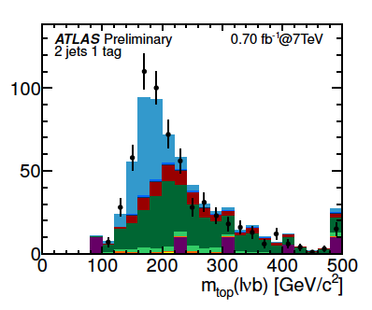
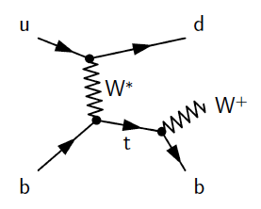
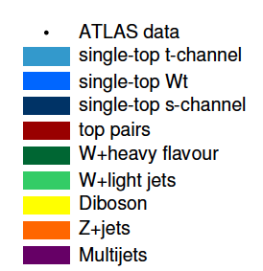
Measurement of single top production
Single top quark production via weak interaction provides a direct probe of W-t-b coupling and it is sensitive to new physics
Measurement of the cross-section determines the quark mixing matrix element V_{tb}without assumption of quark generations
t-channel σ_{t}SM=64.6^{+3.3}_{-2.6} pb
Signature: lepton (e/μ), E_{T}^{miss}, 2-3 jets(b^{tag)}
Cut-Based Analysis using discriminating variables:
m(l,ν,b^{tag}), H_{T}, Δη(b,j₁),|η(j₁)|
Neural Network method has been used too
ATLAS-CONF-2011-101
σ_{t}(t-chan)=90⁺⁹₋₉(stat)⁺³²₋₂₀(syst) =90⁺³²₋₂₂ pb
Wt production σ_{t}SM=15.7^{+1.3}_{-1.4} pb
s-channel σ_{t}SM=4.6±0.3 pb
Signature: 1/2 leptons(e/μ), E_{T}^{miss}, 1/3 jets(b^{tag)}
Cut-Based Analysis
Signature: lepton (e/μ), E_{T}^{miss}, 2 b^{tag}
Cut-Based Analysis
σ_{t}(Wt-channel)<39.1pb @95CL
σ_{t}(s-channel)<26.5pb @95CL
3/11/11

Slide 12
Top production:
Top quark pair cross section
Single top quark cross section
Top Properties:
Top quark Mass
Top quark charge asymmetry
W polarization
Spin correlation
New physics in top sector
Flavour Changing Neutral Current
ttbar resonances
Exotics heavy quark searches
…

Slide 13
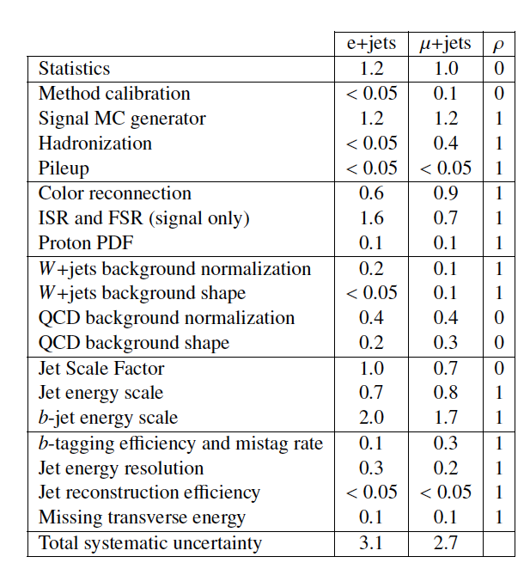
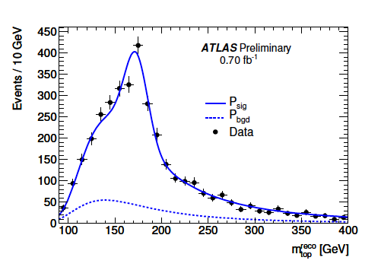
Top Quark Mass
Top quark mass is a fundamental parameter of the SM particle physics
Several ATLAS top mass measurements has been performed:
Signature: 1 lepton (e/μ), E_{T}^{miss}, 4 jets(b^{tag})
Different methods:
1-dimensional Template (R₃₂= m_{W}/m_{top})
2-dimensional template (m_{top} & JES)
Combination:
μ Channel
ATLAS-CONF-2011-120
The uncertainty of the results is domi-
nated by the systematic uncertainties:
JES Uncertainty for b-jets and light-jets
Initial and final state radiation
Some aspects of the MC modelling
m_{top}= (175.9 ± 0.9_{stat} ± 2.7_{syst}) GeV
IFIC: New methods to measure top quark mass in progress

Slide 14
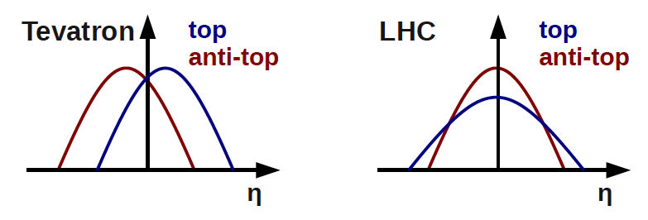
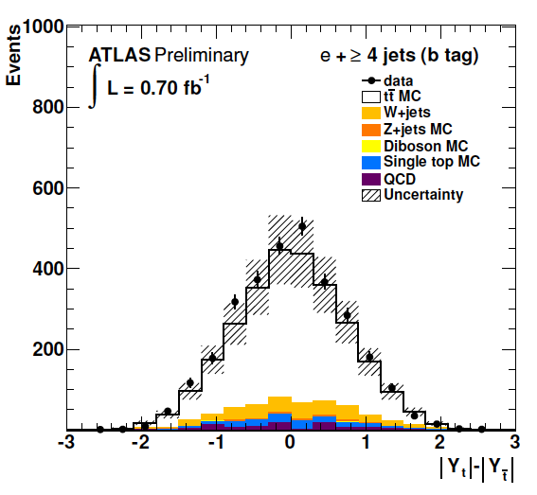
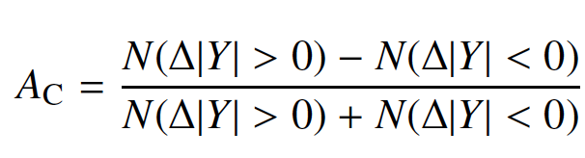

Top Quark Charge Asymmetry
SM expects ttbar production symmetric under charge conjugation
at LO and small asymmetry due to the ISR and FSR at NLO:
gg ttbar: symmetric
qq ttbar: top quarks emitted in the direction of the incoming quark
anti-top quarks in the direction of the incoming anti-quark
IFAE & UV.GRANADA: arXiv:1109.3710v1
IFAE: ATLAS-CONF-2011-106
Tevatron (proton-antiproton): forward-backward asymmetry
qq ttbar (90%)
LHC (proton-proton): top goes into forwards regions whereas anti-top keep more in the central region
qq ttbar (15%)
Several processes BSM can alter this asymmetry
Signature: lepton (e/μ), E_{T}^{miss}, >4 jets
Unfolding: Rapidity distribution for ttbar are distorted
by detector effects and acceptance
SM prediction A_{C}≈ 0.01 (G.Rodrigo)
ATLAS-CONF-2011-106
A_{C}= -0.024±0.016(stat)±0.023(syst)

Slide 15


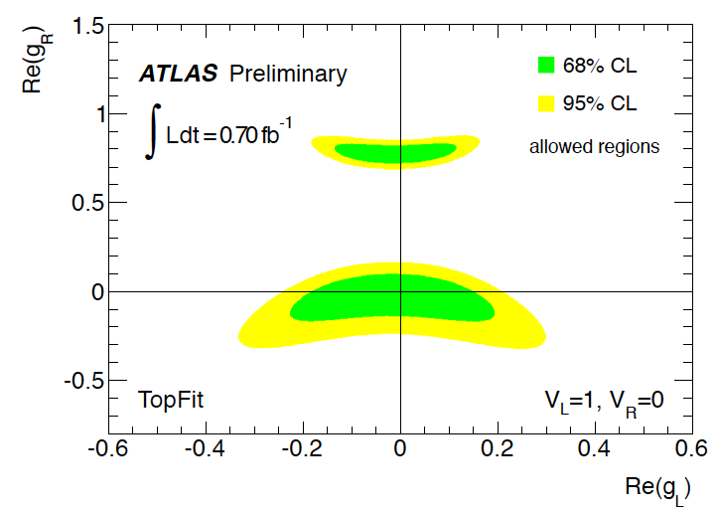
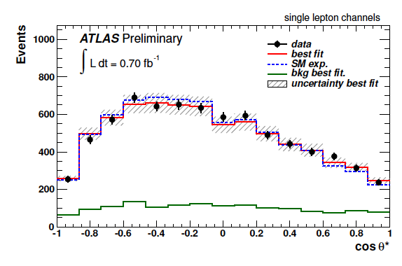
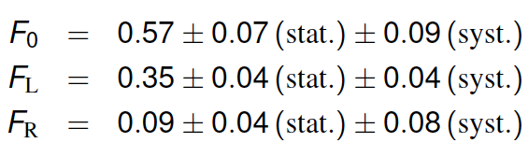
W Polarization
Polarization of W bosons in top quark decays are sensitive to the structure Wtb-vertex
(used to set limits on the anomalous contributions to the Wtb-vertex)
W polarization helicity fractions | F₀^{NNLO}=0.587±0.005
 | F_{L}^{NNLO}=0.311±0.005
 | F_{R}^{NNLO}=0.0017±0.001
New physics can be parametrised in terms of an effective Lagrangian:
Anomalous coupling V_{R,}g_{L} and g_{R} are absent in the SM at tree level
Cosθ*: angle between charged lepton form the W decay and b quark form the top decay in the W boson rest frame
ATLAS-CONF-2011-122
ATLAS-CONF-2011-122
UV.GRANADA: ATLAS-CONF-2011-122
IFIC: W in single top analysis in progress

Slide 16

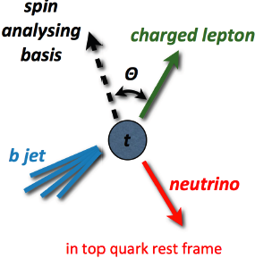
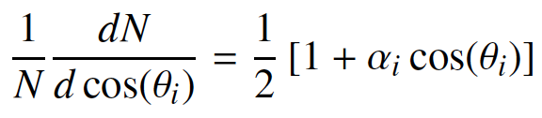
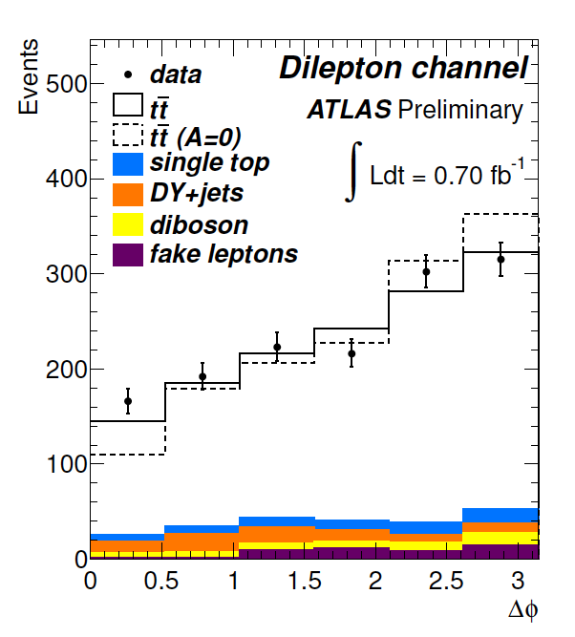
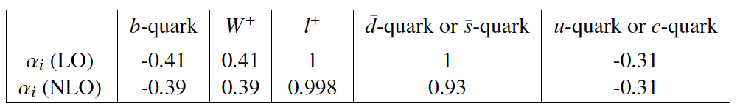



Spin Correlations
Top quark has short lifetime:
Top decays before spin can flip
Spin information is contained in the decay products
(angular distributions)
Dilepton channel promise larger sensitivity:
2 leptons, E_{t}^{miss},≥2jets
fSM is the SM template strength:
fSM =N_{SM}/(N_{SM}+N₀) in SM fSM=1
Results in agreement with ASM_{helicity}=0.32
In the quark decay the V-A couplings fix the angular distribution of the decay products according to the polarization of the parent top quark via:
ΔΦ = |Φ(l₁)-Φ(l₂)|

Slide 17
Top production:
Top quark pair cross section
Single top quark cross section
Top Properties:
Top quark Mass
Top quark charge asymmetry
W polarization
Spin correlation
New physics in top sector
Flavour Changing Neutral Current
ttbar resonances
Exotics heavy quark searches
…

Slide 18
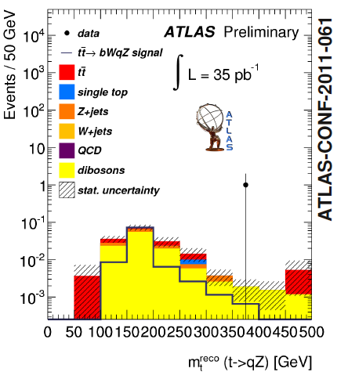
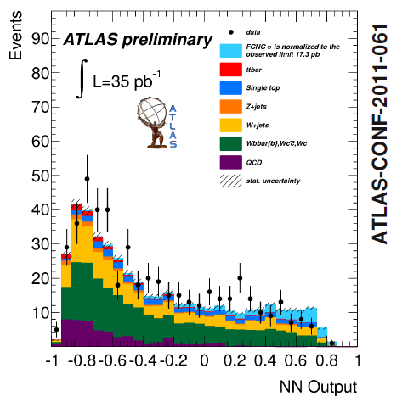
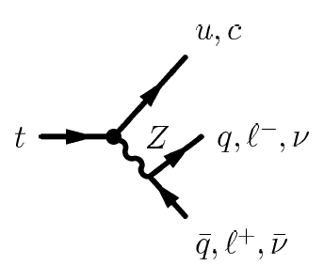
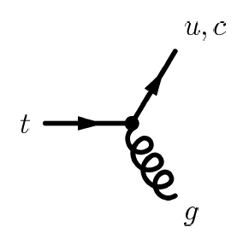

Flavour Changing Neutral Current searches
According to the SM, FCNC are forbidden at tree level and much smaller at one loop.
Several SM extensions predicts higher branching fractions for top quark FCNC decays.
Top Pair
One top decaying through SM and the other trough FCNC
Single top
No evidence of FCNC is found

Slide 19
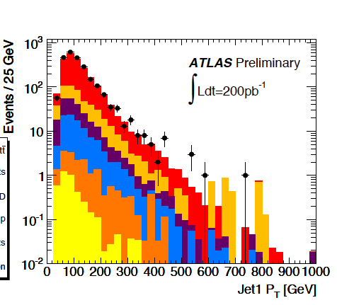
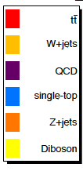
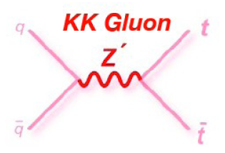
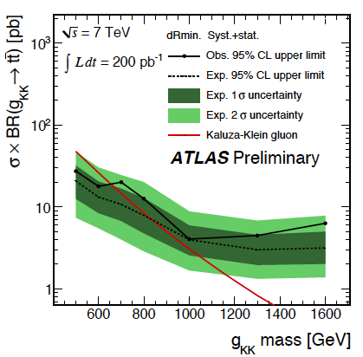
ttbar resonance searches
Many models of physics BSM predict the existence of new resonances that decay predominantly into top quark pairs
Mass resonances in semi-leptonic channel
Z’ resonance in the leptophobic scenario
Special attention on top mass reconstruction (m_{tt}):
Comparison of top quark pair invariant mass with background only and signal+background hypoteses:
If no excess in the comparison with SM predictions
is found limit on the (σxBR) vs m_{tt} is set
Narrow resonances predicted by leptophobic topcolour model can not be excluded
Kaluza-Klein gluon resonance in the Randall-Sundrum model
K-K gluons with masses below 650GeV are
excluded @ 95CL
ATLAS-CONF-2011-087
For resonance masses above 1TeV, the top quark decay products start to become strongly collimated, so reconstruction of these resonances is the subject of forthcoming studies: boosted topology
IFIC: ATLAS-CONF-2011-087

Slide 20
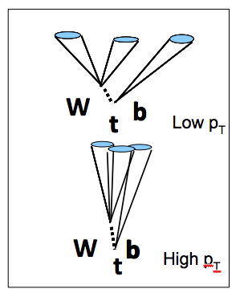
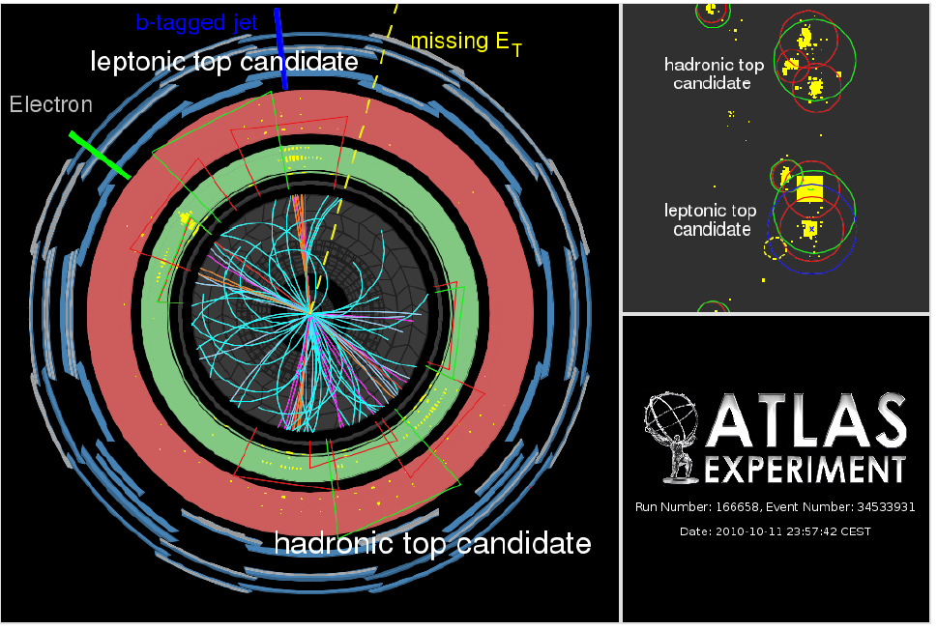
Boosted tops
For resonance masses higher than 1TeV the top quark candidates are Boosted tops
Classical “resolved” algorithms, developed for tops at rest, are not adequate for highly boosted top decays:
Jets from hadronic top decay not resolved
Isolation of leptons
In the “boosted” topology
tops are reconstructed as “fat” jets
ATLAS-CONF-2011-073
IFIC: Imminent publication of ATLAS-CONF-2011-073

Slide 21
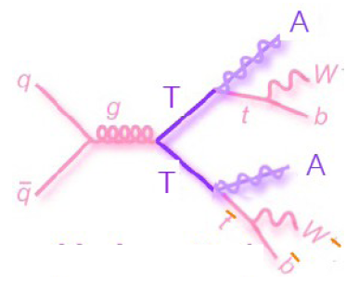

top partner searches
ttbar events with large Missing transverse energy
Model where new top quark partner are pair-produced and each top decay to an on-shell top (or anti-top) quark and long-lived undetected neutral particle
TT->ttA₀A₀:
ttbar signature
Large E_{t}^{miss} form undetected A₀
Many models present this signature
Data consistent with the SM predictions
No evidence of an excess of E_{T}^{miss}
In absence of of signal an upper limit on
the (σxBR) is quoted:
(σxBR) of 1.1pb for m(T)=420GeV and
m(A₀)<1o GeV excluded @ 95%CL
In the exotic model of 4th generation
m(T)>420GeV and m(A₀)>140GeV are
excluded
arXiv:109.4725
IFAE: Top quark 4th generation work in progress

Slide 22






Studies on event and object reconstruction
Top analysis require a hard work in reconstruction, performance detector,…
Jet Shapes data/MC comparison
Tau trigger
Muon Scale Factor
ATL-PHYS-INT-2011-079
arxiv:1110.1530v1
ATL-COM-PHYS-2011-123
B-jes uncertainty validation
Fat Jet systematics
QCD Background studies
ATLAS-CONF-2011-073
IFAE
https://svnweb.cern.ch/trac/atlasgrp/browser/CombPerf/
JetETMiss/JESPaper2010DataJESPaper2010Data.pdf
IFIC

Slide 23
Summary
The top quark physics program in ATLAS is really huge!
Many measurements has been done:
Top Cross section:
Top pair cross section has been performed in almost all the final states
Single top cross section has been measured too
Top quark properties:
These ones have been extensively studied
Searched for new physics:
Studies are on-going and many results will arrive for next conferences
At this moment many studies are on-going:
Using more statistic (ATLAS has now 5.2fb⁻¹)
Increasing understanding of the detectors is continously improving
New top precision measurements and observation are coming!!!
The Spanish contribution to top quark physics in ATLAS is and will be really important

Slide 24
Thank you very much

Slide 25
Measurement of single top production
Single top quark production via weak interaction
Provides a direct probe of W-t-b coupling and is sensitive to new physics
Measurement of the cross-section determines the quark mixing matrix element
V_{tb}without assumption of quark generations
Leptonic decay mode: e/μ, E_{t}^{miss},2-3jets(b^{tag})
Cut-Based analysis
4 discriminan variable: m(l,ν,b^{tag}), H_{T}, Δη(b,j₁),|η(j₁)|
Consistent with SM t-channel expectation
Neural network analysis
13 variables used
t-channel
Single top higher cross section
σ_{t}SM=64.6^{+3.3}_{-2.6} pb
ATLAS-CONF-2011-101
σ_{t}(t-chan)=90⁺⁹₋₉(stat)⁺³²₋₂₀(syst) =90⁺³²₋₂₂ pb
σ_{t}(t-chan)=105±7(stat)⁺³⁶₋₃₀(syst) pb

Slide 26





Measurement of single top production
Wt production
Single top higher cross section
σ_{t}SM=15.7^{+1.3}_{-1.4} pb
Cut-Based method to select Wt contribution
After selection (15% purity)
ATLAS-CONF-2011-104
σ_{t}(Wt-channel)<39.1pb @95CL
s-channel
Single top higher cross section
σ_{t}SM=4.6±0.3 pb
Leptonic decay mode: e/μ, E_{t}^{miss},2 jets(b^{tag})
Cut-based analysis method
Many variables as potential discriminators
between signal and background
Signal purity in the signal region ~6%
ATLAS-CONF-2011-118
σ_{t}(s-channel)<26.5pb @95CL

Slide 27
ttbar resonance searches
Many models of physics BSM predict the existence of new resonances that decay predominantly into top quark pairs
ATLAS-CONF-2011-087
Mass resonances in semi-leptonic channel
Z’ resonance in the leptophobic scenario
Special attention on top mass reconstruction (m_{tt}):
DeltaRmin algorithm to reduce IFS/FSR
Comparison of top quark pair invariant mass with background only and signal-plus-background hypoteses:
Comparison to SM predictions
If no excess is found limit on the (σxBR) vs m_{tt} is set
Narrow resonances predicted by leptophobic topcolour model can not be excluded.
K-K gluon resonances in the Randall-Sundrum model
Semileptonic channel
K-K gluons with masses below 650GeV are excluded @ 95CL
IFIC: ATLAS-CONF-2011-087

Slide 28


ttbar resonance searches
Mass resonances in dileptonic resonances
ATLAS-CONF-2011-123
K-K gluon resoances in the Randall-Sundrum model
Interesting variables:
H_{T} + E_{t}^{miss} : searches for an excess of this distribution (KK gluon resonances harder spectrum than SM quark production)
Resonance searches in the dilepton ttbar final state don’t show significant excess in H_{T} + E_{t}^{miss} spectrum.
Set limits on σB for KK gluon production
Mass of the KK-gluon in the Randall-Sundrum model higher than 0.84TeV @95CLMass
For resonance masses above 1TeV, the top quark decay products start to become strongly collimated, so reconstruction of these resonances is the subject of forthcoming studies: boosted topology
g_{KK} for illustration
IFIC: ATLAS-CONF-2011-123

Slide 29
Measurement of ttbar cross section
Precise measurements of cross-section allow precision tests of perturvative QCD
Validation of the SM at high energies: σ_{tt}SM=164⁺¹¹₋₁₆ pb
Some of these measurements open new windows to new physics
ttbar sample important background in searches for physics BSM
ttbar cross-section in μ+τ final states
IFIC : ATLAS-CONF-2010-119
IFAE+IFIC: Analysis update in progress
Signature: μ and τ leptons, E_{t}^{miss}, 2 or more jets(1b^{tag})
Identification of τ-leptons uses a multivariate
technique based on Boosted Decision Tree
ATLAS-CONF-2010-119
ATLAS-CONF-2010-119
σ_{t}(μ+τ channel)=142 ±21(stat)⁺²⁰₋₁₆(syst)±5(lumi) pb

Slide 30
Measurement of ttbar cross section
σ(tt) in lepton+jets final states
ATLAS-CONF-2011-121
Signature: lepton (e/μ), E_{T}^{miss}, at least 3 jets
Multivariate Analysis:
η_{l}, p_{T}^{leading jet}, aplanarity and H_{T3}
Uncertainty systematically dominated
Challenging theoretical uncertainty:
Δσ/σ = 6.6%
σ_{t}(tt)=179 ±3.9(stat)±9.9(syst)±6.6(lumi) pb
The cross-section measurements has been performed in most of the ttbar final states:
Single lepton+jets channel (w/wo b-tagging)
Dilepton channel including all lepton flavour
All hadronic channel
Most of them are dominated by systematic errors
IFAE: ATLAS-CONF-2011-035
Analysis update in progress

