Slide 1

The Facility for Antiproton and Ion Research

Slide 2
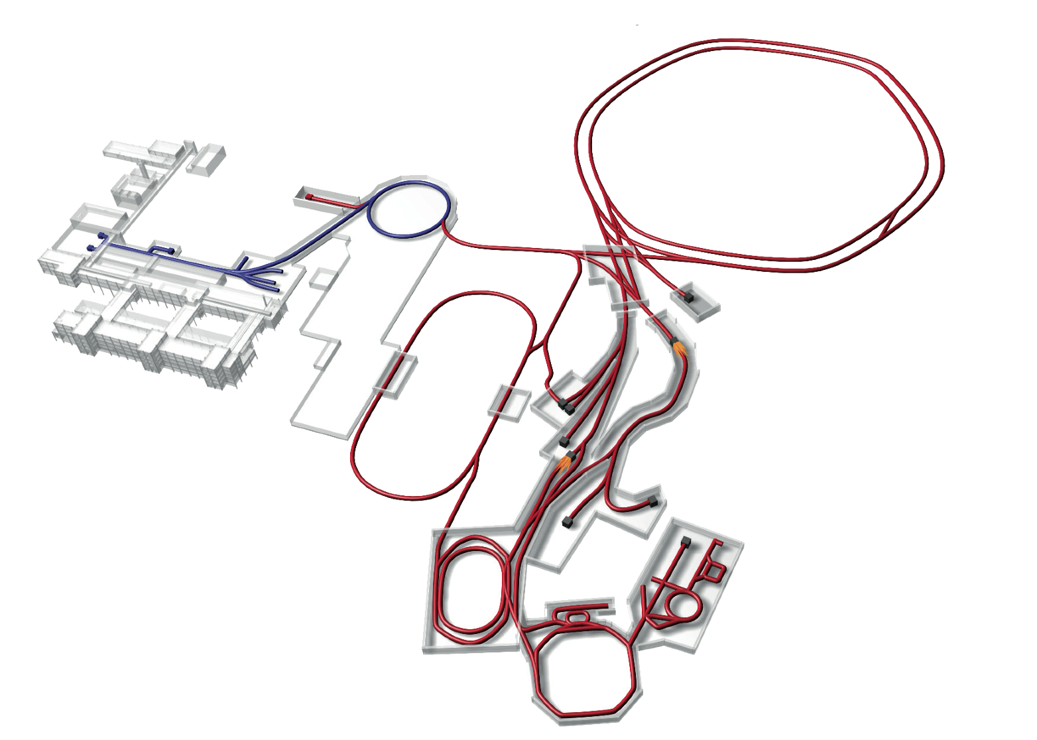
FAIR @ Darmstadt
Nuclear Structure & Astrophysics
(Rare-isotope beams)
Hadron Physics
(Stored and cooled
14 GeV/c anti-protons)
p-Linac
SIS18
SIS100/300
UNILAC
QCD-Phase Diagram
(HI beams 2 to 45 GeV/u)
HESR
Rare-Isotope
Production Target
Fundamental Symmetries
& Ultra-High EM Fields
(Antiprotons & highly stripped ions)
Anti-Proton
Production Target
Dense Bulk Plasmas
(Ion-beam bunch compression
& petawatt-laser)
CR & RESR
Cryring
Materials Science & Radiation Biology
(Ion & antiproton beams)
NESR
100 m
Accelerator Physics

Slide 3
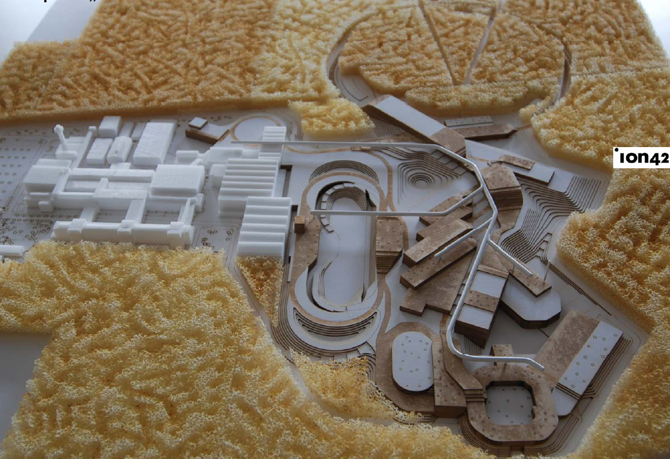
Architects‘ View

Slide 4
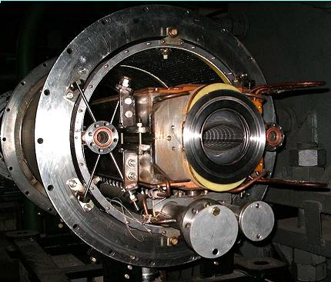
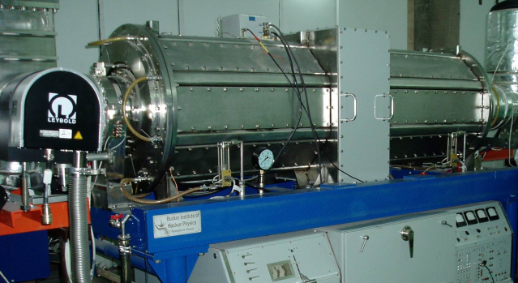
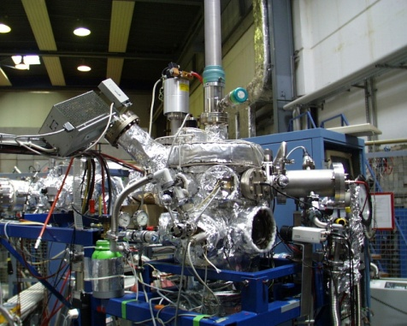
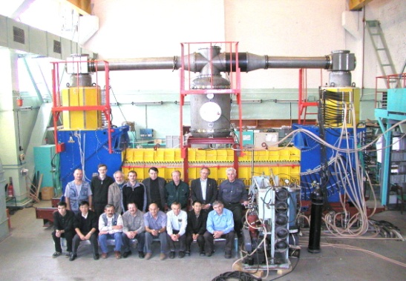
Accelerator Challenges
Compact & cost effective accelerators
Fast cycling superconducting magnets dB/dt ~ 4T/s
Fast acceleration
High gradient, variable frequency Ferrite & MA loaded cavities
XHV @ high beam intensities
Extremely high vacuum ~10⁻¹³ mbar
Precision beams
Electron & stochastic cooling

Slide 5
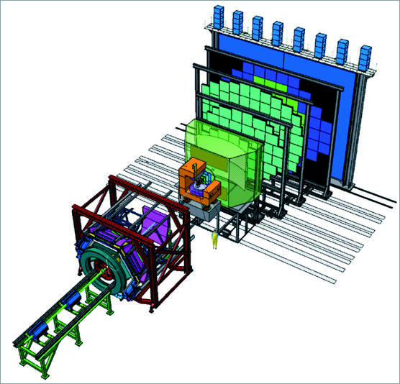
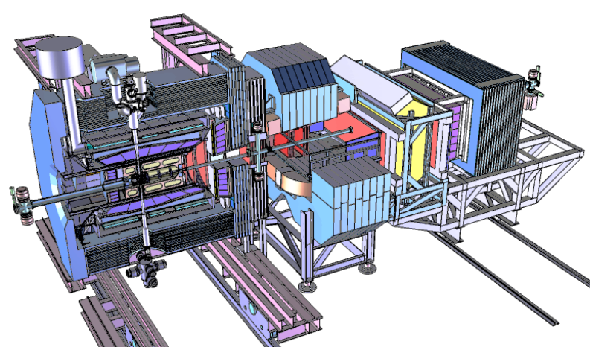
Experiments
CBM
APPA
Super-FRS
PANDA
NuSTAR

Slide 6
Collaborations
APPA
CBM
NuSTAR
PANDA
SPARC
HEDgeHOB
WDM
BIOMAT
LEB Super-FRS
HISPEC/ DESPEC
MATS
LASPEC
R³B
ILIMA
HADES

Slide 7
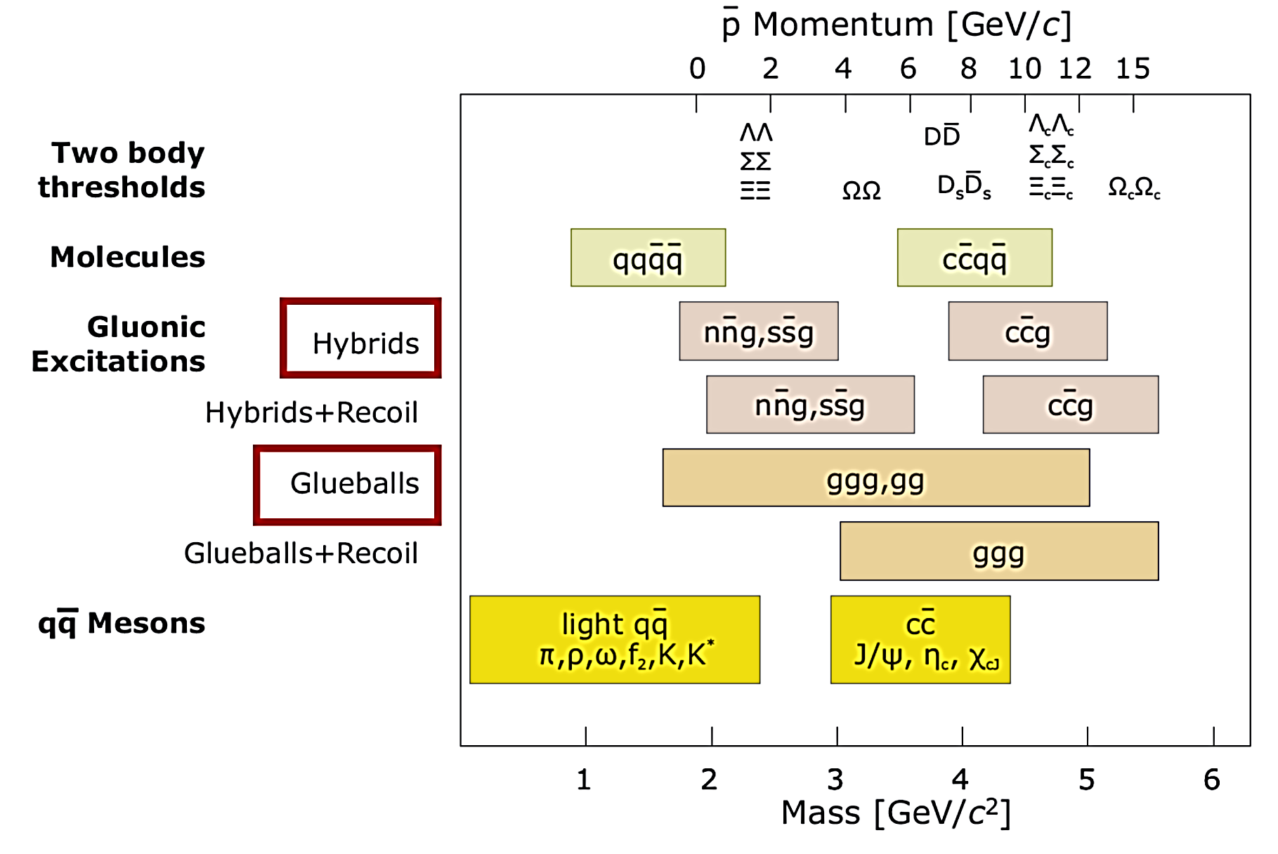
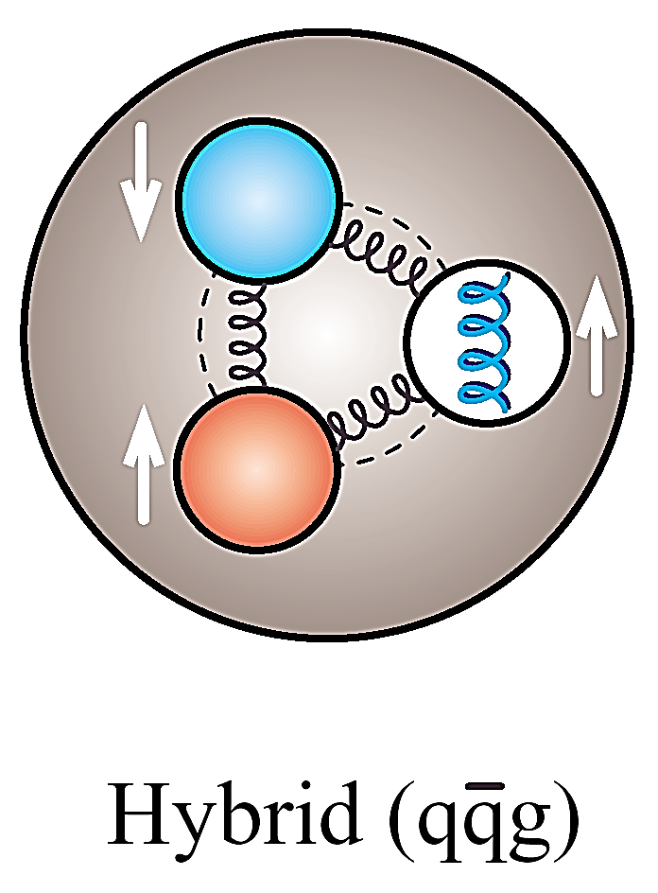
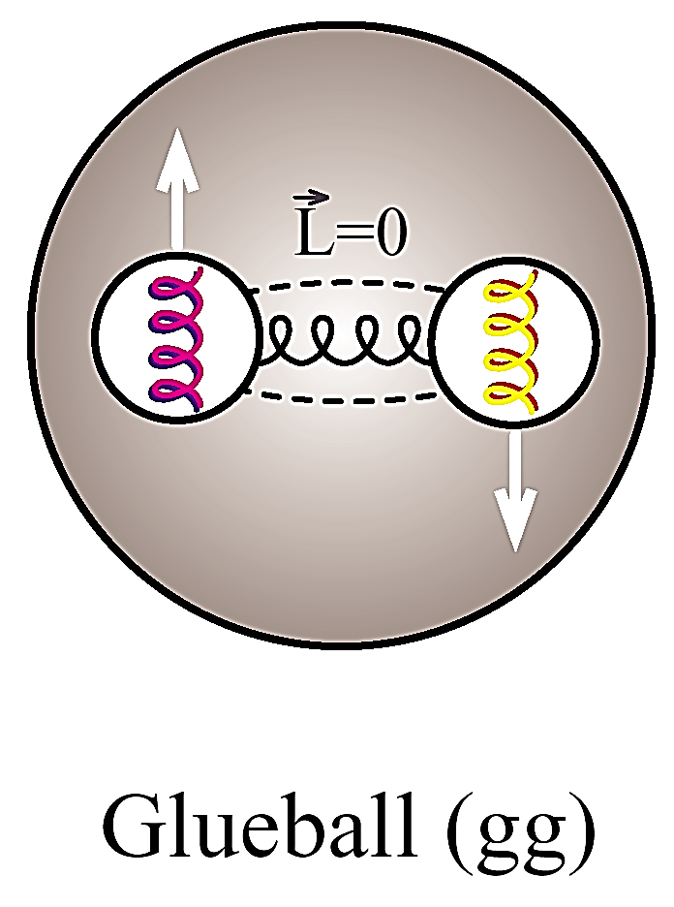
Anti-Proton Annihilation @ DA
PANDA

Slide 8
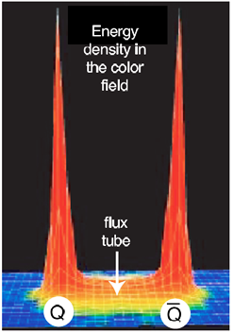
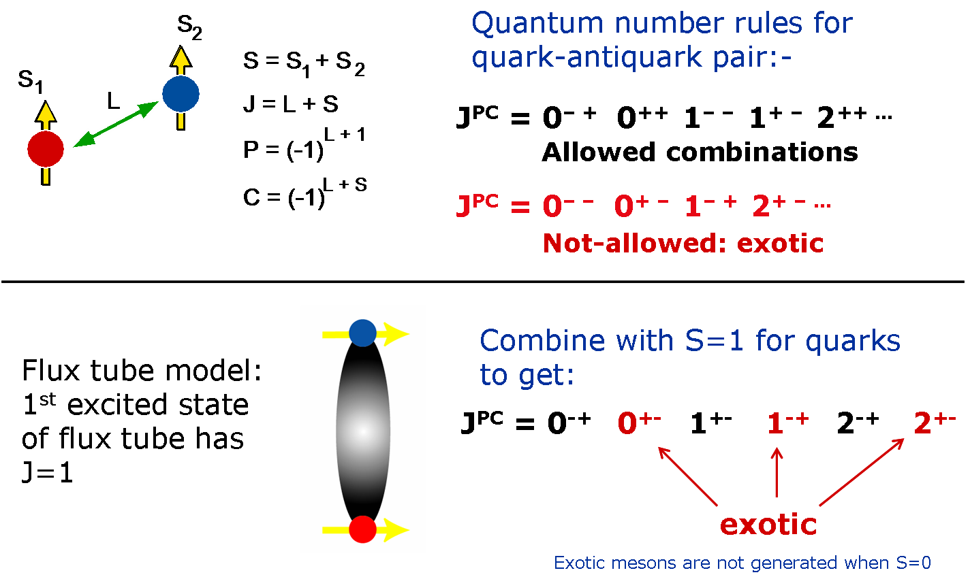
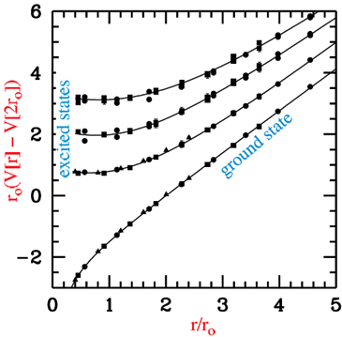
Gluonic excitations
PANDA @ FAIR

Slide 9
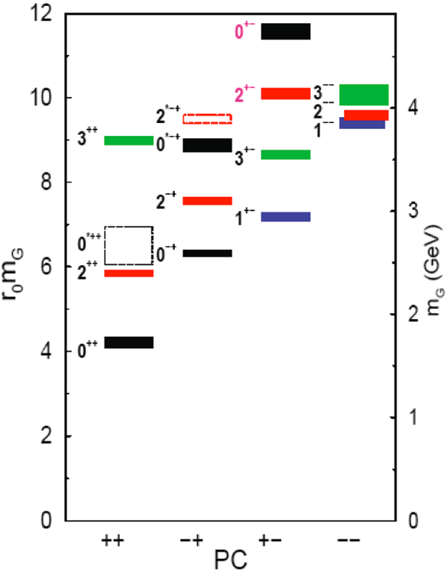
Search for Heavy Glueballs
Charmed glueballs
flavour blind decays
charmed final states
only a few charmed mesons around 3 - 4 MeV/c²
less mixing
Exotic glueballs (oddballs), no mixing!
m(2⁺⁻) = 4140(50)(200) MeV
m(0⁺⁻) = 4740(70)(230) MeV
decay modes φφ, φη, J/ψη, J/ψφ
Narrow widths predicted
Morningstar & Peardon, PRD60(1999)34509 Morningstar & Peardon, PRD56(1997)4043

Slide 10
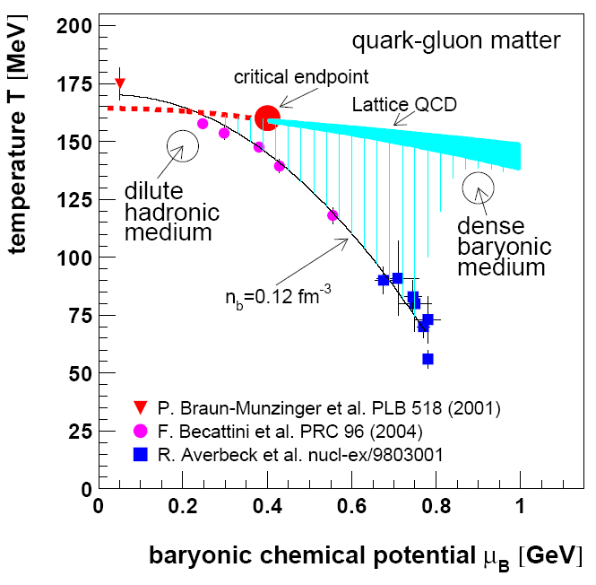
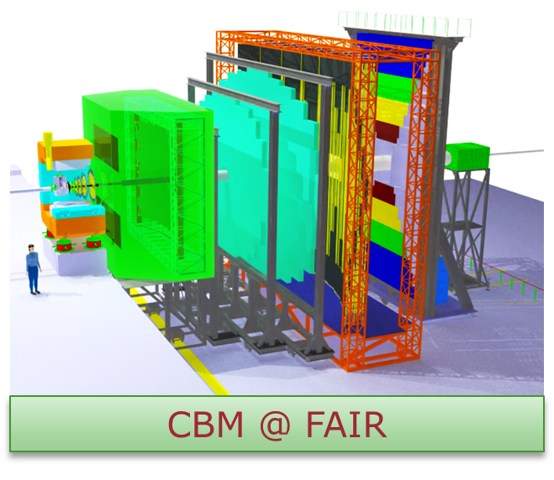
Compressed Baryonic Matter
SIS100/300

Slide 11
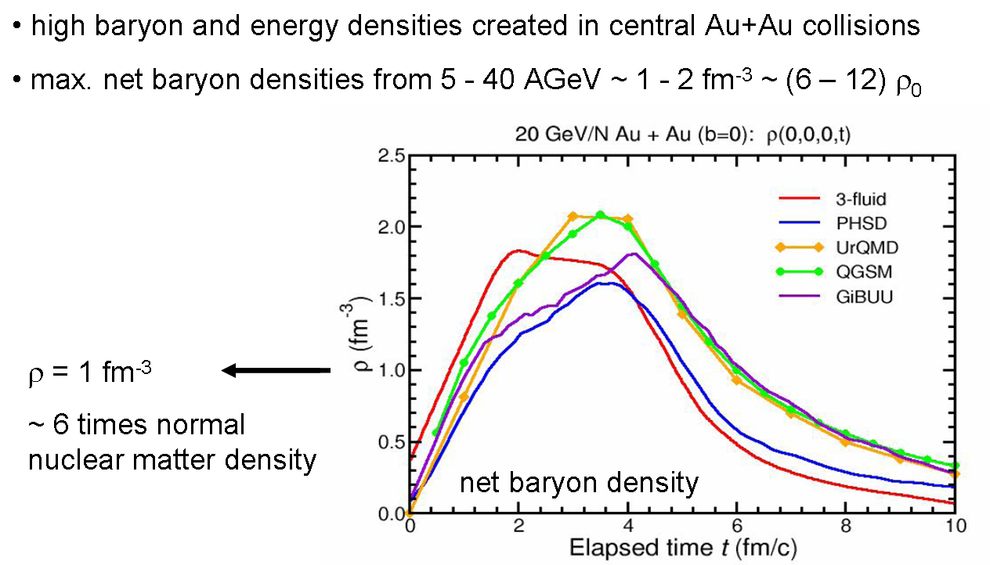
High Baryon Density @ CBM

Slide 12
Hadrons in Nuclear Matter
Partial restoration of chiral symmetry in nuclear matter
Light current quarks sensitive to quark condensate
Charmonium states
Sensitive to gluon condensate
Significant mass shifts expected for χ_{c}, ψ’, ψ(3770): 40, 100, 140 MeV/c² resp.
D mesons - QCD analogue of H-atom
Chiral symmetry to be studied on a single light quark
Theoretical calculations disagree in size and sign of mass shift (50 MeV/c² attractive vs. 160 MeV/c² repulsive)
Vacuum
Nuclear medium
π⁻
π
25 MeV
π⁺
K⁺
K
100 MeV
K⁻
D
D⁻
50 MeV
D⁺
Hayaski, PLB 487 (2000) 96
Morath, Lee, Weise, priv. Comm.

Slide 13
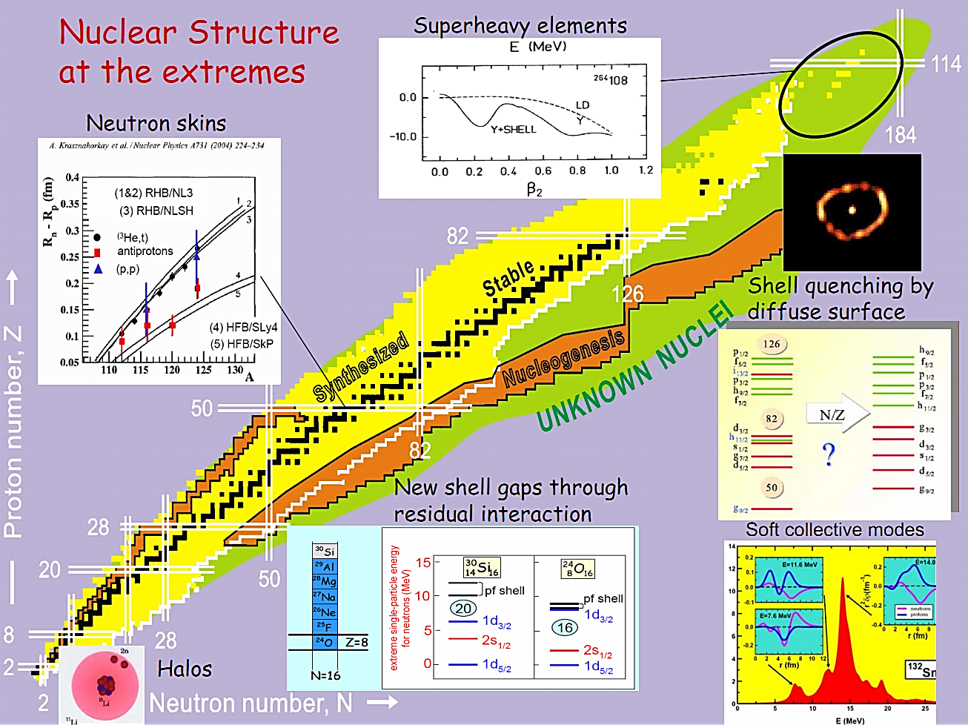
Nuclear Structure & Astrophysics

Slide 14
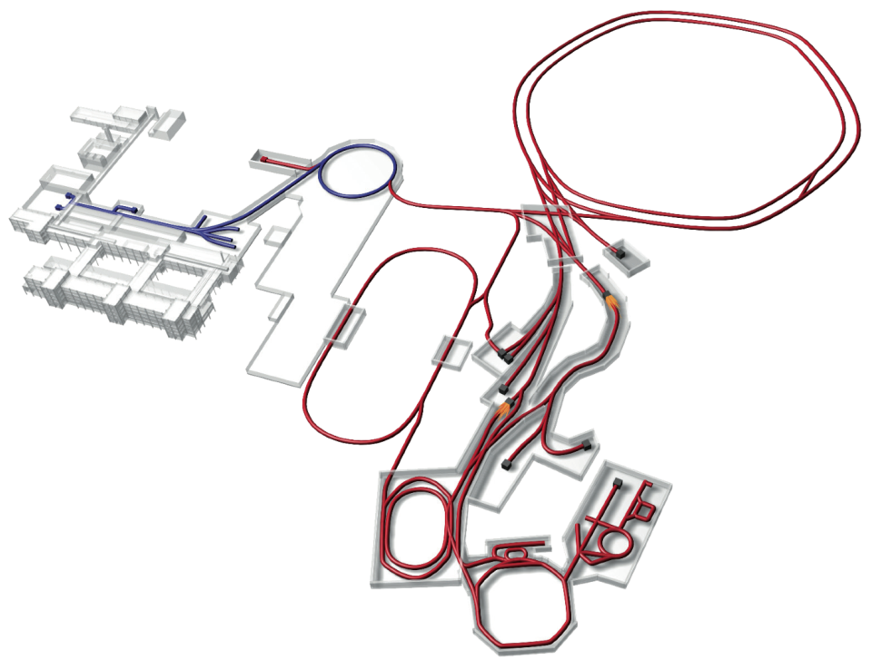
NuSTAR
Primary HI Beams:
⁴⁰Ar¹⁸⁺ 2x10¹²/s @ 1 – 2 GeV/u
²³⁸U^{28+:} 5x10¹¹/s @ 1 – 2 GeV/u
⁴⁰Ar¹⁸⁺ 2x10¹⁰/s @ 1 – 45 GeV/u
²³⁸U^{92+:} 1x10¹⁰/s @ 1 – 35 GeV/u
100 x 1000 times current intensity
Super-FRS
NuSTAR
Secondary Beams:
Broad range of radioactive ion beams up to 2 GeV/u
RI- Intensities up to 10 000 over present

Slide 15
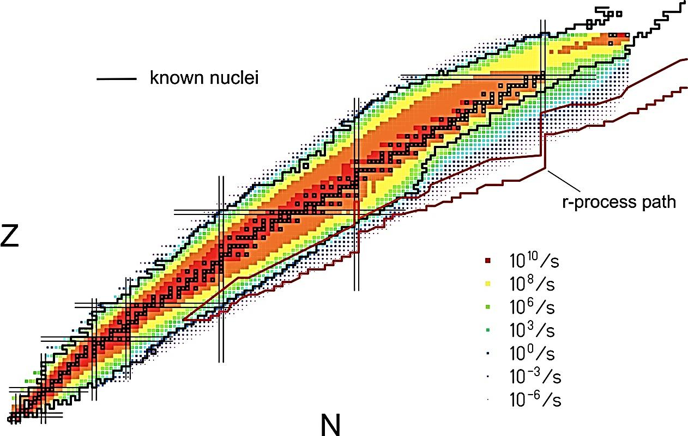
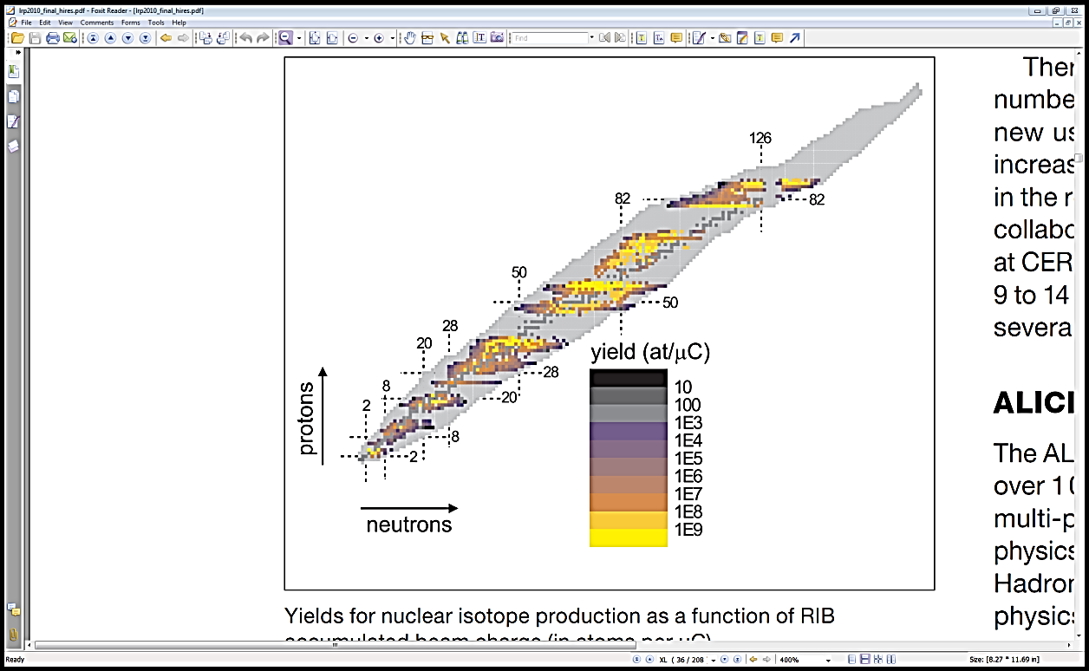
Fragmentation & ISOL
NuSTAR @ FAIR
HIE-ISOLDE @ CERN

Slide 16
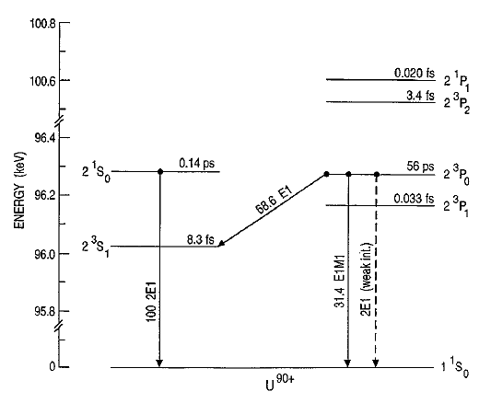
APPA: Parity Violation
Energy levels of He-like uranium
γ
e
e
N
N
2E1 (PNC)
Ζ
e
e
N
N
Mixing coefficient for states with opposite parities:
To “compete” with spontaneous decay channels: induce a two-photon PNC transition by polarised light with intensity 10²⁰ W/cm²
Select case
with small splitting!
Notes:
16

Slide 17
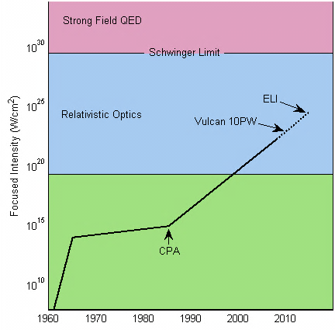
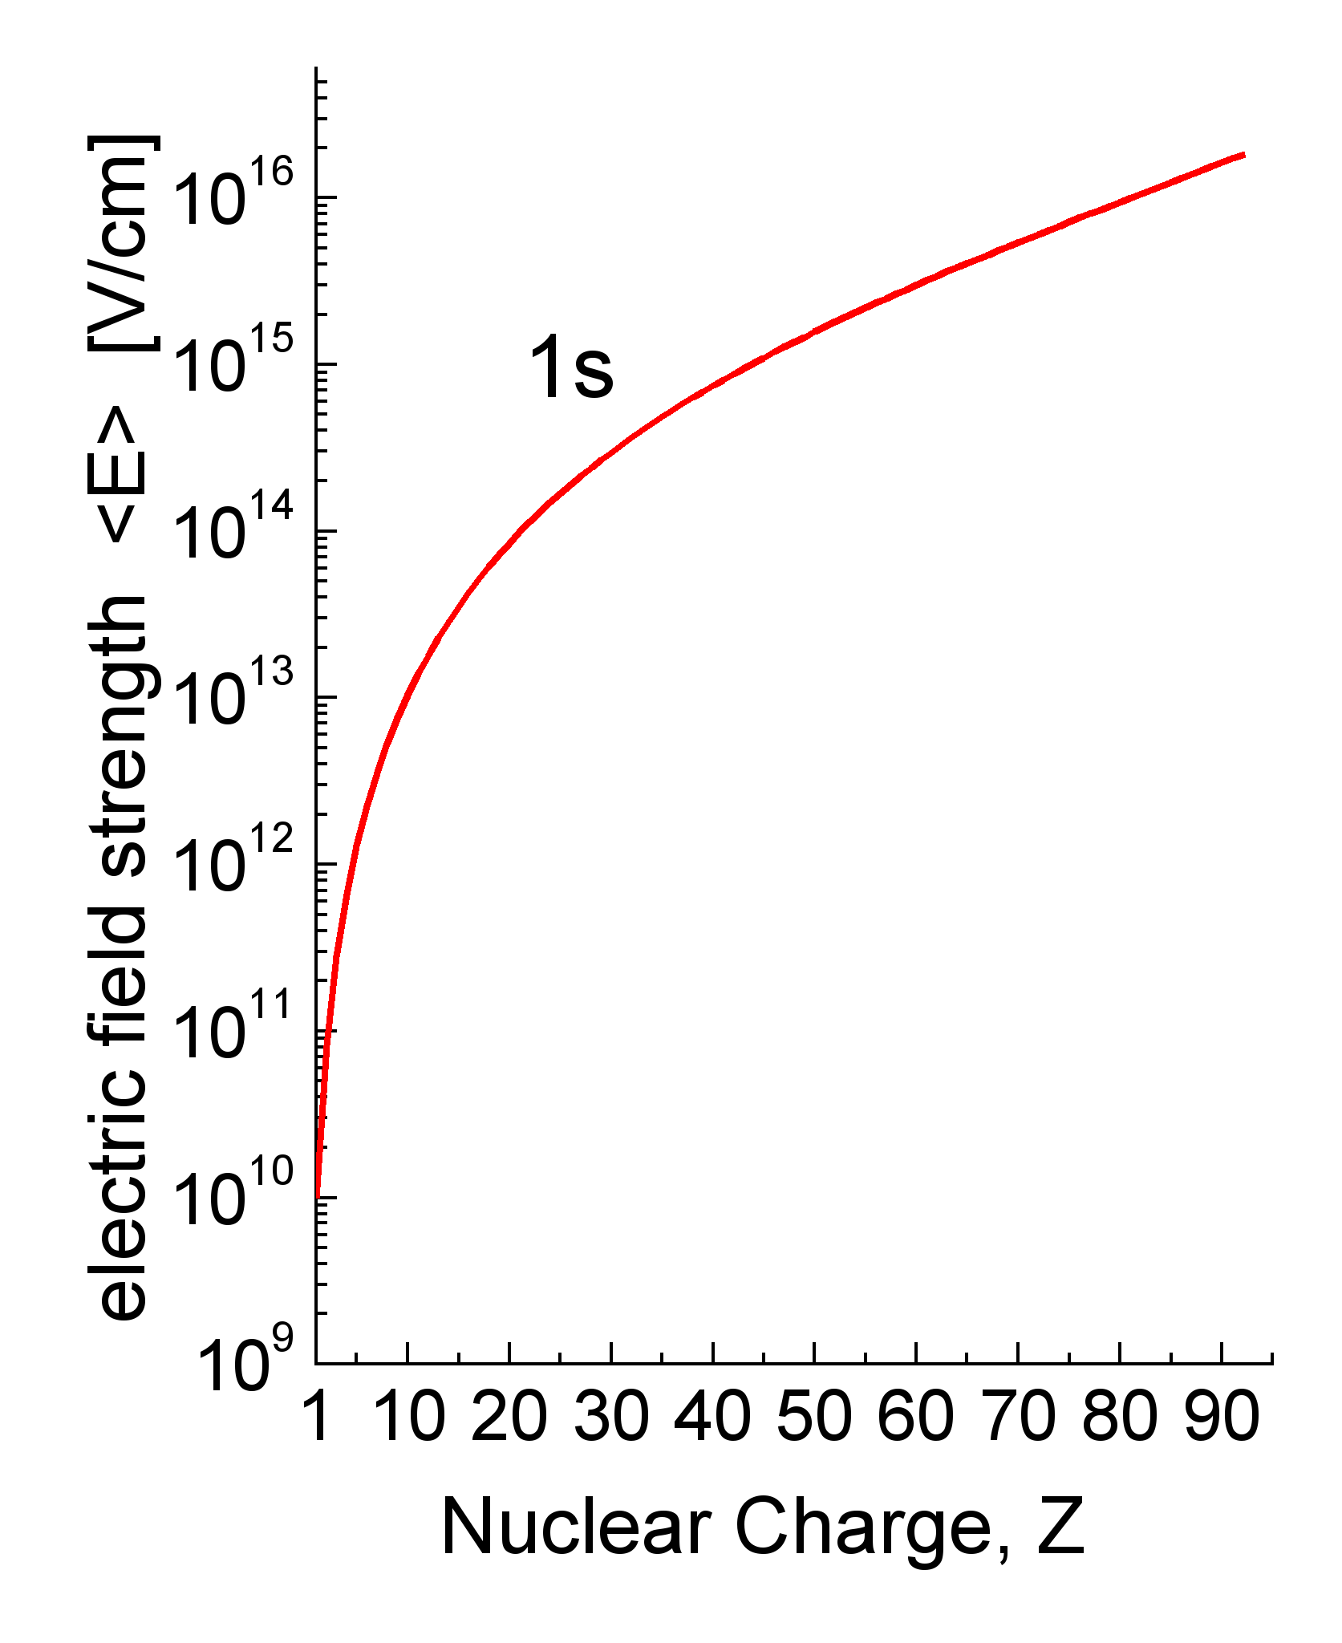
Large EM Fields
Lasers
Heavy ions
Equivalent to I ≥ 10²⁸ W/cm²
(adapted from Mourou, Tajima, Bulanov, RMP 78, 2006)
Sub-fs pulses
Large EM fields, zs pulses
Notes:
17

Slide 18
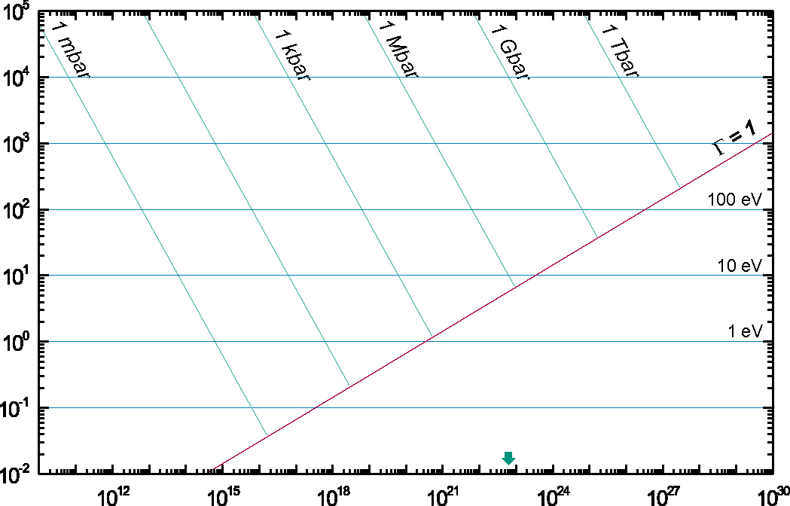
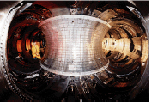
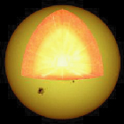
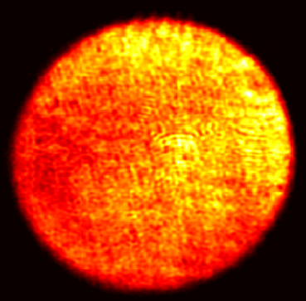
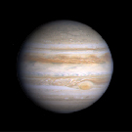
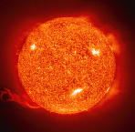
Plasmas
Magnetic Fusion
Inertial
Fusion
Energy
Temperature [eV]
XFEL
Sun Core
PHELIX
SIS
100
Laser
Heating
FLASH
Ideal plasmas
Ion Beam
Heating
Strongly coupled
plasmas
SIS 18
Jupiter
Sun Surface
solid state
density
Particles / cm⁻³
Notes:
18

Slide 19
FAIR Staging
Start Version Phase A (SIS100) |  |  |  |  |  | Phase B (SIS300)
Modularised Start Version
Module 0 | Module 1 | Module 2 | Module 3 | Module 4 | Module 5
SIS100 | Exp. halls for CBM & APPA | Super-FRS for NuSTAR | Antiproton Facility for PANDA & options for NuSTAR | LEB, NESR, FLAIR for NuSTAR & APPA | RESR for PANDA, NuSTAR & APPA
2017/18

Slide 20
MSV Costs
Accelerator and personnel, Modules 0 - 3 | 502 M€
Civil construction, Modules 0 - 3 | 400 M€
FAIR contribution to MSV experimental endstations * | 78 M€
FAIR GmbH personnel and running costs until 2018 | 47 M€
Grand Total Modules 0 - 3 | 1027 M€
in 2005 €
(escalation until 2018 ca. +50%)
* Total MSV exp. endstations: ca. 210 M€ (2005)= 315 M€ (2018)

Slide 21
Funding Modules 0-3
Contracting Party | Contribution (in 2005 M€)
Finland | 5.00
France | 27.00
Germany | 705.00
India | 36.00
Poland | 23.74
Romania | 11.87
Russia | 178.05
Slovenia | 12.00
Sweden | 10.00
Total | 1.008,66
All numbers in 2005 €
(escalation until 2018 ca. +50%)
Spain expected to join soon (with 11.87 M€)
China and the UK will contribute to the experiments (6.6 M€)

Slide 22
FAIR MSV Timelines
2011
2012
2013
2014
2015
2016
2017
2018
2019
6
7
8
9
10
11
12
6
Building permits
Site preparation
Civil construction contracts
Building of accelerator & detector components
Completion of civil construction work
Installation & commissioning of accelerators and detectors
Start Data taking
7
8
9
10
11
12

Slide 23
Timeline Experiments
Finish R&D phase
Deliver prototypes of all essential parts of detectors
Submit complete sets of TDRs
Take decisions on alternative technical solutions
Co-ordinate with
Civil construction requirements
Accelerator setup schedule
Identify critical pathways
Milestones, timelines, deliverables
Submit risk management plan
Secure funding 2011/12
Submit Construction MoUs end of 2012

Slide 24
Timeline Experiments Cont’d
(Europe-wide) tendering 2013
Build detectors 2013-16
Submit Operations MoUs 2016
Commission experiments 2017/18
Initial period of data taking 2018-21

Slide 25
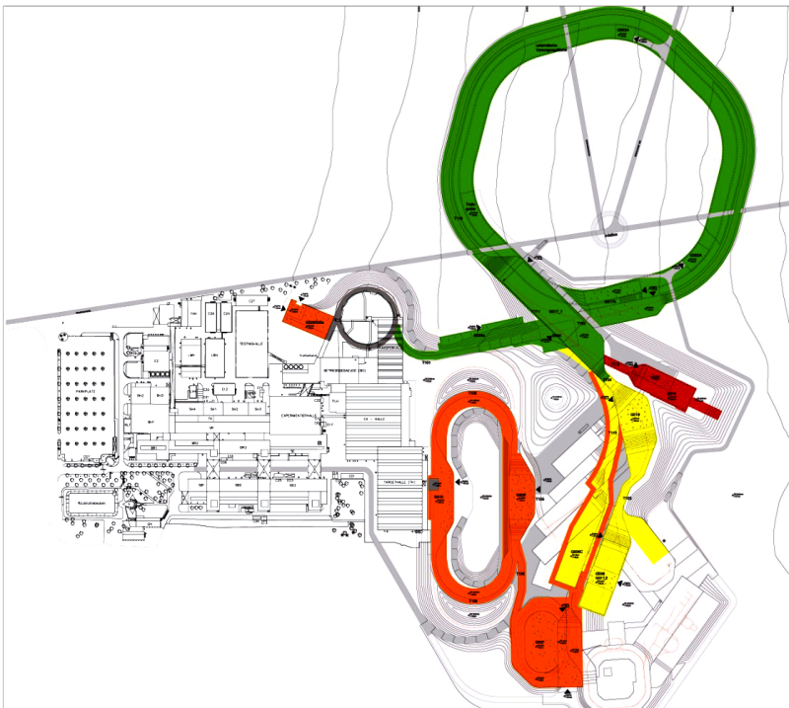
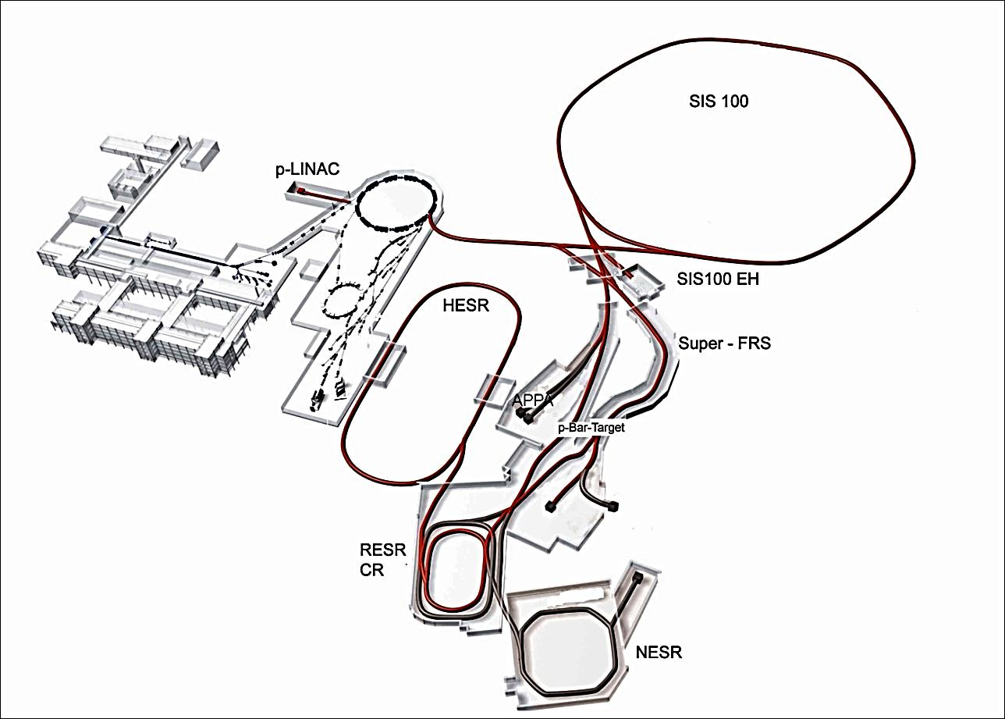
Modularised Start Version
M0
M3
M1
CBM/HADES
M3
M2
APPA
Experiments
M1: APPA
M1: CBM/HADES
M2: NuSTAR
M3: PANDA
PANDA
NuSTAR

Slide 26
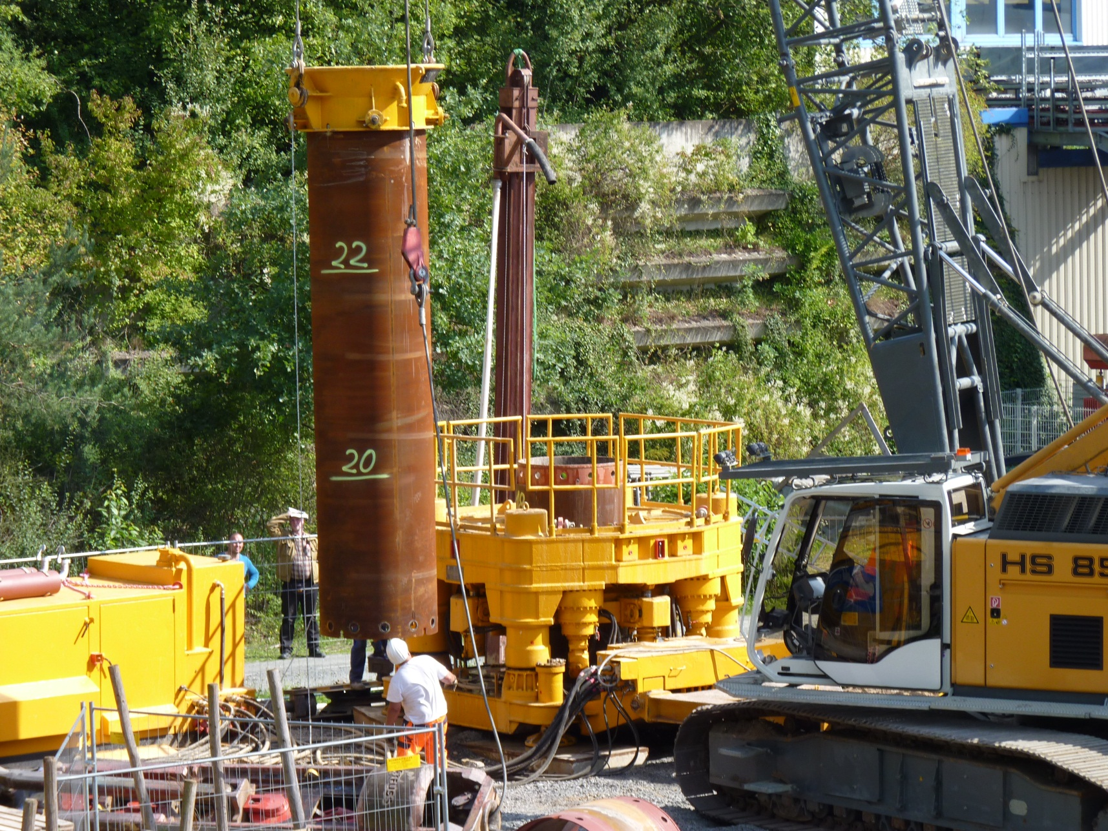
Start Pillar Drilling 31/8/11

Slide 27
Thank you very much

