Slide 1
Stellar and sub-stellar objects in radio and infrared interferometry
Joan Climent
PhD Student at the Departamento de Astronomía y Astrofísica
Universidad de Valencia
cliojuan@uv.es
Student Seminar
9th of July, 2020

Slide 2
Outline
Brief introduction to the interferometry technique.
Presentation of the AB Doradus System.
Infrared interferometry of AB Dor C.
Radio interferometry of AB Dor A.
Summary
Student Seminar
9th of July, 2020

Slide 3
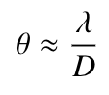
The backbone of our work
Even under the best imaginable observational circumstances, the angular resolution of any telescope is limited by diffraction to
Student Seminar
9th of July, 2020

Slide 4
The backbone of our work
Even under the best imaginable observational circumstances, the angular resolution of any telescope is limited by diffraction to
Not a good plan at lower frequencies
For a resolution of 0.1 arcsec observing at 580 nm (yellow light) one would need a telescope with a diameter of...
For a resolution of 0.1 arcsec observing at 60 mm (5 GHz) one would need a telescope with a diameter of...
1.2 m
125 km
Student Seminar
9th of July, 2020

Slide 5
The backbone of our work
Enter… INTERFEROMETRY
Student Seminar
9th of July, 2020

Slide 6
The backbone of our work
Enter… INTERFEROMETRY
Student Seminar
9th of July, 2020

Slide 7
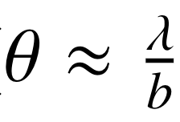
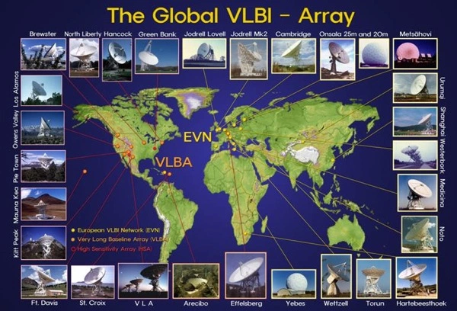
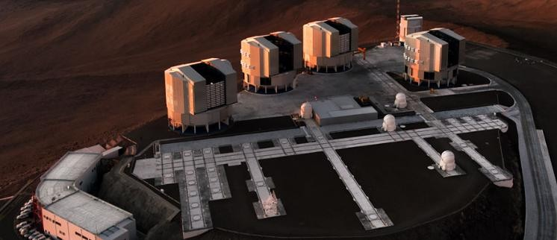
The backbone of our work
Enter… INTERFEROMETRY
where b is the maximum separation between telescopes or antennas
VLTI
Student Seminar
9th of July, 2020

Slide 8

The backbone of our work
Enter… INTERFEROMETRY
where b is the maximum separation between telescopes or antennas
VLTI
Student Seminar
9th of July, 2020

Slide 9
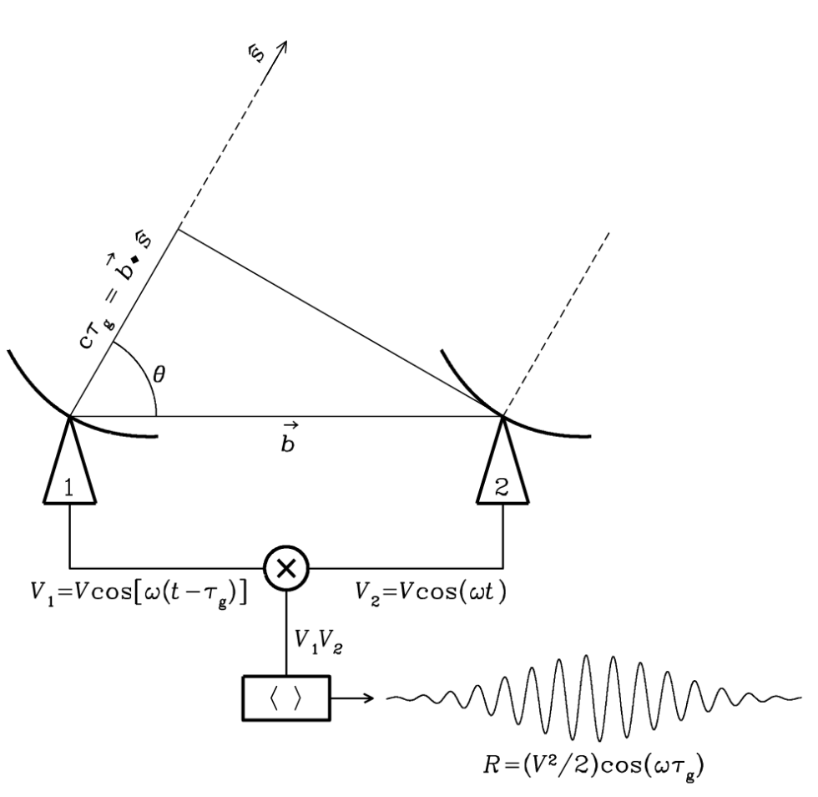
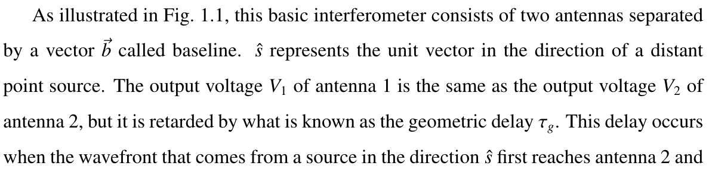

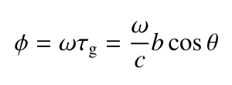
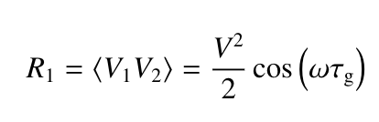
Let’s start with radio!
The correlator multiplies and time averages the two voltages. The fringes would have a phase of:
Final output:
Student Seminar
9th of July, 2020

Slide 10
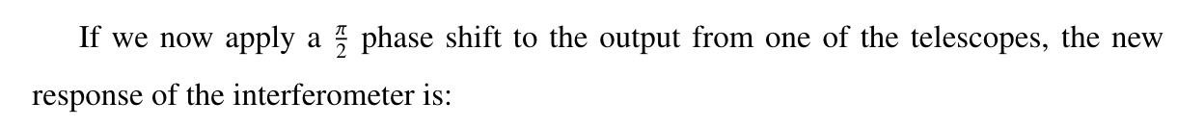
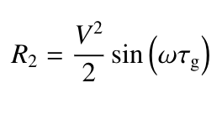
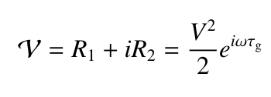
Let’s start with radio!
Final output:
Visibility for a point source:
Student Seminar
9th of July, 2020

Slide 11
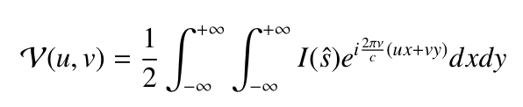
Let’s start with radio!
Final output:
Visibility for an extended source:
Student Seminar
9th of July, 2020

Slide 12
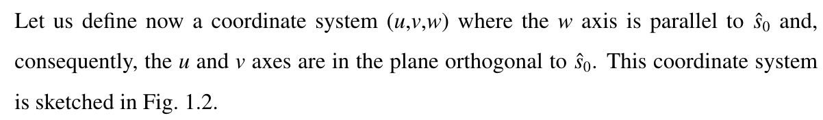


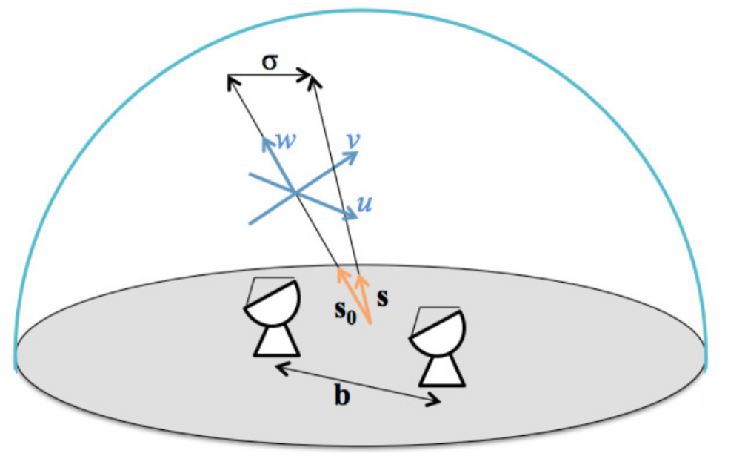

Understanding the uv plane
Student Seminar
9th of July, 2020

Slide 13
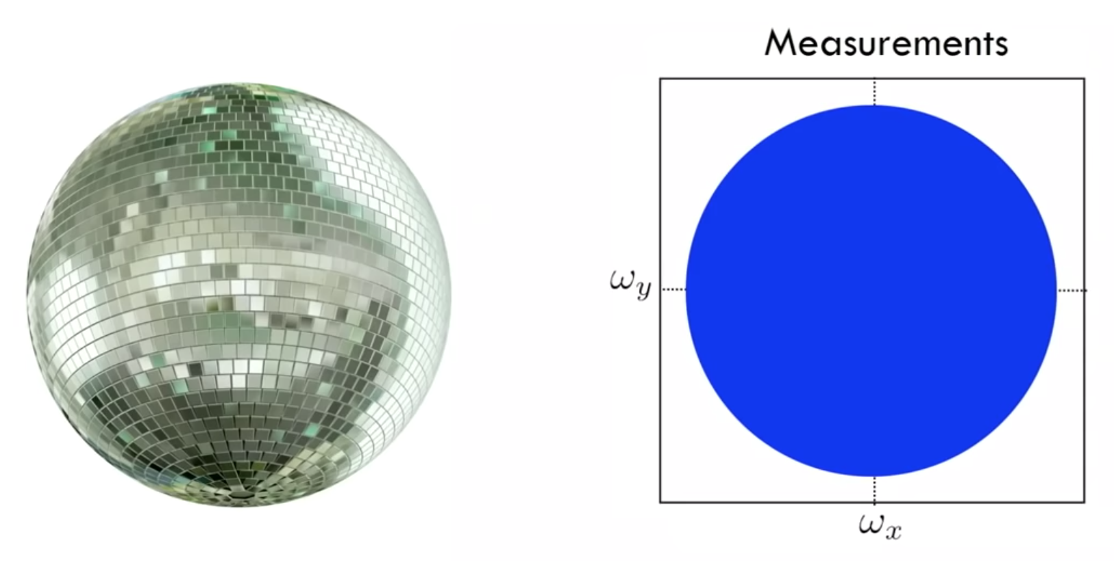
Understanding the uv plane
v
u
Student Seminar
9th of July, 2020

Slide 14
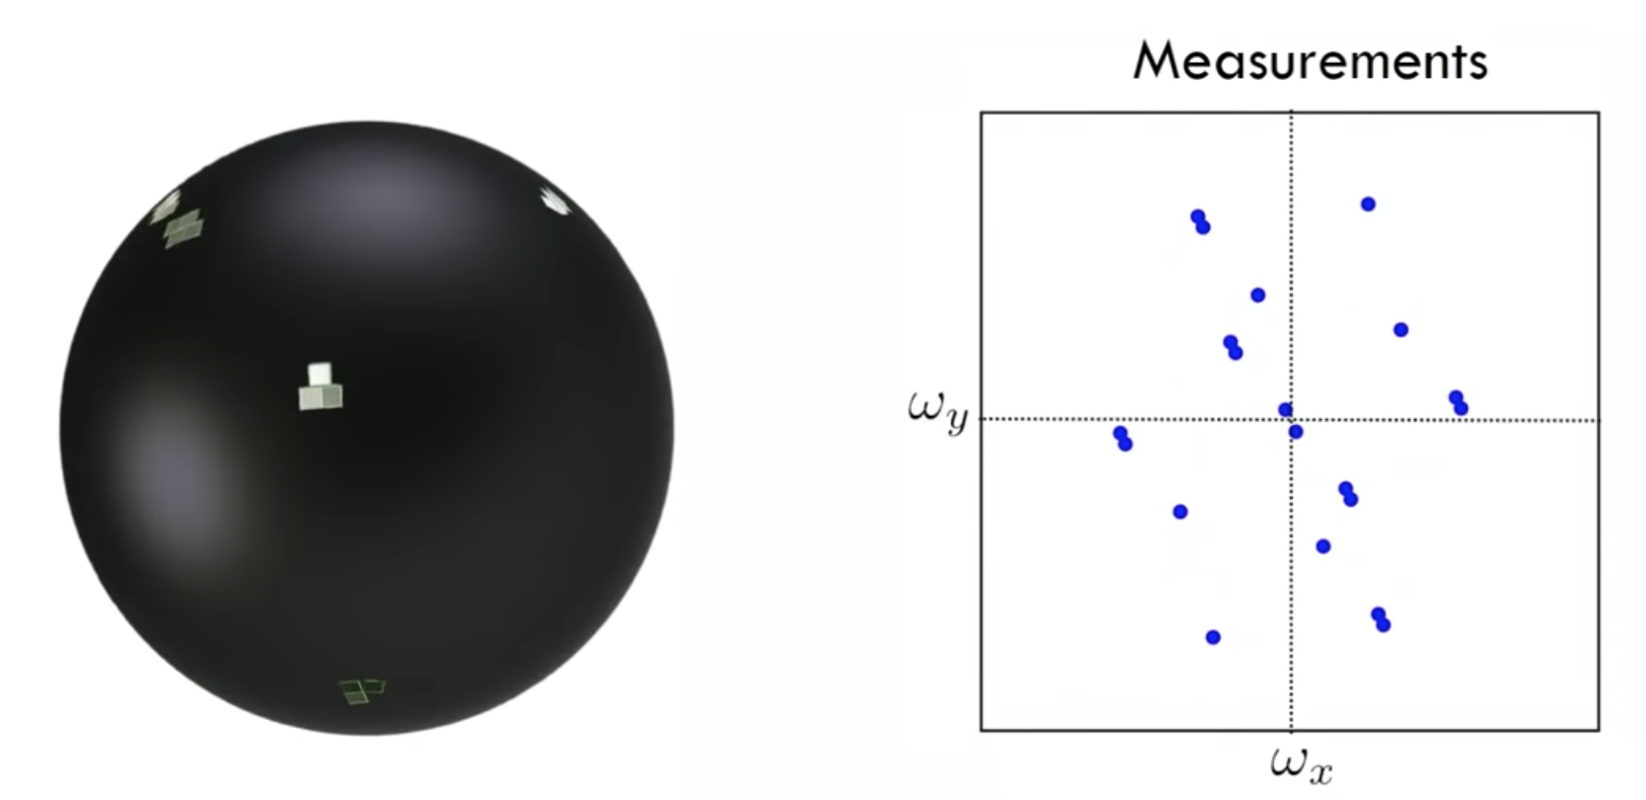
Understanding the uv plane
v
u
Student Seminar
9th of July, 2020

Slide 15

Understanding the uv plane
Student Seminar
9th of July, 2020

Slide 16
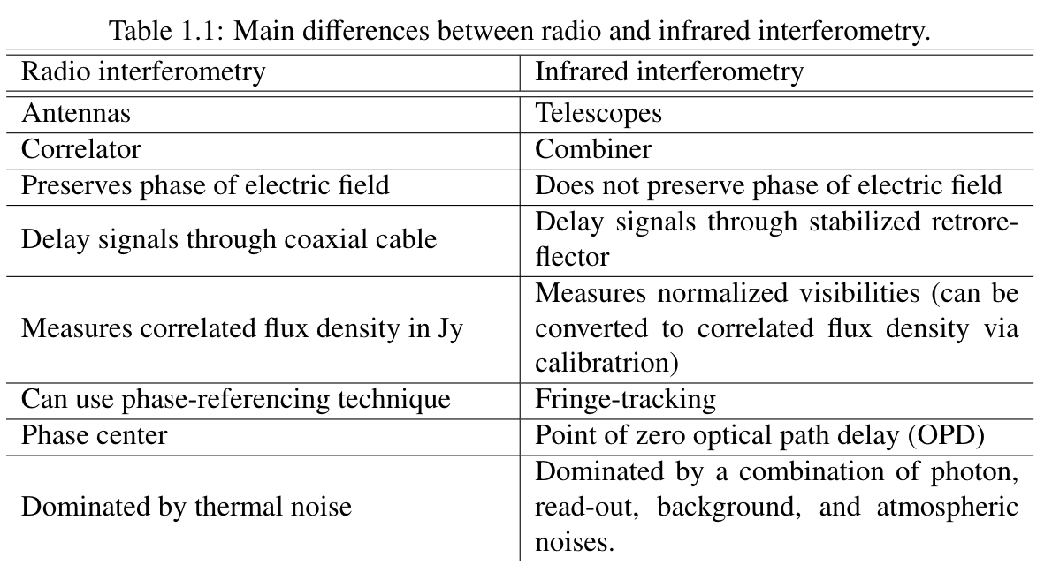
Infrared interferometry
Student Seminar
9th of July, 2020

Slide 17
Now, let’s get back to the science!
Student Seminar
9th of July, 2020

Slide 18
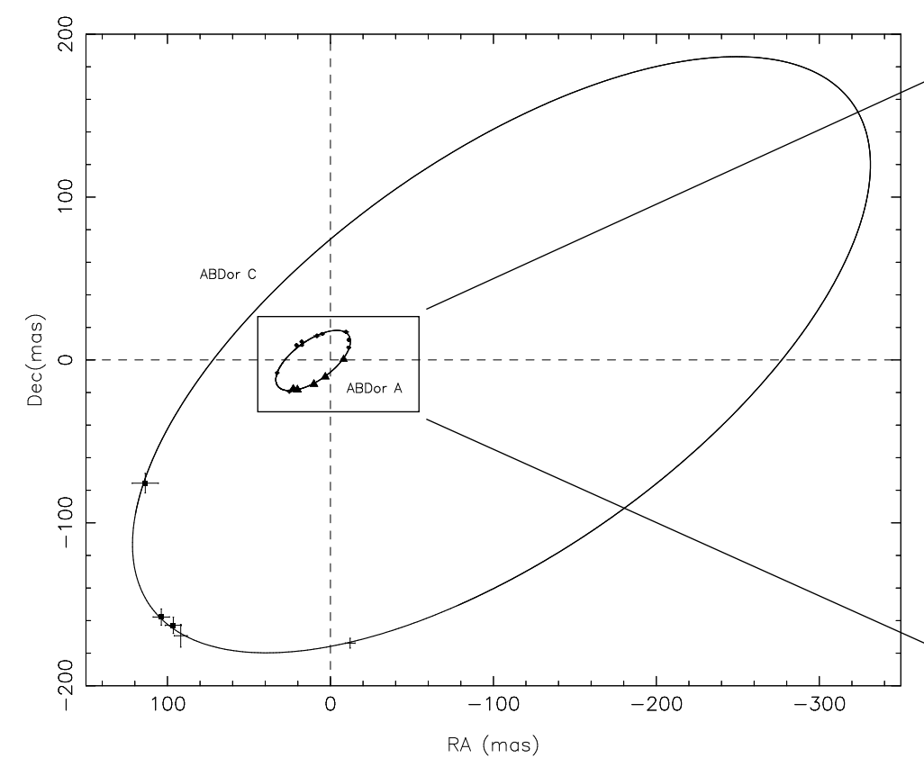
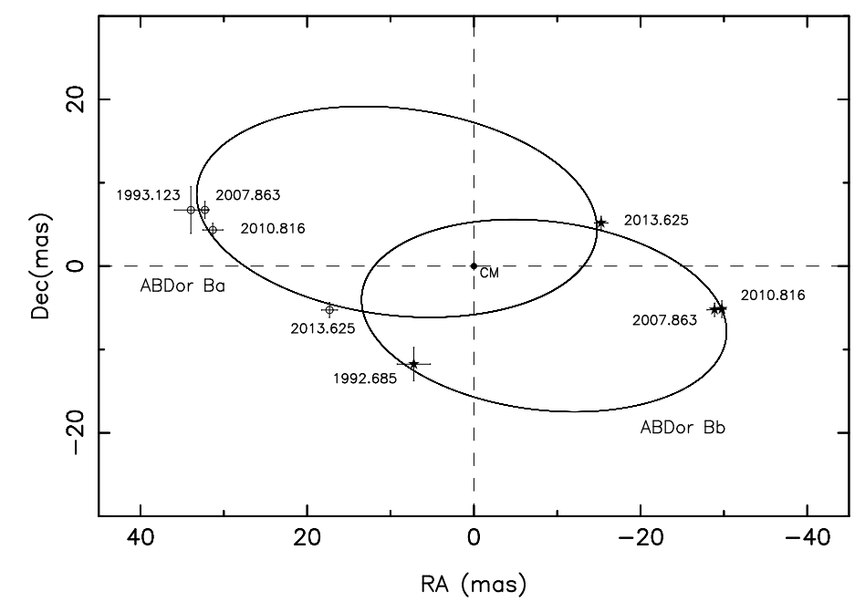
AB Doradus
AB Dor A and AB Dor C
AB Dor Ba and AB Dor Bb
9’’
Student Seminar
9th of July, 2020

Slide 19
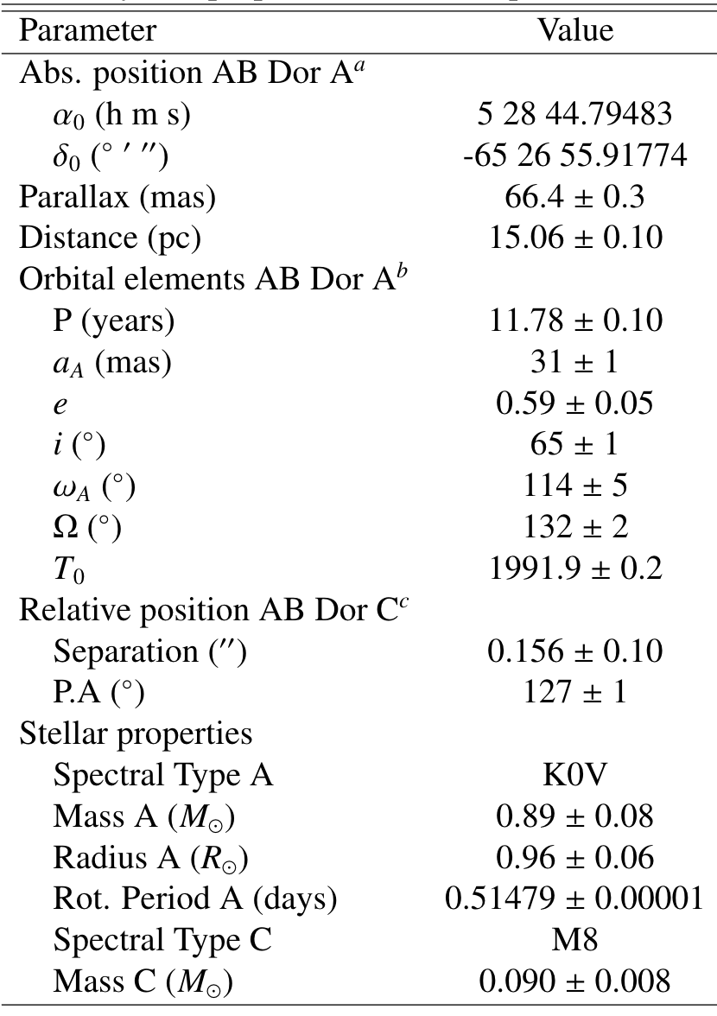
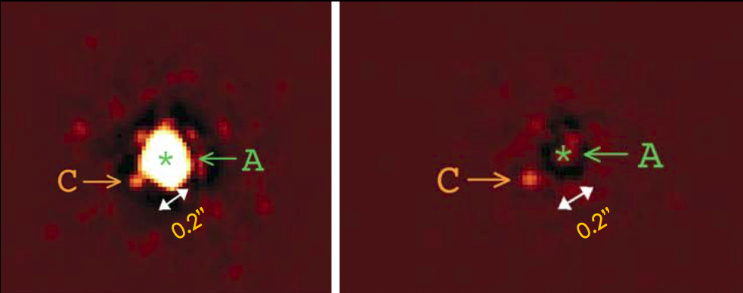
AB Doradus
AB Dor A and AB Dor C
Student Seminar
9th of July, 2020

Slide 20
AB Dor C infrared interferometry
PROBLEM: Stellar evolutionary models show an increasing difficulty in accurately reproducing some of the characteristics of stars with masses below 1.2 M☉. Only stellar systems with dynamically determined masses (like AB Dor) can effectively be used to test and check them.
However, previous works have found a discrepancy between observed magnitudes of AB Dor C and theoretical mass-luminosity relationships. One possible explanation for such discrepancy is that AB Dor C is a binary object. This is the hypothesis we have explored with infrared interferometry.
UT2
We used 3 Unit Telescopes (UT) at the Very Large Telescope: UT1, UT2 and UT4.
Observations at K band (2.0-2.5 μm) with AMBER instrument.
UT4
UT1
Student Seminar
9th of July, 2020

Slide 21
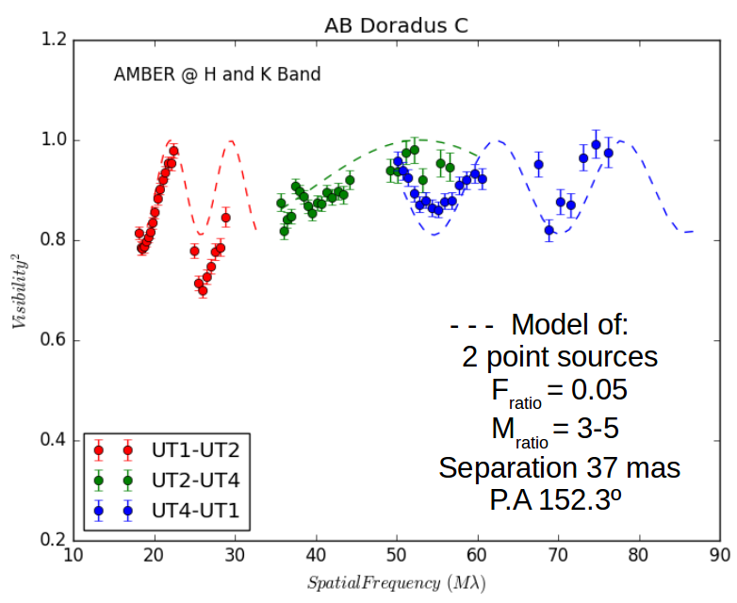
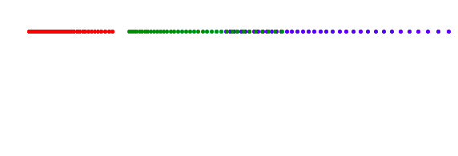
AB Dor C infrared interferometry
If it was a point source...
Student Seminar
9th of July, 2020

Slide 22
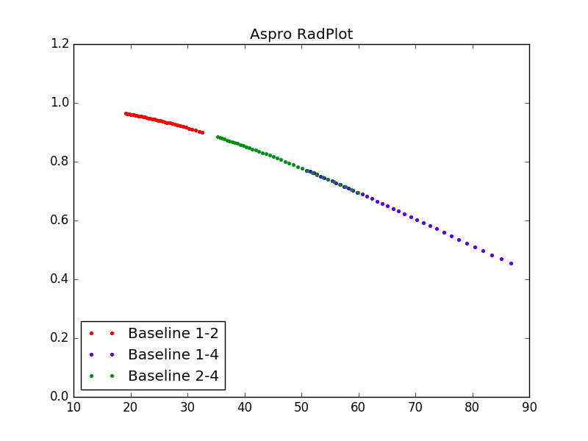
AB Dor C infrared interferometry
If it was a resolved single source...
Student Seminar
9th of July, 2020

Slide 23
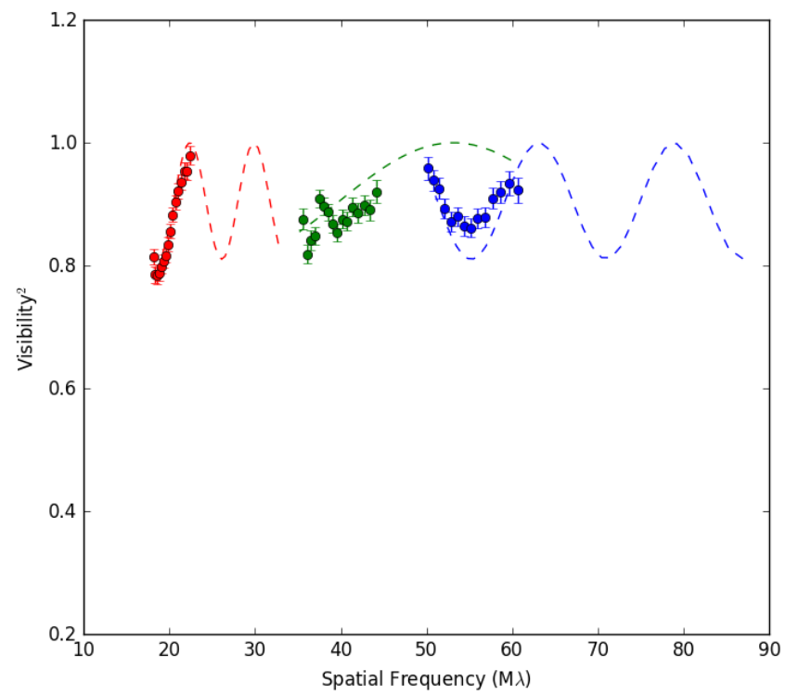
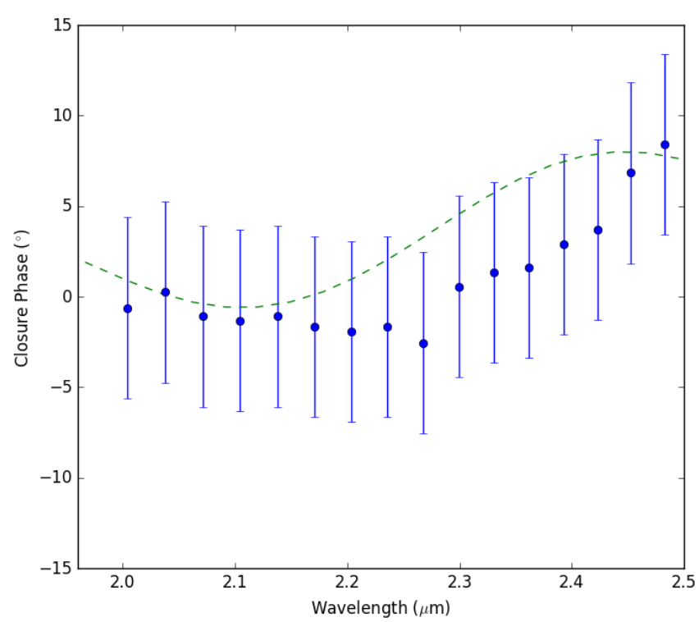
AB Dor C infrared interferometry
Student Seminar
9th of July, 2020

Slide 24
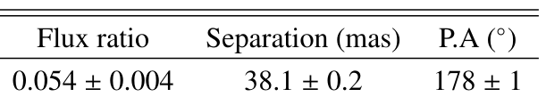
AB Dor C infrared interferometry
The uv-coverage is not good enough to make an image, so we’ll have to fit the visibilities and closure phases...
The best model is a binary! Characteristics for AB Dor Ca/Cb:
Student Seminar
9th of July, 2020

Slide 25

AB Dor C infrared interferometry
Stability of the orbit of AB Dor Ca/Cb
AB Dor Ca and AB Dor Cb with masses:
At 0.2’’ average angular distance from AB Dor C, the more massive AB Dor A could clearly affect the orbit stability of the tentative binary AB Dor Ca/Cb.
However, an analysis of this “triple system” (A, Ca, Cb) using the estimated masses and the well-known orbit reveals that our measured separation would correspond to a stable binary system.
The binarity partially alleviates the disagreement between observed magnitudes and theoretical mass-luminosity relationships.
Climent et al. (2019)
To be confirmed by GRAVITY
Student Seminar
9th of July, 2020

Slide 26
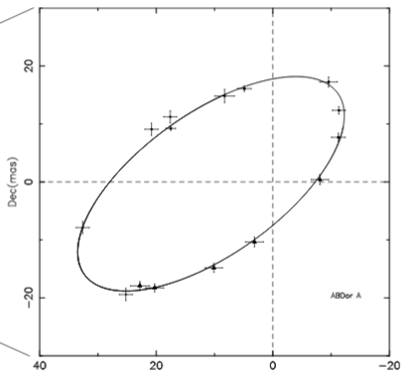
AB Dor A radio interferometry
Student Seminar
9th of July, 2020

Slide 27
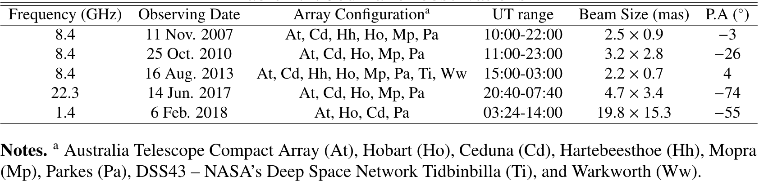
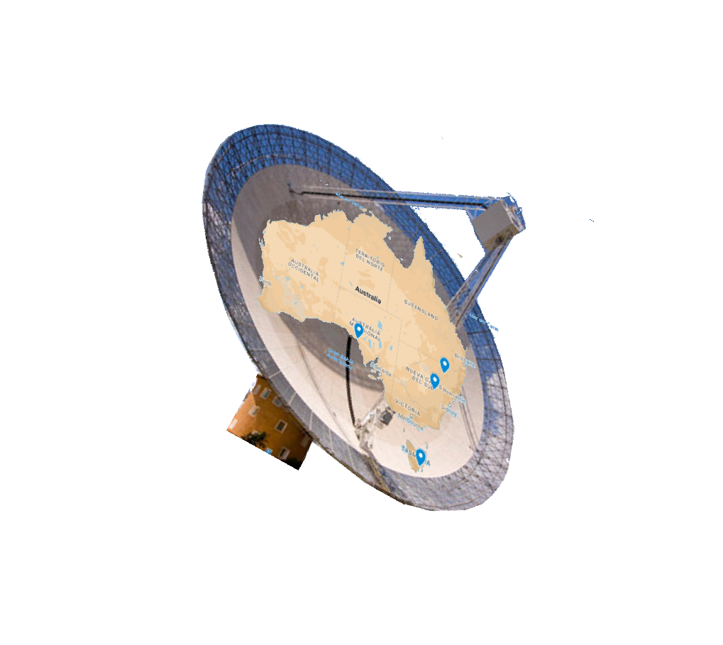
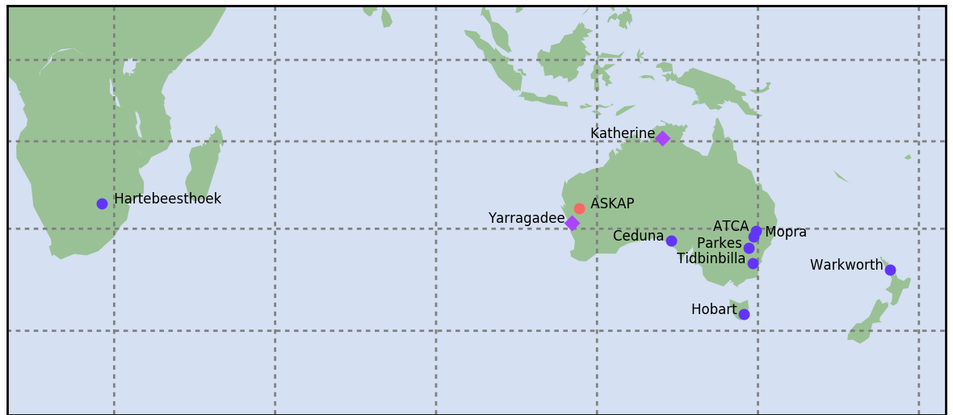
AB Dor A radio interferometry
Student Seminar
9th of July, 2020

Slide 28
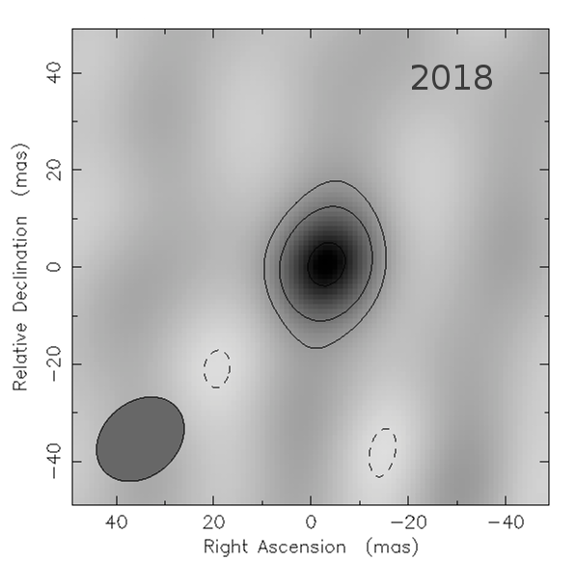
AB Dor A radio interferometry
Diameter: 11 mas/35 Rstar
Flux: 4.8 mJy.
Tb > 10⁷ K
Circular Polarization < 10%
1.4 GHz
Non-thermal origin
Student Seminar
9th of July, 2020

Slide 29
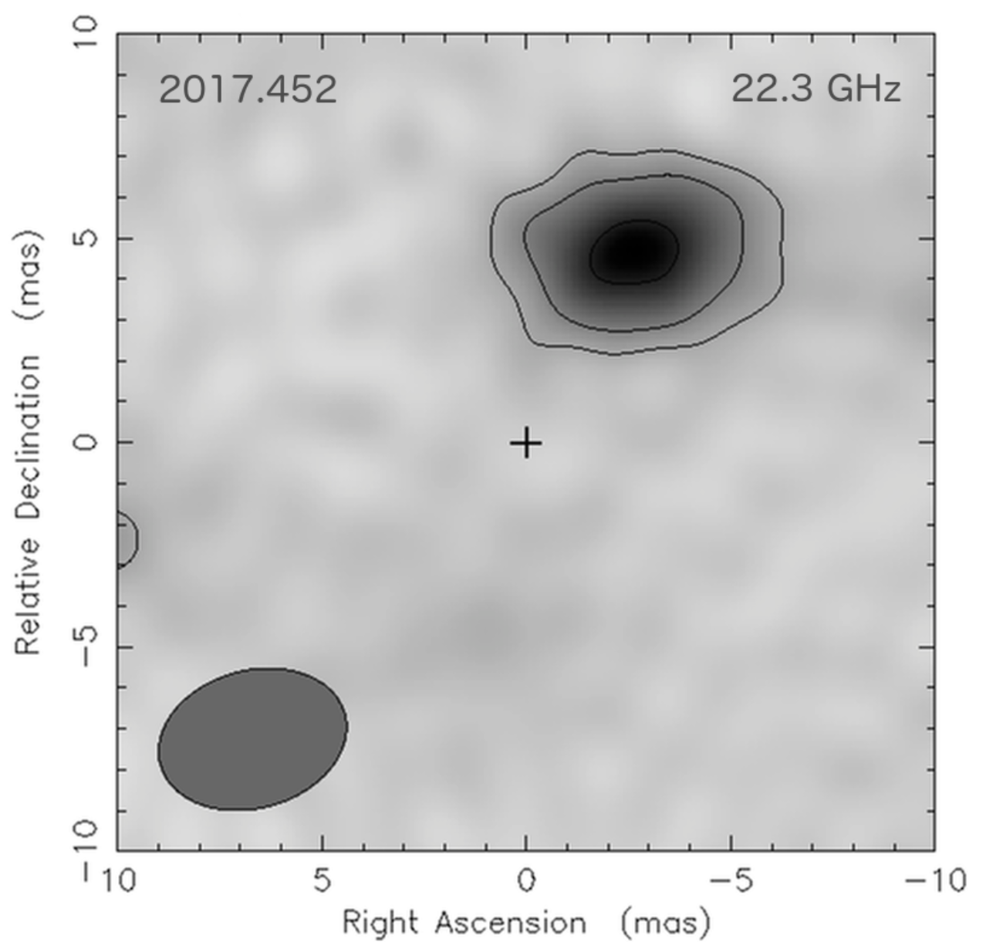
AB Dor A radio interferometry
Diameter: 5 mas/17 Rstar
Flux: 1.2 mJy.
Tb ~ 10⁵ K
Circular Polarization < 5%
Separated 5.5 mas from expected position
Further confirmation
Student Seminar
9th of July, 2020

Slide 30
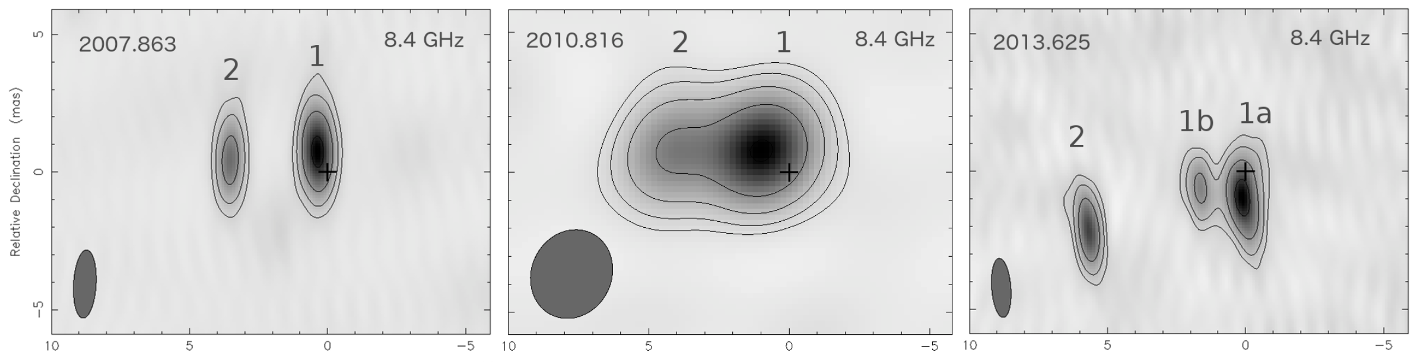
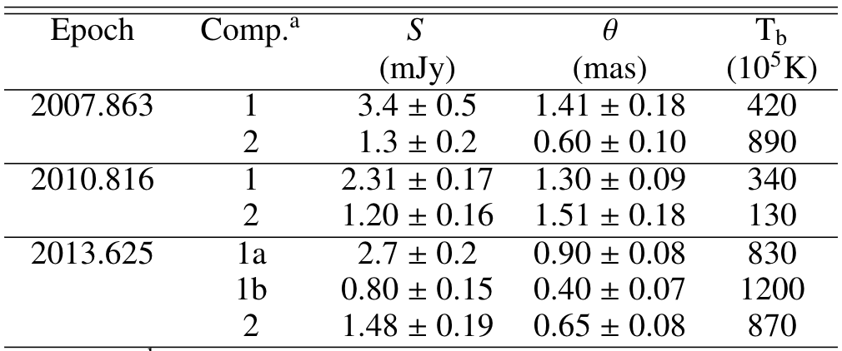
AB Dor A radio interferometry
Student Seminar
9th of July, 2020

Slide 31
AB Dor A radio interferometry
Student Seminar
9th of July, 2020

Slide 32
AB Dor A radio interferometry
Non-thermal origin
Student Seminar
9th of July, 2020

Slide 33
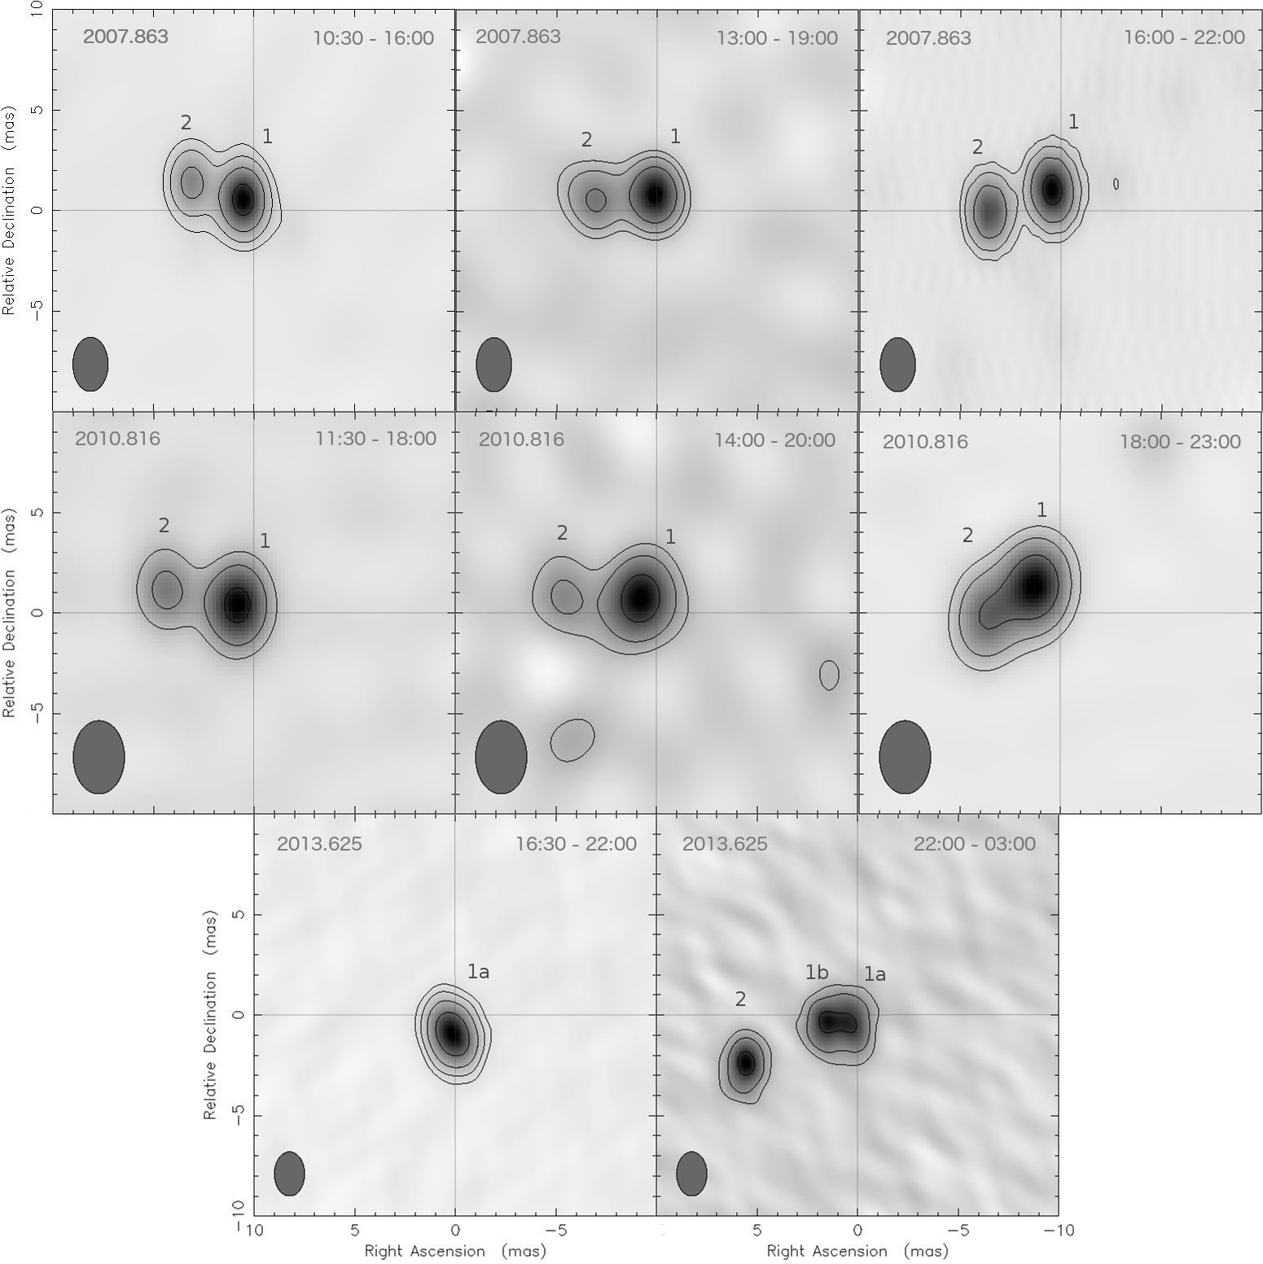

Slide 34
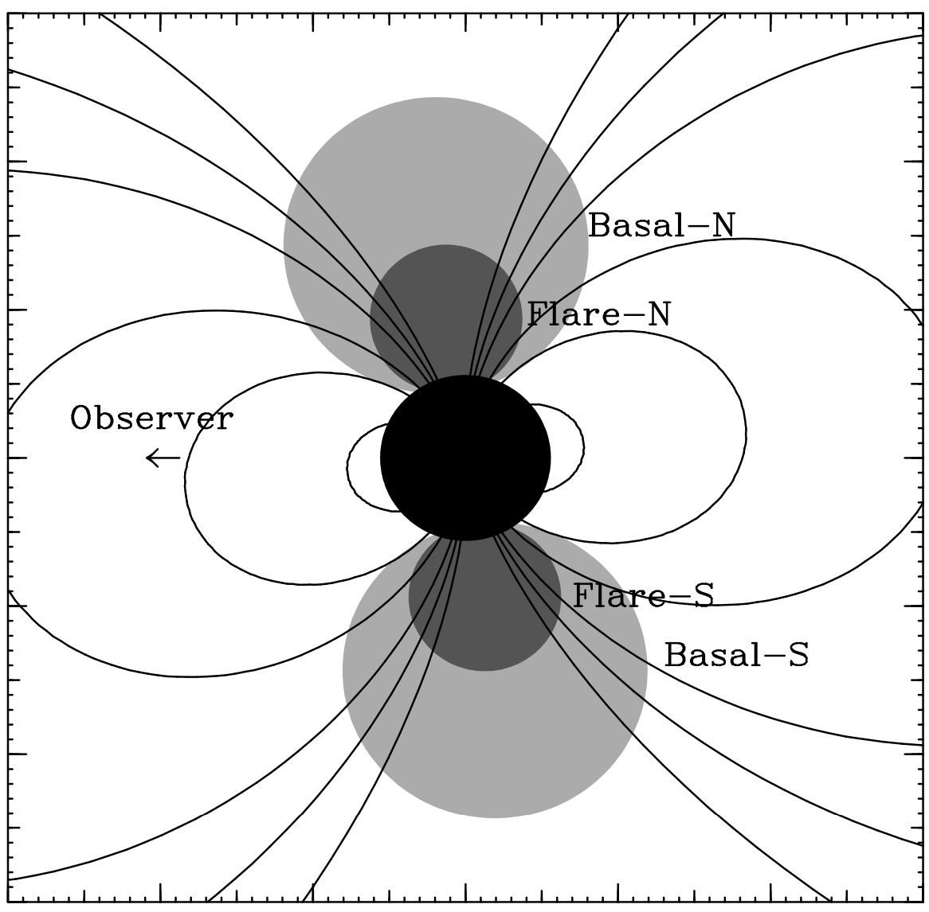
Hypothesis 1: Polar Cap
Polar cap model explaining Algol radio emission (Mutel et al. 1998)
Student Seminar
9th of July, 2020

Slide 35
Hypothesis 1: Polar Cap
Student Seminar
9th of July, 2020

Slide 36
Hypothesis 1: Polar Cap
Magnetic axis oriented east-west
Student Seminar
9th of July, 2020

Slide 37
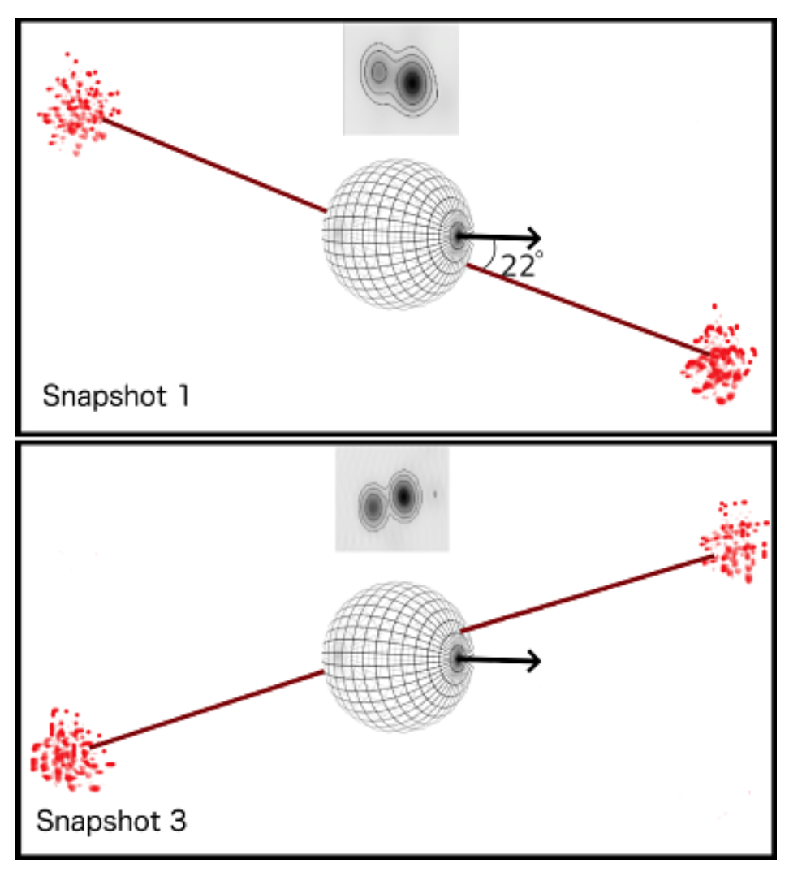
Hypothesis 1: Polar Cap
Student Seminar
9th of July, 2020

Slide 38
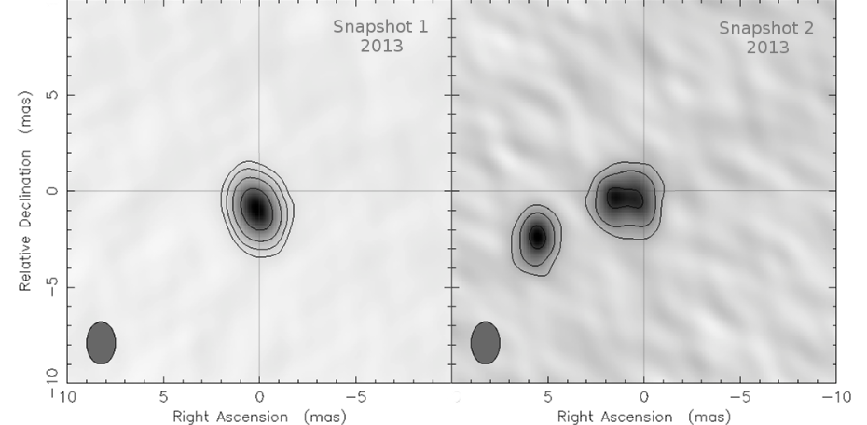
Hypothesis 1: Polar Cap
During the first half of the 2013 observations, emission coming from only one of the polar caps would be detected (component 1a) and during the second half of the observations the emission from both polar caps would be detected.
Student Seminar
9th of July, 2020

Slide 39
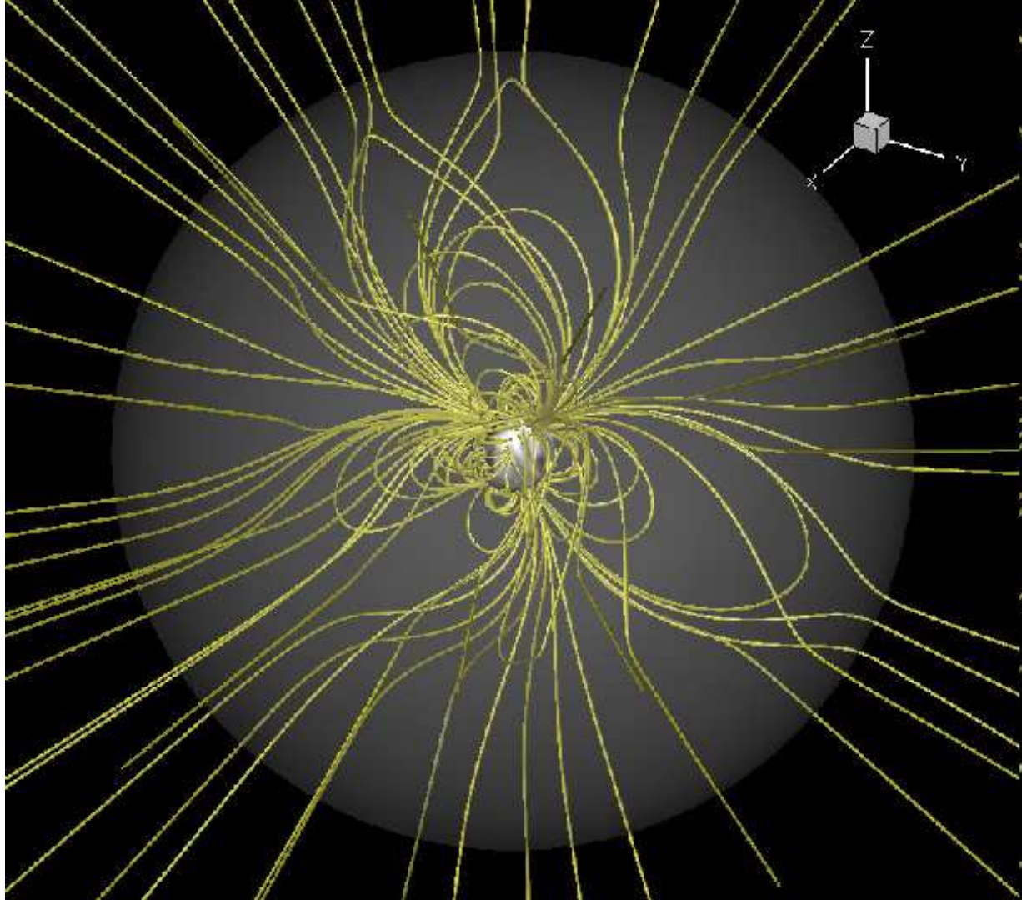
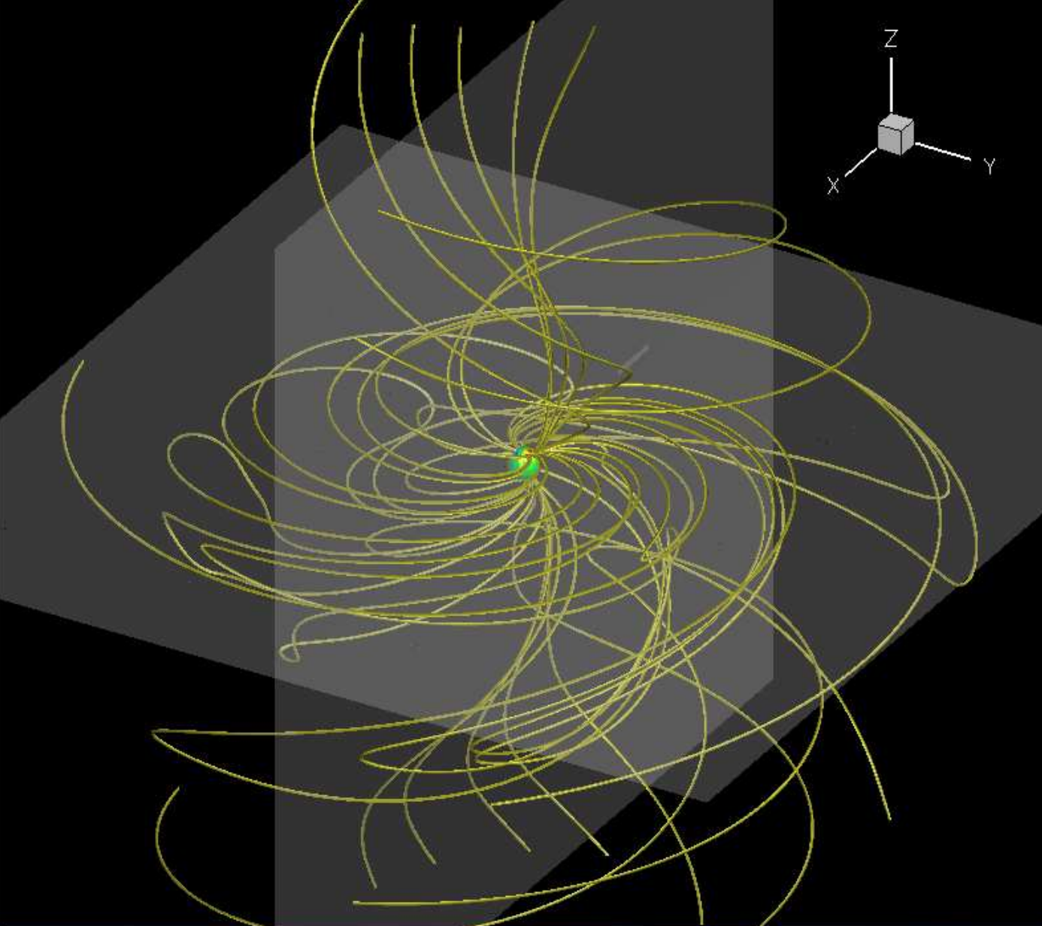
Hypothesis 2: Flaring Loops
A great number of flaring events are known to occur in AB Dor A (Schmitt et al.2019 and references therein). From these and previous studies, it is well established that the corona of this star presents evidence for both compact and extended structures.
Rather than episodic events (which are not excluded), these loops could constitute a quasi-permanent structure azimuthally distributed, as proposed by Lim et al. (1992).
Basically, a long-lived, extended loop structure in AB Dor A
Cohen et al. 2010
Extrapolation from Zeeman-Doppler Imaging
MHD solutions of the coronal magnetic field
Student Seminar
9th of July, 2020

Slide 40
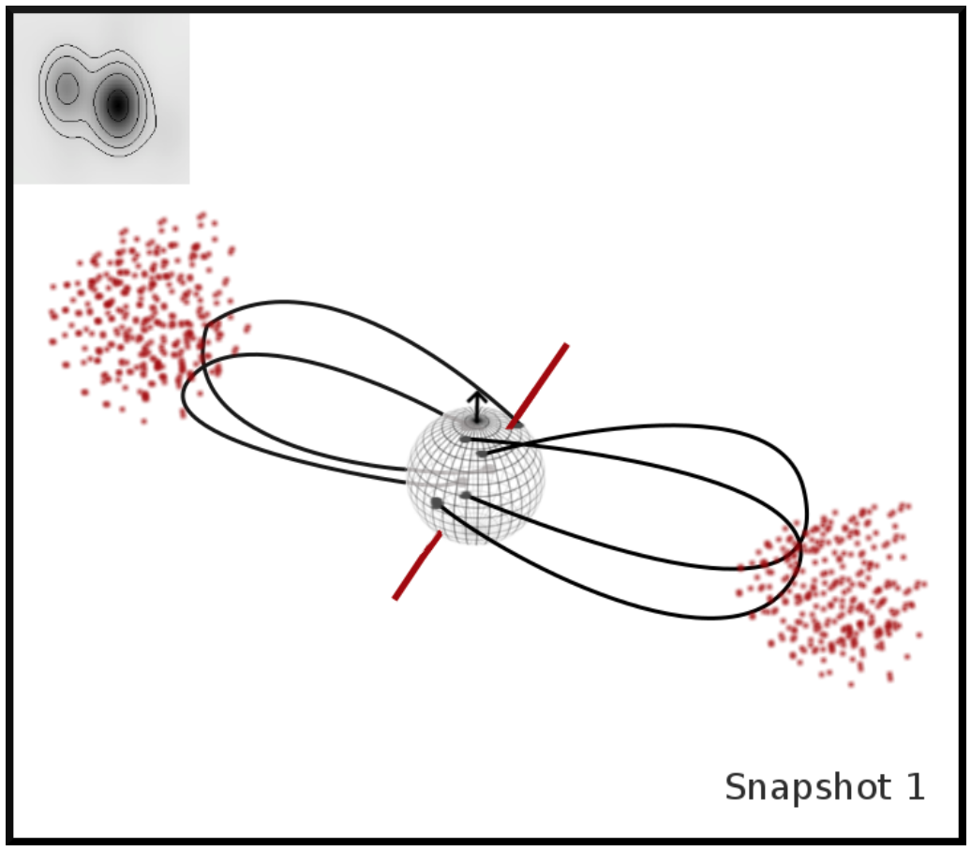
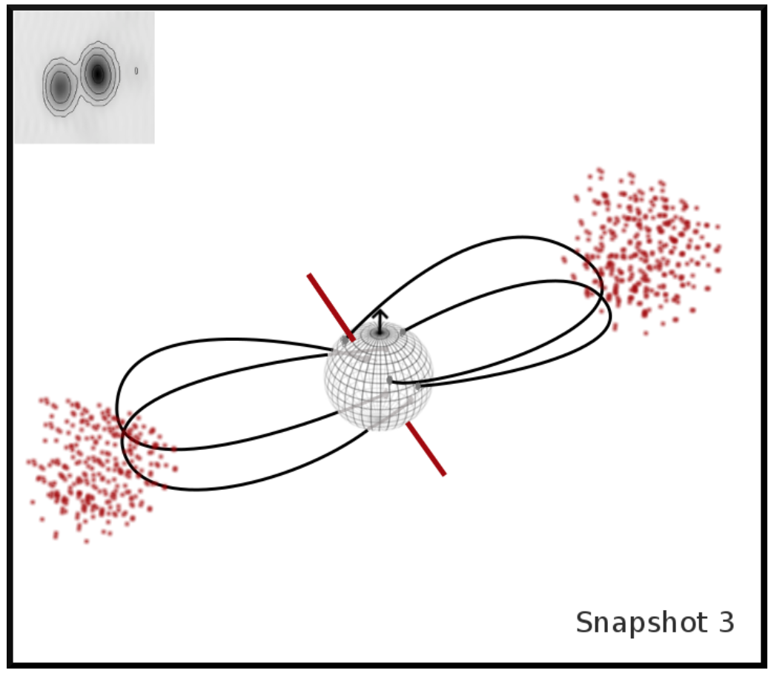

Hypothesis 2: Flaring Loops
misaligned B
misaligned B
Student Seminar
9th of July, 2020

Slide 41
Hypothesis 2: Flaring Loops
misaligned B
misaligned B
This model is also compatible with 2013, if we assume that the left component is not seen or detected during the first part of the observation.
Student Seminar
9th of July, 2020

Slide 42
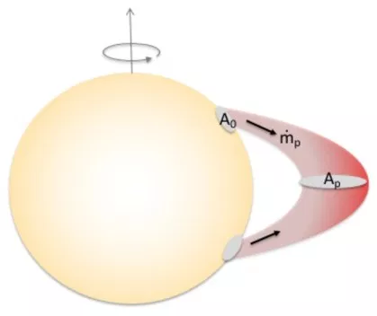
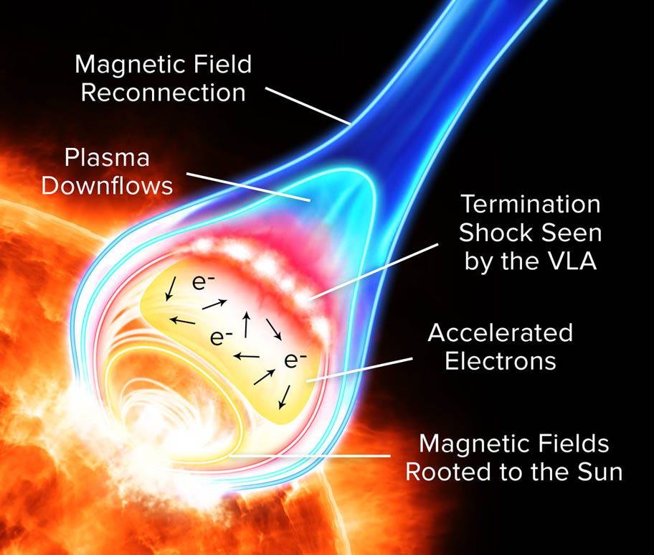
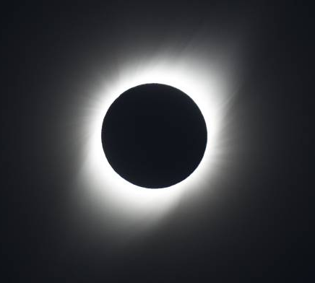
Hypothesis 3: Helmet streamers
AB Dor A is known to have corotating condensations of mostly neutral gas with lifespans of a few days. Similarly to the solar case, helmet streamers and flares are expected to occur at the top of such prominences (although not exclusively) triggered by magnetic reconnection of the coronal loops.
Jardine et al. (2019)
Student Seminar
9th of July, 2020

Slide 43
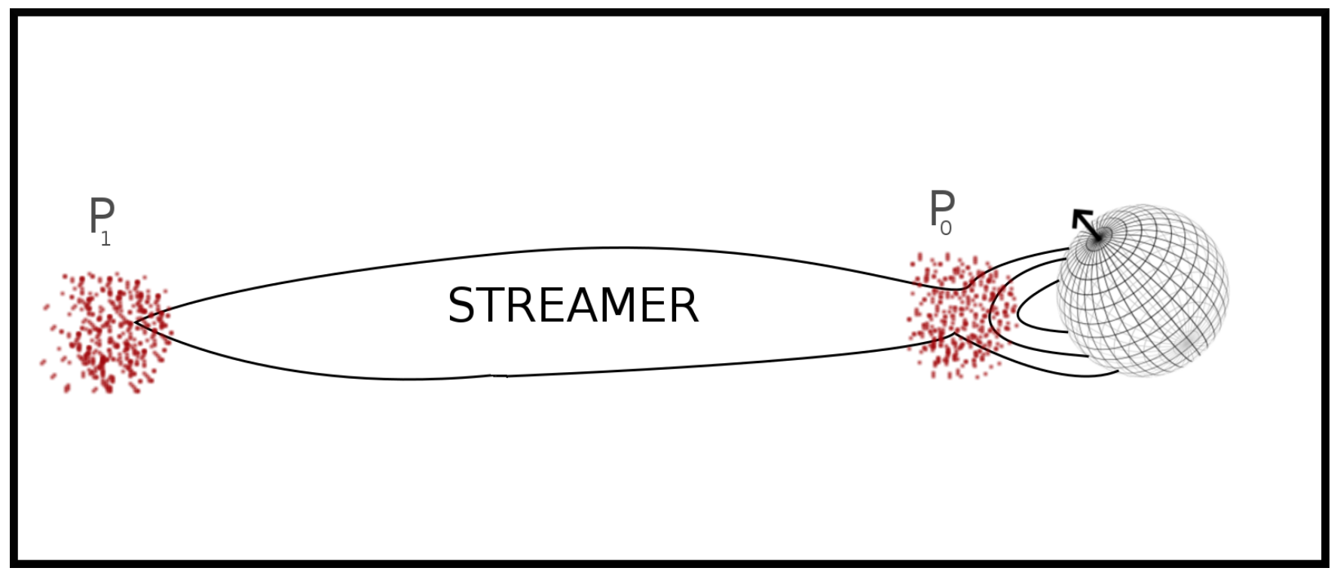
Hypothesis 3: Helmet streamers
Confined particles travel along the streamer and are reflected back between both lower and upper mirror points (Melrose & Brown 1976).
Student Seminar
9th of July, 2020

Slide 44
Hypothesis 3: Helmet streamers
9-10 stellar radii
During the 12 h of observation, the star completes an entire rotation period but the streamer moves much less… But:
Once the helmet streamer has been produced, it is no longer attached to the star surface and may be subjected to curve following the strongly wrapped magnetic field of AB Dor A. In other words, once formed it is free to move independently!
Student Seminar
9th of July, 2020

Slide 45
Hypothesis 3: Helmet streamers
9-10 stellar radii
This model is also compatible with 2013, if we assume that the streamer is only seen during the second half of the observation.
During the 12 h of observation, the star completes an entire rotation period but the streamer moves much less… But:
Once the helmet streamer has been produced, it is no longer attached to the star surface and may be subjected to curve following the strongly wrapped magnetic field of AB Dor A. In other words, once formed it is free to move independently!
Student Seminar
9th of July, 2020

Slide 46
Hypothesis 4: Close companion
Student Seminar
9th of July, 2020

Slide 47
Hypothesis 4: Close companion
So close and with that movement… It would create unacceptable large values of the radial velocity semi-amplitude of the stellar reflex motion, much greater than the precision of previously-reported radial velocity measurements of AB Dor A (Gontcharov 2006).
Student Seminar
9th of July, 2020

Slide 48
AB Dor A radio interferometry
Polar cap
Flaring Loops
Helmet Streamers
Close companion
Student Seminar
9th of July, 2020

Slide 49
In summary
Interferometry allows us to obtain the highest angular resolution in astronomy.
Infrared interferometry of AB Dor C indicates that this object may be a binary:
Partially alleviates the disagreement between observed and predicted magnitudes.
The tentative orbit is stable even under the gravitational influence of AB Dor A.
Radio interferometry of AB Dor A revealed an intriguing structure at 8.4 GHz.
The time analysis shows that this structure varies within the observation.
Hypothesis 1: Polar Cap
Hypothesis 2: Flaring loops
Hypothesis 3: Helmet streamers
Hypothesis 4: Close companion
Student Seminar
9th of July, 2020

Slide 50
In summary
Interferometry allows us to obtain the highest angular resolution in astronomy.
Infrared interferometry of AB Dor C indicates that this object may be a binary:
Partially alleviates the disagreement between observed and predicted magnitudes.
The tentative orbit is stable even under the gravitational influence of AB Dor A.
Radio interferometry of AB Dor A revealed an intriguing structure at 8.4 GHz.
The time analysis shows that this structure varies within the observation.
Hypothesis 1: Polar Cap
Hypothesis 2: Flaring loops
Hypothesis 3: Helmet streamers
Hypothesis 4: Close companion
THANK YOU!
Student Seminar
9th of July, 2020

