Slide 1


Filtering images by Using a New Approach of Anisotropic Diffusion
Université Mohammed-V-Agdale
Faculté des Sciences Rabat, Maroc
Hôpital universitaire internationale Sheikh Zaïd de Rabat,
Maroc
Y. TOUFIQUE*, R.CHERKAOUI EL MOURSLI*, L.MASMOUDI*, M. CHERKAOUI MALKI**. *Université Mohammed V –Agdal, Faculté des Sciences de Rabat, Maroc **L’ Hôpital Internationale CHU Cheik Zaïd, Rabat, Maroc

Slide 2
Object
pre-processing methods that use a new approach of anisotropic diffusion equation to suppress noise or other small fluctuations in the image scanner while preserving frontiers between different regions.

Slide 3
Introduction
pre-processing is an improvement of the image data that correct some degradation in the image or enhances some image features important for further processing and analysis.
A new implementation of the anisotropic diffusion technique, based on Perona-Malik (P-M) equation, which allows us to reduce the noise and better preserve small structures and discontinuities between different regions in the images.
Experimental results on real medical images scanner(CT)e.

Slide 4
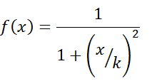

Explication
Matrice image
In practice, this amounts to calculating a "weighted average" of neighboring the central pixel. The weights reflect the difference in intensity with the central pixel. Malik and Perona proposed the following functions to calculate the weights:
12 | 14 | 38
23 | 40 | 19
22 | 30 | 13
I^{t+1}(i,j) = im^{t}(i,j)+delta*[f[im(i,j)-im(i,j-1)]+ f[im(i,j)-im(i,j+1)]+ …. ]
(i - 1, j)
The factor "delta" is used to control the spread of the force, and thus avoid saturating the new value. In practice, we use a low value of "delta" (about 0.1) and performs multiple iterations.
(i , j -1)
40
(i , j +1)
(i + 1, j)

Slide 5
Anisotropic diffusion with adaptive edge magnitude parameter :k
In the Perona-Malik anisotropic diffusion method, the gradient magnitude ‘k’ is used to detect an image edge or boundary as a step discontinuity in intensity.
But If ∇I>> k , then c( ∇I )→0 , and we have an all-passfilter;
If ∇I << k , then c( ∇I )→1, and we achieve isotropic diffusion (Gaussian filtering).
Where c(.) is the conductivity function (or diffusivity function), and ∇ is the gradient operator;

Slide 6
Adaptive edge magnitude parameter
To solve the above problem, we proposed an adaptive determination of k parameter according to the local intensity variance V(i,j).
k_{i,j} should increase when the variance V(i,j) decrease and should decrease when V(i,j) increase.
Moreover, k_{i,j} should be limited between k_{max} and k_{min} . Hence, we use this formulation:
With k_{max}=100 and k_{min}=10

Slide 7
Observation

Slide 8
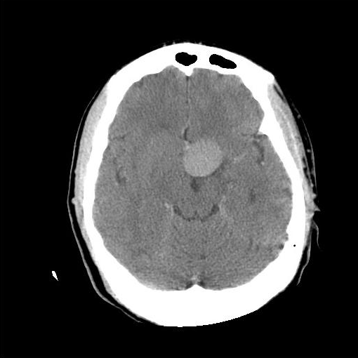

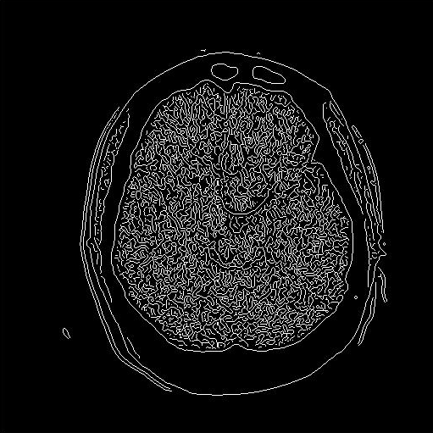
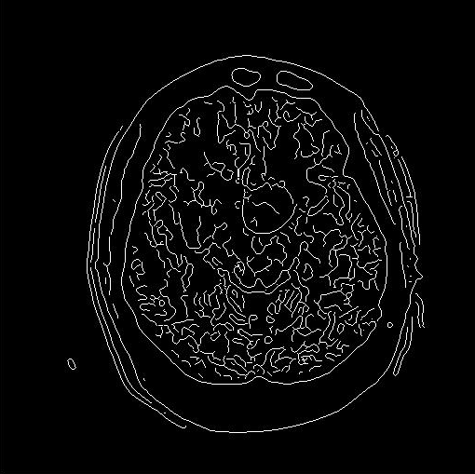
Original image
Smoothed image using P-M
Edge image (orignal)
Edge Image (smoothed)
For k = 5 and number of iterations =15

Slide 9

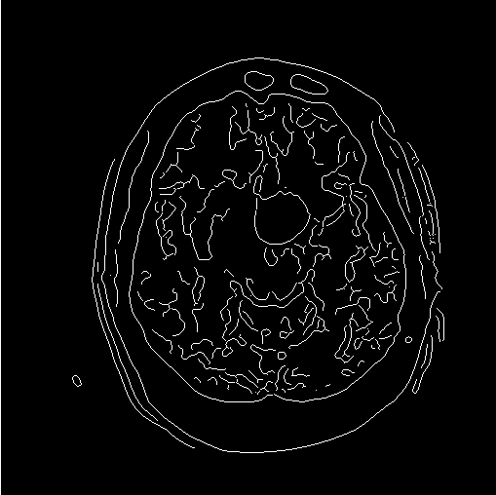
Original image
Smoothed image using P-M
Edge image (orignal)
Edge Image (smoothed)
With the new approach

Slide 10
k = 5 and number of iterations =15
New adaptive

Slide 11
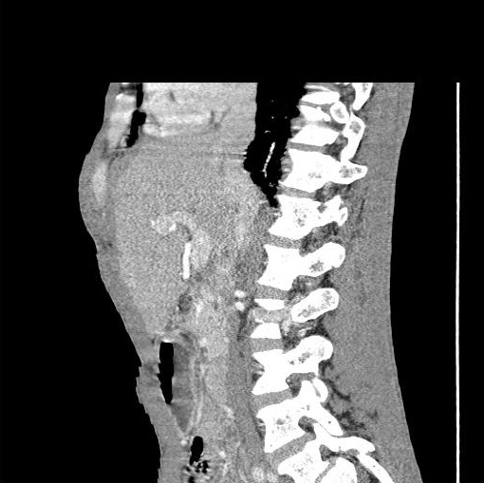
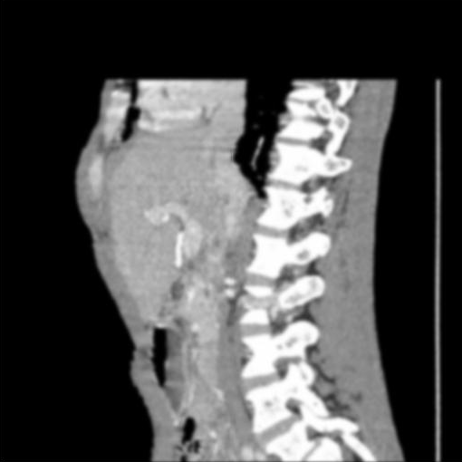
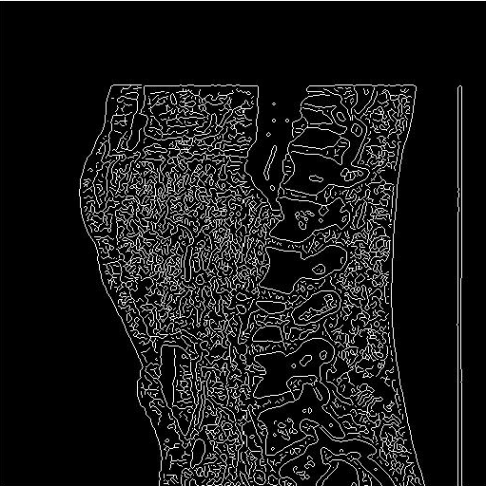
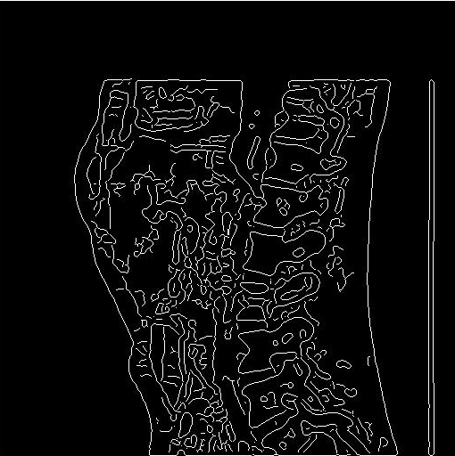
Original image
Smoothed image using P-M
Edge image (orignal)
Edge Image (smoothed)
For k = 5 and number of iterations =15

Slide 12
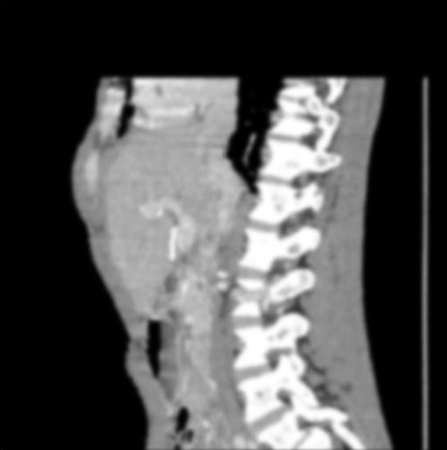
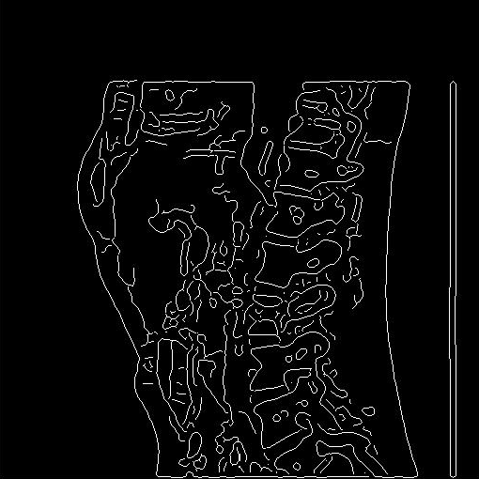
Original image
Smoothed image using P-M
Edge image (orignal)
Edge Image (smoothed)
New approach

Slide 13
k = 5 and number of iterations =15
New adaptive

Slide 14
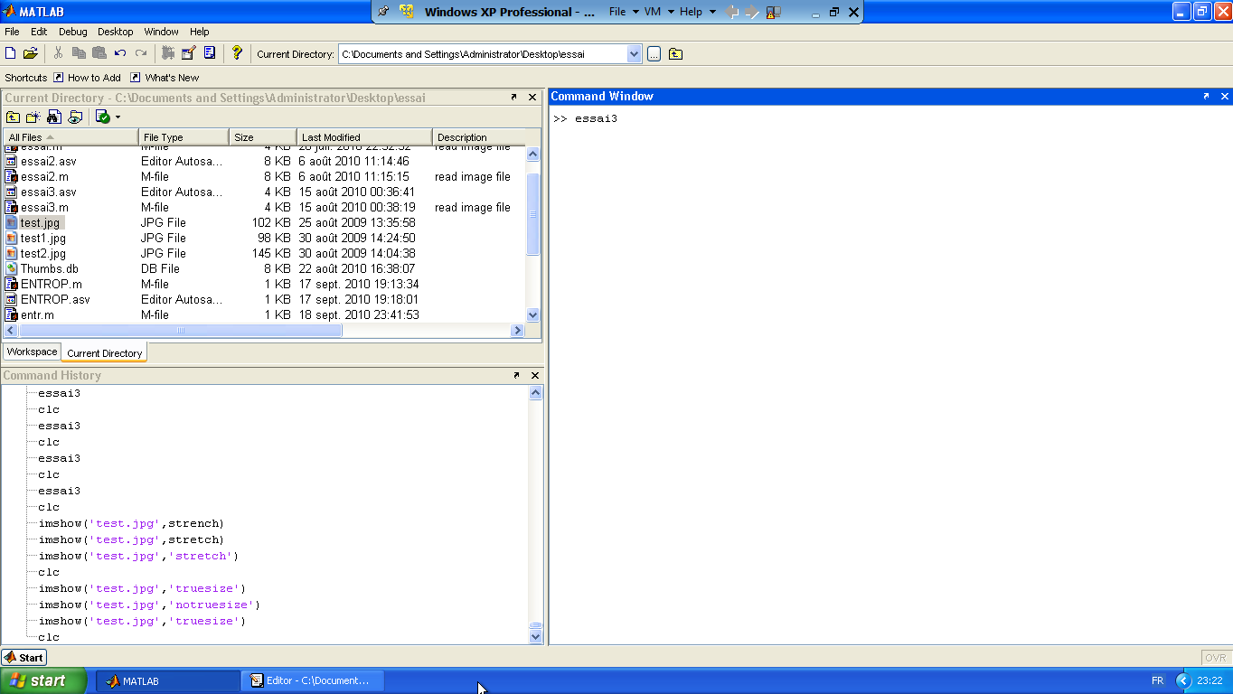

Slide 15
Conclusion
The proposed approach, based on P-M technique, reduces noise and irrelevant details while preserving sharper boundaries.
Extension of this technique to others modalities (RMN, PET,Echography,Doppler …) and /or to 3D medical images can envisaged.
.

Slide 16
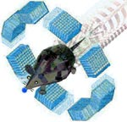
Simulation of a ordinary PET with GATE

Slide 17
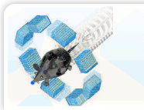

Gate
an advanced opensource software developed by the international OpenGATE collaboration
dedicated to the numerical simulations in medical imaging.
supports simulations of
Emission Tomography (Positron Emission Tomography - PET
Single Photon Emission Computed Tomography - SPECT),
Computed Tomography (CT).

Slide 18
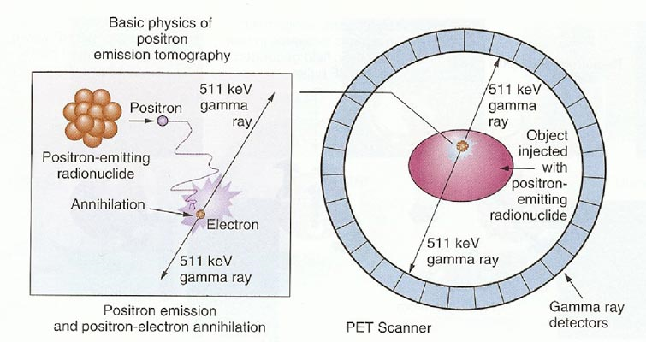
Positron Emission Tomography – Computed Tomography (PET/CT).

Slide 19
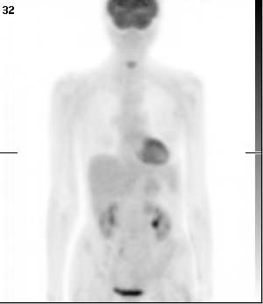
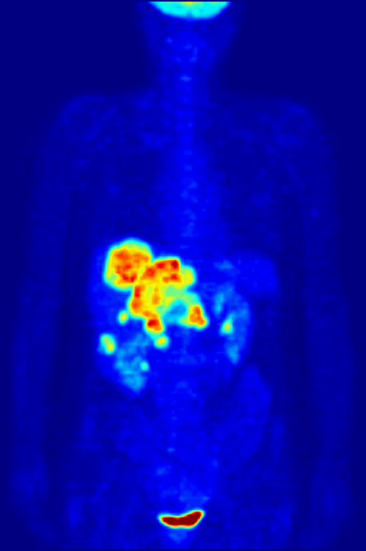
PET
PET-CT

Slide 20
Setting up a GATE simulation
Geometry
Physics
Initialisation
Sources
Runs

Slide 21
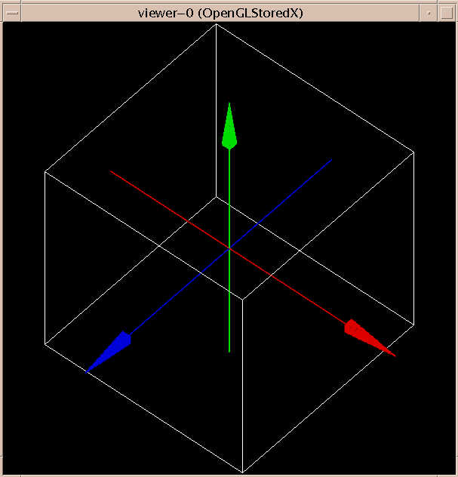
The World
The World
is the only volume initially present in GATE
All volumes are daugthers or grand-daugthers of the world : the World volume is essential
Y axis
WORLD
Volume 1
Volume 2
Volume 3
Z axis
X axis
Volume 4

Slide 22
Building a geometry (1)
The user can create a cylinder, a sphere, an ellipse, a hexagone, a box…...
Generalities:
A new volume must be the daughter of an another volume
The first new volume is the daughter of the world.
New volume appear automatically in the Gate tree. To get information about a new volume, use:
/gate/new_volume/describe
To build a volume :
1. Give the new volume a name
/gate/world/daughters/name vol_name
2. Assign a shape to the new volume
/gate/world/daughters/insert box
//create the volume vol_name

Slide 23
Building a geometry (2)
3. Define the size of the new volume
/gate/vol_name/geometry/setXLength 20. cm
/gate/vol_name/geometry/setYLength 40. cm
/gate/vol_name/geometry/setZLength 40. cm
4. Place the new volume in the user’s geometry
/gate/vol_name/placement/setTranslation 10. 0. 0. cm
Be careful: The position is always given with respect to the center of the father volume.
5. Assign a material to the new volume
/gate/vol_name/setMaterial Air
The list of the available materials is in the GateMaterials.db file

Slide 24
Materials (1)
/gate/vol_name/setMaterial Air
The material used must be in the Gate material database
GateMaterials.db
Various material definitions
Simple
Compound, defined by number of atoms
Compound, defined by fraction
Can be edited to add new materials

Slide 25
Materials (2)
[Elements]
Hydrogen: S= H ; Z= 1 ; A= 1.01 g/mole
Carbon: S= C ; Z= 6 ; A= 12.01 g/mole
Create a new element
[Materials]
Aluminium: d=1.350 g/cm3 ; n=1 ; state=solid
+el: name=auto ; n=1
NaI: d=3.67 g/cm3; n=2; state=solid
+el: name=Sodium ; n=1
+el: name=Iodine ; n=1
CsITl: d=4.51 g/cm3; n=3; state=solid
+el: name=Cesium ; f=0.511
+el: name=Iodine ; f=0.488
+el: name=Thallium ; f=7.86e-04
Create a new material
Elements added by atom number
Elements added by mass fraction

Slide 26
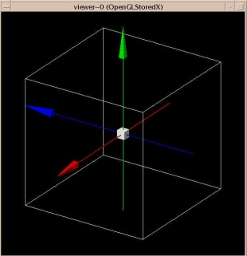
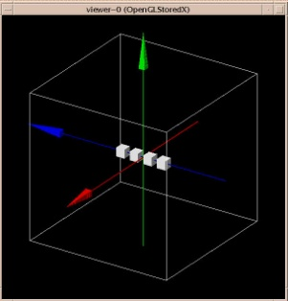
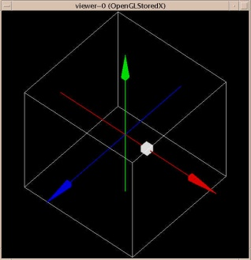
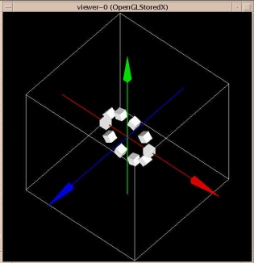
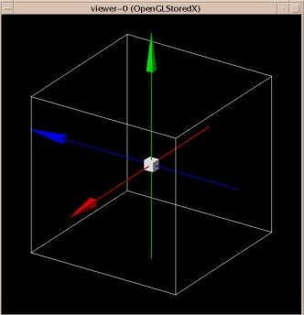
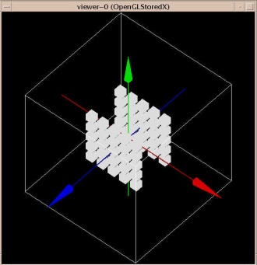
Repeating a volume
Linear repeater
/gate/vol_name/repeaters/insert linear
/gate/vol_name/linear/setRepeatNumber 4
/gate/vol_name/linear/setRepeatVector 0. 0. 5. mm
The volume is repeated four times along the Z axis every 5 mm.
Ring repeater
/gate/vol_name/repeaters/insert ring
/gate/vol_name/ring/setNumber 10
/gate/vol_name/ring/setPoint1 0. 0. 1. mm
/gate/vol_name/ring/setPoint2 0. 0. 0. mm
Point 1 and Point 2 define the axis around which the volume will be repeated :In the above example, the Z axis is considered (default axis)
Cubic array repeater
/gate/vol_name/repeaters/insert cubicArray
/gate/vol_name/cubicArray/setRepeatNumberX 5
/gate/vol_name/cubicArray/setRepeatNumberY 5
/gate/vol_name/cubicArray/setRepeatNumberZ 2
/gate/vol_name/cubicArray/setRepeatVector 5. 5. 15. cm
The volume is repeated five times along the X and Y axes and twice along the Z axis

Slide 27
Moving a volume
Translation
/gate/vol_name/placement/setTranslation 10. 0. 0. cm
Place the volume at the position : X = 10 cm - Y = 0 cm - Z = 0 cm
Rotation
/gate/vol_name/placement/setRotationAxis 0 1 0
/gate/vol_name/placement/setRotationAngle 90 deg
Move with time
✶ Rotation
/gate/vol_name/moves/insert rotation
/gate/vol_name/rotation/setSpeed 1 deg/s
✶ Translation
/gate/SPECThead/moves/insert translation
/gate/SPECThead/translation/setSpeed 0 0 1 cm/s
✶ Orbiting
/gate/SPECThead/moves/insert orbiting
/gate/SPECThead/orbiting/setSpeed 1. deg/s
/gate/SPECThead/orbiting/setPoint1 0 0 0
/gate/SPECThead/orbiting/setPoint2 0 0 1

Slide 28
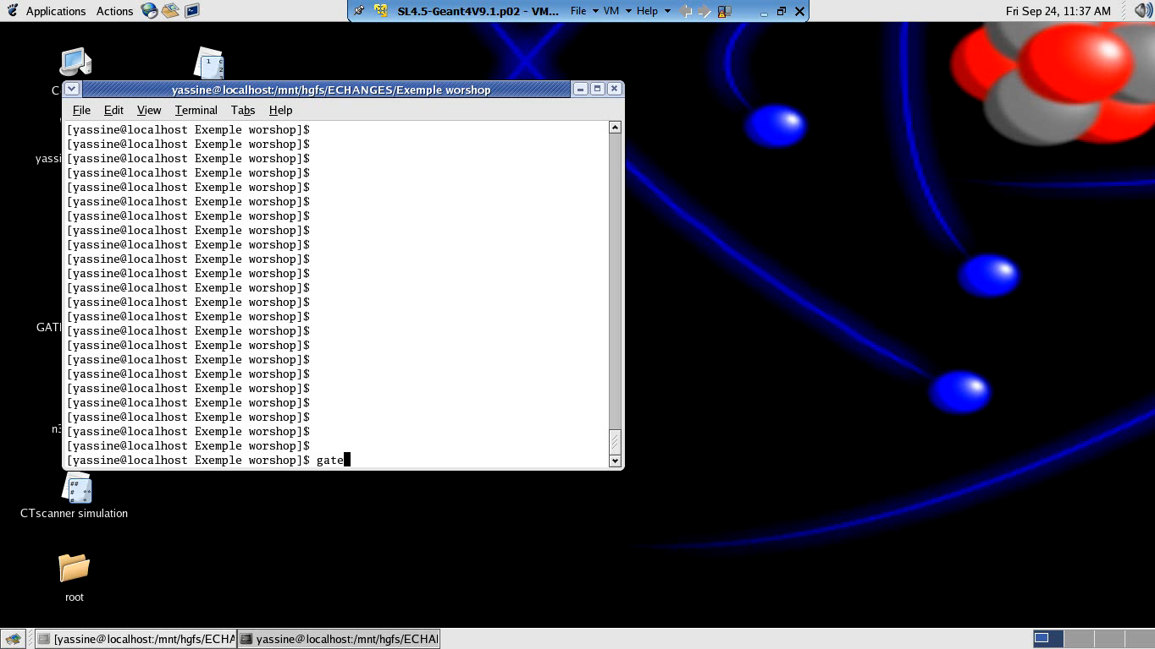
My Simulation

Slide 29
Thank you:
I thank Pr. Magdalena Rafecas Lopez and her group for their help and training during our stay in valencia.
I also want to thank Pr. Jose Salt Cairols and Pr. Santiago Gonzalez de la Hoz and their group for everything they have done to achieve this collaboration.
all my sincere thanks to Professor Farida Fassi for her support in helping us to have this collaboration with our colleagues in Spain.
and finally I thank all who participated in this workshop

Slide 30
Thank you

