Slide 1



Comentario de resultados
Michel Sorel, Mariam Tortola
Masterclass Hands on Particle Physics: ejercicio MINERvA
Abril 2019

Slide 2
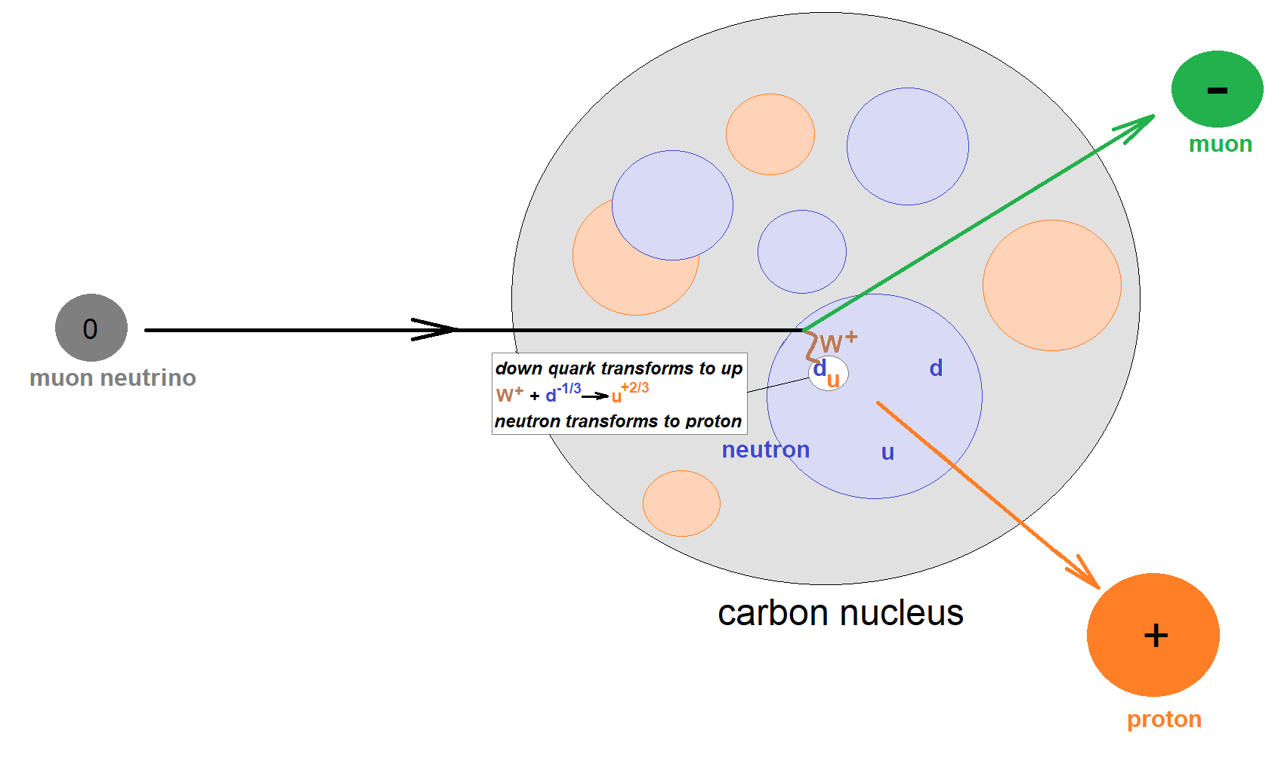
Signal and background events
There are both background and signal events
In each signal event, a neutrino penetrates a nucleus in carbon target and undergoes a weak interaction with a neutron in that nucleus
The neutrino interacts with the neutron to become a muon, causing the neutron to become a proton!
Background event: any other event type

Slide 3
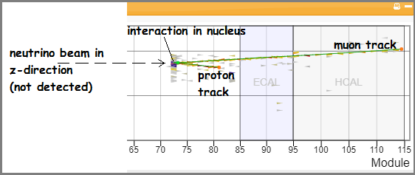
Interaction kinematics
While MINERvA cannot directly detect the neutrino, it detects and measures the kinematics of both the muon and the proton that emerge from the interaction
You can find this kinematic information with Arachne, the MINERvA event display that you will use to visualize the events.
You will then put this information into a spreadsheet which applies conservation of momentum to give the momentum of the system prior to the interaction in three dimensions.

Slide 4
Masterclass objectives
Determine which events are signal events (from which effective measurements may be made) and which events are background (that cannot be used for measurements).
Apply conservation of momentum and energy to measure the approximate energy of a neutrino beam from the Fermilab accelerator complex.
Apply conservation of momentum and energy to measure the properties of neutrons in nuclei of atoms in the target of a neutrino beam.

Slide 5
MINERvA’s Principal Interaction
Of Interest (What we see)
υ_{μ}
p⁺
n⁰
μ⁻
Scintillating Target Material

Slide 6
MINERvA’s Principal Interaction
Of Interest (What we see)
A proton and muon “appear” out of nowhere
in the scintillating target
υ_{μ}
p⁺
n⁰
μ⁻
Scintillating Target Material

Slide 7
MINERvA’s Principal Interaction
Of Interest (Revealed)
neutrino + neutron → proton + muon
ν_{μ-} + n⁰ → p⁺ + μ⁻
p⁺
υ_{μ}
n⁰
μ⁻
Scintillating Target Material

Slide 8
What’s Going On?
A neutrino with kinetic energy strikes a neutron at ‘rest’ in the nucleus of an atom…
Which causes one of the neutron’s down quarks to flip “up” (udd) to (uud) … transforming it
to a proton!
Simultaneously, a muon is generated as the neutrino annihilates
p⁺
υ_{μ}
n⁰
udd —> uud
μ⁻
Scintillating Target Material

Slide 9
What’s Going On?
p⁺
υ_{μ}
n⁰
μ⁻
Also, there is a net gain of mass & a loss of energy during the interaction (E = Δmc²)…
Some of the neutrino’s pre-collision kinetic energy changes into new mass (the muon) and some is transferred to the kinetic energies of the muon and proton.

Slide 10
Important Momentum Ideas
At the position and time
of the interaction only!
Momentum is
conserved in
all 3 axes
p⁺
υ_{μ}
n⁰
μ⁻
Before Collision
After Collision
p_{neutrino} + p_{neutron}
= p_{proton} + p_{muon}

Slide 11
Important Momentum Ideas continued
The beam is aimed so that neutrinos only have momentum in the z-axis!
p⁺
υ_{μ−}
n⁰
z-axis
μ⁻
p_{neutrino} + p_{neutron} = p_{proton} + p_{muon}
In the z-axis: p_{neutrino} = p_{proton} + p_{muon}

Slide 12
Important Momentum Ideas continued
p⁺
z-axis
υ_{μ}
n⁰
μ⁻
z-axis: p_{neutrino} = p_{proton} + p_{muon}
If the target neutron is totally at rest…
… then in the x-axis & y-axis
p_{proton} + p_{muon} = 0

Slide 13
Important Momentum Ideas continued
p⁺
z-axis
υ_{μ−}
n⁰
μ⁻
z-axis: p_{neutrino} = p_{proton} + p_{muon}
If the target neutron has motion…
… then in the x-axis & y-axis
p_{proton} + p_{muon} ≠ 0

Slide 14
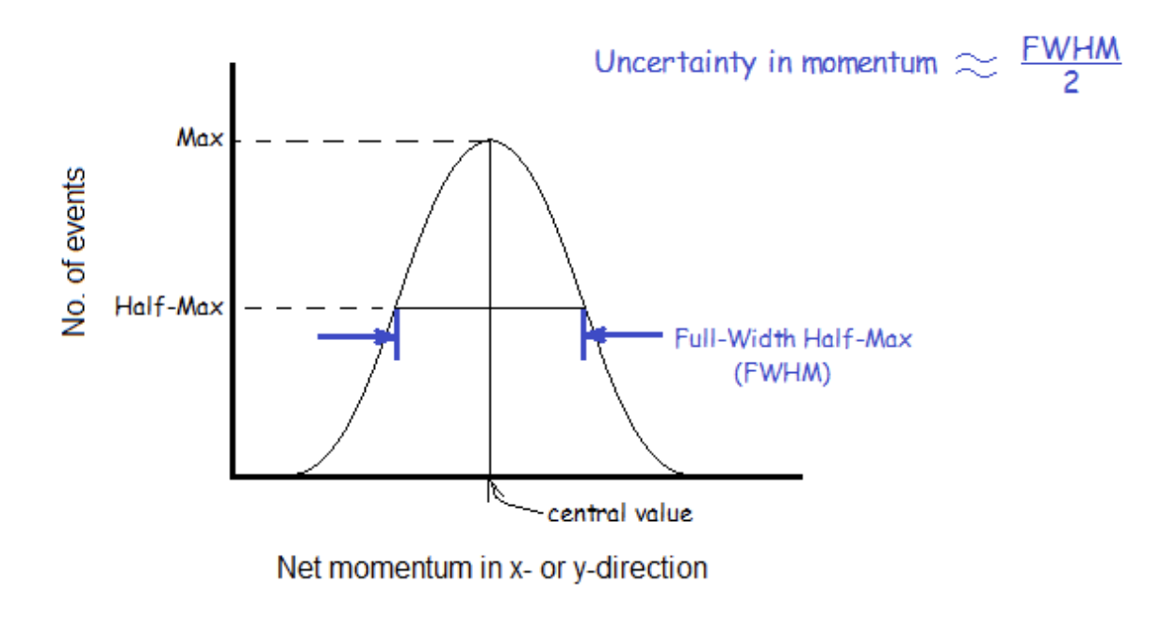
Momentum in x-y directions
Histograms net p_{x} p_{y}
p_{proton} + p_{muon} ≈ 0
Uncertainty in the distribution of p_{x}, p_{y}
⇒ Δpx, Δpy

Slide 15
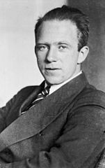
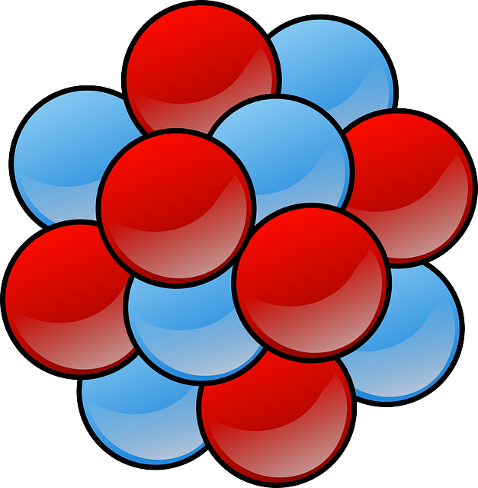
Heisenberg Uncertainty Principle
⇒ The uncertainties in the position and momentum of a particle form a complimentary pair:
Δp_{x} Δx ≥ h/4π → Δx= (100 Mev*fm/c)/ Δp_{x}
Neutrons are not free to move, but behave as a Fermi gas, then:
→ Δx= (300 Mev*fm/c)/ Δp_{x}
To be compared with the carbon nuclear radius
R = (1.25 fm) A^{1/3} → R(C, A=12) = 2.7 fm

