Slide 1

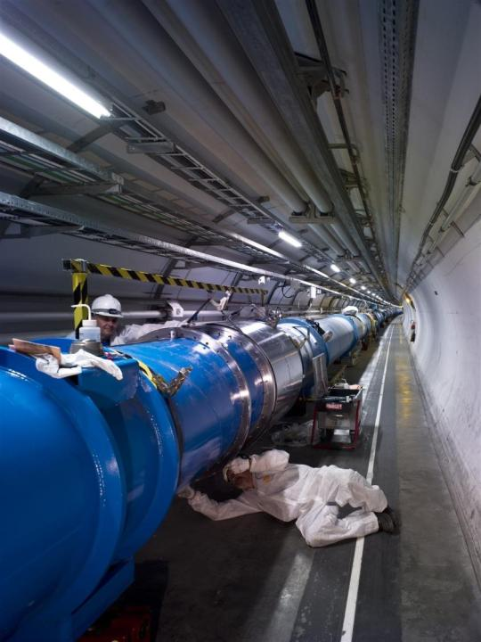





Introduction to LHC
& ATLAS experiment
José Salt
26th/March/2018
Special thanks to S. Martí & C. García

Slide 2

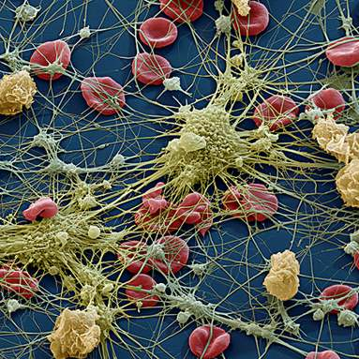
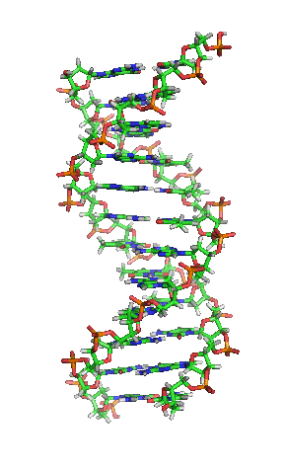
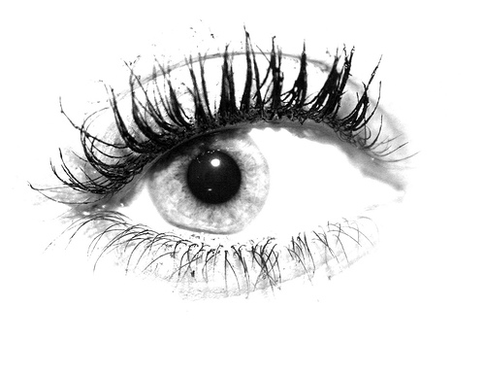
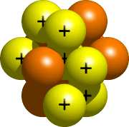
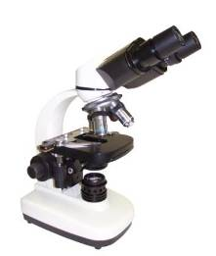
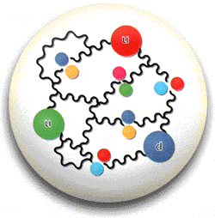
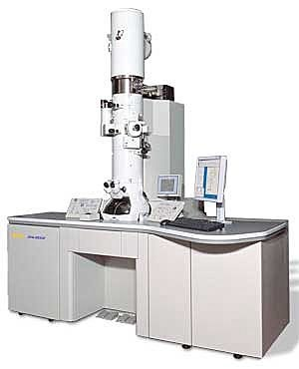
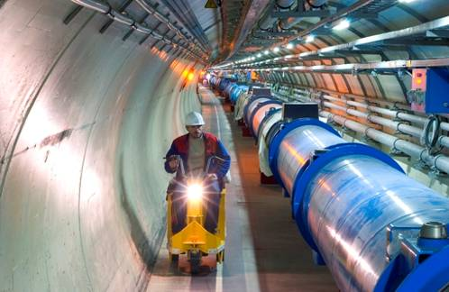
A particle collider is a … microscope
10 cm
50 μm
2 nm
m
1
10⁻³
2 fm
10⁻⁶
< 1 am
10⁻⁹
Eye
10⁻¹²
10⁻¹⁵
Microscope
10⁻¹⁸
Electronic
microscope
h
λ =
p
Particle accelerator

Slide 3




















Particle collisions: what for ?
Particle collisions: what for ?
CLASSICAL MECHANICS

Slide 4


Particle collisions: what for ?
Dark matter ?
Higgs Boson ?
E=mc²
QUANTUM MECHANICS

Slide 5
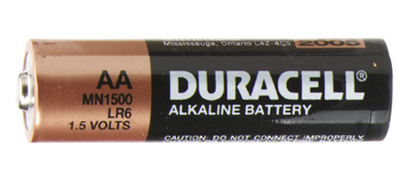
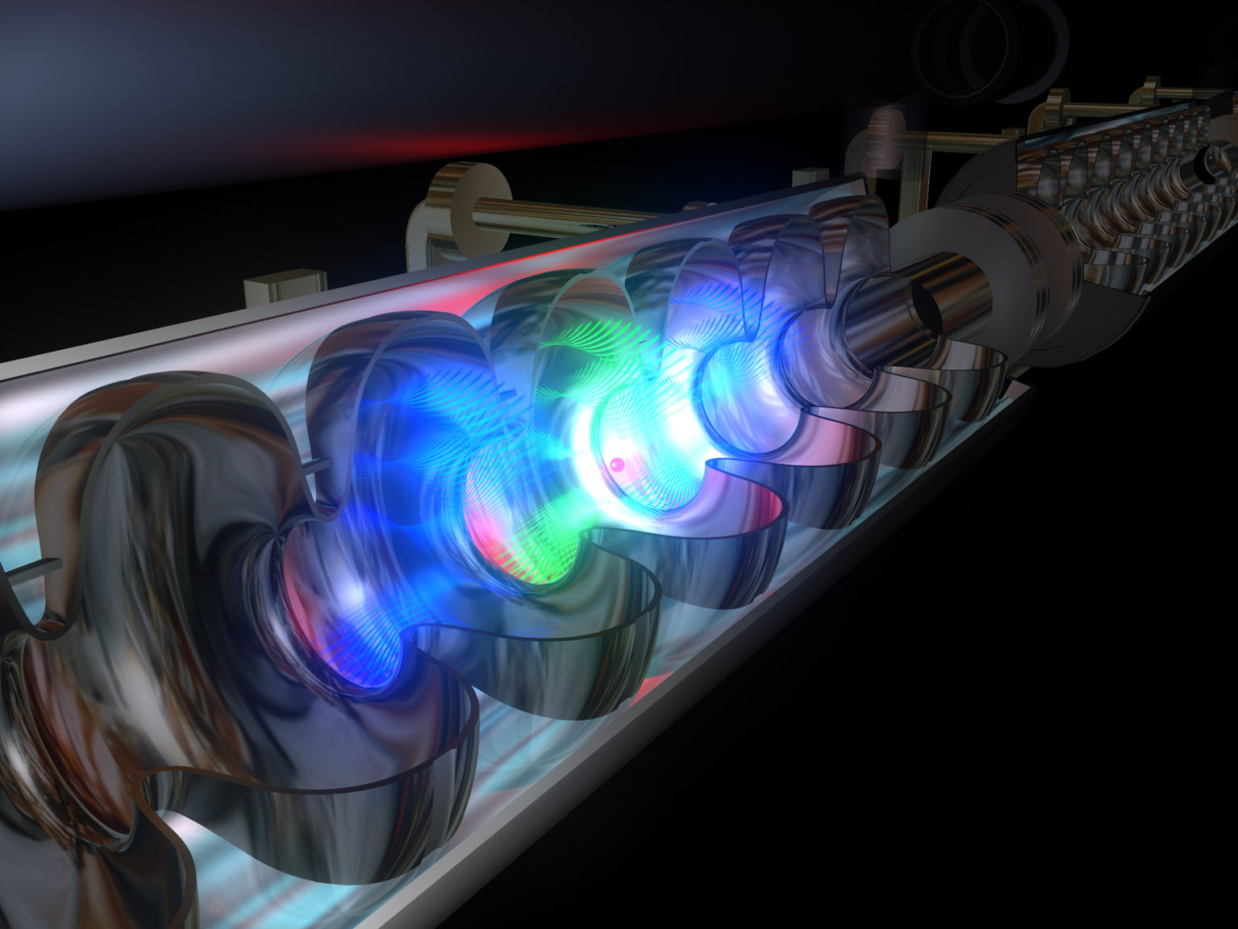
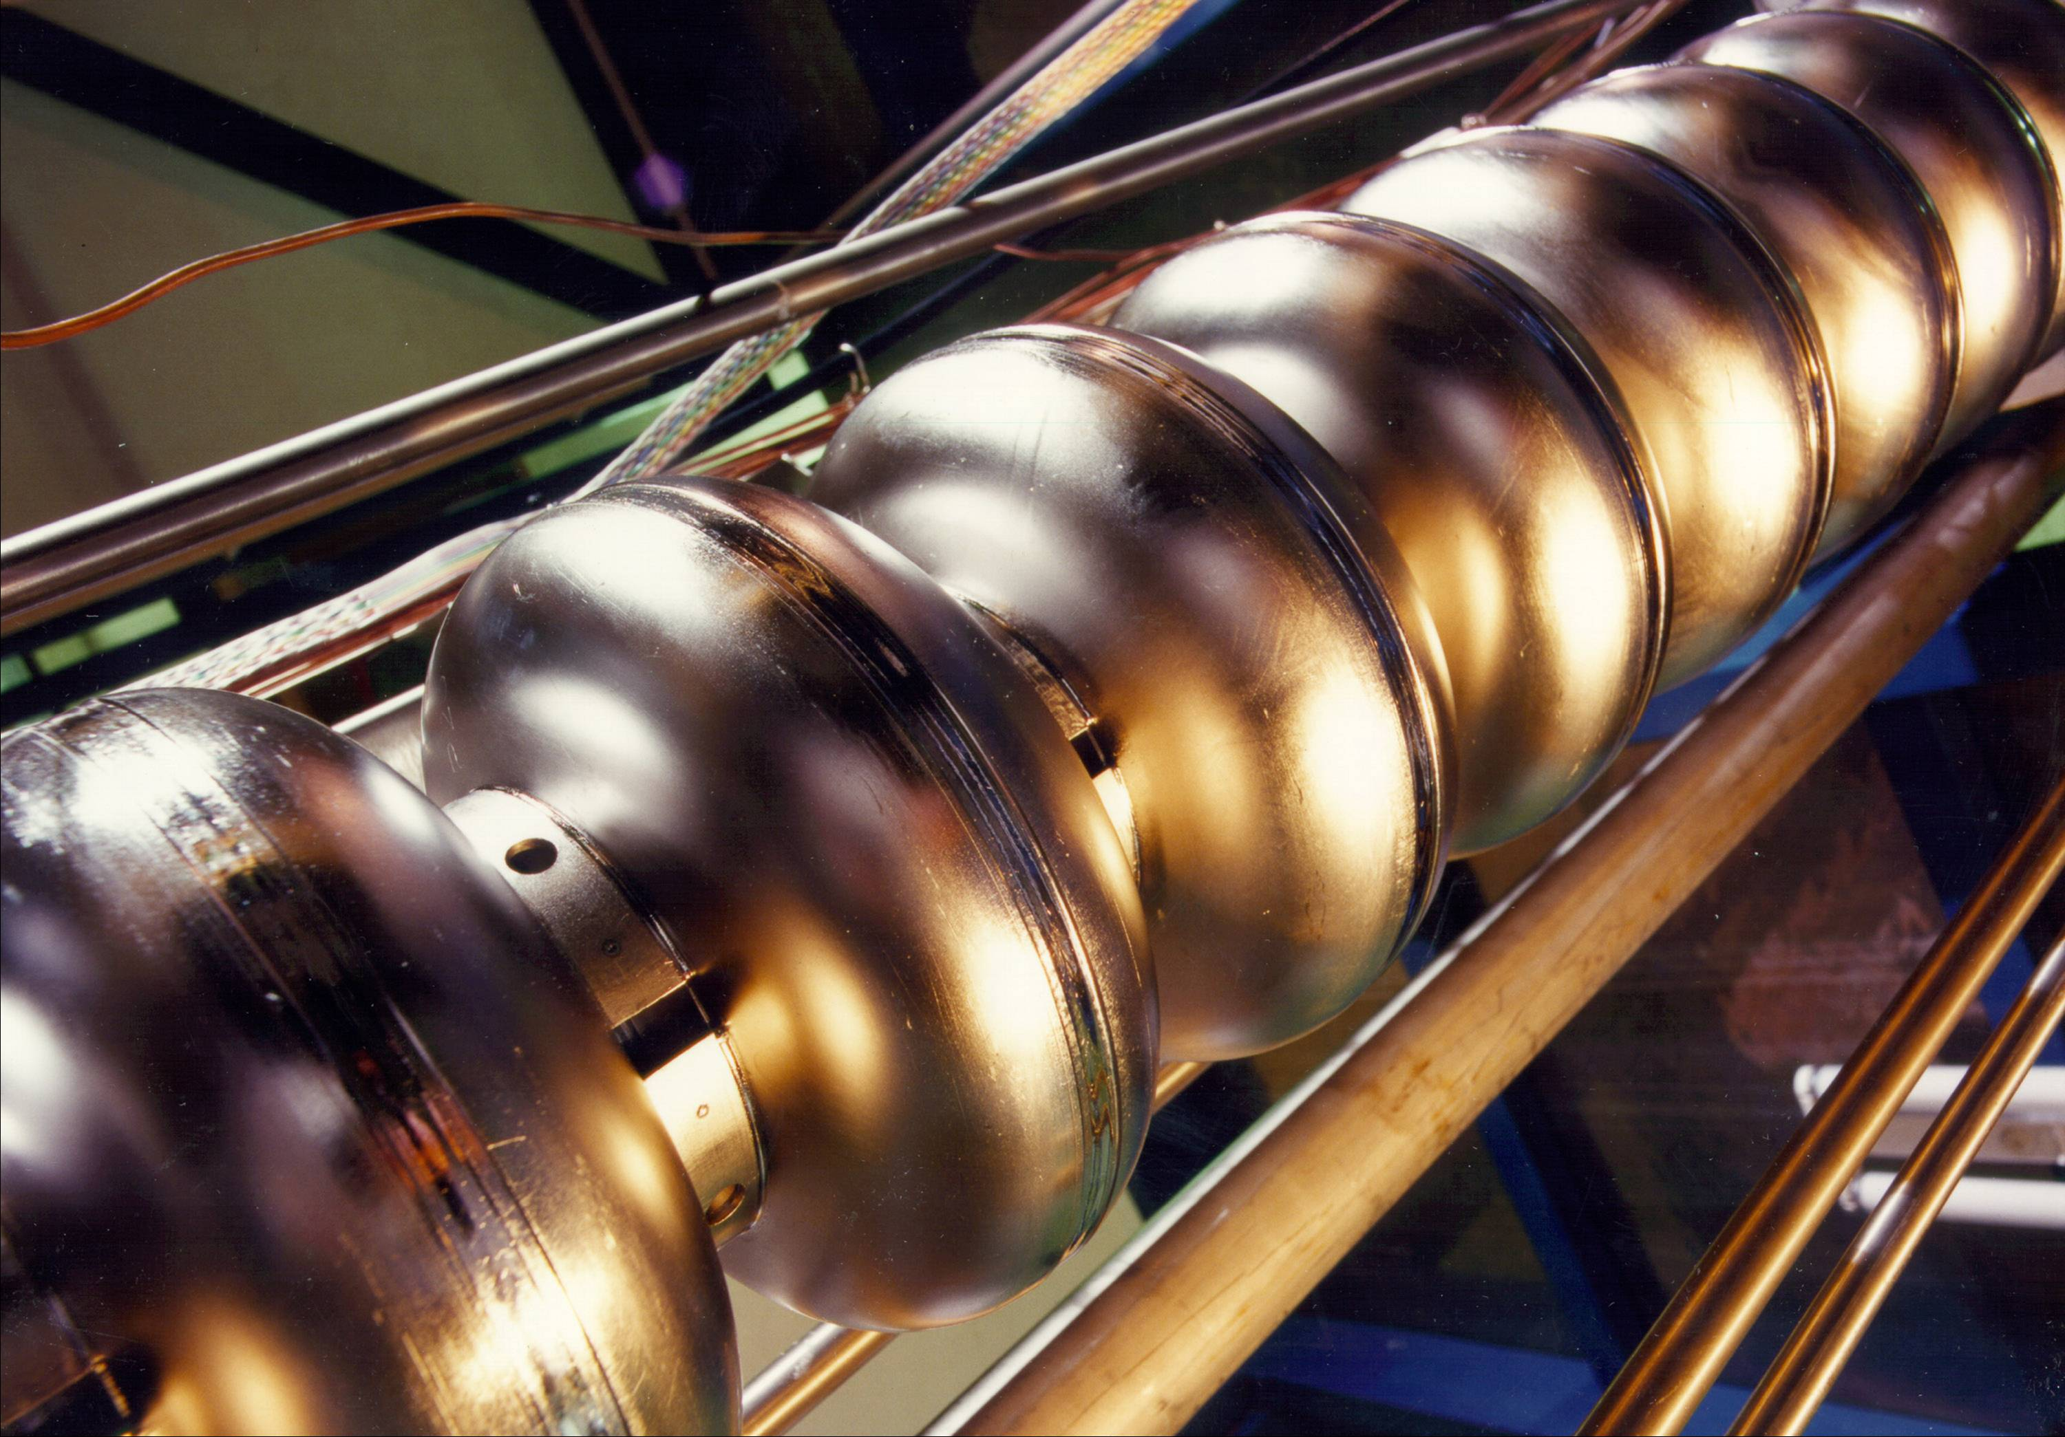
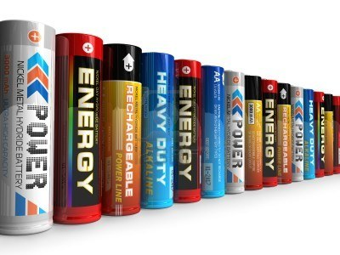
Particle accelerators
+
Apply a potential difference (voltatge)
One can use a battery to build an easy-accelerator
Voltatge ~ Energy
+
The LHC accelerates protons with 7.000.000.000.000 Volts / beam
x 2 beams ➔ 14 TeV
Radio-frequency cavities
10,000,000,000,000 AA type batteries
0,05m x 10¹³ = 500 Gm ~ 3 x Earth-to-Sun distance
MV/m

Slide 6

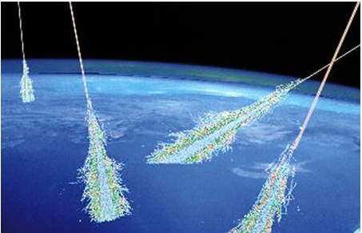
High Energy Physics
Also known as Elementary Particles Physics
It serves to study how the matter constituents interact
  Of course, “high energy” is an evolving concept dependent on our technical capabilities
  Today: TeV (Tera-electronvolt = 10¹² electronvolt)
  Kinetic energy of a mosquito
    M_mosquito ~ 2 mg
    V_mosquito ~ 3,6 Km/h E = ½ m v² ~ 10⁻⁶ J
    Energy of an LHC proton ➔ 6,5 TeV
    = 6,5 x 10¹² V x 1,6 10⁻¹⁹ C ~ 10⁻⁶ J
Even higher energies are obtained in experiments watching the cosmic rays

Slide 7

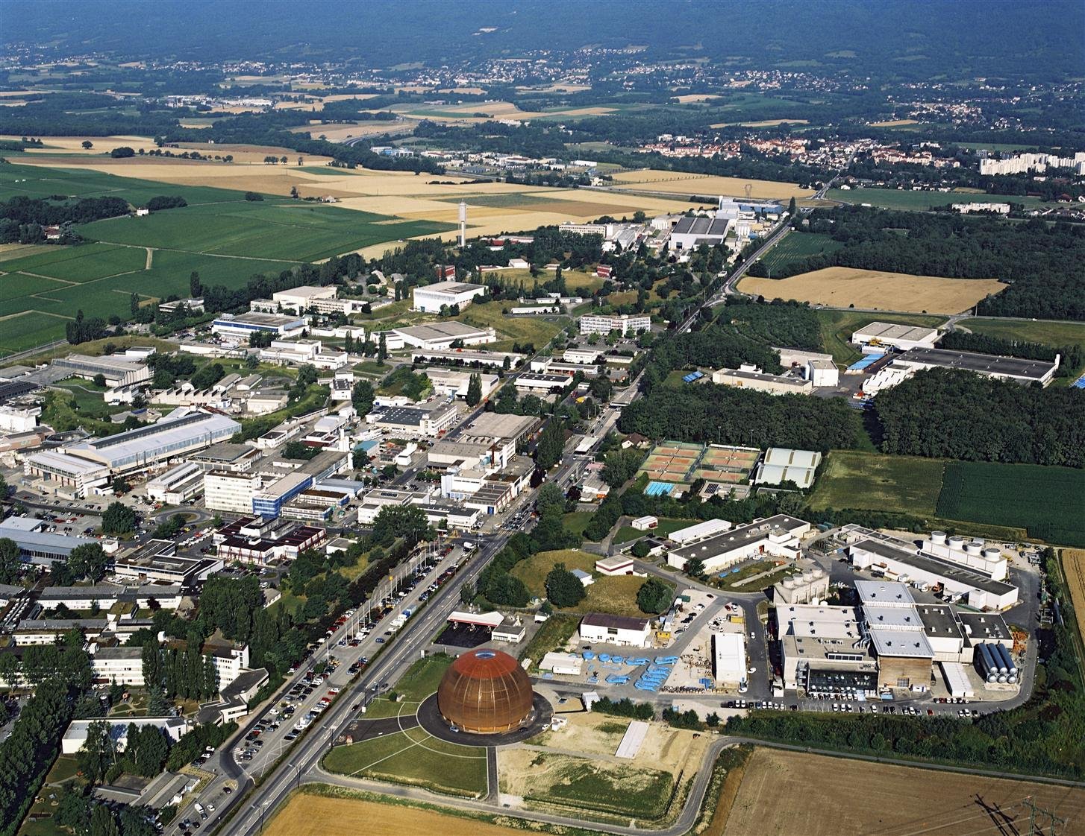
CERN
CERN is a european research laboratory for particle and nuclear physics
Established in 1954
  Before the European Union (1957)
It is located in the outskirt of Geneva
Just in the border between Switzerland and France
There exist CERN facilities at both sides of the border

Slide 8
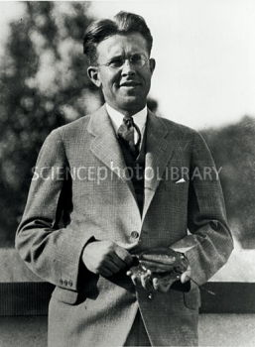
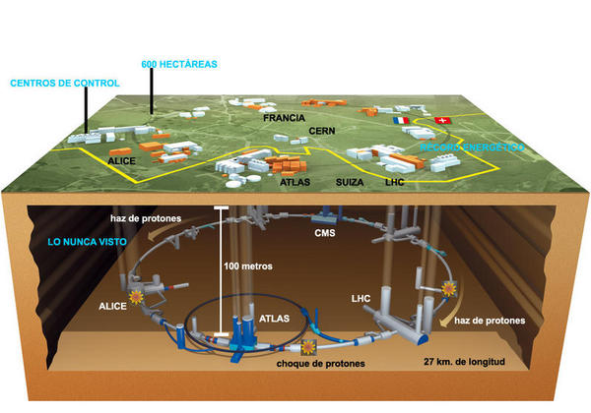
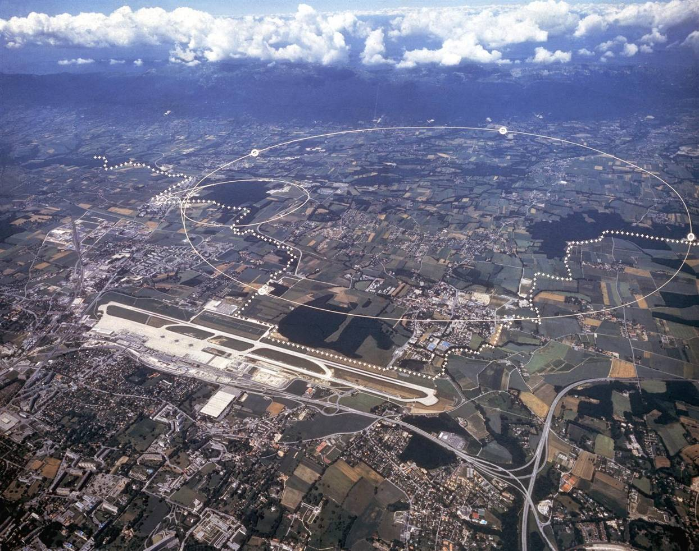

The Large Hadron Collider (LHC)
Francia
CERN
27 km
B
v
Suiza
Lawrence and the
first accelerator
The LHC is the largest and most powerfull particle accelerator
It is 27 km long.
Built ~100 m underground

Slide 9
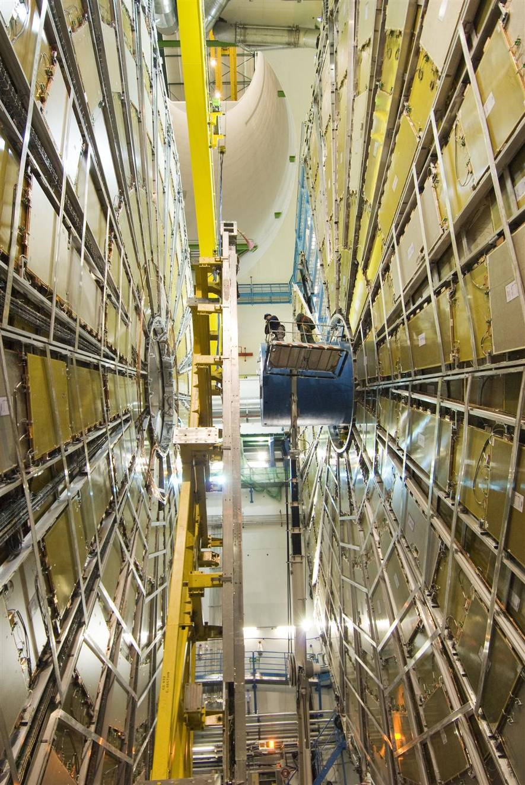
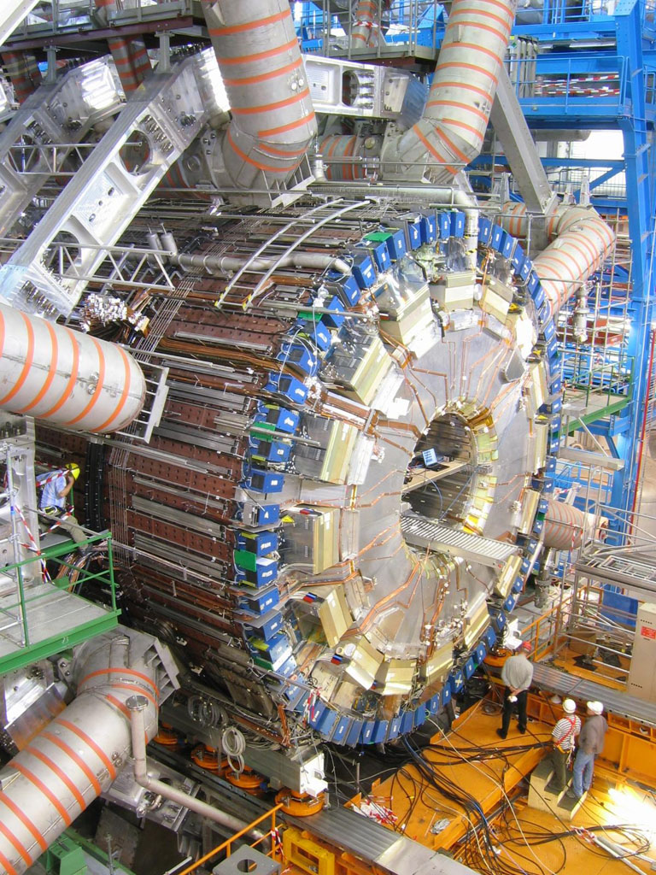
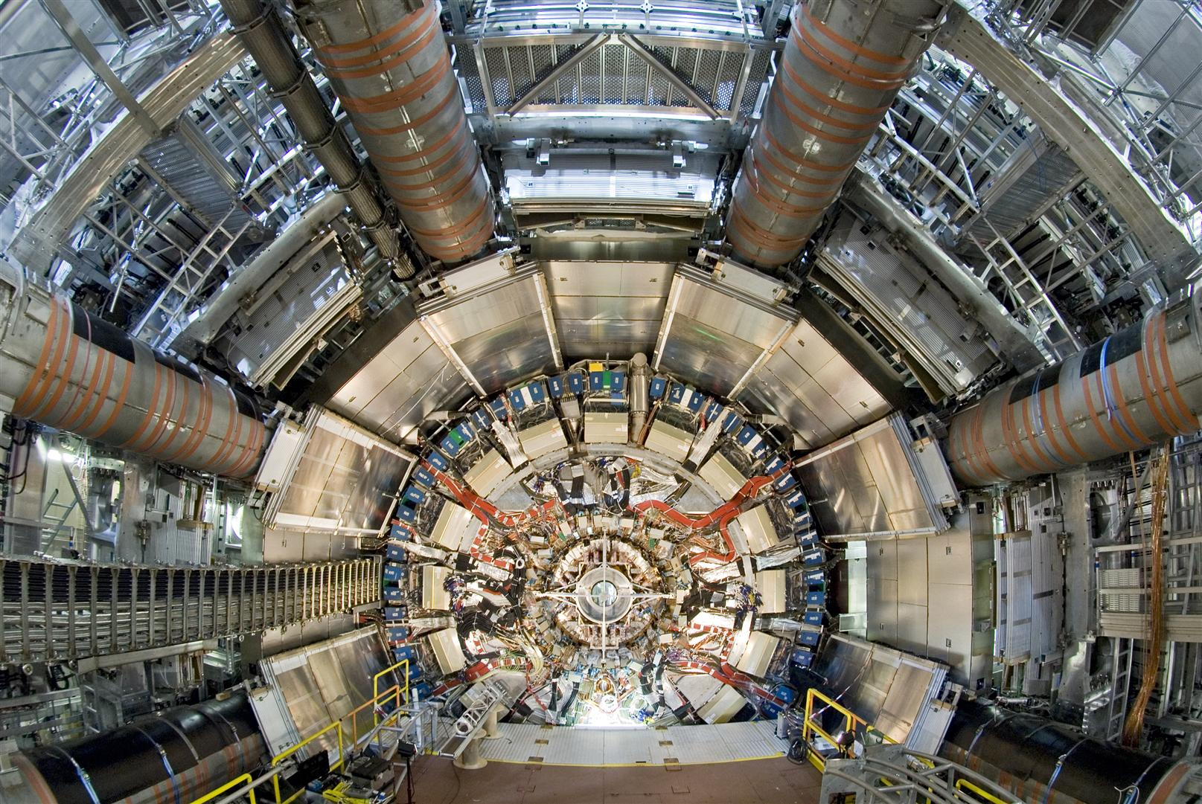
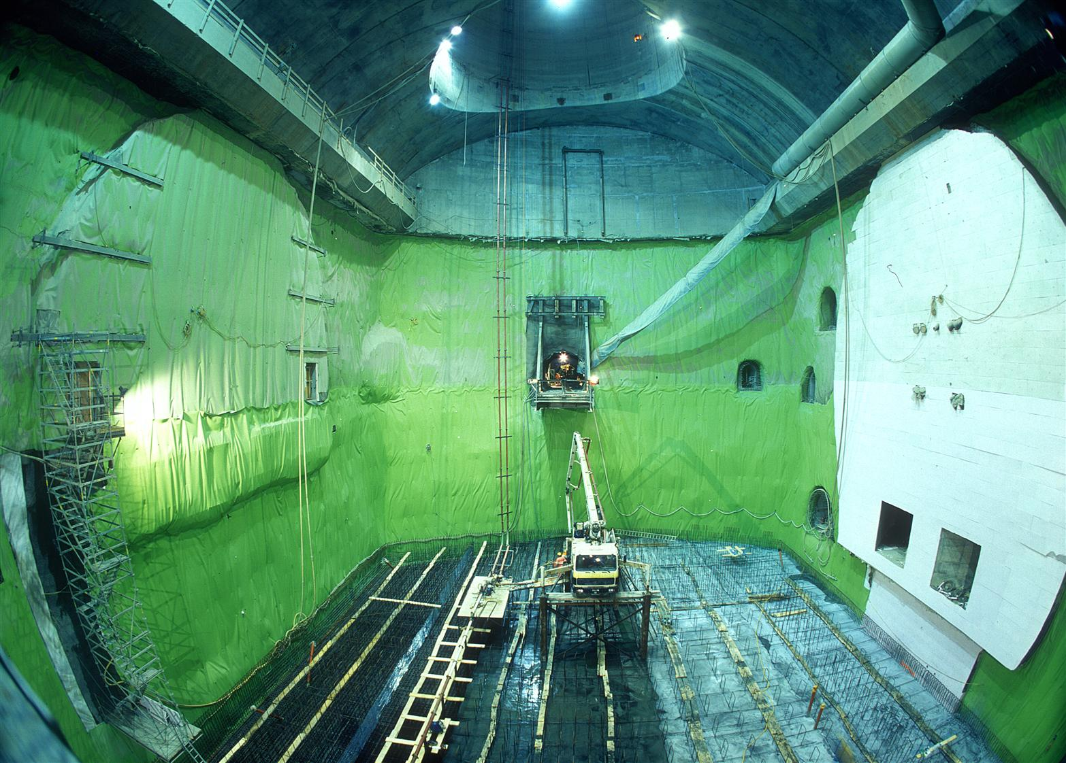
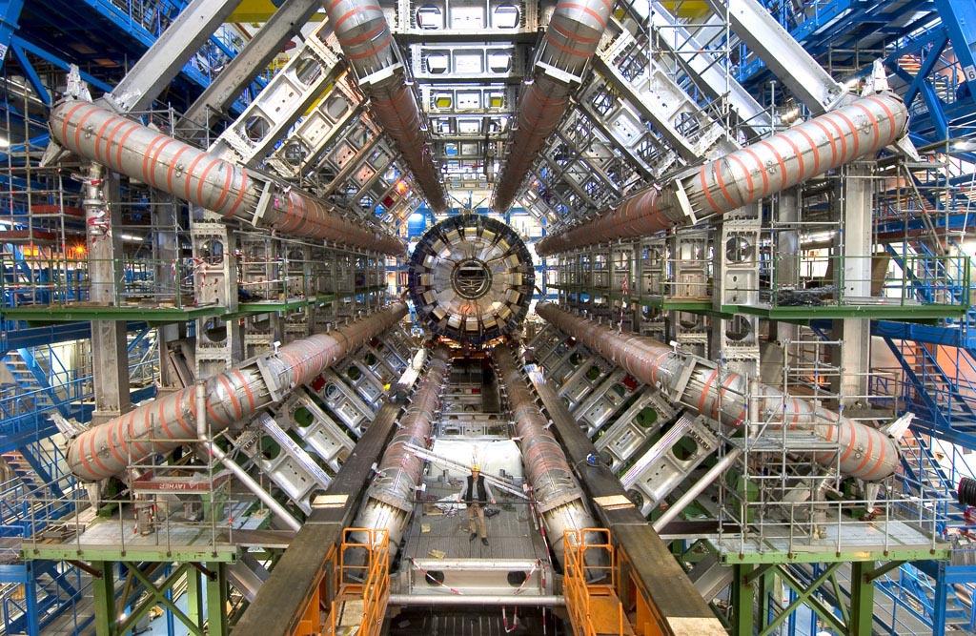
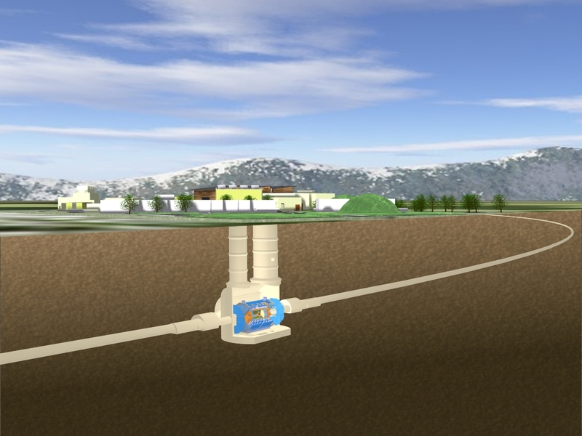

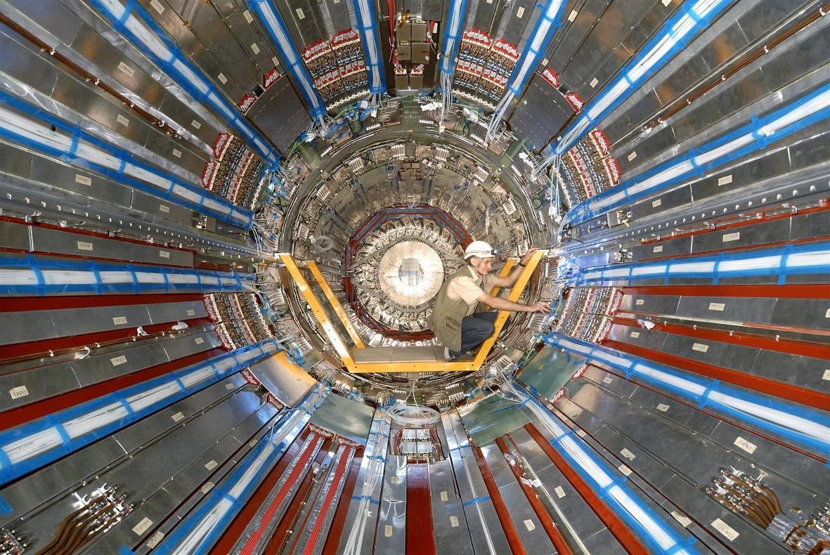
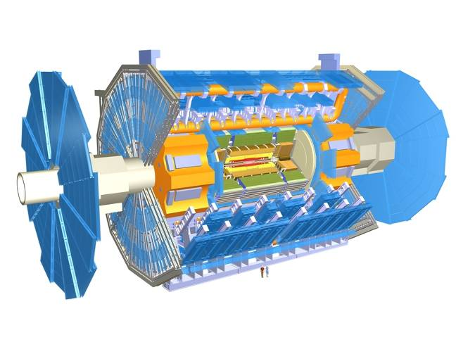
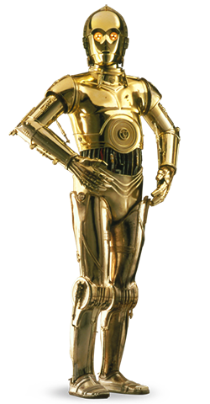
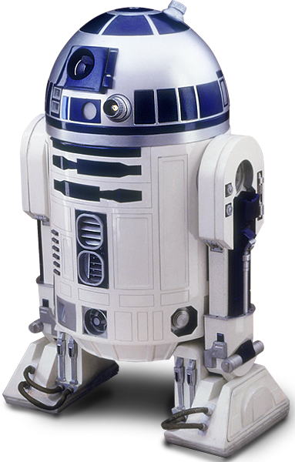
ATLAS
Diameter 25 m
Length 46 m
Weight 7000 Tons
Cables 3000 Km
Electronics channels 100.000.000
It is like a giant camera
1 picture every 25 ns
40.000.000 pictures/second

Slide 10
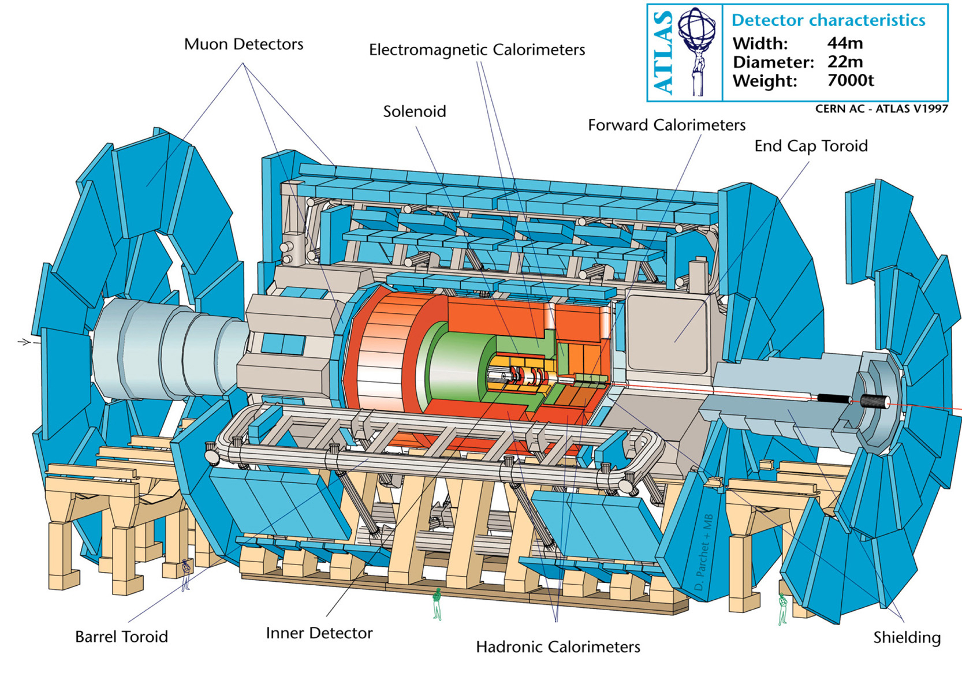
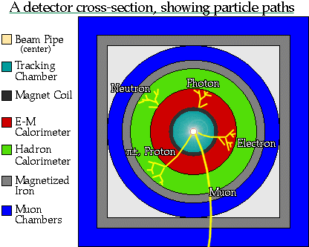
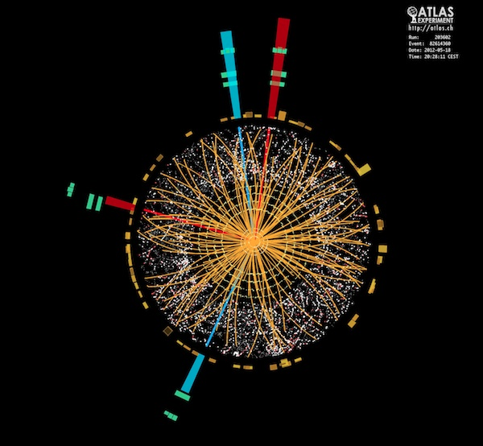
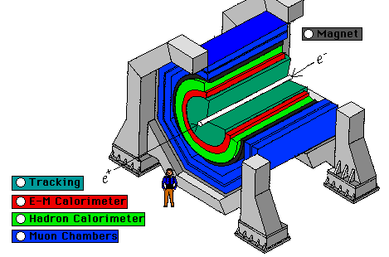
Particle detectors and ATLAS
Each of the detectors is specialized in the detection and extraction of the properties of a given type of particles.

Slide 11
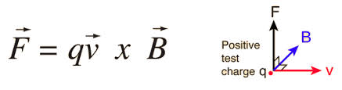
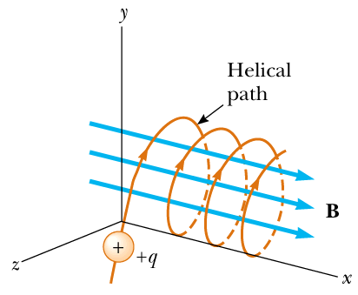
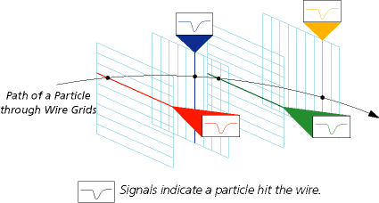
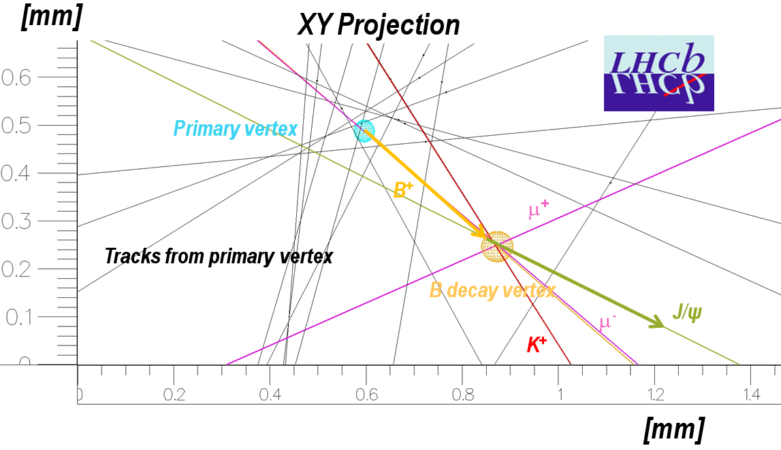
Particle detectors and ATLAS
Tracking detectors: located closer to the interaction point
  Precise reconstruction of the trajectory thanks to their high spatial resolution
  Precise reconstruction of interaction vertices
    Able to see short-lived particles
  Solenoid field → curvature of the trajectories:

Slide 12
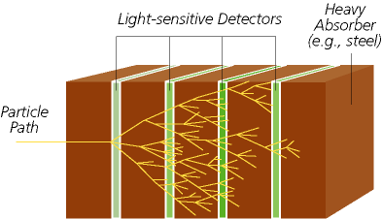
Particle detectors and ATLAS
Calorimeters: measurement of the energy of the particles by stopping them
  Passive material acting as stopper (high density: iron, lead crystals…)
  Active material acting as absorber that measures the energy deposited
Two main types:
  Electromagnetic: for electrons and photons
  Hadronic: for hadrons (pions, kaons, protons, deuterons…)

Slide 13
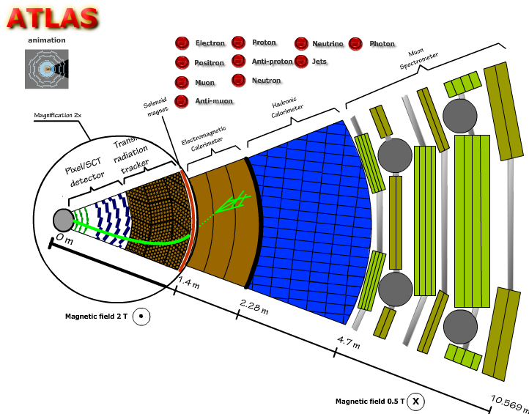
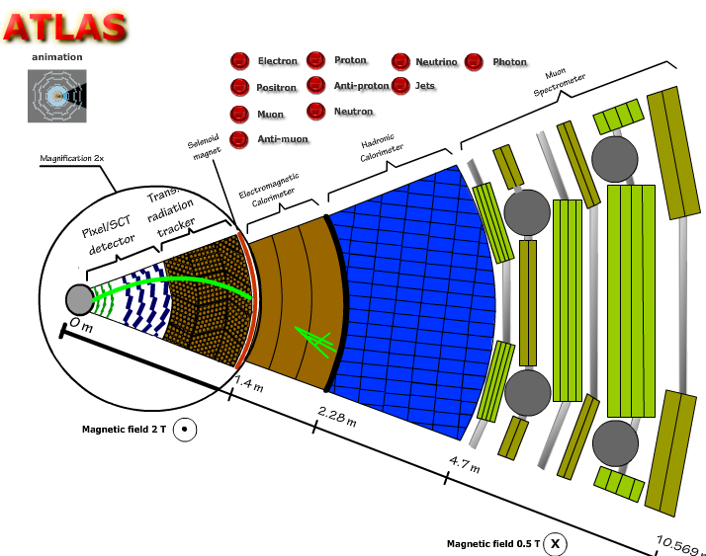
Particles in ATLAS
electron
positron

Slide 14
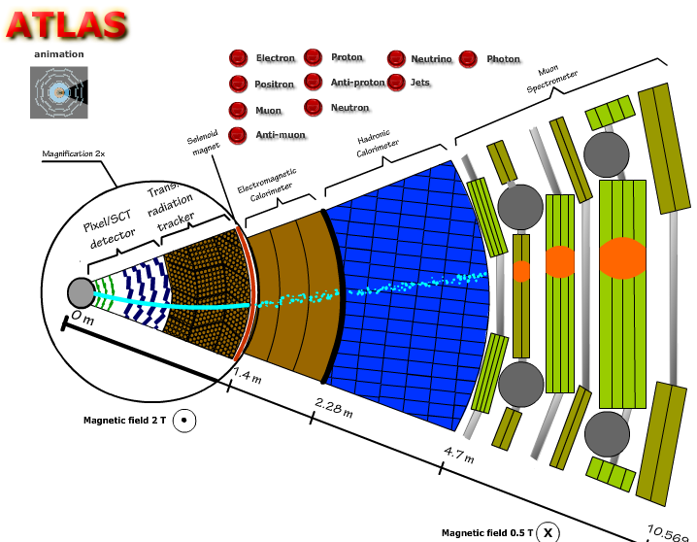
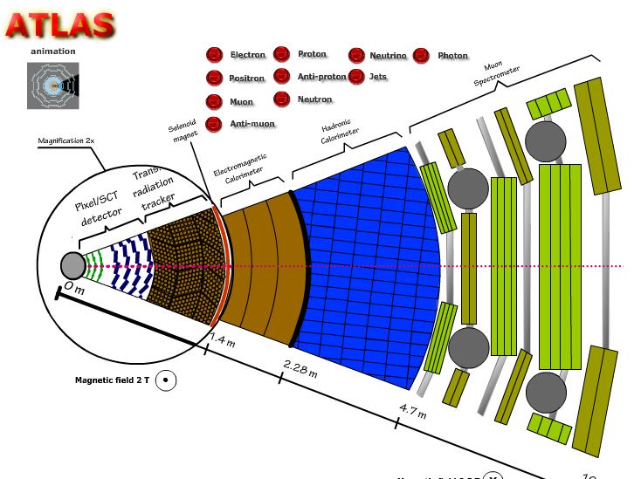
Particles in ATLAS
muon
Muon chambers:
  specialized tracking detector located in the outer layers. Large lever arm for improved momentum measurement
neutrino
Neutrinos: very elusive particles
that scape undetected
Hint: use momentum
conservation to guess the
presence of a neutrino

Slide 15
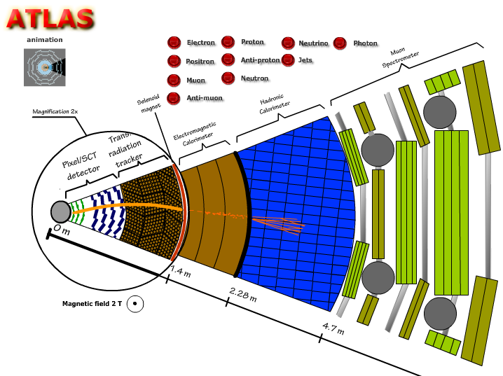
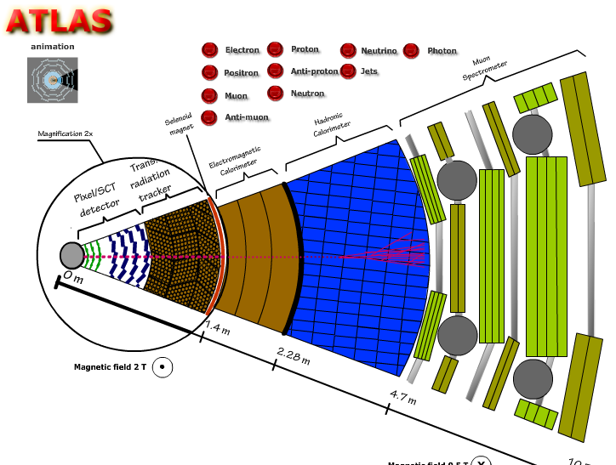
Particles in ATLAS
Charged hadron: e.g. proton
Neutral hadron: e.g. neutron

Slide 16
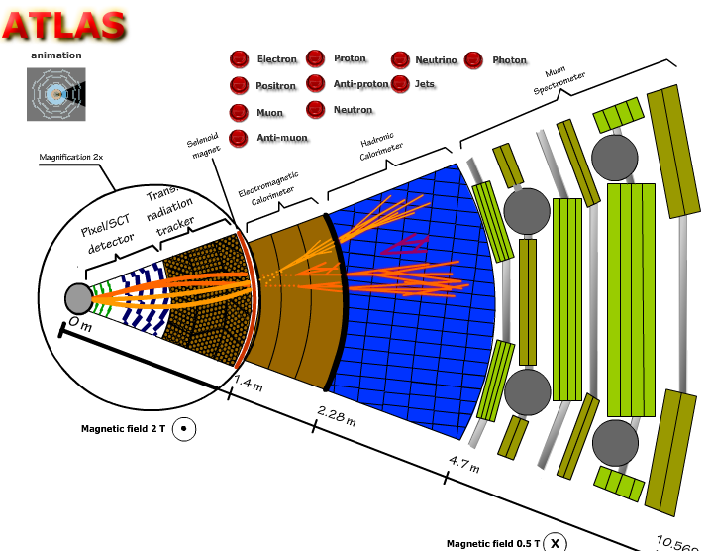
Particles in ATLAS
Hadron particle jets:
Quarks can not appear in
free states. They appear in
bound states called
Hadrons.
Due to the strong interaction
a quark may give rise to many
other quarks, forming a
JET of particles

Slide 17
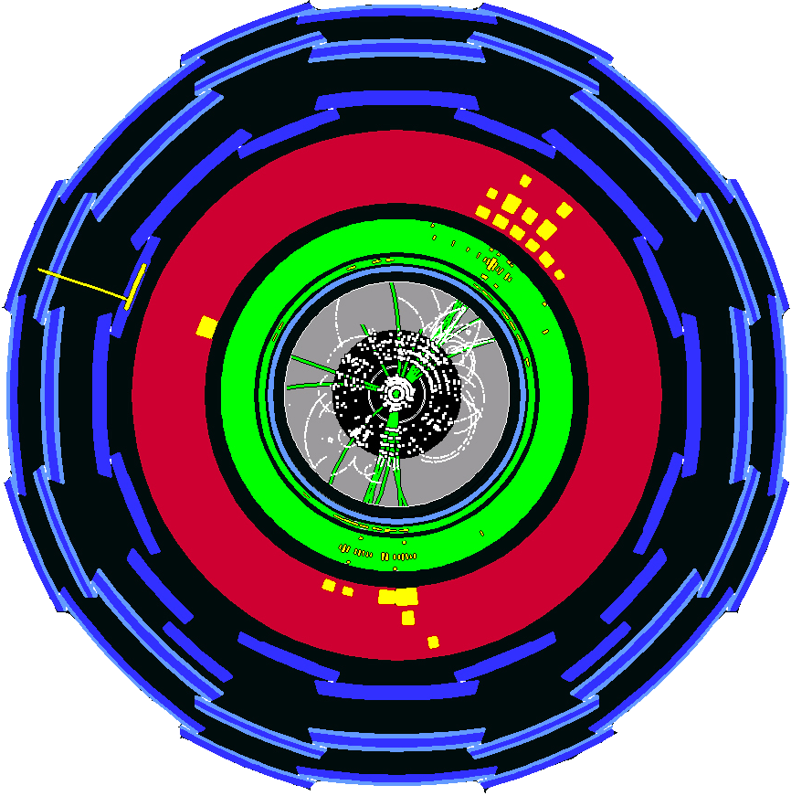
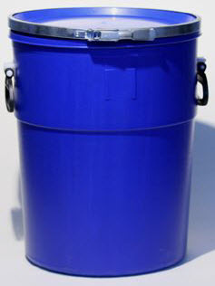
Not all the collisions are intereting,
So, we keep 1 out of 500.000
Information technologies in HEP
Enough data to fill
1 CD / 2 segons
DATA
STORAGE

Slide 18
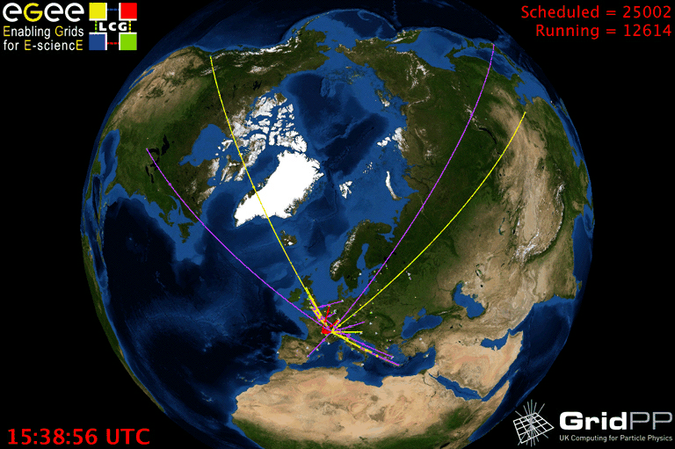
GRID: the NETWORK OF NETWORKS
DATA
STORAGE
18

Slide 19
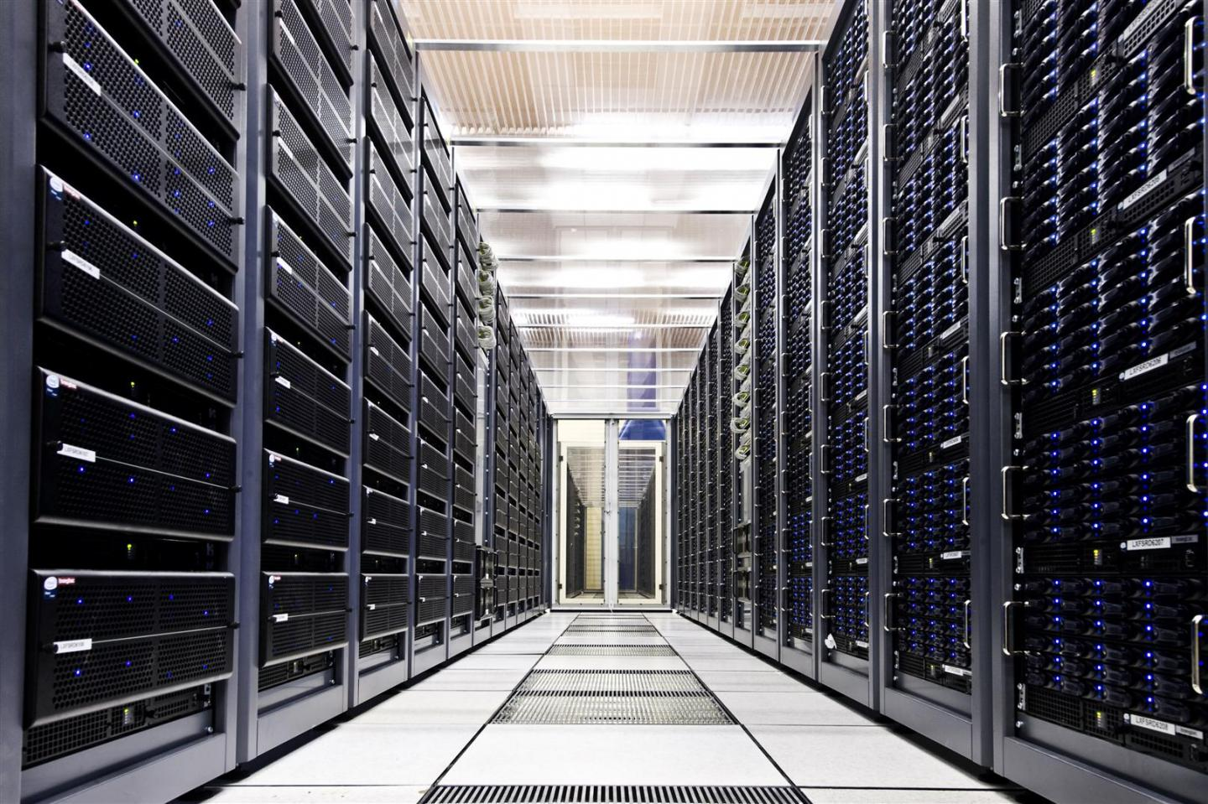

Slide 20
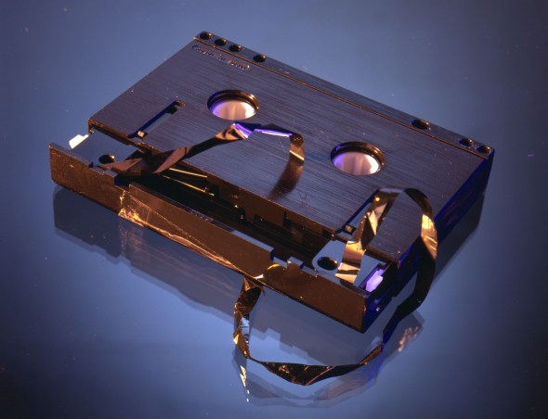
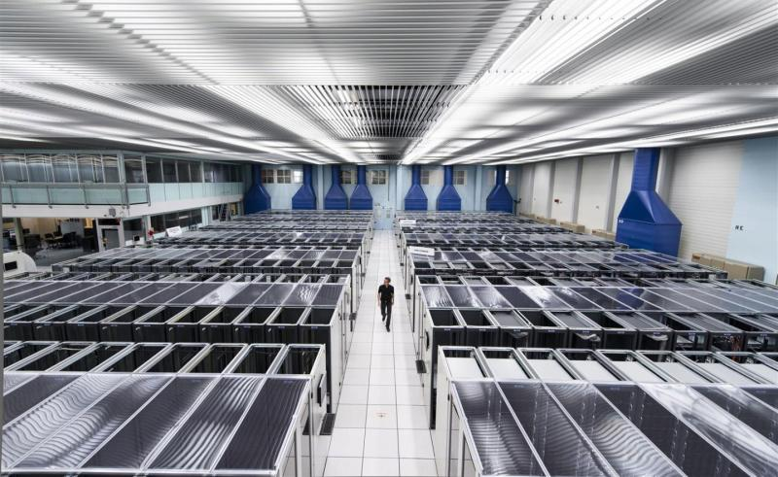

Slide 21








Informació i tecnologia de les comunicacions
The most important example: World Wide Web was born at CERN
GRID
Bioinformatics (genomics and proteomics studies)
Nanotechnology (new materials at molecular scale)
Engineering (design, simulation, analysis of structures...)
Natural resources and environment (weather forecast, planet watching, models and complex systems evolution…)

Slide 22











Medical Physics
Particle accelerators for terapy
Particle detectors for imaging
GRID computation for treatment simulations and data analysis
Photons
Protons
Tumor
Haz de hadrones
CT
PET

Slide 23

Summary
High Energy experimental physics uses detectors to register the passage of particles and measure their properties with accuracy
It is the physicist duty to analyse and interpret the data
A discovery may be around the corner!

