Slide 1
Accelerators introduction and hadrontherapy medical applications
Daniel Esperante Pereira

Slide 2
Introduction
This is just a very basic introduction to particle accelerators and medical hadrontherapy applications.
No beam physics/optics
No beam diagnostics/instrumentation
No treatment of technologies (RF, magnets, superconductivity, vacuum…)
No medical x-ray therapy or imaging applications
No many things…
A detailed course on the matter can take from months to years.
There is a lot of bibliography about particle accelerators:
Books
Particle accelerator schools: JUAS, CAS, USPAS…
Open access articles and review papers
About hadrontherapy accelerators there are less resources:
Books
Review papers: “History of hadron therapy accelerators”, A. Degiovanni and U. Amaldi

Slide 3
An introductory course to accelerators for medical applications is 1 week teaching

Slide 4
What’s an accelerator
Source
Accelerator
Target
Ti
Tf
It is a device that transfers energy to charged particle by electromagnetic or electrostatic fields. The particles are injected at initial energy of Ti and they arrive to final energy Tf.

Slide 5
Multi and inter-disciplinary field
Mathematics:
Differential equations
Probability theory
Numerical methods
…
Electrical engineering
Physics:
Classical electrodynamics
Quantum electrodynamics
Optics
Plasma Physics
Superconductivity
…
Computers
Electronics
RF-Microwave engineering
Mechanics:
Analytical mechanics
Non-linear mechanics
Stochastics mechanics
High-voltage systems
Vacuum systems
Cybernetics:
Control theory
AI expert systems
Cryogenics
Ion optics
Electron optics

Slide 6
MAIN INGREDIENTS To understand about accelerators

Slide 7
Energy Units
Energy = 1 eV
Energy gain
1 eV is the energy that an elementary charge gains when it is accelerated through a potential difference of 1 Volt
1 eV = 1.6 10⁻¹⁹ J
------------------------------------------
1 keV = 1 000 eV
1 MeV = 1 000 000 eV
1 GeV = 10⁹ eV
1 TeV = 10¹² eV
1 V

Slide 8
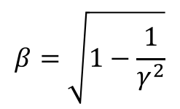
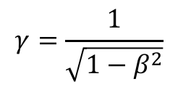





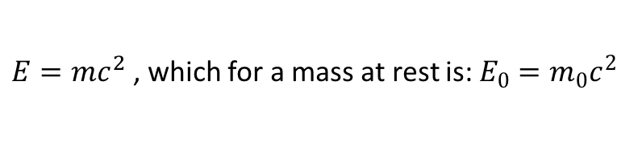
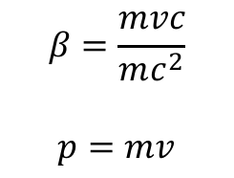
Energy and mass and momentum
Einstein’s formula:
$E=mc^{2}$, which for a mass at rest is: $E_{0}=m_{0}c^{2}$
Ratio between the total energy and rest energy
$$γ=\frac{E}{E_{0}}$$
Ratio between the velocity and velocity of light
$$β=\frac{v}{c}$$
These parameters are related
$$γ=\frac{1}{\sqrt{1−β^{2}}}$$
$$β=\sqrt{1−\frac{1}{γ^{2}}}$$
Through these formulas we can express mass in units of eV/c² and momentum in units of eV/c
m (eV/c²) = m(kg)c²1.6.10⁻¹⁹
Proton rest mass: 1.67 ∙ 10⁻²⁷ kg
938.27 MeV/c²
$$β=\frac{mvc}{mc^{2}}$$
$$p=mv$$
$$β=\frac{pc}{E}$$
Electron rest mass: 9.1095∙10⁻³¹ kg
0.511 MeV/c²
$$p=\frac{Eβ}{c}$$
In both cases the units are often just given as eV
$$E^{2}={\left(m_{0}c^{2}\right)}^{2}+p^{2}c^{2}$$
Energy of a proton in the LHC: 7 TeV = 1.12 x 10⁻⁶ J (β ~ 99.9999991 %) (γ ~ 7460)
💡 the same energy of a body of mass = 1 mg moving at speed = 1.5 m/s (a mosquito!)

Slide 9
Example
Protons are accelerated to a kinetic energy of 200 MeV
Calculate their total energy, their momentum and their velocity in our units:
This is a practical energy in proton therapy => p velocity is just a fraction of speed of light

Slide 10
Energy, frequency and wavelength
E = hυ = hc/λ
Increasing the energy will increase the frequency
Increasing the energy will decrease the wavelength
1 eV
1 keV
1 MeV

Slide 11
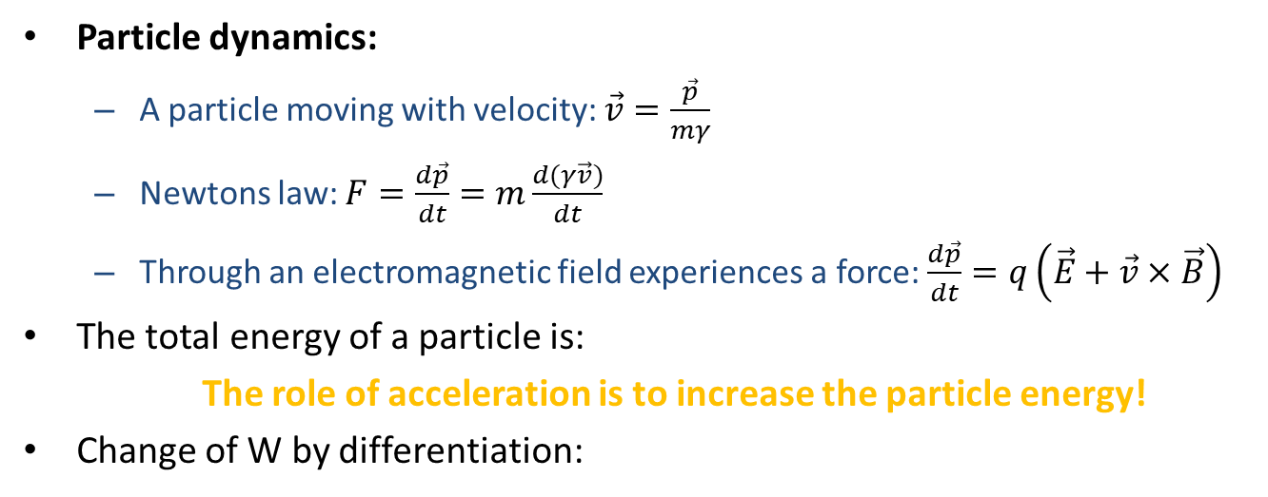

Lorentz force & Maxwell
Particle dynamics:
A particle moving with velocity: $\vec{v}=\frac{\vec{p}}{mγ}$
Newtons law: $F=\frac{d\vec{p}}{dt}=m\frac{d(γ\vec{v})}{dt}$
Through an electromagnetic field experiences a force: $\frac{d\vec{p}}{dt}=q\left(\vec{E}+\vec{v}×\vec{B}\right)$
The total energy of a particle is:
The role of acceleration is to increase the particle energy!
Change of W by differentiation:
$$W^{2}={\left(m_{0}c^{2}\right)}^{2}+p^{2}c^{2}$$
Only the electric field can change the particle energy!
And finally the Maxwell’s equations.
But we’re not gonna go through! ☺

Slide 12
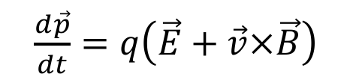
Electrical and magnetic field
$\frac{d\vec{p}}{dt}=q\left(\vec{E}+\vec{v}×\vec{B}\right)$
Electrical fields => accelerate
Need for Electric field sources
Magnetic fields => Change direction
Need for magnets
DC accelerators
Resonant cavities
Inductive acceleration
Dipole Magnet: bends the particle trajectory
Quadrupole: focused the particles
Sextupoles, kickers and others…

Slide 13
TYPES OF accelerators

Slide 14
DC accelerators
Cockcroft‐Walton, 1930s
Van der Graaff, 1930s
Moving belt to carry charge to High Voltage Terminal
Voltage multiplier with diodes
These early electrostatic accelerators continue to provide a useful source of low energy particles but ultimately are limited to voltages of around 10 MV by problems of voltage breakdown.

Slide 15
RF accelerators
How to overcome the 10 MV limit? => RF acceleration
DC
RF
vs.
Proposed by Gustav Ising (1925)
First linac built by Wideröe (1928)
Alvarez version of linac (1955)
Lawrence (1932) - Cyclotron
S. Marcuss Oliphant (1952) - Synchrotron
Condition for synchronicity;
L ~ βλ where β = v/c

Slide 16
RF accelerators
When the field is rising the phase is stable since a particle arriving too early will be less accelerated and slip slightly in phase until the next gap; vice versa for a late particle. The other phase is unstable.
Particle arrives late
Particle arrives on time
Particle arrives early
Unstable phase

Slide 17
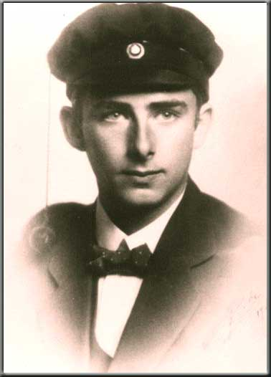
Early Linear Accelerators (Drift Tube)
R. Wideröe proposed an accelerator by using an alternating voltage across many alternating “gaps.”
It was not without a myriad of problems
- Focusing of beam
- Vacuum leaks
- Oscillating high voltages
- Again, imagination
His professor refused any further work because it was “sure to fail.”
- Wideröe still published his idea in Archiv fur Electrotechnic
Wideröe, elaborating a scheme proposed earlier by Gustav Ising in Sweden, sought to use a low potential over and over to accelerate atoms to high energies. In his design a potential of 25,000 volts alternated from positive to negative at radio frequencies. Ions were pulled into a straight cylindrical electrode by a negative potential and then pushed from the other end by a positive potential. One could add more cylinders, each longer than the last to accommodate the increasing speed of the particles, to reach higher energies.
Alvarez version

Slide 18
Cavity Linacs
These devices store large amounts of energy at a specific frequency allowing low power sources to reach high fields.

Slide 19
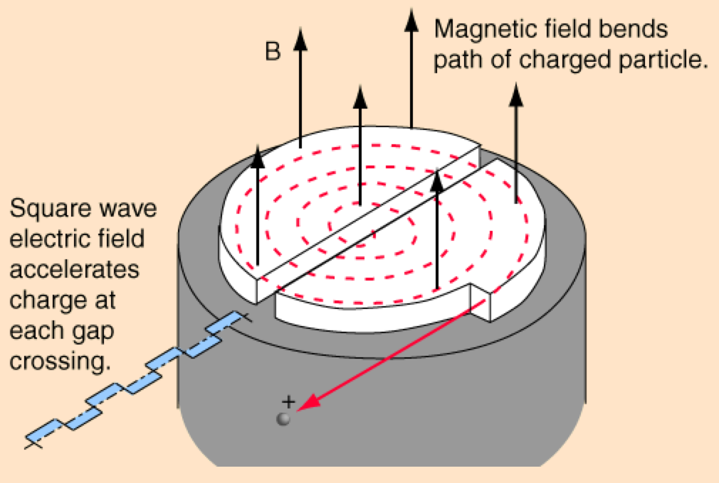
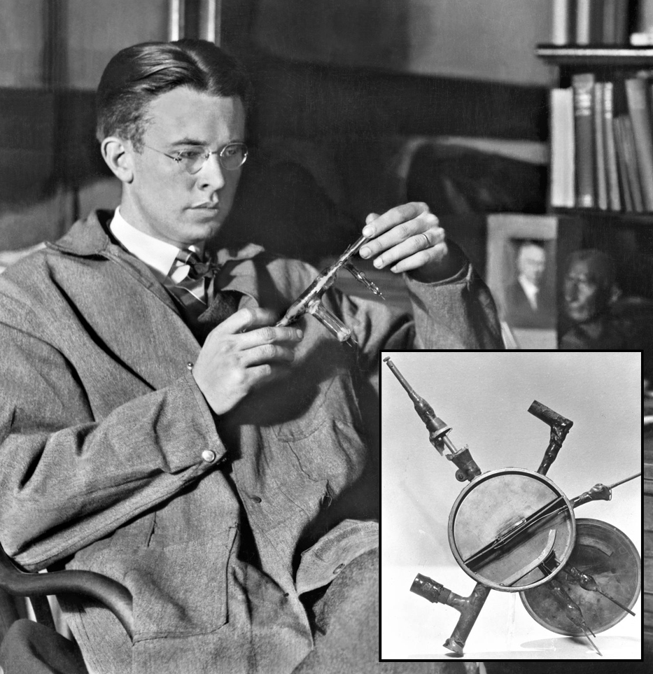
Cyclotron
1932: 1.2 MeV – 1940: 20 MeV (E.O. Lawrence, M.S. Livingston)
Repeatedly traverse an accelerating structure
Implies a circular machine, which means a Bending field (Constant magnetic field)
Alternating voltage between the two D’s
Increasing particle orbit radius
Development lead to the synchro-cyclotron to cope with the relativistic effects
In 1939 E. Lawrence received the Nobel prize for his work.

Slide 20
Synchrotrons
1943: M. Oliphant described his synchrotron invention in a memo to the UK Atomic Energy directorate
1959: CERN-PS and BNL-AGS
Fixed radius for particle orbit
Varying magnetic field and radio frequency
Phase stability
Important focusing of particle beams (Courant – Snyder)
Providing beam for fixed target physics
Paved the way to colliders

Slide 21
aPPLICATIONS OF aCCELERATORS

Slide 22
Particle accelerators at our disposal
Linear accelerators:
Good for electrons (which can be used to produce X-rays)
Cyclotrons:
Compact and (relatively) simple
Synchrotrons:
Scalable and versatile
Not to forget other current and future technologies:
Fixed Field Alternating Gradient accelerators
Plasma Wake Accelerators
Dielectric Laser Accelerators

Slide 23
Some 30 000 accelerators worldwide

Slide 24
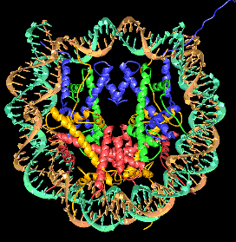
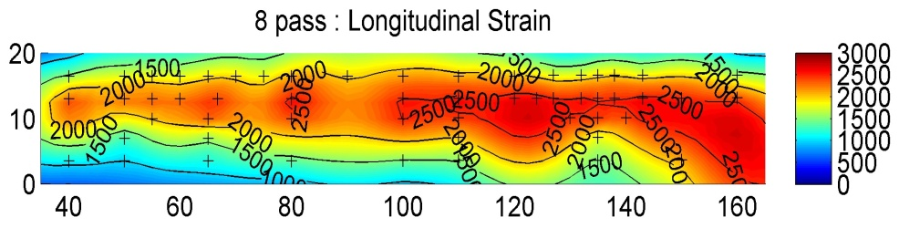
Industrial applications snapshot
Synchrotron light for
Biology, chemistry, material science, heritage and more
Neutrons for
Semiconductor system testing
Material science (stress measurements)
Unblocking oil pipes
Reconstruction of the 3D structure of a nucleosome (DNA packaging) with a resolution of 0.2 nm
‘Neutrons tell you where atoms are and what atoms do’
Stresses in Airbus A380 Wing

Slide 25
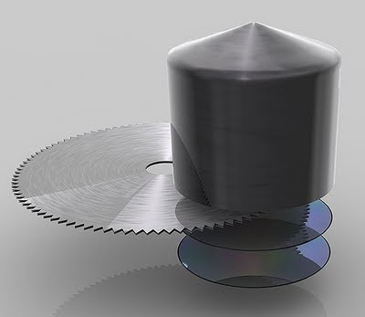
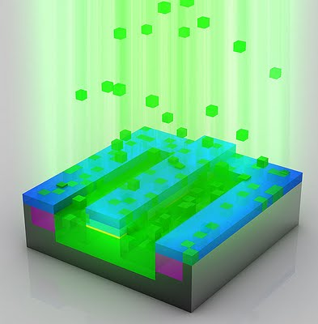
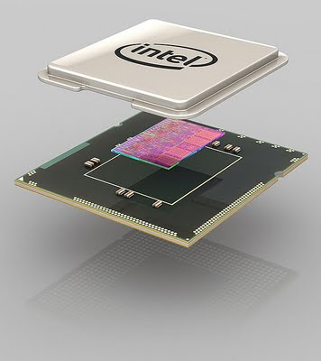
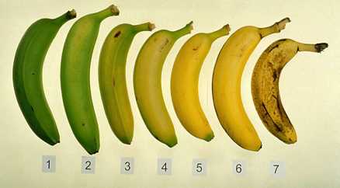





Industrial applications snapshot
Industrial processes
Ion implantation
Electron beam processing
Food irradiation
Equipment sterilization
Security and energy applications
Cargo scanning
Material testing for fusion
Accelerator Driven Systems
Images courtesy of Intel
Foods authorised for irradiation in the EU:
Lower dose
Higher dose
‘Cold pasteurisation’ or ‘electronic pasteurisation’
Uses electrons (from an accelerator) or X-rays produced using an accelerator.
The words ‘irradiated’ or ‘treated with ionising radiation’ must appear on the label packaging.
In the US all irradiated foods have this symbol

Slide 26
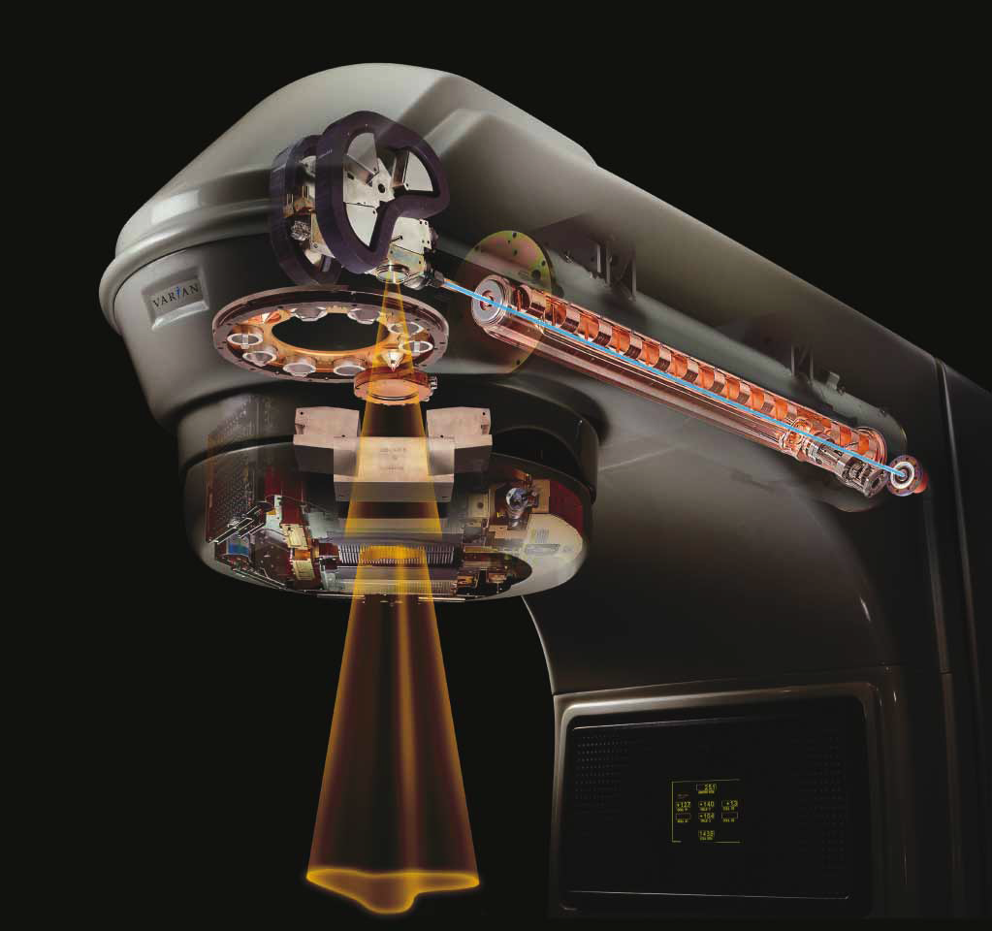
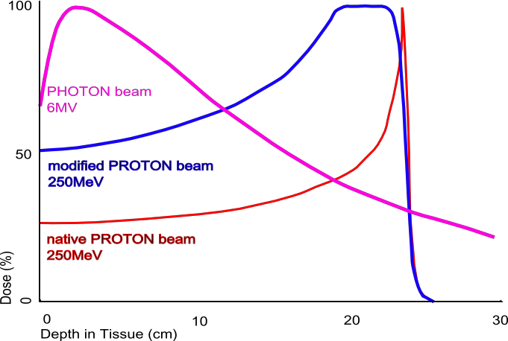
Medical and research applications
Medical treatment and research:
Radioisotopes
Cancer therapy
X-rays
Radiotherapy
Hadrontherapy
Equipment sterilization
Fundamental research:
Understanding the fundamental building blocks of nature and the forces that act upon them
Image: copyright Varian medical systems
Hadrontherapy
Uses protons and ions
Particles at “high” energy deposit little at entrance and transit
Then deposit large amount in a very narrow peak (Bragg peak)
Very localized dose deposition
Depth and magnitude of Bragg peak depends on
Mass
Charge
Particle Energy

Slide 27
MEDICAL aPLICATIONS: HADRONTHERAPY

Slide 28
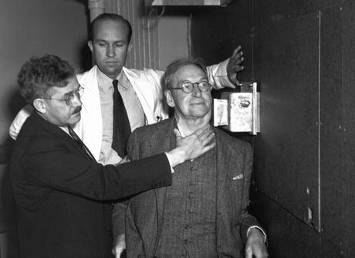
1938-Berkeley. A human tumour was irradiated for the first time with neutrons
John Lawrence watches Robert Stone aligning a patient in the neutron beam produced by the 60-in. cyclotron (Courtesy Lawrence Berkeley National Laboratory)
In 1948 Stone evaluated the effects of neutron therapy on 226 patients and concluded: “Neutron therapy as administered by us has resulted in such bad late sequels in proportion to the few good results that it should not be continued.”

Slide 29
Medical Applications

Slide 30
Bragg-peak
The corner-stone of hadron-therapy
Radiation beam in matter

Slide 31
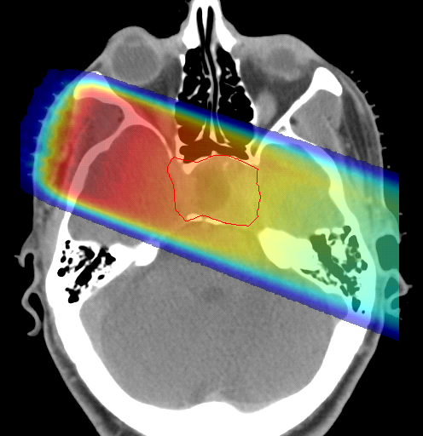
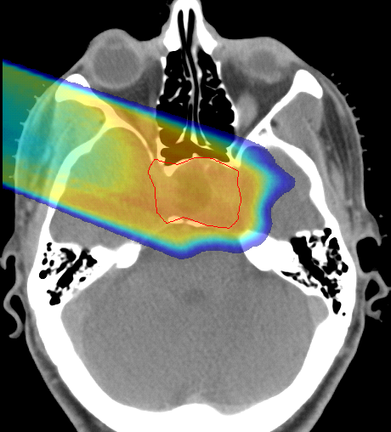

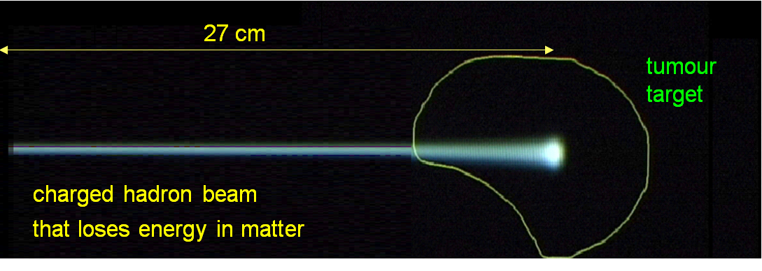
Protons and ions spare healthy tissues
protons or
carbon ions
X rays
Photons
Protons
25 cm
200 MeV - 1 nA
protons
4800 MeV – 0.1 nA
carbon ions
(radioresistant tumours)
Courtesy of PSI

Slide 32
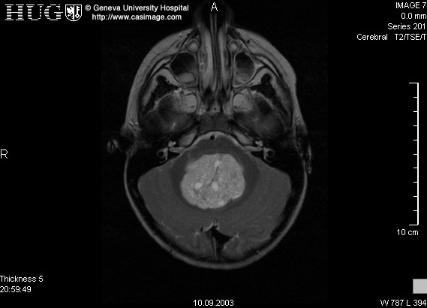
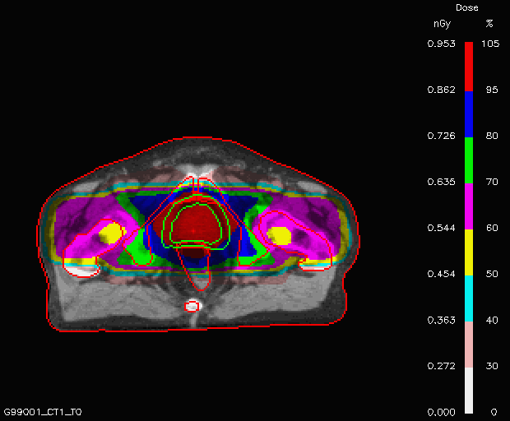
One lateral photon beam deliver a non conformal dose
80
50
30

Slide 33
Two opposite photon beams are not enough to deliver a conformal dose
110
100
110

Slide 34
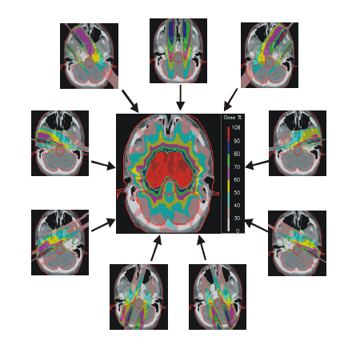
IMRT = Intensity Modulated Radiation Therapy with photons
9 NON-UNIFORM FIELDS
PSI

Slide 35
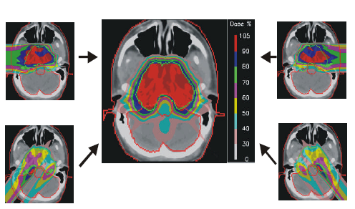
IMPT = Intensity Modulated Particle Therapy with protons
4 NON-UNIFORM FIELDS
PSI
Notes:
35

Slide 36
BIOLOGICAL EFFECTS

Slide 37
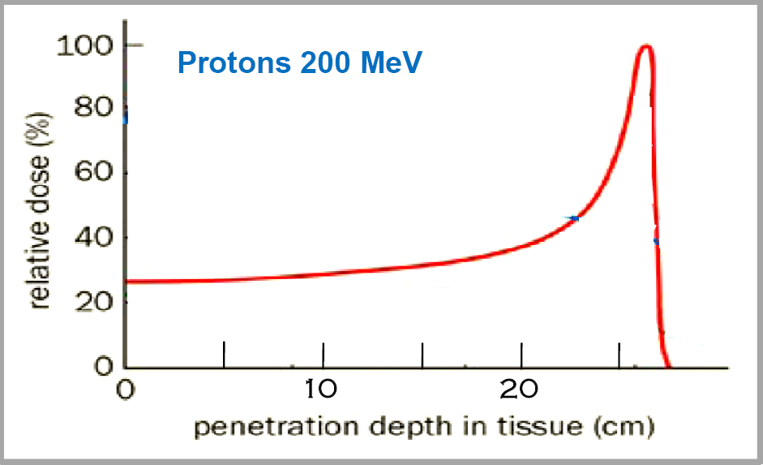
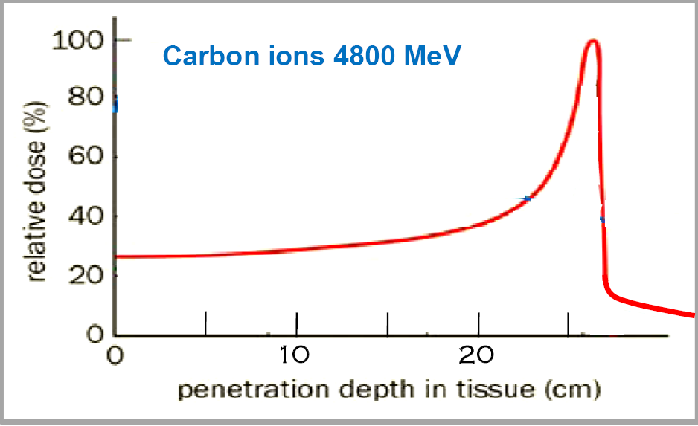

Microscopic distribution of the hadronic ionizations
SSB
←
DSB
→
20 nm
2 nm
keV/μm 0.45 0.55 2.5 10
keV/μm 10 14 20 140
res R
Kin En.
d_av
- 260 mm
200 MeV
d=90 nm
- 75mm
100 MeV
d=50 nm
- 4 mm
20 MeV
d=15 nm
- 0.2 mm
4 MeV
d=4 nm
- 260 mm
4800 MeV
d=4 nm
- 100 mm
2800 MeV
d=3 nm
- 42 mm
1800 MeV
d= 2 nm
- 1 mm
200 MeV
d=0.3 nm

Slide 38
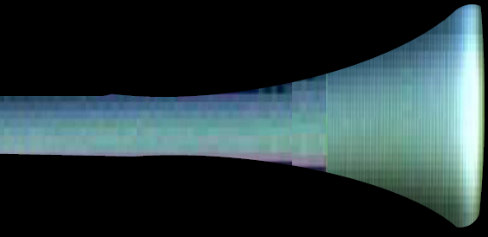
Protons: 1. more favorable dose 2. same ‘indirect effects’
d=130 nm
30 cm
X-rays beam
Beam of 200 MeV protons
d=90 nm
d=50 nm
d= 15 nm
Protons are SPARSELY IONIZING as X-rays

Slide 39
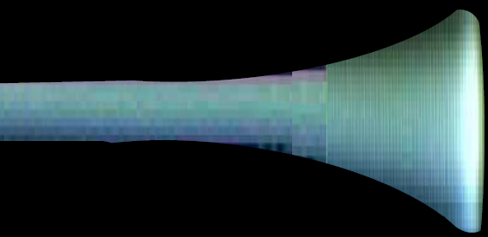
Carbon ions: 1. more favorable dose 2. ‘direct effects’
d=130 nm
30 cm
X-rays beam
Beam of 200 MeV protons
Beam of 4800 MeV carbon ions
d= 4 nm
d= 2 nm
d= 0.3 nm
Carbon ions are DENSELY IONIZING
(higher biological effectiveness)

Slide 40
Elective indications of carbon ions
Radioresistance
of the TUMOUR
7%
3%
YES
YES
radioresistant tumour
80%
10%
radiosensitive tumour
NO
YES
Radiosensitivity
of the NORMAL TISSUES
radioresistant healthy tissue
radiosensitivehealthy tissue

Slide 41
Numbers of potential patients (*)
X-ray therapy
every 10 million inhabitants: 20'000 pts/year
Protontherapy
12% of X-ray patients: 2'400 pts/year
Therapy with Carbon ions for radio-resistant tumour
3% of X-ray patients: 600 pts/year
TOTAL every 10 M about 3'000 pts/year
______
(*) Combining studies made in Austria, Germany, France and Italy in the framework of ENLIGHT - Coordinator: Manjit Dosanjh –
Projects in FP7: ULICE, PARTNER, ENVISION , ENTERVISION for a total of 22 MEuro

Slide 42
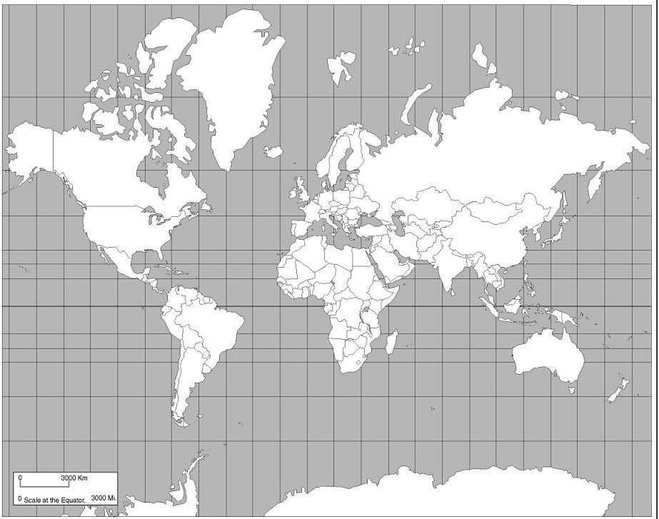
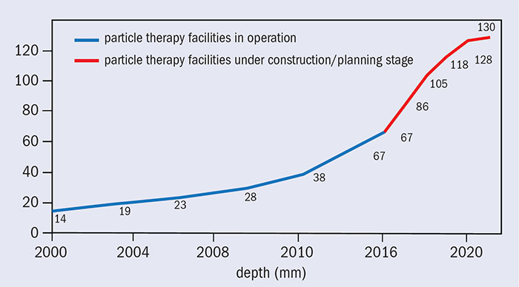
Hadrontherapy centres IN OPERATION and UNDER CONSTRUCTION worldwide (2018)
Planned/Under construction (73)
In operation (74)
(PTCOG Data)
M. Dosanjh (PTCOG Data)

Slide 43
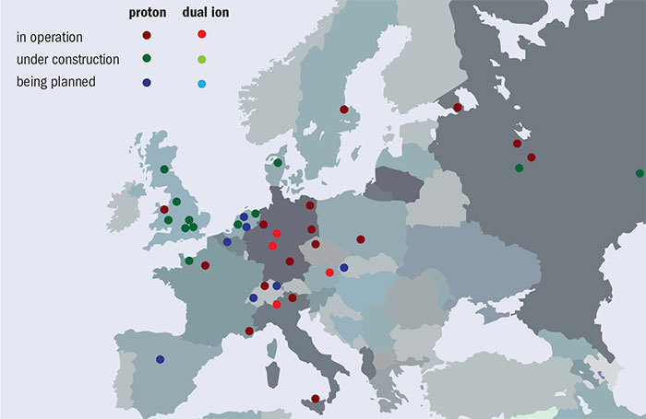

Slide 44
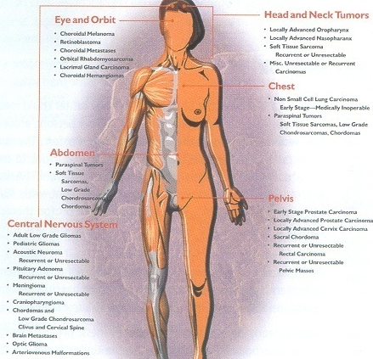
The area treated with hadrons
In the world
protons:
100'000 patients
(+10% per year)
carbon ions
8’500 patients

Slide 45
Key elements of a Hadron-therapy center
Building
Accelerator complex:
Particles sources
Accelerating cavities
Magnets
Transport, injection and extraction lines
Energy control
Beam diagnosis
Treatment area
Gantry
Treatment diagnosis

Slide 46
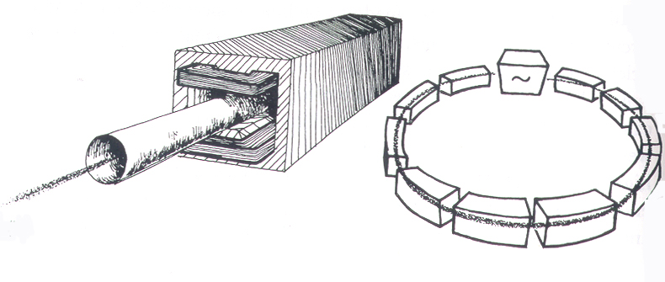
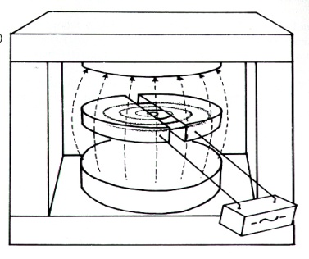
The accelerators used today in hadrontherapy are “circular”
Hadrontherapy with protons (200-250 MeV)
CYCLOTRONS (*) (Normal or SC)
SYNCHROTRONS
OR
6-9 metres
4-5 metres
(*) also synchrocyclotrons
Hadrontherapy with carbon ions (4800 MeV = 400 MeV/u)
SYNCHROTRONS
18-25 metres

Slide 47
Elements of hadron-therapy center
Heidelberg Ion Therapy (HIT)
Beam transport lines
Ion
Sources
Synchrotron
Gantry
LINAC
Treatment areas
13 m
22 m

Slide 48
Proton accelerators

Slide 49
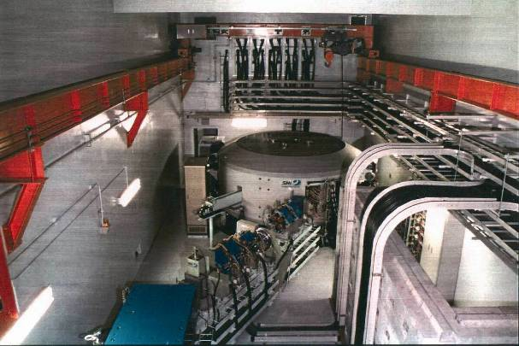
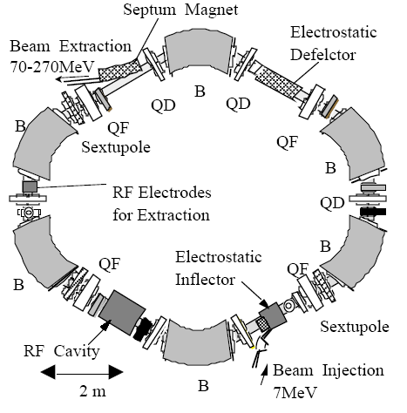
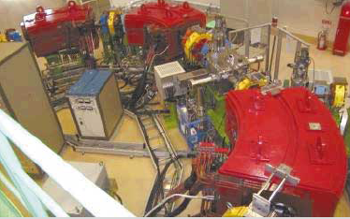
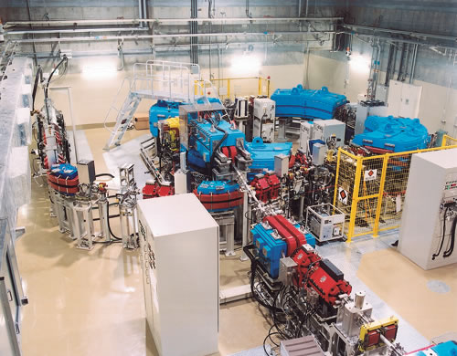
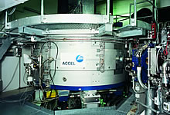
4 commercial 230-250 MeV p⁺ accelerators
Normal Conducting
cyclotron
Synchrotron
The cost of the accelerator is about ~25% of the cost of the centre:
accelerator ~25%
building ~25%
3 gantries ~25% (~30 MEuro)
IBA
Hitachi
Mitsubishi
Varian
Synchrotron
SC cyclotron

Slide 50
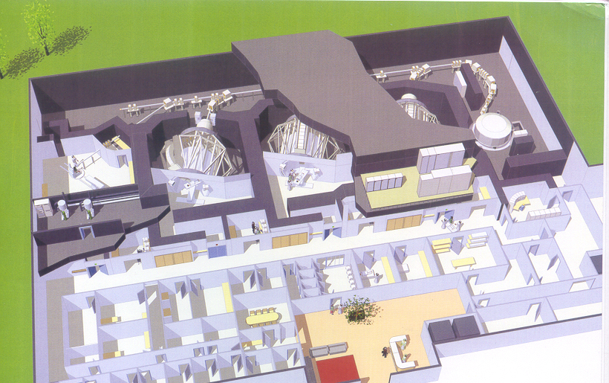
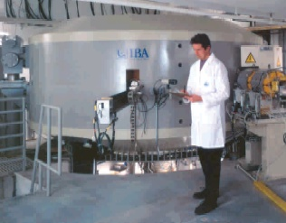
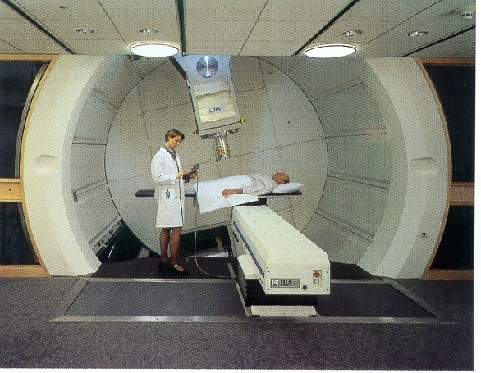
Cyclotron for protons by Ion Beam Applications - Belgium
ESS
gantry
IBA
Turn-key centres are offered for ≈130-150 M€.
If proton accelerators were ‘small’ and ‘cheap’,
no radiation oncologist would use X rays.
Courtesy of Elekta

Slide 51
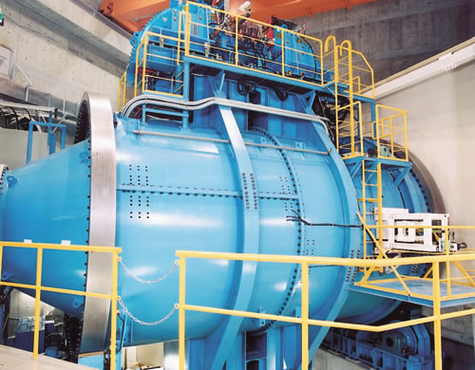
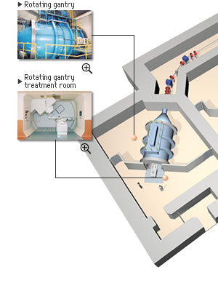
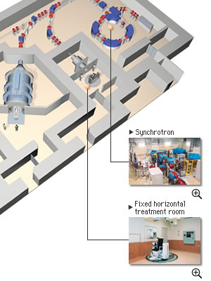
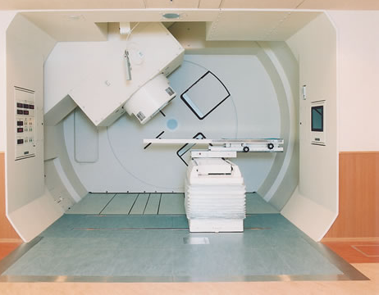
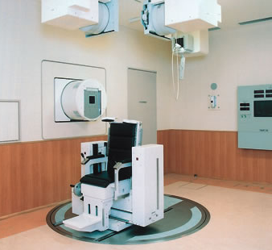
Mitsubishi solution for Shizuoka - Japan
4 Bending Magnets

Slide 52



Rinecker Proton Therapy Centre - Munich
VARIAN
Notes:
52

Slide 53
Dual centers (p⁺ / C⁶⁺ accelerators)

Slide 54
HIMAC in Chiba is the pioneer of carbon therapy
Yasuo Hirao
Hirohiko Tsujii
5000 pts 1994-2010
Since the cells do not repair. less fractions are possible
HIMAC: 4-9 fractions!

Slide 55
Japan is the best equipped region
GUNMA UNIV. HEAVY ION MED. CENTRE
Gunma (2010)
C ions (≤ 400 MeV/u) Synchrotron
1 h beam, 1 h+v beam, 1 v beam
TSUKUBA CENTRE
Ibaraki (2001)
protons (≤ 270 MeV) synchrotron (Hitachi)
2 gantries
2 beam for research
200 patients
with carbon ions
WAKASA BAY PROJECT
by Wakasa-Bay Energy Research Center
Fukui (2002)
protons (≤ 200 MeV) synchrotron (Hitachi)
1 h beam + 1 v beam + 1 gantry
KASHIWA CENTER
Chiba (1998)
protons (≤ 235 MeV)
cyclotron (IBA – SHI)
2 Gantries + 1 hor. beam
HYOGO MED CENTRE
Hyogo (2001)
protons (≤ 230 MeV) - He and C ions (≤ 320 MeV/u) Mitsubishi synchrotron
2 p gantries + 2 fixed p beam + 2 ion rooms
HEAVY ION MEDICAL ACCELERATOR
HIMAC of NIRS (1995)
He and C (≤ 430 MeV/u) 2 synchrotrons
2 h beams + 2 v beams
1000 patients
with carbon ions
6500 patients
with carbon ions
SHIZUOKA FACILITY
Shizuoka (2002)
Proton synchrotron
2 gantries + 1 h beam
Notes:
ADD GUNMA center

Slide 56
HIT at Heidelberg
Medical Director: J. Debus
Technical Director: T. Haberer
First patient: September 2009
High Energy Beam Transport Line
Ion-Sources
Synchrotron
Quality
Assurance
LINAC
Gantry
Treatment halls by Siemens Medical
Notes:
56

Slide 57


CNAO: Centro Nazionale Adroterapia Oncologica at Pavia
2 sources
7 MeV/u linac
quadrupole
bending magnet
RF cavity

Slide 58




CNAO: the treatment room
Sept 2011:
1st patient treated
with protons
Nov. 2012:
1st patient treated with C ions
H. Schaer, Switzerland

Slide 59
Treatment modalities

Slide 60

Two methods for imparting the dose: 1A. Passive beam spreading

Slide 61



1A. Standard procedure: Passive beam spreading with respiratory gating
Double scatterer
PSI
Collimator
Bolus: has to be machined for each case.

Slide 62

1A. Standard procedure: Passive beam spreading with respiratory gating
Double scatterer
PSI
Collimator
Bolus: has to be machined for each case.

Slide 63


2A. Active “spot scanning” technique by PSI with respiratory gating (Villigen)
Single ‘spot’ pencil beam
Lateral scanning with magnets: 2 ms/step
Depth scanning: ENERGY MODULATION
3D conformal treament

Slide 64

2B. Active “raster scanning” technique by GSI with respiratory gating
The synchrotron beam is moved continously

Slide 65
challEnges in hadrontherapy

Slide 66

Treating moving organs GSI approach depth scanning with fast absorbers
p⁺¹ or C⁺⁶
BETTER SOLUTION: energy variation by electronics and not mechanics
Sven O. Grözinger, GSI Darmstadt

Slide 67
Proton single room-facilities
The reasons for proton single room-facilities*:
ENLIGHT results
1 Proton single-room facility
every 8 X-ray rooms
in 3-4 close-by hospitals
serving ≤2 million people
* U. Amaldi et. al, NIM A 620 (2010), 563-577

Slide 68

Properties of the beams of different accelerators
Accelerator type | Beam always present ? | Energy variation by electronic means | Time needed for varying the energy
Cyclotron | ??? | ??? | ???
Synchrotron | ??? | ??? | ???
Yes (MHz)
No
80-100 ms (with abs)
No
Yes
1-2 second

Slide 69
Properties of the beams of different accelerators
Accelerator type | Beam always present during treatment ? | Energy variation by electronic means | Time needed for varying the energy
Cyclotron | Yes | No | 80-100 ms (*)
Synchrotron | No | Yes | 1-2 second
Linac | Yes | Yes | 1-2 ms
The energy is varied by adjusting the RF pulses to the modules and allows 10 paintings
(*) With advanced movable absorbers

Slide 70



1991: first “all-linac” approach to proton therapy
review paper

Slide 71


1994: “cyclinac” approach to proton therapy
review paper
Notes:
As you can see, in comparison with the 20 MeV electron linacs, the beam energy required for protons is above 200 MeV corresponding to 30 cm in the human body.

Slide 72

TERA approach to treat moving organs and for single room facilities: the CYCLINAC
Beam suitable for the 4D spot scanning technique

Slide 73

The energy of a cyclinac can be varied in 1-2 ms
Cyclotron
source

Slide 74
The cyclinac beam is ideal for spot-scanning with many paintings and position feedbacks
200-400 Hz
5.0 - 2.5 ms
2.5 – 5.0 μs
E_{cycl} ≤ E ≤ E_{max}
hadron pulse
The number of hadrons N, the two transverse positions and the depth of the spot can be varied every pulse, because the linac energy E can be adjusted every 1-2 ms

Slide 75





The LIGHT full linac solution
proton pulses 2.5us @ 200 Hz
~ 28 m
CCL (3 GHz):
37.5 – 230 MeV
ADAM
SCDTL (3 GHz):
5-37.5 MeV
ENEA (L. Picardi, C. Ronsivalle)
RFQ (750 MHz):
0.04 – 5 MeV
CERN (M. Vretenar, A. Lombardi)

Slide 76

LIGHT = Linac for Image Guided Hadron Therapy

Slide 77
Novel accelerators and gantries designs

Slide 78
Single room facility by TERA: TULIP
Present technology : 30 MV/m
80-230 MeV
on 20x20 cm2
with 120 Hz spot scanning and
3D feedback for moving organs
Int. Particle Accel. Conf. 2013,
A. Degiovanni et al.
DESIGN OF A FAST-CYCLING HIGH-GRADIENT ROTATING LINAC FOR PROTONTHERAPY

Slide 79

Single room facility by TERA: TULIP
Room surface
17x24 m2
CYCLOTRON
TR24 (by ACSi)

Slide 80




Travelling wave linac prototype
TERA Foundation – CLIC
(S. Benedetti, A. Grudiev)
200 mm
Compact size
Acceptable BDR
β= 0.38 structure successfully tuned

Slide 81
Single room facility by TERA: TULIP
LINAC Conference 2014,
S. Benedetti et al.
RF DESIGN OF A NOVEL BACKWARD TRAVELLING WAVE LINAC FOR PROTON THERAPY
CLIC technology : 50 MV/m
prototype is being built by
CERN and TERA

Slide 82

CABOTO-C: a cyclinac for a compact ‘dual’ machine
150
MeV/u
CABOTO-C
150-400 MeV/u
400
MeV/u
CABOTO-C components
Source | EBIS - SC
Cyclotron | K 600 - SC 200 tons
Linac | CCL @ 5.7 GHz 14 modules
RF power system | Klystron (P_{peak} 12 MW)
CABOTO =
CArbon BOoster for Therapy in Oncology

Slide 83


Dimensional comparison among carbon ion accelerators

Slide 84
Summary

Slide 85
JUAS School

Slide 86
Overview of accelerators and technology for hadrontherapy
Introduction to the field of accelerators and its different applications
Foundations of accelerator physics was shown
Main types of accelerators
Applications for different fields and purposes
Foundations of Hadrontherapy
Bragg-peak
Biological effects
Hadrontherapy is booming worldwide
Circular machines for hadrontherapy
Treatment modalities (passive spreading vs. active scanning)
Future challenges in hadrontherapy
Treatment of moving organs
Compact and cost effective machines (single room facilities and gantries)
New technologies are under development
Linacs - Cyclinacs
Not explained but upcoming: Fixed Field Accelerating Gradients (FFAG), Laser-plasma accelerators, Dielectric Wall Accelerators (DWA), Superconducting magnets for carbon ion gantries

Slide 87
Acknowlegements
Many Thanks to Alberto Degiovanni for all his supporting material, which a great part of it is used in these slides.
Acknowledgements to the companies and institutions where pictures were taken from to show in the slides.
Acknowledgements to Marie Curie actions program. The project to build the Hig-Gradient RF-Lab for Hadron-therapy applications has received funding from the European Union’s Horizon 2020 research and innovation programme under the Marie Skłodowska-Curie Grant Agreement No. 750871 — HGRF-IFIC.

Slide 88
THANK YOU FOR YOUR ATTENTION

Slide 89
Disclaimer
“Viki” Weisskopf, Director General of CERN from 1961 to 1965: “There are three kinds of physicists, namely the machine builders, the experimental physicists, and the theoretical physicists. The machine builders are the most important ones, because if they were not there, we would not get into this small-scale region of space. If we compare this with the discovery of America, the machine builders correspond to captains and ship builders who really developed the techniques at that time. The experimentalists were those fellows on the ships who sailed to the other side of the world and then landed on the new islands and wrote down what they saw. The theoretical physicists are those who stayed behind in Madrid and told Columbus that he was going to land in India.”

Slide 91
Hadrontherapy centres IN OPERATION and UNDER CONSTRUCTION wordwide (2013)
Planned/Under construction (25)
In operation (42)
(PTCOG Data)
M. Dosanjh (PTCOG Data)

Slide 93


IBA Superconducting cyclotron for carbon, helium and protons

Slide 94

Proton single room facility by Mevion
9 T superconducting
Synchro-cyclotron

Slide 95
Particle therapy facilities in operation (last update: July 2018)
Information about technical equipment. Log in to get newest data on patient statistics.
* S/C/SC = Synchrotron (S) or Cyclotron (C) or SynchroCyclotron (SC)
** with pencil beam scanning
*** with spread beam and pencil beam scanning
**** degraded beam
COUNTRY | WHO, WHERE | PARTICLE | S/C/SC* MAX. ENERGY (MeV) | BEAM DIRECTIONS | START OF TREATMENT
Austria | MedAustron, Wiener Neustadt | p | S 250 | 2 fixed beams**, 1 gantry** (under construction) | 2017
Austria | MedAustron, Wiener Neustadt | C-ion | S 430/u | 2 fixed beams** | 2017
Canada | TRIUMF, Vancouver | p | C 72 | 1 fixed beam | 1995
Czech Republic | PTC Czech r.s.o., Prague | p | C 230 | 3 gantries**, 1 fixed beam | 2012
China | WPTC, Wanjie, Zi-Bo | p | C 230 | 2 gantries, 1 fixed beam | 2004
China | IMP-CAS, Lanzhou | C-ion | S 400/u | 1 fixed beam | 2006
China | SPHIC, Shanghai | p | S 250 | 3 fixed beams** | 2014
China | SPHIC, Shanghai | C-ion | S 430/u | 3 fixed beams** | 2014
England | Clatterbridge | p | C 62 | 1 fixed beam | 1989
France | CAL/IMPT, Nice | p | C165, SC 235 | 1 fixed beam, 1 gantry | 1991, 2016
France | CPO, Orsay | p | C 230 | 1 gantry, 2 fixed beams | 1991, 2014
Germany | HZB, Berlin | p | C 250 | 1 fixed beam | 1998
Germany | RPTC, Munich | p | C 250 | 4 gantries**, 1 fixed beam | 2009
Germany | HIT, Heidelberg | p | S 250 | 2 fixed beams, 1 gantry** | 2009, 2012
Germany | HIT, Heidelberg | C-ion | S 430/u | 2 fixed beams, 1 gantry** | 2009, 2012
Germany | WPE, Essen | p | C 230 | 4 gantries***, 1 fixed beam | 2013
Germany | UPTD, Dresden | p | C 230 | 1 gantry*** | 2014
Germany | MIT, Marburg | p | S 250 | 3 horiz., 1 45deg. fixed beams** | 2015
Germany | MIT, Marburg | C-ion | S 430/u | 3 horiz., 1 45deg. fixed beams** | 2015
Italy | INFN-LNS, Catania | p | C 60 | 1 fixe beam | 2002
Italy | CNAO, Pavia | p | S 250 | 3 horiz., 1 vertical, fixed beams | 2011
Italy | CNAO, Pavia | C-ion | S 480/u | 3 horiz., 1 vertical, fixed beams | 2012
Italy | APSS, Trento | p | C 230 | 2 gantries**, 1 fixed beams | 2014
Japan | HIMAC, Chiba | C-ion | S 800/u | horiz.***, vertical***, fixed beams, 1 gantry | 1994, 2017
Japan | NCC, Kashiwa | p | C 235 | 2 gantries*** | 1998
Japan | HIBMC, Hyogo | p | S 230 | 1 gantry | 2001
Japan | HIBMC, Hyogo | C-ion | S 320/u | horiz.,vertical, fixed beams | 2002
Japan | PMRC 2, Tsukuba | p | S 250 | 2 gantries*** | 2001
Japan | Shizuoka Cancer Center | p | S 235 | 3 gantries, 1 fixed beam | 2003
Japan | STPTC, Koriyama-City | p | S 235 | 2 gantries**, 1 fixed beam | 2008
Japan | GHMC, Gunma | C-ion | S 400/u | 3 horiz., 1 vertical, fixed beams | 2010
Japan | MPTRC, Ibusuki | p | S 250 | 3 gantries*** | 2011
Japan | Fukui Prefectural Hospital PTC, Fukui City | p | S 235 | 2 gantries***, 1 fixed beam | 2011
Japan | Nagoya PTC, Nagoya City, Aichi | p | S 250 | 2 gantries***, 1 fixed beam | 2013
Japan | SAGA-HIMAT, Tosu | C-ion | S 400/u | 3 horiz., vertical, 45 deg., fixed beams | 2013
Japan | Hokkaido Univ. Hospital PBTC, Hokkaido | p | S 220 | 1 gantry | 2014
Japan | Aizawa Hospital PTC, Nagano | p | C 235 | 1 gantry | 2014
Japan | i-Rock Kanagawa Cancer Center, Yokohama | C-ion | S 430/u | 4 horiz., 2 vertical, fixed beams | 2015
Japan | Tsuyama Chuo Hospital, Okayama | p | S 235 | 1 gantry | 2016
Japan | Hakuhokai Group Osaka PT Clinic, Osaka | p | S 235 | 1 gantry | 2017
Japan | Kobe Proton Centrer, Kobe | p | S 235 | 1 gantry | 2017
Poland | IFJ PAN, Krakow | p | C 230 | 1 fixed beam, 2 gantries | 2011, 2016
Russia | ITEP, Moscow | p | S 250 | 1 fixed beam | 1969
Russia | JINR 2, Dubna | p | C 200**** | 1 fixed beam | 1999
Russia | MIBS, Saint-Petersburg | p | C 250 | 2 gantries** | 2018
South Africa | NRF - iThemba Labs | p | C 200 | 1 fixed beam | 1993
South Korea | KNCC, IIsan | p | C 230 | 2 gantrie, 1 fixed beam | 2007
South Korea | Samsung PTC, Seoul | p | C 230 | 2 gantries | 2015
Sweden | The Skandion Clinic,Uppsala | p | C 230 | 2 gantries** | 2015
Switzerland | CPT, PSI, Villigen | p | C 250 | 2 gantries**, 1 fixed beam | 1984, 1996, 2013
Taiwan | Chang Gung Memorial Hospital, Taipei | p | C 230 | 4 gantries**, 1 fixed beam exp. | 2015
The Netherlands | UMC PTC, Groningen | p | C 230 | 2 gantries*** | 2018
USA, CA. | J. Slater PTC, Loma Linda | p | S 250 | 3 gantries, 1 fixed beam | 1990
USA, CA. | UCSF-CNL, San Francisco | p | C 60 | 1 fixed beam | 1994
USA, MA. | MGH Francis H. Burr PTC, Boston | p | C 235 | 2 gantries***, 1 fixed beam | 2001
USA, TX. | MD Anderson Cancer Center, Houston | p | S 250 | 3 gantries***, 1 fixed beam | 2006
USA, FL. | UFHPTI, Jacksonville | p | C 230 | 3 gantries***, 1 fixed beam | 2006
USA, OK. | ProCure PTC, Oklahoma City | p | C 230 | 1 gantry, 3 fixed beams | 2009
USA, PA. | Roberts PTC,UPenn, Philadelphia | p | C 230 | 4 gantries***, 1 fixed beam | 2010
USA, IL. | Chicago Proton Center, Warrenville | p | C 230 | 1 gantry**, 3 fixed beams | 2010
USA, VA. | HUPTI, Hampton | p | C 230 | 4 gantries, 1 fixed beam | 2010
USA, NJ. | ProCure Proton Therapy Center, Somerset | p | C 230 | 4 gantries*** | 2012
USA, WA. | SCCA ProCure Proton Therapy Center, Seattle | p | C 230 | 4 gantries*** | 2013
USA, MO. | S. Lee Kling PTC, Barnes Jewish Hospital, St. Louis | p | SC 250 | 1 gantry | 2013
USA, TN. | ProVision Cancer Cares Proton Therapy Center, Knoxville | p | C 230 | 3 gantries** | 2014
USA, CA. | California Protons Cancer Therapy Center, San Diego | p | C 250 | 3 gantries**, 2 fixed beams** | 2014
USA, LA. | Willis Knighton Proton Therapy Cancer Center, Shreveport | p | C 230 | 1 gantry** | 2014
USA, FL. | Ackerman Cancer Center, Jacksonville | p | SC 250 | 1 gantry | 2015
USA, MN. | Mayo Clinic Proton Beam Therapy Center, Rochester | p | S 220 | 4 gantries** | 2015
USA, NJ. | Laurie Proton Center of Robert Wood Johnson Univ. Hospital, New Brunswick | p | SC 250 | 1 gantry | 2015
USA, TX. | Texas Center for Proton Therapy, Irving | p | C 230 | 2 gantries**, 1 fixed beam | 2015
USA, TN. | St. Jude Red Frog Events Proton Therapy Center, Memphis | p | S 220 | 2 gantries**, 1 fixed beam | 2015
USA, AZ. | Mayo Clinic Proton Therapy Center, Phoenix | p | S 220 | 4 gantries** | 2016
USA, MD. | Maryland Proton Treatment Center, Baltimore | p | C 250 | 4 gantries**, 1 fixed beam** | 2016
USA, FL. | Orlando Health PTC, Orlando | p | SC 250 | 1 gantry | 2016
USA, OH. | UH Sideman CC, Cleveland | p | SC 250 | 1 gantry | 2016
USA, OH. | Cincinnati Children's Proton Therapy Center, Cincinnati | p | C 250 | 3 gantries** | 2016
USA, MI. | Beaumont Health Proton Therapy Center, Detroit | p | C 230 | 1 gantry** | 2017
USA, FL. | Baptist Hospital's Cancer Institute PTC, Miami | p | C 230 | 3 gantries** | 2017

Slide 96
Particle therapy facilities in construction stage
COUNTRY | WHO, WHERE | PARTICLE(S) | MAX. ENERGY (MeV) ACCELERATOR TYPE (VENDOR)* | BEAM DIRECTIONS | NO. OF TREATMENT ROOMS | START OF TREATMENT PLANNED
Belgium | ParTICLe, Leuven | p | 230 SC cyclotron (IBA) | 1 gantry (PBS), 1 horiz. beamline (research) | 2 | 2019
China | HITFil at IMP, Lanzhou, Gansu | C-ion | 400/u synchrotron (?) | 4 horiz, vertical, oblique, fixed beams | 4 | 2018
China | Heavy Ion Cancer Treatment Center, Wuwei, Gansu | C-ion | 400/u synchrotron (?) | 4 horiz, vertical, oblique, fixed beams | 4 | 2018
China | Ruijin Hospital, Jiao Tong University, Shanghai | p | 250 synchrotron (?) | 1 gantry, 2 horiz. fixed beams | 3 | 2019
China | Yizhou Proton Therapy Center, Baoding, Hebei | p | 230 cyclotron (IBA) | 4 gantries, 1 horiz. fixed beam | 5 | 2018
China | Guangdong Hen Ju Medical Technologies Co., Guangzhou | p | 230 cyclotron (IBA) | 3 gantries | 3 | 2018
China | Qingdao Zhong Jia Lian He Healthcare, Shandong | p | 230 cyclotron (IBA) | 4 gantries, 1 fixed beam | 5 | 2018
China | Beijing Proton Center, Beijing | p | 230 cyclotron (?) | 3 gantries, 1 horiz. fixed beam | 4 | 2019?
China | HIMC Center, Hefei, Anhui | p | 250 SC cyclotron (Varian) | 3 gantries, 1 horiz. fixed beam | 4 | 2018
Denmark | DCPT, Aarhus | p | 250 SC cyclotron (Varian) | 3 gantries, 1 horiz. fixed beam | 4 | 2018
Emirate of Abu Dhabi | Proton Partners Int., Abu Dhabi | p | 230 cyclotron (IBA) | 1 gantry, 1 horiz. fixed beam | 1 | 2018
France | ARCHADE, Caen | p | 230 cyclotron (IBA) | 1 gantry | 1 | 2018
India | Apollo Hospitals PTC, Chennai | p | 230 cyclotron (IBA) | 2 gantries, 1 horiz. fixed beam | 3 | 2018
India | Tata Memorial Centre, Mumbai | p | 230 cyclotron (IBA) | 3 gantries | 3 | 2019
Japan | Osaka Heavy Ion Therapy Center, Osaka | C-ion | 400/u synchrotron (Hitachi) | 3 rooms,6 ports | 3 | 2018
Japan | Social Medical Corporation Kouseikai Takai Hospital, Tenri City, Nara Pref. | p | 230 cyclotron (Sumitomo) | 1 gantry | 1 | 2018
Japan | Teishinkai Hospital, Sapporo, Hokkaido | p | 235 cyclotron (Sumitomo) | 1 gantry | 1 | 2018
Japan | Hokkaido Ohno Memorial Hospital, Sapporo | p | 230 cyclotron (IBA) | 1 gantry | 1 | 2018?
Japan | Narita Memorial Proton Center, Shirakawa | p | 230 cyclotron (IBA) | 1 gantry | 1 | 2018?
Japan | Nagamori Memorial Center of Innovative Cancer Therapy, Kyoto Univ. of Medicine | p | 220 synchrotron (Hitachi) | 2 gantries | 2 | 2019
Japan | Yamagata University Hospital, Yamagata | C-ion | 430/u synchrotron (Toshiba) | 1 SC gantry, 1 horiz. & vertical fixed beam | 2 | 2020
Netherland | HollandPTC, Delft | p | 250 SC cyclotron (Varian) | 2 gantries, 1 horiz. fixed beam | 3 | 2018
Netherland | ZON PTC, Maastricht | p | 250 SC synchro-cyclotron (Mevion) | 1 gantry | 1 | 2018
Russia | PMHPTC, Protvino | p | 250 synchrotron (?) | 1 horiz. fixed beam | 1 | ?
Russia | Federal HighTech Center of FMBA, Dimitrovgrad | p | 230 cyclotron (IBA) | 4 gantries | 4 | 2018
Saudi Arabia | King Fahad Medical City PTC, Riyahdt | p | 250 SC cyclotron (Varian) | 3 gantries, 2 fixed beams | 5 | 2018
Singapore | National Cancer Center Singapore (NCCS) | p | 250 synchrotron (Hitachi) | 4 gantries, 1 horiz. fixed beam | 5 | 2021
Slovak Rep | CMHPTC, Ruzomberok | p | 250 synchrotron (?) | 1 horiz. fixed beam | 1 | ?
South Korea | KIRAMS, Busan | C-ion, p | 430/u, 230 synchrotron (?) | 2 vertical and horiz. fixed beams, 1 horiz. fixed beam | 3 | 2019?
Tailand | Her Royal Highness Princess Chakri Sirindrom PTC, Bangkok | p | 250 SC cyclotron (Varian) | 1 gantry | 1 | 2020
Taiwan | National Taiwan University CC, Taipei | p | 250 SC cyclotron (Varian) | 2 gantries, 1 experimental room | 3 | 2018
United Kingdom | The Christie Proton Therapy Center, Manchester | p | 250 SC cyclotron (Varian) | 3 gantries | 3 | 2018
United Kingdom | PTC UCLH, London | p | 250 SC cyclotron (Varian) | 3 gantries | 3 | 2019
United Kingdom | Proton Partners Int., Northumbria | p | 230 cyclotron (IBA) | 1 gantry | 1 | 2018
United Kingdom | Proton Partners Int., Newport, Wales | p | 230 cyclotron (IBA) | 1 gantry | 1 | 2018
United Kingdom | Proton Partners Int., Reading | p | 230 cyclotron (IBA) | 1 gantry | 1 | 2018
United Kingdom | Proton Partners Int., Imperial-West, London | p | 230 cyclotron (IBA) | 1 gantry | 1 | 2019
USA | Oklahoma University, Oklahoma City, OK | p | 250 SC synchro- cyclotron (Mevion) | 1 gantry | 1 | 2018
USA | McLaren PTC, Flint, MI | p | 250/330 synchrotron (ProNova) | 3 gantries | 3 | 2018
USA | Emory Proton Therapy Center, , Atlanta, GA | p | 250 SC cyclotron (Varian) | 3 gantries, 2 horiz. fixed beams | 5 | 2018
USA | Dallas Proton Treatment Center, Dallas, TX | p | 250 SC cyclotron (Varian) | 3 gantries, 2 horiz. fixed beams | 5 | ?
USA | Lombardi Comprehensive CC, Georgetown Univ., Washington D.C. | p | 250 SC synchro-cyclotron (Mevion) | 1 gantry | 1 | 2018
USA | MGH, Boston, MA | p | 330 synchrotron (ProTom) | 1 gantry | 1 | 2018
USA | UFHPTI, Jacksonville, FL | p | 230 cyclotron (IBA) | 1 gantry | 1 | 2018
USA | The New York Proton Center, East Harlem, New York, NY. | p | 250 SC cyclotron (Varian) | 3 gantries | 3 | 2019
USA | Sibley Memorial Hospital, Washington D.C. | p | 250 synchrotron (Hitachi) | 3 gantries, 1 horiz. fixed beam | 4 | 2019
USA | University of Alabama PTC, Birmingham | p | 250 SC cyclotron (Varian) | 1 gantry | 1 | 2020

Slide 97
Particle therapy facilities in a planning stage
COUNTRY | WHO, WHERE | PARTICLE | MAX. ENERGY (MeV), ACCELERATOR TYPE, (VENDOR) | BEAM DIRECTIONS | NO. OF TREATMENT ROOMS | START OF TREATMENT PLANNED
Australia | Australian Bragg Centre for Proton Therapy and Research (SAHMRI), Adelaide | p | 230, synchrotron, (?) | 2 gantries, 1 fixed beam | 3 | 2020
Argentina | Instituto de Oncologia Angel Ruffo Hospital, Buenos Aires | p | 230, cyclotron, (IBA) | 2 gantries | 2 | 2019/2020
Belgium | University Hospitals Wallonia, Charleroi | p | 230, cyclotron, (IBA) | 1 gantry | 1 | 2020
China | Hong Kong Sanatorium and Hospital PTC, Shau Kei Wan, Hong Kong | p | 220, synchrotron, (Hitachi) | 2 gantries | 2 | 2020
China | Tianjin Taishan Cancer Hospital, Sino-US proton treatment & research center, TAEA, Tianjin | p | 230, cyclotron, (?) | 3 gantries | 3 | 2020
China | Guangzhou Concord Cancer Hospital, Guangzhou, Guangdong | p | 250, SC cyclotron, (Varian) | 4 gantries | 4 | 2020
China | Boao Evergrande International Hospital, Boao Lecheng, Hainan | p | 250, synchrotron, (ProTom) | 2 gantries, 1 fixed beam | 3 | 2019
Egypt | Children's Cancer Hospital Foundation, Cairo | p | 230, cyclotron, (IBA) | 1 gantry | 1 | 2020
India | Tata Memorial Centre, Proton Therapy, Mumbai | p | 230, cyclotron, (IBA) | 3 gantries | 3 | 2019
Italy | European Institute of Oncology, Milan | p | 230, cyclotron, (IBA) | 1 gantry | 1 | 2020
Netherland | APTC Amsterdam | p | 230, cyclotron, (ProNova) | 2 gantries | 2 | 2019
Norway | Norwegian Radium Hospital, Oslo | p | open (procurement started) | 3 gantries, 1 fixed beam for clinical research | 3 | 2023
Norway | Haukeland University Hospital, Bergen | p | open (procurement started) | 1 gantry, 1 additonal gantry as an option | 1 (2) | 2023-2025
Russia | Hospital No.63 PTC, Moscow | p | 250, synchrotron, (Hitachi) | open | ? | 2020?
Singapore | Proton Therapy Pte, Singapore | p | 250, SC cyclotron, (Varian) | 1 gantry | 1 | 2020
South Korea | Yonsei Univ. Hospital,Seoul | C-Ion | 430/u, synchrotron, () | 2 gantries | 2 | 2022?
Spain. | Quirónsalud Hospital, Madrid | p | 230, cyclotron, (IBA) | 1 gantry | 1 | 2019
Spain. | CUN, Madrid | p | 220, synchrotron, (Hitachi) | 1 gantry | 1 | 2020
Switzerland | PTC Zürichobersee, Galgenen | p | 230, cyclotron, (Sumitomo) | 4 gantries | 4 | 2020
Switzerland | CHUV, Lausanne | p | 250, SC synchro-cyclotron, (Mevion) | 1 gantry | 1 | 2020
Taiwan | National Taiwan University CC, Taipei | p | 250, SC cyclotron, (Varian) | 2 gantries, 1 horiz fixed beam | 3 | 2018?
USA | Atlantic Health System, New Jersey, NY | p | 330, synchrotron, (?) | 2? gantries | 2? | 2020?
USA | Los Angeles Proton Center, Montebello, CA. | p | 250, SC synchro-cyclotron, (Mevion) | 3 single rooms ( with gantries) | 3 | 2018?
USA | Penn Medcine, Philadelphia, PA. | p | 250, SC cyclotron (Varian) | 1 gantry | 1 | 2020
USA | Sylvester Comprehensive Cancer Center, , Miami, FL. | p | 250, SC cyclotron (Varian) | 1 gantry | 1 | 2020

