Slide 1
New computing and service demands for research oriented to innovation
Support @IFIC: Direction + (J. Sánchez + IT Crow)
42 is the answer + Detectors
@IFIC: F. Albiol, L. Caballero, A. Corbi, C. Domingo
@UPV: A. Albiol, A. Albiol, J Rubio
@Clinic: Dr. Celso, Sofía Ferreras
Absence of women in STEM will be
the next gender salary discrimination

Slide 2
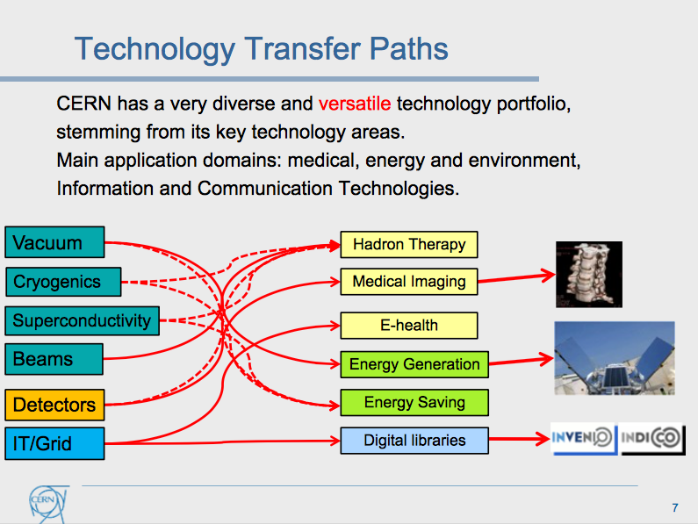
http://slideplayer.com/slide/10665366/

Slide 3
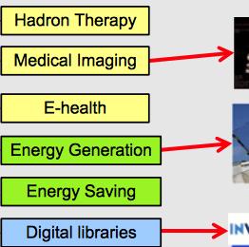
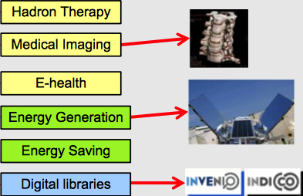
INNOVATION @IFIC(42)
IFIC has produced, developed, licensed and transferred patent based RESEARCH and BigData technologies
Artificial Intelligence + Big Data
Dose reduction
NUCLEAR RECYCLING
CLIMATE CHANGE

Slide 4
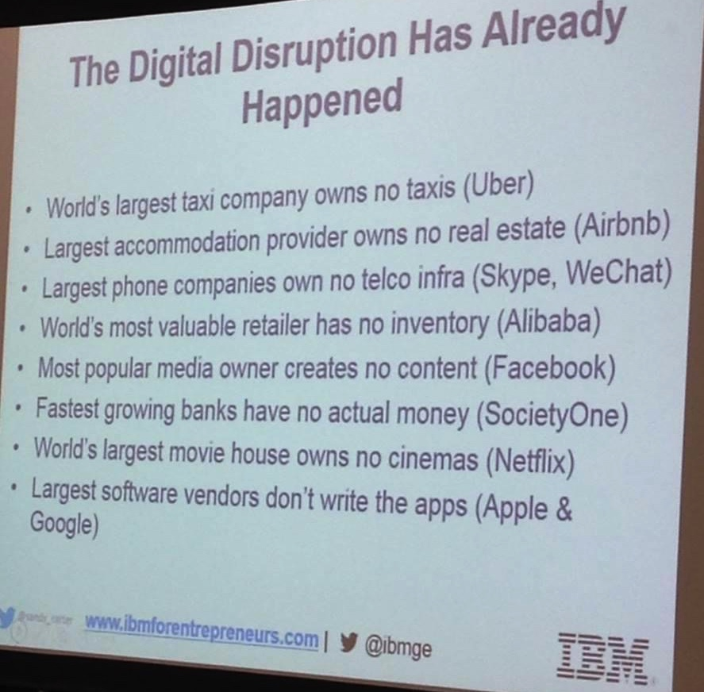
http://www.bbc.com/news/science-environment-37630414
"If you want a career in medicine these days you're better off studying mathematics or computing than biology.”
Sir Rory Collins,
Absence of women in STEM will be
the next gender salary discrimination

Slide 5
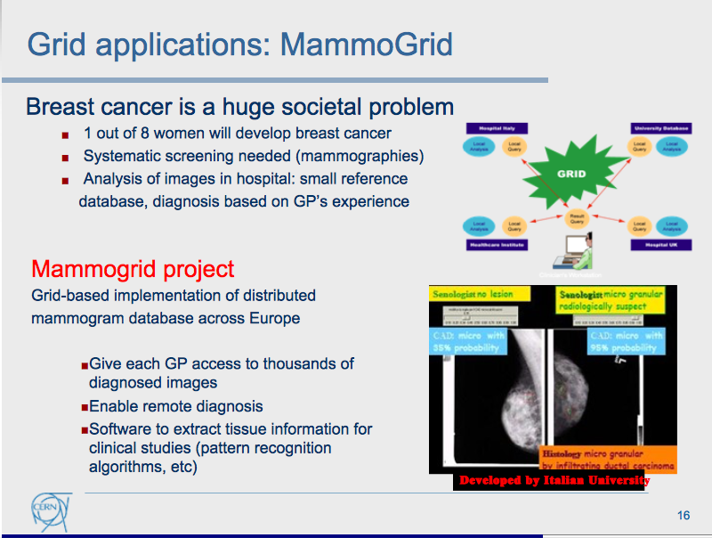


http://slideplayer.com/slide/10665366/

Slide 6
topics
Integrate Artificial Intelligence to improve detectors, imaging and real time systems
Medical Physics (focus in practical aspects)
Focus on Application Social Benefit of the RESEARCH
Absence of women in STEM will be
the next gender salary discrimination

Slide 7
VISION
Open Data
Open Research
Open Standards
Reproducible Research
Produce RESEARCH ready to be used!
Absence of women in STEM will be
the next gender salary discrimination

Slide 8

PatENTs IN MEDICAL PHYSICS and recent projects
Patent ID | Nombre Interno | Descripción
España: P201231243 EU: EP13825508.8 EEUU: US14418608 | Imagen Densitométrica | Dispositivo y procedimiento de obtención de imágenes densitométricas de objetos mediante combinación de sistemas radiológicos y cámaras de profundidad
España: P201530432 EU: 2017 EEUU: 2017 | Imagen 3D | Dispositivo para extraer información tridimensional de imágenes radiográficas de un objeto y procedimiento de calibración de dicho dispositivo y procedimiento para generar dichas imágenes radiográficas
España: 2017 | PRIORIDAD | PRIORIDAD
Sistemas de análisis para la reducción de la dosis efectiva (proyecto TSI 100101-2013-19) cofinanciado por IST Medical y el Ministerio de Industria, Energía y Turismo en el Subprograma: Acción Estratégica de Economía y Sociedad Digital.
Mejora de técnicas de diagnóstico mediante grid radiológico (proyecto TSI 100105-2014-129) cofinanciado por IST Medical y el Ministerio de Industria, Energía y Turismo en el Subprograma: Acción Estratégica de Economía y Sociedad Digital.
Facem 3D Confinanciado IST y CDTI, colaboración con IBV
(Proyecto IDI-20161034)
Jornadas Formativas Big Data Private funded
Predicciones Sector Eléctrico Private funded
Absence of women in STEM will be
the next gender salary discrimination

Slide 9
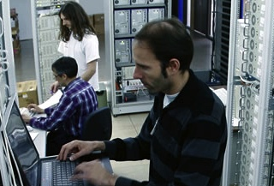
INFRAESTRUCTURAS
BIG DATA
FOR CANCER
CURE @IFIC
Absence of women in STEM will be
the next gender salary discrimination

Slide 10
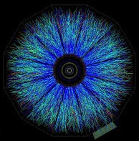
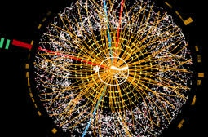
MACHINE LEARNING
HEP/NUCLEAR PHYSICS
TAG: Identify events according to triggers/props
Absence of women in STEM will be
the next gender salary discrimination

Slide 11

DEEP LEARNING + GPU
Absence of women in STEM will be
the next gender salary discrimination

Slide 12
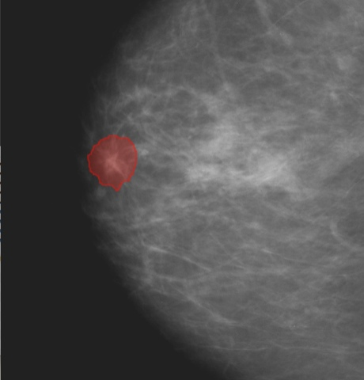
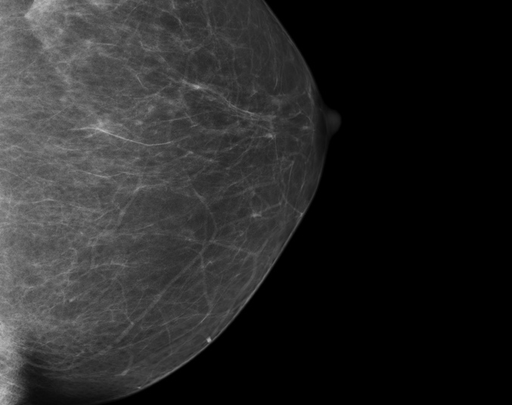
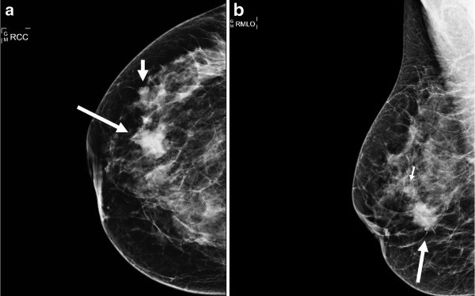
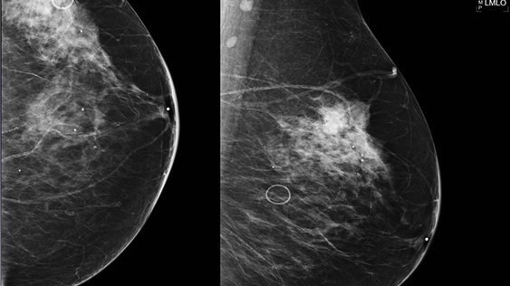
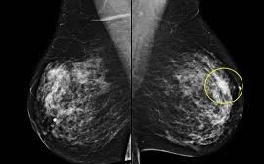
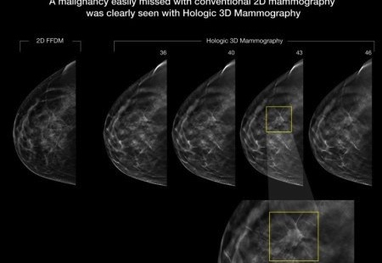
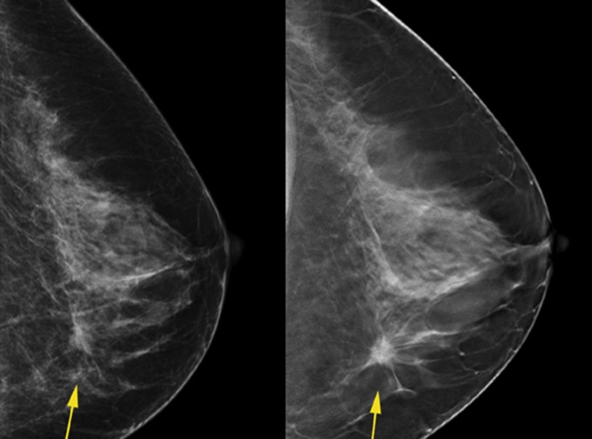
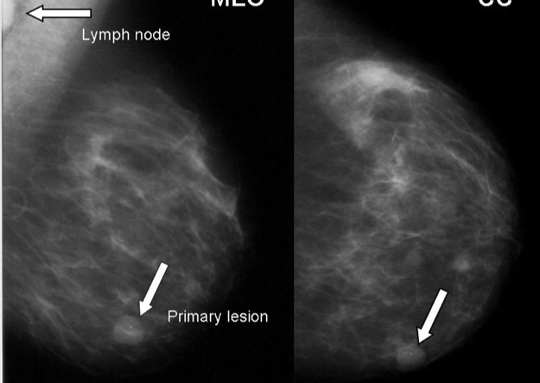
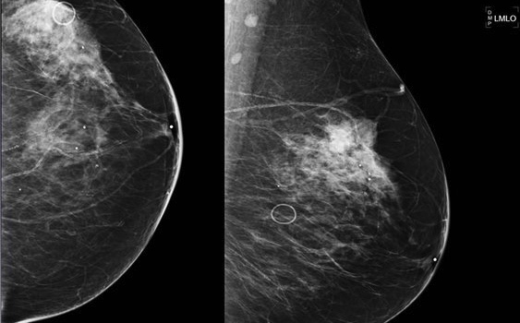
DEEP LEARNING + GPU
Absence of women in STEM will be
the next gender salary discrimination

Slide 13

ACADEMIC PROBLEM
Absence of women in STEM will be
the next gender salary discrimination

Slide 14

Original Image
Distance to the nipple map
Absence of women in STEM will be
the next gender salary discrimination

Slide 15
’42 is the answer normalization’
High frecuency feature mask (calcs)
Absence of women in STEM will be
the next gender salary discrimination

Slide 16
Train
Pyramid
End Models
Absence of women in STEM will be
the next gender salary discrimination

Slide 17
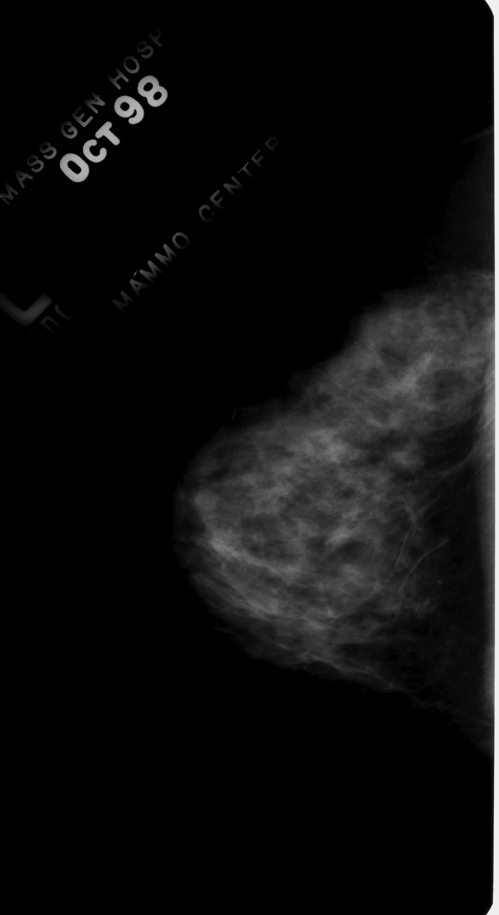
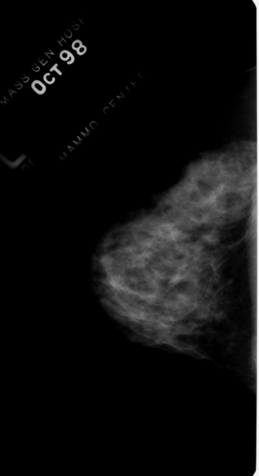
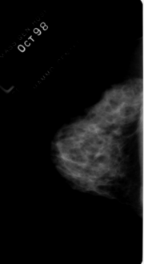


Piramid multiresolution resize
PYRAMID OBSERVATION LOW TO HIGH SCALE
Lesion not found
Absence of women in STEM will be
the next gender salary discrimination

Slide 18
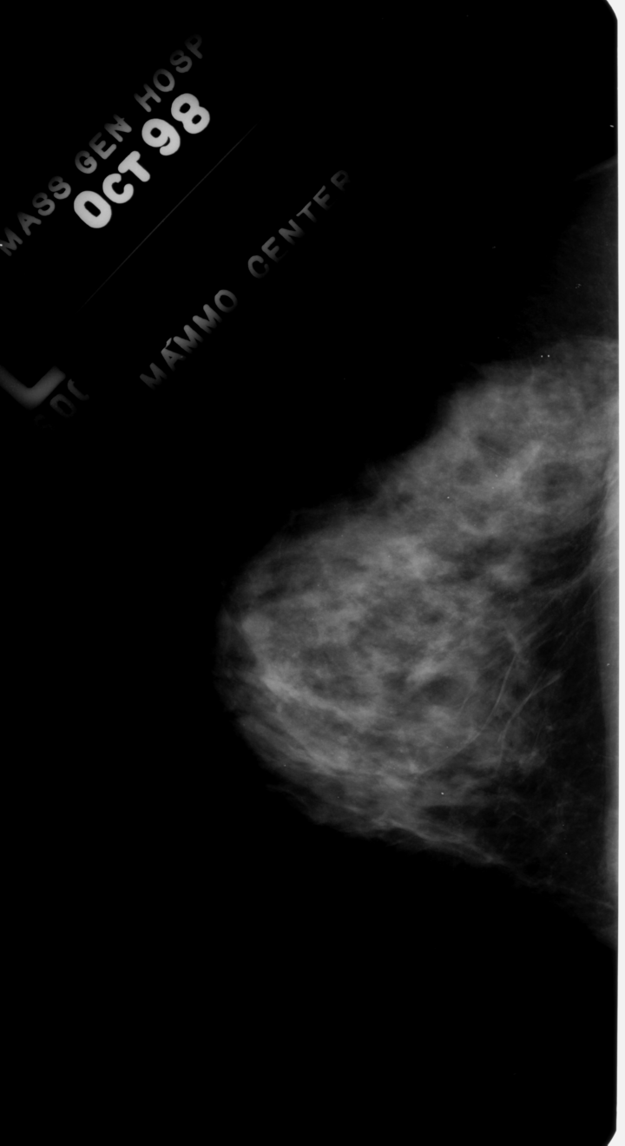
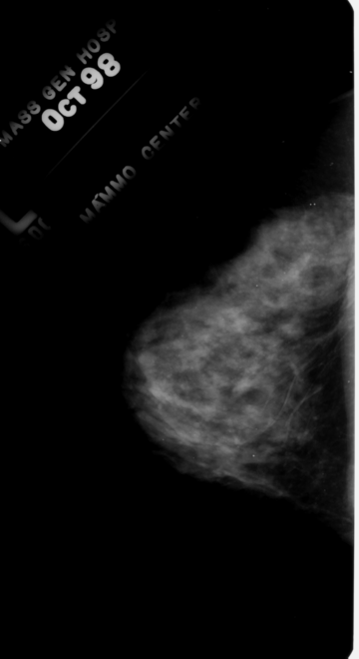



Piramid multiresolution maxpool resize
PYRAMID OBSERVATION LOW TO HIGH SCALE MAXPOOLED
Lesion present
Absence of women in STEM will be
the next gender salary discrimination

Slide 19
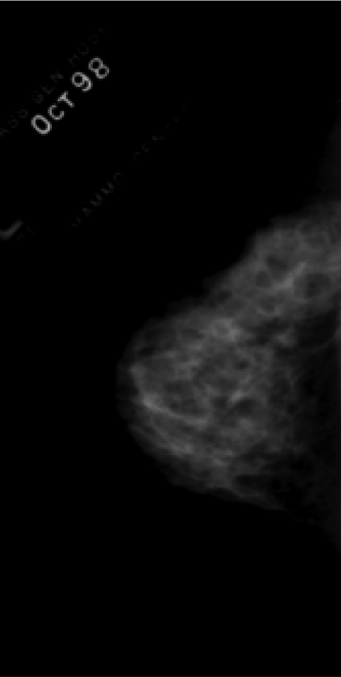
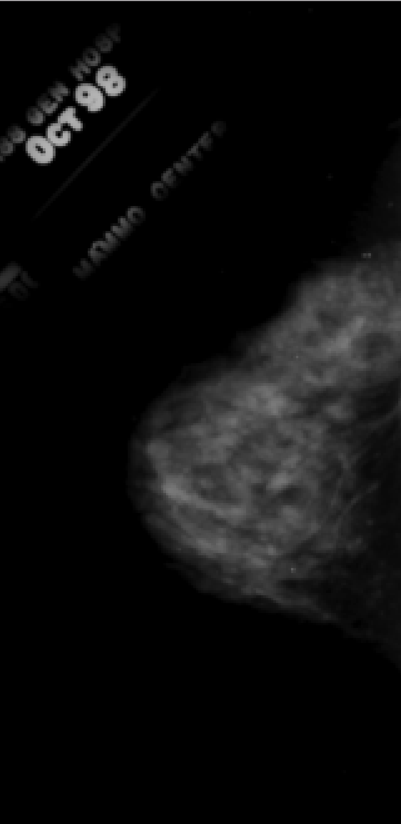
DETAILED TO 1/16 ORIGINAL SIZE
Low Res: multiresolution
conventional resizing vs maxpool resize

Slide 20


DETAILED TO 1/64 ORIGINAL SIZE
Low Res: multiresolution
conventional resizing vs maxpool resize

Slide 21
Absence of women in STEM will be
the next gender salary discrimination

Slide 22
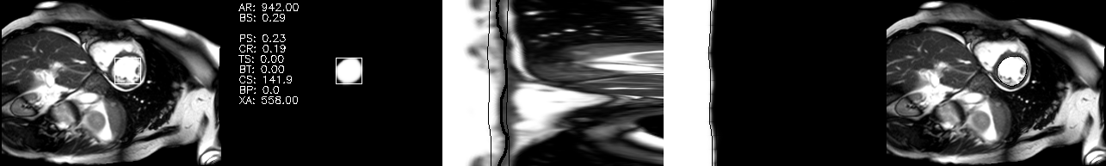
Other GPU problems
TENSOR SEGMENTATION
Credits: Yuanfang Guan
Absence of women in STEM will be
the next gender salary discrimination

Slide 23
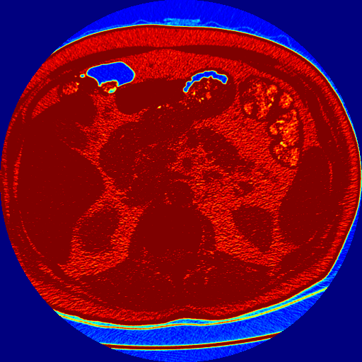
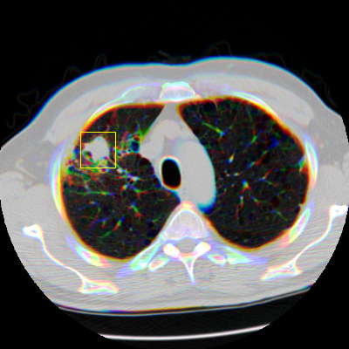
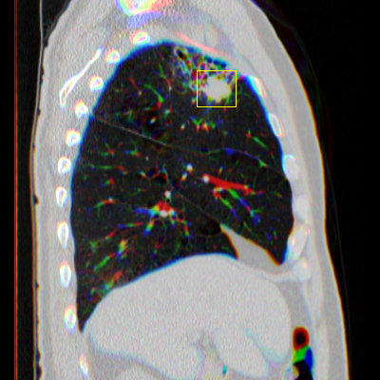
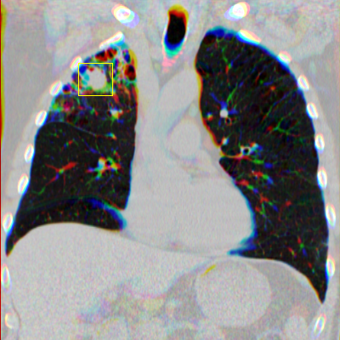
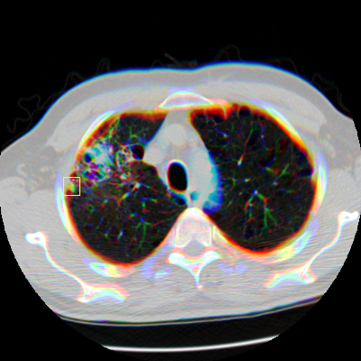
Other GPU problems
LUNG CANCER DETECTION
Credits: Yuanfang Guan
Absence of women in STEM will be
the next gender salary discrimination

Slide 24
SOME RESUMED DIFF/SIM
 | AUGMENTATION | Observable Size | Volume | Variety | Velocity
HEP | Montecarlo | Small | Large | Partial | Yes
GOOG | Not needed | Large | Med Large | Yes | Yes
MEDIC | Needed Hard | Very Large | Low | No (Yes) | No
 | Software | Data | Dependences | AI | Runtime | GPU | Regulat
HEP | Mostly provided | In House | Internal | Nerual Networks + Fitting | Well defined | Part/NO | NO
MEDIC | Full in house | External | External | Convolutional Nerual Network | Many (virtual) | Yes | HIGH
Use of Reproducible Research
Participating actively in OpenData initiatives Locally
Security Safety Traceability By Design
Absence of women in STEM will be
the next gender salary discrimination

Slide 25
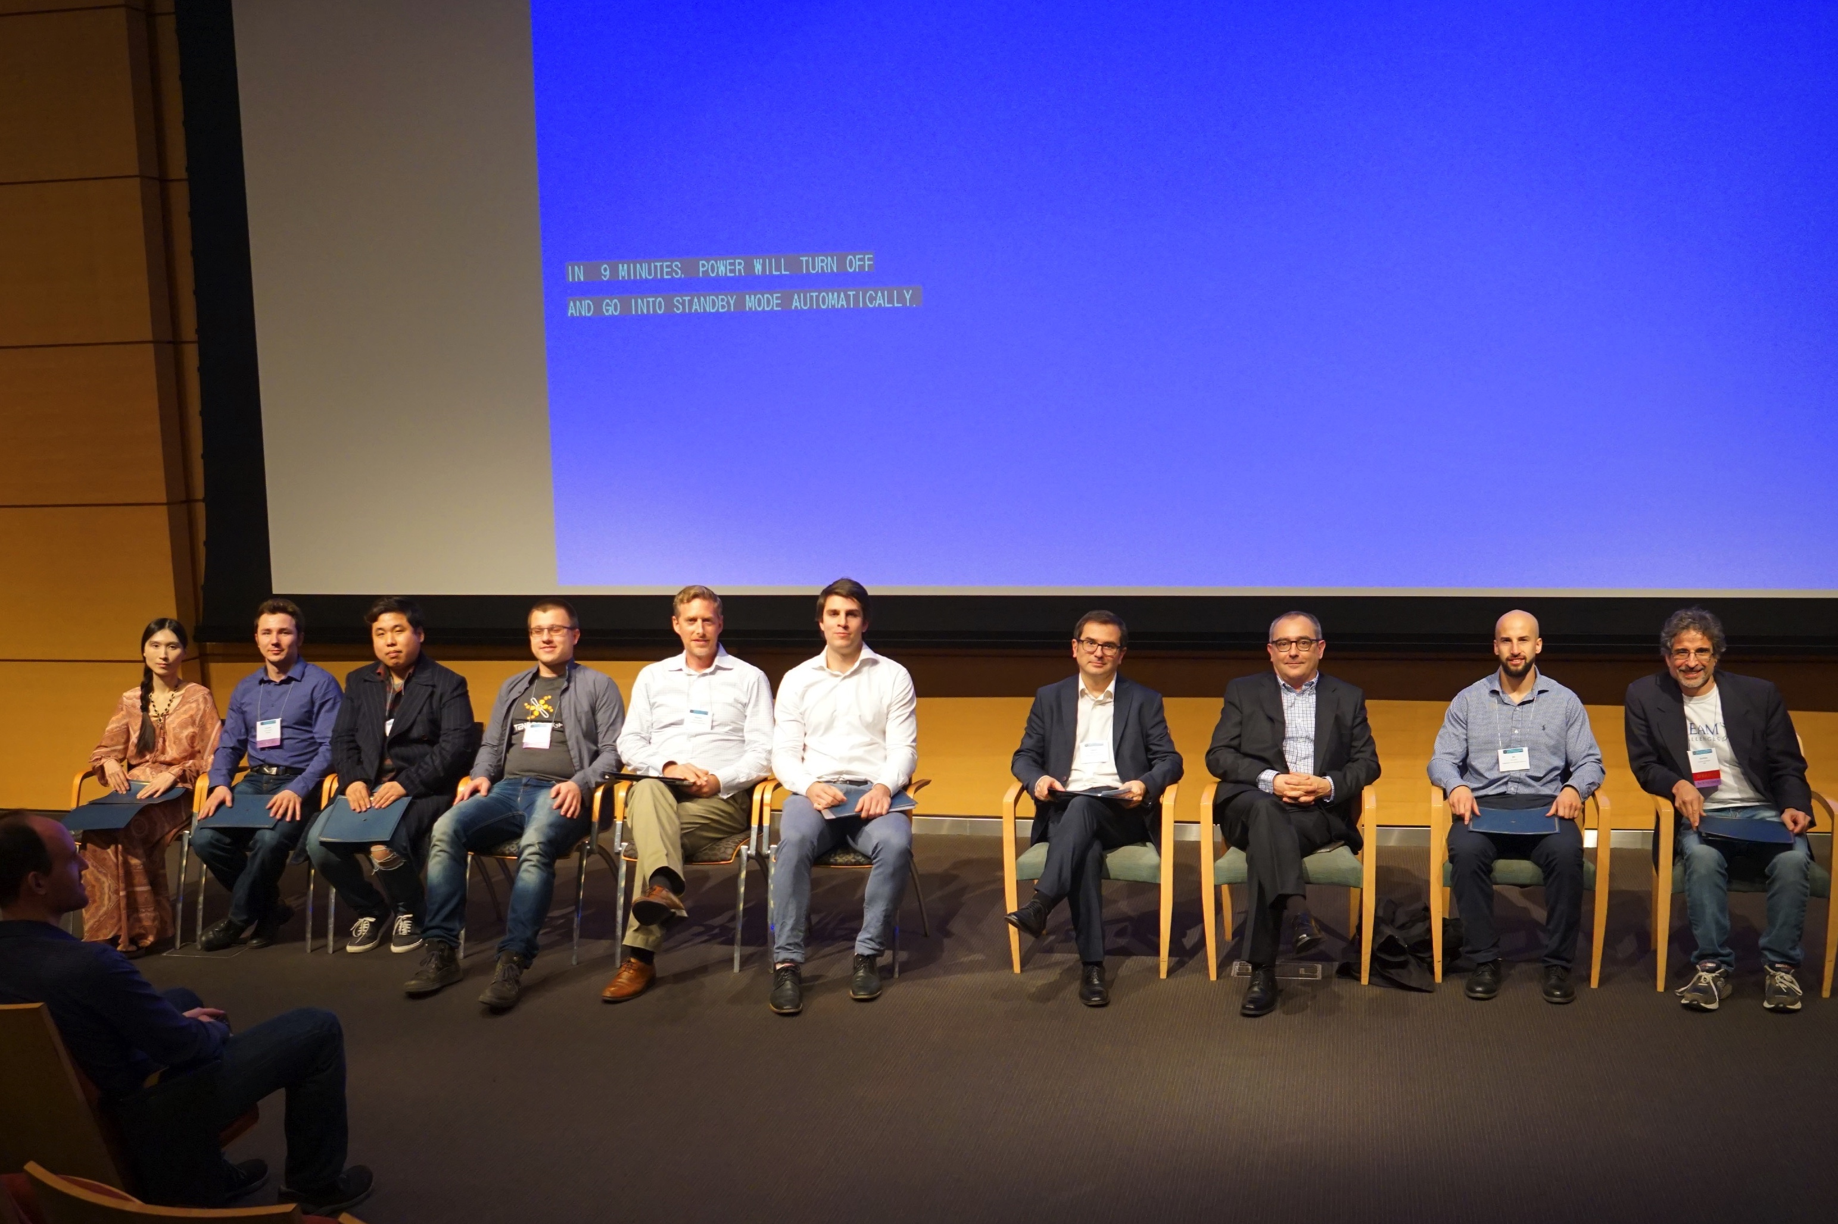
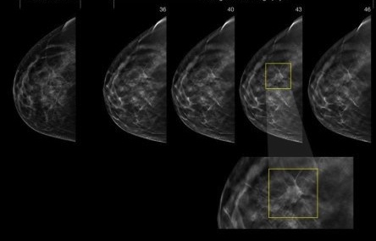
42 IS THE ANSWER
AT NYC 2017
(LA COMA & ELS TARONGERS TEAM)
University of Michigan
Echole Polythecnique
Korea Univ
London University
Budapest University
MIT
IBM
10%
90%
Absence of women in STEM will be
the next gender salary discrimination

