Slide 1
High Gradient RF Lab at IFIC
Daniel Esperante Pereira
On behalf of the Group of Accelerator Physics (IFIC)
C. Blanch, M. Boronat, D. Esperante, J. Fuster, B. Gimeno, D. González, A. Vnuchenko

Slide 2
Outline
Overview and motivation
The IFIC-HGRF lab, design aspects and status:
The XBOX inspiration
The HPRF subsystem
The LLRF subsystem
New developments
Summary & plans

Slide 3
The IFIC-HGRF Lab: Overview
Aim:
High-gradient normal conducting RF cavities research topics at S-Band (2.9985 GHz)
RF Frequency: 2.9985 GHz
Repetition rate: 400 Hz
Pulse length: 5 µs
Pk power:
15 MW
Up to now ~20 MV/m => With high-gradient technology up to 100 MV/m

Slide 4
The IFIC-HGRF Lab: Overview
Aim:
High-gradient research topics at S-Band (2.9985 GHz)
Technical specifications:
S-Band (2.9985 GHz)
Pulsed High Power RF (HPRF):
2 x pulsed power klystron: to 7.5 MW, 5 us pulse, 400 Hz
High power waveguide RF network that allows power combining: enables to test 2 structures at a time at up to 15 MW, 5 us pulse, 200 Hz repetition rate
Low level RF (LLRF): real-time control system with fast system interlock based on Ni-PXI acquisition system
Running on Ultra-High vacuum (10⁻⁹ mbar)

Slide 5
Motivation
Funding for research high-gradient/high performance RF topics in S-Band:
Granted funding by the Spanish government coming from ERDF funds
Got funds for a collaboration project between IFIC and CERN-CLIC => KE project, apply HG to medical physics
Recently:
Marie Curie – IF: D. Esperante, grant to develop the system and upgrade it
Marie Curie – ITN-OMA: A. Vnuchenko. Optimization of Medical Accelerators Innovative Training Network (H2020)
Build a facility to open the possibility of several High-Gradient RF studies in S-Band:
High-Power performance: of different prototype designs to determine the right direction towards higher gradients at acceptable breakdown rates
Breakdown rate dependencies: with gradient and pulse length, to test the experimental power laws and develop physical models
Breakdown localization: techniques to monitor the performance of the structure and better understand the BD formation process and precursors
Surface field emission: current measurements
Development of alternative diagnostics and analysis techniques: to follow further breakdown studies and high-power phenomena
Design and development of RF components and technology (mostly in S-Band)

Slide 6
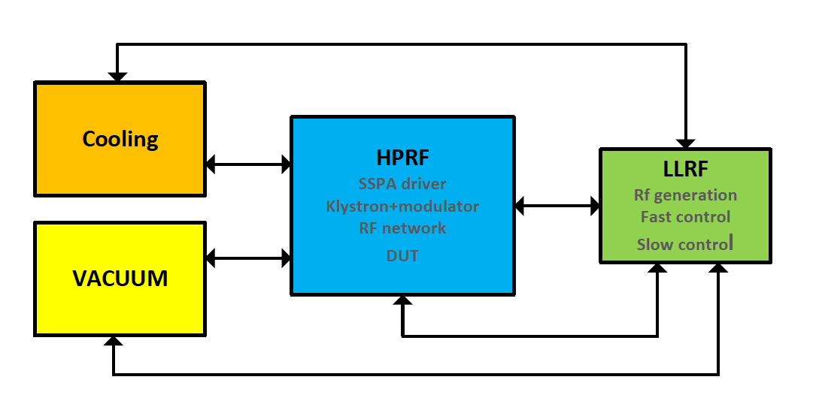
System level simplified scheme
System level simplified scheme
Simplified, NOT SIMPLE!! ☺
Output data for
character-ization and analysis
WP4
WP3
WP2

Slide 7
Outline
Overview and motivation
The IFIC-HGRF lab, design aspects and status:
The XBOX inspiration
The HPRF subsystem
The LLRF subsystem
New developments
Summary & plans

Slide 8
The HPRF subsystem: XBOX inspiration
The XBOX’s are X-band (11.994 GHz). The Val-HGRF lab is S-Band (2.9985 GHz)
Try to keep as much as possible the same of hardware and software. (This is the most cost-effective solution: optimize the development time and manpower ☺)
BUNKER
7.5 MW x 5µs x 400 Hz
RF/vacuum pumping port
15 MW x 5µs x 200 Hz
DUT
with Faraday cups and Pumping ports
RF load
Pulse compressor
3 dB hybrid combiner
Preamp
Klystron + modulator
Directional coupler

Slide 9
Outline
Overview and motivation
The IFIC-HGRF lab, design aspects and status:
The XBOX inspiration
The HPRF subsystem
The LLRF subsystem
New developments
Summary & plans

Slide 10
The HPRF subsystem
7.5 MW x 5µs x 400 Hz
15 MW x 5µs x 200 Hz
BUNKER
SSPA
Modulator+Klystron
Waveguide components
Status summary:
Modulator: Jema. 1st modulator test with Klystron done by mid-September
Klystron: CPI. Factory tests OK. Integration test with modulator done
Waveguide components: MegaInd. Vacuum and RF tested
Solid-state power amplifiers: MicroWave Amplifiers. Tested

Slide 11
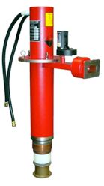
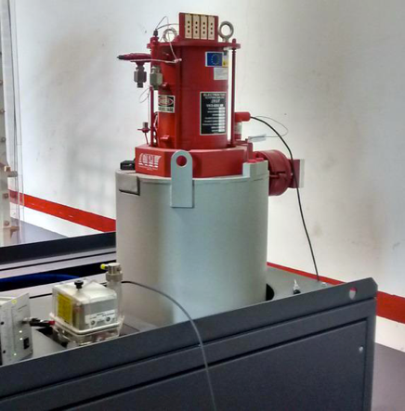
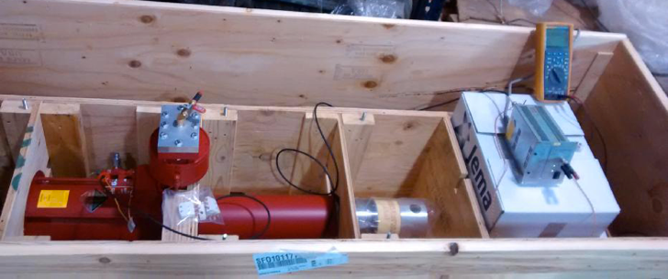
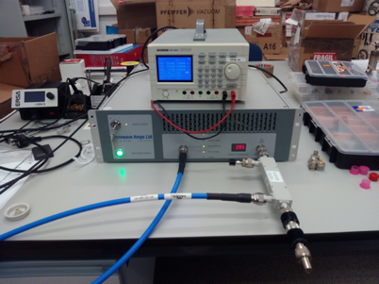
The HPRF subsystem: Amplifiers
Klystron VKS8262G1:
Provider: CPI
LIL output port flange for UHV
Peak power: 7.6 MW @145 kV & 105 A
Tp = 5 us, 400 Hz
Status: RF tests in CPI. Now in JEMA facility (integrated into the modulator)
SSPA (Solid-state Power Amplifier):
To drive the Klystron
Solid-state: MicrowaveAmplifiers:
AM10 S-Band 400W Power Amplifier.
Acceptance tests done
Status: tested at IFIMED, and one to be used at CERN soon

Slide 12
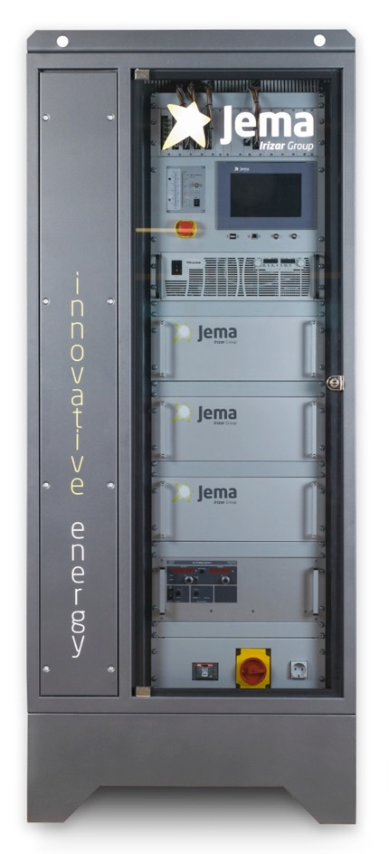
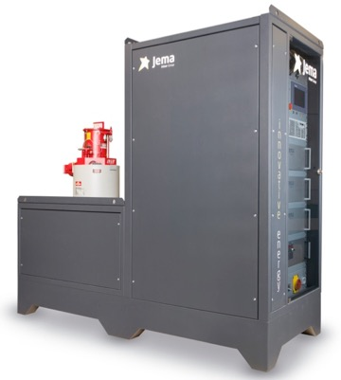
HPRF: Modulator (1)
This is the one of the key elements of the system.
Solid-state switching modulator. Specs:
Provider: JEMA (Lasarte-Oria)
Vpeak, typical: 145 kV
Ipeak, typical: 105 A
Tp = 5 us, 400 Hz
Voltage flatness: <=+/-0.25%
Stability, pulse to pulse: <= 0.1%
Risetime (10->90%): <=2us
Falltime (90->10%): <=2us
Adjustable voltage: (45kV - 150kV)
Status: Integration with Klystron done (see next slides)

Slide 13
HPRF: Modulator (2), Visit on September
Visit to Jema on the 21st of September: G. McMonagle (CERN), O. Sablic (CPI) and my self (IFIC).
Purpose: integration of modulator with Klystron
Outcome very successful:
The tests were OK, despite some shortcomings:
All interlocks OK
Klystron pulsed at 100 Hz (No RF)
Pulse to pulse stability OK
Tests at 400 Hz with load OK
Some few fixes to be done, already implemented
The flat top of the pulses has some ripple (to be understood)
Pulse width higher than expected. Rise time is higher than 2 us, while fall time looks good
Next steps:
Modulator shipped to IFIC, integrate it and start pulsing: 13 March 2018

Slide 14
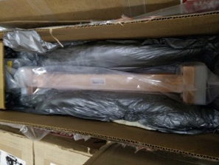
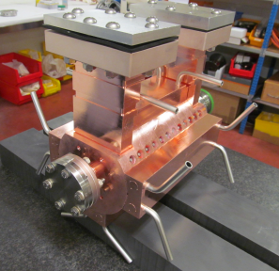
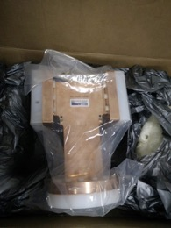
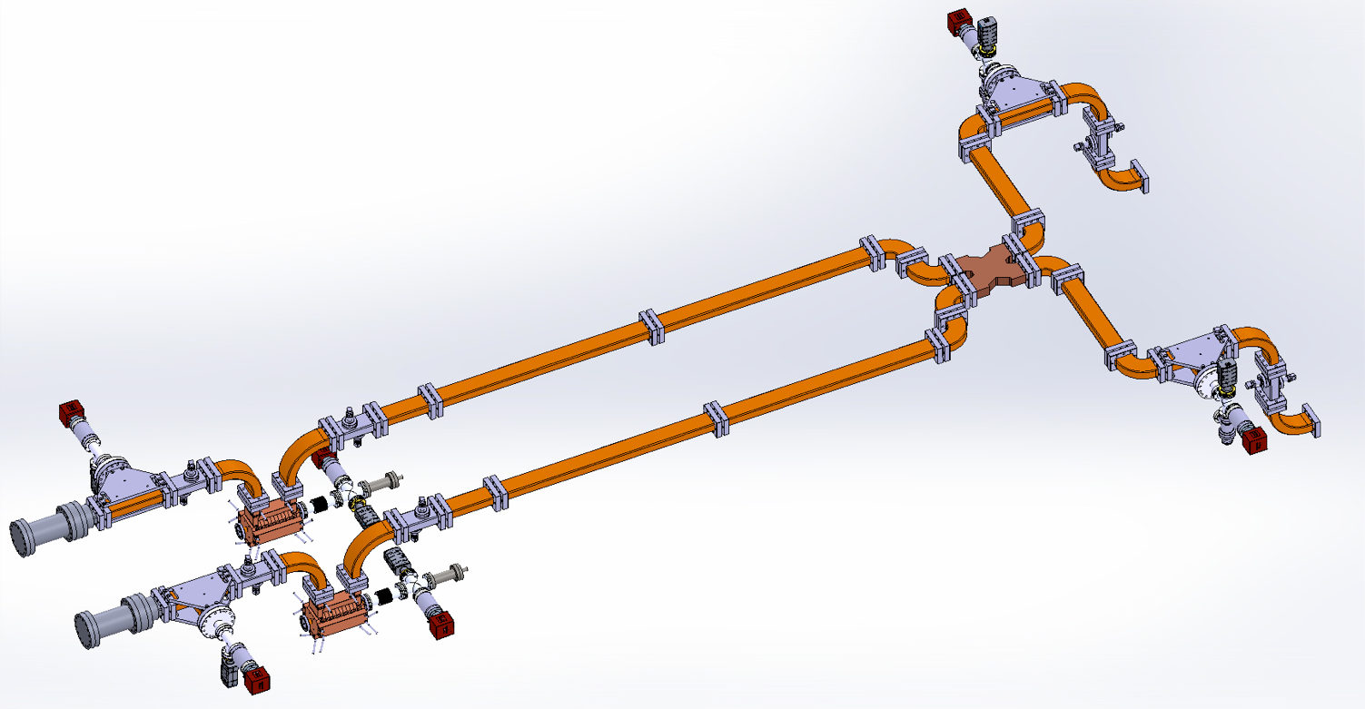
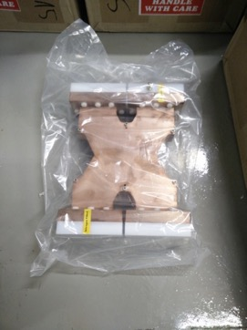
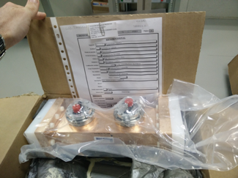
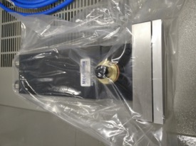
The HPRF subsystem: waveguide components
WR284 waveguides
RF/vacuum pumping port
DUT
with Faraday cups and Pumping ports
3 dB hybrid combiner
Directional coupler
Klystron output
RF load

Slide 15
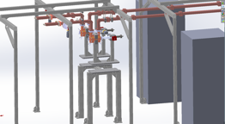
The HPRF subsystem: lab integration
Modulator+ 7.5 MW Klystron units
Accelerating structures
Devices under test inside the bunker
3dB hybrid
Bunker
The bunker is in place.
The supporting structure as well.
New integration plan to be done due to modulator size mismatch.
Accelerating structures

Slide 16
The HPRF subsystem: NEW lab integration
New integration plan designed due to modulator size mismatch
Less free space than before but things still fit

Slide 17
HPRF installation: Modulator and waveguides
2
3
4
5
1
6
6
The bunker:
The bunker (1), the crane (2) and the supporting structure (3)
Waveguides (4)
Rack for vacuum components (5)
Modulator and Klystron connected (6). Some lessons learnt and fixes applied.

Slide 18
Outline
Overview and motivation
The IFIC-HGRF lab, design aspects and status:
The XBOX inspiration
The HPRF subsystem
The LLRF subsystem
New developments
Summary & plans

Slide 19
The LLRF subsystem
7.5 MW x 5µs x 400 Hz
15 MW x 5µs x 200 Hz
BUNKER
BDR studies:
20 ns time resolution needed
RF diagnose signals:
- Phase & amplitude @62.5 MHz. @250MSPS → Structure RF Signals
- Phase & amplitude @62.5 MHz @ 250MSPS → Phase but not speed is key
- Slow Amplitude only. Log det. @250MSPS → Reflected signals/machine protection (x6)
-Faraday Cup Signals (x4)

Slide 20
LLRF subsystem components: status (1)
UNDER CONSTRUCTION!!
High Power RF:
Solid state amplifier
Klistron+modulator
RF network
Device under test
LLRF
RF generation
National Instruments
PXI real-time system:
RF generation
RF signals acquisition
Signal processing
External systems control, environmental monitoring and interlock
Calibration power meter
Log detector
RF diagnosis
Down-mixer
Environmental monitoring
Environmental signals
Ext. systems:
Cooling
Vacuum
Access
Modulator interlocks
Intfce Intlck Box
Control, monitoring and interlocks

Slide 21

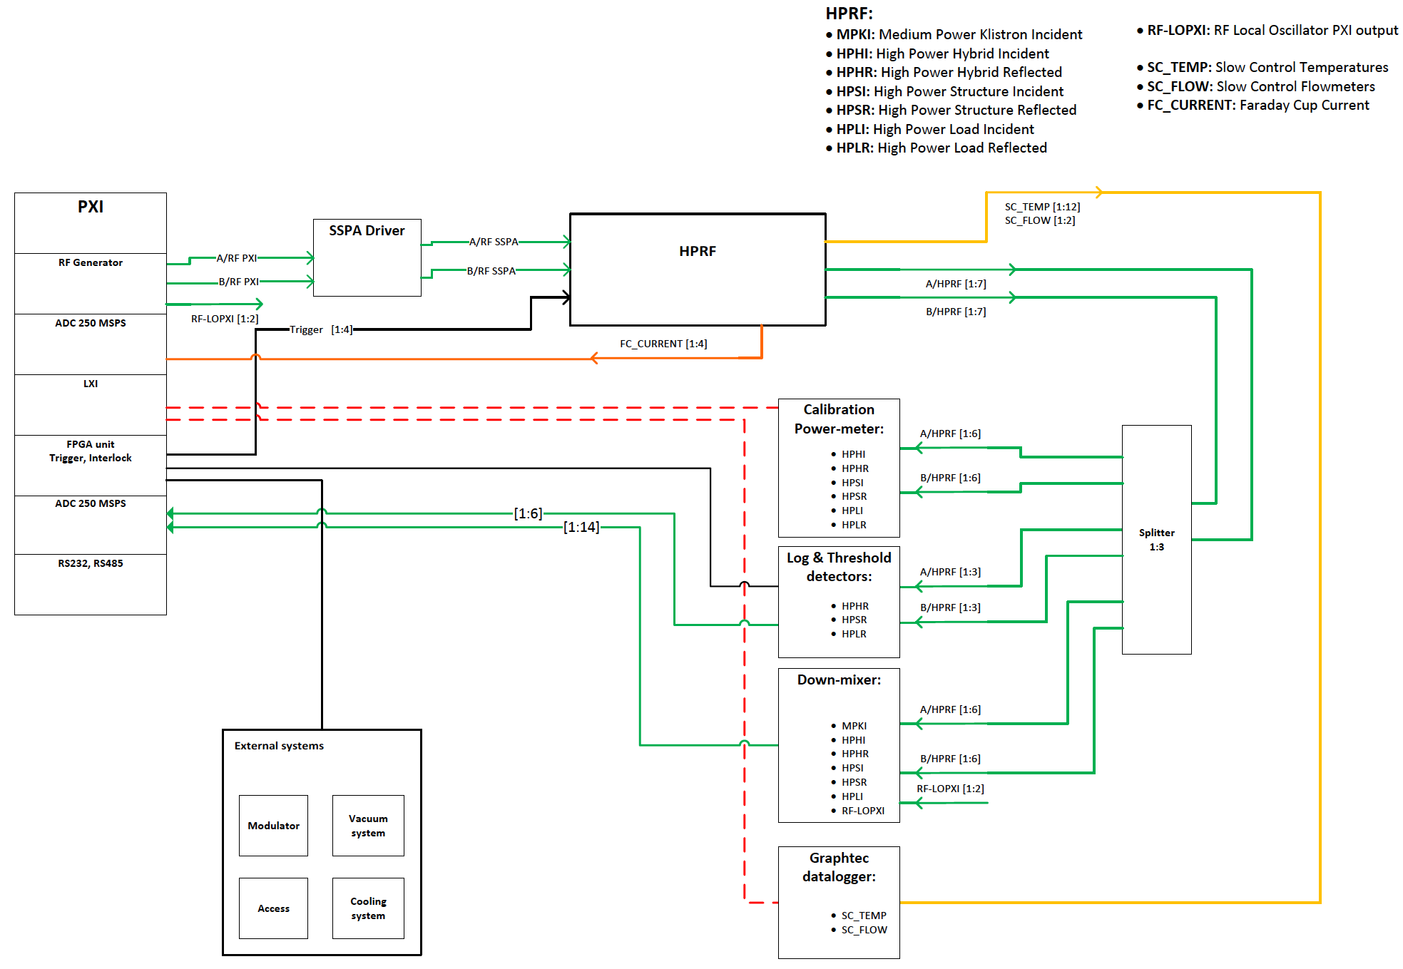









System layout: subsystem interconnect level
Explanation for kids:
Imagine this is smurfland

Slide 22

A name for the lab
We should coin a name to de Lab.
It’s difficult to compete with a name so notorious as the XBOX…
So here my proposal…
S-Band Multi-Use Radio-Frequency Lab
SMURF Lab

Slide 23
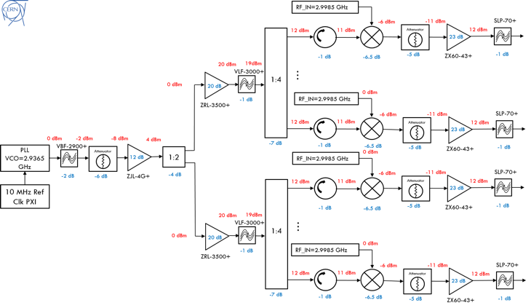
The LLRF system: status (2)
Down-mixer: Fully assembled and tested!!
16 channel downmixing system to move from 3 GHz to 62.5 MHz and get 4 samples per RF period and perform a “quick” IQ demodulation
One built and being used at CERN for the testing of the KT structure
One replica built at IFIC
PLL synthesizer
Power splitter
PLL synthesizer
Power splitters
Mixing channels
Mixing channels
Notes:
Already explained to slides before the purpose of the different devices.

Slide 24
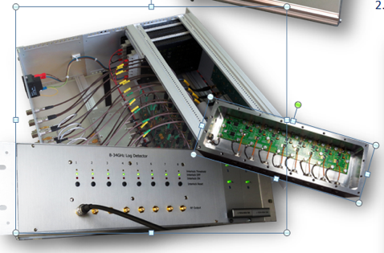

The LLRF system: status (3)
Log amp: Under development, but not critical for startup!!
Needed to detect the the power of reflected signals and fast interlock if the power is too high in order to for Klystron protection:
8 channels, 1-10 GHz detection bandwidth
45 dB dynamic range and 20 ns rise/fall time
It consists of:
8 Log-detector PCB (inside a shielded box)
An 8 channel amplifier and signal conditioning PCB Outputs analog power levels and digital interlocks
Electrical tests done
Mechanical components built
Assembly process ongoing
Single channel log-detector
Notes:
Already explained to slides before the purpose of the different devices.

Slide 25
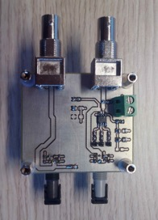
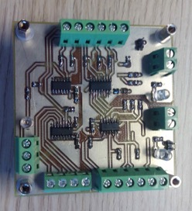
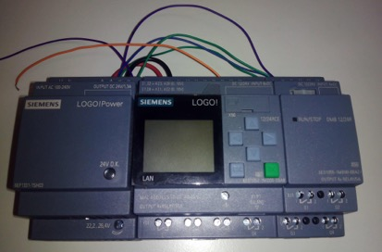
The LLRF system: status (5)
Interlock system:
Electrical engineering Bachelor degree thesis, A. Delgado Llop.

Slide 26
The LLRF system: status (4)
Trigger-interlock box:
RF distributor:
It adapts the input and output voltage signal levels from the NI-PXI to the rest of the setup
Fully assembled and tested!!
It splits the RF signals coming to the different stages: down-mixers, log-detector, power calibrations
Built and fully characterized with the VNA by the Bsc. student
Other elements:
Cabling installation and calibration missing. Need to wait for modulator installation
Full integration to be done

Slide 27
The LLRF system: status (5)
PXI and LabVIEW:
Chasis | 1 |  | NI PXIe-1085, 18 slots
Controller PXI | 1 |  | NI PXIe-8135
Trigger+interlock card | 1 |  | NI 6583 + FPGA
RF Generator (4.4 GHz) | 2 |  | NI 5793 + FPGA
4 ch 250 MSPS ADC | 6 |  | NI 5171. 4xAC(RF signals) + 1xDC (Faraday cup)
RS232, RS485 gauge det. | 2 |  | NI PXI-8432/8 (RS232) and NI PXI-8433/4 (RS485). Vacuum gauges
Slow monitoring | 1 |  | NI 6363. Voltage signals like vacuum, temperature and flowmeter
Fast acq 4 ch 2.5 GSPS | 1 |  | NI 5160. Not needed for S-band: cell bining resolution of 20 ns

Slide 28
Outline
Overview and motivation
The IFIC-HGRF lab, design aspects and status:
The XBOX inspiration
The HPRF subsystem
The LLRF subsystem
New developments
Summary & plans

Slide 29
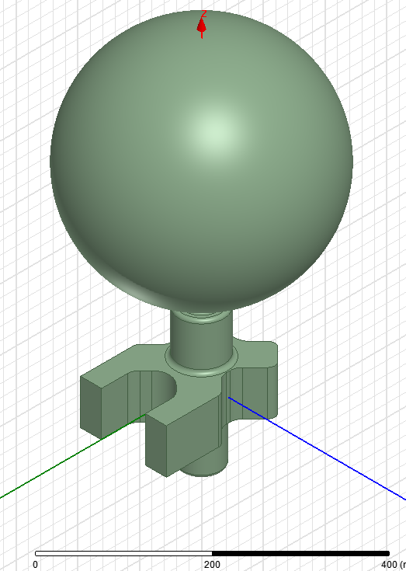
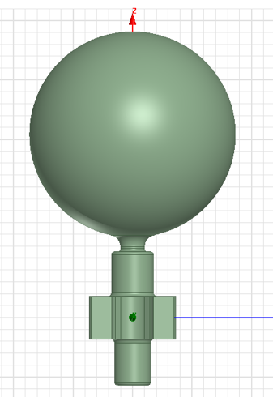
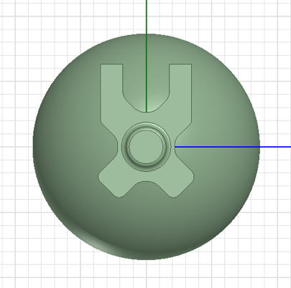
New RF developments
Spherical compact RF Pulse Compressor. Joint development:
C. Serpico and S. Nuaman from Elettra are doing all the RF design with support from A. Grudiev (CERN)
IFIC will take care of the vacuum simulations and mechanical design
140 mm
200 mm
595 mm
347 mm

Slide 30
Outline
Overview and motivation
The IFIC-HGRF lab, design aspects and status:
The XBOX inspiration
The HPRF subsystem
The LLRF subsystem
New developments
Summary & plans

Slide 31
Summary
RF Lab construction:
Lab building construction is ready
Lab design concept performed
Commercial equipment reception and acceptance mostly done
Redesign of some of the LLRF elements done
Vacuum system tests done
Modulator commissioning with Klystron done
To do:
Few components still to be finalized
Control software being readapted
Cooling system and demineralizer installation under final commissioning
Entering in commissioning phase, first modulator pulsing by the end of the year
Take care of the pulse compressor
The new IFIC RF labs is on benefit of an open collaboration between IFIC, CERN, others for High-Gradient developments
We’ll soon have and RF lab with high-power / high-gradient / high-rate testing capability

Slide 32
Acknowledgements
Former and present team group members and students: A. Faus-Golfe, J. Giner, C. Blanch, T. Argyropoulos, J. Fuster, A. Vnuchenko, M. Boronat, M. Usó, O. García, C. Llácer
XBOX team: W. Wuensch, W. Wolley, G. McMonagle, N. Catalán-Lasheras, M. Volpi, I. Syratchev, A. Grudiev
Elettra guys: C. Serpico, S. Nuaman
To the Marie-Curie actions program

Slide 33
THANK YOU FOR YOUR ATTENTION

Slide 34
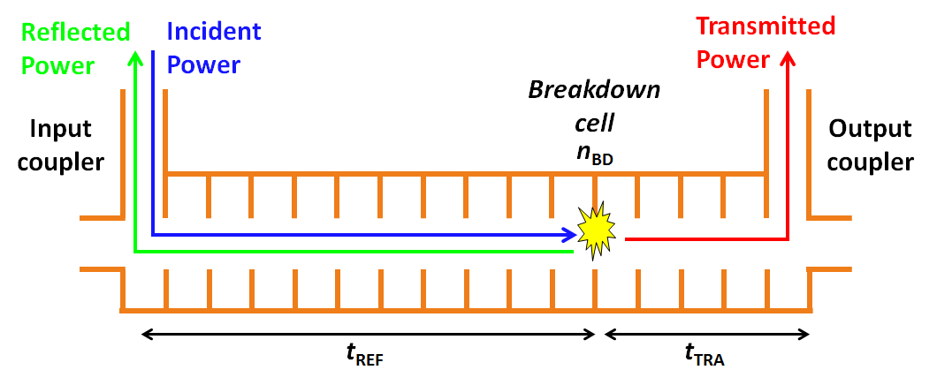


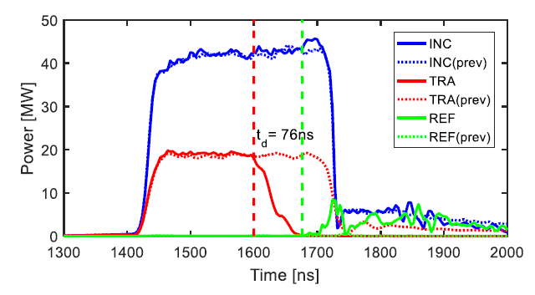
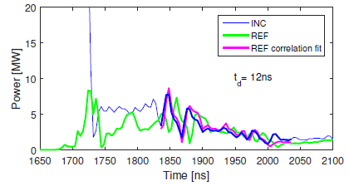
Data analysis: RF breakdown localization
More details in following talks.
We are interested in finding the regions which limit the overall performance of the structure. A combination of different methods is used.
Edge method: compares the time of detection in which the reflected power rises and the transmitted drops
Correlation method: compares the delay time between the incident signal and the repeated pattern of the reflected after breakdown forms.

