Slide 1




Technical aspects of the Spanish ATLAS Tier-2 Project @ IFIC
Santiago González de la Hoz and José Francisco Salt Cairols
Grupo de GRID y e-Ciencia del IFIC
Jornadas Técnicas del IFIC: 12 y 13 de Marzo de 2018
13 de Marzo de 2018

Slide 2
Contents:
1.- Introduction.
2.- Evolution of the ATLAS Computing Model.
3.- The Spanish ATLAS Tier-2
4- Technical issues from the Tier-2 project
5.- Perspectives and conclusions

Slide 3
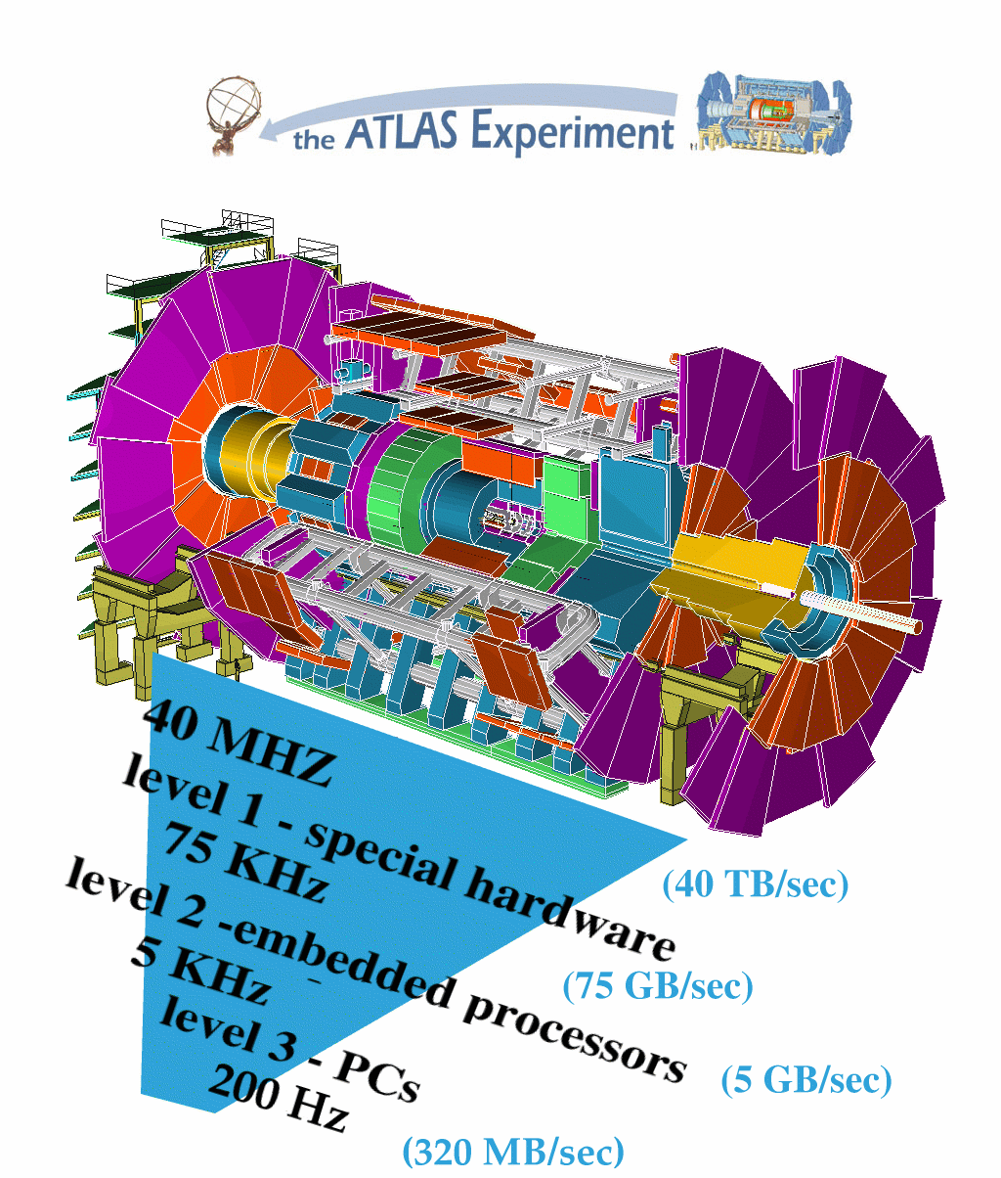
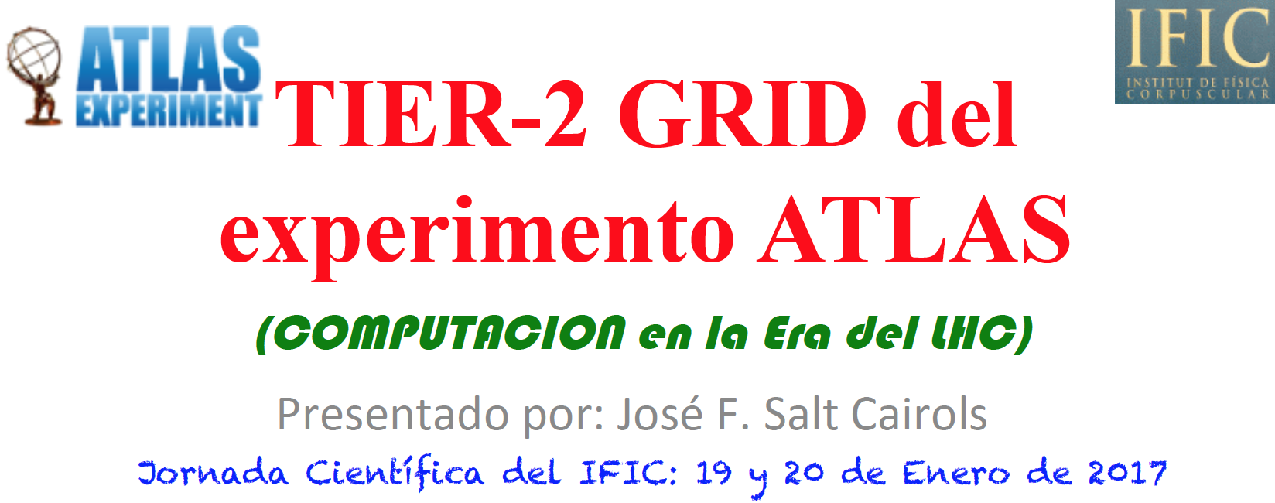
1.-INTRODUCTION
:1 year ago, we had the IFIC Scientific Days…
The Spanish ATLAS Tier-2 project is a it's an almost totally technological project
So it fits well in these Technical Days: a lot of technical aspects can be mentioned

Slide 4
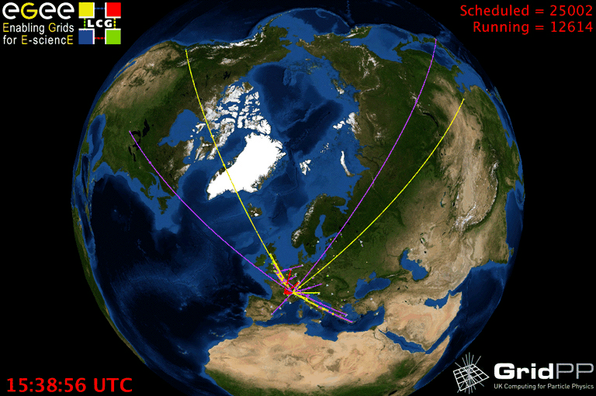
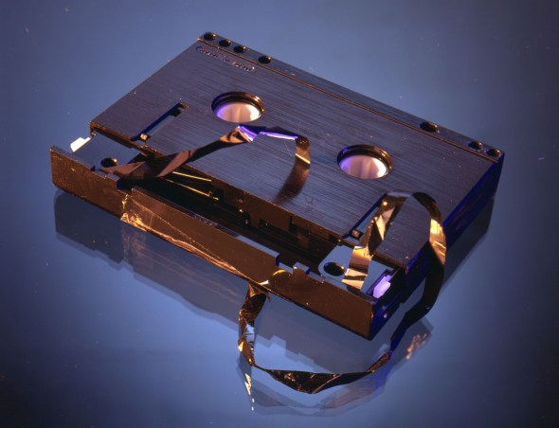
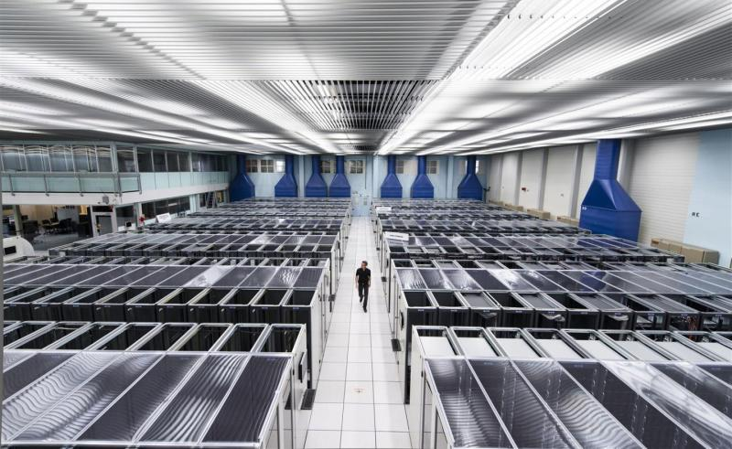
ATLAS Computing Challenges
The offline computing:
- Output event rate: 200 Hz ~ 10⁹ events/year
- Average event size (raw data): 1.6 MB/event
To analyze all this data , 100,000 current PCs and a huge storage capacacity are needed. And a excellent network
Processing:
- order of 100k of today’s fastest PCs
Storage:
- Raw data recording rate 320 MB/sec
- Accumulating at 5-8 PB/year
A solution: Grid technologies
Worldwide LHC Computing Grid (WLCG)
CERN provides 30% of the computing power for LHC: 30,000 CPUs.
5 million Gbits of disk storage.
16 million Gbits of magnetic tape storage.
Connected to other centers at 10Gbits / s.
ATLAS Data Challenge (DC)
ATLAS Production System (ProdSys)
Notes:
los Data Challenge (DC) han sido los programas que ha llevado el CERN y los distintos experimentos para entrenar su modelo de computing y de datos.

Slide 5
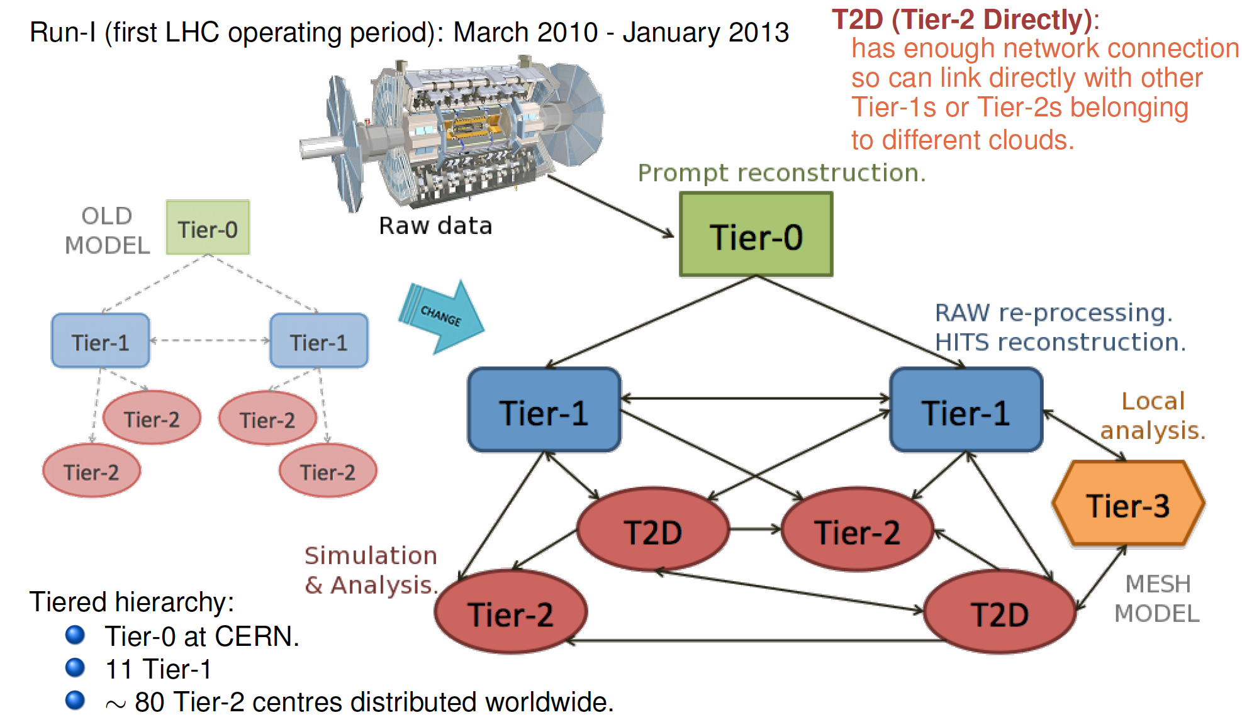
2.- Evolution of the ATLAS Computing Model

Slide 6
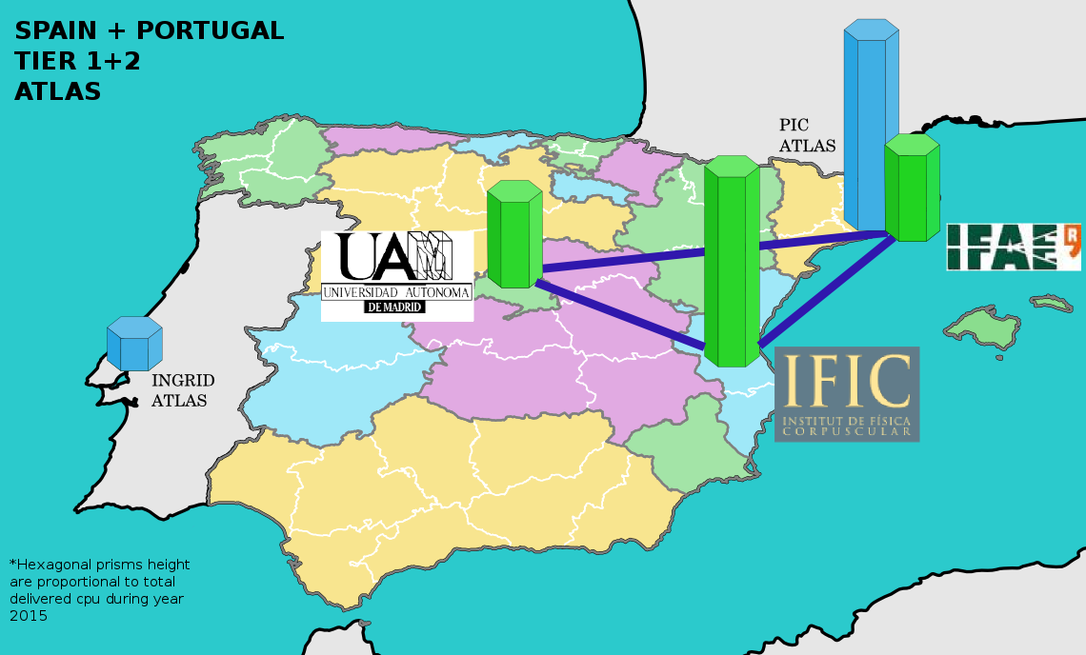
3.- The Spanish ATLAS Tier-2
Federation of 3 centers:
IFIC (Valencia), 60%
IFAE(Barcelona), 25%
UAM(Madrid),15%
Spanish ATLAS Tier-2 Infrastructure, started in 2005 Associated to Iberian Cloud (PIC as Tier-1)
4% of all ATLAS Tier-2

Slide 7
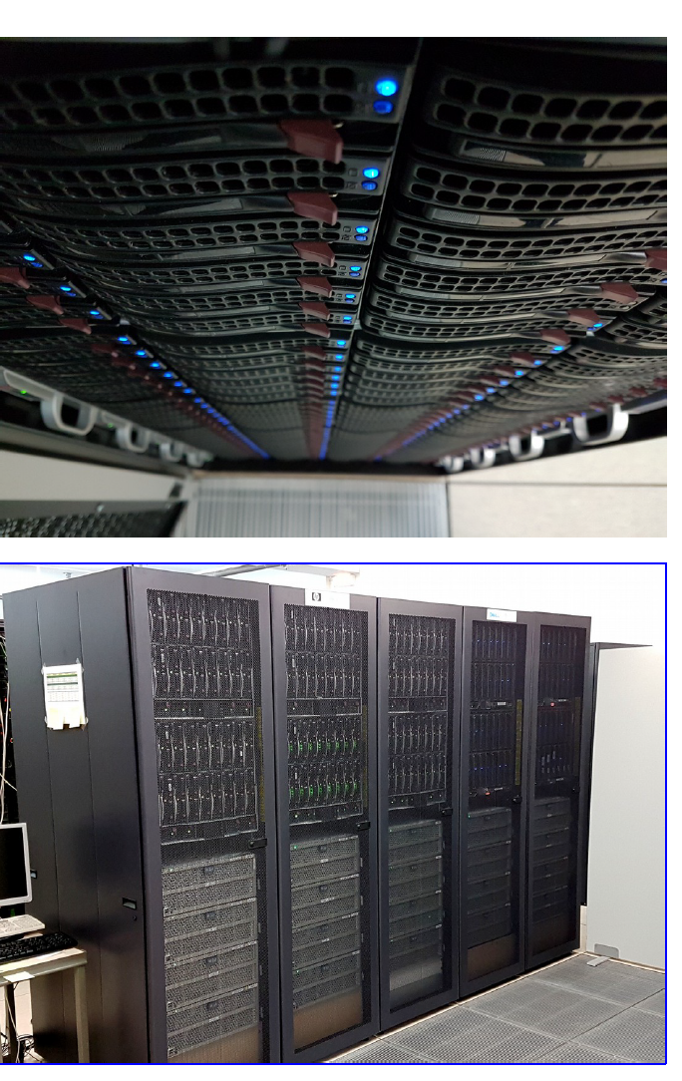
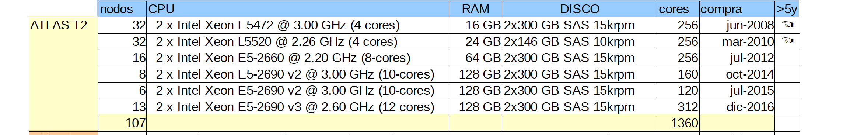
Personnel and resources of the ATLAS TIER-2 Valencia
STAFF | A. Fernández Casani S. González de la Hoz J. F. Salt Cairols J. Sánchez Martínez
STUDENTS POSTDOCS ENGINEERS | E. Fullana Torregrosa (postdoc S8A) J. Lozano (Contratado proyecto) F. Fassi (Dr. Vinculada) C. Garcia Montoro (PTA) J. Aparisi (Contratado proyecto)
COLAB. EXTERNOS | G. Amorós (AEMET) M. Vilaplana (postdoc en INFN-Milán)

Slide 8
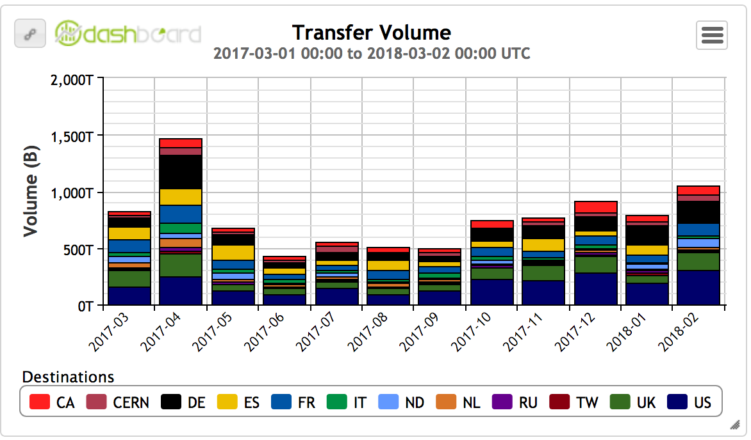
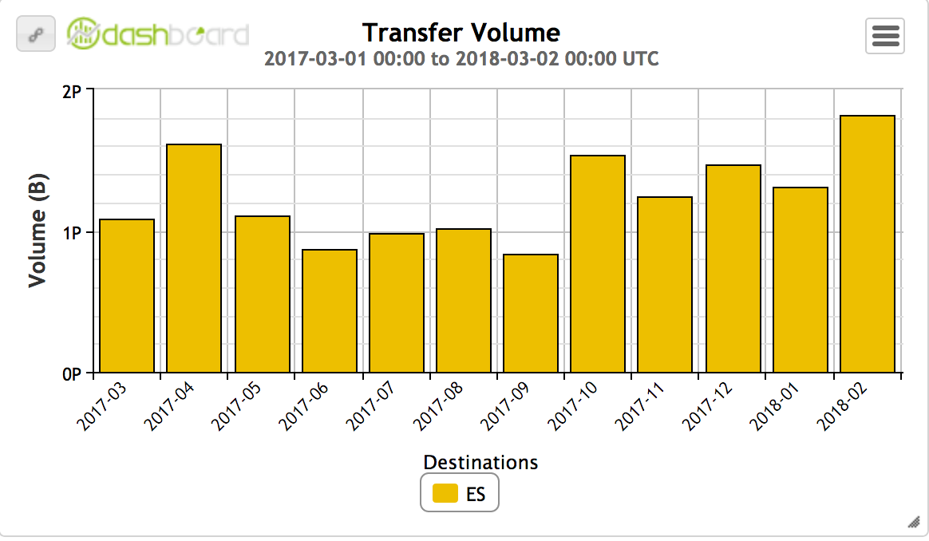
Maintenance & Operation of a complex Infrastructure and
continouosly updated
Transfers in the last year from the rest of the World to Tier2
=> More than 2 PetaBytes of transferred data
Transfers in the last year from the
Tier2 to the rest of the World

Slide 9
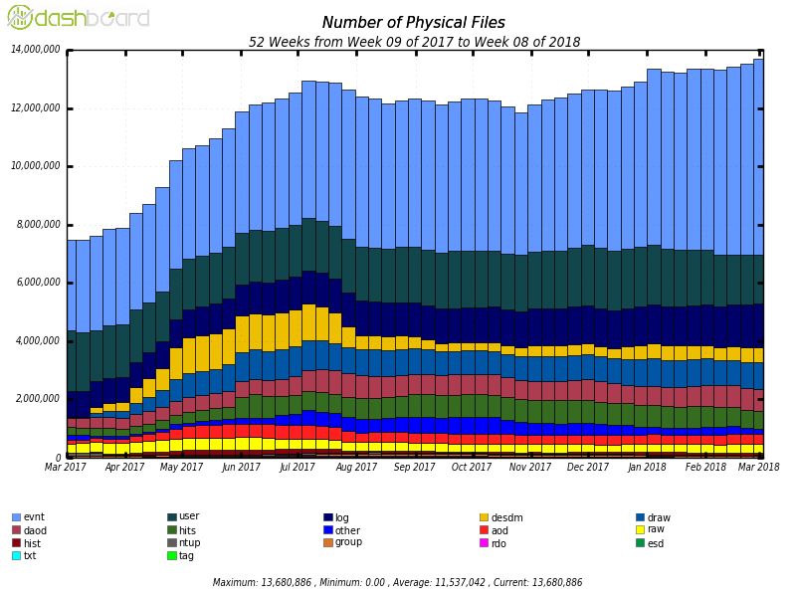
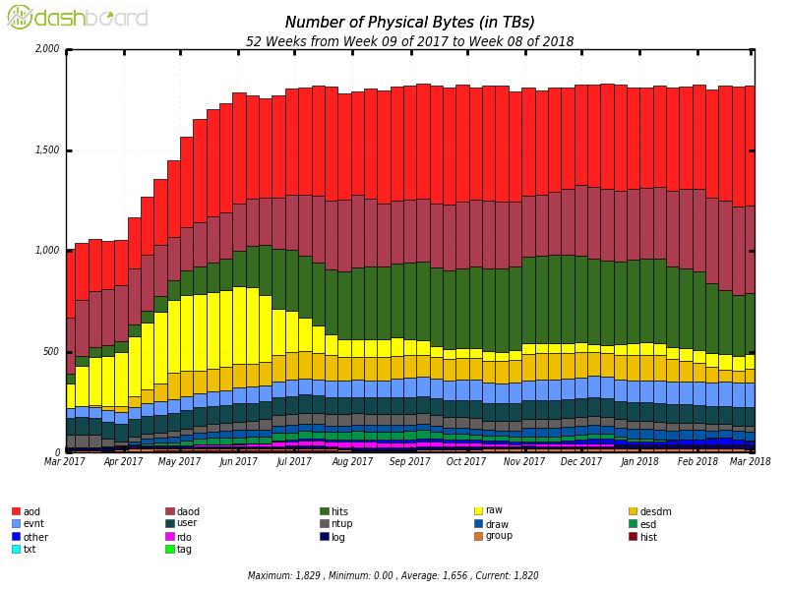
Tier-2 IFIC performance:
Data produced at Tier-2/IFIC in the last year (More than 14M files and more than 2 PBs )

Slide 10
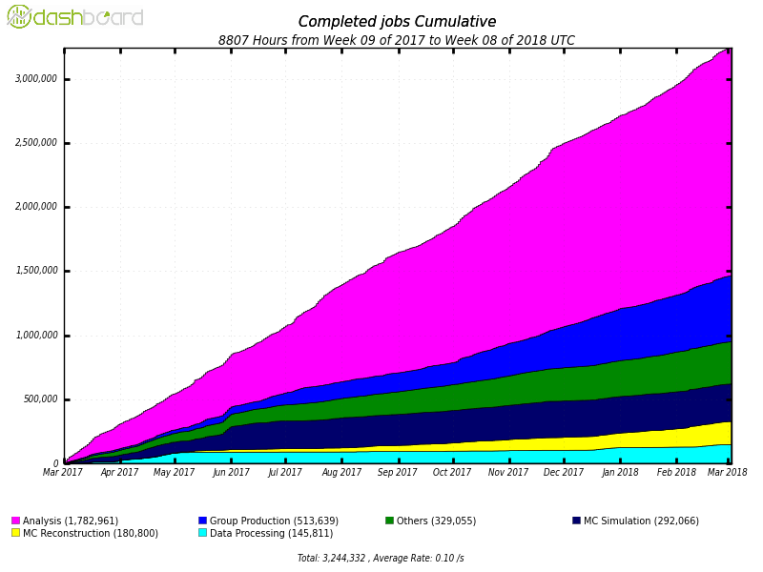
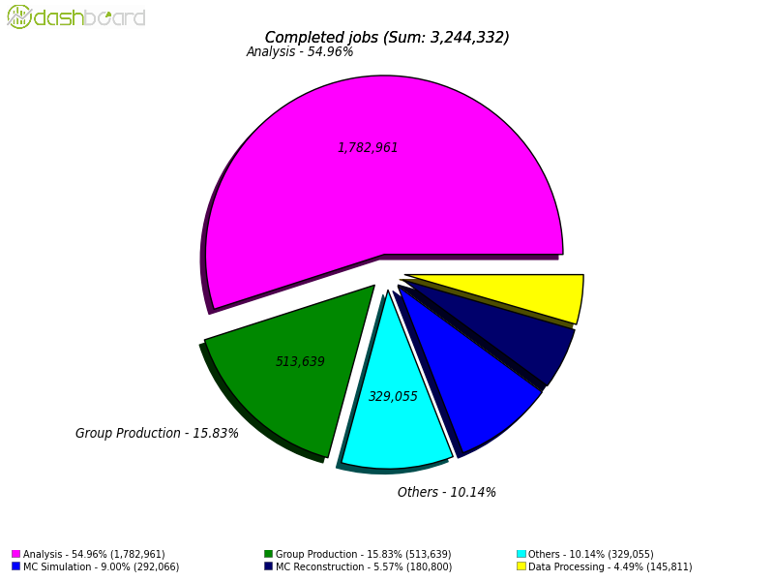
Executed jobs in the last year @ Tier-2 ( more than 3 M)

Slide 11
Proyectos/tareas de Investigación relacionados con el Tier2 de IFIC: the computing challenge for HL-LHC
4.- Technical issues from Tier-2 project
ATLAS and CMS will need x20 more ressources at HL-LHC with respect to today
Flat budget and +20%/year from technology evolution fills part of this gap but there is still a factor x5. Storage looks like the main challenge to address
Project of the National Program of Particle Physics: FPA2016, 3 years project (2017-18-19)
Towards a genuine TIER-2 Spanish Federation of ATLAS to face the challenge of the management and processing of the Big Data of the LHC.

Slide 12
Research tasks included in the Tier-2 Project
Talks
Monitorización de los servidores Frontier de ATLAS (ver charla de LOZANO BAHILO, Julio)
Monitoring de las transferencias del TIER2 con ELK (ver charla de APARISI POZO, Javier)
ATLAS EventIndex y EventWhiteboard. Un sistema de indexado y catalogado de eventos para experimentos con grandes cantidades de datos(ver charla de FERNÁNDEZ, Álvaro)
ATLAS EventIndex Trigger Counter, una herramienta de análisis del trigger que emplea MapReduce (ver charla de GARCíA MONTORO, Carlos)
Aplicación de Machine Learning al análisis de física en ATLAS (ver charla de CAMPO,Samuel)
Tasks
Infrastructure Management & Operations
Distributed Computing: GRID, Cloud, HPC
Data Bases: NoSQL,
Big Data
Data Storage
Machine Learning techniques
…

Slide 13
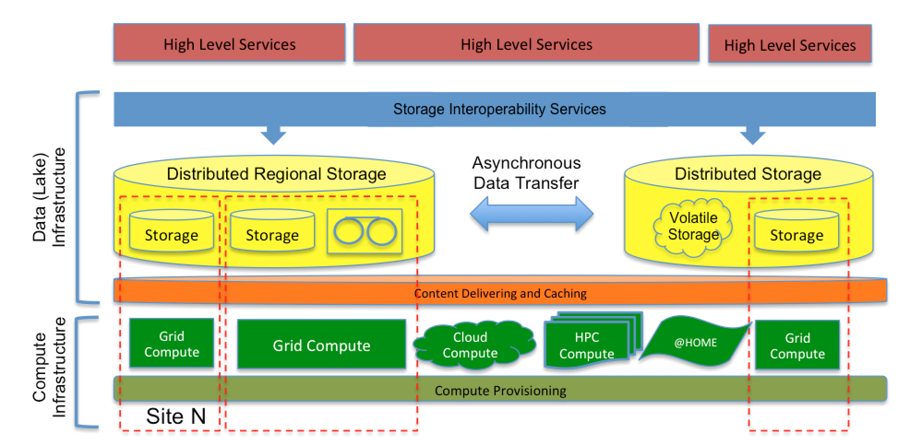
Quo Vadis, Computing?:::Towards: Data & Compute Infrastructure (also known as ‘Data Lake’)
5.- Perspectives and conclusions
P
From Ian Bird’s presentation @ S&C Technical Meeting ATLAS

Slide 14
Conclusions:
The computing(&data) ‘ecosystem’ is more complex than 10 years ago:
The GRID IFIC group has got a high level experience
Scenario: Cloud computing, HPC, GRID resources, volunteer (@home),…
The Spanish LHC Computing (GRID) community: to establish the main guidelines for the next years (HL-LHC):
Update of the LHC Computing @ Spain
Extension to another FPA sectors to take profit of experience
Moving towards common implementations (where realistic); joint efforts => i.e. In Data Management, Data lake(s)
Training of ‘Data Scientists’ ( physicists & technologists): staff well valued at the experiment
Strategy @ IFIC : Confluence of interests, synergy between projects, collaborative environments,…

Slide 15
GRACIAS POR VUESTRA ATENCION
PREGUNTAS

