Slide 1





Hadrontherapy Information Sharing Platform
Faustin Laurentiu Roman
CERN / IFIC
faustin.roman@cern.ch
Particle Therapy
Motivation
Project description
Legal and ethical framework
Status
Notes:
I will present you our prototype for sharing medical data for particle therapy.
The work is done in the framework of the EU FP7 PARTNER Project, an Marie Curie ITN.
I work at CERN and I am associated with IFIC and I do a PhD in UV.
So, I will explain you the (very) basics of PT, the motivation of having a data sharing platform and how grids are helping to achieve that.

Slide 2

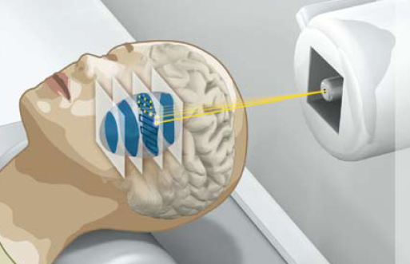
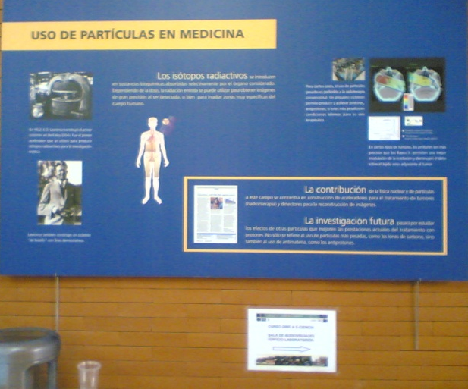

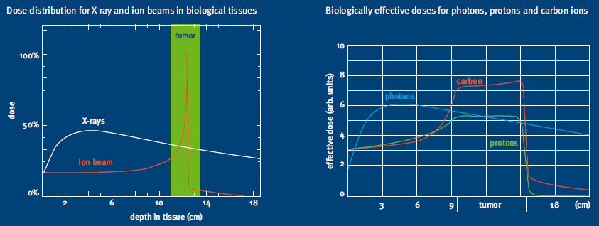
Particle therapy
CANCER = EU 2nd largest cause of death & No. 1 for age 45-64
See board outside…
http://www.klinikum.uni-heidelberg.de/fileadmin/pressestelle/pdf/080218HIT_BR_SS_Broschuere_engl.pdf
Notes:
In Europe cancer is the second largest cause of death, responsible for 25% of all deaths and is the biggest killer of people aged 45-64
Particle therapy is a form of radiotherapy that uses beams of energetic protons or ions (also called hadrons) for cancer treatment. Hadron therapy makes use of the Bragg Peak effect and Relative Biological Efectiveness of the hadrons to induce local damage
The goal is to damage as many cancer cells as possible, while limiting harm to nearby healthy tissue.
Outside this room there is also a poster in Spanish explaining the method so you can have a look there or just ask me after the presentation if you are interested in the subject.

Slide 3
Motivation
People
Patient referral
Research
EU Hadrontherapy
Prove efficacy
Model treatment
outcome
Information
Notes:
Here is a map with the future PT facilities in EU.
In November 2009 the HIT facility treated the first patient. Next will follow CNAO, ETOILE and MedAustron.
Also in order to fight against cancer one needs a multidisciplinary effort: biology, physics, genetics, imaging…
Currently there is no software platform connecting people, information and research across the hadron therapy community in Europe.
Building such platform would allow to aggregate and reuse data to address the needs of:
Patient referral
Model treatment outcome
Prove the efficacy of ion therapy

Slide 4

Hadrontherapy Information Sharing Platform (HISP)
Connect:
Users
Data sources
by
Grid core
Security
Integration
Portals
Interfaces
RTDB
Research
Patient
Referral
Grid
Middleware
Data Integration
Data Access Services
Security
Further
Use Case
Use Scenarios
HISP
DNA
PACS
Tissue
HIS
Data Sources
Physics
Notes:
To answer all the challenges and requirements of the Hadron Therapy community we are building a software platform based on Grids and here is the conceptual view of it.
The HISP role is to connect users with data sources.
Conceptually consists of:
A grid middleware for basic services like data storage
A security layer to enforce ethical and legal aspects of medical data
A data integration and access service for semantic linking of data.
A portal for various usecases: cross-border patient referral and research - RTDB will be presented further.
Al these linked by open and standard interfaces

Slide 5
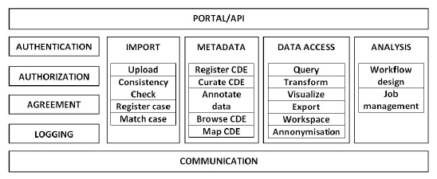
Conceptual Services and functions
Core services
Security
Interfaces
Data management
Metadata registry
Data mining & HPC
SLA Negotiation
AuthN & AuthZ
Agreement
Single-sign-on
Protection Framework
Standard + Interop
Transparent to HIS
Med.: HL7/DICOM
IT: SQL/ WS-*/XML..
Notes:
Here are the ingredients of the infrastructure;
Core services based on grid services will agregate data and metadata and provide computational power
Medical data is sensitive data thus requires proper ethical and legal frameworks.
Strong grid security mechanisms will ensure AuthN and AuthZ and patient data will be protected by anonymisation and encryption.
Role-based access: the molecular biologist doesn’t need to know about the patient’s name when doing research but the clinician will need to know when reffering form one site to another…
Standard Interfaces to hospital information systems will ensure proper data aggregation. Also standard languages to query the platform will keep it accessible and extendible to other services and uses.
Semantic layer will add meaning to data and allow ‘smart’ queries to be made.

Slide 6

Data integration
What?
  Separate description of data, data definition and domain knowledge.
Why?
Semantic interoperability: receiver interprets information in the same way as sender
How?
add metadata to data, in order to clarify meaning of data
use standardised terminologies
Definition
Data
More info: Daniel.Abler@cern.ch
Notes:
A few words about Data integration. We would need a semantic service to annotate data to ensure interoperability and clear meaning of data. This part would be done by my coleague Daniel.
We will provide a service to describe the type of data in the standard or language used by a poarticular user. Also we will have an service to transform this annotation in custum represenation and ontologies.

Slide 7
Rare tumour database
Rare Tumour = low incidence rate (<6/100.000/yr.)
Lack of data ➔ poor statistics
Lack of established best practices for treatment
Challenges: Define data set (biological/medical/physical) to be able to predict treatment outcome/give indication for HT
Functionality of RTDB: develop tools for
DB search for comparison of therapies
Implementation of new prognostic factors
Implementation of prediction models for treatment outcome
More info: Vassiliki.Kanellopoulos@cern.ch
Notes:
Application: Rare tumour database
Rare tumor incidence rate <6/100.000/yr.
Example in erice with 29.000 inhabitants there is only 1 person per year with this tumor (upper bound). in comparison: new breast cancer patietns per year: ca 90
Goal (violett) Find Hadron Therapy indication, Model treatment outcome

Slide 8
Medical Data: ethical and legal aspects
What I may see or hear in the course of treatment or even outside of the treatment in regard to the life of men, which on no account one must spread abroad, I will keep myself holding such things shameful to be spoken about.
http://en.wikipedia.org/wiki/Hippocratic_Oath
Directive 95/46/EC, European Data Protection
Directive 2002/58/EC on e-Privacy
EC Recommendation (EC Rec. 2008/594/EC) on cross-border interoperability of electronic health record systems
Country specific: UK DPA 1998, DE BDSG,…
Privacy
Confidentiality
Autonomy
Liability
Adequate, relevant
Informed Consent
(Pseudo)Anonymization
Publish findings
Clinical data
Research data
Notes:
Medical Data exchange presents the challenge of respecting the ethical and legal frameworks.
Starting with the HO and gettiing to the EU legislation on data protection we have to ensure that patient rights and the research needs are balanced.

Slide 9
Status
Develop web service: AMGA-MDR
Security framework: roles and privileges
Workflow and portal integration
More on:
https://espace.cern.ch/partnersite/workspace/faust/
Soon public: http://twiki.cern.ch/twiki/bin/view/PARTNERitESR

Slide 10
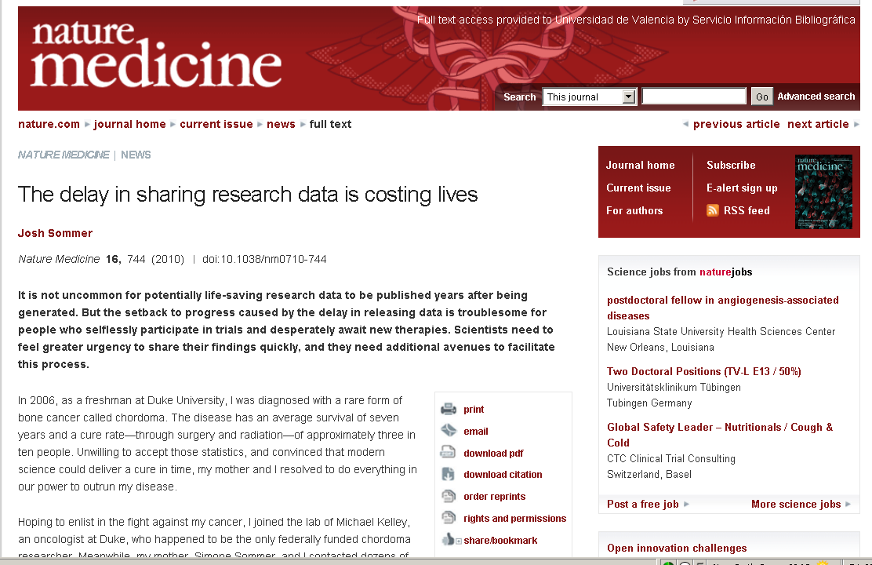
A patient opinion…
http://www.nature.com/nm/journal/v16/n7/full/nm0710-744.html

Slide 11
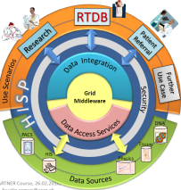
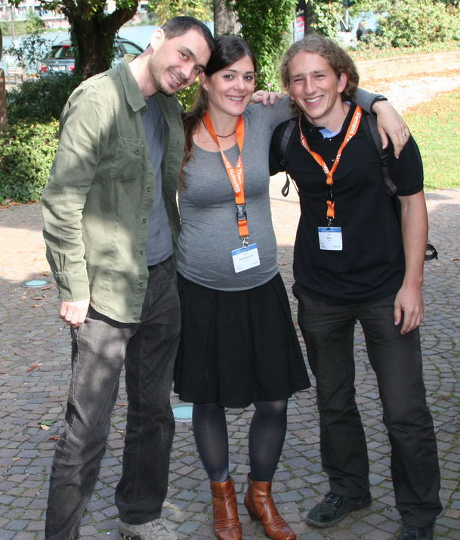


Coordinated resource sharing and problem solving in dynamic, multi-institutional virtual organizations… (I. Foster et al)

