Slide 2
Augmenting Reality
Axions, Anyons, …

Slide 3
Axions

Slide 4
Few aspects of experience are as striking as the asymmetry between past and future.
If you run a movie of everyday life backwards, it does not look like everyday life.

Slide 5
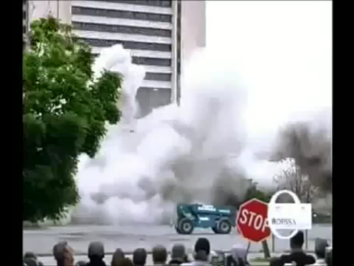

Slide 6
Yet time-reversal symmetry (T) was a notable property of the fundamental laws of physics for several centuries, starting with Newtonian mechanics, and continuing through general relativity and quantum electrodynamics.

Slide 7
Why?

Slide 8
As long as T symmetry appeared to be an exact, fundamental feature of physical law, it was unclear that asking “Why?” would be fruitful.
T symmetry might be rock bottom.

Slide 9
In 1964, James Cronin and Val Fitch discovered a subtle effect in K meson decays that slightly violates T symmetry.
⇒ T symmetry is not rock bottom.
It’s not even quite true - just very nearly so.

Slide 10
Why?

Slide 11
We’ve almost nailed it.

Slide 12
The basic, sacred* principles of modern physics - relativity + quantum mechanics + local symmetry - are very powerful.
There are exactly two possible sources of T symmetry violation, that are consistent with those principles.
One of them beautifully explains what Cronin and Fitch observed, and a lot more.
The other doesn’t happen.

Slide 13
Why?

Slide 14
Over the past 40+ years, there have been several attempts to explain it, but only one has stood the test of time.

Slide 15
We promote the unwanted term to a dynamical entity - a “field”, which evolves to zero.
The new field is made of a new kind of particle.
I named it the axion, in homage to a laundry detergent:

Slide 16
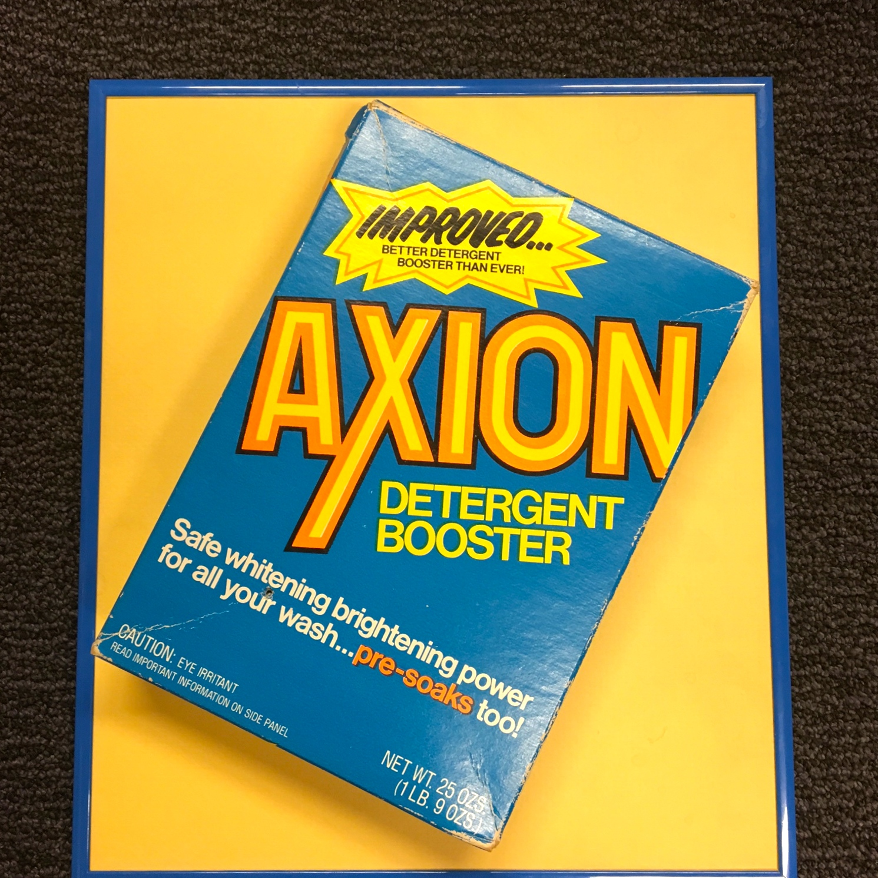

Slide 17
Do axions exist?
We still don’t know for sure - but in recent years the stakes have risen dramatically.

Slide 18
We can calculate that axions get produced in the big bang, and survive to this day.
The relic axion gas has properties consistent with the observed properties of the astronomers’ “dark matter”.

Slide 19
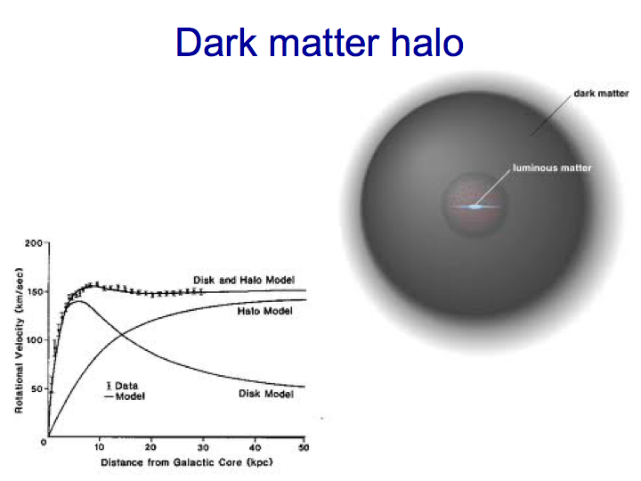

Slide 20
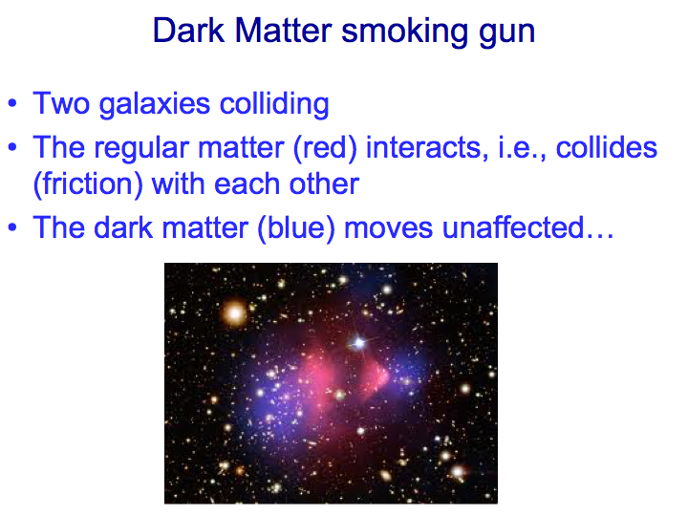

Slide 21
Bottom line:
If axions exist at all, they must contribute significantly to the dark matter. Plausibly, they dominate it.

Slide 22


Slide 23
Several clever strategies for axion detection have emerged.
It’s won’t be easy, but many determined people are at work …

Slide 25
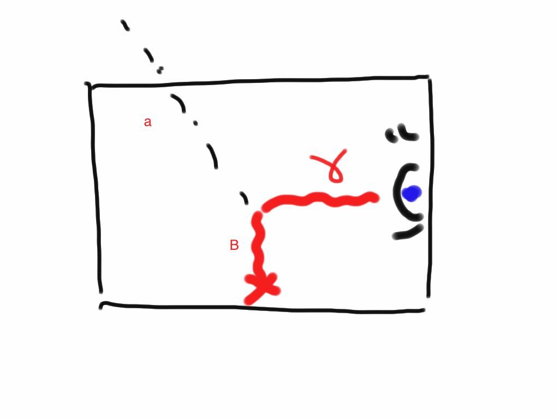

Slide 26
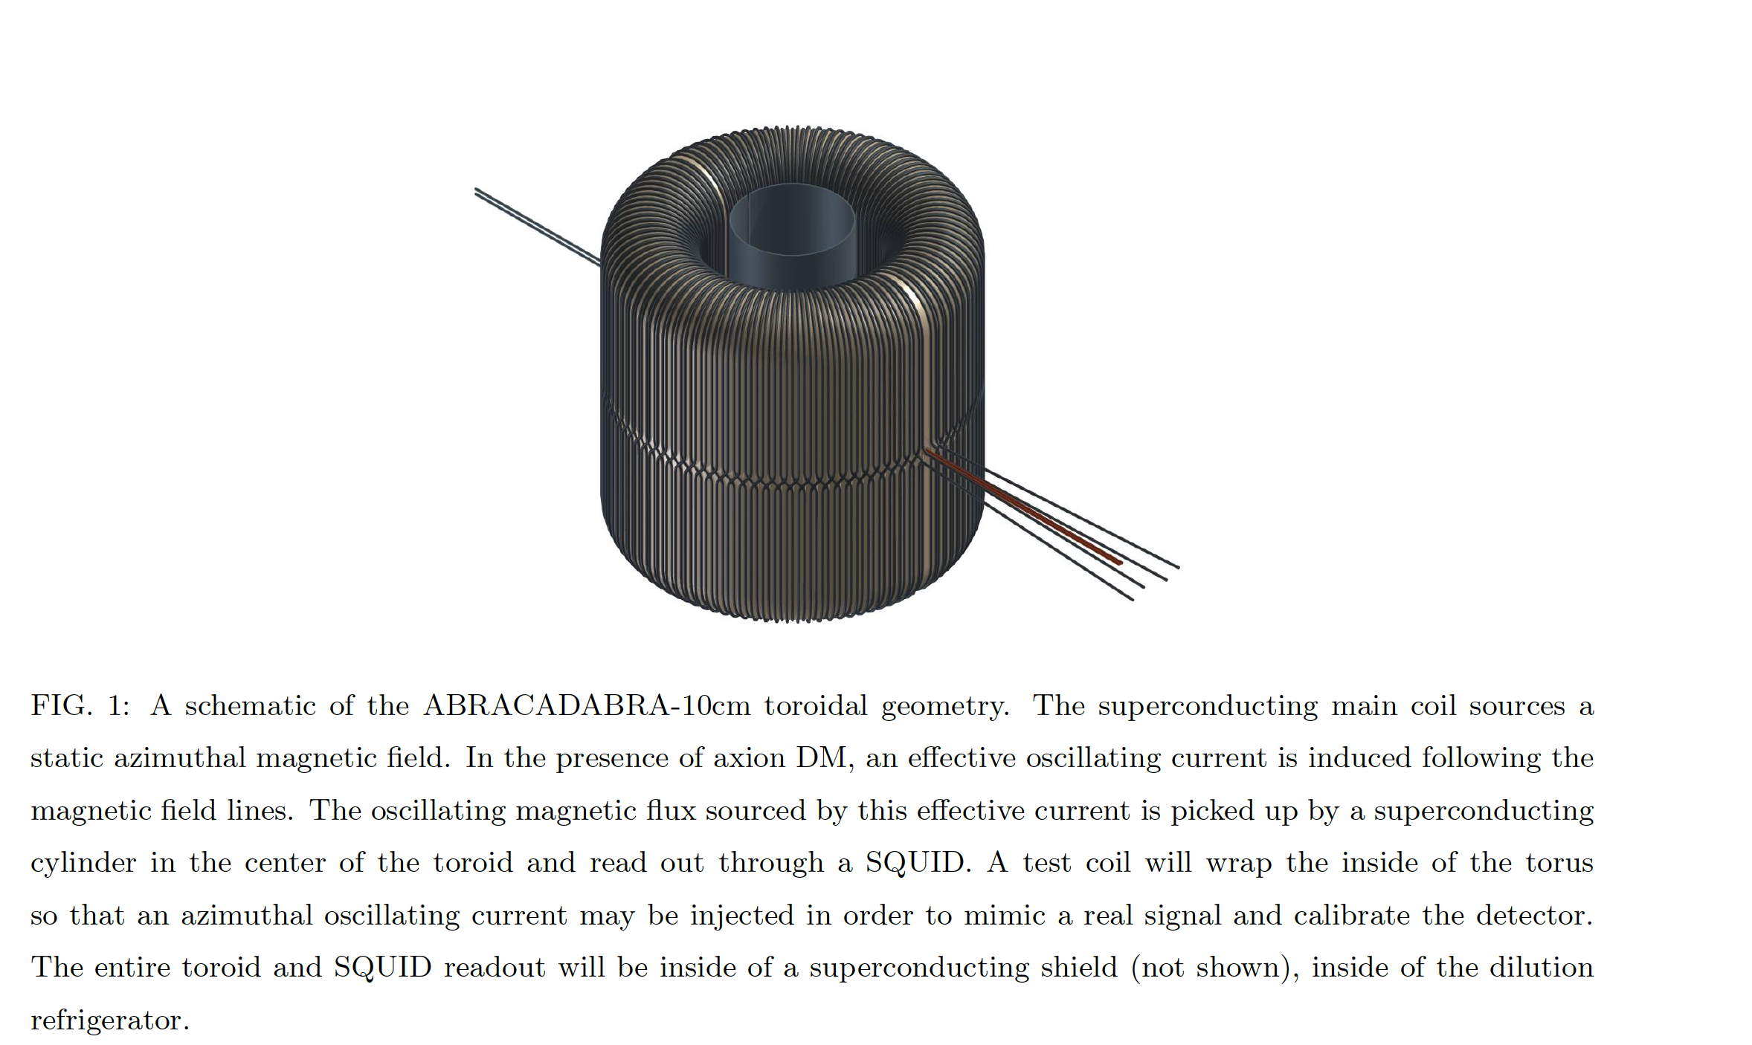
abracadabra white paper

Slide 27


Slide 28

keeping the past and the future in balance

Slide 29
Anyons

Slide 30
Since the discovery of wave-particle duality, and its elaboration in quantum theory, we understand that the basic units of all forms of matter - including light - the same sort of thing: “wavicles”, “laves” …
or, to keep it simple, particles.

Slide 31
But when we consider the behavior not of single particles, but of groups of them, we find that particles divide into two great kingdoms, bosons and fermions.

Slide 32
Bosons are collectivists. They like to do the same thing.
(Technically, they like to occupy the same quantum state.)
Photons are bosons. A laser beam is an excellent example of their boson-ness in action.

Slide 33
Fermions are individualists. They hate to do the same thing.
(They refuse to occupy the same quantum state: Pauli’s exclusion principle.)
Electrons are fermions. The “solidity” of matter is an excellent example of their fermion-ness in action.

Slide 34
In a 3-dimensional (or more) world, that’s all there is.
In a 2-dimensional world - in Flatland - things get much more interesting, theoretically.
Less is more.
The reason is closely related to the theory of knots.
(In 4 dimensions, knots are not knotty.)

Slide 35
I named the new kinds of particles anyons, as in “anything goes”.

Slide 36
Experimenters can construct a wide variety of two-dimensional worlds, also known as thin layers of material.
In some of them, electrons fission into anyons.
For the electrons, this can be a shattering experience …

Slide 37
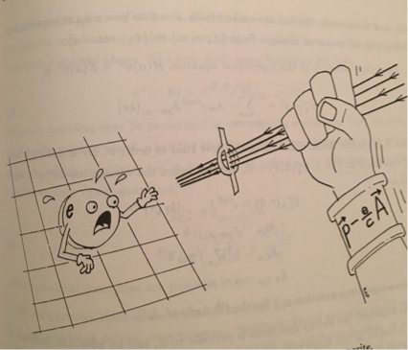

Slide 38
… but their offspring, which are anyons, emerge with brilliant new powers.
Anyons, unlike bosons or fermions, have memories.

Slide 39
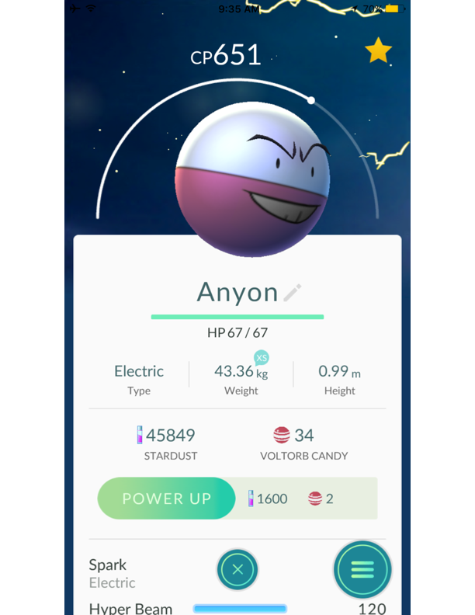

Slide 40
Some anyons support a very rich collective memory.
When you wind them around each other, their wave-function changes, making a record of what you’ve done.
This is the basis for “topological quantum computing”, in which Microsoft is investing heavily.

Slide 41
imprinting a memory
reading it out

