Slide 1



Inner Tracker
and
Physics at ATLAS y MoEDAL
C. García

Slide 2
Background
20 years of projects:
  AEN96-1661-C03-02 (1996) AEN97-1712-C02 (1997-2000) (*), FPA2000-1560-C02 (2001-2003) (*),FPA2003-03878-C02 (2003-2006) (*), FPA2006-13238-C02 (2006-2009) (*) (**), FPA2009-13234-C04 (2010-2012) (*) (**), FPA2012-39055-C02 2013-2015) (*) (**), FPA2015-65652-C4-1-R (2016-2018) (*) (**)
Devoted to the design and construction of the Semiconducter Tracker (SCT), integration in the Inner Tracker (ID), installation in ATLAS, commissioning, operation and data analysis
(*) En coordination IFIC y CNM since 1997.
(**) Since 2007 working in the new tracker (ITk) fro the HL-LHC phase.
FPA2015 project is the coordination of four sub-projects
ATLAS/MoEDAL
+
Tracker Upgrade
Tracker Upgrade
IMB-CNM
ATLAS
+
TileCal Upgrade
ATLAS
+
Future Coll. R&D

Slide 3
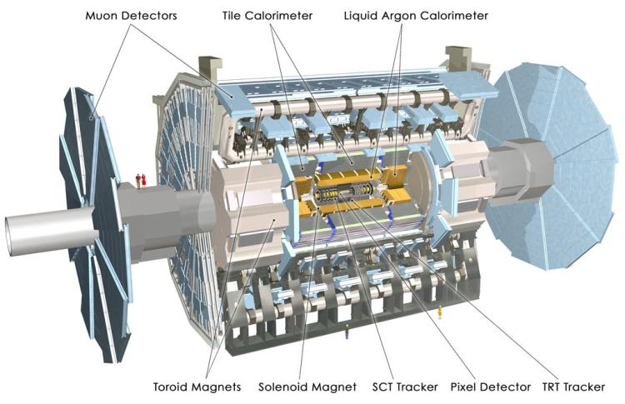
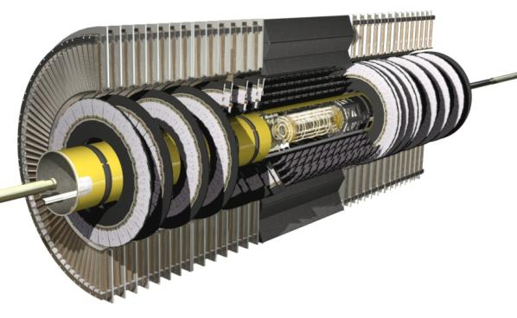
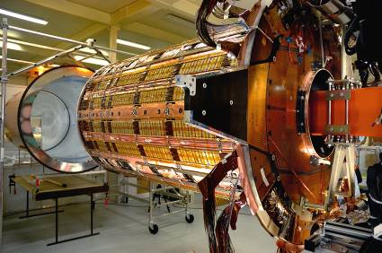
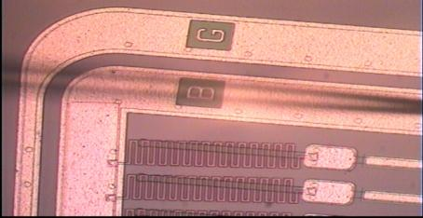
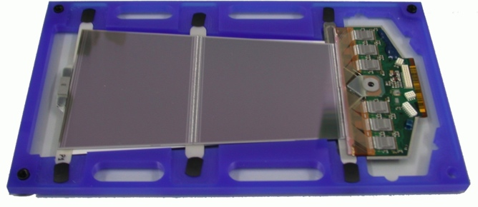
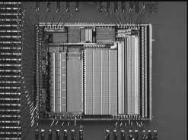
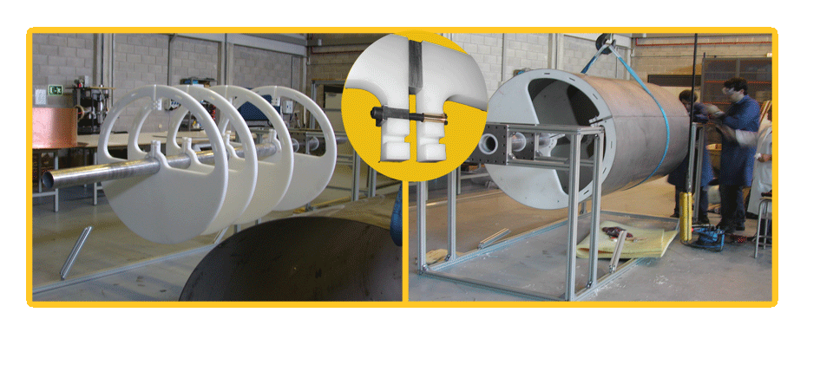
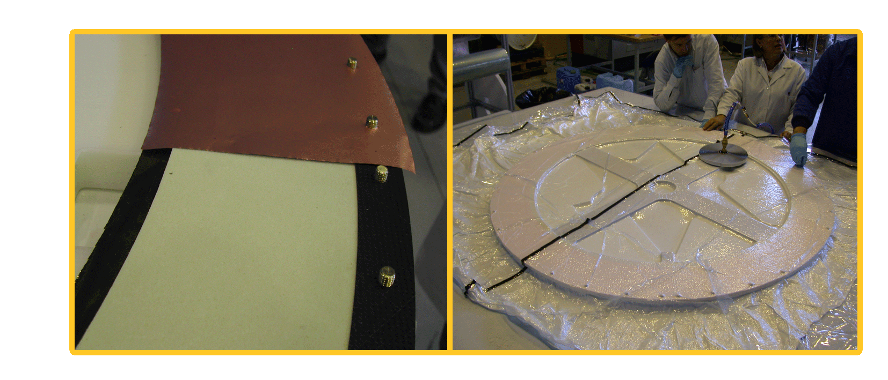
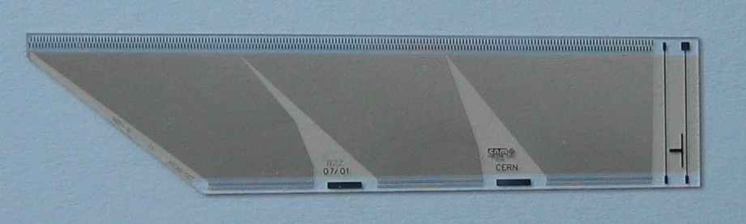



SCT Construction
Cubierta Térmica
Módulos Detector Interno
TRT
SCT
Pixels
OTE
Sensor
SCT módulo
ASICs
Ensamblaje y caracterización de 280 módulos
Completa caracterización de los componen-tes: 1200 obleas, 300 híbridos, 300 espinas….
Fabricación de los 10.000 Fan-ins del end-Cap (Contrato CNM: 430.000 €)
Fan-ins
Tolerancia: D = 1213.29 ⁺¹ mm
Completed in 2006
- 0

Slide 4
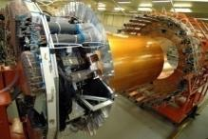
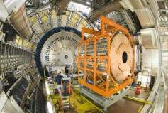
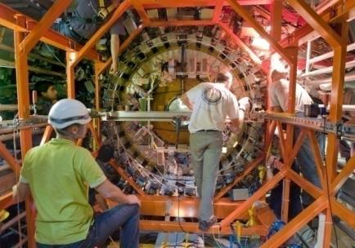
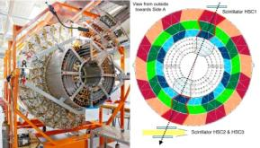
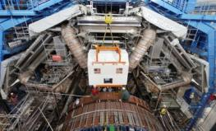
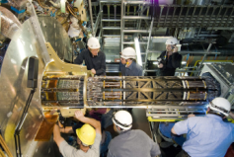
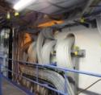
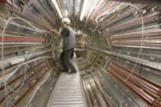

ID integration and Instalation
SCT + TRT Endcap test @ SR1
Fall-2006
SCT+TRT Endcap installed with in ATLA S April-2007
SCT + TRT barrel test @ SR1
June-2006
SCT+TRT Barrel Installed with in ATLAS
Agust-2006
2006
2007
2008
2009
Cosmics
Cosmics
Cosmics
Barrels macro-assembly
Endcaps @ SR1
ROD installed
Pixels with in ATLAS
June-2007
SCT service installation @ ATLAS pit

Slide 5
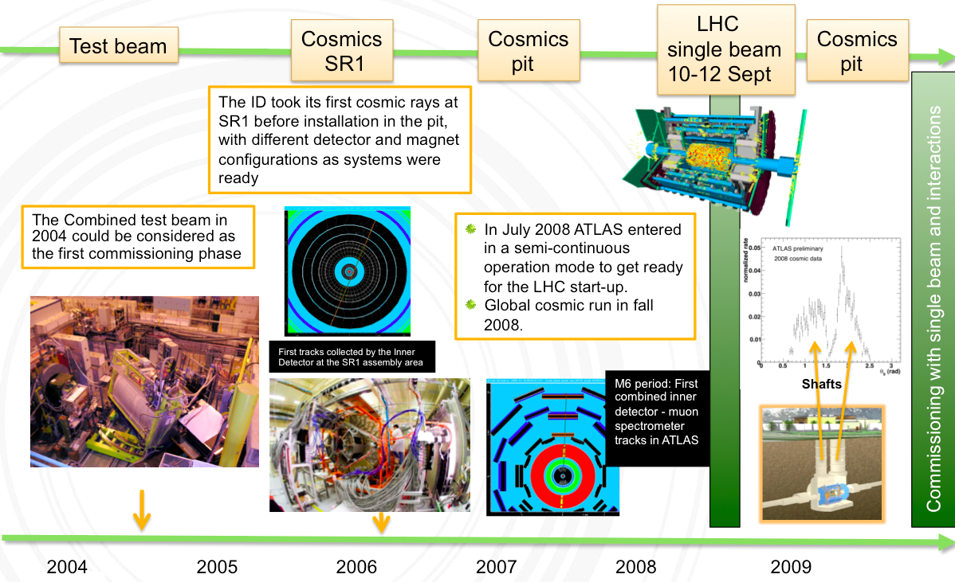
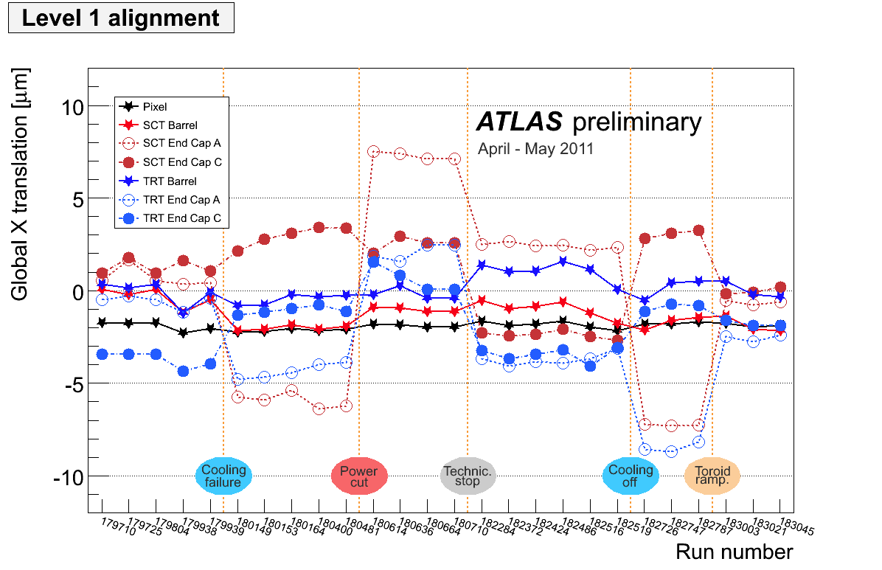
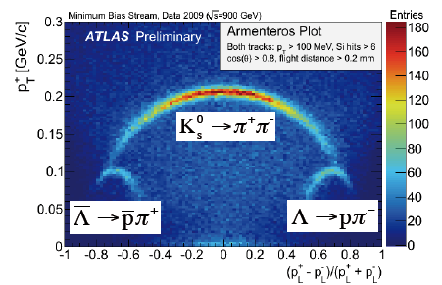
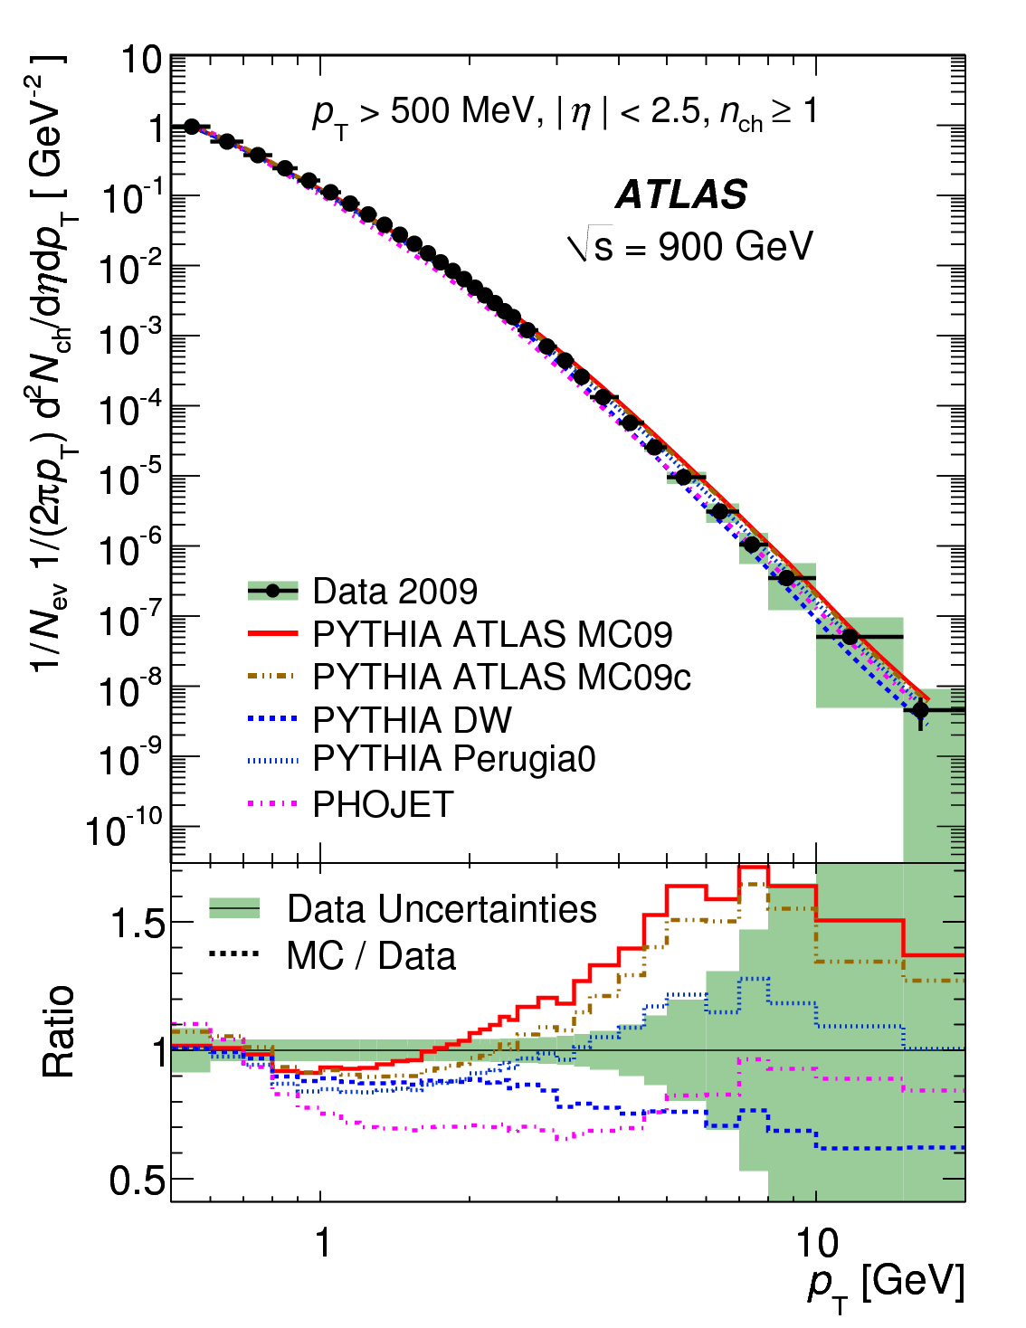
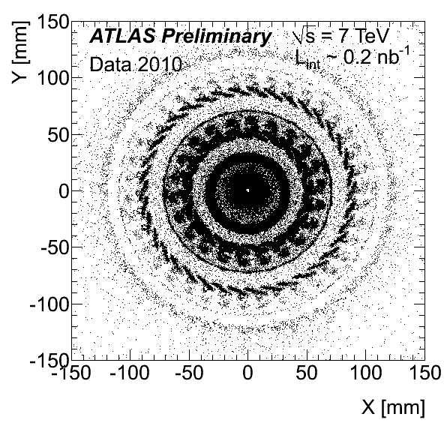
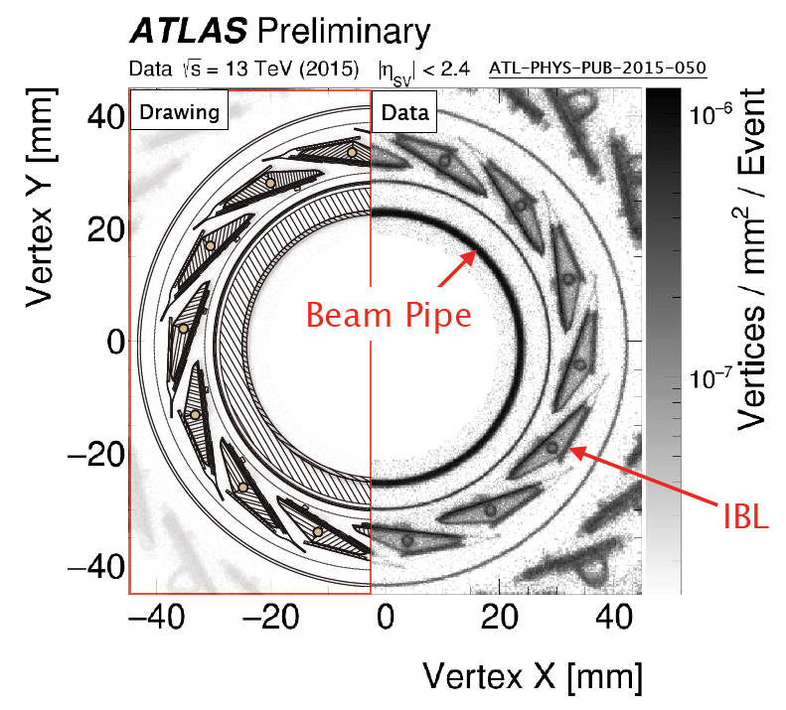
Commissioning
The ATLAS detector was commissioned using all types of physics data available: cosmic muons, beam gas interactions during the single-beam period and pp collisions data.
Track alignment
Track and vertex reconstruction
Material determination

Slide 6
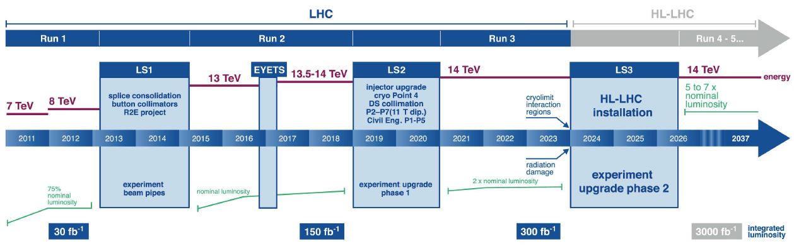
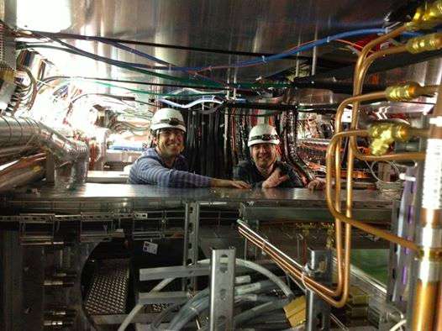
LHC and HL-LHC
IFIC-SCT
TWO EPERIMENTS SIMULTANEOUSLY
construction, installation, commissioning of the new ITK, at a the same time we have to operate ATLAS detector and to analyse the data

Slide 7
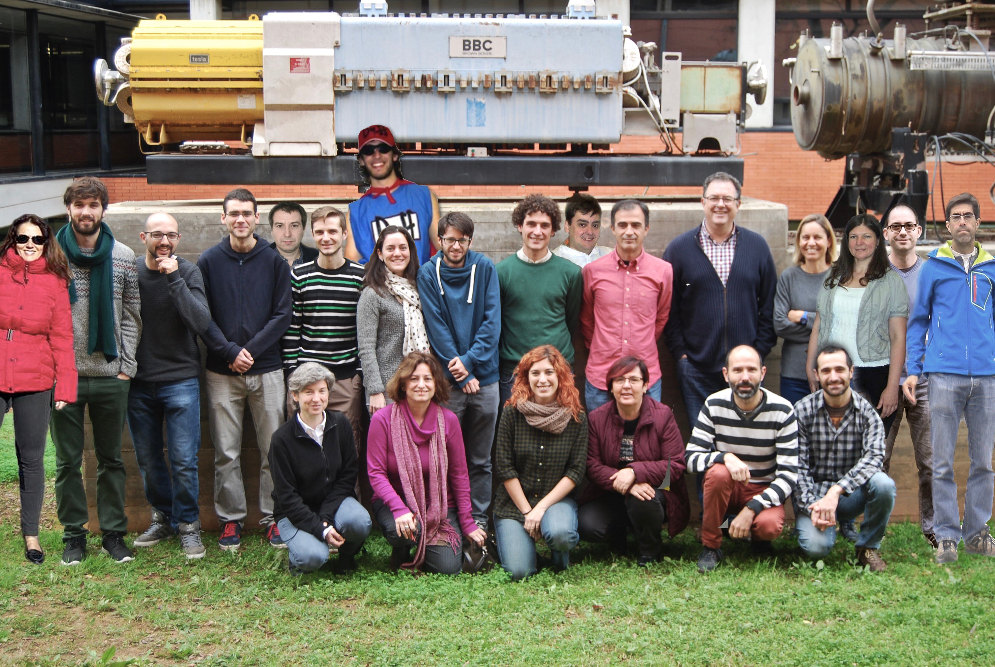

Personnel IFIC-tracker project
(2017)
IFIC-SCT
STAFF | Carmen García
 | Salvador Martí
 | Carlos Lacasta
 | M. José Costa
 | Susana Cabrera
 | Vasiliki Mitsou
 | J. Enrique García (RyC ext)
POSTDOC | Judita Mamuzic (50% MoEDAL)
 | Carlos Escobar
 | Mercedes Miñano
 | Daniele Malaffari (upgrade)
 | Arka Santra (50% MoEDAL)
ENGINEERS | José Bernabeu Verdú (50%)
 | J. Sánchez Martínez (10%)
 | M. Ángel Villarejo (80%)
 | Pablo León
 | Carles Solaz
Tech | Adrián Platero
STUDENTS | Urmila Soldevilla (PTA)
 | Javier Jiménez
 | Laura Barranco
 | Daniel Rodríguez
 | Oscar Estrada
 | Florencia Castillo
J. Vicente Civera
Paco González

Slide 8
Budget
IFIC-SCT
PROYECTOS |  | Costes Directos (€) | Costes Indirectos (€)
FPA2009-13234-C04-01 | 2009-2012 | 1.610.510 | 1.331.000
FPA2012-39055-C02-01 | 2013-2015 | 1.064.700 | 910.000
PA2015-65652-C4-1-R | 2015-2018 | 1.833.150 | 1.000.000 (1.515.000 (*))
(*) ATLAS M&O included
PROMETEO/2010/021 (ATLAS)
PROMETEO II/2013-017 (LHC & Cosmology)
(Mainly for contracts)

Slide 9
Main goals of the project
IFIC-SCT
Contribute to the Operation and Maintenance of the ATLAS detector, in particular the Inner Tracker, with especial emphasis in the tracker alignment.
Exploit the ATLAS full potential for physics studies and discoveries, in particular:
  Top physics: precision measurements as well as direct searches of new physics with top quark final states.
  Search for Supersymmetry and Dark Matter.
Design and construction of the new ATLAS Inner tracker for the HL-LHC phase.

Slide 10
Detector operation
IFIC-SCT
We have to contribute to the ATLAS Operation according with the ATLAS fair-sharing ⁽*⁾ . The OT include experts, shifters and on-call duties
Remote shifts
Experts
~ 2.6 FTE/year
~ 250 (8 hours shift) /year
Some of the more relevant contributions to ATLAS Operation as EXPERTS:
Development of track and vertex reconstruction and related performance studies with A. Wildauer as convener of the “Inner Tracking Combined Performance Group (2008-2010)”.
ID Tracking validation Contact (S. Cabrera)
Track-based alignment of the ID is one of our responsibilities, involving may member of the group (S. Martí as ID Alignment convener (2006-2011) and many others involve in alignment development.
Physics Validation, coordination M. José Costa, (2009-2011) and E Garcia-Navarro, 2011-2013), and S. Cabrera for the validation of the Top Working Group and E. Romero together with V.Mitsou for the SUSY Working Group.
Monte Carlo production coordinator (J.E Garcia-Navarro, 2013-2015).
Physic Office (V Mitsou, 2011-2012)
⁽*⁾ IFIC is 1.26% of ATLAS authors with PhD.

Slide 11
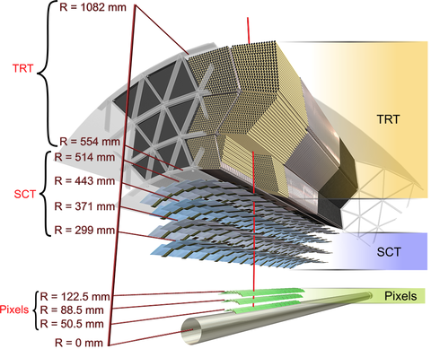
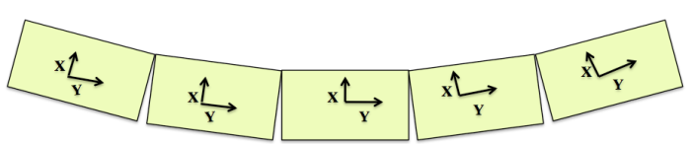
Track-base alignment
Hits are used to reconstruct track and their kinematic parameters.
The accuracy is limited by: the intrinsic resolutions, the knowledge of the magnetic field, the locations of the detector elements and the amount of material.
Misalignments of detector elements deteriorate the resolution of the reconstructed track, while correlated geometrical distortions can lead to systematic biases on the reconstructed track parameters (momentum and impact parameter)
Aligned using a track-based techniques
Base on residual χ² minimization.
Weak Modes (collective detector deformations that transform the trajectory into another trajectory, without affecting the quality of the track fit. There are some tools to determine these weak modes;
  Combine interaction, cosmic rays and beam halo data,
  Vertex and beam spot constraint
  External surveys and FSI Information
  E/p ratio, Z-> μ+μ-, J/ψ→ μ+μ
Bowed Pixel’s stave

Slide 12
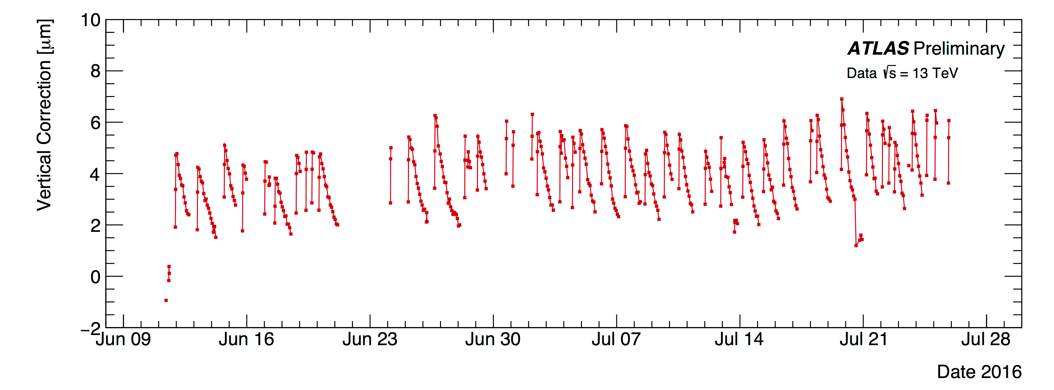
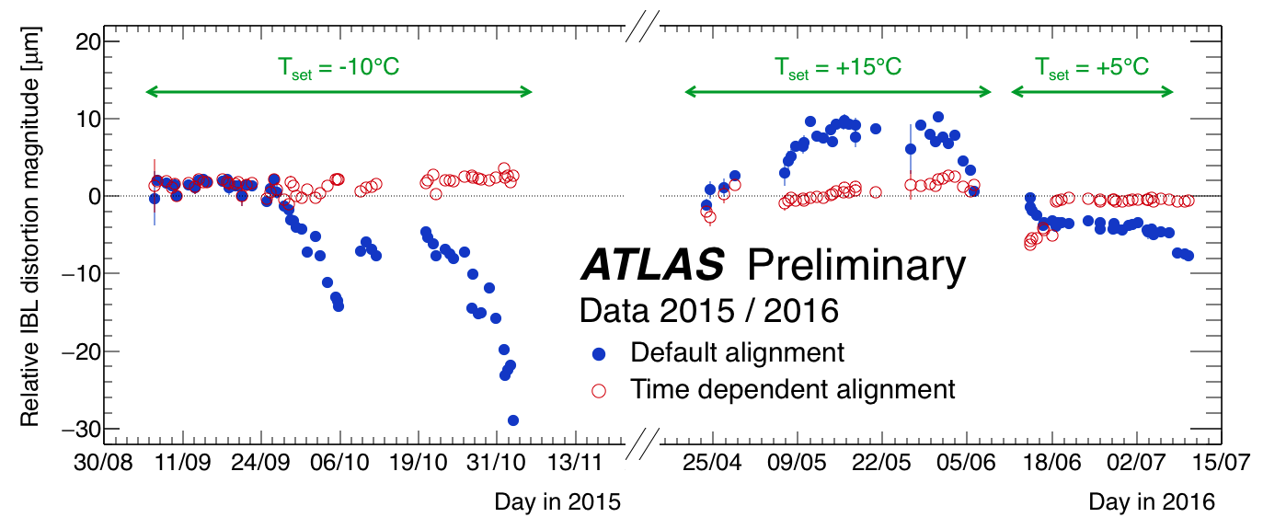
Track-base alignment
Alignment is under continues development and improvement
ID alignment is parte of the “calibration loop”: big structures are aligned every 20min. Alignment constants should be ready in <24 hours after the run is completed.
Off-line: all detector is realigned, form big structures to individual modules/tube (> 700,000 Dof)
Time-dependent alignment corrections were introduced in 2012 to correct for movements of the ID induced by environmental changes. At present , the alignment constant are calculated also for intervals of runs (lumi-blocks)
Pixels go up and down during a run
IBL move with the temperature
The last implementation has been the calculation of systematic error using Z and J/ψ→ μ+μ events. (Early studies to systematics to ensure that the mass obtained for the Higgs in the 4-lepton channel was not biased.
S. Martí, C. Escobar, R. Moles, V. Lacuesta, E. Romero-Adam, S.Pedraza, J. Jimenez, L. Barranco and O. Estrada.

Slide 13
Top Physics
Why is important to study the top quak sectors?
Top large mass -> large coupling to the Higgs boson -> it may play a special role in the mechanism of electroweak symmetry breaking -> many models for new physics predict the existence of new particles that would preferentially couple to top quarks.
  → Essential to measure with the highest possible precision the top quark properties and confront them with the SM predictions and perform direct searches of new physics in top production and decay.
Main analyses contributions:
Run-1: Focused on precision measurements
Top quark mass
Top pair production cross section
Top and W polarisation observables in single top t-channel (sensitive to possible anomalous couplings in the Wtb vertex)
Run-2: In addition:
Direct searches for dark matter candidates in associated production with top quarks.
Main responsibilities:
Convener ATLAS Top Physics Working Group (M.J. Costa, 2011-2013).
Convener ATLAS Single Top group (J.E. García, 2014).
Convener LHC Top Working Group (M.J. Costa, 2013-2015).

Slide 14
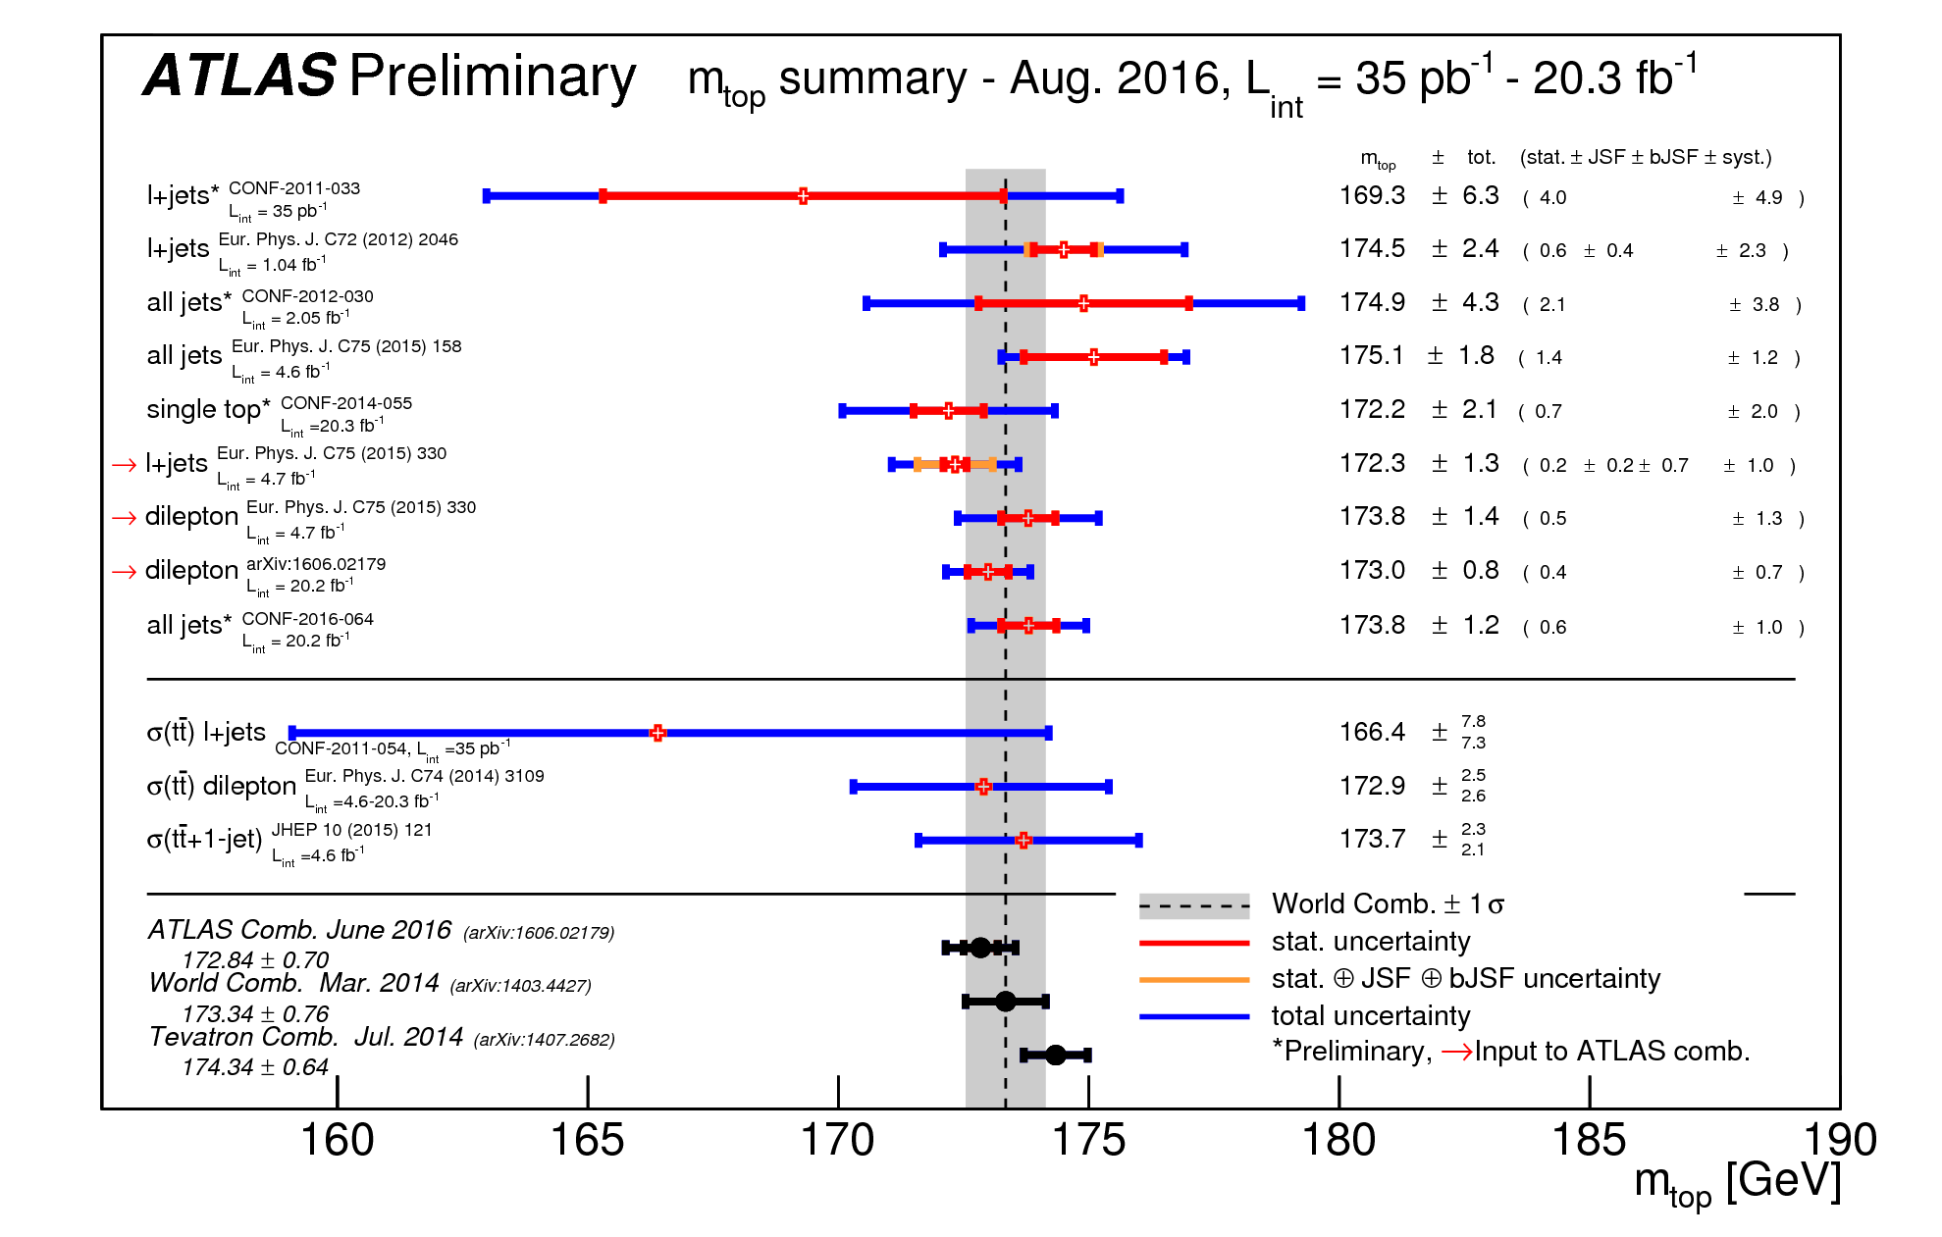
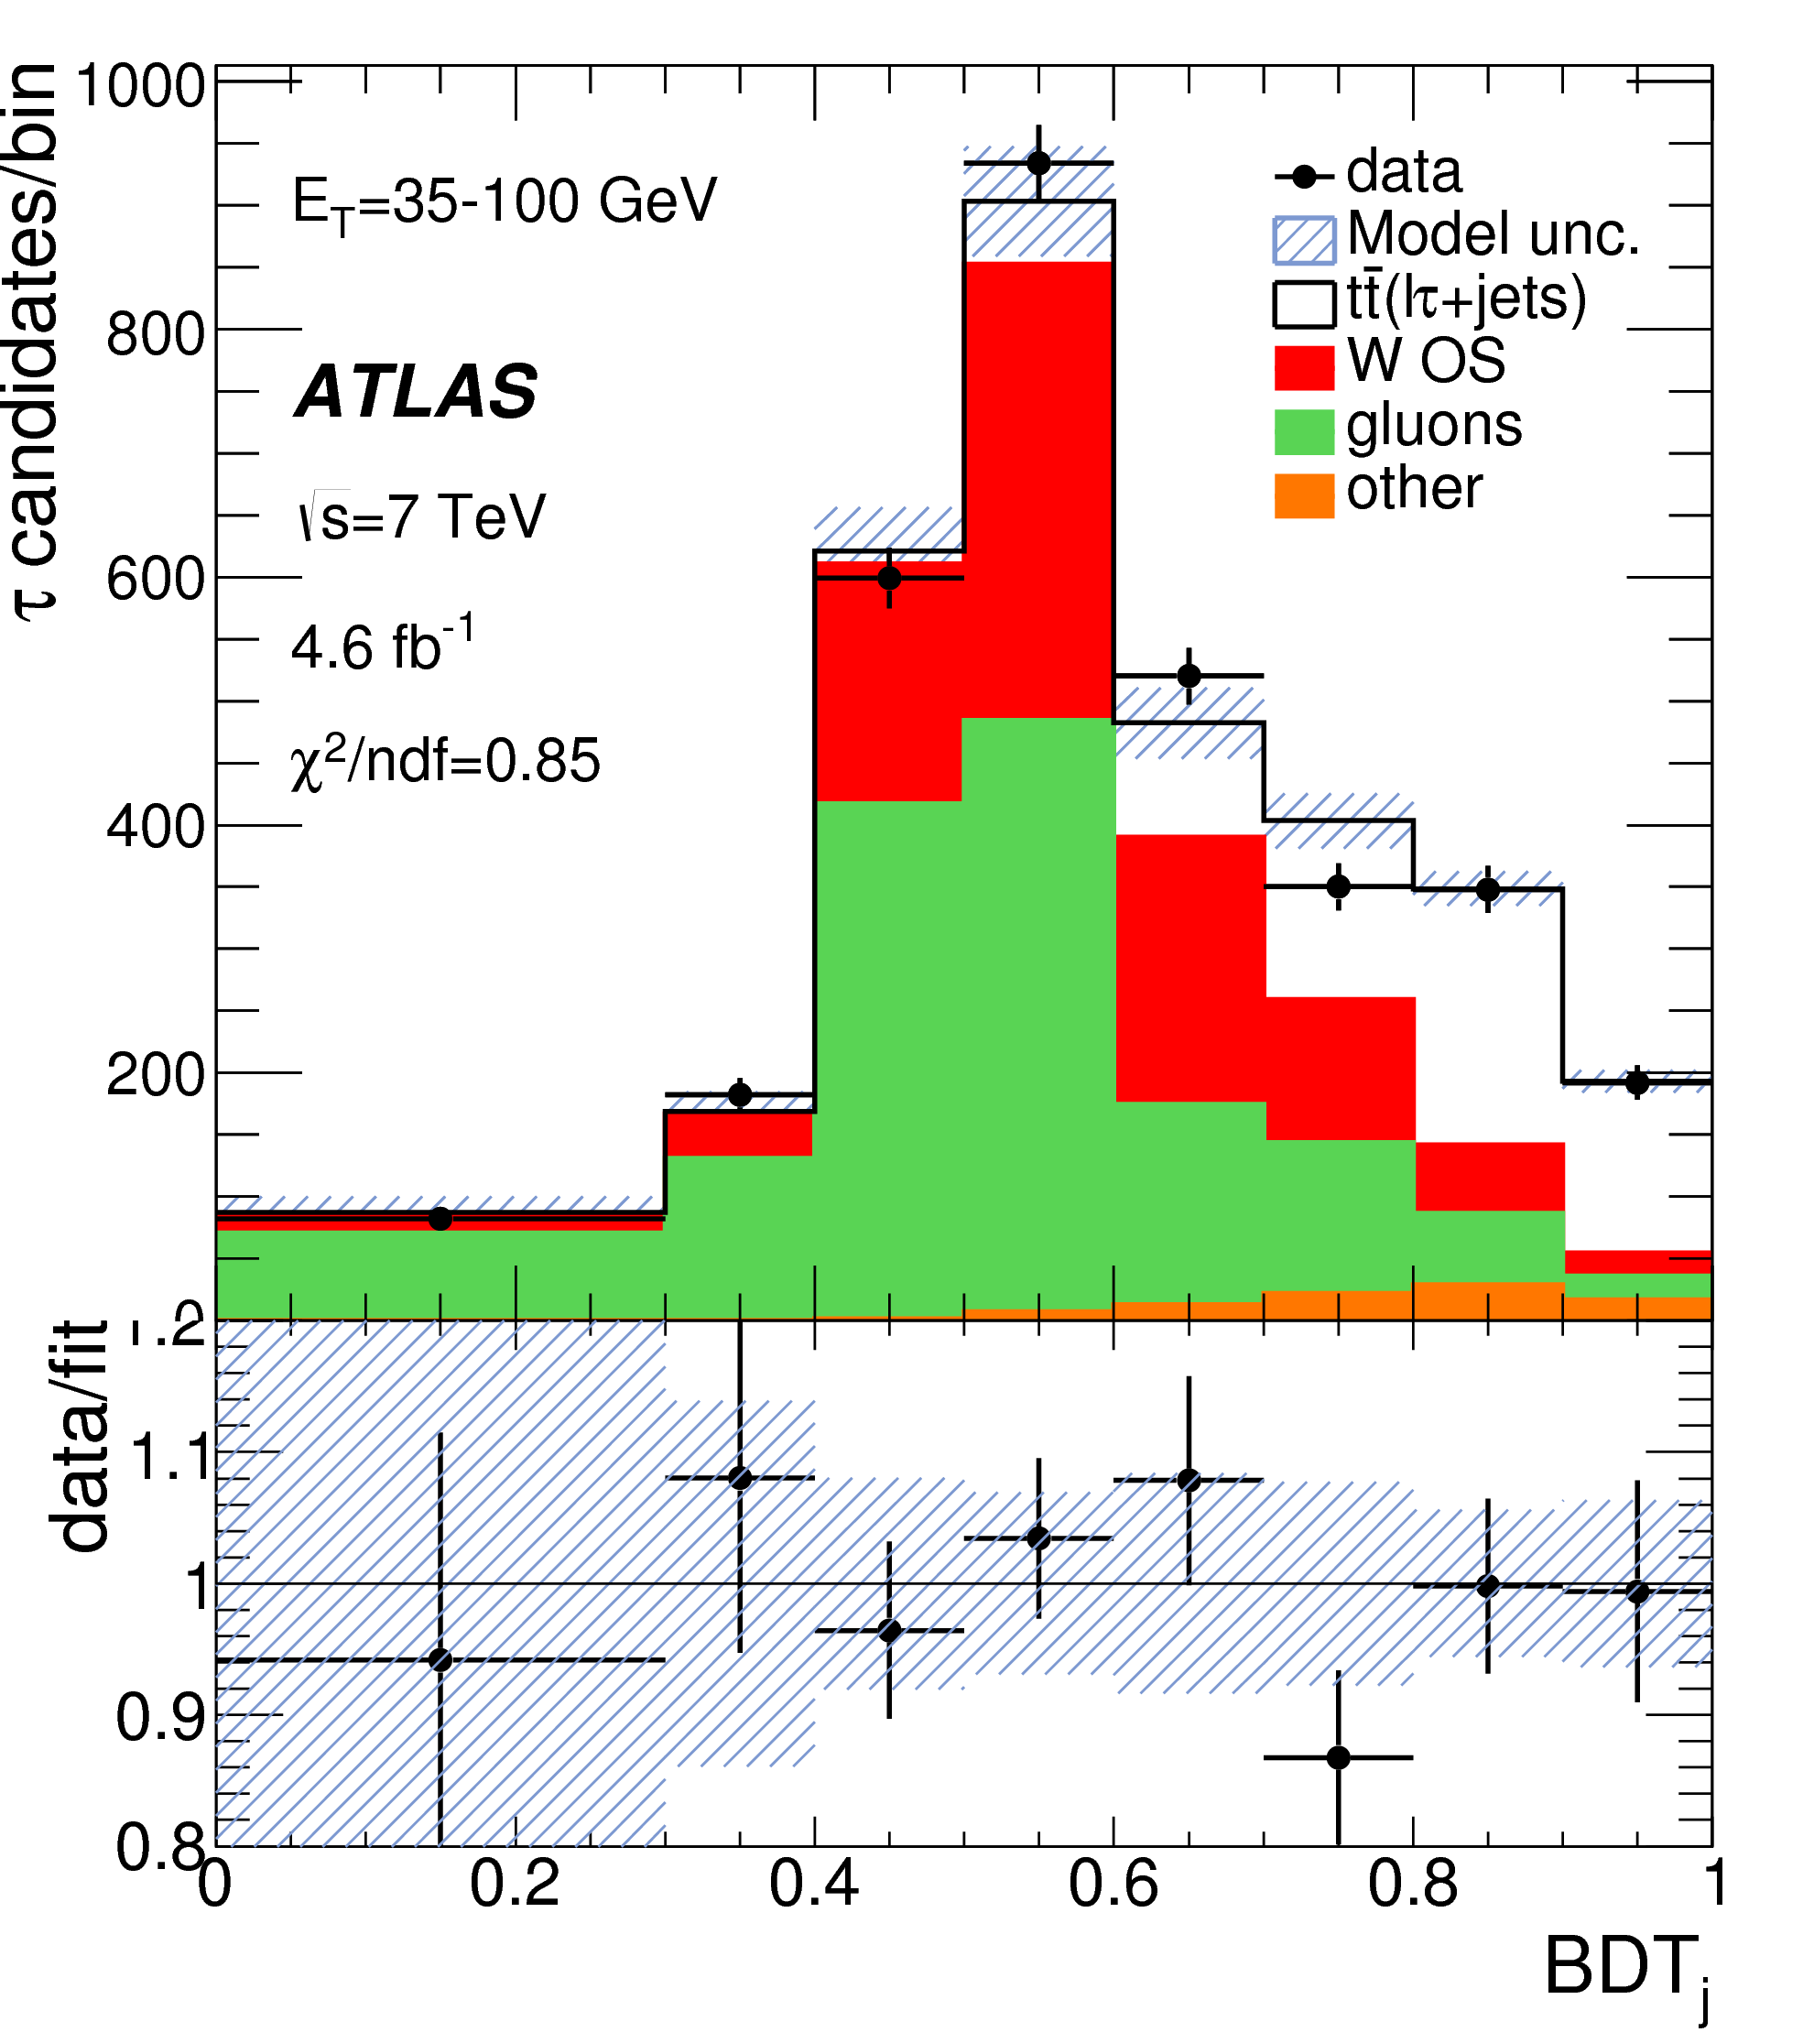
Top quark mass and top quark pair production
MASS
First ATLAS published measurement of the top mass using template methods (R. Moles PhD), with special focus on understanding the dominant source of systematic uncertainty, i.e. the jet energy scale. Eur. Phys. J. C72 (2012) 2046
Other studies: b-jet energy scale uncertainty Eur. Phys. J. C, 73 3 (2013) 2304
Cross Section
The group has contributed to measurement of the top quark pair cross section in (e/μ)+τ final states using a matrix method analysis technique (T. Pérez PhDs) Phys.Lett. B717 (2012) 89-108).
We have developed a novel technique using a BDT (Boosted Decision Trees) variable that improves previous results. Phys. Rev. D 92, 072005 (2015)

Slide 15
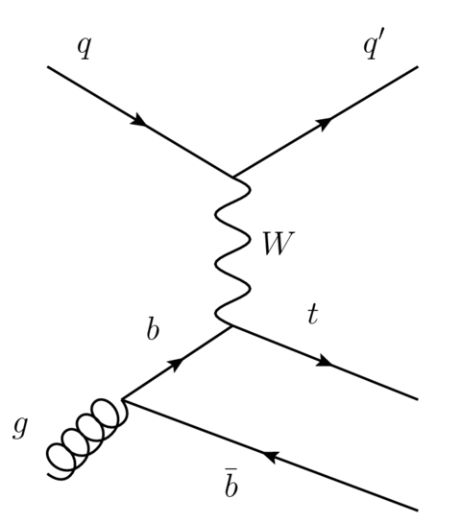
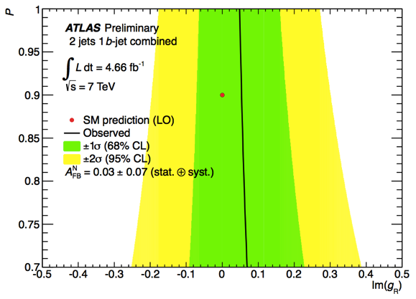
Top quark and W boson polarisation observables
Triggered by a collaboration with theorists from IFIC (J. Bernabeu) and the U. Granada (J.A. Aguilar-Saavedra), our group propose to ATLAS several analyses of measurements sensitive to Wtb anomalous couplings using t-channel single top quark produced events (the top quarks are predicted to be highly polarised).
The initial studies search for CP violation bases on the theoretical paper Nucl. Phys.B840 (2010) 349–378.
Standard Model the couplings of the Wtb vertex V_{L}≃1 and V_{R}=g_{L,R}=0
A^{N}_{FB}, is used to probe the complex phase of g_{R}. Non-zero value of this asymmetry signals a CP-violating contribution to the Wtb vertex not accounted for in the Standard Model.
First limits on Im g_{R} provided with assumptions on the top polarisation using 7 TeV data.
ATLAS-CONF-2013-032. (M.Moreno and V. Lacuesta PhDs)

Slide 16
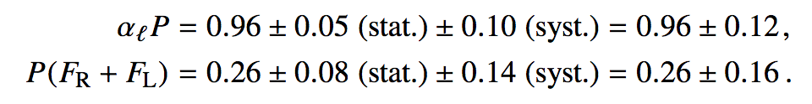
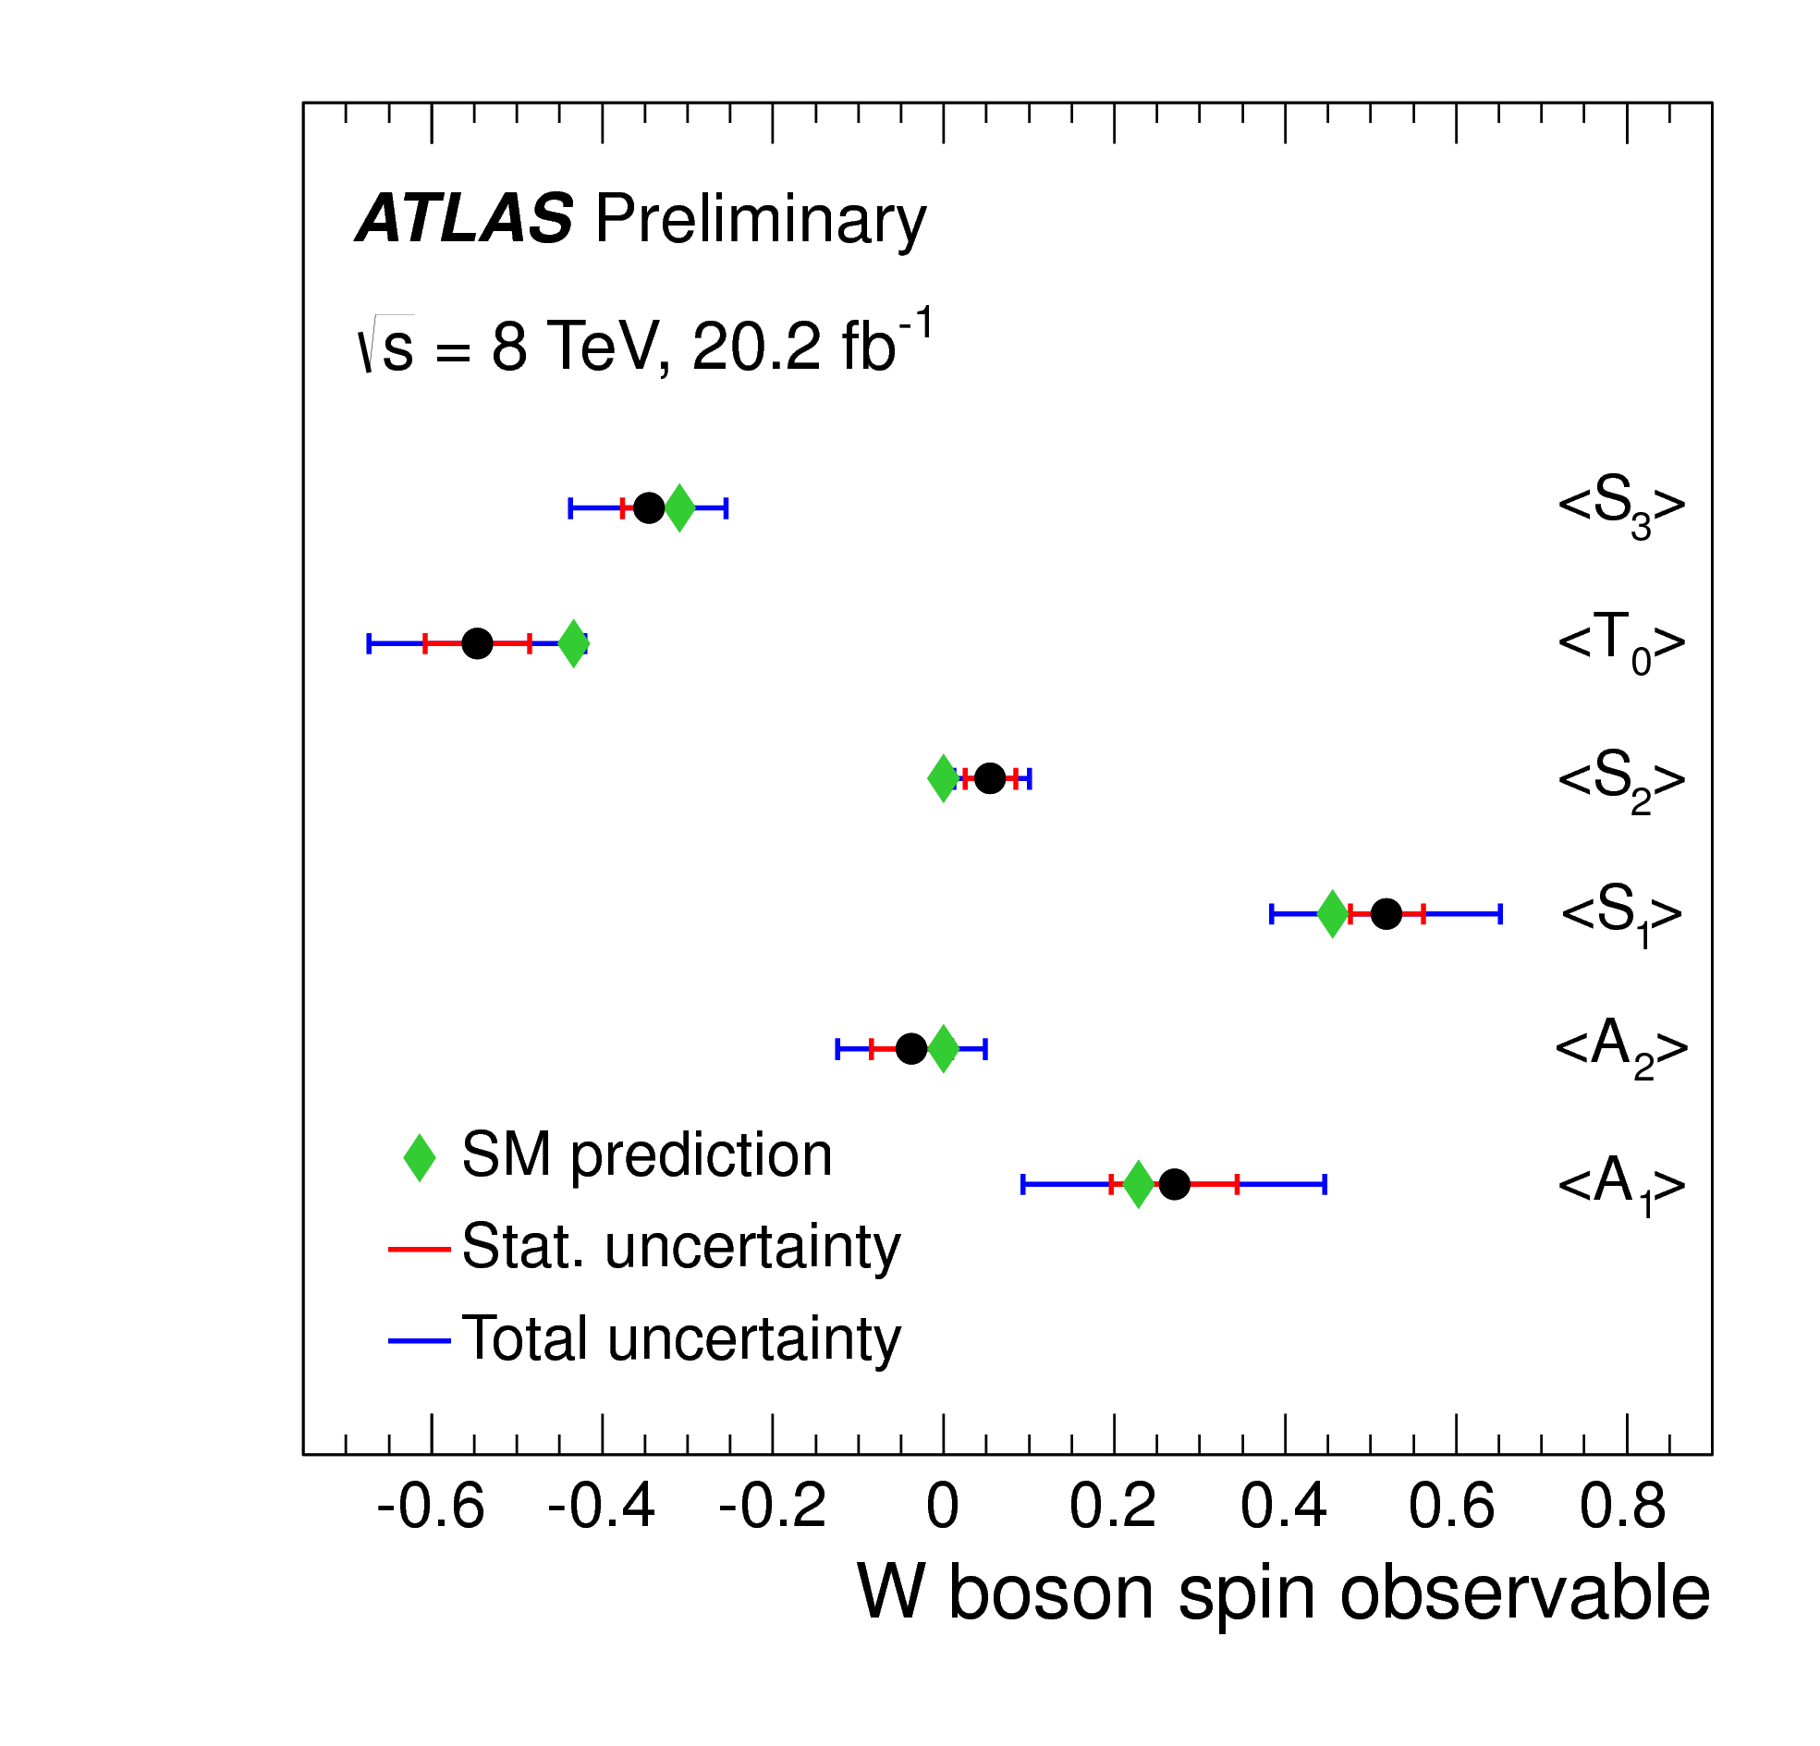
Top quark and W boson polarisation observables
The structure of the Wtb vertex has been probed at both production and decay using t-channel top events.
First measurement of all W spin observables (proposed by Aguilar-Saavedra and Bernabeu Phys. Rev. D 93 (2016) 011301).
Best measurement of top quark polarisation.
All measurements in agreement with SM predictions.
Best limits on complex phase of anomalous couplings (sensitive to CP violation effects in the top sector) set.
W spin observables
Top Polarisation
Constraints on top anomalous couplings
All results presented @ Top2016 Conference for the first time (ATLAS-CONF-2016-097).
Will be reflected in PhD Thesis L. Barranco, J. Jiménez, S. Pedraza. Final paper in latest steps of ATLAS review.

Slide 17
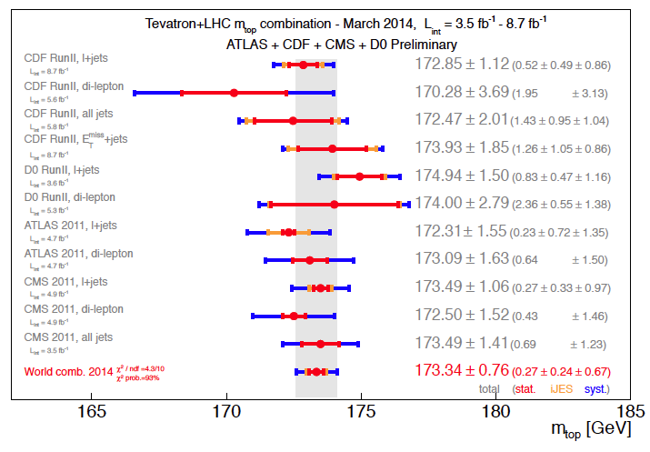
LHC Top Working Group
M.J Costa has coordinated the “Top LHC Working Group” (2014), belonging to the LHC Physics Center at CERN (LPCC), with the main aim of combining the ATLAS and CMS measurements. Some of the results are:
the combination of the charge asymmetry in top quark pairs (ATLAS-CONF-2014-012),
top quark pair production cross-section (ATLASCONF-2014-054) and,
cross-section measurements for associated production of a single topquark and a W boson (ATLAS-CONF-2014-052) as well as the first world wide measurement of the top quark mass (arXiv:1403.4427v1).
The group has also provided recommendation on experimental and theoretical uncertainties.

Slide 18

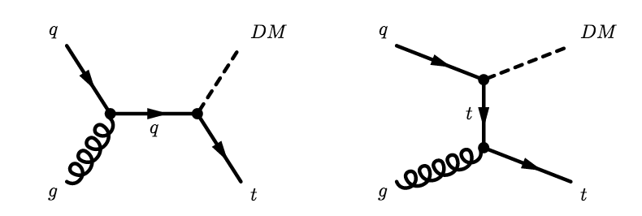
Dark matter search associated to top quark production
Various models of new physics (extra dimensions or supersymmetry) , predict the existence of new massive particles which are weakly interacting with matter. Their existence can only be inferred by the presence of large missing transverse energy.
Both he ATLAS and the CMS collaborations have performed searches for mono-jes and mono-photon, but , no events have been observed so far.
It is possible that the new particles favor coupling to massive SM particles, such as the top quark. Mono-tops has been search with run-1 data and at CDF.
Mono-tops
The previous experience of the group in top physics analyses will certainly be beneficial for the success of this project from both technical and physics point of view
(F. Castillo PhD)

Slide 19
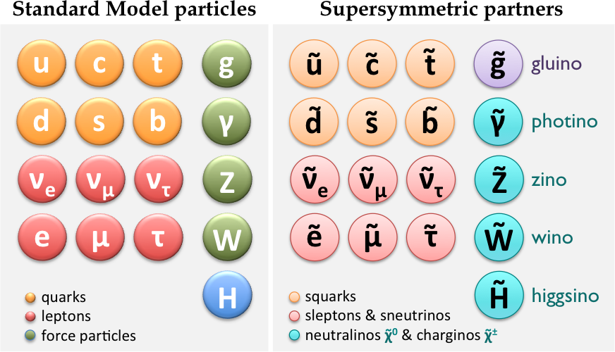
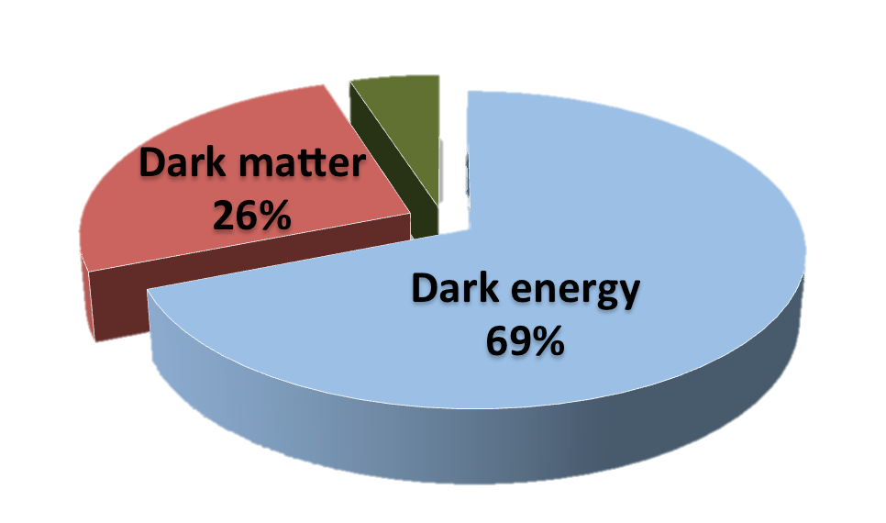
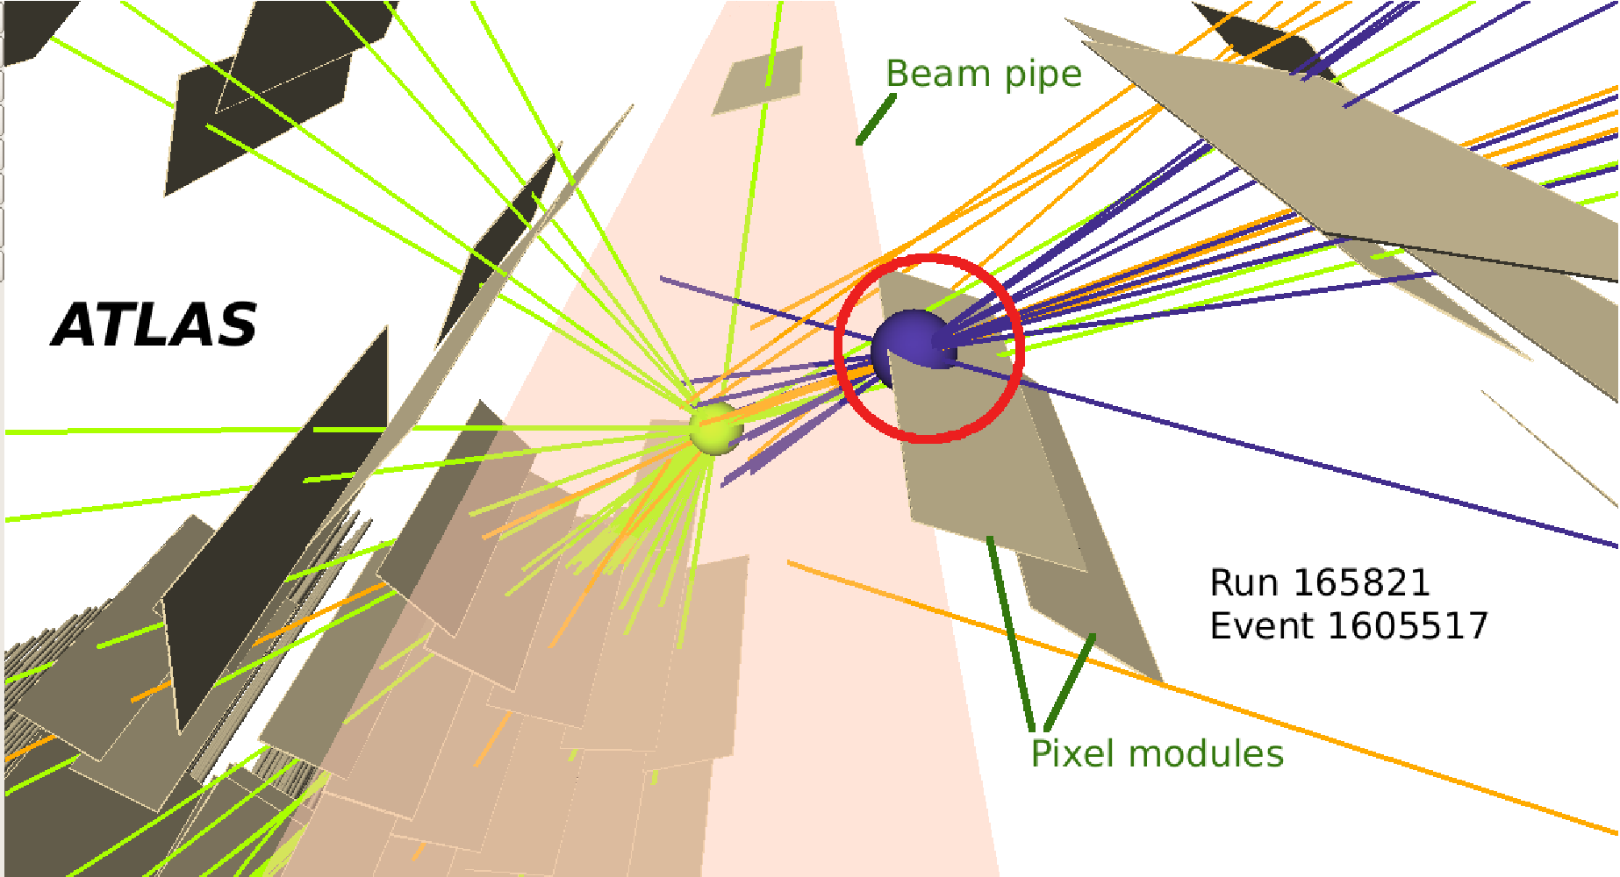
Supersymmetry
Supersymmetry (SUSY): global symmetry between fermions & bosons
Why search for it?
  Higgs: predicts a below-135-GeV scalar that may be SM-like – solves hierarchy problem
  unification of gauge couplings at single scale
  dark matter candidate
  introduces neutrino masses in bilinear R-parity violation (bRPV)
  [Valle, Hirsch, Porod, Romao, Diaz et al]
bRPV @ LHC
  moderately large MET due to ν-production
  LSP may be long lived ➞ displaced vertices
  IFIC group set first exclusion limits on bRPV

Slide 20
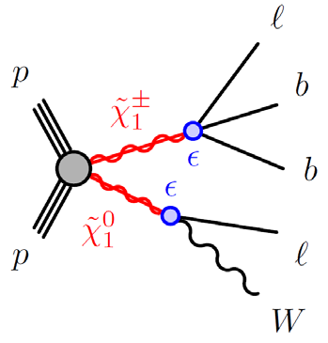
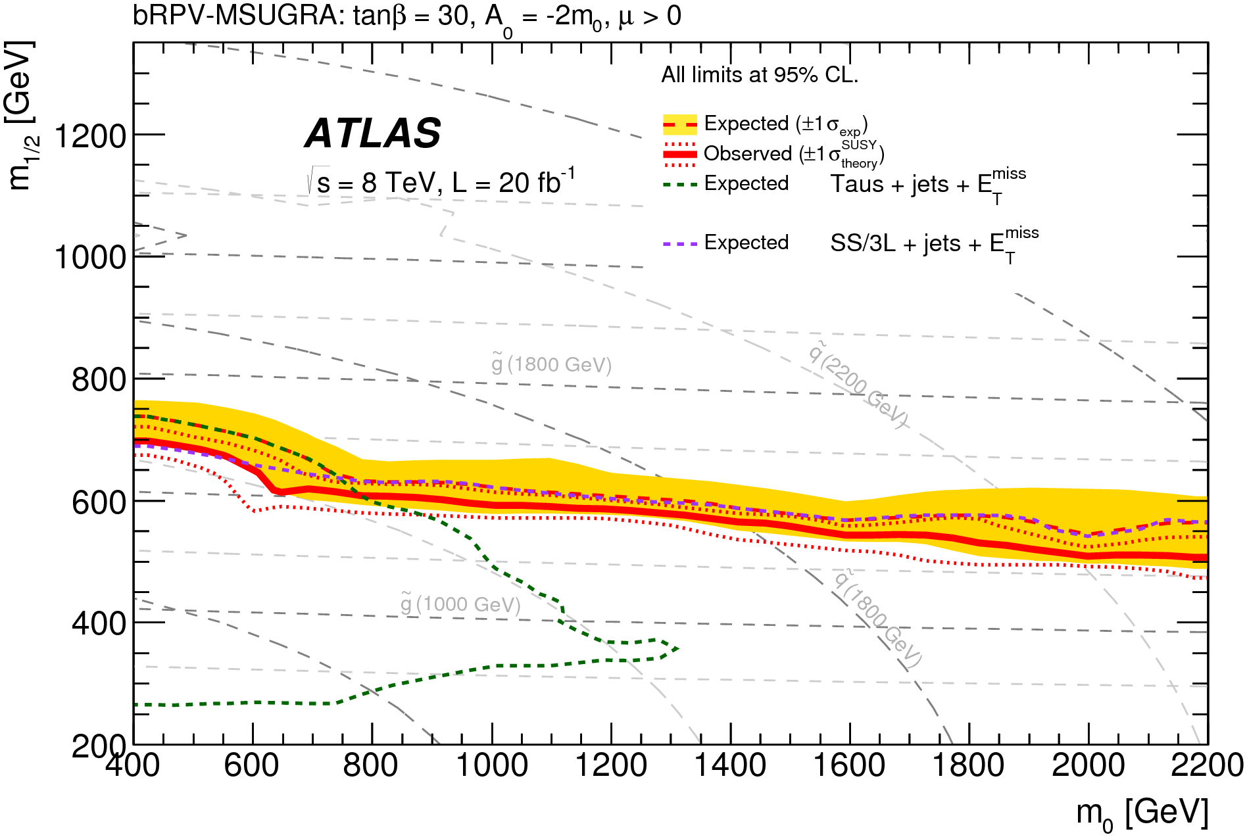
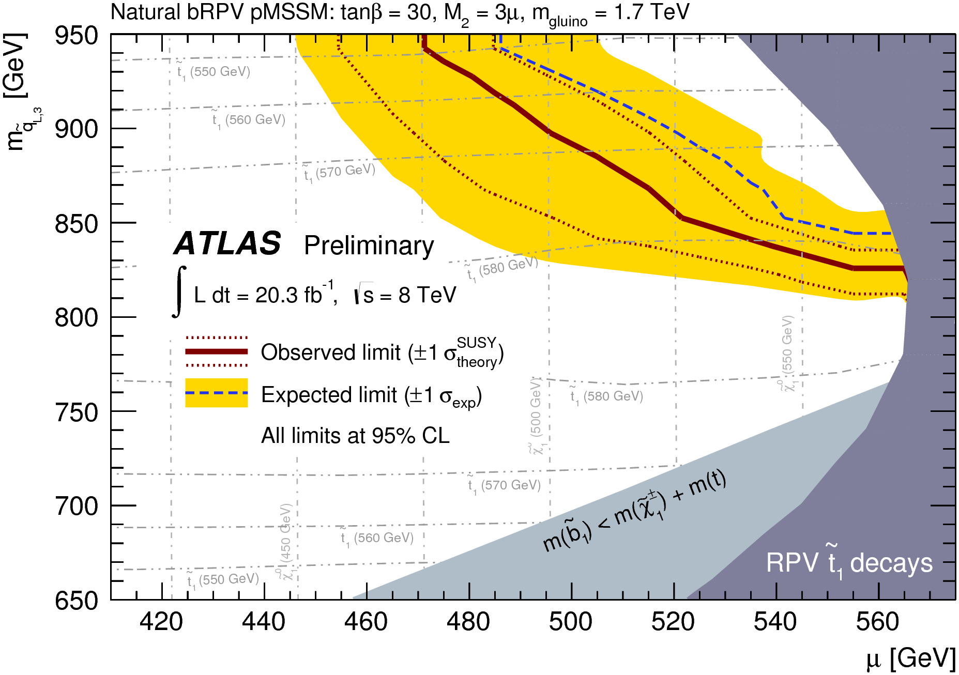
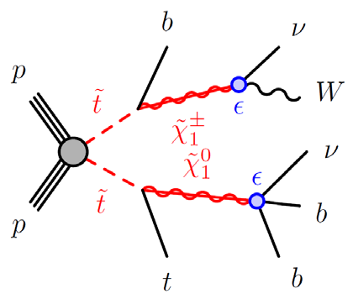
SUSY Searches: R-parity violation
Minimal Supergravity
(MSSM with R-parity violation)
Electrons, muons or taus & large MET
Limits weaker than Rp-conserving mSUGRA at high m₀
  Natural pMSSM
Light higgsinos & 3rd gen. squarks
2 same-sign leptons or 3 leptons
JHEP 10 (2015) 054
ATLAS-CONF-2015-018
1-lepton+MET+jets searches [Phys.Rev. D85 (2012) 012006,
ATLAS-CONF-2012-140, PhD E. Torró & E. Romero]
Limits on: mSUSY, simplified SUSY models with specific squark and gluino decay modes, and limits on parameters of a model with bilinear R-parity violation.
Notes:
pMSSM: phenomenological MSSM. Se ereducen a 19 los 107 parametros de SUSY cusando restricciones fenomenológicas

Slide 21
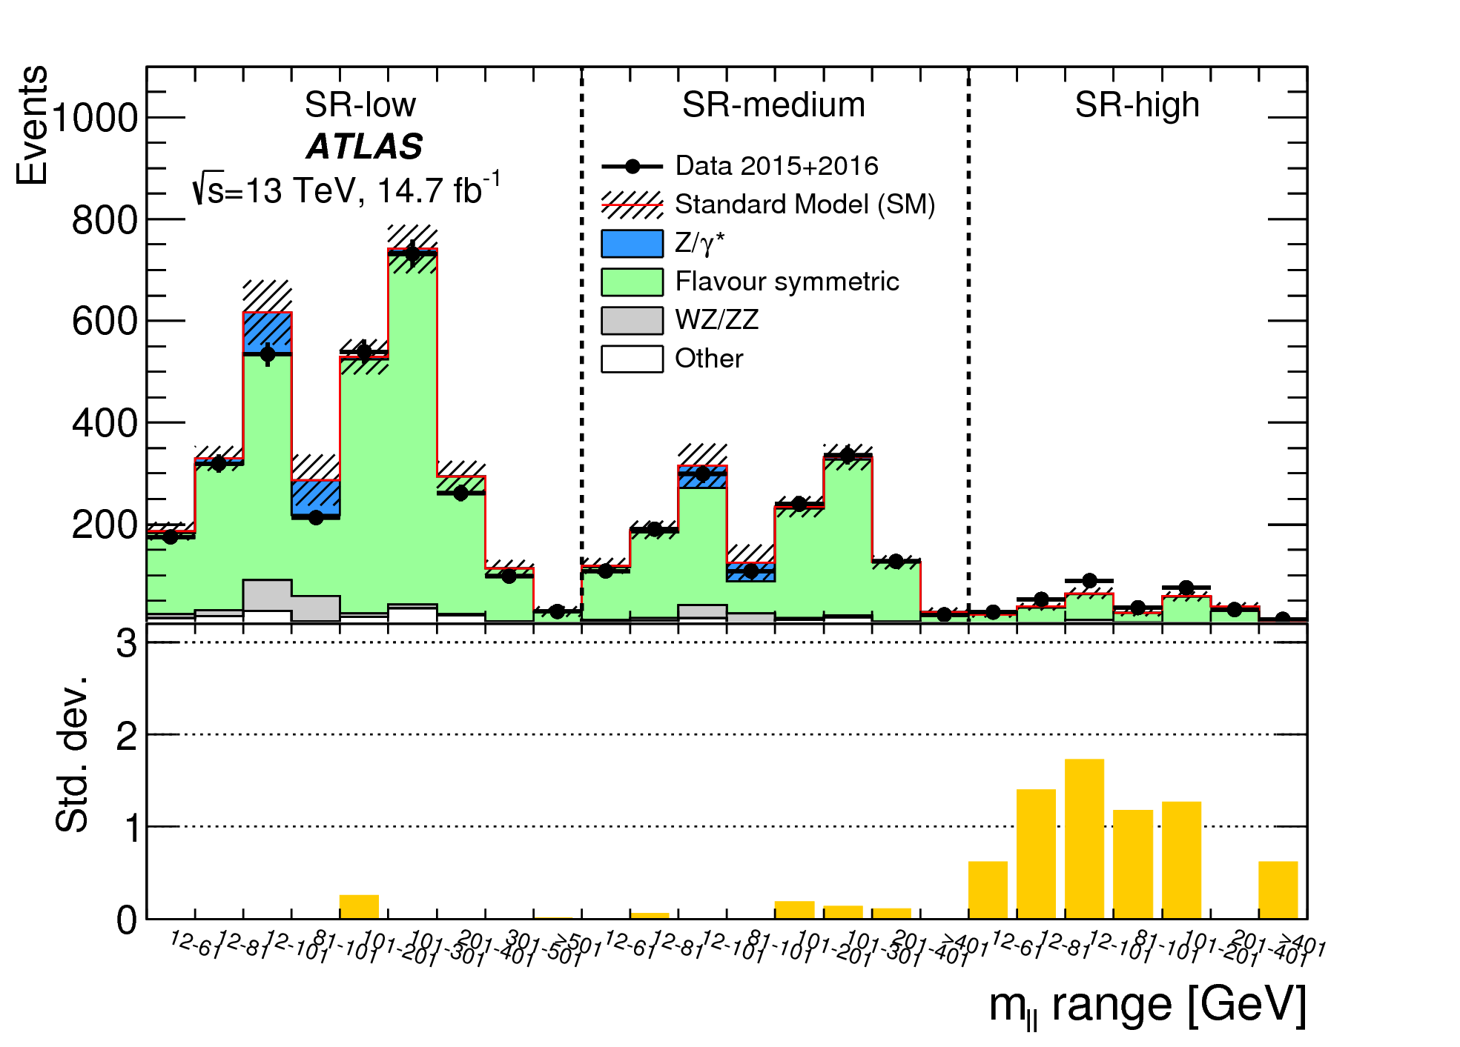
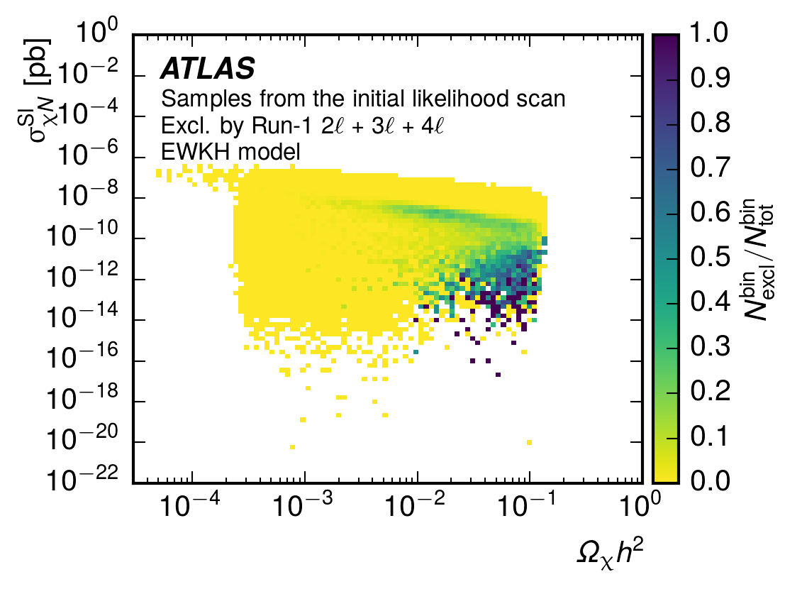
SUSY Searches: Z+MET, dark matter
2 lepton + jets + MET: Z mass & “edge” analysis
At 8 Tev, a 3σ excess observed at Z peak
[Eur. Phys. J. C75 (2015) 318]
Z analysis with first 13 TeV results gave a
2.2σ excess [ATLAS-CONF-2015-082]
With ICHEP2016 dataset agreement with SM
[ATLAS-CONF-2016-098, arXiv:1611.05791, Submitted to: Eur. Phys. J. C]
ALSO: Development of generic code for global p-value calculation of observed “bumps”
Dark matter & EW searches
Quantifying EW SUSY searches impact on dark
matter candidates
Focus on gaugino-higgsino and Higgs sector of
pMSSM
☞ ATLAS Short Term Associate: R. Ruiz de Austri
ATLAS publication: JHEP 1609 (2016) 175

Slide 22
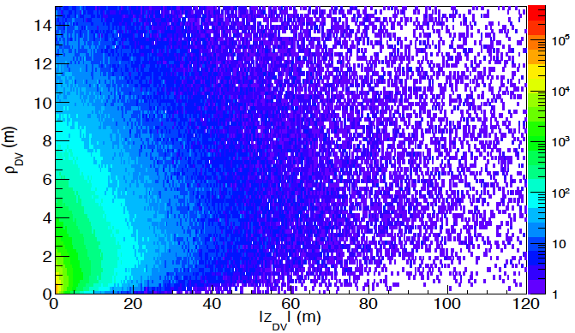

SUSY Searches: input from theory
Searches optimisation by including distribution shape information [Cabrera, Casas, VA Mitsou, Ruiz de Austri, Terrón, JHEP 1204 (2012) 133]
  LHC phenomenology of μνMSSM model [Ghosh, López-Fogliani, VA Mitsou, Muñoz, Ruiz de Austri, Phys.Rev. D88 (2013) 015009, JHEP 1411 (2014) 102, Phys.Rev. D91 (2015) 035020]
  R-parity violating terms
  predicts neutrino masses
  solves μ problem
  large Higgs sector → easy 125-GeV Higgs
“METing SUSY on the Z peak”
[Barenboim, Bernabeu, VA Mitsou, Romero,
Vives, EPJ C76 (2016) 57]
  profiling the ATLAS Z+MET events
Z-spin [Aguilar-Saavedra, Bernabeu,
VA Mitsou, Segarra, arXiv:1701.03115]
  using Z boson spin observables to
  probe Z origin at LHC, e.g. from SUSY partners
  μνSSM: extremely displaced vertices
χ̃₄⁰ → ττν
√s = 8 TeV
L = 20 fb⁻¹
h₄ ➞ χ̃₄⁰ χ̃₄⁰ ➞ 2 h_{i}/P_{i} + 2ν ➞ 2τ⁺2τ⁻2ν
Notes:
JHEP 1204 (2012) 133: compare experimental and theoretical histograms
μνMSSM: extends the MSSM particle content with three singlet chiral superfield. R parity explicitly. But only generates lepton number violating interactions. avitino could be a viable DM candidate producing.

Slide 23

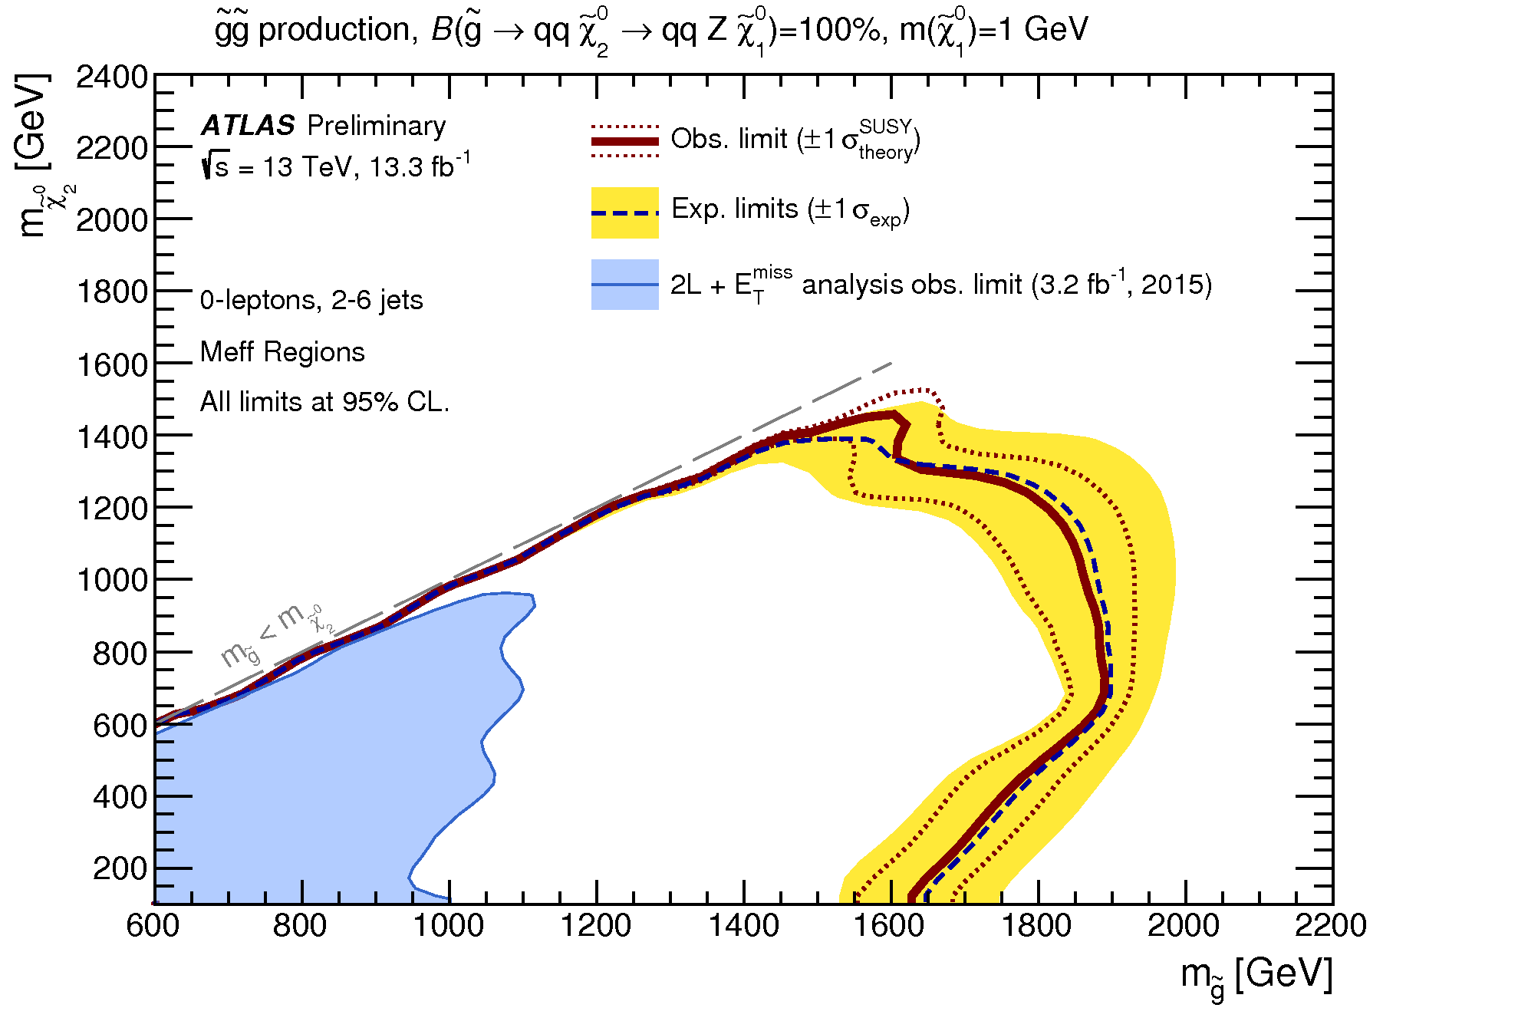
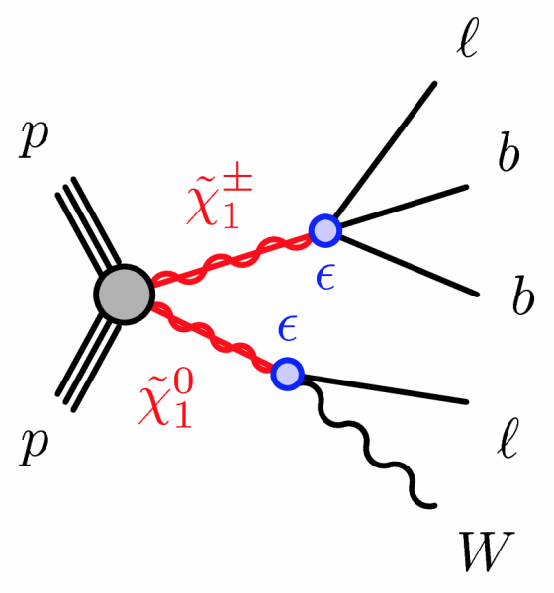
SUSY Searches: present & future
0 lepton + 2-6 jets + MET
Continuing 2-lepton analysis with full 2015-2016
dataset @ 13 TeV
  optimisation for the slepton and Z* models
  add interpretation for bRPV model
  exclusion plots
Incorporate the 0-lepton channel in strong
production studies (Judita Mamuzic )
  pMSSM with long decay chains
  Radiatively Driven Natural SUSY with NUHM2 model
Maintenance and application to other SUSY searches
of generic code for global p-value calculation of
observed excesses
Bilinear R-parity violation: EW SUSY production
for models with light higgsinos
  interesting for “natural” SUSY
  many final states can be probed
ATLAS-CONF-2016-078
Notes:
NUHM2 model : two-extra parameter non-universal Higgs model

Slide 24
Relevant ATLAS positions
ATLAS management :
Collaboration Board Chair Advisory Board (M.J. Costa) 2011-2013.
Speakers Committee member (S. Martí), Desde 2014
Member of the Phisics Office (V. Mitsou), 2011-2012
Physics coordination:
    Convenor Top Working group ( M.J. Costa) 2011-2014
    Monte Carlo Production Convenor (J. E. García-Navarro), 2013-2015
    Convener LHC Top Working Group of LPCC ( M.J. Costa), 2013-2016
    Physics Validation Coordination (M. Jose Costa), 2009-2011, (J. E. García-Navarro), 2011-2013.
    Single top subgroup convener (J. E. García-Navarro), 2014-2016
    Prompt R-parity violating searches convener (V. Mitsou), 2009-2011
  Physics Performance:
  Convener Inner Tracking Combined Performance Group (A. Wildauer), 2008-2010
  Inner Detector Tracking validation Contact (S. Cabrera), desde 2015
  Top-Tau Liaison Contact (S.Cabrera), 2009 – 2011
  Top-Jet Liaison Contact (M.J.Costa) 2011
  SUSY - Statistics Forum Liaison (V. Mitsou), 2009 – 2011
Operación del detector:
    Convener Inner Detector Alignment (S. Martí), 2006-2011
Many presentations on conference on behalf of ATLAS/LHC.
Editor of many papers and conference notes

Slide 25




MoEDAL Experiment
Monopole & Exotics Detector At LHC
Searches for massive, long-lived & highly
ionising particles (HIPs)
Mostly passive detectors; no trigger;
no readout
Largest deployment of Nuclear Track Detectors at a collider
First time trapping detectors deployed as a
detector
LHC Point 8
MoEDAL
LHCb
25
International collaboration of ~65 physicists from 21 participating institutions
IFIC Valencia Team
J. Bernabeu, J. Mamuzic,
V.A. Mitsou (leader), C. García,
R. Ruiz de Austri, V. Vento,
O. Vives
V.A. Mitsou: Chair of
Collaboration Board
MoEDAL

Slide 26



MoEDAL detectors
MoEDAL
Nuclear Track Detectors (NTDs)
  HIP passage through plastic NTD sheets marked
  by invisible “latent track” along the trajectory
  damage zone revealed as cone-shaped “etch-pit”
  when plastic sheet is chemically etched
  plastic sheets are later scanned to detect etch-pits
Monopole Trapping detector (MMT)
  magnetic monopoles can stop (‘trapped’) at aluminum bars
  bars are analysed in remote superconducting magnetometer
  facility (ETH Zurich).
TimePix radiation background monitor
NTDs
LHCb VELO
TimePix
beam
pipe
MMTs
MoEDAL

Slide 27

MoEDAL physics
Key feature: High Ionisation
MoEDAL detectors have a threshold of z/β ~ 5
charge
= z/β
velocity: β = v/c
Physics program [MoEDAL Collab, IJMP A29 (2014) 1430050]
Magnetic monopoles, dyons
Supersymmetry: sleptons, R-hadrons
Long-lived doubly charged Higgs
Black-hole remnants
Quirks, Q-balls, ….
MoEDAL

Slide 28



MoEDAL results & plans
MoEDAL
  Searches for magnetic monopoles with MMTs
  @ 8 TeV [JHEP 08 (2016) 067]
    ☛ CERN Press Release
  @ 13 TeV [arXiv:1611.06817, PRL to appear]
  no monopole detected
  first time charges > 1.5 g_{D} probed at LHC
  world best limits for charges > 2 g_{D}
  nice complementarity with ATLAS sensitivity
Group’s present & future studies
Sensitivity on stable electrically-charged particles, e.g. SUSY
Simulation of monopole production via photon fusion
Monopolium phenomenology
MoEDAL

Slide 29
New Itk tracker for
HL-LHC
Reunión seguimiento- Madrid 14-7-2014

Slide 30

HL-LHC
HL-LHC programme:
Start in 2024 after a ~30-month shutdown (LS3)
Peak luminosity: ~5e³⁴cm⁻²s⁻¹
~140 pp collisions bunch crossing
Collect ~250-300fb-1/year/exp for a total of ~3000fb-1 by the mid-2030s

Slide 31





“All-Si Tracker” (HL-LHC)
Strips
Pixel
SCT and Pixels strongly affected by radiation
TRT can not handle the huge flow of particles
We need an “All-si tracker” (Pixel + Strips):
  Large granularity
  More radiation tolerance
  Lighter
  Covering larger η
  More redundant ( >15 hits/track)

Slide 32
IFIC @ ATLAS ITk
IFIC and CNM-IMB work together in a coordinated project in the ATLAS Inner Tracker (ITk) for the HL-LHC.
IFIC works on the Endcap Silicon Strip system of the ATLAS ITk covering various aspects
  Common Mechanics: services
  Integration: Global Support Structure
  Local Support
  Sensor + Electronics: modules
  Production
IFIC coordinates 3 of the 8 main working packages of the ITk Strips project
Filled “boxes” are led by IFIC

Slide 33








Sensors
Started R&D on sensors with the ROSE collaboration that later became, in 2001, the RD50 collaboration, also within the ATLAS project “Development of non-inverting Silicon strip detectors for the ATLAS ID”
  Identification of the best technology for radiation tolerant silicon micro-strip sensors for the ATLAS ITk.
  Selection of n+ on p as baseline technology
Close collaboration IFIC-CNM.
Today we design the layout of the Endcap sensors and act as contact persons with possible suppliers: HPK, Infineon, CiS.
Responsible of the Market Survey for the production procurement.
embedded fanins

Slide 34



Petals
Sensors are glued in local supports (Petals). This is the building block of the system. A carbon fiber sandwich with integrated cooling and electronics.
Double sided object with 18 sensors, 70cm height, 10-20cm width
Sensors
Front End electronics (ASICS)
Cooling pipes
Bus tape to distribute power and signals

Slide 35



Petals
We have designed, prototyped and characterized those objects in Valencia
Fabrication

Slide 36





Petals
Thermal (IR) image of prototype
FEA results
Petal prototypes have been measured in house to validate FEA models and study their mechanical properties

Slide 37





Petals
Petal test frame
Bustape design
4 row wire-bonding

Slide 38

Petalet
Collaboration: CNM, DESY,
U. Freiburg, H.U. Berlin, IFIC,
JSI-Ljubljana
A full “electrical” petal is a very expensive object to prototype due to 6 different sensor flavours. Electrical properties studied with an affordable, smaller version of the petal.
IFIC designed the concept, bus tape, flex circuits for the ASICs and sensors. CNM designed and fabricated the sensors.

Slide 39

Electrical tests @ CERN
Extensive electrical tests on large objects help deciding on the final powering system (DC-DC .vs. serial) for the detector.
A 10x10 cm² barrel module (top)
A 12 module long barrel stave.

Slide 40

Global Support and Integration
Active in engineering studies for the ATLAS ITk since long, long ago (2005)
Have designed the global support structure of the Endcap Tracker
2016: a closer to reality endcap with far more detail.
2006: first “alternative” solutions, like this conical endcap

Slide 41



Global Support and Integration
Design of the global support structure and petal fixation to the structure.
IFIC design was selected as the ITk baseline.
Finite Element Analysis to optimize the structural stability of the system.
Not at scale

Slide 42



Global Support and Integration
Design of the service module bringing power, control signals and cooling to the petals.
Cooling manifolding.
Service patch panel in the structural bulkhead to connect to services beyond the ITk volume
Deformation of the cables: 9mm (longest cable)
Service Tray

Slide 43

Schedule
Technical Design Review (TDR) in Dec. 2016.
2017 iMoU to start ordering components.
2018 Module pre-production
2018 MoU for production
2019 Production starts

Slide 44
Production @ IFIC
IFIC-Valencia is planning to build and assemble at least 30 of those petals
  Gluing flex circuit with ASICs to sensor
  Wire-bond from ASIC to sensor
  Glue sensors to petal
  And test, test, test
We are working to outsource the petal core fabrication to a Spanish company
  There is an on-going R&D program to optimize and transfer the fabrication process
We should participate in the pre-production in 2018 and Start production in 2019!

Slide 45
Finial remarks
Well define program for ATLAS and MoEDAL, focused in the search for new physics.
Close collaborations with theoretical colleagues in may areas, both in ATLAS and MoEDAL.
This year is going to be crucial to establish our participation the the construction of the ITK detector.

