Slide 1

Third BRIKEN WORKSHOP – IFIC (Valencia, Spain) / July 22-24, 2015
BRIKEN detector: UPC Monte Carlo design compact geometry
Albert Riego, Guillem Cortes, Francisco Calviño
July 22th, 2015
Universitat Politecnica de Catalunya, Barcelona (Spain)
E-mail: albert.riego@upc.edu
http://greener.upc.edu/greter

Slide 2
Contents
Matrix geometry
Counters employed
Simulations
Results
Conclusions

Slide 3
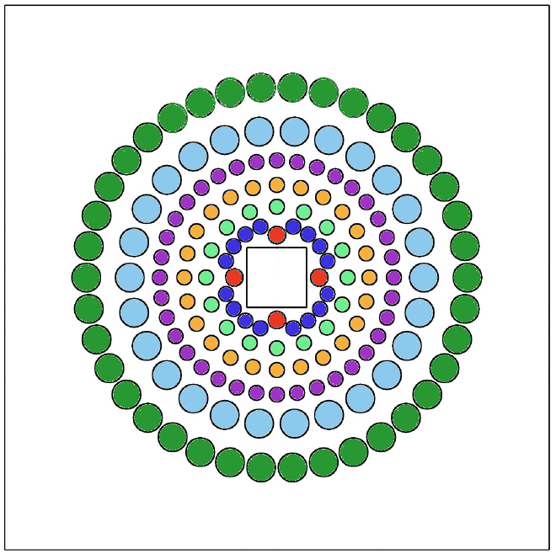
1. Final matrix geometry
Frontal view of polyethylene matrix
Material
High density polyethylene
Density: 0.93 g/cm³
Dimensions
7 concentric rings
Squared section: 1000 mm x 1000 mm
Length: 800 mm
Squared beam hole: 110 mm x 110 mm

Slide 4
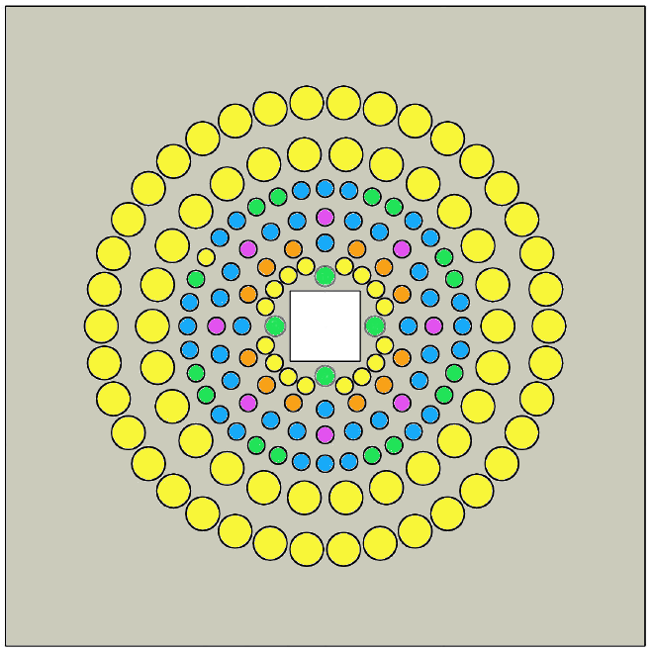
2. Counters employed for the detector design
Institution | Filling gas | Pressure (atm) | DIMENSIONS |  | Number of counters
 |  |  | Diameter (inch/cm) | Effective length (inch/cm)
GSI | He-3 | 10 | 1 / 2.54 | 23.62 / 600 | 10
JINR | He-3 | 4 | 1.18 / 3.0 | 19.69 / 500 | 20
ORNL | He-3 | 10 | 2 / 5.08 | 24 / 609.6 | 58
 | He-3 | 10 | 1 / 2.54 | 24 / 609.6 | 16
RIKEN | He-3 | 4 | 1 / 2.54 | 118.1 / 300 | 42
UPC | He-3 | 16 | 1 / 2.54 | 23.62 / 600 | 172
Transversal section of polyethylene matrix.

Slide 5
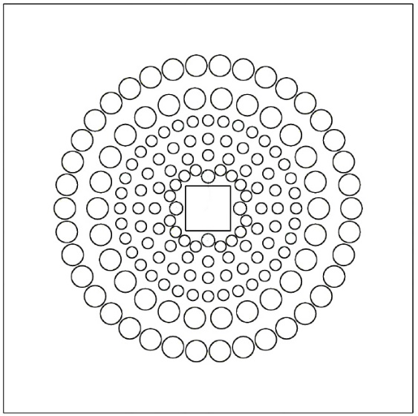
3. Simulations
Frontal view
Monte Carlo codes used
MCNPX, version 2.5
GEANT 4, release 10.0.02p02
Neutron source
Point source
Inside the beam hole
Centered in the matrix
Neutrons emitted in all directions (isotropic distribution)
Neutron energies simulated
0.0001 MeV
0.001 MeV
0.01 MeV
0.1 MeV
1 MeV
2 MeV
3 MeV
4 MeV
5 MeV
Lateral view
Polyethylene matrix
Beam hole (air)

Slide 6
3. Simulations
Goal to reach by MC simulations
Flat efficiency and high efficiency up to E_{n}= 5 MeV

Slide 7
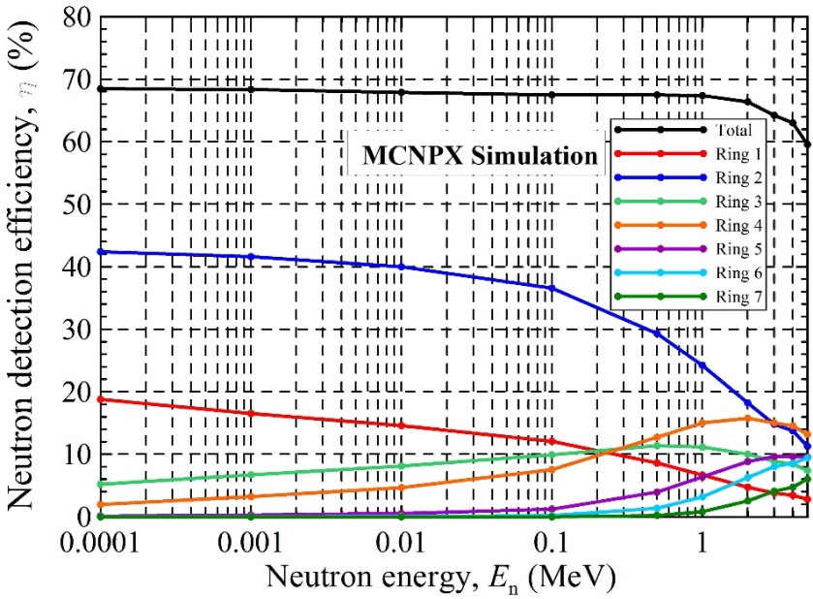
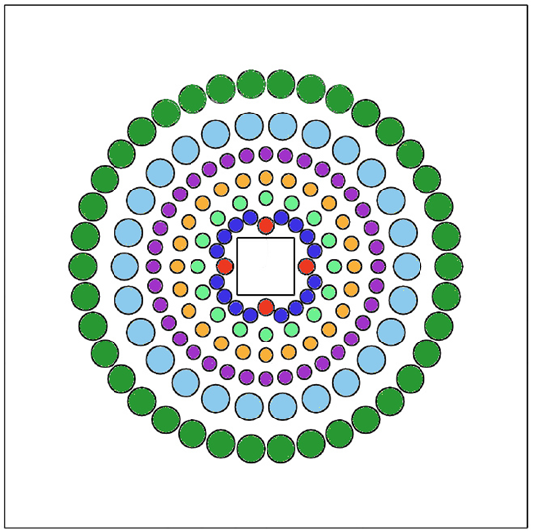
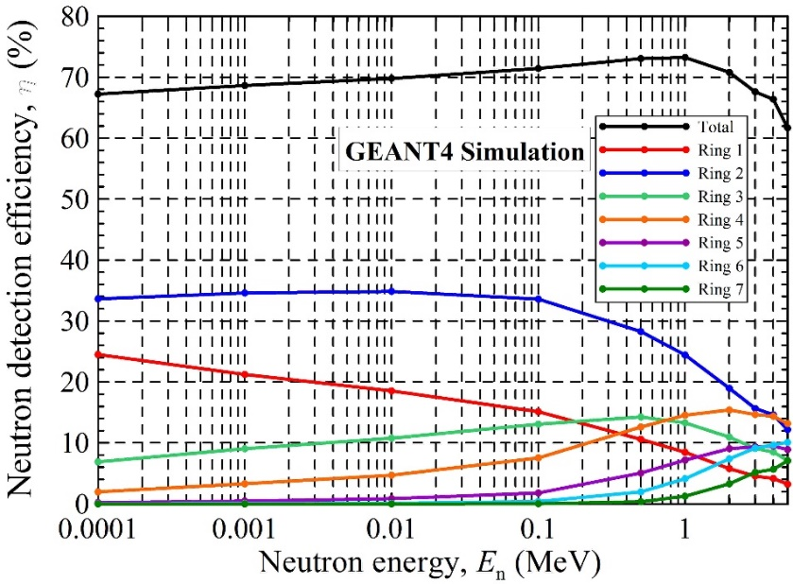
4. Results
Contribution of each ring to the neutron detection efficiency

Slide 8
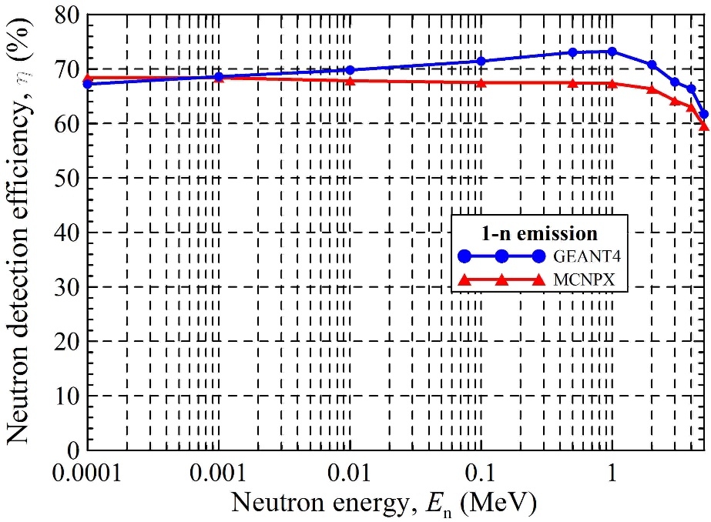
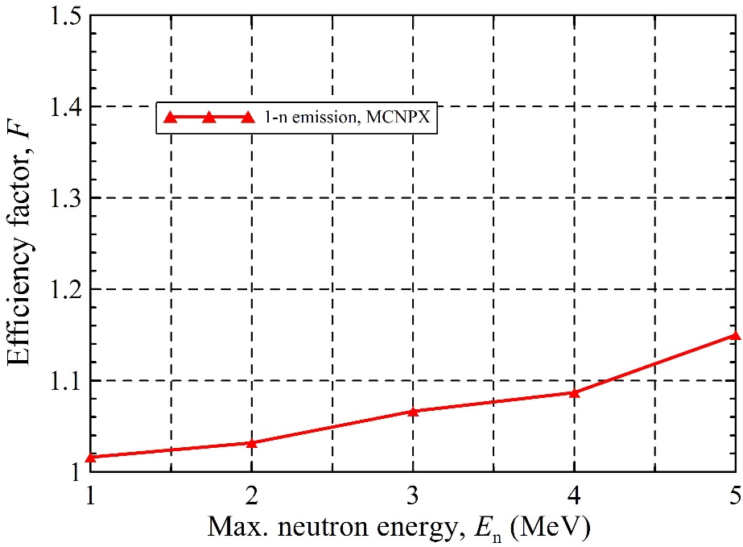
4. Results
1-neutron emission.
MCNPX code
GEANT4 code

Slide 9
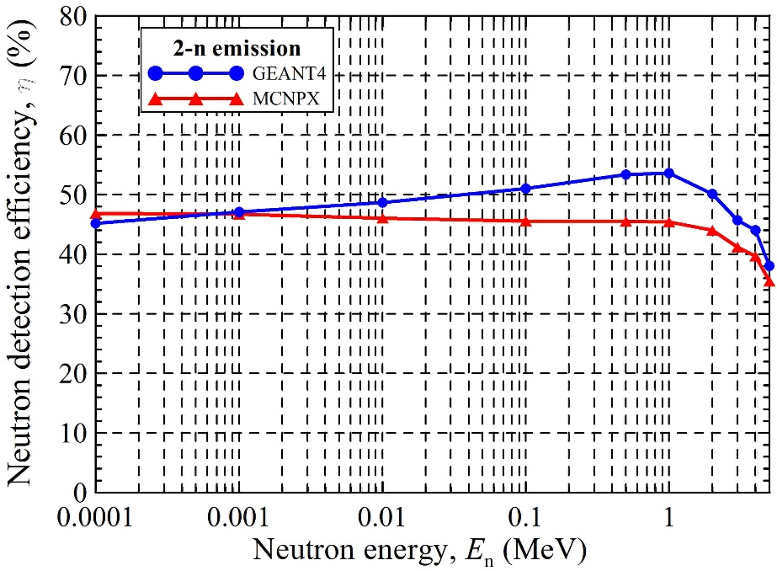
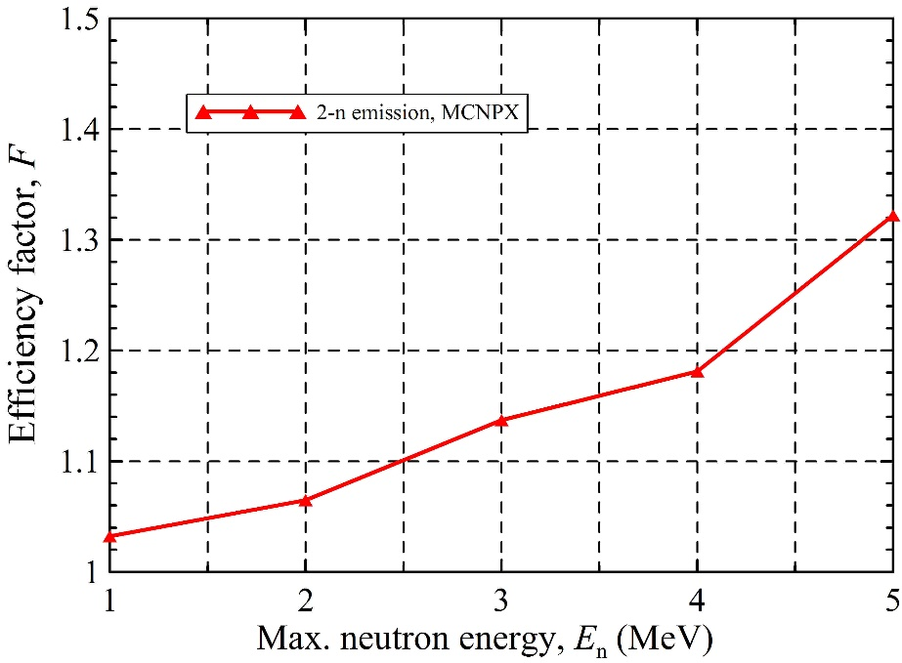
4. Results
2-neutron emission.
MCNPX code
GEANT4 code

Slide 10
5. Conclusions
The design has been optimized for 172 He-3 counters with the properties of the counters available
We have optimized the neutron detection efficiency to obtain a high and flat efficiency
Polyethylene matrix of 100 cm x 100 cm and 80 cm length for neutron moderation
We have employed 172 He-3 counters at different pressures, diameters and length
He-3 counters distributed in 7 concentric rings
The geometry is based on cylindric symmetry
The simulations have been done by means of MCNX an GEANT4 codes
The mean efficiencies and efficiency factors for 1-n emission are:
Max neutron energy of 1 MeV: η = 67.8 % & F= 1.016
Max neutron energy of 3 MeV: η = 67.2 % & F= 1.066
Max neutron energy of 5 MeV: η = 66.0 % & F= 1.150
The mean efficiencies and efficiency factors for 2-n emission are:
Max neutron energy of 1 MeV: η = 70.6 % & F= 1.089
Max neutron energy of 3 MeV: η = 70.2 % & F= 1.089
Max neutron energy of 5 MeV: η = 69.0 % & F= 1.187
Possibility to define new geometries to optimize the neutron detection efficiency for higher neutron energies than 5 MeV
Possibility to optimize the geometries shown in this presentation to increase the mean efficiency

Slide 11
Thank you for your attention

