Slide 1
Approaching the precursor nuclei of the Rare Earth Peak
J. Agramunt, A. Algora, C. Domingo-Pardo, A. Morales, B. Rubio, J.L. Taín, A. Tarifeño-Saldivia
IFIC, CSIC-University of Valencia, Spain
F. Montes
NSCL-MSU, USA
A. Arcones
Technische Universität Darmstadt, Germany
3rd BRIKEN Workshop, IFIC, Valencia 22-24/07/2015

Slide 2
Outline
Introduction & Motivation
Goal of this proposal
Experimental approach
Outlook

Slide 3
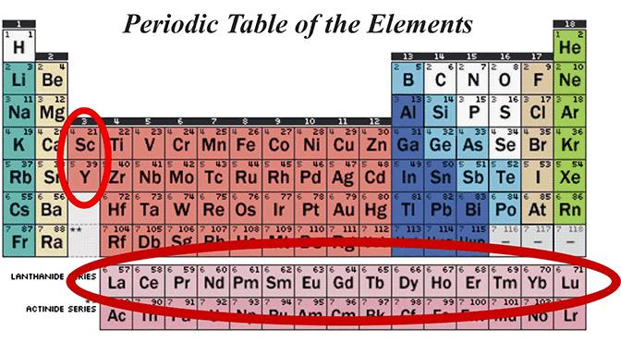
The rare-earth peak or abundance (positive) anomaly
Opto-chemical properties of the REEs

Slide 4
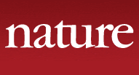
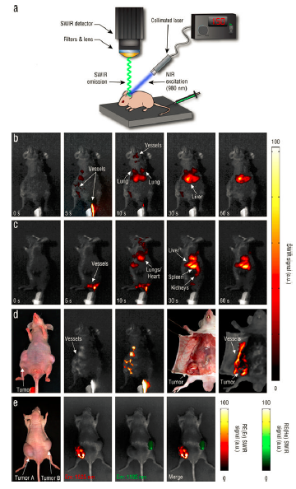
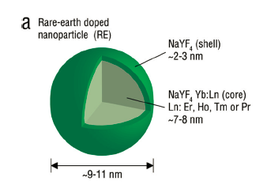
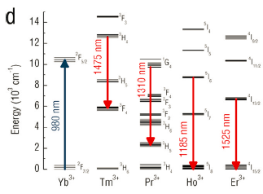
The rare-earth peak or abundance (positive) anomaly
→In-vivo imaging for disease screening and image-guided surgical intervention
→ Tissue-specific materials that optically transmit through living tissue and can be imaged with portable systems that display data in real-time
Rare-earth-doped biological composites as in vivo shortwave infrared reporters
D. J. Naczynski, M. C. Tan, M. Zevon, B. Wall, J. Kohl,
A. Kulesa, S. Chen, C. M. Roth, R. E. Riman & P. V. Moghe
Nature Communications 4, Article number: 2199 doi:10.1038/ncomms3199, 22 July 2013

Slide 5
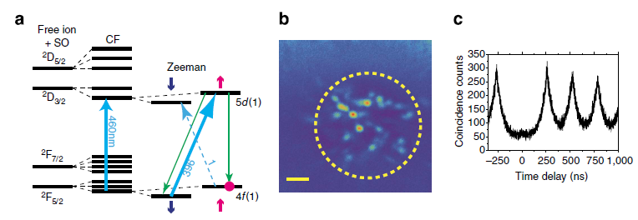
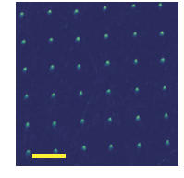
The rare-earth peak or abundance (positive) anomaly
Rare-earth-doped crystals are excellent hardware for quantum storage of photons.
Quantum computing
Coherent properties of single rare-earth spin qubits
P. Siyushev,K. Xia, R. Reuter, M. Jamali, N. Zhao, N. Yang, C. Duan, N. Kukharchyk, A. D. Wieck, R. Kolesov & J. Wrachtrup
Nature Communications 5, Article number: 3895 doi:10.1038/ncomms4895 , 14 May 2014

Slide 6
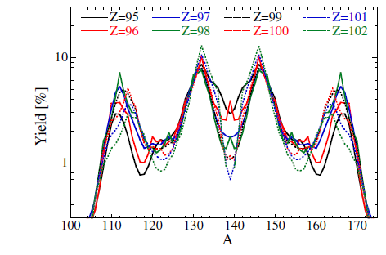
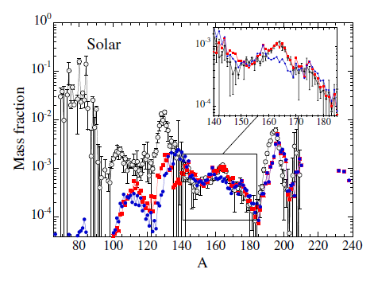
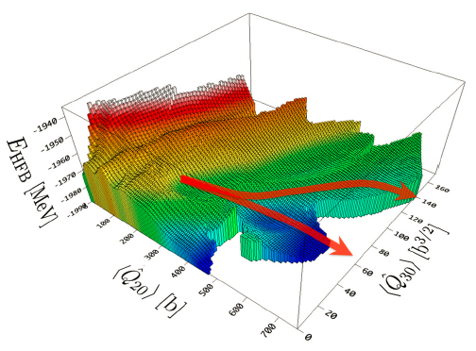
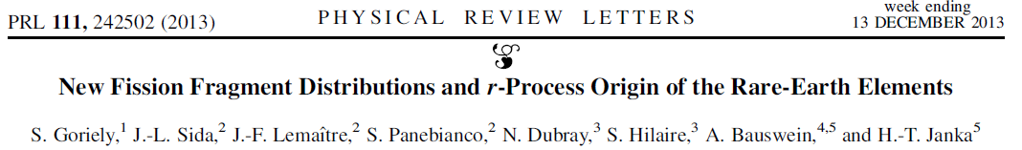
Origin of the REP
Option 1) NS merger via fission:

Slide 7
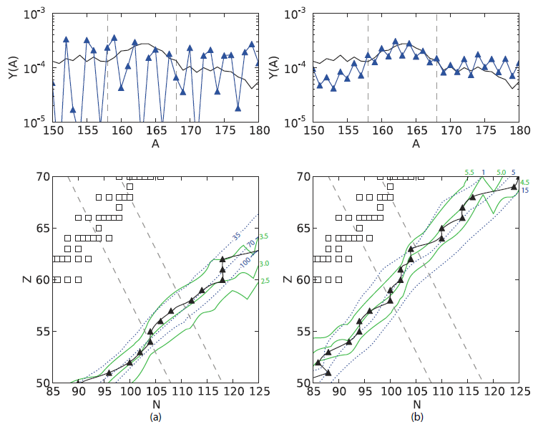
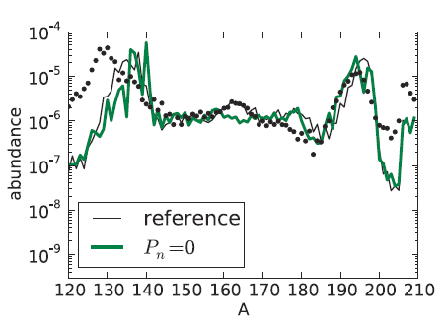
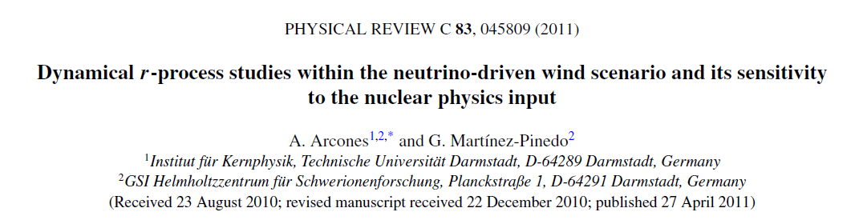
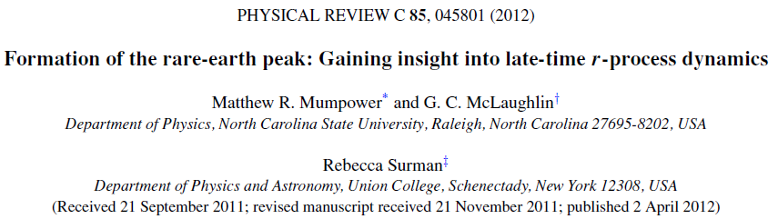
Origin of the REP
Option 2) SN origin via beta-delayed neutrons:

Slide 8
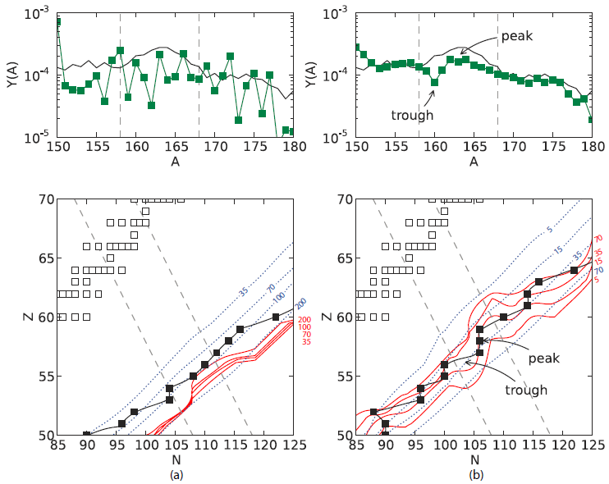
The REP formation @ Cold Env.

Slide 9
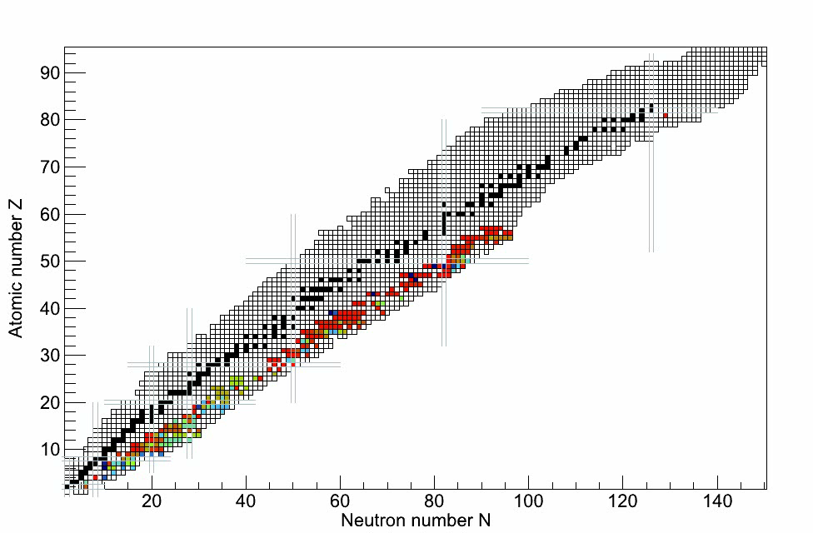
Specific Pn-Sensitivity Analysis by M.Mumpower
Dedicated Sensitivity Study on the β-delayed neutron emission probabilities
by M.Mumpower
(North Carolina State University, USA)
Known Pn-Values

Slide 10
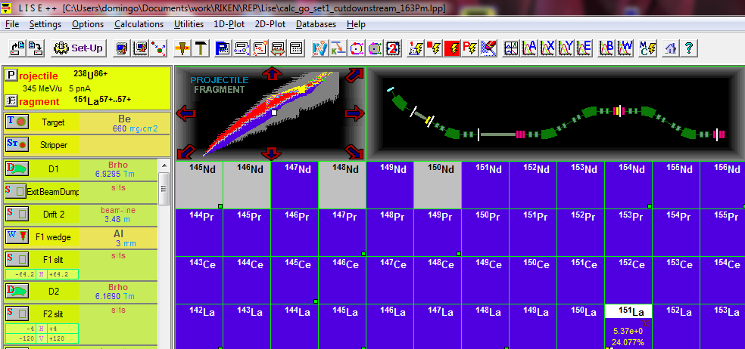
Unique possibility to access this region: high rates of RIKEN and high efficiency of BRIKEN

Slide 11
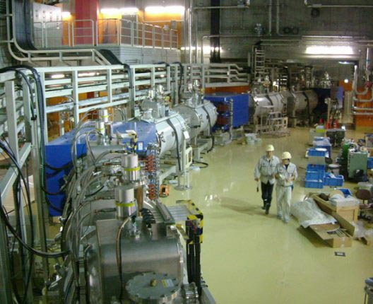
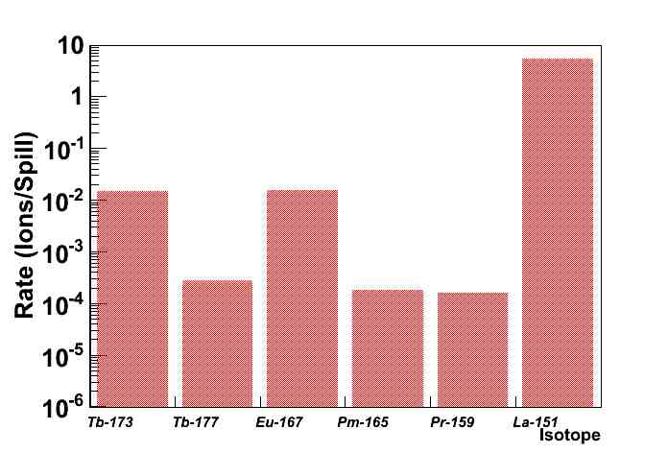
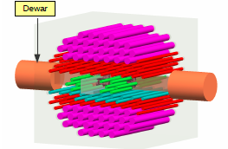
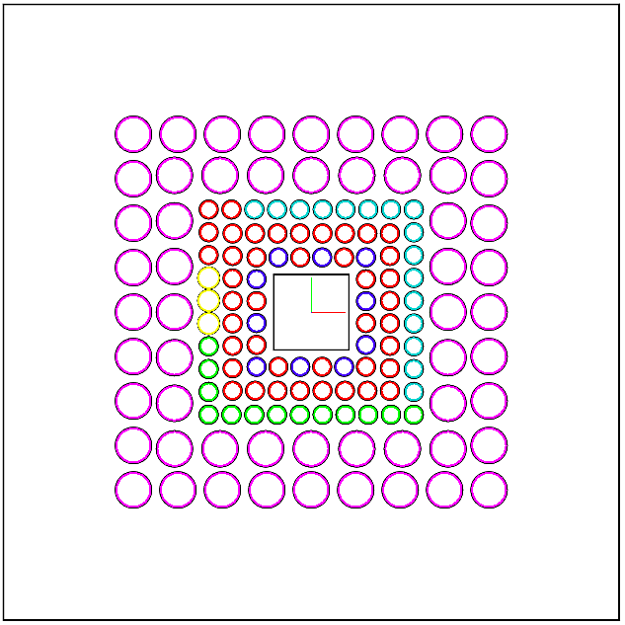
Unique possibility to access this region: high rates of RIKEN and high efficiency of BRIKEN
BRIKEN

Slide 12
Summary & Outlook
The REP represents a unique approach for the study of the late-time evolution of the r-process environment.
The involved isotopes are extremly exotic and until now, all r-process model calculations attempting to reproduce this region rely –exclusively- on theoretical models.
The high primary beam intensities available at RIKEN in combination with the high-efficiency of the BRIKEN neutron detector represent a unique opportunity to access experimentally –for first time- this region. And achieve a more comprensive understanding on the underlying stellar nucleosynthesis place.

Slide 13
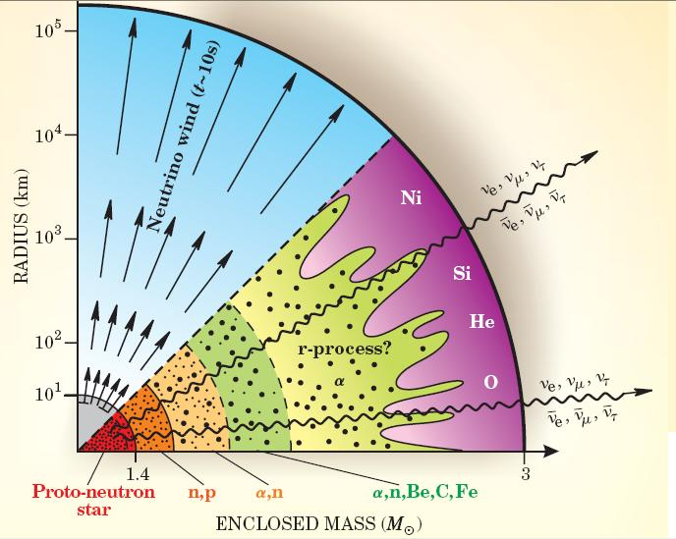
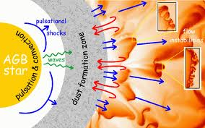
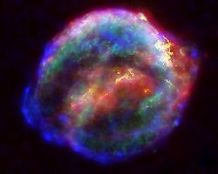
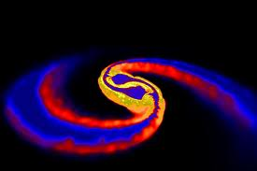
Introduction: nucleosynthesis beyond Fe, s- and r-process
s-process: slow n-capture in stellar envolopes
BB
Fusion
Neutrons
abundance
Fe
r-process: unkonwn site
r
s
s
SNe?
r
NS-Mergers?
mass number
Neutrons produce 75% of the stable isotopes, but only 0.005% of total abundances
Notes:
Pros/Cons of Sne, and Pros/Cons NS-Mergers

Slide 14
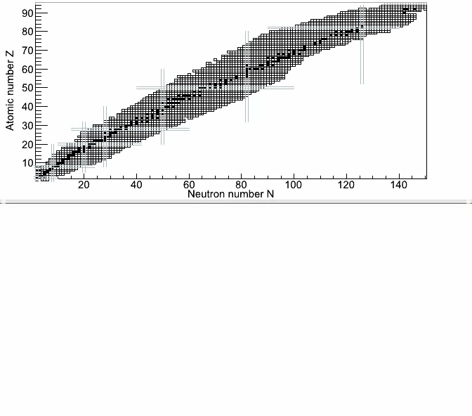
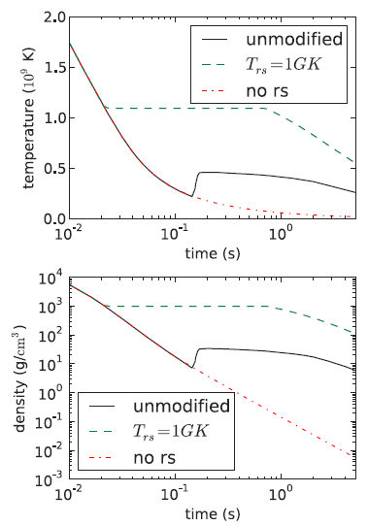
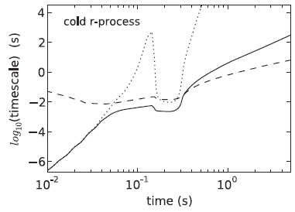
R-Process: Nuclear Physics Input
HOT
COLD
COLD r-process
(γ,n)
ν_{e} + n → p + e⁻
ν_{e} + p → n + e⁺
β
(n,γ)
COLD
r-process
Network code from B.S. Meyer (Clemson University)
Adapted from Phys. Rev. C, 83, A.Arcones 2011

