Slide 1
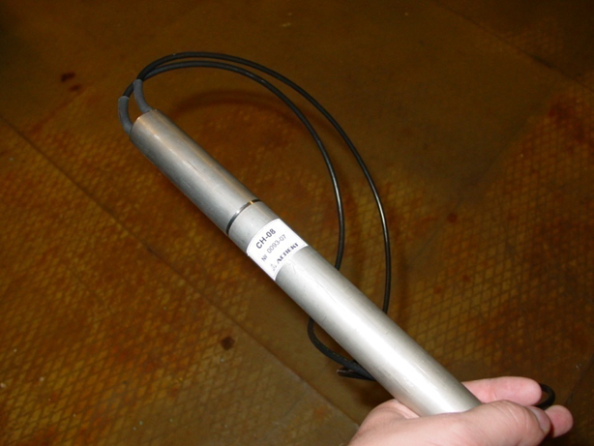
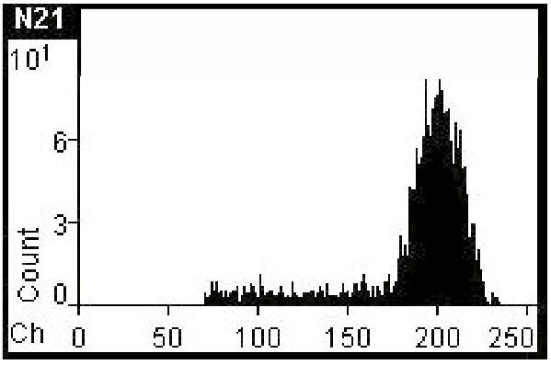
Status of JINR ³He-counters (20 detectors)
Description:
Diameter = 30 mm
Length = 600 mm (500 mm – det., 100 mm – PA)
Power requirements:
Preamp.: + 5÷6 V (15 mA); - 5÷6 V (4 mA)
Detector: + 1400÷1500 V

Slide 2
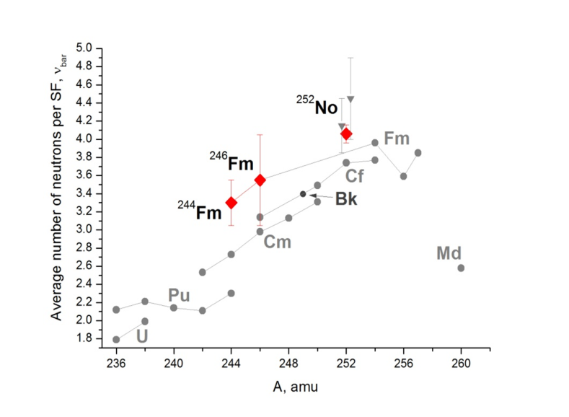
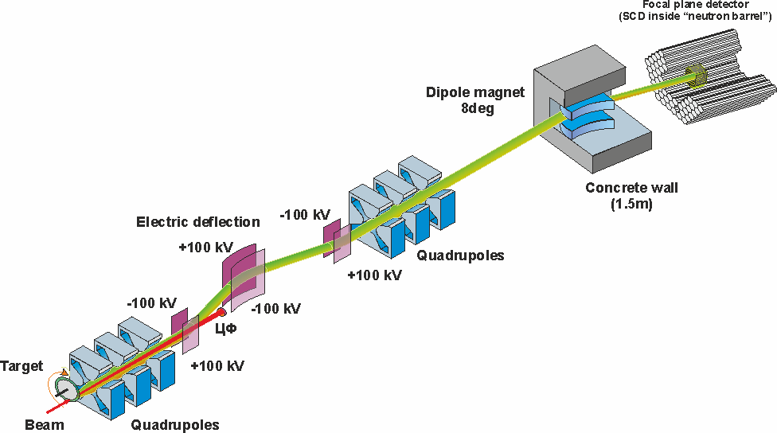
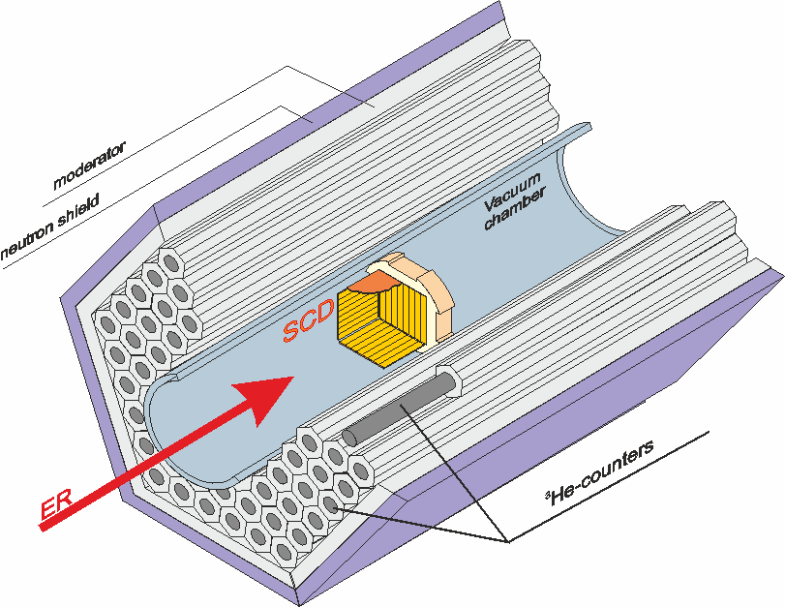
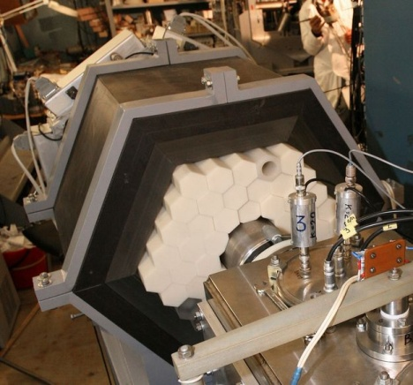
Status of JINR ³He-counters (20 detectors)
Experiments:
The investigation of properties of short-lived SF isotopes (Z > 100) at the focal plane of VASSILISSA separator
Multiplicity
distribution,
Av. number
of neutrons
per SF

Slide 3
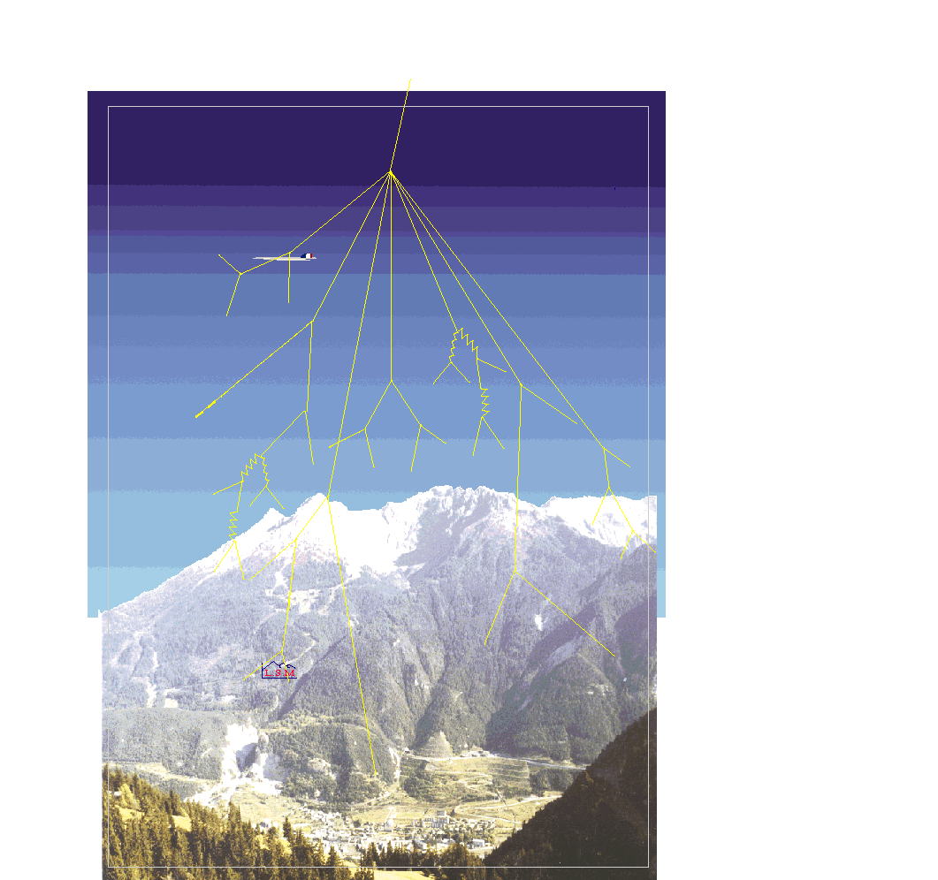
Status of JINR ³He-counters (20 detectors)
Experiments:
Neutrons from spontaneous fission of long-lived super heavy nuclei
60 counters (7 Atm) ε = 60 %
Fréjus peak
Entrance of road tunnel
Modane

Slide 4
Status of JINR ³He-counters (20 detectors)
Agreement (MoU) - September 2015
Export permission –
(export control office, customs office) December 2015
Shipment - January 2016

