Slide 1
BRIKEN DAQ
Status.
DAQ Integration, tests and background measurements at RIKEN.
Jorge Agramunt Ros
3º BRIKEN Workshop 22-25 July 2015 (Valencia)

Slide 2
Available Hardware
3 Crate VME controller SIS3100 and SIS3104 (Struck)
8 8 channels digitizers SIS3302
8 16 channels SIS3316
1 clock distributor with 32 programmable clock outputs.
5 16 Channels differential to singled ended JYFL

Slide 3
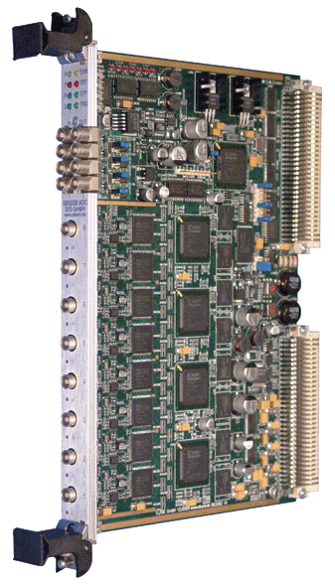
SIS3302 ADC digitizer
SIS3302 Characteristics:
100MHz sampling digitizer 50MHz Band width
32 MSamples memory/channel (in two swap pages)
Readout simultaneous to acquisition
16-bit resolution (13 effective bits)
8 modules available
Data stream
Each channel has a trigger
Time-stamp at trigger
Up to 65532 samples
FIR (Finite Impulse Response) filter to determine signal energy
Notes:
For the implementation
SIS3302, memory swap -> no readout dead time
Each data energy and timestamp.

Slide 4
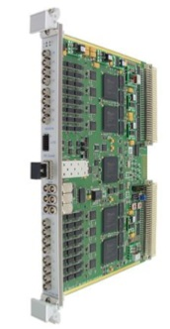
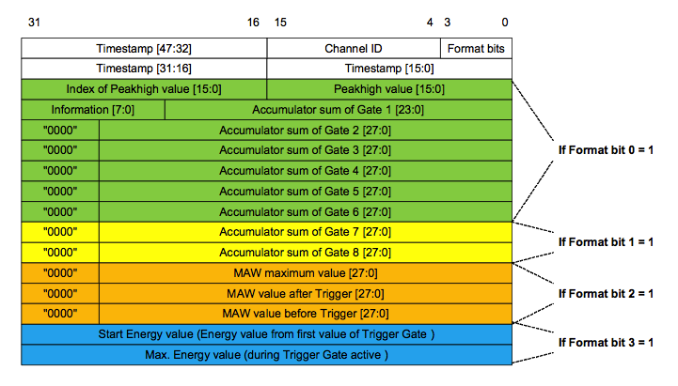
SIS3316 ADC digitizer
SIS3302 Characteristics:
250MHz sampling digitizer 125MHz Band width
64MSamples memory/channel (in two swap pages)
Readout simultaneous to acquisition
14-bit resolution (12 effective bits)
8 modules available
Data stream
Each channel has a self trigger
Time-stamp at trigger
Up to 65532 samples
FIR (Finite Impulse Response) filter to determine signal energy
Up to 8 gate integration
Notes:
For the implementation
SIS3302, memory swap -> no readout dead time
Each data energy and timestamp.

Slide 5
Gasific70 readout: Flux Diagram
Several processes run in parallel
Data shared in the same memory space
Several semaphores synchronize the processes
Readout dispatcher: Get Data from Hardware and put it in the shared memory
Store dispatcher: take data from the shared memory and send it to storage
Analysis dispatcher: Copy a data block from the shared memory and send it to analyze
Notes:
Several processes run in parallel
Main functions of a DAQ
Shared the data are synchronize by IPC tools

Slide 6
Asynchronous data readout
As there are not a common trigger, event structure does not exist
Each channel is readout independently
Readout does not interrupt the data acquisition, as the ADC memory is swapped before the readout
Analysis conditions are set by the common timestamp in each data
Notes:
Data readout when one memory is near to be full
Broadcast swaps all memory
PC made readout one after the other.

Slide 7
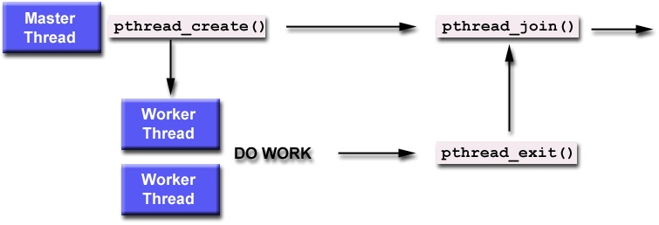
Gasific70 Online: Parallel processing
Parallel processing
Unpacking data and making correlation is a repetitive process ideal for parallel processing
Optimized for multi processor CPU
The program sends several tasks to the operating system as independent threads without waiting for them
The main thread waits for all tasks to be finished
Notes:
To analyze as much as possible
Optimize CPU power
Several task send in different thread

Slide 8
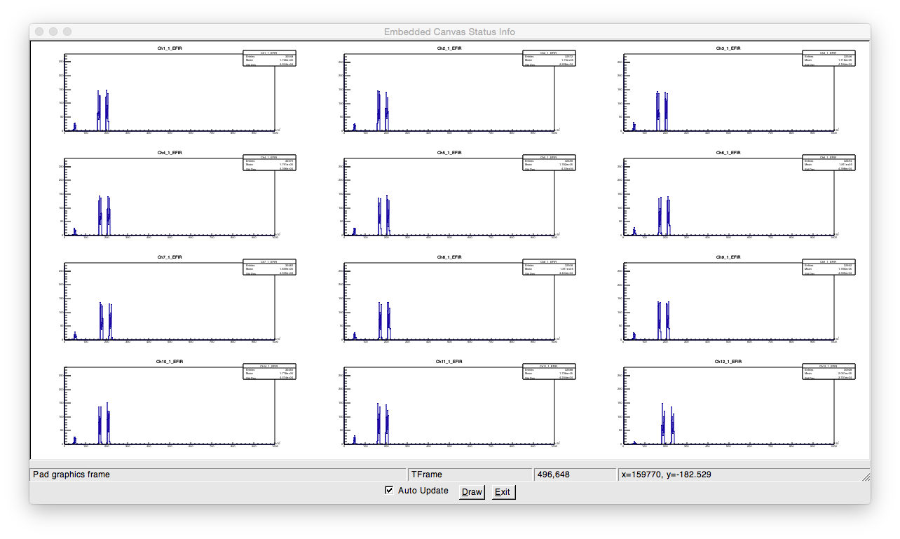
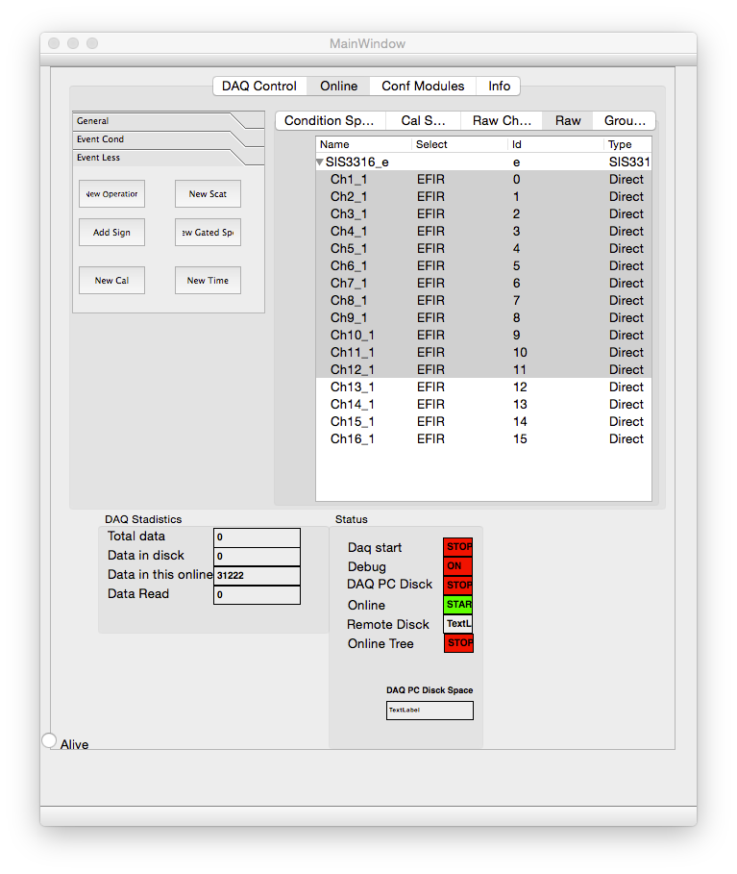
Gasific70 GUI: Control window
To control the system, a graphical user interface was programmed using Qt libraries
The main window is divided in tabs with the different functions
Scope function: Show a window with input signal
Filter output: in order to optimize the filter parameters we can see also the filter output
Using ROOT libraries, displays with all the ROOT analysis tools
Channels groups per module in a tree view
Possibility t view and define groups in a easy way.
Notes:
To control the system
To represent the online data
To view signals
Root functionalities

Slide 9
Gasific70: More features
Offline
Tree converter
Setup:
Spread sheet (OpenOffice) interface
Hardware configuration file
Calibration file
Personal configuration file: Groups, conditions…

Slide 10
Gasific70 : Status
Task | Status
GUI useful for many channels | Done
Configuration files | To Do
Online | Done
Offline | Done
Tree converter | Done (prepare to be adapted to RIKEN specs.)
SIS3316 | Done (Test in JYFL Lab with BELEN48)
SIS3302 | Done
N crates | Done
Stress test with 150 Channel test | Done

Slide 11
Synchronization: Starting point
We have three independent setups.
Independent acq hardware
Independent acq software
Three different data files
Common time reference, a possible solution.
Time Ref
Experiment salad
Experiment in the same framework
Neutron lmd file
Neutron Detector
Neutron lmd file
Offline
Acq
Offline
AIDA detector
AIDA lmd file
Offline
Acq
Offline
BEAM Detectors
BEAM lmd file
Offline
Acq
Offline

Slide 12
Synchronization: road map
Millestone | Date
Agreed the synchronization system | 2013-2014
First pulser test at Daresbury | December 2014
Pulser test of the three systems at RIKEN | February 2015
Parasitic test at RIKEN | May 2015
Commissioning | Spring 2016?

Slide 13
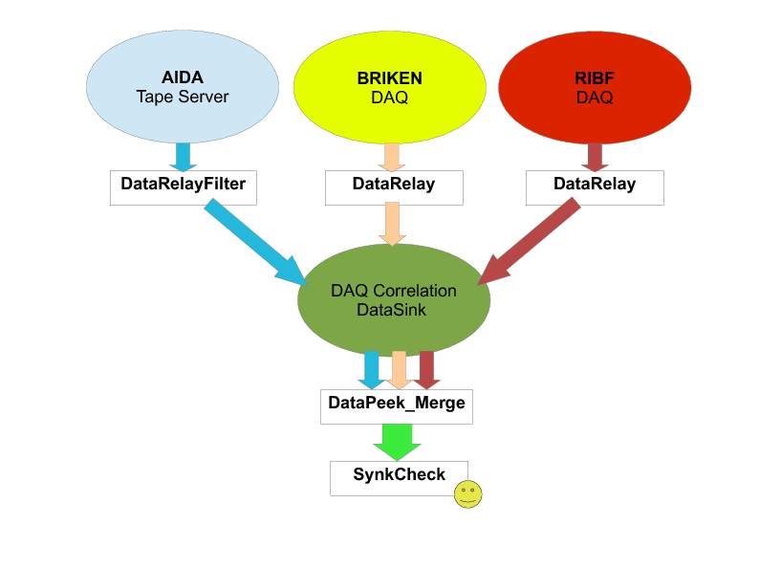
Synchronization: Online
In order to have a online check of the synchronization, we perform a common frame for incoming data from all the setups.
Each setup send a percent of his data via socket to a data sink.
A process merge all the data in a multimap (STL feature) arranged according to the common time stamp.

Slide 14
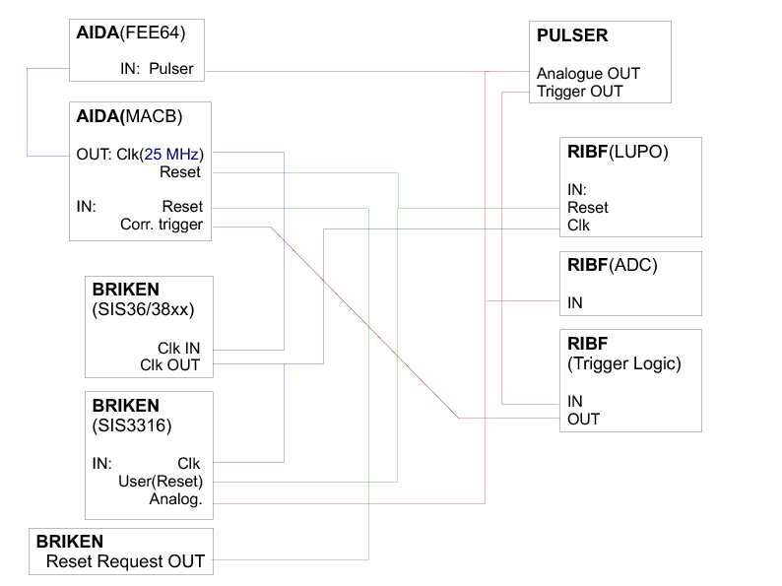
Synchronization: Scheme

Slide 15
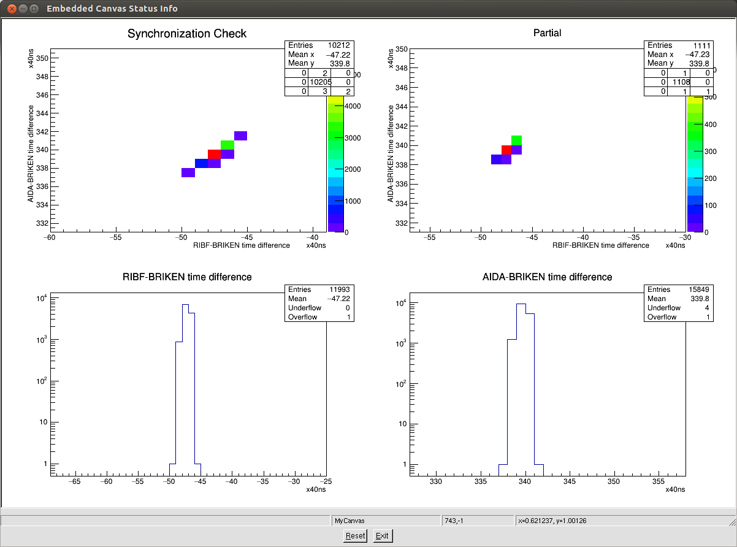
Synchronization: Pulser test results
Multi thread program, accept data from the setups, merge data, histograming and display.
The use of root libraries compiled in C++ permit to display the data in a root canvas, in TH1 and TH2 histograms

Slide 16
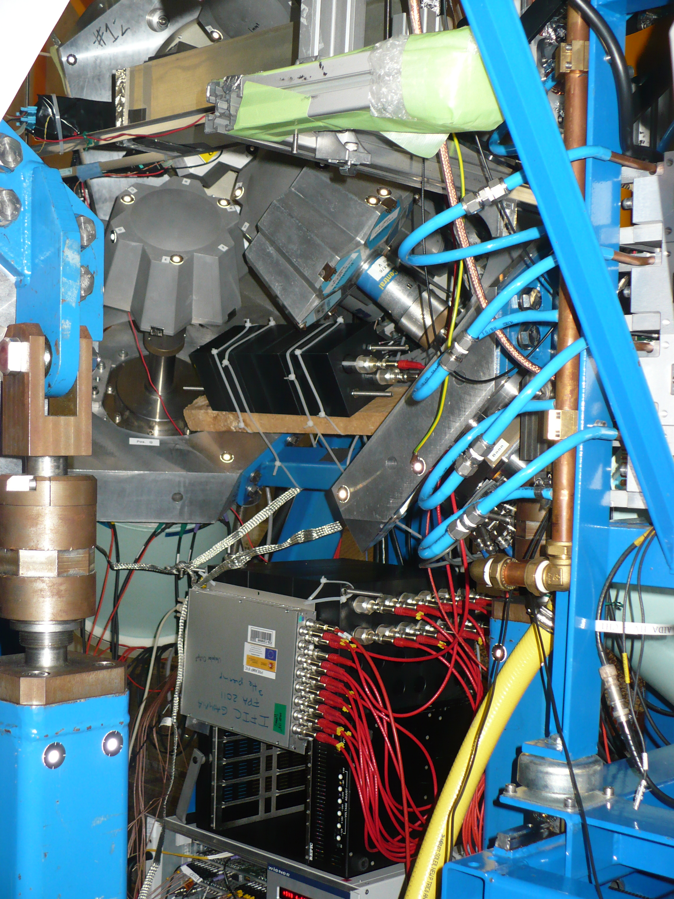
Synchronization: Parasitic objectives
Test the online data communications to prepare a basic online program for the experiment
Check the beam induced neutron background

Slide 17
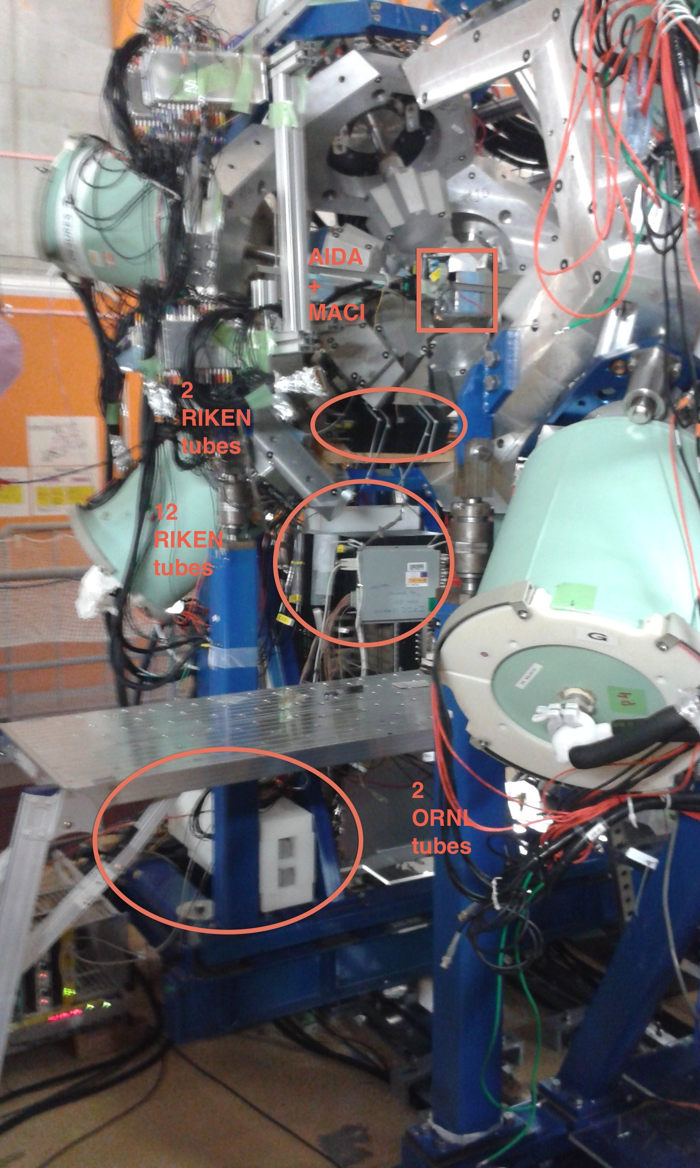
Synchronization: Parasitic @RIKEN
. Beam/Experiment
Parasitic to Doornenbal-Obertelli (p,2p) SEASTAR experiment (April 28 – May 6)
348MeV/u 238U (~30pnA) on Be (3mm)
BigRIPS+ZDS
MINOS (10mm LH2 target) + DALI at F8
EURICA+AIDA+MACI(plastic ToF array)+3He-tubes at F11
Reactions (BigRIPS-secondary-beam / ZDS-setting): 85Ga(p,2p)84Zn, 111Nb(p,2p)110Zr, 89As(p,2p)88Ge, 95Br(p2p)94Se, 101Rb(p,2p)100Kr

Slide 18
Synchronization: ³He counters positions
³He counters positions:
2 RIKEN tubes in PE block of 10cmx10cmx30cm about 40cm below AIDA within EURIKA frame.
12 RIKEN tubes in a 20cmx30cmx30cm PE block (24 holes: upper 12 occupied) about 80cm below AIDA.
2 ORNL 2” tubes between PE slabs (close to the floor at about 1.8m from AIDA).
Later on one RIKEN tube between PE slabs placed below MUSIC chamber at about 2.5m from AIDA.
Extra PE shielding added later: one piece on top of PE block for D tubes covering the 4 left most tubes, and another piece in front of the 4 right most tubes.

Slide 19
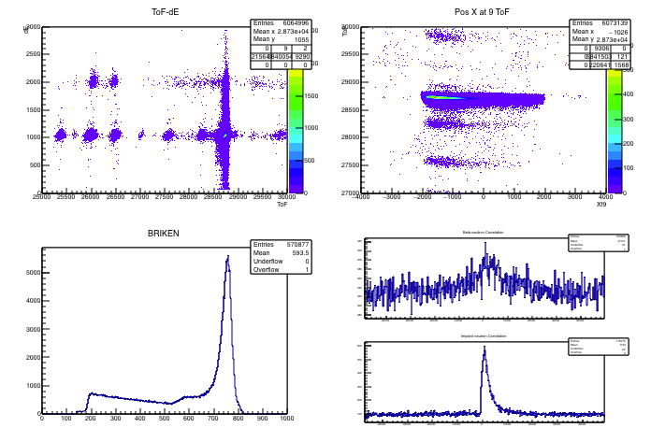
Synchronization: Results
Online

Slide 20
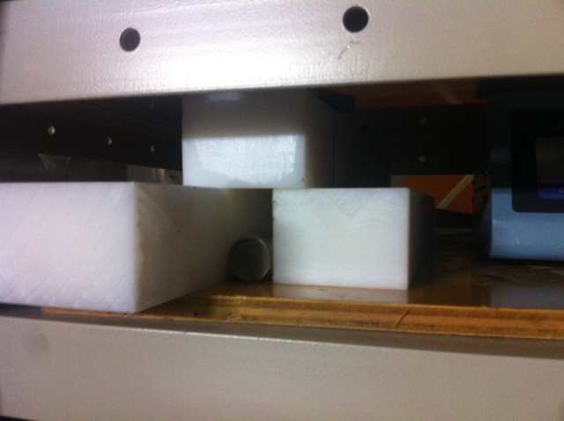
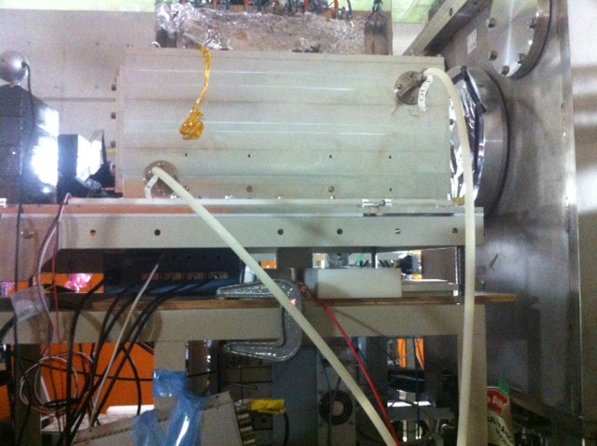
Beam Background test
Three diferents mesures:
Beam off.
²³⁸U Beam Be target.
⁷⁸Kr Beam Be target.

Slide 21
Beam Background test: results
No beam:
Detector | Bck
In Eurika frame U(n/s) | 0.008
Below Eurika D(n/s) | 0.005
ORNL 2” tubes Us(n/s) | 0.021
Below beam B(n/s) | 0.007
²³⁸U beam:
 | ¹¹⁰Zr(1) | ¹¹⁰Zr(2) | ⁸⁸Ge | ⁹⁴Se(1) | ⁹⁴Se(2) | ⁹⁴Se(3) | ⁹⁵kr | ¹⁰⁰Kr
U(n/s) | 0.48 | 0.87 | 1.27 | 1.27 | 0.97 | 3.55 | 4.75 | 2.06
D(n/s) | 0.14 | 0.24 | 0.35 | 0.35 | 0.26 | 0.9 | 1.32 | 0.61
US-B*(n/s) | 0.29 | 0.52 | 0.71 | 0.72 | 0.54 | 0.43* | 0.58* | 0.28*
78Kr beam: 70Kr selected in BigRips: B(n/s) 0.013

Slide 22
Conclusion
The main needs of the BRIKEN DAQ are ready and tested.
The DAQ was successfully tested for a number of channels near the experimental situation.
The synchronization was successfully implemented and tested.
The three systems of the experimental setup (BRIKEN, AIDA and BigRips) were running together with a common clock.
An elementary online framework was implemented and tested
We are able to see data from the three systems in the same framework.
We could see data correlation between AIDA , BigRips and BRIKEN.
A DAQ group to clarify Online/Offline analysis of the three setups is really needed.

