Slide 1
3rd BRIKEN WORKSHOP: Welcome!
C. Domingo-Pardo
IFIC (CSIC-University of Valencia)
3rd BRIKEN WORKSHOP, IFIC, Valencia 22-24/07/2015
Notes:
Thank the organizers, Christian Stahl, for the opportunity to present remotely this proposal.
Proposal prepared mainly by Tomas Rodriguez and Myslef, and we have presented it already at the AGATA Physics Workshop in Istanbul, and latter several times in 2009 and 2010 at GSI.
So the goal of the proposal is to study the rich shape coexistence phenomena that apparently happen in the nucleus Zirconium-80, which has 40 protons and 40 neutrons.

Slide 2
Outline
Short overview of the BRIKEN project
Summary of the previous BRIKEN Workshops
Goals for the present workshop

Slide 3
Brief history of the BRIKEN Project
BRIKEN stands for Beta delayed neutron emission measurements at RIKEN
BRIKEN was born as a scientific need of nuclear data for:
Astrophysics
Nuclear structure
Reactor technology
BRIKEN aims at:
most exotic nuclei → RIKEN BigRIPS
largest detection sensitivity → largest array of ³He counters
1st BRIKEN Workshop, December 2012, Valencia
2nd BRIKEN Workshop, July 2013, Tokyo
3rd BRIKEN Workshop, July 2015, Valencia
→See talks today by G. Kiss, K. Rykaczewski & G. Lorusso
→See talks on Friday by A. Algora, P. Ascher and C. Domingo

Slide 4
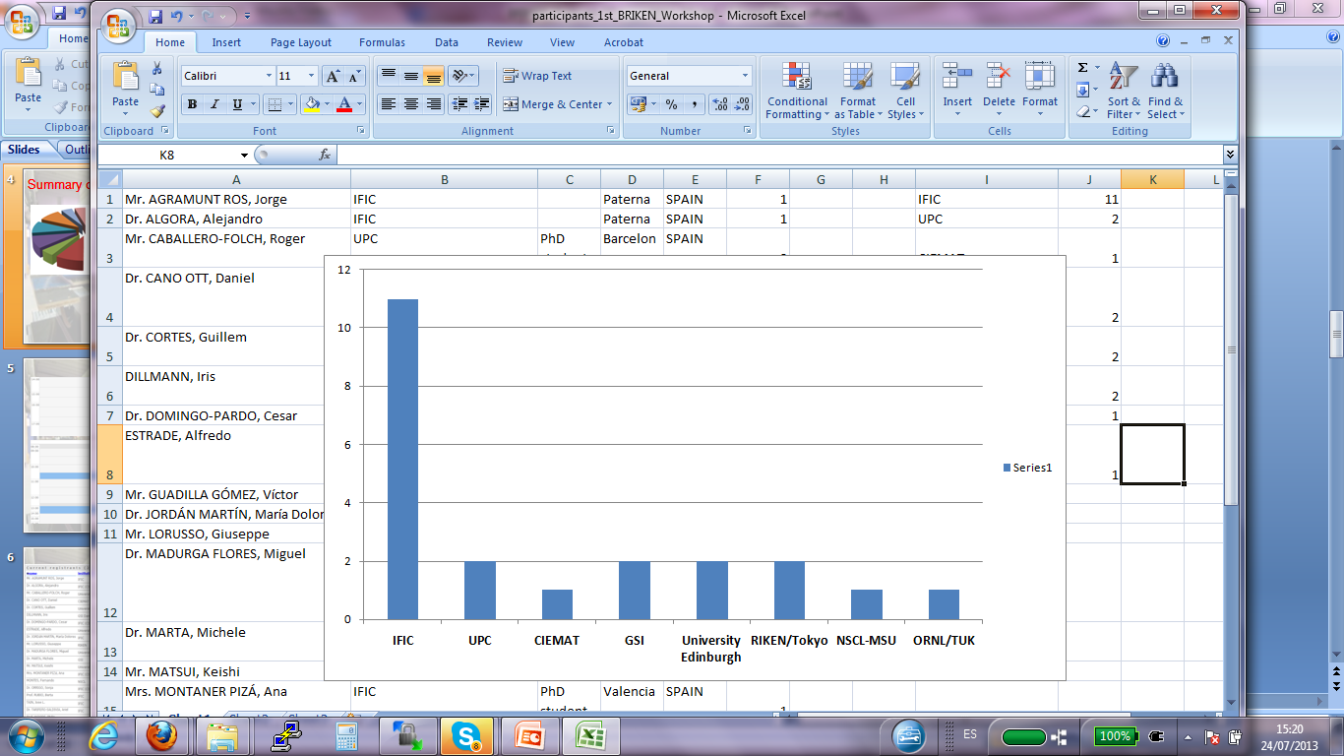
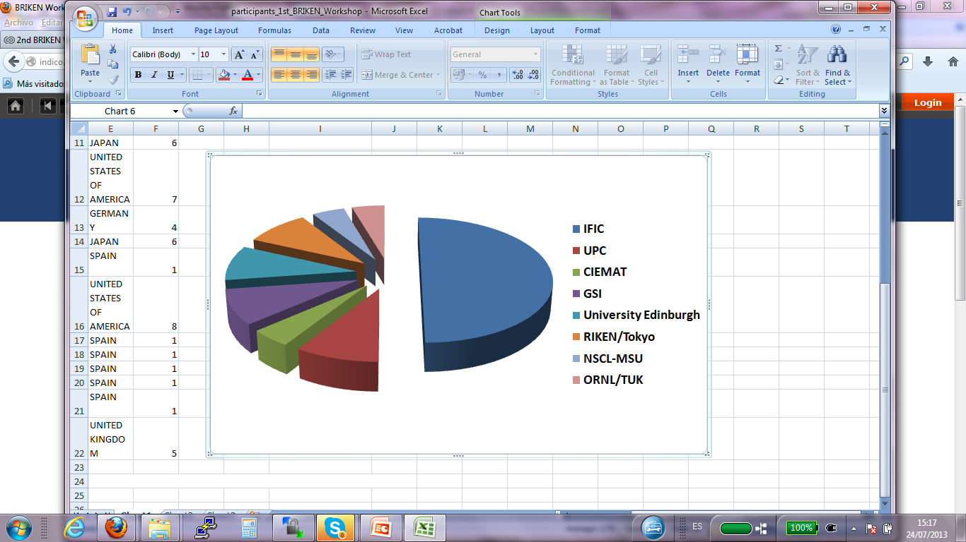

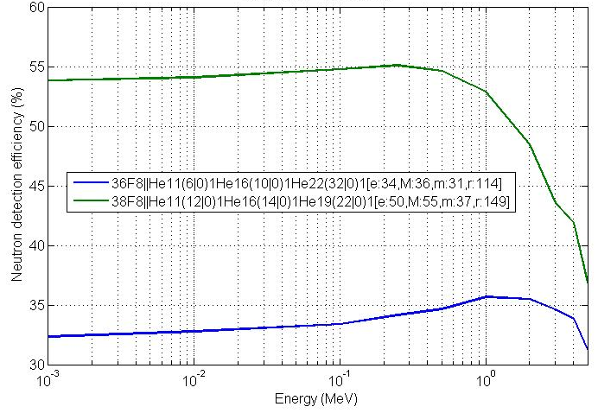

Summary of the 1st BRIKEN Workshop, Valencia 2012
Implantation/Decay device discussed (WAS3ABI vs. AIDA) and decided: AIDA
Preliminary configuration for BRIKEN detector (at that time just BELEN):
20 participants
(→see talk today by A. Estrade)
48 tubes → ε_{n}=54%
48 tubes → ε_{n}=33%
16cm
16cm
MCNPX Simulations by UPC-Barcelona Group

Slide 5
Summary of the 1st BRIKEN Workshop, Valencia 2012
General talks:
Experiments with BELEN detector at JYFL and at GSI, R.Caballero (UPC)
(early) Plans for VANDLE at RIKEN, M.Madurga (Univ. of Tennessee)
One talk dedicated to Digital Data Acquisition System (J.Agramunt)
A flavour of the BRIKEN physics:
Presenter | Institute | Physics
Estrade | University of Edinburgh, UK | Synergy for masses and neutron branching measurements
I. Dillmann & M. Marta | GSI Darmstadt, Germany | Multiple neutron emitters, several candidates around ⁷⁸Ni and ¹³²Sn
D. Cano-Ott | CIEMAT Madrid, Spain | High-accuracy data on FF neutron branching ratios for GenIV reactors and ADS systems
C. Domingo-Pardo | IFIC Valencia, Spain | b-delayed n-emission for the Rare Earth Peak (A =160 region)
F. Montes | NSCL-MSU, USA | b-decay studies relevant for the A=130 r-process peak (¹³⁹Sb)

Slide 6
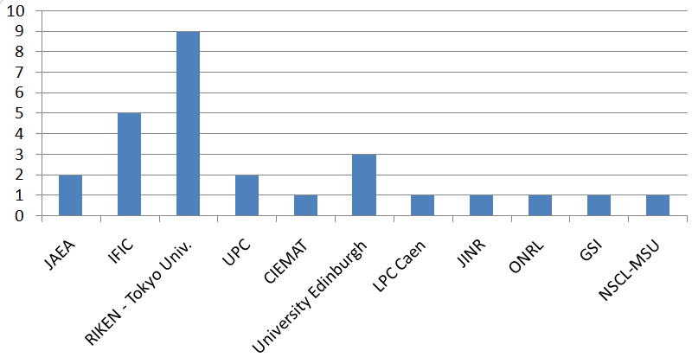
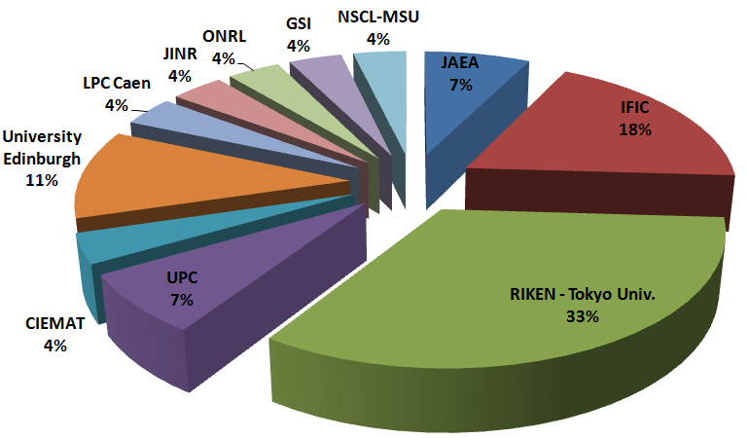
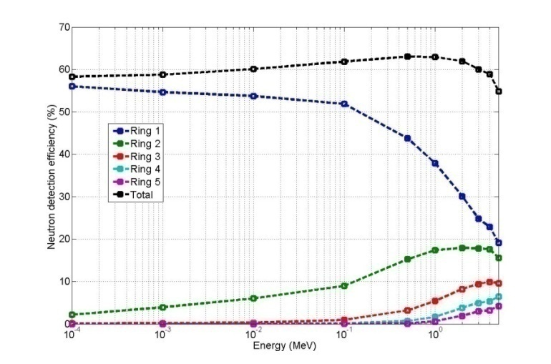

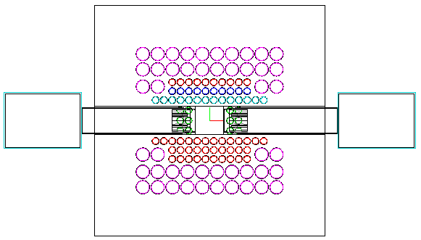
Summary of the 2nd BRIKEN Workshop, Tokyo 2013
2nd BRIKEN Workshop:
27 participants
149 ³He counters, UPC, 5MeV max. neutron energy
Radii (cm) | Number of counters | Institute
12.5 | 10 | ORNL
19.5 | 42 | UPC
25.0 | 10+13x2+15 | GSI+RIKEN+JINR
30.5 | 22 | ORNL
36.0 | 24 | ORNL
UPC: 42
GSI: 10
ORNLs: 16
ORNLl: 48
RIKEN: 24
Eff(0.5MeV)=71.7%
Eff(2.5MeV)=61.3%
→see talks today PM by Phong Vi, G.Cortes and A. Tarifeño
IFIC, J.L. Taín

Slide 7
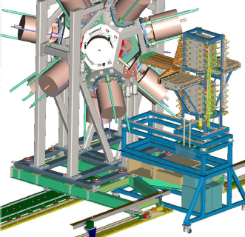
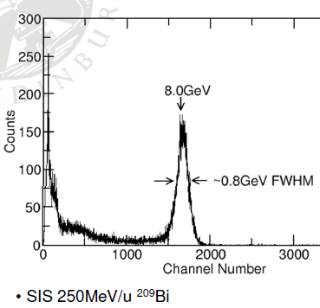
Summary of the 2nd BRIKEN Workshop, Tokyo 2013
Preliminary AIDA performance test results:
→ See talk by A. Estrade today
Presenter | Topic | Nuclei
S.Nishimura | 2nd r-process peak | A=110-125
F. Montes | 2nd r-process peak | ¹³⁹Sb
C.Domingo | REP | ¹⁵¹La-¹⁷³Tb, etc
M.Marta I.Dillmann | Multiple n’s,2n, 3n | ⁷⁸Ni (⁷⁶Co-⁸¹Cu), etc
K.Rykaczewski | Multiple n | ⁷⁸Ni-⁸¹Ga, etc
R.Grywacz | Multiple n | ⁴⁸Cl-⁶⁴V, etc
G. Lorusso | 2nd r-process | ¹²⁹Ag-¹⁴²Te, etc
Algora | Nucl. shapes | ¹⁰⁶Zr-¹¹⁴Mo, etc
B. Rubio | TAS+Neutrons | N>82 ¹³⁰Ag-¹³⁸Sb, etc
Estrade | MBRIKEN | Several
J.L. Tain | B-strength func. | 85Ge-97Br, etc
D. Cano-Ott | Reactor Techno. | Ge86-As86, etc
Large list of physics cases!

Slide 8
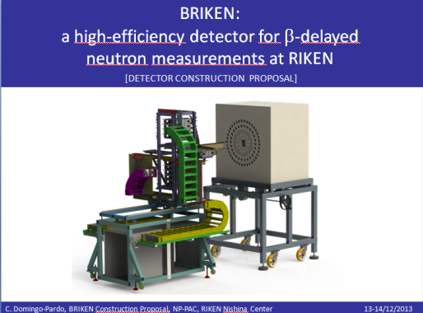
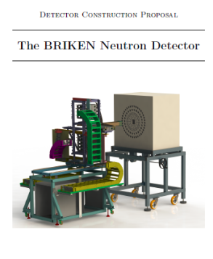
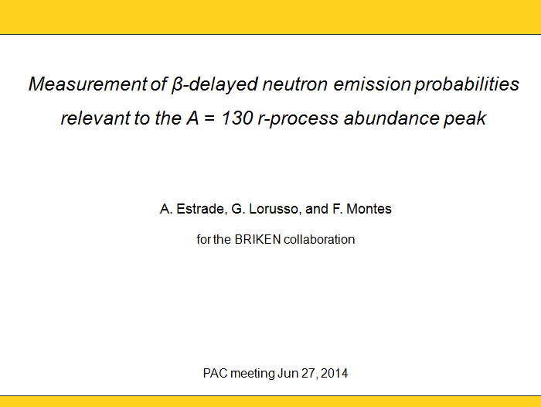
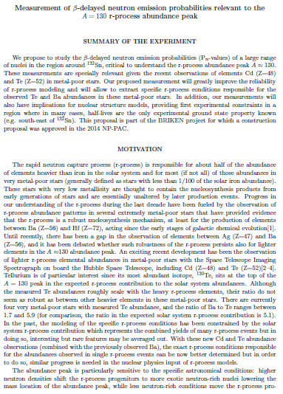
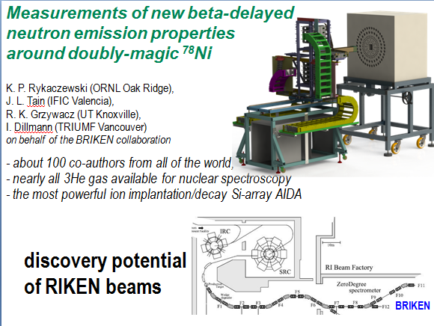
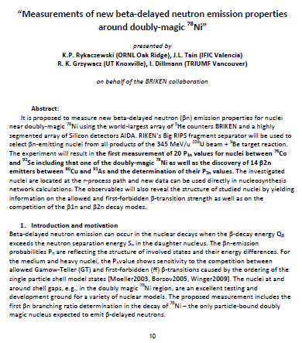
First achievements of the BRIKEN Collaboration, 2013-2014
→BRIKEN Construction Proposal, approved PAC-Meeting, Dec. 2013
→ NP1406-RIBF128, approved PAC-Meeting, June 2014
6.5 days of beam-time!
→ NP1412-RIBF127R1, approved PAC-Meeting, December 2014
4 days of beam-time!

Slide 9
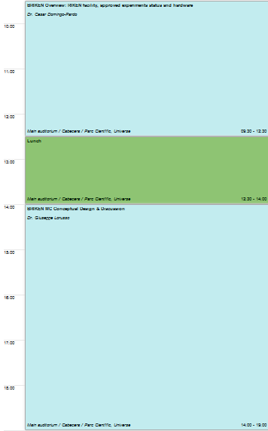
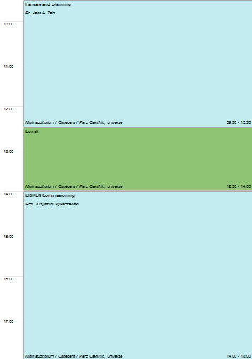
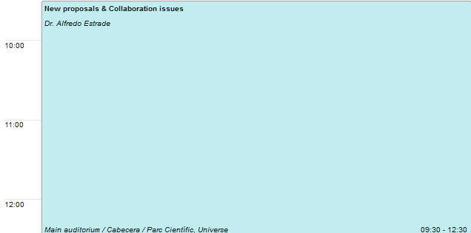
Goals for the present workshop
Discuss the set-up for BRIKEN: decide the FINAL geometry compact/hybrid geometry, etc
Plan the set-up of the full system (AIDA + BRIKEN) at BigRIPS
Plan the commissioning and the experiments
Discuss organizatorial issues: scientific board, contributions to conferences, publications, author’s lists, etc.
Discuss future proposals, which and when

Slide 10
Thank you, and enjoy this workshop!

