Slide 1
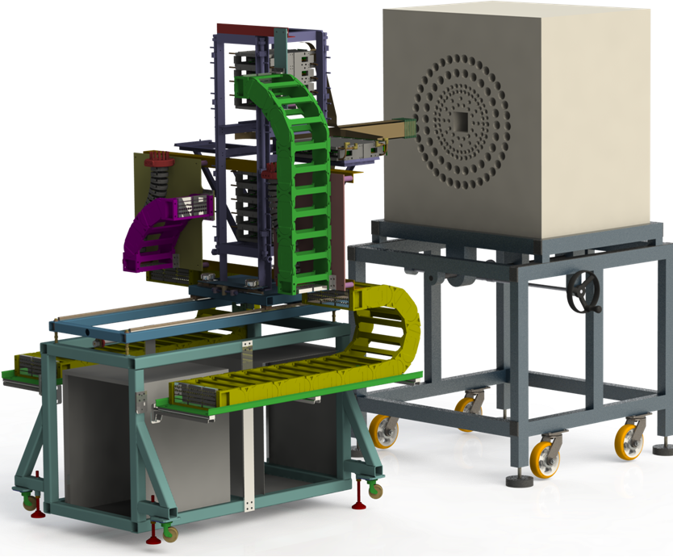
Measurements of new beta-delayed neutron emission properties around doubly-magic ⁷⁸Ni
(NP1406-RIBF127 proposal)
K.P. Rykaczewski (ORNL Oak Ridge)
in collaboration with
J.L. Tain (IFIC Valencia), R.K. Grzywacz (UT Knoxville)
I. Dillmann (TRIUMF Vancouver) and BRIKEN team
Local coordinator: S. Nishimura
BRIKEN:
nearly all 3He gas available for nuclear spectroscopy
the most powerful ion implantation/decay Si-array AIDA
to be operated at F12 position at Big RIPS

Slide 2
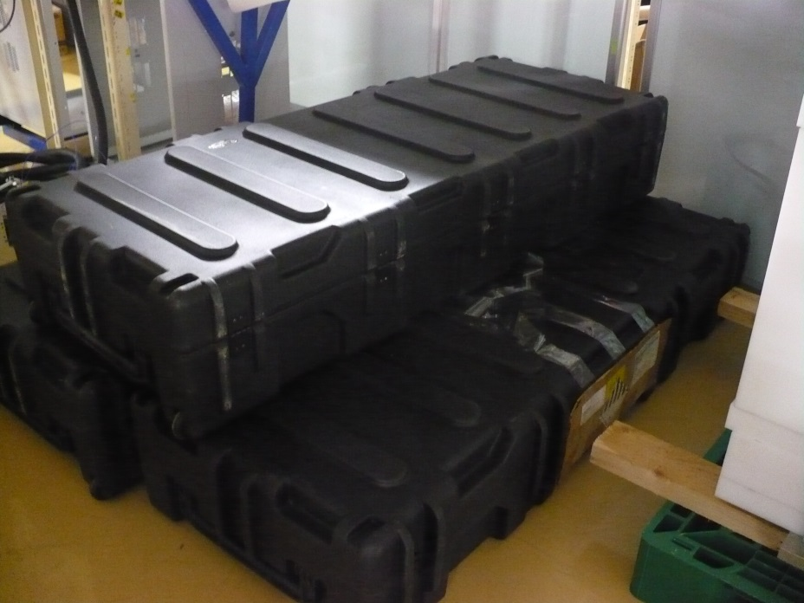
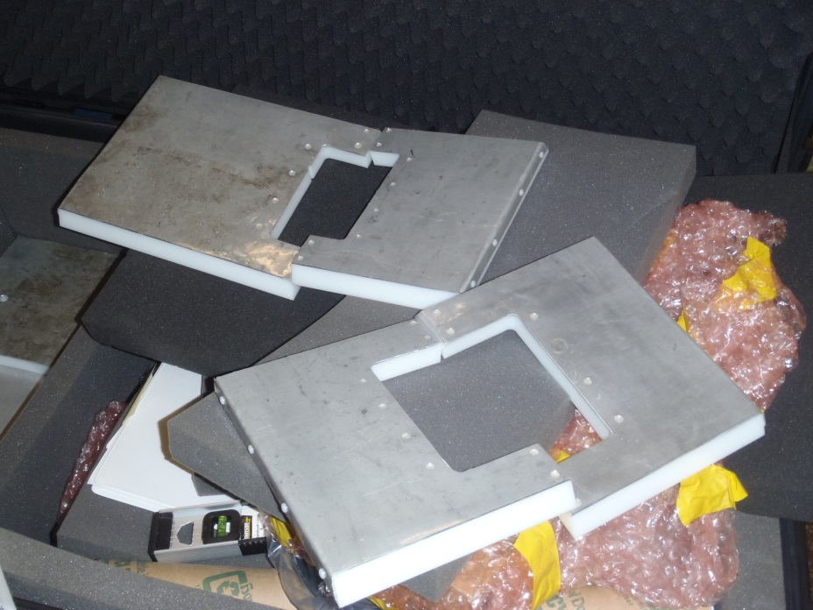
BRIKEN RIBF127 status
Proposal to measure β1n/β2n emission between ⁷⁶Co and ⁹²Se got category A in Dec. 2014 (4 days)
All eighty one 3He tubes at 10 atm (17 1” diameter and 64 2” tubes) with their UTK preamps,
ORNL HV system , cables, cable panel etc.. were delivered to RIKEN in April 2015
(after ~2 years of paperwork),
We can supply two clovers for April 2016 test, and later for the main run if CAGRA clovers are
not available (clovers have to travel between ORNL and RIKEN)
We can supply some Cd shielding plates, with 1” HDPE+1 mm Cd
As for today, ORNL/UTK manpower can be available for late April 2016 test run and its preparations
RIKEN April 2015
Hybrid 3Hen HDPE-Cd shields

Slide 3
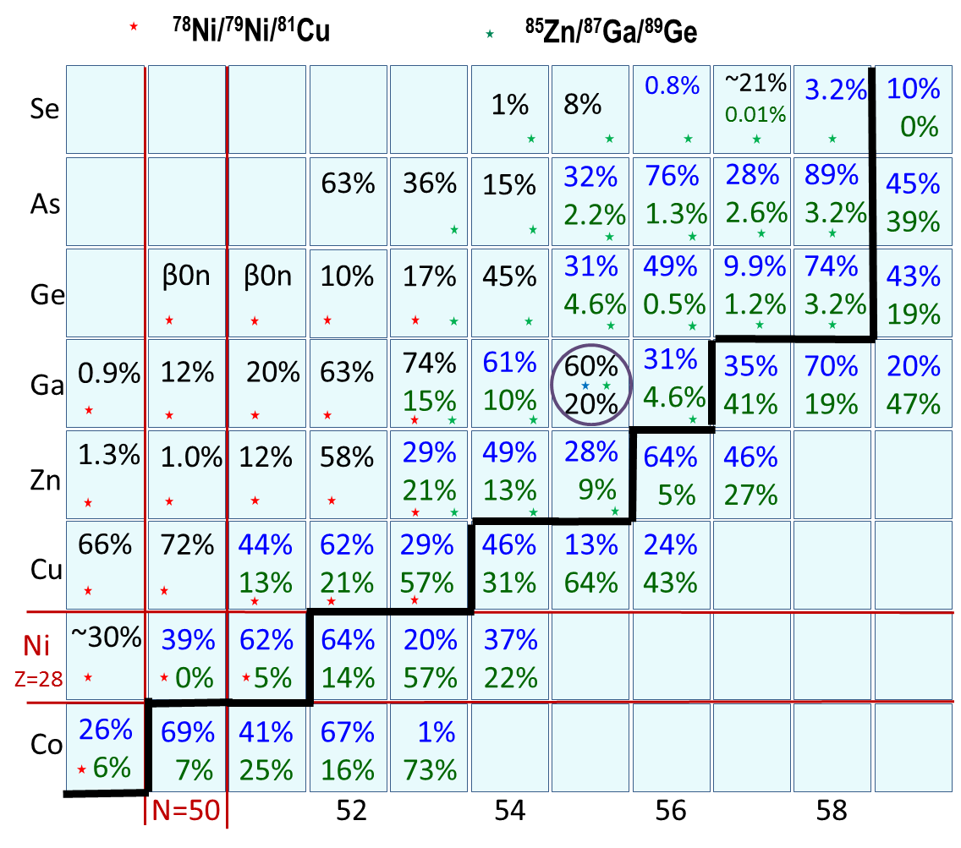
Region of interest (2 Big RIPS settings now, not 3)
Experimental P_{β1n} values
are given in black
Predicted P_{β1n} and P_{β2n} values
listed according to Moeller 2003
~ 20 new P_{n} and 14 new P_{2n}
values

Slide 4
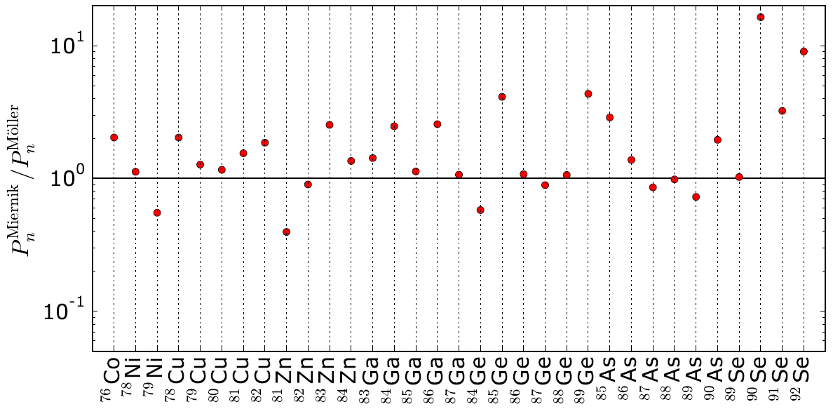
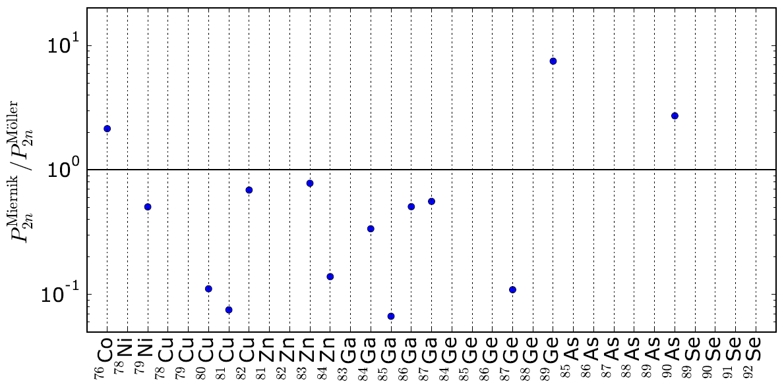
P_{1n} and P_{2n} values predicted for “our” new nuclei
comparison of Miernik’s EDM 2014 vs Moeller’s QRPA 2003
Larger P_{1n}
Lower P_{2n}

Slide 5
Reduction of anticipated β2n counts, if P_{2n} is closer to Miernik’s predictions
In most cases we expect few hundred+ of b2n counts, so we should be safe with respect
to counting statistics IF background will not kill us
(efficiencies of 60% beta and 60% 1n were included in rate calculations)
⁸¹Cu PM 21%→ 130 counts KM 1. 6% → 10 counts
⁸⁷Ga PM 13%→ 64 counts KM 7.2% → 35 counts
⁸⁸Ge PM 0.5% → 270 counts KM < 0.1% → < 54 counts
⁹¹As PM 3.2%→ 120 counts KM 0.9% → 34 counts
β – n – n should offer cleaner events in comparison to β – n
(background free spectrum of 11 β – n – n events of ⁸⁶Ga decay at the HRIBF, Miernik PRL 2013

Slide 6
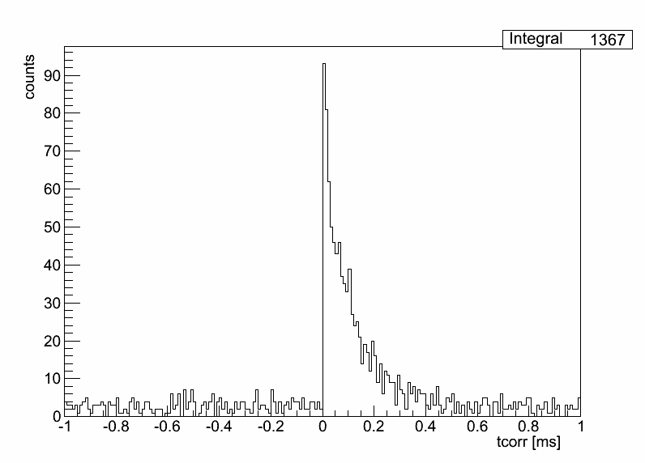
Signal to background rate for ⁷⁸Ni, T_{1/2}=122(5) ms
2 day measurement: about 5600 ⁷⁸Ni ions and about 780 ion-β-correlated neutron counts
total rate ~ 800 ions /s and ~ 50 n/s
distributed over at least ~ 12 000 pixels and 172 ³He counters
1 ion per pixel per 15 seconds and about 1 neutron per 20 ms in ALL 172 3He tubes
⁷⁸Ni βn-decay
MC simulations
J. L.Tain
⁷⁸Ni ion-β correlation time of ten half-lives=1.22 s
1 ms thermalization time window for β-n
for large BRIKEN moderator
It gives 5.6 % random background
for the 780 true events of ⁷⁸Ni-β-n counts
e.g., P_{1n}(⁷⁸Ni) = 40 (3) %
Nuclear Chemistry Gordon Conference, 2013

Slide 7
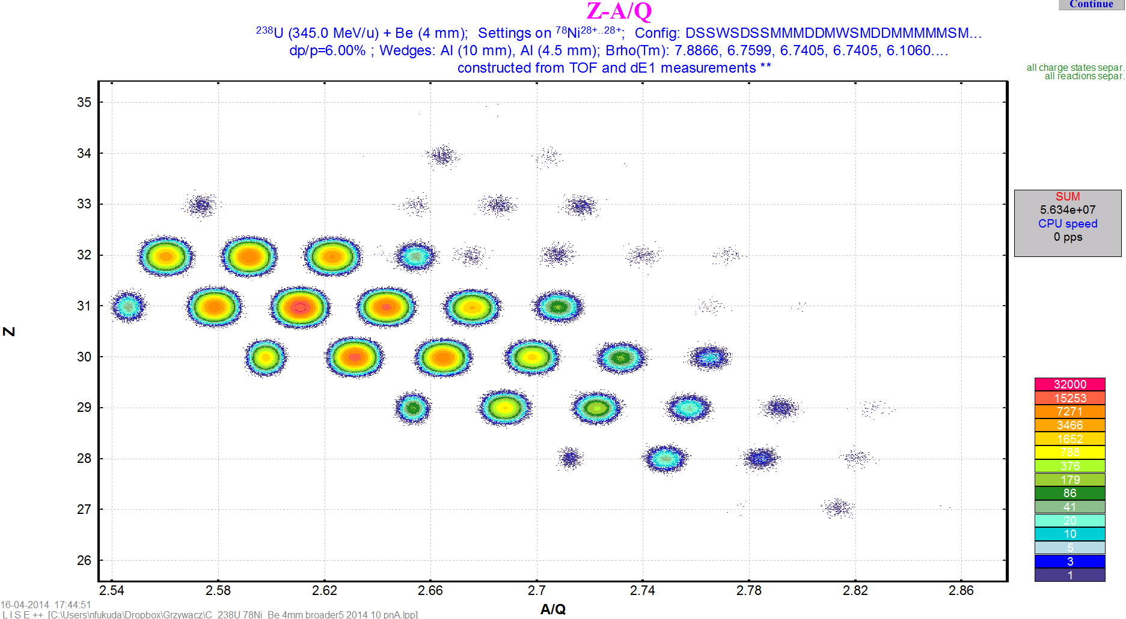
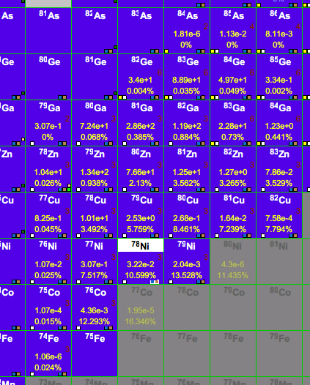
⁷⁸Ni/⁷⁹Ni/⁸¹Cu setting
(R. Grzywacz, N. Fukuda and BigRIPS team)
²³⁸U 10 pnA
⁸¹Cu
⁷⁸Ni
⁷⁹Ni
It is ⁷⁸Ni/⁷⁹Ni^{/81}Cu setting
with higher Bρ values with respect
to the optimum ⁷⁸Ni setting.
It allows us to cut the rates
of less-exotic but very abundant fragments.
⁸²Cu - 7.8% transmission

Slide 8
Hybrid BRIKEN vs maximized efficiency BRIKEN
⁸²Cu β-decay to s_{1/2} state in N=51 ⁸¹Zn, see 2nd BRIKEN workshop
( ^{80,81,82}Cu β-decay experiments were accepted at the HRIBF)
⁸²Cu
(4-,5-)
Q_{β}~ 17 MeV
T_{1/2} ~ 60 ms
βn
~ 0.6 MeV
s_{1/2}
S_{n}~ 5 MeV
d_{5/2}
2⁺
⁸¹Zn
N=51
~ 0.7 MeV
0⁺
⁸²Zn
YES for hybrid BRIKEN, in particular since the 60% flat efficiency for hybrid BRIKEN
seems to be achievable with our large amount of 3He tubes and large moderator.
For ⁸²Cu, with optimized setting and 20 pnA ²³⁸U beam, we can expect about 500 ions in 2 days.
With 5% γ-efficiency and ca 30% P_{1n} to the s_{1/2} state it gives 3 counts in ion-β-n-γ spectrum.

Slide 9
Summary
I’m impressed by test run results (Alfredo, Gabor, Jose, Shunji.. et al)
ORNL/UTK hardware contribution was delivered to RIKEN in April 2015
Additional contributions like 2 clovers with their HV, and the HDPE-Cd shields possible
Manpower for late April 2016 and later main run “available” so far,
including Shintaro Go – PhD at RIKEN, now a postdoc at UTK.
To be done:
Decide about (hybrid)-BRIKEN design, moderator, Cd shields, clovers
Constant development of data ACQ and on-line analysis
Meeting on data acquisition, in particular AIDA calibration procedures,
and on general evaluation procedures (UTK experts including Shintaro)
Writing a request and filling the forms for BRIKEN test run
Setting up for test run
Asking for main experiment, RIB-127 and 128 , to be run together
Nuclear Chemistry Gordon Conference, 2013

