Slide 1
Flavor structure of Λ baryons from lattice QCD
Philipp Gubler (ECT*)
Toru T. Takahashi (Gunma National College of Technology)
Makoto Oka (Tokyo Institute of Technology)

Slide 2
Λ baryons
Λ
Λ_{c}
u
d
u
d
s
c
I=0
I=0
J^{P}=1/2±, 3/2±
J^{P}=1/2±, 3/2±
S=-1
C=1

Slide 3
Motivation
Λ
Λ_{c}
Λ(1405)
How do these states evolve as a function of the heavy quark mass?
Interesting dynamics of Qqq-system
(J^{P}=1/2⁻)
Possible probe of di-quarks
ρ-mode, λ-mode
Lightest negative parity baryon
Meson-baryon molecule?
ρ-mode
Can it be reproduced on the lattice?
q
q
q
q
Can we say anything about its structure?
λ-mode
Q
Q

Slide 4
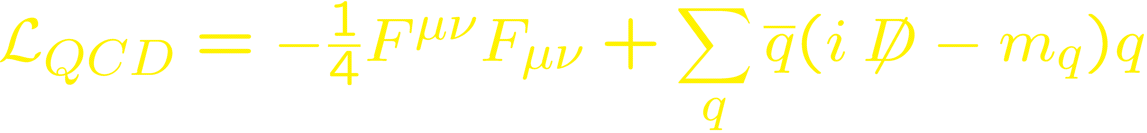
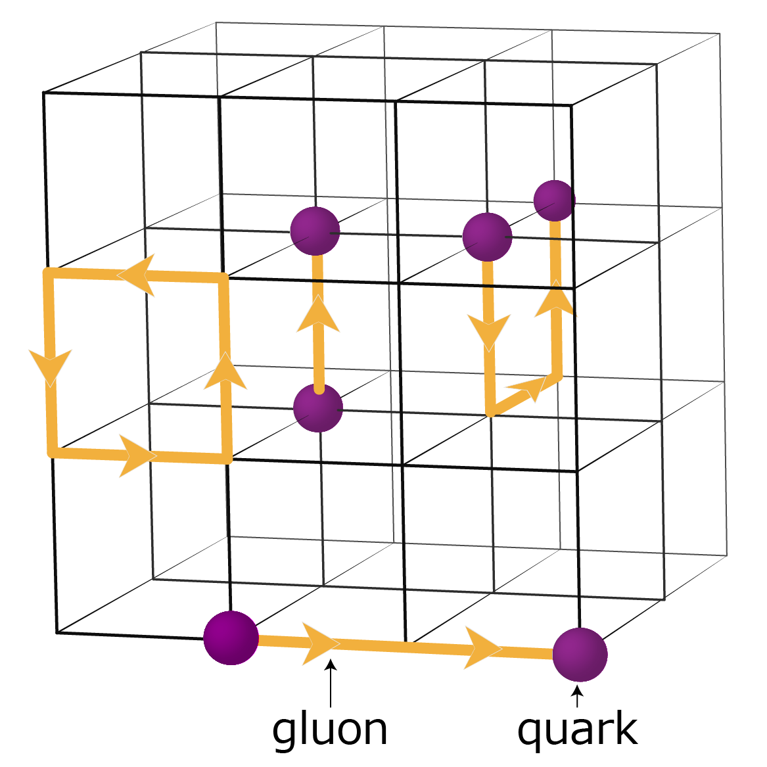
Our Method: Lattice QCD
→ Reformulate QCD on a lattice
→ Go to imaginary time
→ Perform the path integral statistically
(important sampling)
→ Extract the spectrum

Slide 5


How to extract the spectrum
Operators constructed from quark fields
t: large
ground state mass

Slide 6
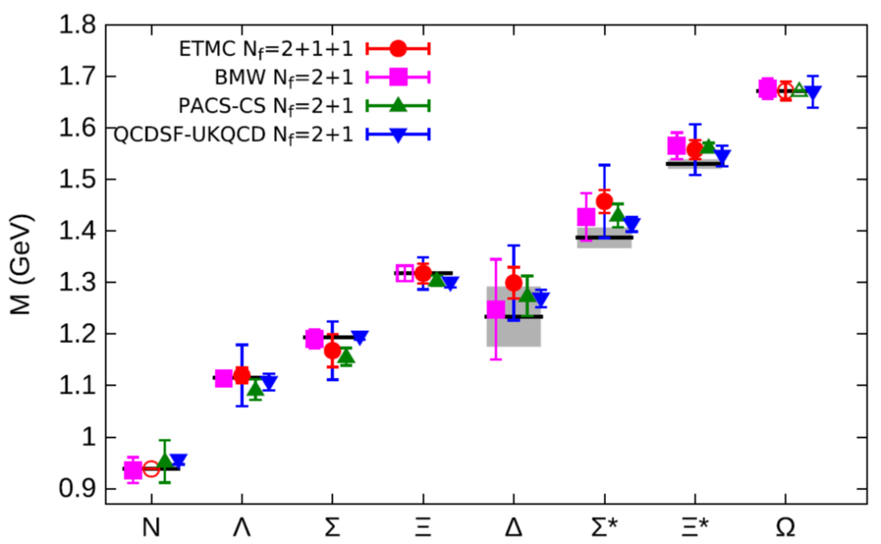
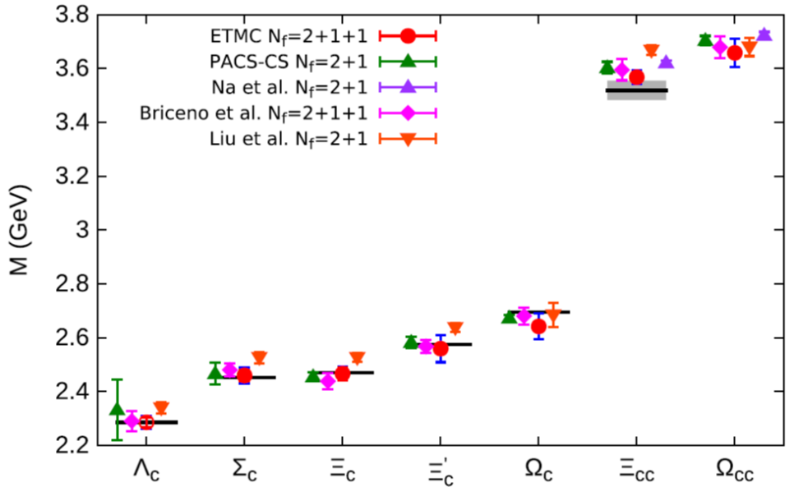
Sample results for baryonic ground states
C. Alexandrou et al. (ETM Collaboration), Phys. Rev. D 90, 074501 (2014).

Slide 7



Method for studying the flavor structure
Use correlation matrix:
singlet
Couplings to singlet/octet operators provide information about flavor structure of the states
octet

Slide 8
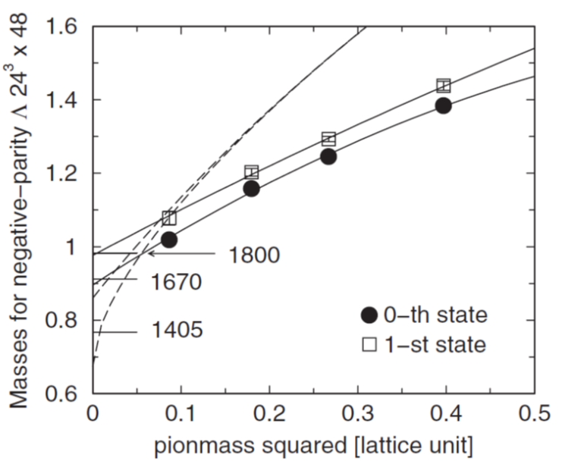
Recent studies of the Λ spectrum
J^{P}=1/2⁻
- full 2-flavor QCD
- lightest pion mass: ~500 MeV
→ no Λ(1405) ?
T.T. Takahashi and M. Oka, Phys. Rev. D 81, 034505 (2010).

Slide 9
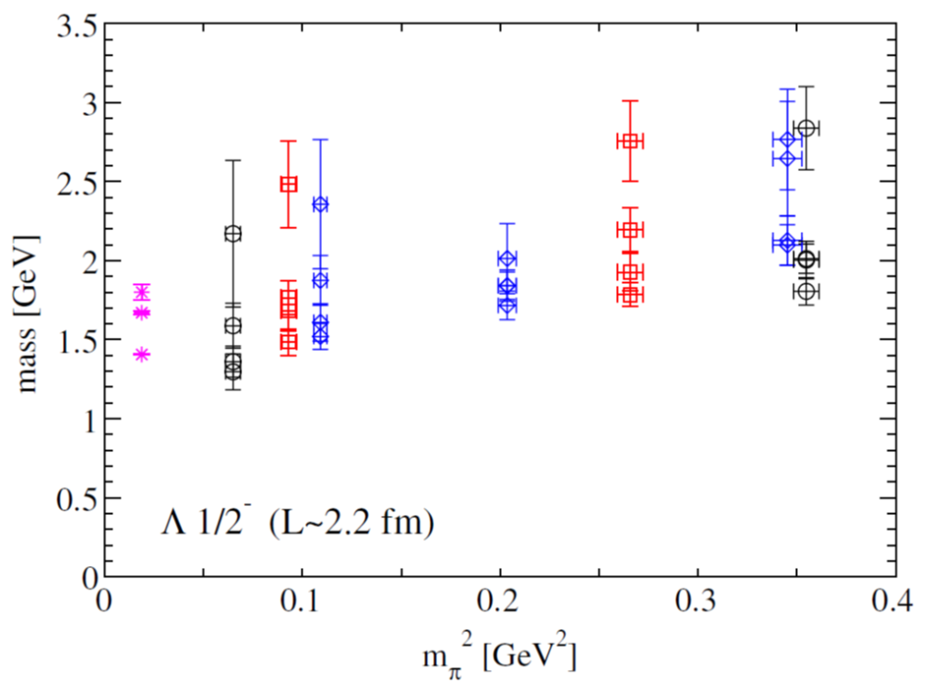
Recent studies of the Λ spectrum (cont`d)
J^{P}=1/2⁻
- full 2-flavor QCD
- lightest pion mass: ~255 MeV
→ Λ(1405) successfully
reproduced?
G.P. Engel, C.B. Lang and A. Schaefer (BGR Collaboration), Phys. Rev. D 87, 034502 (2013).

Slide 10
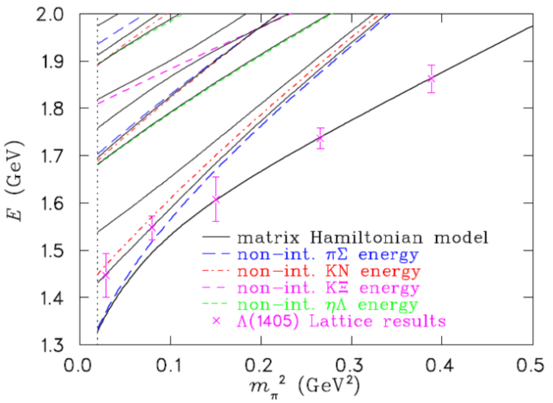
Recent studies of the Λ spectrum (cont`d)
J^{P}=1/2⁻
- full 2+1-flavor QCD
- lightest pion mass: ~156 MeV
→ Λ(1405) again
reproduced
J.M.M. Hall et al., Phys. Rev. Lett. 114, 132002 (2015).

Slide 11
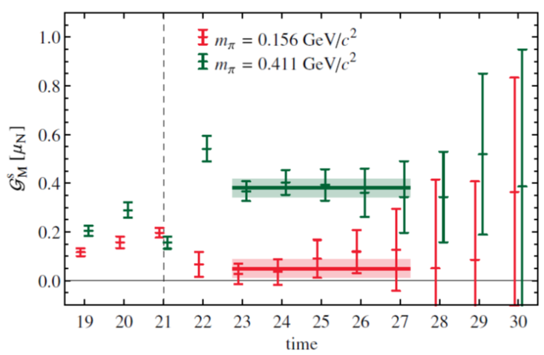
Recent studies of the Λ spectrum (cont`d)
J^{P}=1/2⁻
u
d
s
Measurement of the strange magnetic form factor of the Λ(1405)
→ Information on
internal structure of the state
s
u
u
d
u
J.M.M. Hall et al., Phys. Rev. Lett. 114, 132002 (2015).

Slide 12
Our lattice parameters
- 2+1-flavors of dynamical quarks
(Gauge configurations generated by the PACS-CS Collaboration)
- Renormalization-group improved gauge action at β=1.9 and a=0.0907 fm
- Lattice size: 32³ x 64 → (2.9 fm)³ x (5.8 fm)
- 4 Hopping parameters for light quark masses
→ Pion masses: 296 MeV ~ 702 MeV
- 5 Hopping parameters for heavy quark masses
→ 2 for physical strange and charm quarks
→ 3 for non-physical quarks interpolating between s and c

Slide 13
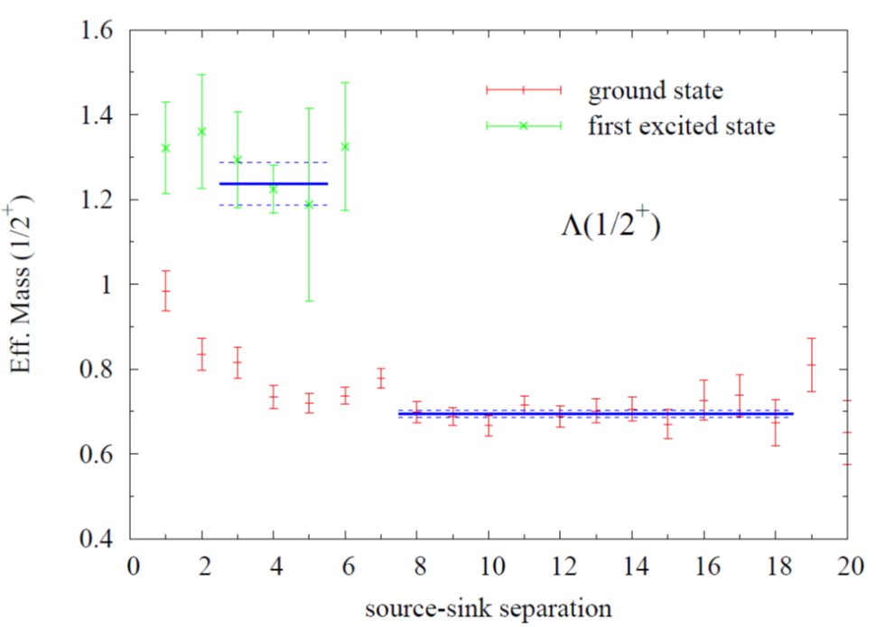
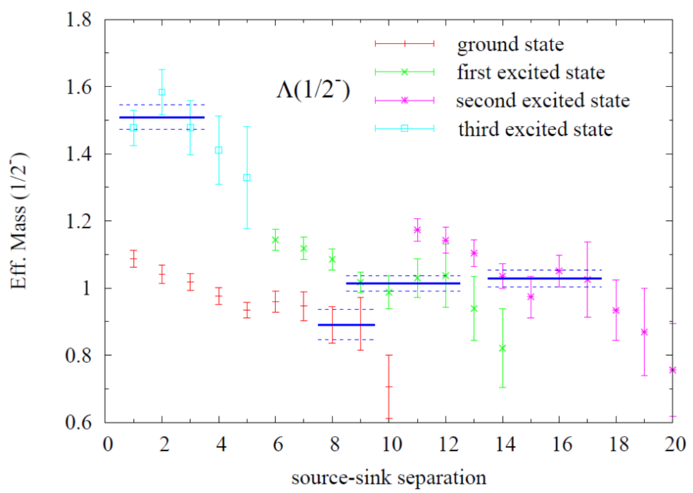
Effective masses (Λ)
m_{π} = 570 MeV

Slide 14
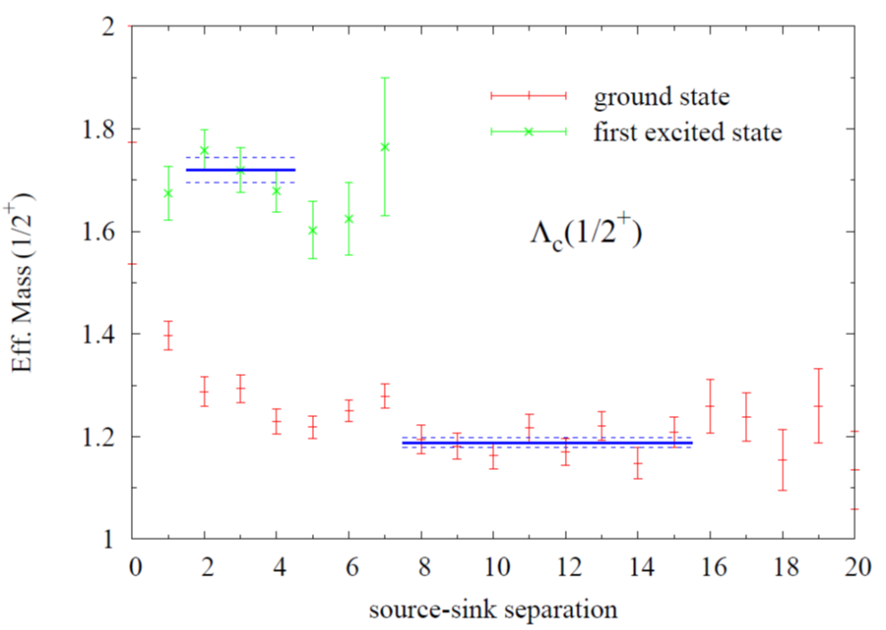
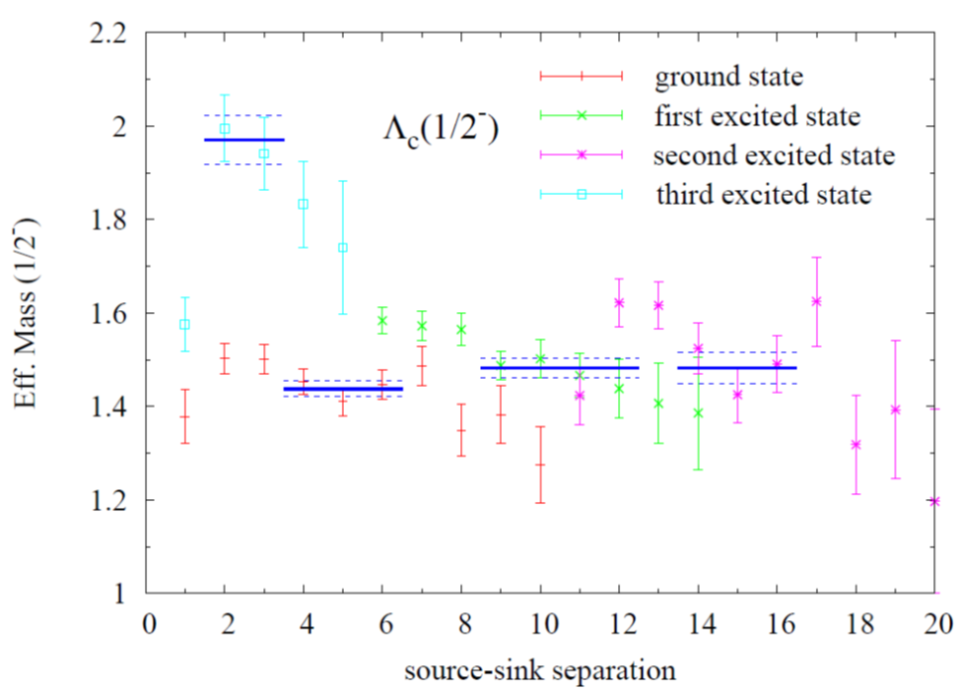
Effective masses (Λ_{c})
m_{π} = 570 MeV

Slide 15
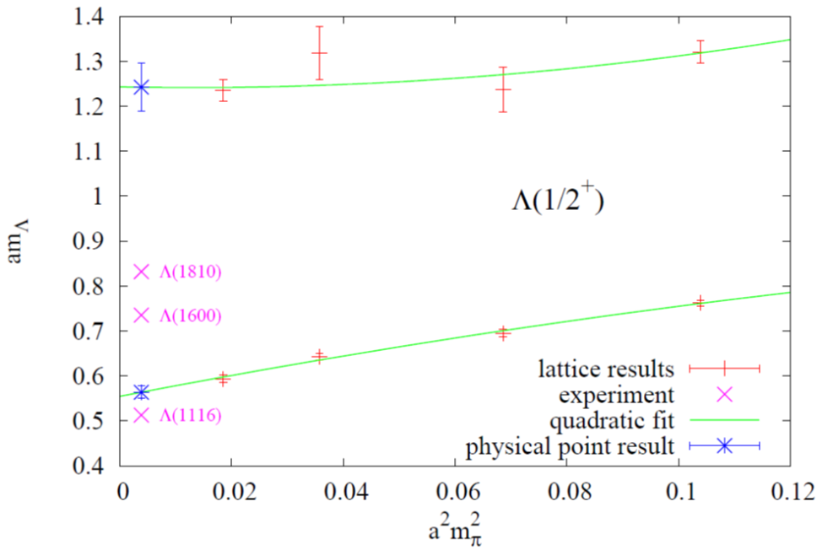
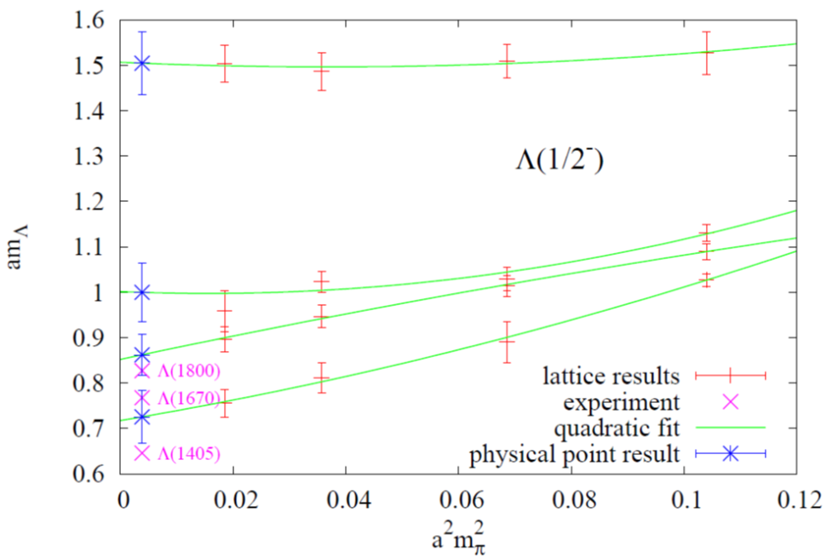
Chiral extrapolations (Λ)
Extracted masses are a bit too high compared to experiment.
→ too large strange quark mass?

Slide 16
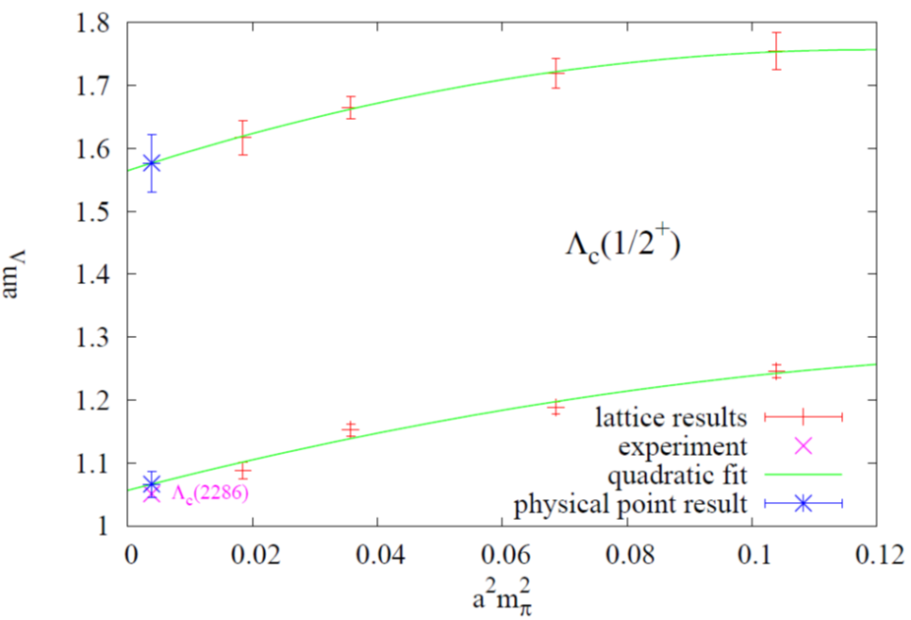
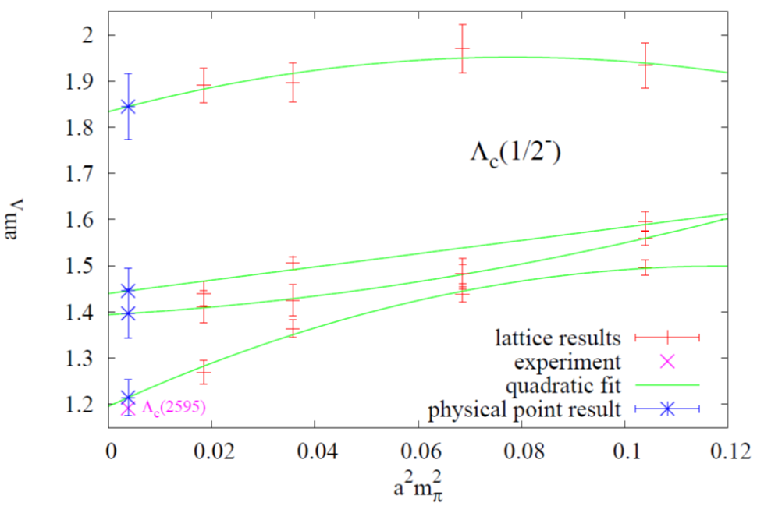
Chiral extrapolations (Λ_{c})
Good agreement of ground state masses with experimental values

Slide 17
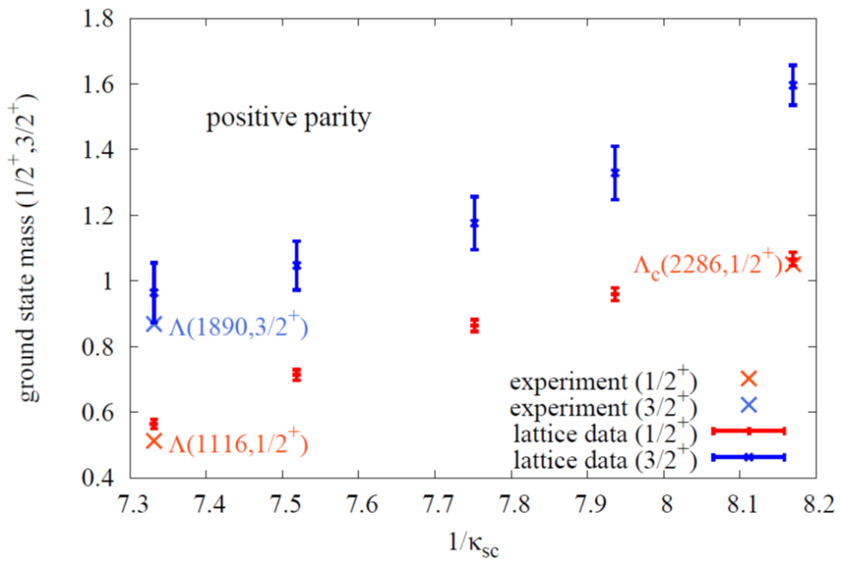
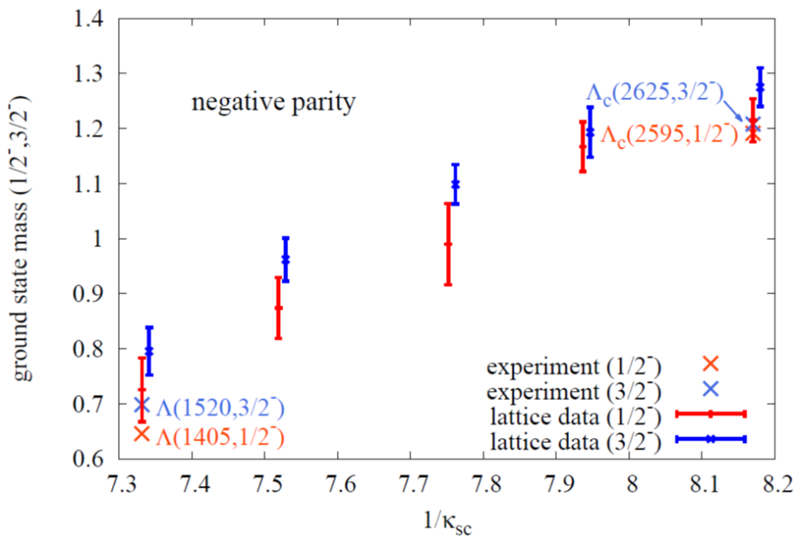
Letting the Λ evolve into the Λ_{c}
(Masses)
m_{s}
m_{c}
m_{s}
m_{c}

Slide 18
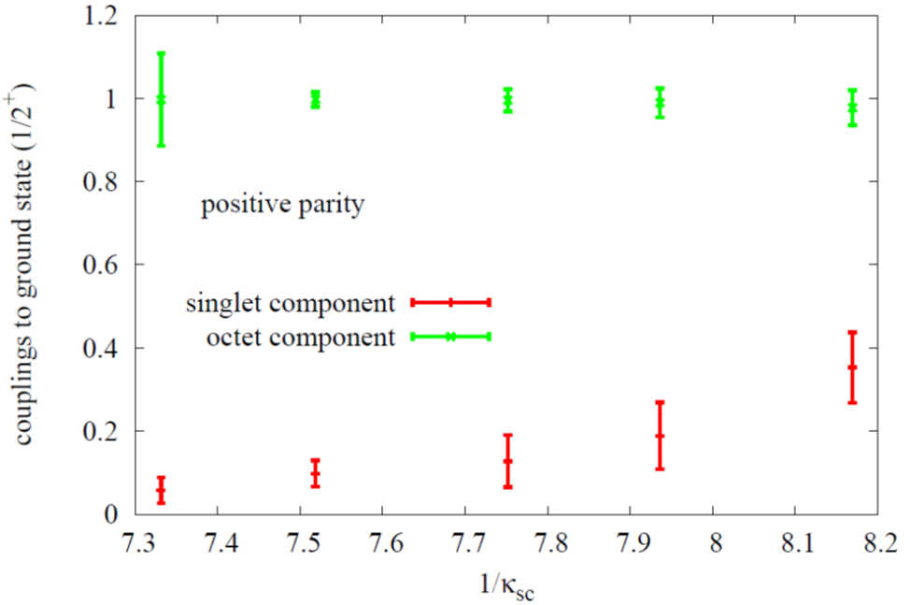
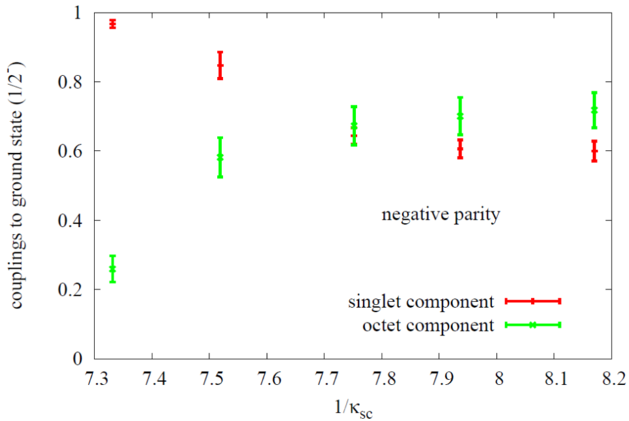
Letting the Λ evolve into the Λ_{c}
[Flavor decomposition, SU(3): (u,d,Q)]
m_{s}
m_{c}
m_{s}
m_{c}

Slide 19


Significance for structure of Λ_{c}(1/2⁻)
Possible excitations of Λ_{c}:
ρ-mode
u
d
u
d
λ-mode
C
C
Favored by our lattice results!

Slide 20
Summary and Conclusions
- Lattice QCD can be used to study hadrons
(energy levels, internal structure)
- We have studied the spectrum and flavor structure
of Λ baryons with J^{π}=1/2±, 3/2±
- In contrast to most other channels, the flavor structure
of the Λ_{c}(1/2⁻) differs strongly from its strange counterpart
Λ(1/2⁻)

Slide 21
Backup slides

Slide 22
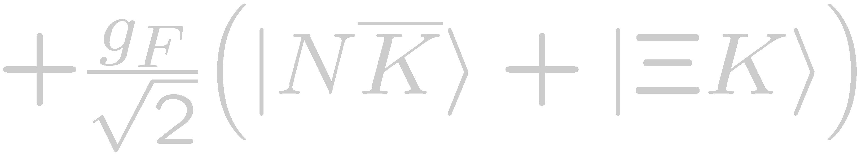
Change to particle basis
SU(3) Clebsh-Gordan coefficients give:
As however g_{D} and g_{F} are undetermined, the states can at present not be uniquely expressed in the particle basis

Slide 23
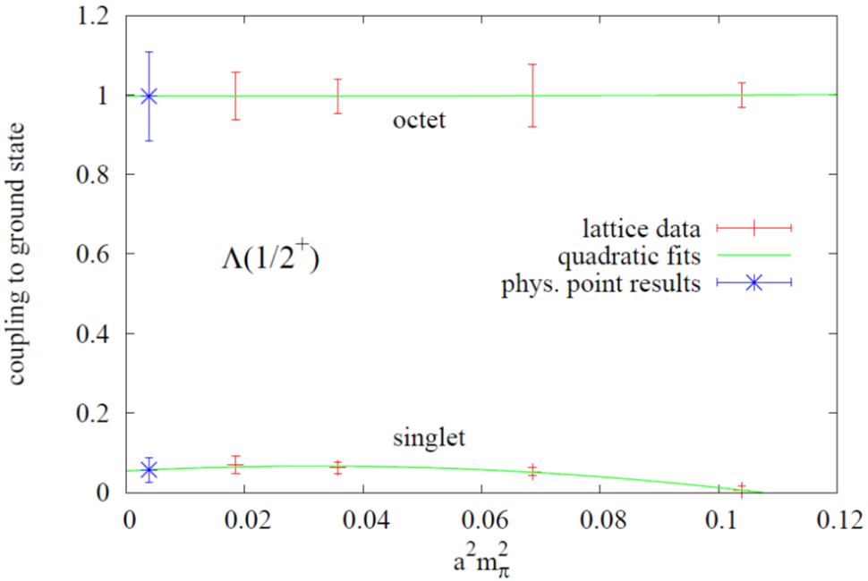
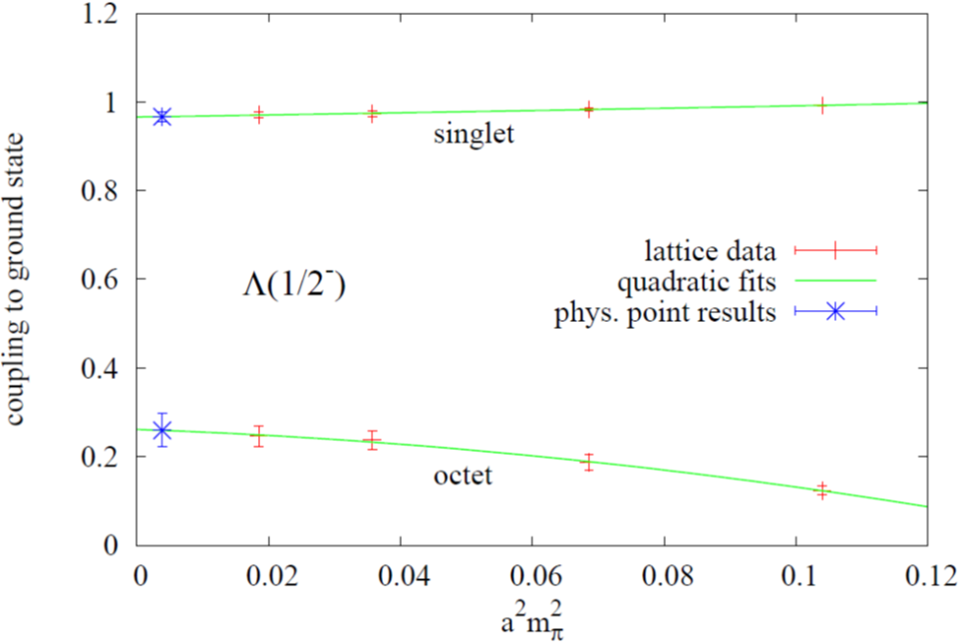
Chiral extrapolations of flavor components (Λ)
The light quark mass dependence is relatively weak

Slide 24
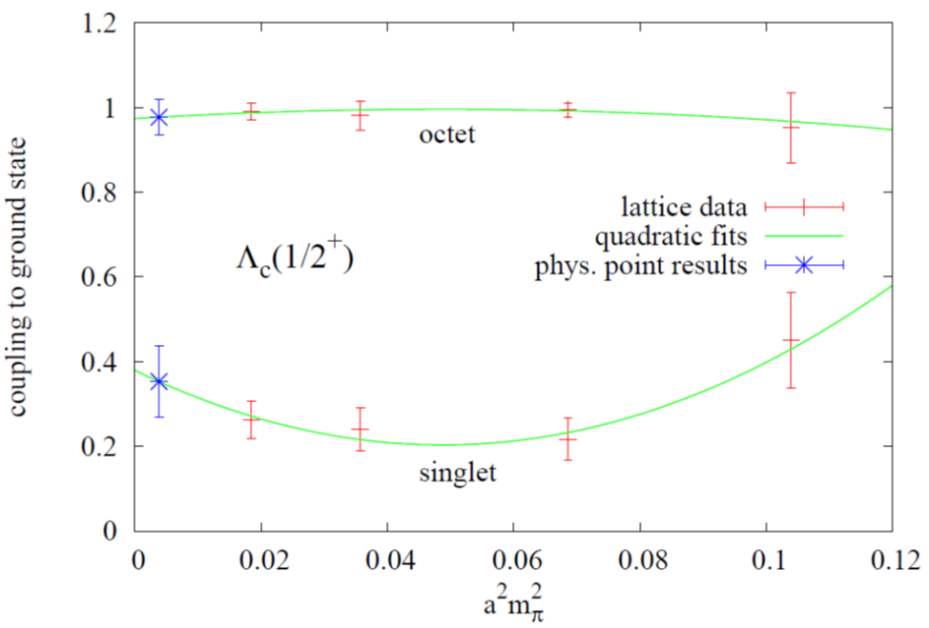
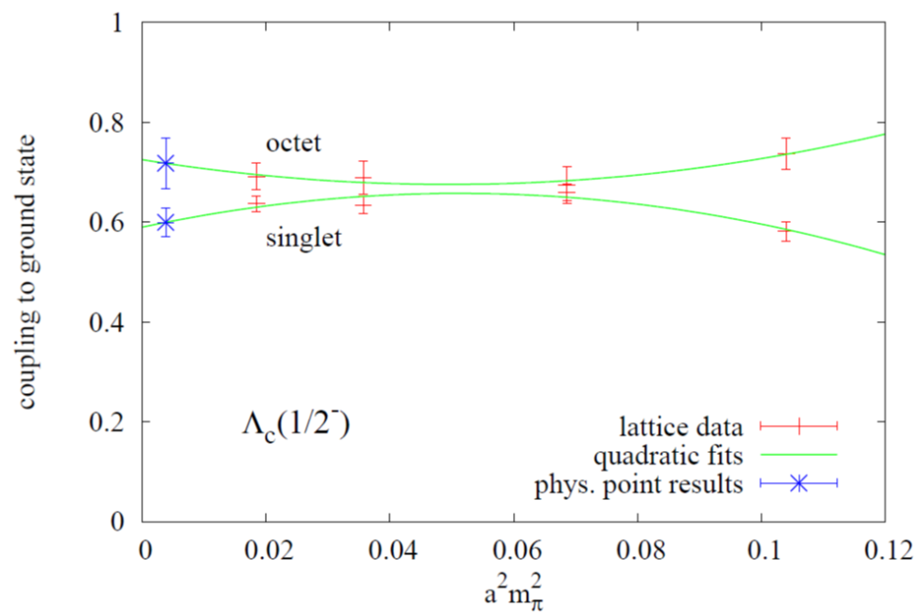
Chiral extrapolations of flavor components (Λ_{c})
The light quark mass dependence is relatively weak

Slide 25
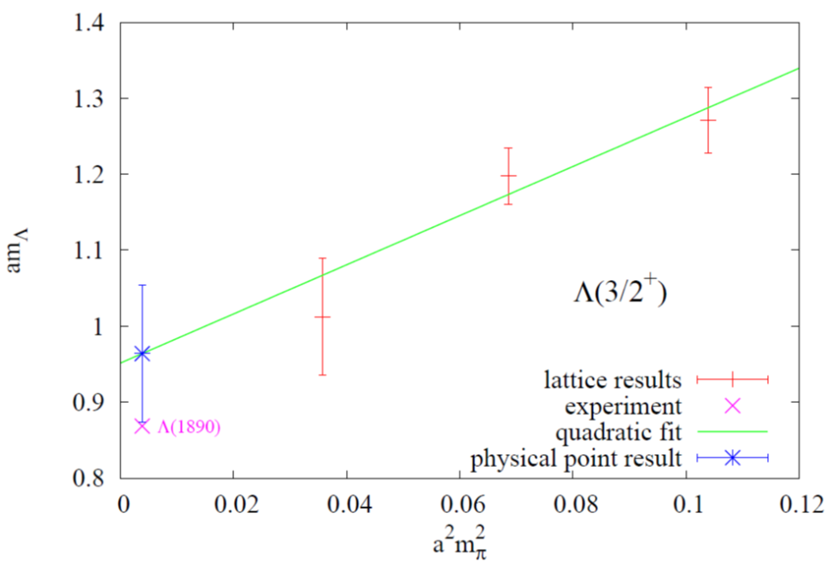
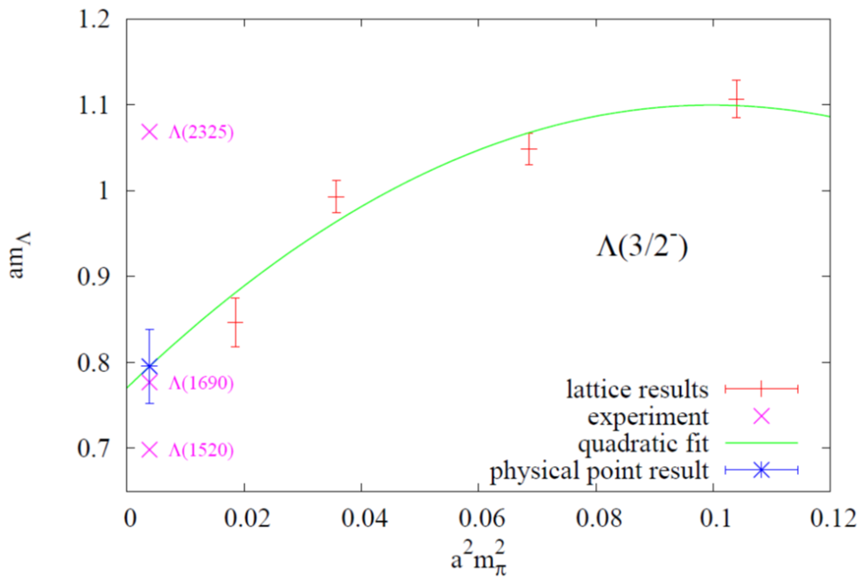
Chiral extrapolations (Λ,J=3/2)

Slide 26
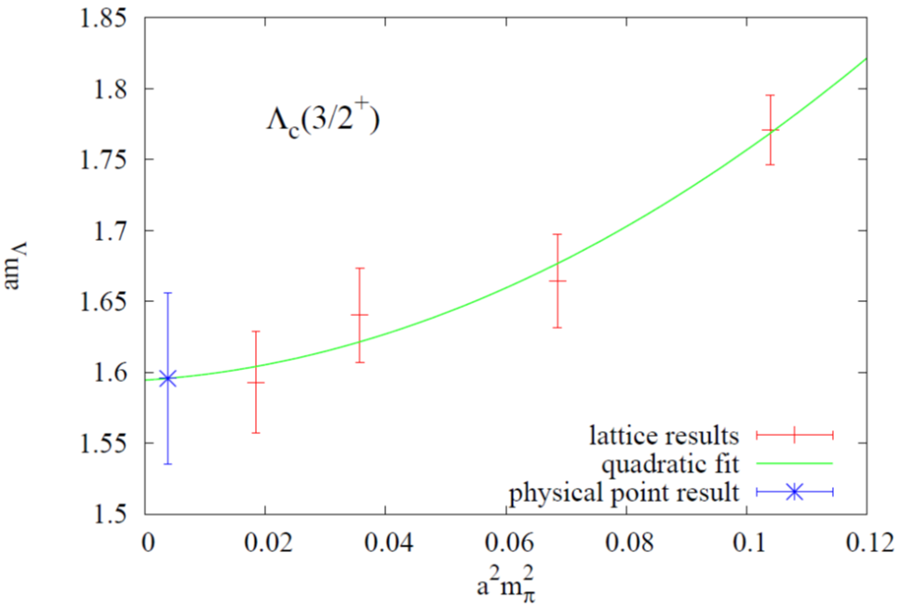
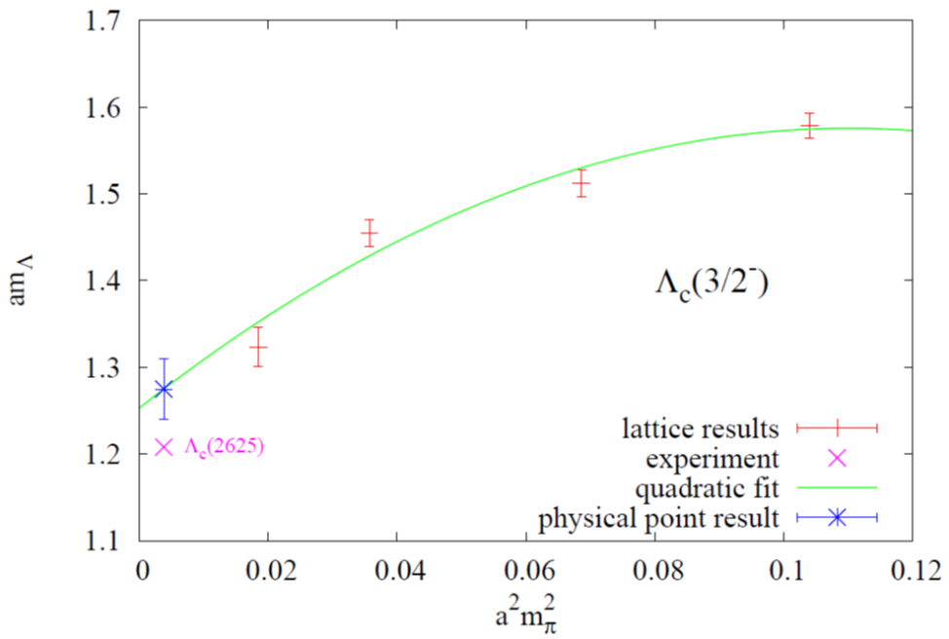
Chiral extrapolations (Λ_{c},J=3/2)

