Slide 1

Departamento de Física Teórica II. Universidad Complutense de Madrid
Identification of non-ordinary mesons from their Regge trajectories obtained from partial wave poles
J. R. Peláez
Based on:
T. Londergan ,J. Nebreda, JRP, A. Szczepaniak, Phys. Lett. B 729 (2014) 9–14
J.A.. Carrasco J. Nebreda, JRP, A. Szczepaniak, arXiv:1504.03248
1st Spanish HADRON Network Days- Valencia U. - IFIC 15-17 June 2015

Slide 2
Motivation
Interest in identification of non-ordinary Quark Model states (non qqbar?)
“Easy” if quantum numbers are not qqbar -> Exotics!
Not so easy for cryptoexotics like light scalars.
Particularly the f0(500) or σ-meson nature has been debated for over 50 years
despite being very relevant for NN attraction, chiral symmetry breaking,
Glueball search, lots of decays, etc…
Hard to tell what a non-ordinary meson resonance is: tetraquark, molecule, glueball…
Classification in terms of SU(3) multiplets complicated by mixing.
But “ordinary” qqbar mesons also follow another classification

Slide 3
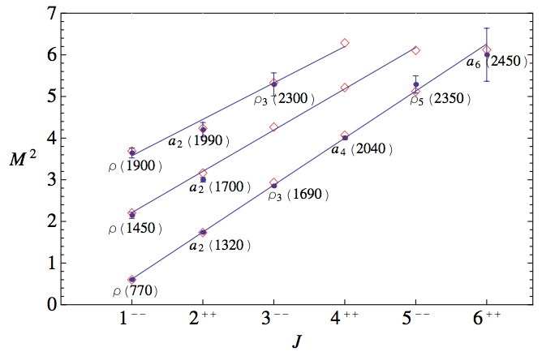
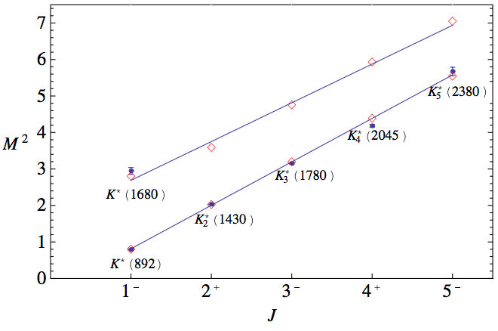
Introduction: Regge trajectories
Particles with same quantum numbers and signature (τ=(-1)^{J})
can be classified in linear trajectories of (mass)² vs. (spin) with a “universal” slope of ~1 GeV⁻²
Anisovich-Anisovich-Sarantsev-Phys.Rev.D62.051502-4
Warning…, resonances have a width, and this variable here is… “ only M² ”
…some authors use width as uncertainty

Slide 4
Introduction: Regge trajectories
Particles on each trajectory are somehow related by similar dynamics
Quark-antiquark and qqq states are well accommodated in these trajectories
Thus “ordinary” mesons, usually identified as qqbar states,
fit within
linear Regge trajectories
But if other resonances have different nature…
…. they do not have to fit well in this scheme

Slide 5
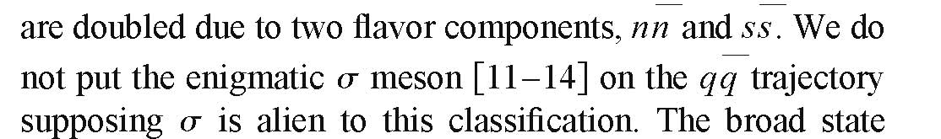
Introduction: Regge trajectories
Actually, this happens with the f0(500) or sigma meson
Anisovich-Anisovich-Sarantsev-Phys.Rev.D62.051502-4
Other authors considered that since the f0(500) had such a big uncertainty in te PDG it could be ignored.

Slide 6
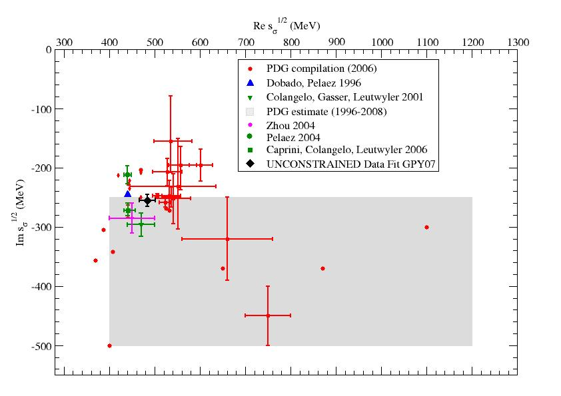
Introduction: Regge trajectories

Slide 7
Introduction: Regge trajectories
Actually, this happens with the f0(500) or sigma meson
Anisovich-Anisovich-Sarantsev-Phys.Rev.D62.051502-4
Other authors considered that since the f0(500) had such a big uncertainty in te PDG it could be ignored.
That is no longer an excuse.
One could still think of using the large width as an uncertainty…
But here will study its Regge the trajectory as a complex pole,
thus taking into account its width.

Slide 8
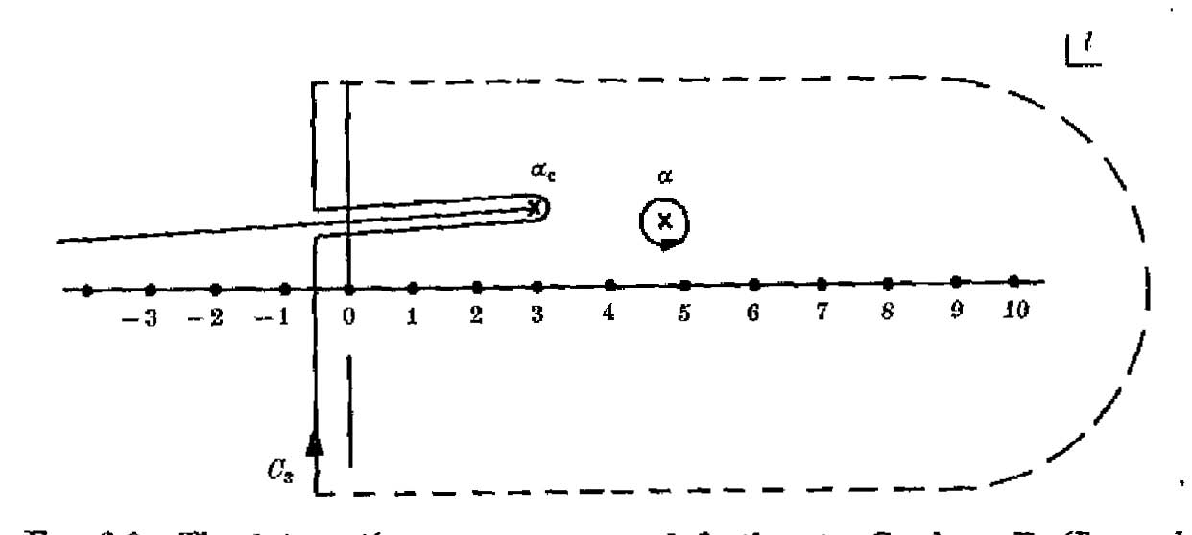
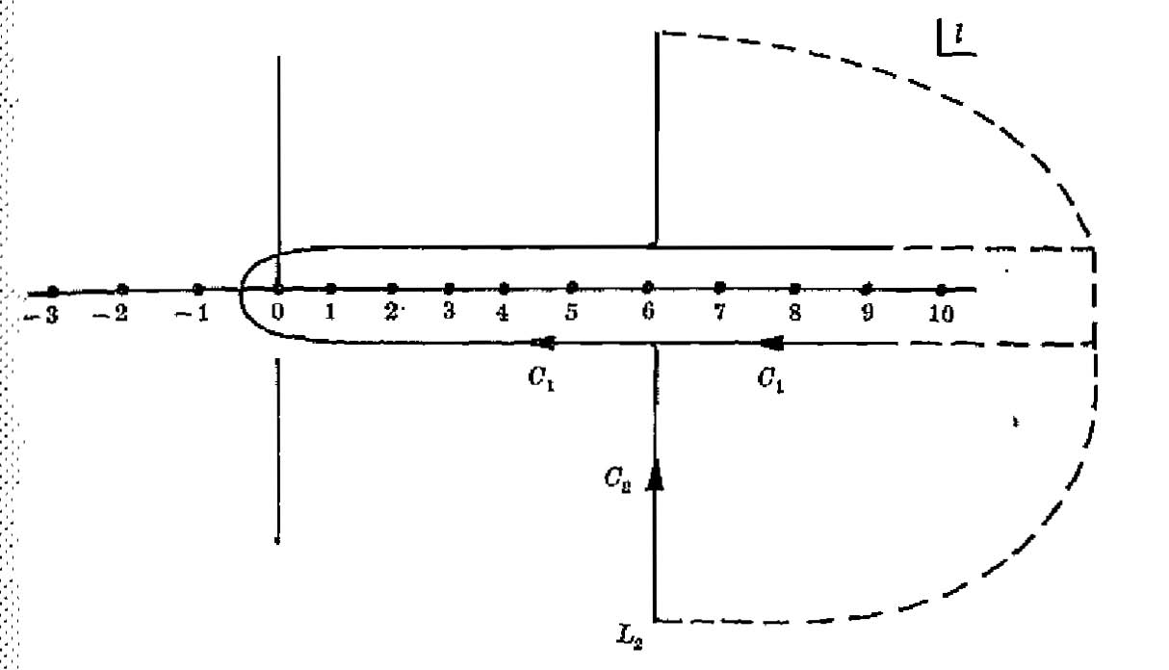
Introduction: Regge Theory
The Regge trajectories can be understood from the analytic extension to the complex angular momentum plane of the partial wave expansion through the Sommerfeld-Watson transform:
Complex J plane
Complex J plane
Regge
pole

Slide 9
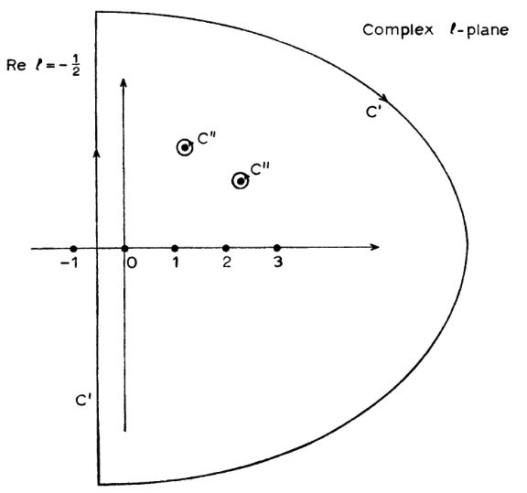

Introduction: Regge Theory
Complex J plane
Regge poles
Position α(s)
Residue β(s)
The contribution of a single Regge pole to a partial wave, is shown to be
“background” regular function.
Assumption: WE WILL NEGLECT/AVOID IT in our cases

Slide 10
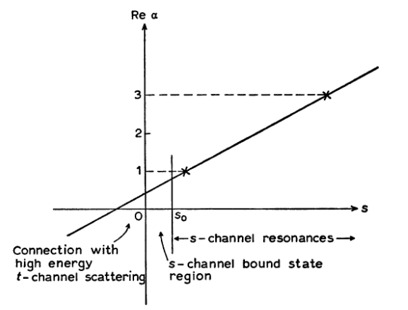
Introduction: Regge Theory
Complex J plane
Regge poles
Position α(s)
Residue β(s)
For different s poles move
in the complex J plane along
Regge Trajectories
Linear trajectories of qqbar
mesons are just an example
of some specific dynamics

Slide 11


Introduction: Regge Theory
But other dynamics could lead to different trajectories.
However, trajectories and residues cannot be completely arbitrary due to their analytic properties (Collins, Introduction to Regge Theory)
Twice-subtracted dispersion relations
with

Slide 12





Parametrization of pole dominated amplitudes
Chu, Epstein, Kaus, Slansky, Zachariasen, PR175, 2098 (1968).
Moreover, for ππ scattering:
Unitarity condition on the real axis implies
Further properties of β(s)
threshold behavior
suppress poles
of full amplitude
analytic function:
β(s) real on real axis
⇒ phase of ϒ(s) known
⇒ Omnès-type disp. relation

Slide 13
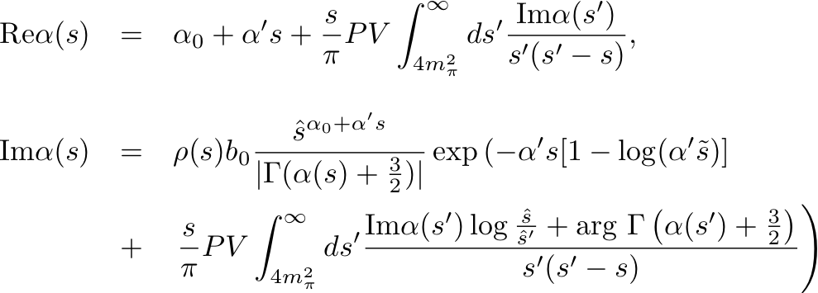
Parametrization of pole dominated amplitudes
Thus, the trajectory and residue should satisfy a system of integral equations:
THESE ARE THE EQUATIONS WE HAVE TO SOLVE
In order to have a consistent trajectory
In the scalar case a slight modification is introduced (Adler zero)

Slide 14

Our Approach
Fix the subtraction constants JUST from the scattering pole
for a given set of α₀, α’ and b₀:
solve the coupled equations
get α(s) and β(s) in real axis
extend to complex s-plane
obtain pole position and residue
fit α₀, α’ and b₀ so that the pole position and residue coincide with those given by a dispersive analysis of scattering data
Garcia-Martin, Kaminski, Pelaez and Ruiz de Elvira, Phys. Rev. Lett. 107, 072001 (2011)

Slide 15
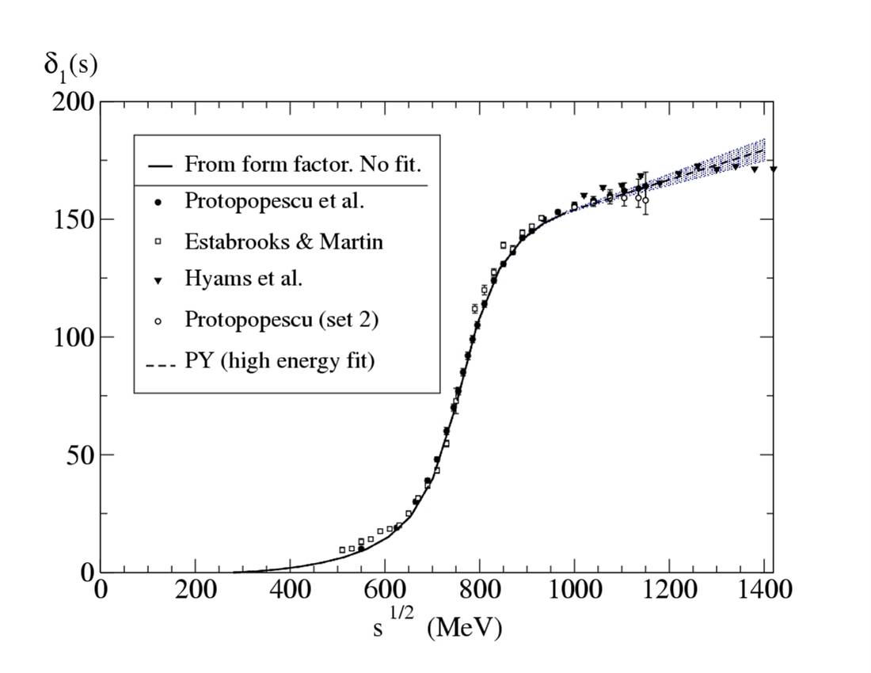
INPUT:Analytic continuation to the complex plane of a dispersive analysis of data
INPUT for our purposes: The ρ pole:

Slide 16
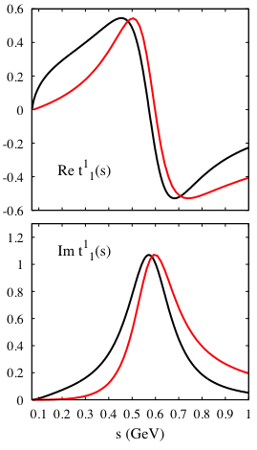
Results: ρ case (I = 1, J = 1)
We (black) recover a fair representation of the partial wave, in agreement with the GKPY amplitude (red)
Neglecting the “background” vs. Regge pole gives a 10-15% error.
Particularly in the resonance region
Fair enough to look for the Regge trajectory

Slide 17
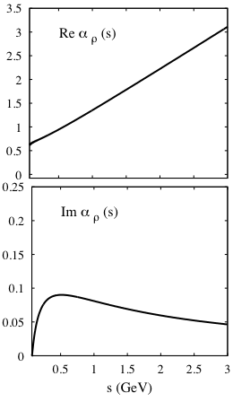
Results: ρ case (I = 1, J = 1)
We get a prediction for the ρ Regge trajectory, which is almost real
Almost LINEAR α(s) ~α₀+α’ s
intercept α₀= 0.520±0.002
slope α’ = 0.902±0.004 GeV⁻²
Previous studies from FITS:
[1] α₀= 0.5
[2] α₀= 0.52 ± 0.02
[3] α₀= 0.450 ± 0.005
[1] A. V. Anisovich et al., Phys. Rev. D 62, 051502 (2000)
[2] J. R. Pelaez and F. J. Yndurain, Phys. Rev. D 69, 114001 (2004)
[3] J. Beringer et al. (PDG), Phys. Rev. D86, 010001 (2012)
[4] P. Masjuan et al., Phys. Rev. D 85, 094006 (2012)
[1] α’= 0.83 GeV⁻²
[2] α’= 0.9 GeV⁻²
[4] α’= 0.87 ± 0.06 GeV⁻²
This is a “prediction” for the whole tower of
ρ(770) Regge partners:
ρ(1690)
ρ(2350)
….
the LINEAR behavior
is a RESULT
Remarkably consistent with the literature!!,
(taking into account our approximations)

Slide 18
f₂(1275) and f₂’(1525) cases (I = 0, J = 2)
J.A.. Carrasco J. Nebreda, JRP,
A. Szczepaniak, arXiv:1504.03248
Almost elastic: f₂(1275) BR (π π) = 85% and f_{2’}(1525) BR(KK)=90%.
Solving the integral equations we “predict” again:
Almost real and LINEAR α(s) ~α₀+α’ s
For the f₂(1275)
+0.2
-0.3
α₀= 0.9
+0.3
-0.2
α’ = 0.7 GeV⁻²
For the f ’₂(1525)
+0.10
-0.44
α₀= 0.53
+0.20
-0.06
α’ = 0.63 GeV⁻²
Fair agreement with the literature!!
(taking into account our approximations)
Remember this is NOT a fit!!

Slide 19

For Mike Pennington…
J.A.. Carrasco J. Nebreda, JRP,
A. Szczepaniak, arXiv:1504.03248
Is linearity due to the two subtractions and a small width?
… if we neglect Im α…
…and we get a straight line
So, we have also made three subtractions. Thus if we neglect Im α…
…and we would naturally find a parabola

Slide 20
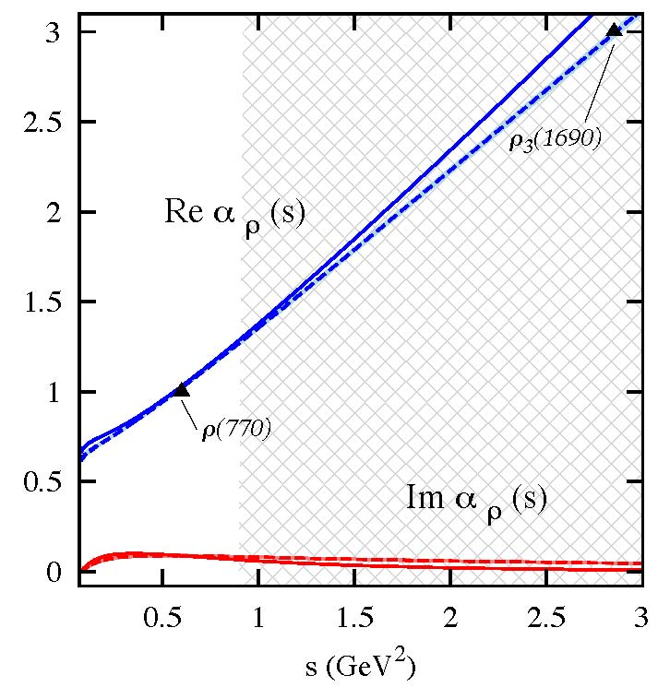
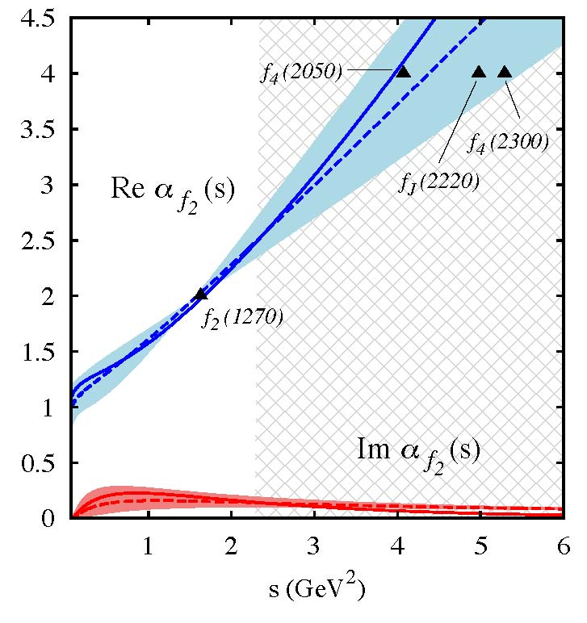
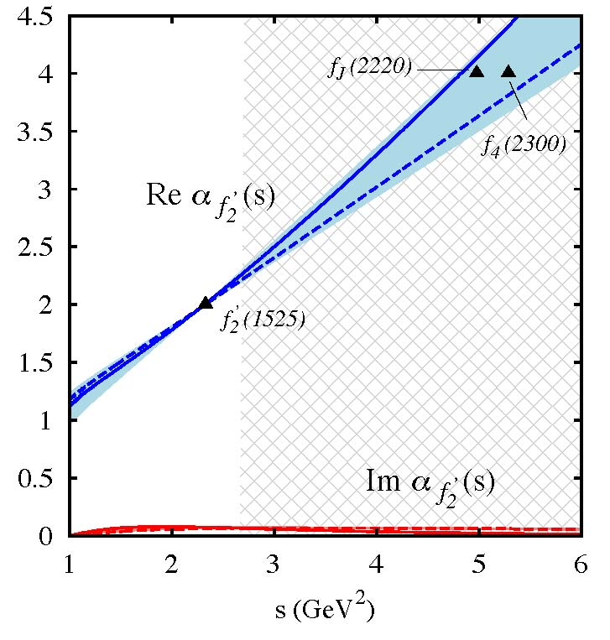
3 vs 2 subtractions
J.A.. Carrasco J. Nebreda, JRP,
A. Szczepaniak, arXiv:1504.03248
The fit to the pole parameters does not improve
The results barely change in the region of applicability. The trajectories are still
almost a straight line and the slope at the resonance mass is almost identical

Slide 21
This “prediction” for the rho trajectory
Was known since the 70’s, we have just updated it
and obtained new “predictions” for the f₂ and f₂’
So, once we have checked that our approach
Predicts the established Regge trajectories just from the pole position and residue…
What about the f₀(500) ?
The f0(500) or σ is a difficult task that requieres
S-MATRIX special abilities…
Thus, this is a case of….

Slide 22


The S-MATRIX RELOADED authors
The σ-challenge requires the abilities of a not so glamorous author…
J.A.
Carrasco
T. Londergan
Jenifer “Trinity”- Nebreda
Neo-Regge
Szczepaniak
σ
σ-MAN* !!
* Invention of name to be credited to E. Ruiz Arriola
Based on an idea by M. Pennnington
Whose real identity is secret , of course

Slide 23
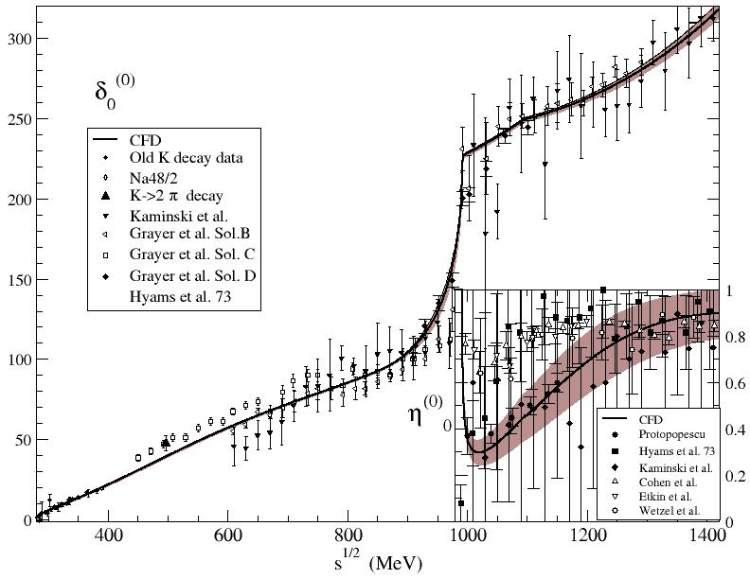
INPUT:Analytic continuation to the complex plane of a dispersive analysis of data
INPUT for our purposes: The σ pole:

Slide 24
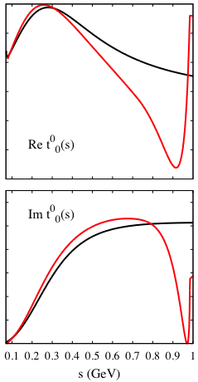
Results: σ case (I = 0, J = 0)
Somewhat better agreement in the resonance region of the Regge pole dominated amplitude with the dispersive amplitude.
So, we apply a similar procedure but now for the f0(500)

Slide 25
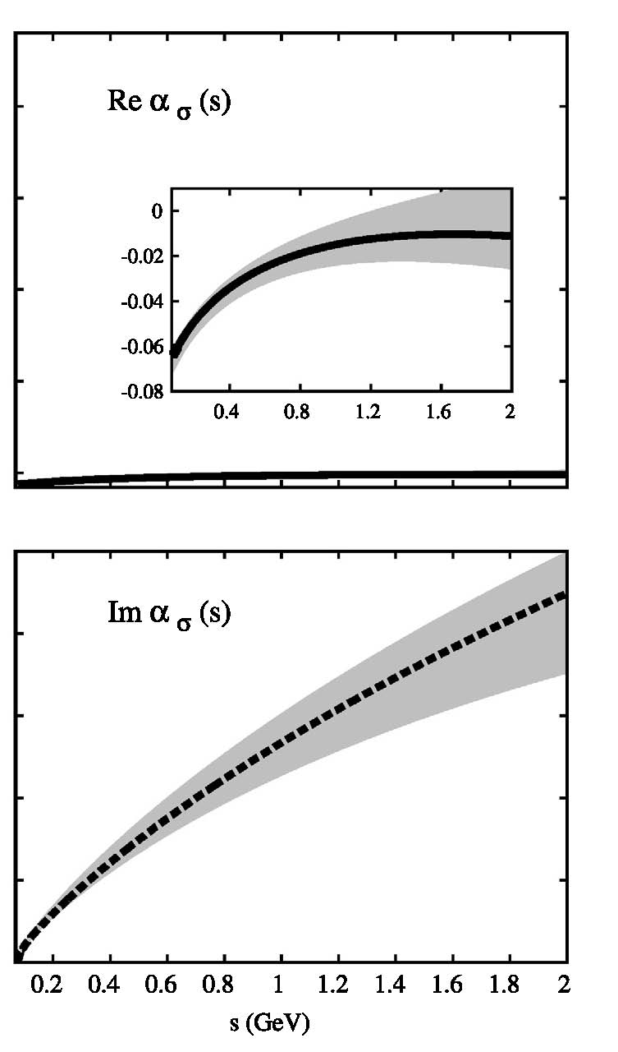
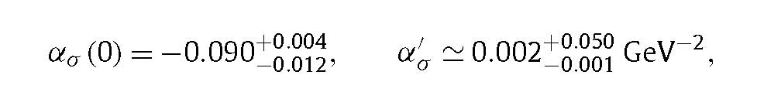
Results: σ case (I = 0, J = 0)
The prediction for the σ Regge trajectory, is:
NOT approximately real
NOT linear
intercept
slope
Compare with the rho result…
α₀= 0.52
α’ = 0.913 GeV⁻²
The sigma does NOT fit the ordinary meson trajectory
Two orders of magnitude flatter than other hadrons
Typical of meson physics?
F_{π} , m_{π} ?

Slide 26
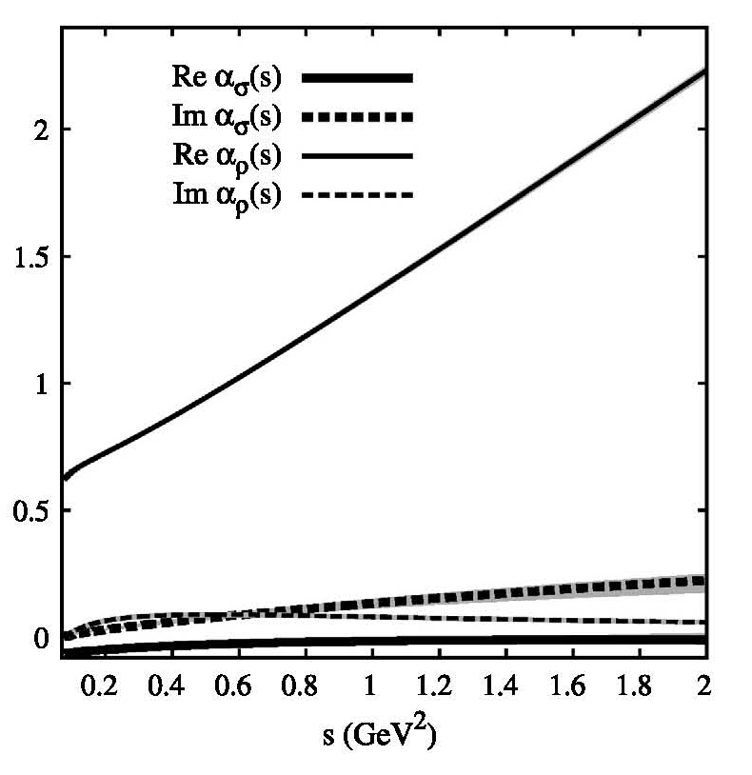
Results: σ vs. ρ trajectories
Using the same scale….
No evident
Regge partners
for the f0(500)

Slide 27
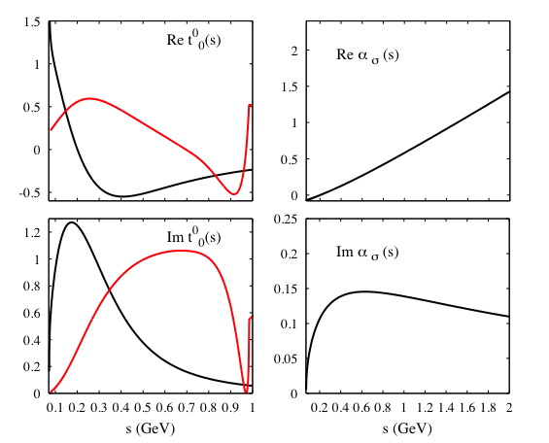
Results: σ case (I = 0, J = 0)
IF WE INSISTED in fixing the α’ to an “ordinary” value ~ 1 GeV⁻²
The data description
would be severely spoilt

Slide 28
If not-ordinary…
What then?
Can we identify the dynamics of the trajectory?
Not quite yet… but…

Slide 29
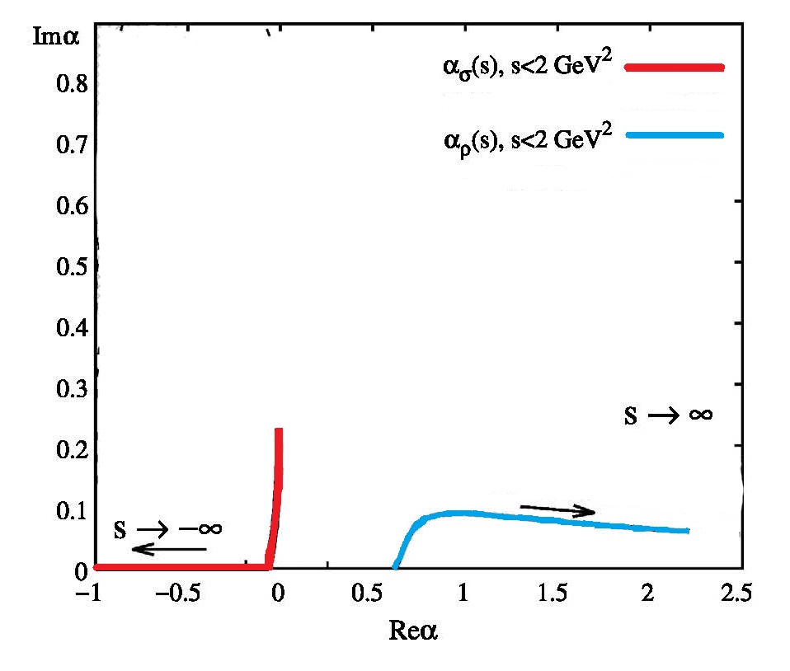
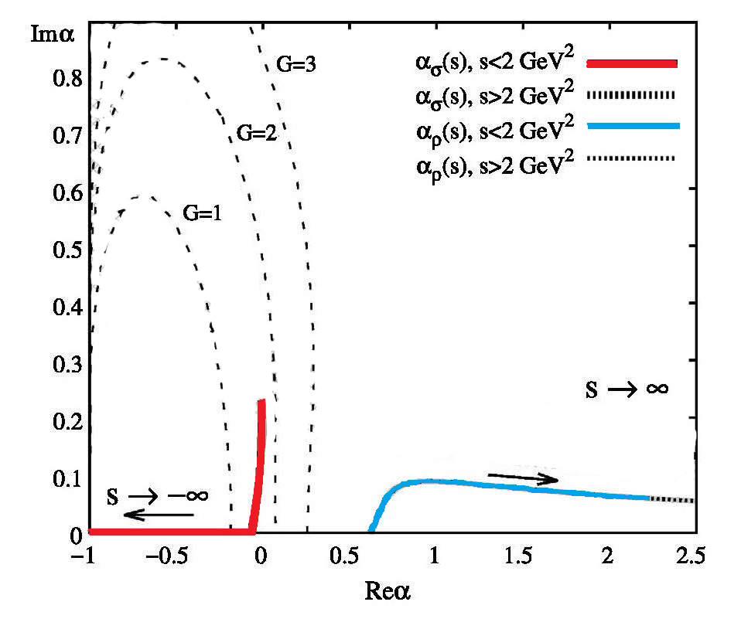
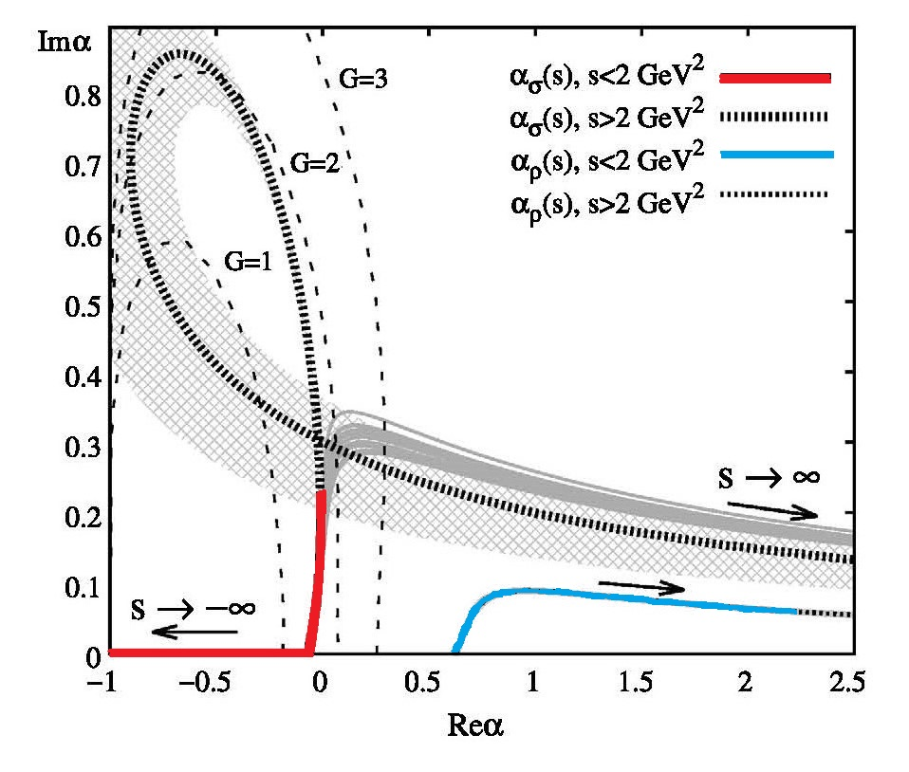
Ploting the trajectories in the complex J plane…
Striking similarity with
Yukawa potentials at low
energy:
V(r)=−Ga exp(−r/a)/r
Our result is mimicked
with a=0.5 GeV⁻¹
to compare with
S-wave ππ scattering length 1.6 GeV⁻¹
“a” rather small !!!
Non-ordinary σ trajectory
Ordinary ρ trajectory
The extrapolation of our trajectory also follows a Yukawa but deviates at
very high energy

Slide 30
Summary
Analytic constraints on Regge trajectories as integral equations.
Consistent treatment of the width
Fitting JUST the pole position and residue of an isolated resonance,
yields its Regge trajectory parameters
ρ, f2 and f2’ trajectories: COME OUT LINEAR, with universal parameters.
Linear trajectories are not imposed nor naturally arising from number of subtractions
σ trajectory: NON-LINEAR.
Trajectory slope two orders of magnitude smaller
No partnerts.
If we force the σ trajectory to have universal slope, data description ruined
At low energies, striking similarities with trajectories of Yukawa potential

Slide 31
Outlook
Different mass case (kappa, K*…)
Meson-nucleon (Delta, etc…)
Similar non-linear behavior for other non-ordinary states?
Coupled channels
Microscopic models, relation to compositeness, etc…

