Slide 1
Pion emission decays of excited charm baryons
Ref. Phys. Rev. D91, 014031 (2015)
Tokyo Institute of Technology
Shigehiro YASUI
Spanish-Japanese JPSP Workshop@Valencia University, 15– 17 June. 2015

Slide 2
Contents
Heavy quark symmetry
2. Decays of excited heavy baryons
3. Conclusion

Slide 3






t
1. Heavy quark symmetry
c
u
173,000 MeV
b
2 MeV
1300 MeV
s
d
4200 MeV
5 MeV
100 MeV

Slide 4
t
1. Heavy quark symmetry
c
u
173,000 MeV
b
2 MeV
1300 MeV
>Λ_{QCD}
s
d
4200 MeV
5 MeV
100 MeV
>>Λ_{QCD}

Slide 5

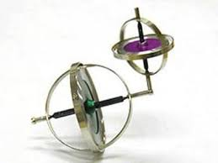
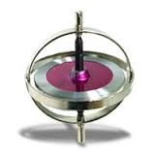

1. Heavy quark symmetry
Heavy quark symmetry (HQS)
Heavy baryon (Qqq)
Manohar, Wise, Luke, Grinstein, ...
“Brown Muck” : Light quarks and gluons
quark # = 2 and color 3^{bar}
Ψ^{(j)}_{J}
j
definite total spin j
j
j
Heavy quark
spin 1/2
J=j±1/2
1/2
Mass spectrum
HQS doublet/singlet
(j≠0) (j=0)
Cf. Heavy-flavor nuclei; SY, Sudoh, Yamaguchi, Ohkoda, Hyodo, Hosaka, Phys. Lett. B727, 185 (2013)

Slide 6



1. Heavy quark symmetry
(1) Heavy Hadron Mass Spectrum
3/2, 1/2 → HQS doublet
Δ
Σ*
Spin 3/2
Σ_{c}*
Σ_{b}*
1230 MeV
1385 MeV
2520 MeV
5830 MeV
290 MeV
195 MeV
65 MeV
20 MeV
5810 MeV
2455 MeV
Σ_{b}
1190 MeV
Σ_{c}
Σ
Spin 1/2
940 MeV
2286 MeV
5619 MeV
N
1115 MeV
Λ
Λ_{c}
Λ_{b}
Spin 1/2
1/2 → HQS singlet

Slide 7
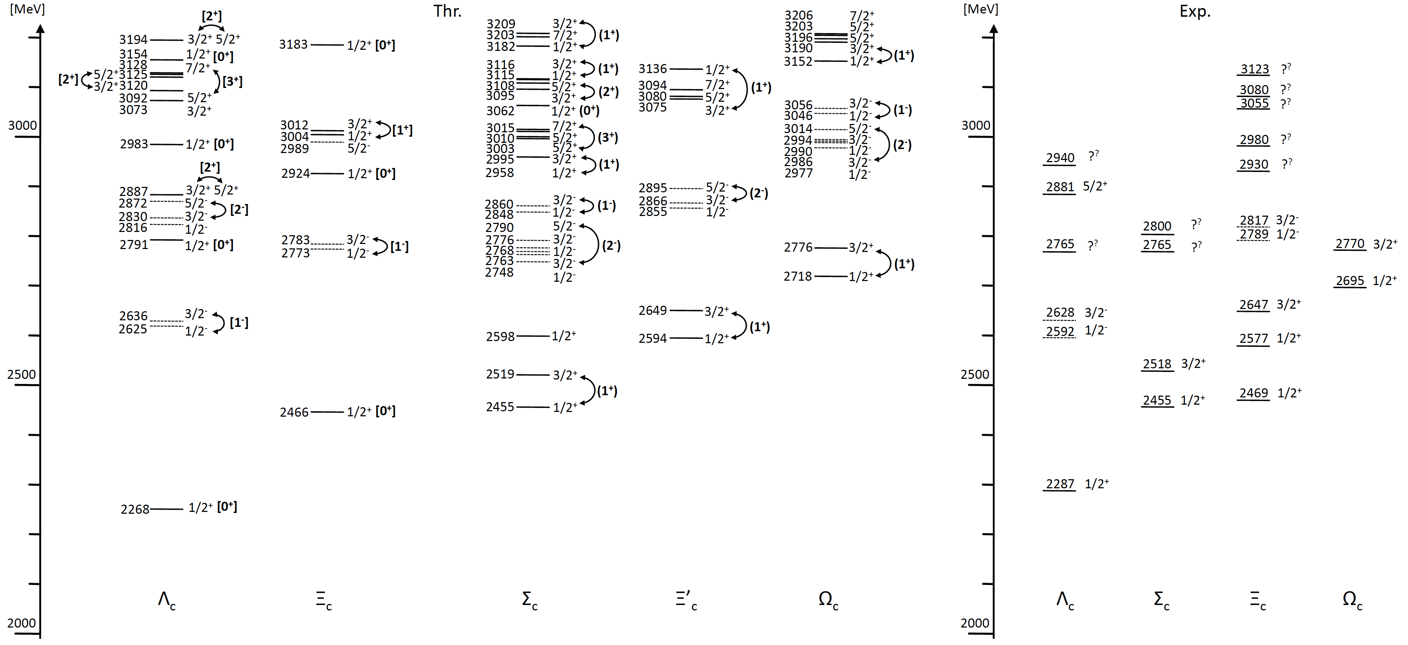
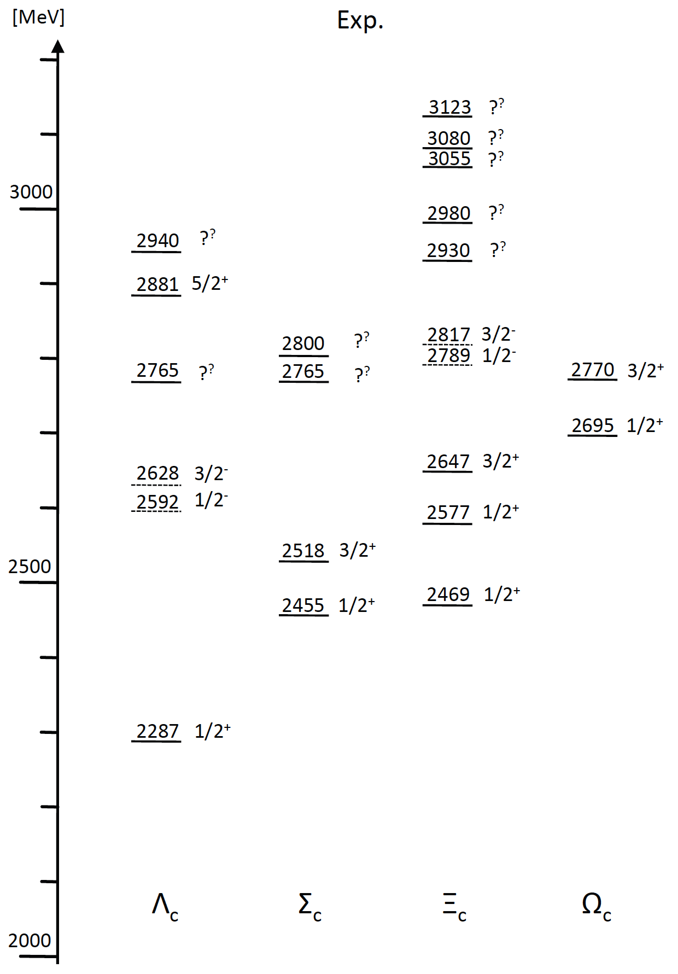
1. Heavy quark symmetry
D*+N
D+N
DN-D*N hadronic molecules?
HQS
doublet/singlet
Quark model
W.Roberts, M.Pervin, Int. J. Mod. Phys. A23, 19 (2008); Y.Yamaguchi, S.Ohkoda, T.Hyodo, A.Hosaka, S.Y., Phys. Rev. D91, 034034 (2015)
Cf. Skyrme model; Y. Oh, B-Y. Park, D-P. Min Phys. Rev. D50, 3350 (1994)

Slide 8

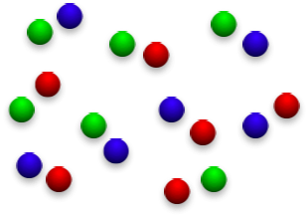

1. Heavy quark symmetry
(2) Diquark Phase Diagram
Heavy baryon
Diquarks in light baryon (qqq)
and scalar meson (qqqq) ?
I(J^{P})=1(1⁺), 0(1⁻), 0(0⁻), 1(2⁻), …
(Exotic) color superconductivity
(s-wave, p-wave, d-wave, …)
Exciting energy
Diquarks as
“Brown Muck”
I(J^{P})=0(0⁺)
Baryon number density

Slide 10
2. Decays of excited heavy baryons
Transitions by strong decay
Heavy baryon (Qqq)
Ψ^{(j)}_{J}
j
J=j±1/2

Slide 11
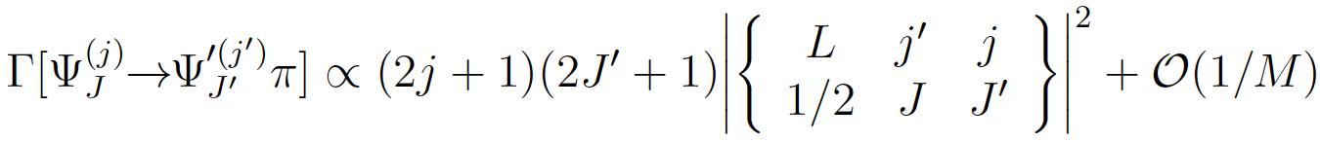
2. Decays of excited heavy baryons
Transitions by strong decay
π
Heavy baryon (Qqq)
Ψ^{(j)}_{J}
j
L
j’
Ψ’^{(j’)}_{J’}
J=j±1/2
J’=j’±1/2
Heavy quark limit (M→∞)
Conservation of “spin” of brown muck: j=j’+L
Isgur and Wise, Phys. Rev. Lett. 66, 1130 (1991)
Question: what is O(1/M)?

Slide 12
2. Decays of excited heavy baryons
Heavy-baryon effective Lagrangian
1. Heavy quark symmetry is conserved at O(1).
Brown Muck
Heavy quark
with spin 1/2
=
2. Inv. under velocity rearrangement at O(1)+O(1/M).
v → w = v + q/M ( q/M << 1 )
v-frame
v
“velocity rearrangement” :
Lorentz boost (L) between v-frame and w-frame
up to O(1/M): Ψ_{w}(x) = L(q/M)Ψ_{v}(x)
Ψ_{v}(x)
w-frame
w = v + q/M
Question: what is O(1/M)?
Ψ_{w}(x)
Luke, Manohar, PLB286, 348 (1992), Kitazawa, Kurimoto, PLB323, 65 (1994)

Slide 13
2. Decays of excited heavy baryons
Heavy-baryon effective Lagrangian
1. Heavy quark symmetry is conserved at O(1).
Brown Muck
Heavy quark
with spin 1/2
=
2. Inv. under velocity rearrangement at O(1)+O(1/M).
v → w = v + q/M ( q/M << 1 )
3. Heavy quark symmetry breaking terms at O(1/M).
≠

Slide 14
2. Decays of excited heavy baryons
(A part of) brief history of “Qqq baryon” effective theory
Heavy Mass Expansion
Brown Muck spin and parity
LO_{O(1)}
NLO_{O(1/M)}
T-M. Yan, H-Y Cheng, C-Y. Cheung,
G-L. Lin, Y-C. Lin,, H-L. Yu
PRD46, 1148 (1992)
H-Y. Cheng, C-Y. Cheung, G-L. Lin,
Y-C. Lin, T-M. Yan, H-L. Yu
PRD49, 2490 (1994)
j^{P}=0⁺, 1⁺
(P-wave decay)
(P-wave decay)
j^{P}=0±, 1±
H-Y. Cheng, C-K. Chua
PRD75, 014006 (2007)
(j^{P},j^{P’}) and (j^{P},j+1^{P’})
(S-, P-, D-wave decay)
Arbitrary j^{P}
SY. PRD91, 014031 (2015)
(j,j)^{P} and (j,j+1)^{P}
(P-wave decay)

Slide 15

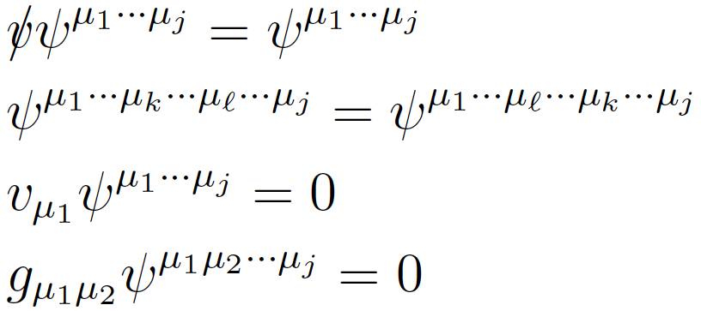
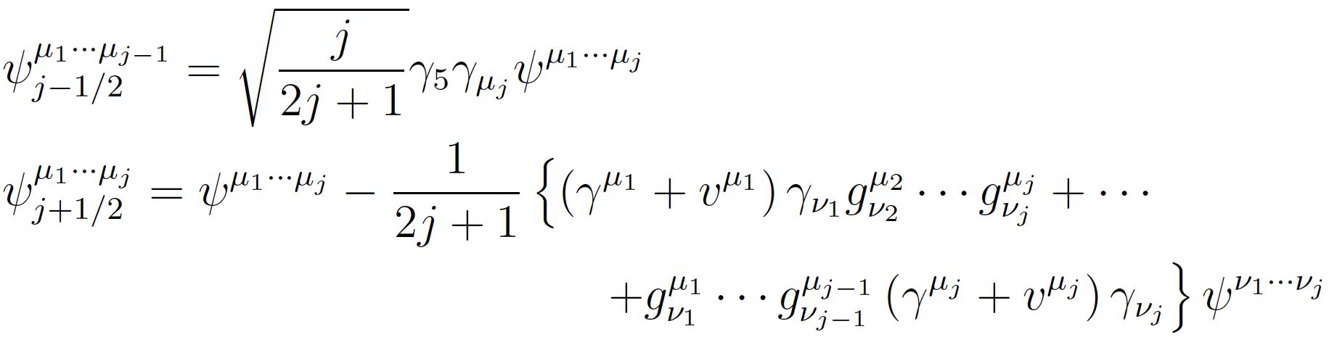
2. Decays of excited heavy baryons
Falk, Nucl. Phys. B378, 79 (1992)
Effective baryon field with brown muck spin j
Brown muck
with spin j
Heavy quark
spin 1/2
- Constraint conditions
Positive-energy
heavy quark
Total spin j±1/2
Cf. Rarita-Schwinger field
for spin 3/2
- Projection to j-1/2 and j+1/2 states

Slide 16
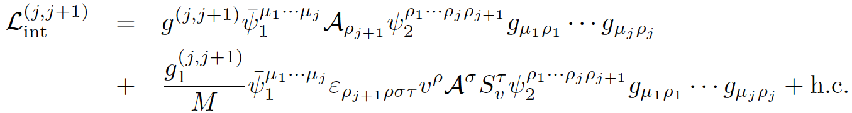
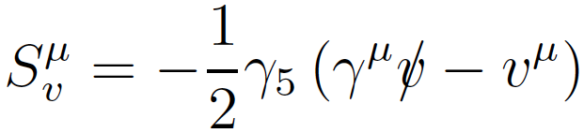
2. Decays of excited heavy baryons
Interaction Lagrangian at LO+NLO
SY. PRD91, 014031 (2015)
(j,j+1) transitions -- different brown-muck spin j, j+1 in initial and final states --
LO (HQS conserving)
Cf. For j=0,1; Cheng, et al.,
PRD49, 2490 (1994)
Ψ^{(j+1)}_{J} → Ψ^{(j)}_{J’}+π
p-wave
NLO (HQS breaking)
Unknown
Pauli-Lubanski vector
(spin operator)
j+1
j
But …
J=j+3/2, j+1/2
J’=j±1/2

Slide 17
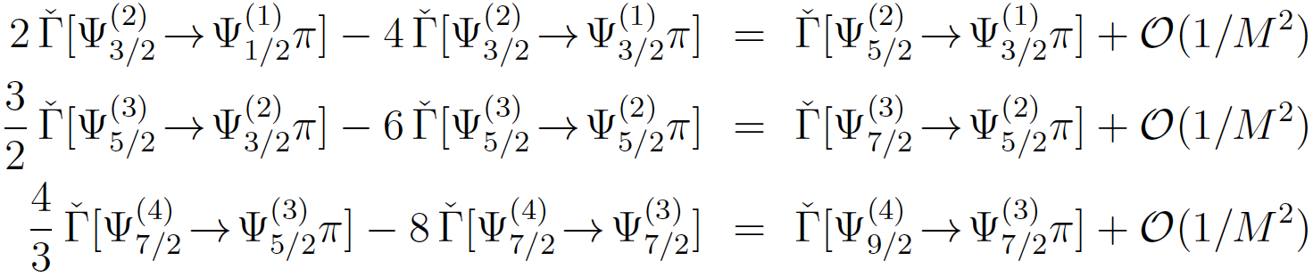
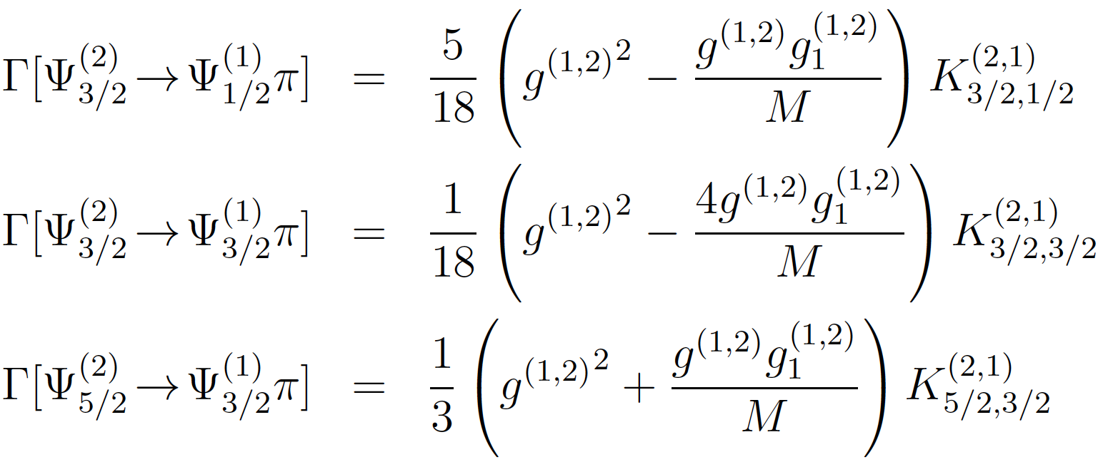
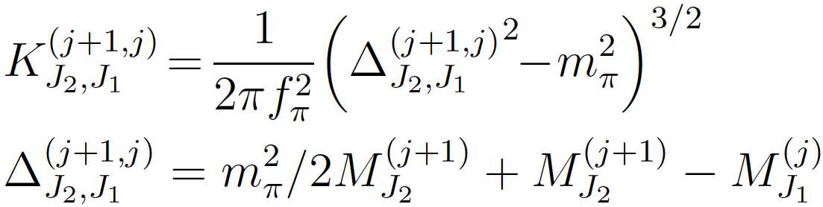
2. Decays of excited heavy baryons
Constraint among decay widths
SY. PRD91, 014031 (2015)
(j,j+1) transitions
Example: j=1
For any j≥1 ...
A constraint on different decay channels at O(1/M).
This is a “weaker” constraint to Isgur-Wise’s constraint.

Slide 18
2. Decays of excited heavy baryons
SY. PRD91, 014031 (2015)
Another example

Slide 19
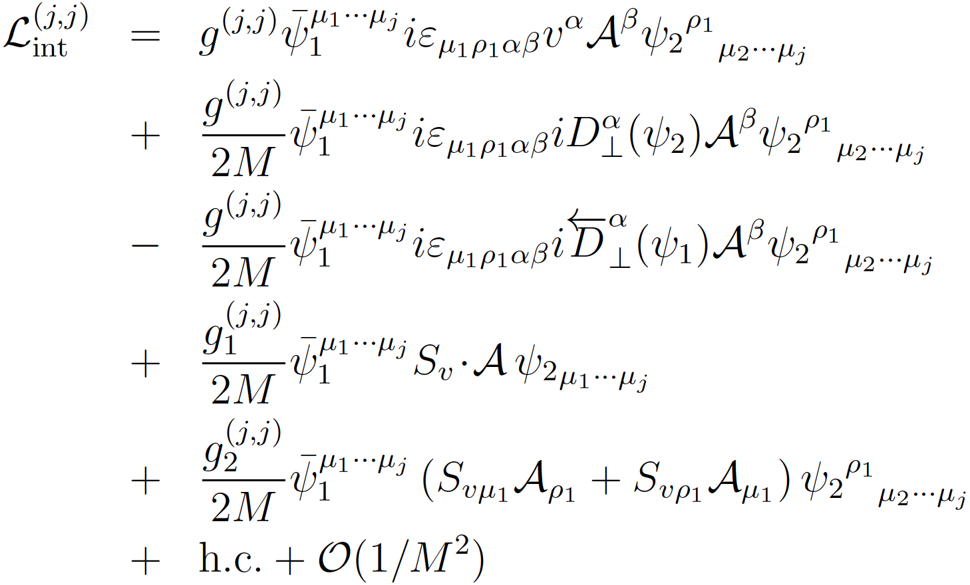
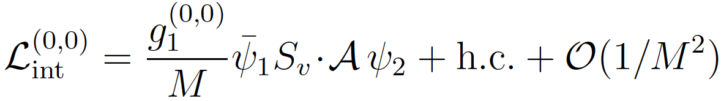
2. Decays of excited heavy baryons
Interaction Lagrangian at LO+NLO
SY. PRD91, 014031 (2015)
(j,j) transitions -- same brown-muck spin j in initial and final states --
j ≥ 1
NLO (velocity-rearrangement)
NLO (HQS breaking)
Σ_{c}(3062)(QM) → Λ_{c}π
Ξ_{c}(2924)(QM) → Ξ_{c}π
1/2± → 1/2± transition
is very small, O(1/M²).
j = 0

Slide 20
2. Decays of excited heavy baryons
O(1/M²)
O(1/M²)
HQS
doublet/singlet
Quark model
W.Roberts, M.Pervin, Int. J. Mod. Phys. A23, 19 (2008); Y.Yamaguchi, S.Ohkoda, T.Hyodo, A.Hosaka, S.Y., arXiv:1402.5222 [hep-ph]
Cf. Skyrme model; Y. Oh, B-Y. Park, D-P. Min Phys. Rev. D50, 3350 (1994)

Slide 21
2. Decays of excited heavy baryons
Interaction Lagrangian at LO+NLO
SY. PRD91, 014031 (2015)
(j,j) transitions -- same brown-muck spin j in initial and final states --
j ≥ 1
NLO (velocity-rearrangement)
NLO (HQS breaking)
Σ_{c}(3062)(QM) → Λ_{c}π
Ξ_{c}(2924)(QM) → Ξ_{c}π
1/2± → 1/2± transition
is very small, O(1/M²).
j = 0

Slide 22
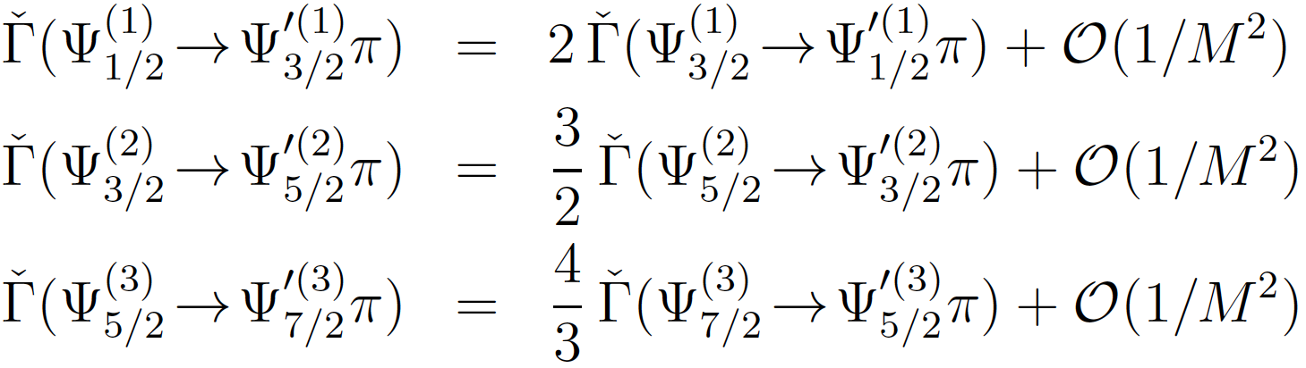
2. Decays of excited heavy baryons
Interaction Lagrangian at LO+NLO
SY. PRD91, 014031 (2015)
(j,j) transitions -- same brown-muck spin j in initial and final states --
For any j≥1 ...
This holds not only at O(1/M) but also at O(1).

Slide 23
2. Decays of excited heavy baryons

Slide 24

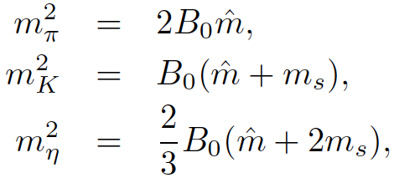
2. Decays of excited heavy baryons
SY. PRD91, 014031 (2015)
Analogy
Gell-Mann, Okubo relation
Flavor SU(3) symmetry breaking
(Gell-Mann, Oaks, Renner relation)

Slide 25
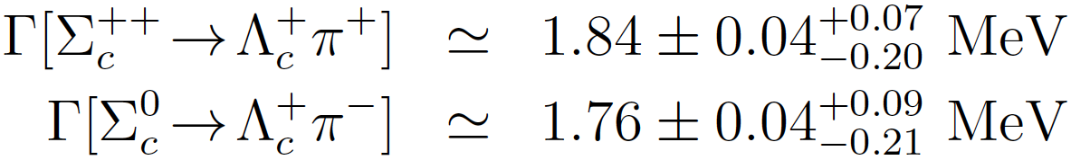
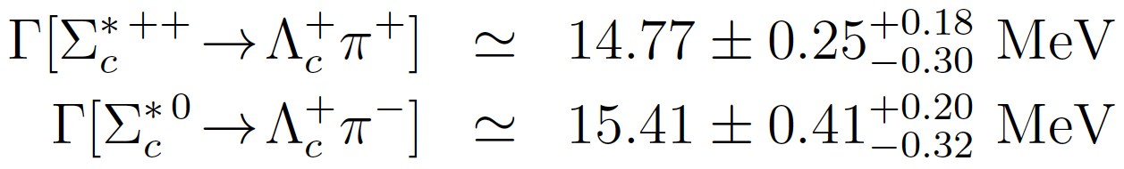

2. Decays of excited heavy baryons
Some numerical studies ...
SY. PRD91, 014031 (2015)
(1,0) transitions
Σ_{Q}^{(*)} → Λ_{Q}π
j=1
j=0
Charm
Belle, arXiv:1404.5389
: p-wave π transition assumed

Slide 26
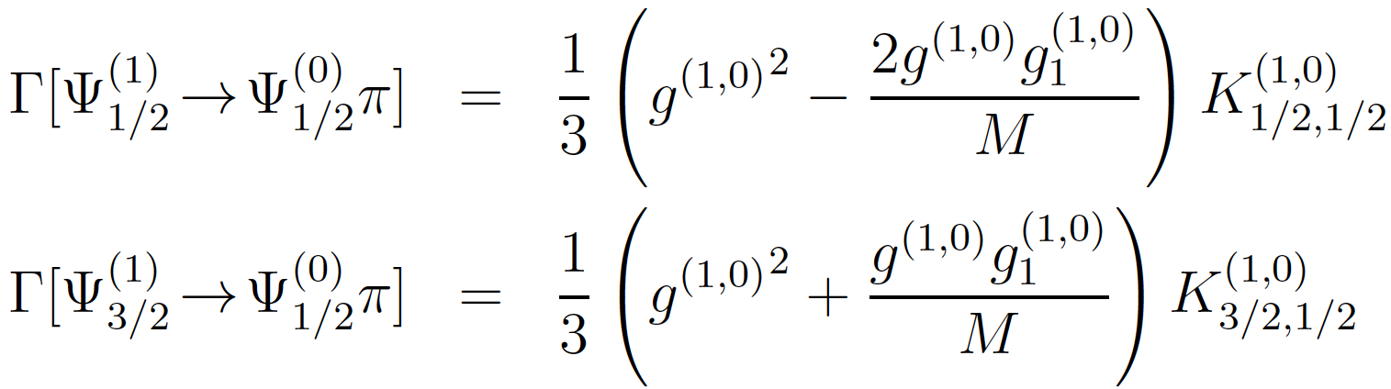

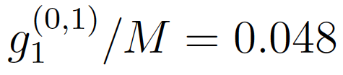
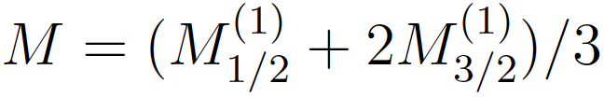
2. Decays of excited heavy baryons
Some numerical studies ...
SY. PRD91, 014031 (2015)
(1,0) transitions
Σ_{Q}^{(*)} → Λ_{Q}π
j=1
j=0
~ 6 % (？)

Slide 27
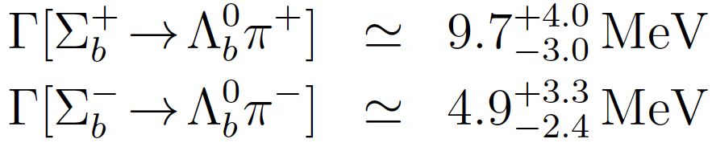
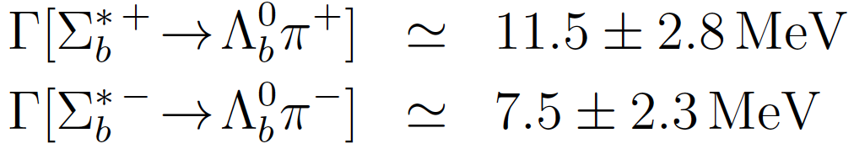
2. Decays of excited heavy baryons
Some numerical studies ...
SY. PRD91, 014031 (2015)
(1,0) transitions
Σ_{Q}^{(*)} → Λ_{Q}π
j=1
j=0
Bottom
PDG2014
5.1 MeV
(present theory)
9.6 MeV
(present theory)
: p-wave transition supposed

Slide 28
3. Conclusion
1. Strong decays of one-pion emission from
excited heavy baryons are discussed.
2. Heavy quark symmetry (HQS) at LO+NLO in
1/m_{Q} expansion is considered.
3. Relations for decay widths in several channels
are obtained model-independently.
4. They will be useful for identifications of HQS
doublet/singlet in experimental analysis.
5. Other contributions except for 1/m_{Q}?
(isospin breaking, chiral expansion, etc.)

Slide 29
Topics which was not covered ….
X, Y, Z
A new collaboration
for Spain-Japan!!
Yamaguchi, Ohkoda, SY, Sudoh, Hosaka, Phys. Rev. D86, 014004 (2012)
Yamaguchi, Ohkoda, SY, Sudoh, Hosaka, Phys. Rev. D86, 034019 (2012
Ohkoda, Yamaguchi, Yasui, Hosaka, Phys. Rev. D86, 117502 (2012)
Ohkoda, Yamaguchi, Yasui, Hosaka, Phys. Rev. D87, 074019 (2012)
Ohkoda, Yamaguchi, Yasui, Hosaka, arXiv:1310.3029 [hep-ph]
Hyodo, Liu, Oka, Sudoh, Yasui, Phys. Lett. B721, 56 (2013)
Charm Nuclei
S.Y., K.Sudoh, Phys. Rev. D80, 034008 (2009)
Y.Yamaguchi, S.Ohkoda, S.Y., A.Hosaka, Phys. Rev. D84, 014032 (2011)
Y.Yamaguchi, S.Ohkoda, S.Y., A.Hosaka, Phys. Rev. D85, 054003 (2013)
Y.Yamaguchi, S.Y., A.Hosaka, Nucl. Phys. A927, 110 (2014)
S.Y., K.Sudoh, Phys. Rev. C87, 015202 (2013)
S.Y., K.Sudoh, Phys. Rev. C88, 015201 (2013)
S.Y., K.Sudoh, Phys. Rev. C89, 015201 (2014)

Slide 31
Noumi 2014

Slide 32
Noumi 2014

Slide 33


1. Heavy quark symmetry
1/m_{Q} expansion
(positive energy state Q_{v} with velocity v)
Manohar, Wise, Luke, Grinstein, ...
LO
Heavy quark spin in m_{Q}→∞ is
conserved.
Heavy quark symmetry (HQS)

Slide 34
1. Heavy quark symmetry
Heavy quark symmetry (HQS)
ρ
K*
Light quark+gluon
Spin 1
D*
Heavy quark
770 MeV
B*
890 MeV
2010 MeV
5325 MeV
630 MeV
390 MeV
140 MeV
45 MeV
5280 MeV
B
1870 MeV
D
0, 1→ HQS doublet
500 MeV
K
140 MeV
Spin 0
π

