Slide 1
Status and Plans for Xilinx Development
Pablo Moreno (IFIC, Valencia)

Slide 2
Overview
Design using GTP Transceivers
  GTP Dual Tile
  GTP Transmitter
  GTP Receiver
  Loopback Modes
  RocketIO Implementation and Simulation

Slide 3
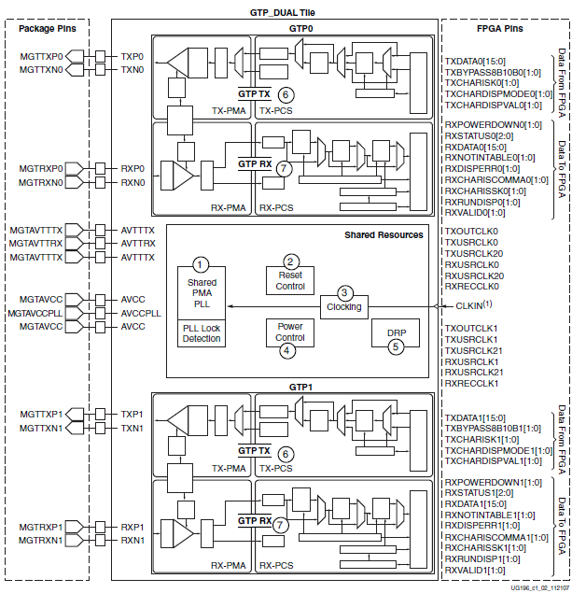
Design using GTP Transceivers
GTP Dual Tile
GTP Dual Tile
  2 Transceivers
    TX0
    RX0
    TX1
    RX1
  Shared Resources
    Oscilator
    Reset control
    Power control
    Clocking
    DRP

Slide 4
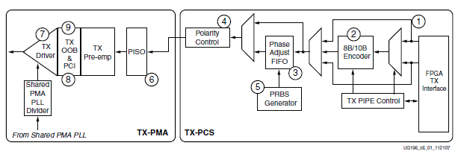
Design using GTP Transceivers
GTP Transmitter (TX)
Physical Coding Sub-layer (PCS), which is the logical sub-layer of the PHY
  FPGA TX interface
  8B/10B encoder
  TX Buffer and Phase Alignment
  Polarity Control
  PRBS Generator
Physical Media Attachment (PMA), electrical sub-layer of the PHY
  Parallel In to Serial Out
  TX Driver

Slide 5
Design using GTP Transceivers
GTP Transmitter (TX) - PCS
FPGA TX Interface
  Parallel data input of the transceiver
    Width of the data port: 1 or 2 bytes
    Width of the internal datapath:
      8 or 10 bits for 1 byte mode
      16 or 20 bits for 2 bytes mode
8B/10B Encoder
  Industry standard encoding scheme that trades 2 bits overhead per transmitted byte
    DC Balance
    Error Detection
    Limited Run Lengths
    Control Characters (K)
  Block may be bypassed if not needed for reduced latency

Slide 6
Design using GTP Transceivers
GTP Transmitter (TX) - PCS
TX Buffer, Phase Aligner
  2 clock domains inside PCS
    PMA Parallel Clock
    PCS Parallel Clock
  Phase differences between domains must be resolved using one of these methods
    TX Buffer: Easy to use, robust, poor latency, required when oversampling
    TX Phase Aligner: complex, fewer latency, required to reduce lane skew when multiple channels operating

Slide 7
Design using GTP Transceivers
GTP Transmitter (TX) - PCS
Polarity Control
  Permits polarity of outgoing data to be inverted before serialization and transmission. Avoid HW fixes for swapped TXP/TXN traces on a board
PRBS Generator
  3 different Pseudo Random Bit Sequences are generated here in order to test the signal integrity of high speed links

Slide 8
Design using GTP Transceivers
GTP Transmitter (TX) - PMA
Parallel In to Serial Out
  Core of the GTP TX data path. Serializes 8 or 10 bits per parallel clock cycle.
  Line rate depends on
    PLL clock rate
    Oversampling mode
    Clock dividers used

Slide 9
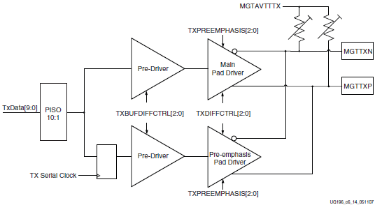
Design using GTP Transceivers
GTP Transmitter (TX) - PMA
Configurable TX Driver
  High Speed Current Mode Differential Buffer
    Differential voltage control
    Pre-emphasis for equalization of HF loss of high speed traces
    Configurable termination impedance

Slide 10
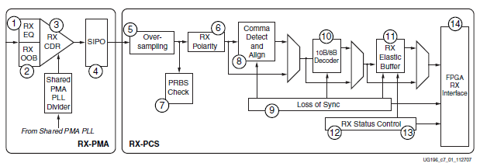
Design using GTP Transceivers
GTP Receiver (RX)
Physical Media Attachment (PMA), electrical sub-layer of the PHY
  Termination and Equalization
  Clock Data Recovery (CDR)
  Serial in to Parallel Out
Physical Coding Sub-layer (PCS), logical sub-layer of the PHY
  Oversampling
  RX Polarity Control
  PRBS Detection
  Comma Alignment and Detection
  Loss of Sync State Machine
  8B/10B Decoder
  Elastic Buffer and Phase Aligner
  CLK correction
  FPGA RX Interface

Slide 11
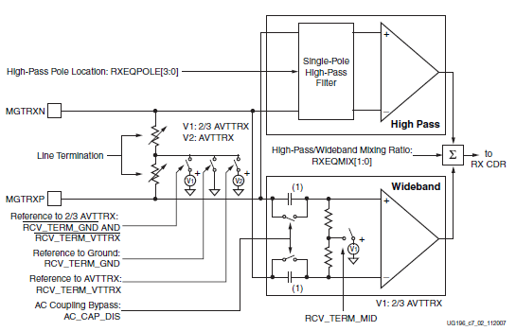
Design using GTP Transceivers
GTP Receiver (RX) – PMA
RX Termination and Equalization
Current Mode Logic (CML)Receiver
  Determines the value of the differential input signal
  Termination Voltage
  Termination Impedance
Equalizer
  AC Coupling
  Optional Configurable Linear Equalizer for HF loss in high speed traces

Slide 12
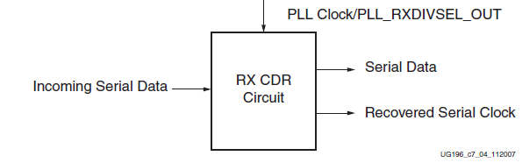
Design using GTP Transceivers
GTP Receiver (RX) - PMA
Clock Data Recovery
  CDR allows to extract a recovered clock signal from received data (embedded clock)
  Result: clock that matches clock originally used to generate serial stream of data
  Conditions
    Line rate of recovered clock matches RX line rate within 1000 ppm
    Sufficient transitions in data

Slide 13
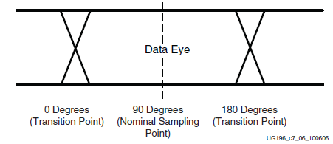
Design using GTP Transceivers
GTP Receiver (RX) - PMA
  Horizontal sample point shift
    Transition points used to recover frequency of incoming clock
    Transition points used to find the optimal time to sample data.
    Configurable data sampling point relative to the first transition

Slide 14
Design using GTP Transceivers
GTP Receiver (RX) - PMA
Serial In to Parallel Out (SIPO)
  Heart of RX datapath. Takes the incoming serial sequence and delivers deserialized data words to the PCS
  Clocks that take part (recovered from CDR)
    Serial clock (line rate)
    Parallel clock (one cycle per n-bit word)

Slide 15
Design using GTP Transceivers
GTP Receiver (RX) - PCS
Oversampling
  5x oversampling enables serial rates from 100 Mb/s to 500 Mb/s (CDR must operate 5x the desired rate to stay in regular operation limits)
  2 bits of recovered data from 10 received bits
  Oversampling block enabled in both sides of the channel (TX and RX)

Slide 16
Design using GTP Transceivers
GTP Receiver (RX) - PCS
RX Polarity Control
  GTP RX is able to invert incoming data polarity using this block if differential traces are swapped by error.
PRBS Detection
  GTP RX includes a built-in Pseudo Random Bit Sequence checker, used for testing the signal integrity of the channel.
  A register stores the number of received errors, and a flag signal alerts when a certain configurable trigger is exceeded in a counter.

Slide 17
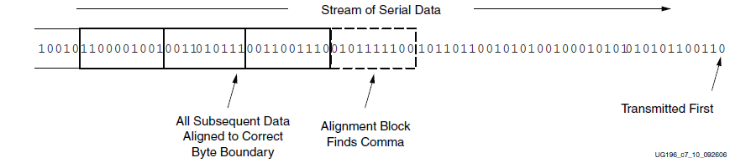
Design using GTP Transceivers
GTP Receiver (RX) - PCS
Comma Alignment and Detection
  Serial data must be aligned to symbol boundaries before it can be used as parallel data…. Where does a byte starting and ending in a stream of data?
  TX send a special character (comma)
  RX searches the pattern of a comma till it is founded. Then received bits are packed from comma boundary

Slide 18
Design using GTP Transceivers
GTP Receiver (RX) - PCS
Configurable Loss-of-Sync State Machine
  Some 8B/10B protocols make use of a state machine in order to detect malfunction of the channel
  GTP RX has this LOS block implemented
  When not used, its ports can be re-used to monitor incoming data.

Slide 19
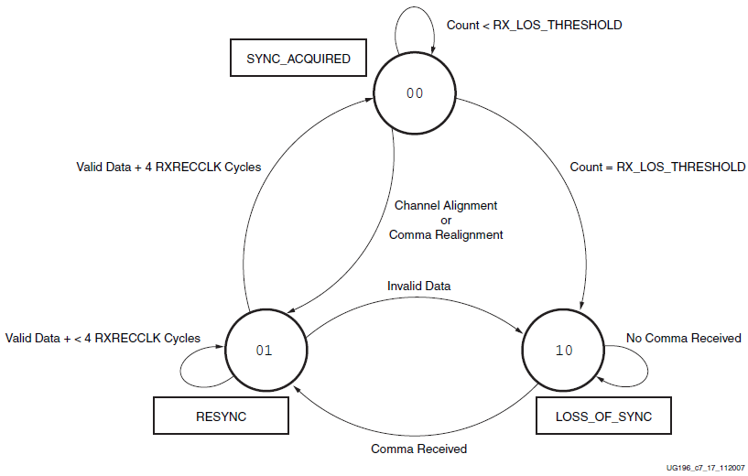
Design using GTP Transceivers
GTP Receiver (RX) - PCS
Configurable Loss-of-Sync State Machine

Slide 20
Design using GTP Transceivers
GTP Receiver (RX) - PCS
Configurable 8B/10B Decoder
  8 bit data and control values (K characters) mapped into 10 bit sequences
  When activated, internal datapath is always 10 bits
  Running Disparity (1/0 balance) can be observed in a port
  Error signals notify when disparity or “non in table” errors are produced

Slide 21
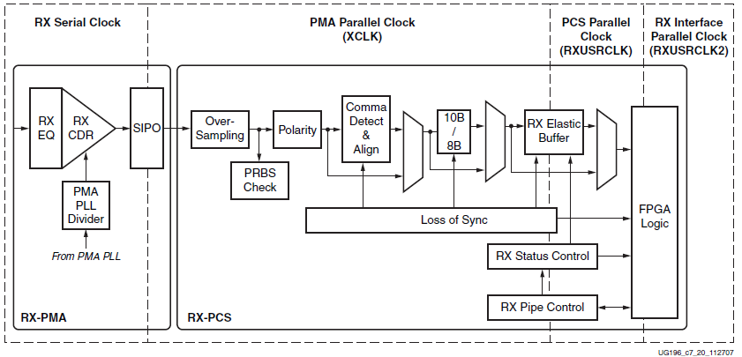
Design using GTP Transceivers
GTP Receiver (RX) - PCS
Configurable Elastic Buffer and Phase Aligner
  GTP RX has two parallel clock domains
    Elastic buffer resolves phase differences between the two domains

Slide 22
Design using GTP Transceivers
GTP Receiver (RX) - PCS
Configurable Elastic Buffer and Phase Aligner
  Possibilities
    Elastic Buffer: Works immediately , 8/10 bits internal datapath, permits clock correction
    Phase Aligner: Needs some clock cycles to stabilize, fewer latency, only 10 bits internal datapath
Configurable Clock Correction
  Allows to correct frequency differences between clock domains
  Performance
    Replicates idle characters when elastic buffer gets empty
    Eliminates idle characters when elastic buffer gets full
    Special clock correction received sequence is needed to proceed

Slide 23
Design using GTP Transceivers
GTP Receiver (RX) - PCS
FPGA RX Interface
  The FPGA logic can access to incoming data on the positive edge of the parallel clock using this interface.
  Received data can be 8/10/16/20 bits long

Slide 24
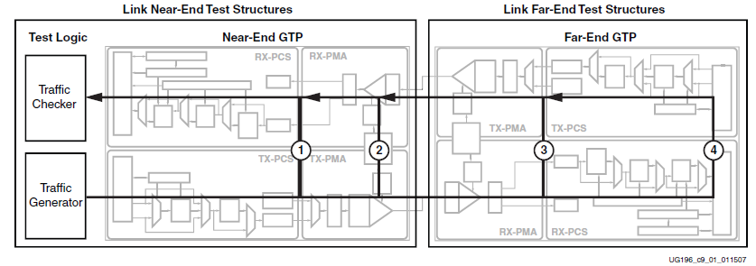
Design using GTP Transceivers
GTP Loopback Modes
Specialized configurations of the datapath where the traffic patterns (PRBS) are transmitted and folded back to the source to be compared and check transmission errors.
  Near-end loopback
    PCS loopback
    PMA loopback
  Far-end loopback
    3. PMA loopback
    4. PCS loopback

Slide 25
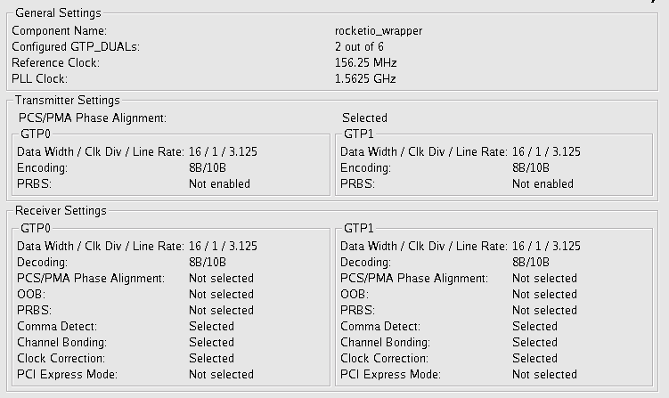
Design using GTP Transceivers
RocketIO Implementation and Simulation
GTP transceivers IP core has been implemented and configured to XAUI protocol using Xilinx RocketIO GTP Wizard core

Slide 26
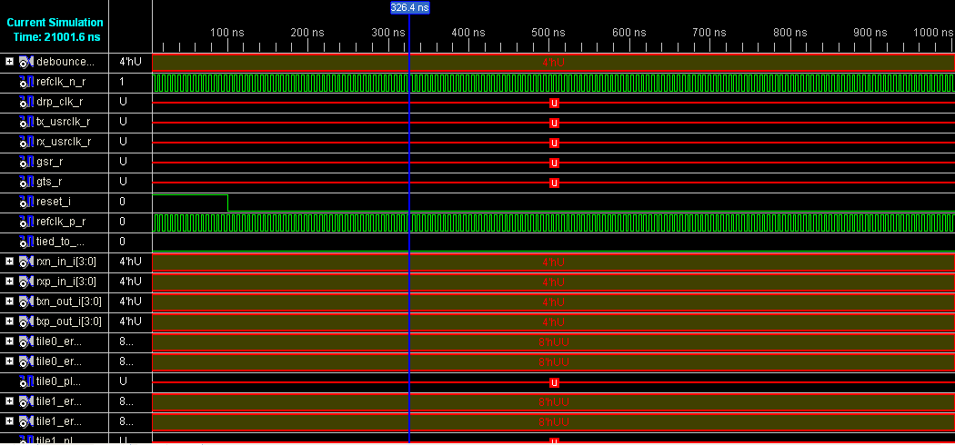
Design using GTP Transceivers
RocketIO Implementation and Simulation

Slide 27
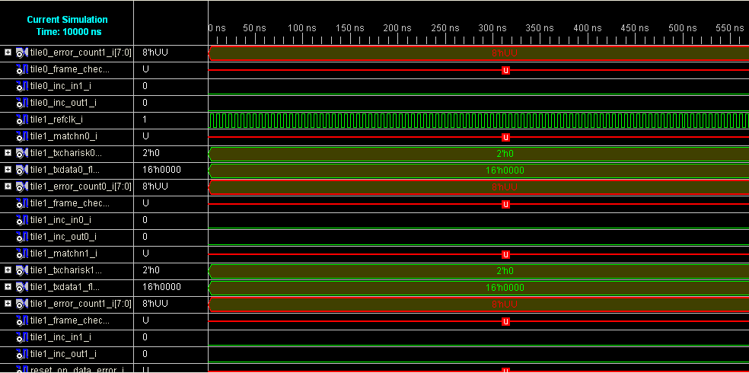
Design using GTP Transceivers
RocketIO Implementation and Simulation

