Slide 1
VALENCIA, Julio 2014

Slide 2

THE THREE QUARK
FRENCH CONNECTION
Pedro González

Slide 3
Inversion Problem in Baryon Spectroscopy
In quark models based on reasonable two-quark interactions (OGE, OBE) the first excited state of negative parity lies in general below the first excitation of positive parity.
Is it possible to implement an effective quark interaction to solve this problem?

Slide 4
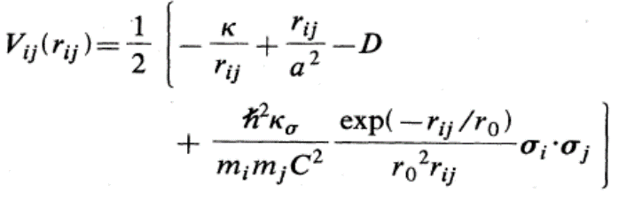
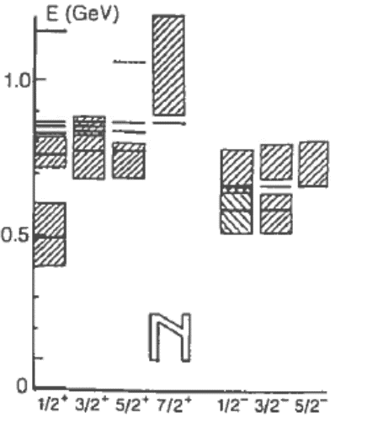
BCN two-quark Interaction
Bertrand’s three-quark Interaction

Slide 5
What may be representing this effective potential?
The effect of genuine three-quark forces (two sigma exchange)
A way to take into account other corrections (relativistic, chiral,
meson-baryon components…)

Slide 6
In order to really check the validity of a quark model to explain the baryon structure one has to go beyond the description of the spectral masses and consider transition processes.
EEM
3P0

Slide 7
STRONG PION DECAY WIDTHS
EEM
3P0
EXP
Conclusion: Meson-baryon components implemented through the 3P0 model play a very relevant role in the description of the first positive parity excitations. Roper resonances have significant 3q as well as meson-baryon components.

Slide 8



Slide 9
VALENCIA, Julio 2014

Slide 10



