Slide 1
Back-end Electronics Upgrade
TileCal Meeting
23/10/2009

Slide 2
OMB Production Status
28/38 OMBs validated (73.7%)
  10 are already in CERN
12/38 OMB repaired (31.2%)
  10 with G-link chips problems
    23 chips resoldered
    2 chips replaced
10/38 OMBs still being tested (26.3%)
  At least 8 have problems

Slide 3
OMB Production Status
OMB ID | PROBLEMS
OMB17 | 2 x G-link chips badly soldered
OMB24 | J-Tag chain: Not possible to program
OMB27 | 2 x G-link chips badly soldered
OMB30 | TTC and CRC FPGAs: no communication
OMB31 | TTC or VME FPGA: no VME access possible
OMB35 | G-link badly soldered
OMB37 | G-link badly soldered
OMB38 | LEMO connector badly soldered

Slide 4
Back-end Electronics Upgrade
Main Idea for the Back-end Upgrade R&D
  Fact: Higher system integration could be achieved using last generation FPGAs.
    More functional blocks of the present system may be implemented within these FPGAs
  Advantages:
    Flexibility: architecture can be modified by firmware
    Versatility: DSP hardware slices within FPGA
    Shorter interconnections: Faster data transfers

Slide 5
Back-end Electronics Upgrade
Target: Implement scaled version of the BE Upgrade in a Last Generation FPGA
  BE in embedded system using Xilinx MicroBlaze processor with EDK Tools
First steps in the embedded system
  Implement Optimal Filtering in FPGA DSP slices
  Implement G-link in FPGA GTP transceivers
  Create the embedded system and start interconnecting the functional blocks
  Monitor the BE processing tasks from the PC through PCI

Slide 6
Back-end Electronics Upgrade
FPGA
Histograms
µBlaze
GTP
Transceiver
PCI Interface
Pipeline
Event Buffer
Optimal
Filtering
Weights Constants
Embedded system using a Xilinx µBlaze processor

Slide 7
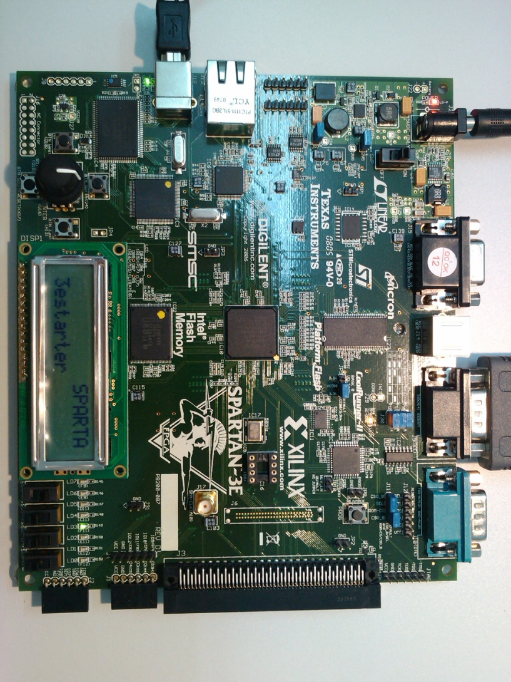
Back-end Electronics Upgrade
Problem: We have no longer the Xilinx ML555
Expected to have new Xilinx Virtex-6 Evaluation board on December
Meanwhile use Digilent Spartan3E Starter Kit

Slide 8
Back-end Electronics Upgrade
Practicing with EDK Tools tutorials
  Achieved until now:
    Embedded system with 32-bit 50 MHz MicroBlaze
    Communication with board peripherals
      LEDs, pushbuttons, switches, LCD, RS232 output
    Use of GPIOs
    Creation and communication with user defined custom-peripheral in FPGA
    Instantiation of interrupt controller, use of interruptions with timers
    HW/SW Debugging

Slide 9
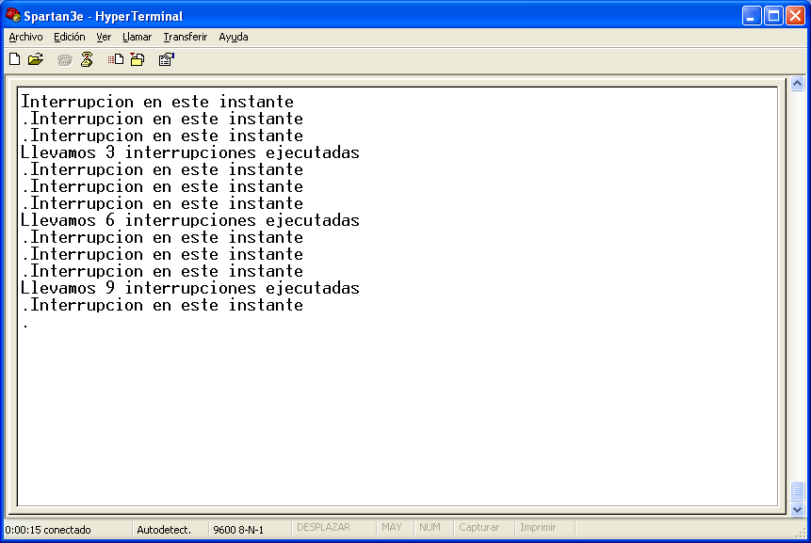
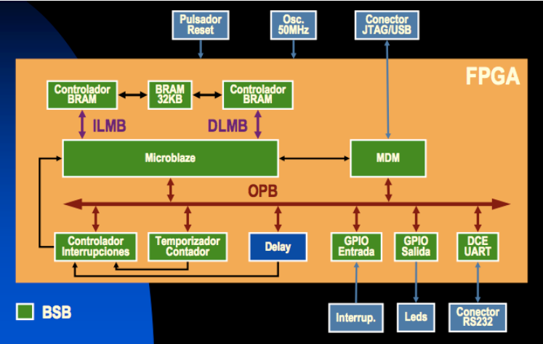
Back-end Electronics Upgrade

