Slide 1
Reconstruction Validation
Alberto Valero
Universidad De Valencia
On Behalf Of The Tile Reconstruction Validation Task Force
1 : October : 2009 TileCal Week

Slide 2
Outline
Optimal Filtering Performance
New Implementation of QF
Reconstruction of Laser Pulse Shape
Monitoring
CIS Analysis

Slide 3
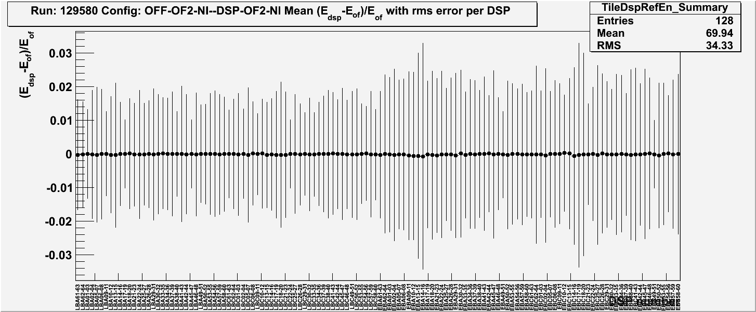
Optimal Filtering Performace
CIS runs with Non Iterative algorithm

Slide 4
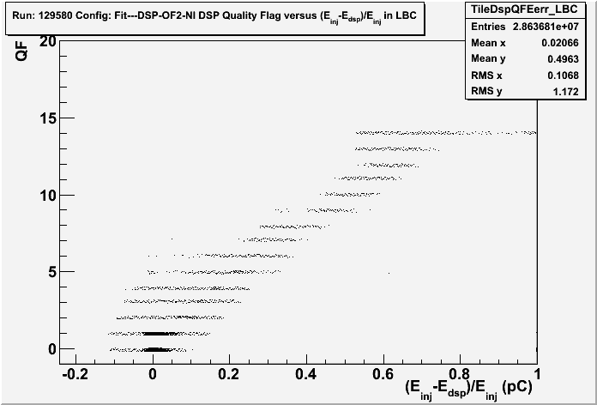
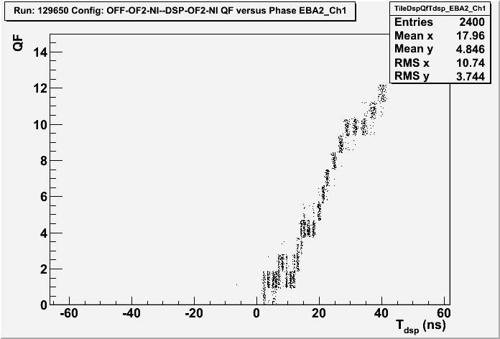
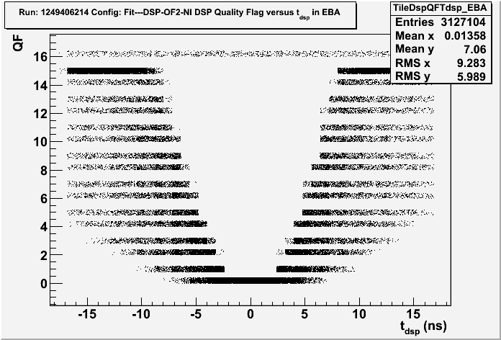
New QF implementation. Plot del mes
CIS scan- Autogain
Ideal pulse

