Slide 1



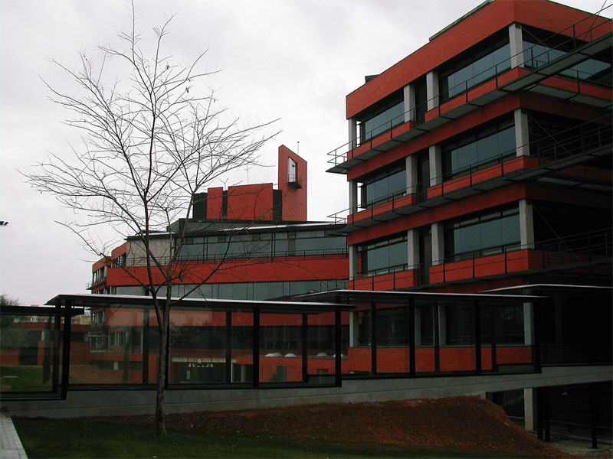
Actividades IFIC-TEO 2013 Universitat de València & CSIC
Juan M Nieves
20 Dic 2013

Slide 2
José Adolfo de Azcárraga Feliu: Presidente de la RSEF
Miguel Angel Sanchis Lozano: Vicepresidente de la RSEF
Albert Aparici Benages: Premio Opinion Innovadora organizado por la UV y el diario Las Provincias
Gonzalo J. Olmo: group of Outstanding Referees of the Physical Review and Physical Review Letters journals (2013)
Jorge Martín Camalich: Premio Extraordinário Doctorado 2013 (la tesis doctoral también fue premiada por la división nuclear de la EPS en el área de física nuclear y teórica)
Andrea Donini: Se ha incorporado definitivamente en la RPT del IFIC
DFT ha participado activamente en el Programa de Seminarios (IVICFA) & Colloquia del IFIC
Participado en la organización de:

Slide 3



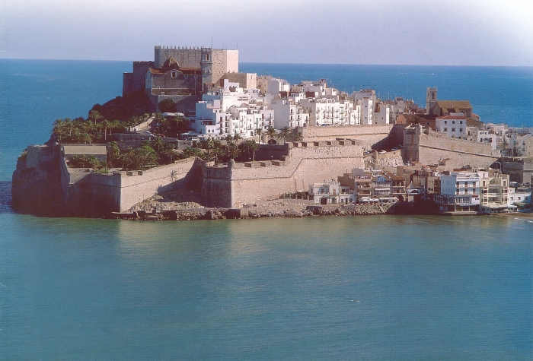
CosmoRENATA 2013
Cosmology Conference
NSTAR 2013 Workshop

Slide 8
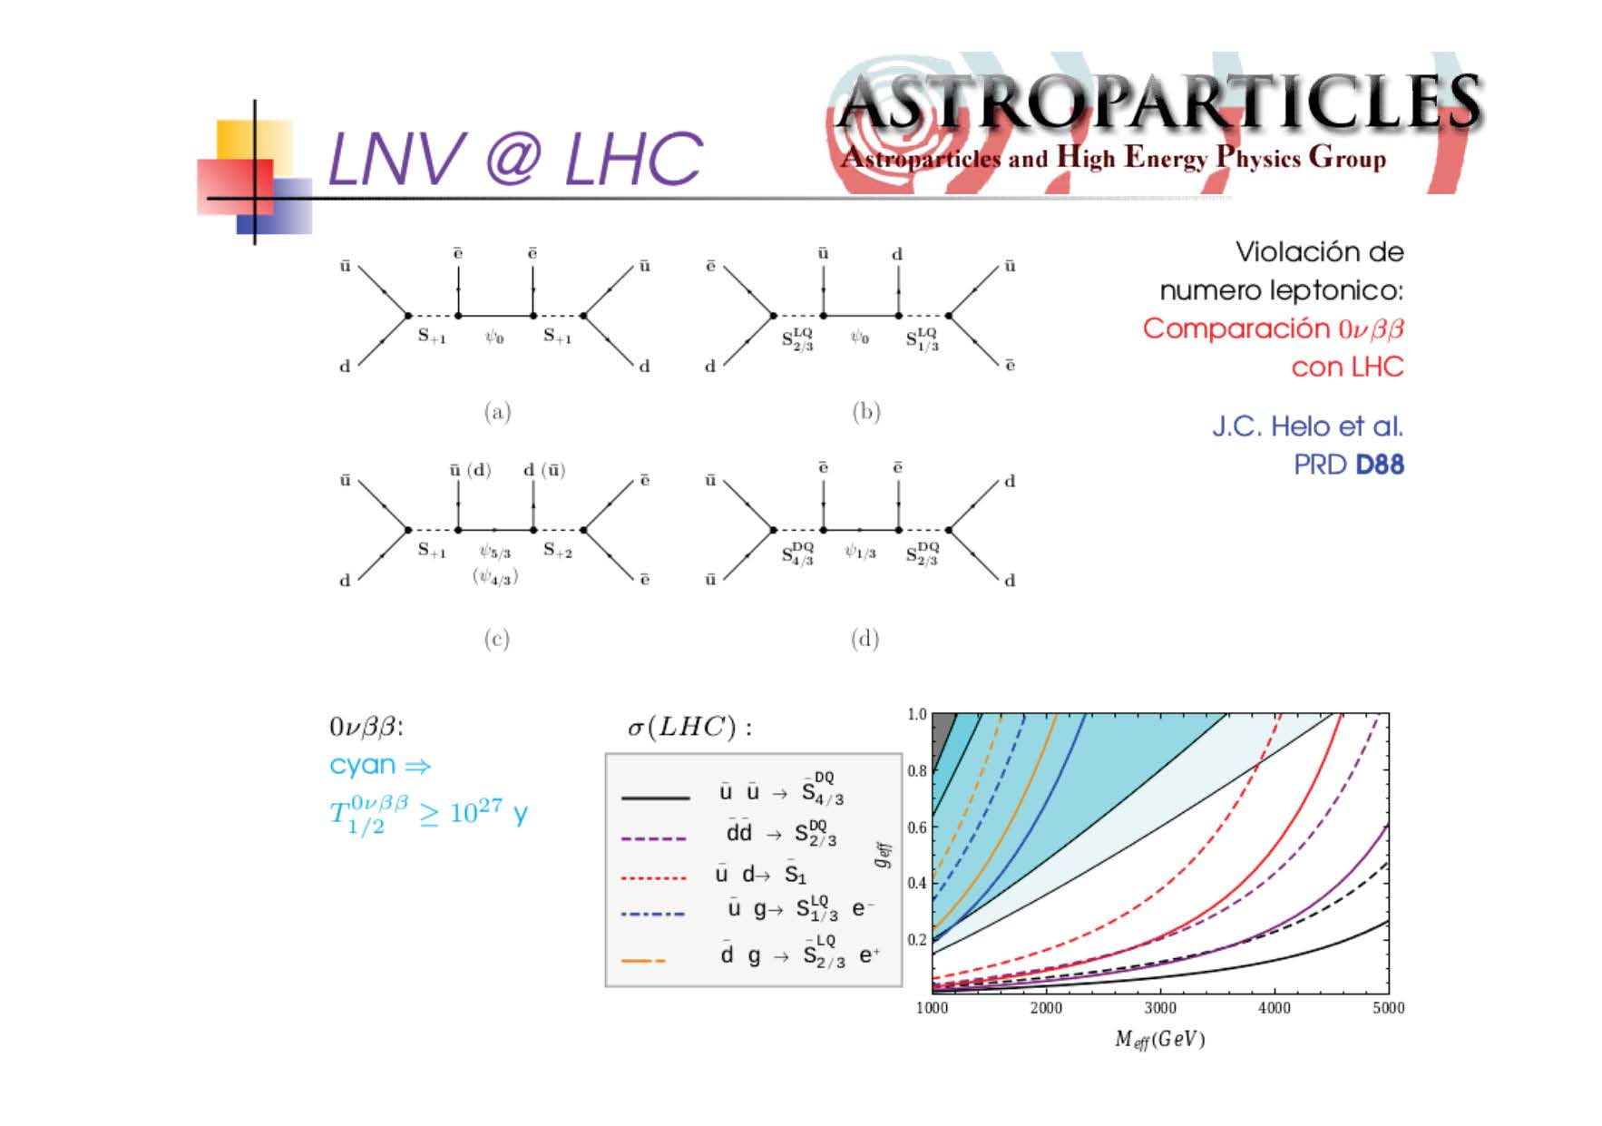

Slide 13
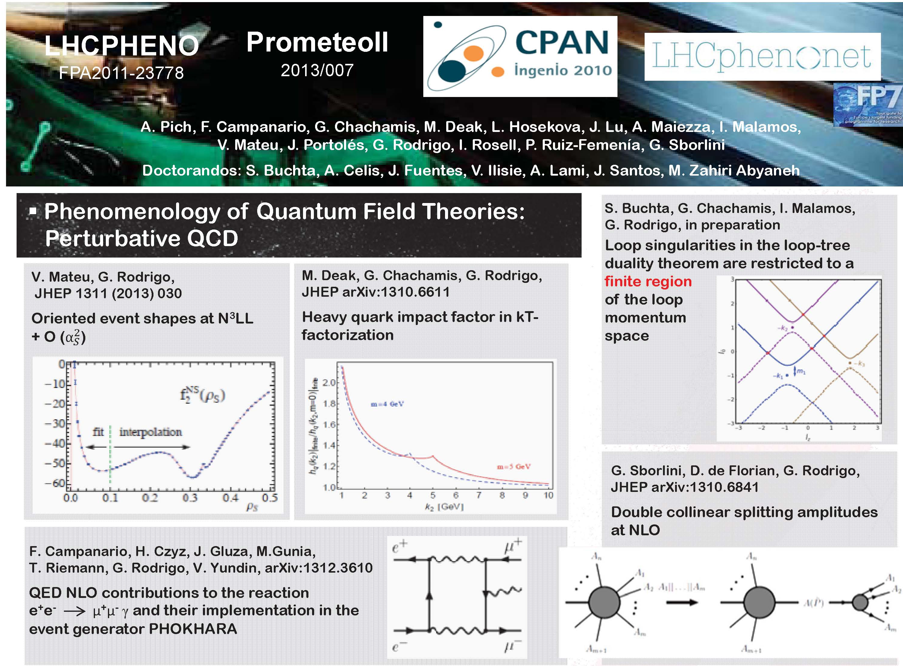

Slide 14
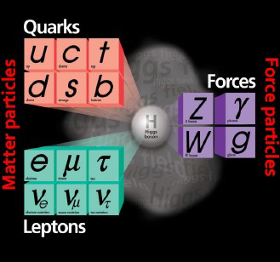
Hadron Physics and Fundamental Interactions 2013
Pedro González, Santiago Noguera, Alexandr Pimikov, Vicente Vento and Javier Vijande.
The project has two fundamental lines of research: hadrons
i) hadron structure, specially for
those hadrons associated with heavy quarks: charm and bottom; ii) the structure and phenomenology of exotic hadrons, multiquarks and glueballs; iii) deep inelastic scattering properties of nucleons and mesons; iv) nuclear interaction inside a medium; v) the behavior of hadrons at high temperatures and densities.
… and monopoles study of magnetic monopoles and their detection. Gran Unified Theories and Strings allow for the existence of magnetic monopoles. We have studied recently the structure of monopoles from the theoretical point of view and their impact in the present LHC experiments (Vicente Vento, Valentina Mantovani Sarti, arXiv:1306.4213 [hep-ph])

Slide 15
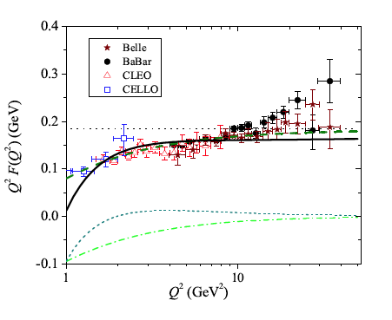
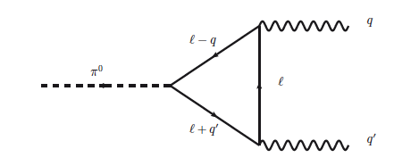
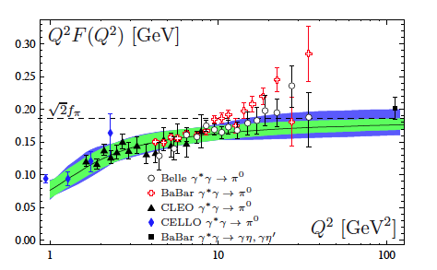
Pion transition formfactor
A. V. Pimikov et al.,, Phys. Rev. D 87,
094025 (2013). using sum rules
Noguera et al., arXiv:
1311.3595 [hep-ph]using nonlinear models

Slide 16
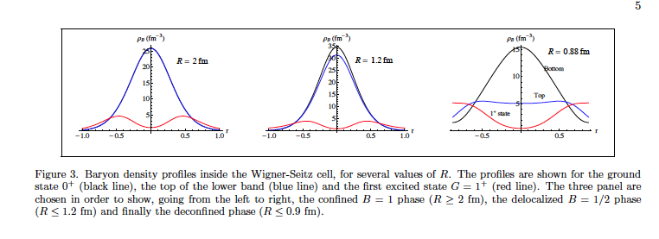
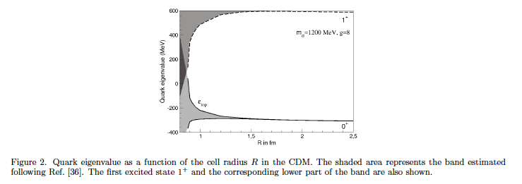
As matter gets compressed density ~ 1/R³ quarks in the lowest band mix with quarks in the first excited band leading to a delocalization of baryon number called B= ½ phase, further compression leads to deconfinement (Valentina Mantovani Sarti, Vicente Vento., arXiv:1309.0639 [nucl-th]. Phys. Lett. B in press)
Valentina Mantovani Sarti, Byung-Yoon Park, Vicente Vento. Int.J.Mod.Phys. A28 (2013) 27, 1350136
Excited band
Lowest band

Slide 17
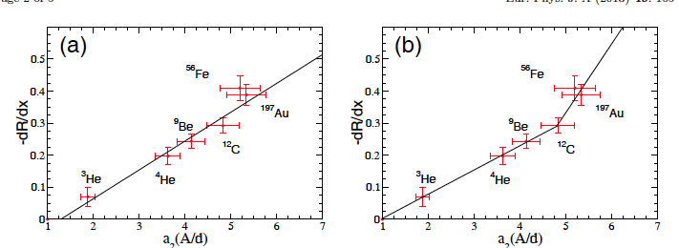
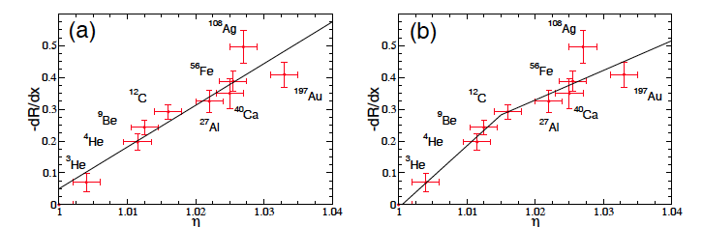
Observation: linear relation between EMC slope and short range correlations is too confirmed from a x-rescaling analysis
C.A. García Canal, T. Tarutina, Vicente Vento. Eur.Phys.J. A49 (2013) 105

Slide 24
Física teórica nuclear y de muchos cuerpos
Members: E. Oset, J. Navarro, J. Ros, M. J. Vicente-Vacas, J. Nieves, L. Alvarez-Ruso (RyC), T. Ledwig (pdoc), T. Uchino (pdoc), J. Garzón (doc), F. Aceti (doc), En Wang (doc), C. Hidalgo (doc), C.W. Xiao (doc), A. Hiller (doc), J. Morais (doc)
Topics:
Dynamically generated three-hadron resonances
Finite volume treatment of scattering of hadrons and limits to phase shifts extraction from lattice QCD
Hadron properties (spectroscopy, magnetic moments, form factors)‏ in the free space and in nuclei
Neutrino-nucleon and neutrino-nucleus reactions
Chiral perturbation theory with Δ states
Heavy quark spin and flavor symmetries
Dinámica no-lineal y sistemas complejos
Función de respuesta en materia nuclear usando interacciones efectivas
Collaborations:
Granada, Murcia, Salamanca, Barcelona, Córdoba, Madrid, Osaka, Beijing, Jülich, Nara, Kyoto, Bonn, Minesota…
Notes:
24

Slide 25
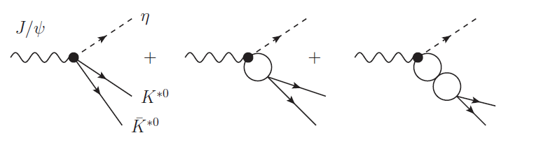
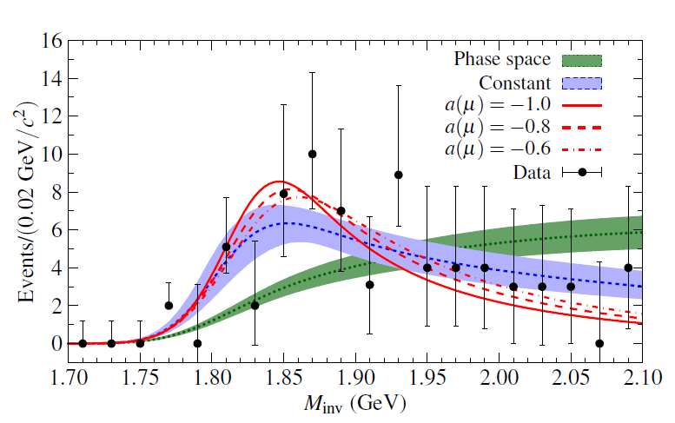
0⁺ (0⁻ ⁺)
0⁻ (1⁻ ⁻ )
0⁻ (1 ⁺ ⁻)
L=0
Ju-Jun Xie, M. Albaladejo and E. Oset arXiv: 1306.6594 (PLB in print)
The local hidden gauge theory predicts
a h₁ state around 1800 MeV from K* K*bar
interaction. A BES experiment provides a
K* K*bar distribution from this reaction with a clear peak which is interpreted as a h₁ resonance around 1830 MeV. The combination of the theory and
experiment allows to extract a
new resonance, h₁(1830).

Slide 26
MINIBOONE CCQE, NCγ, π prod XSECTS
microscopical evaluation !
M.J. Vicente-Vacas, L. Alvarez-Ruso, E. Wang & J. Nieves (IFIC), E. Hernández (Salamanca), F. Sánchez (IFAE), R.Gran (Minesota)
PLB 721 (2013) 90
PRD 87 (2013) 113009
arXiv:1304.2701
Electroweak Nuclear Reactions at Intermediate Energies

Slide 27
D^{(*)} Dbar^{(*)} Molecules
in a finite box !
Phys.Rev. D88 (2013) 014510
C. Hidalgo, E. Oset, J. Nieves (IFIC), F.K. Guo (Bonn), M. Pavón y M. Albaladejo (Paris)
 | Consequences of Heavy Quark Symmetries for Hadronic Molecules
Phys.Rev. D88 (2013) 054007

Slide 28
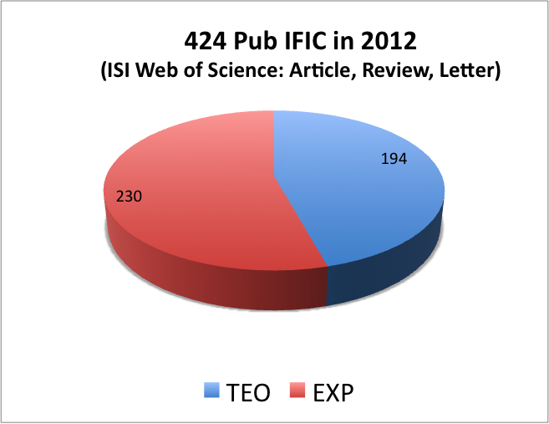
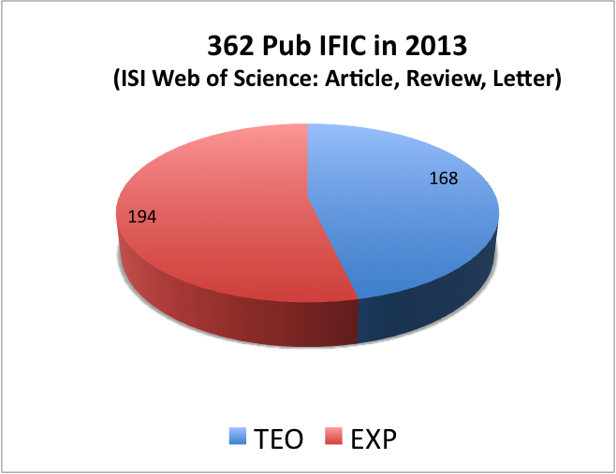
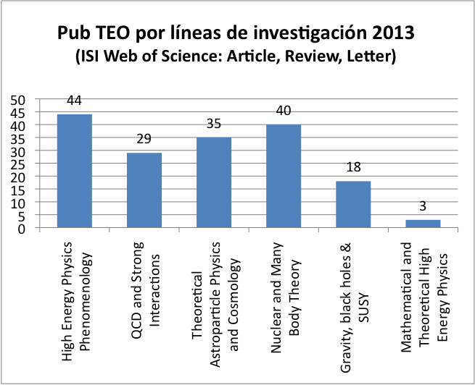
7 Tesis doctorales
4 RyC: 30/11/2015
30/11/2016
30/09/2017
15/12/2017
Provisional Diciembre 2013

Slide 29

Gracias a José Valle por su dedicación durante todos estos años al frente de la Unidad !
Felices Fiestas

