Slide 1
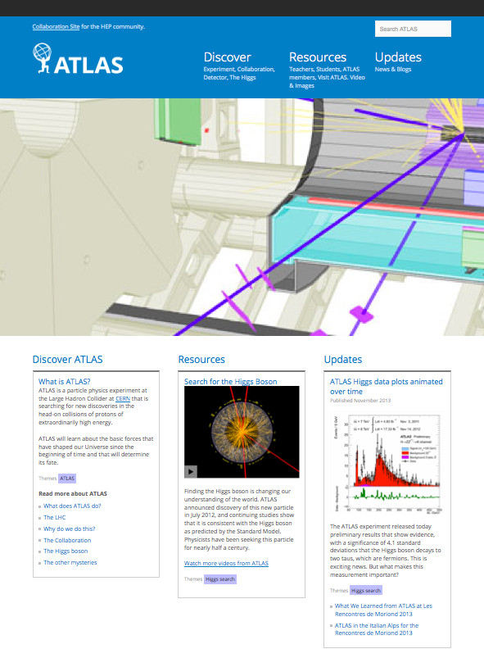
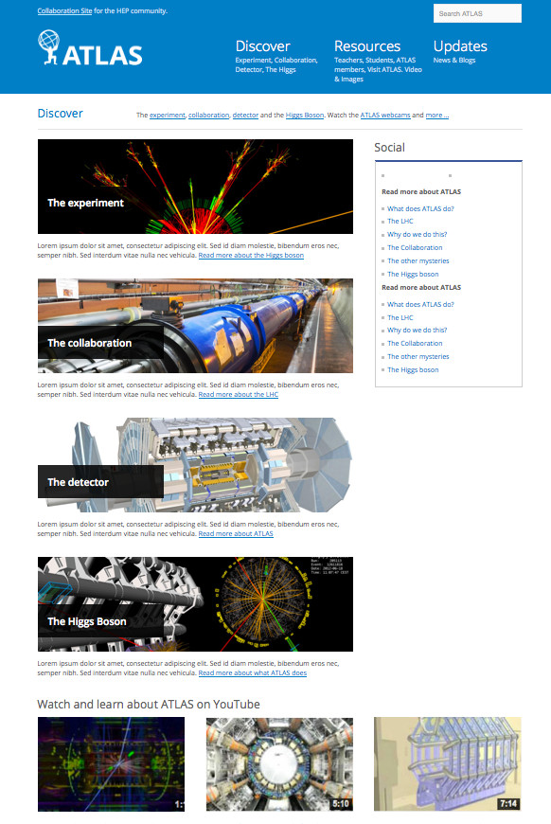
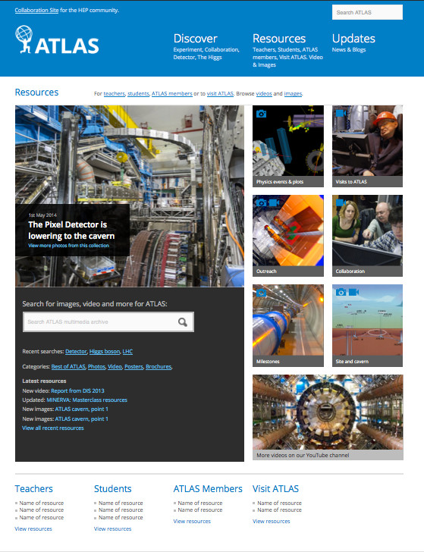
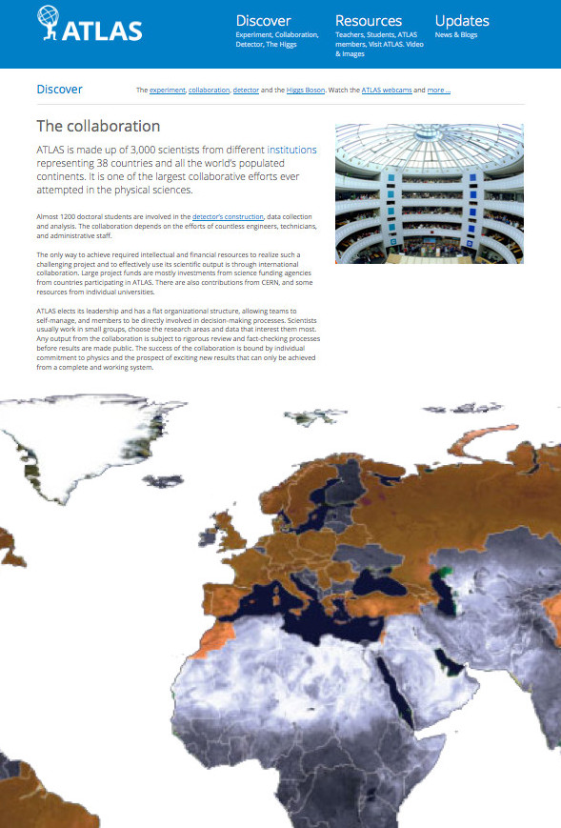
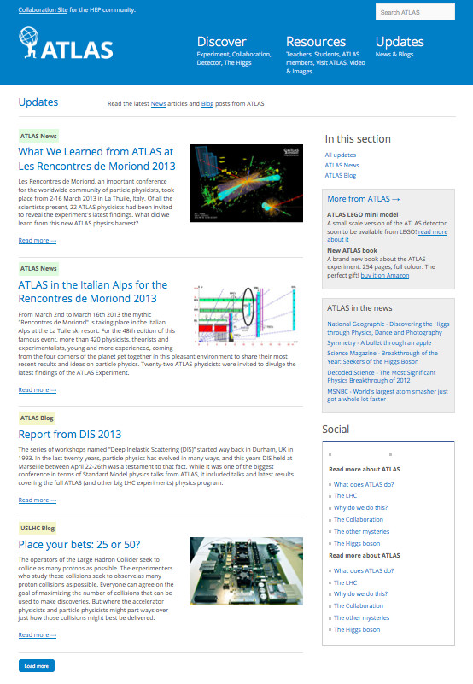

Remaking the ATLAS public website
Goals of the website:
demonstrate what ATLAS is and does
provide timely content as news & updates
provide resources for internal & external audience
provide content to support educational tasks
The research
What we did
User survey
What we learned
79% male, age 16-55
Most of our audience are students and educators
Majority get news about ATLAS from our website, social media and CERN communication platforms
Stakeholders
interview
ATLAS members use the site for presentation resources
It is important to convey the difference between CERN and ATLAS
Content navigation needs to be easier and targeted
The process
Content audit
Qualitative assessment of all existing published web content
Information
architecture
Theme for main landing pages based on research: Discover (what ATLAS is & does), Resources (rich content, video, images), News & Updates
Content
strategy
Developing and managing content for specific target groups
Design development
Improved user experience that supports the information architecture with scope for future content development
http://atlas.ch

