Slide 1




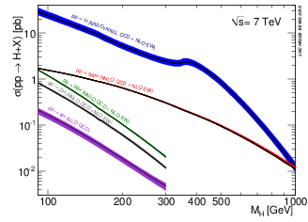
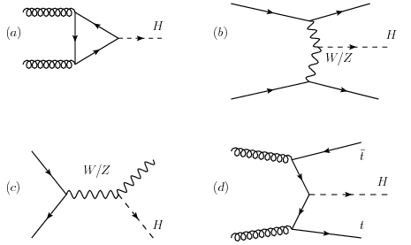
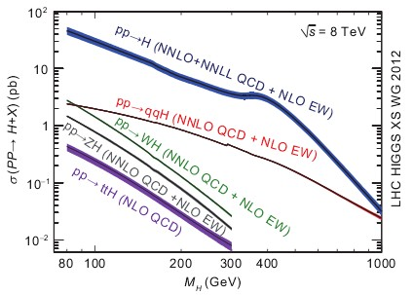
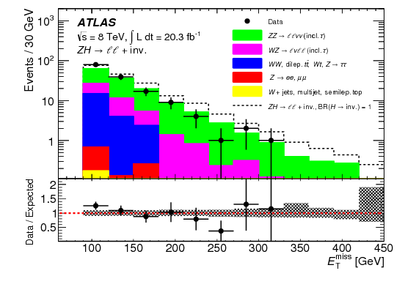

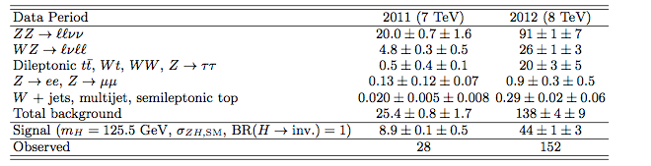
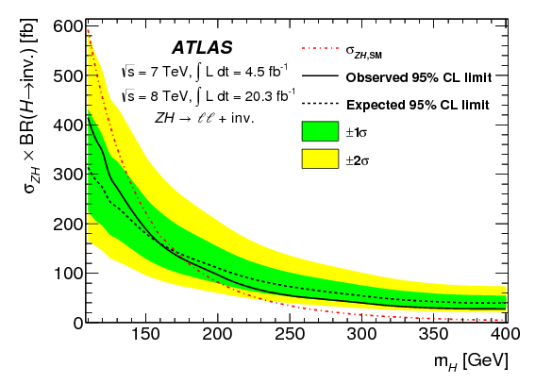
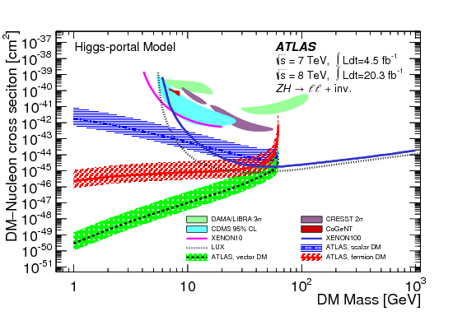

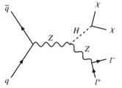
Searches for Invisibly Decaying Higgs Boson with ATLAS
Kate Shaw (INFN Udine / ICTP Trieste) on behalf of the ATLAS Collaboration
Higgs Production Cross-sections
A number of extensions of the Standard Model allow for a significant Branching Ratio (BR) for a Higgs Boson to decay into stable neutral weakly interacting particles that are invisible to the ATLAS Detector.
Excess of events consistent with this decay would constitute evidence for Beyond the Standard Model (BSM) physics such as SUSY, extra dimensions and Higgs portal dark matter.
Using data collected by the ATLAS Experiment the branching ratio of the discovered Higgs Boson to invisible particles can be constrained
Furthermore limits can be placed on the cross section times branching ratio of any additional Higgs bosons to invisible particles.
Higgs Production channels [1]
gg fusion (ggF) via top quark loop (gg -> H)
(b) Vector Boson Fusion (qq -> qqH)
(c) Associated with vector bosons (qq -> ZH/WH)
(d) Associated with top quark pairs (gg/qq -> ttH)
Invisible Higgs Boson produced in association with a Z Boson
Missing transverse energy (E_{T}miss) distribution
Systematics as nuisance parameters constrained by Gaussian distributions
Dominant uncertainties include
Theo. Uncert. of ZZ/WZ backgrounds (8-13%)
Theo. Uncert. on ZH cross-section (3.6 – 5.7%)
Jet energy scale and resolution (3-6%)
Search for Higgs associated production with Z decaying into leptons (e, μ) using 4.5 fb⁻¹ of 7 TeV and 20.3 fb⁻¹ of 8 TeV pp collision data collected by the ATLAS Experiment [2]
Event Selection
Pair of isolated leptons (e,μ) p_{T} > 20 GeV
Dilepton system consistent with Z decay
(76 < mιι < 106 GeV)
Missing transverse energy > 90 GeV
Require no reconstructed jets p_{T} > 20
Azimuthal angles between E_{T}miss and P_{T}miss
Main backgrounds include ZZ-> llνν (68%) irreducible and WZ-> lνll (19%) (estimated from simulation)
Signal expectation corresponds to Higgs M_{H} = 125.5 GeV with SM ZH production rate and BR(H ➔ inv.) =1
Limit Setting
In the Higgs-portal Dark Matter (DM) scenario the Higgs boson acts as a mediator between DM and SM particles
Limit on BR(H ➔ inv.) for 125.5 GeV Higgs boson interpreted in terms of upper limit on DM-nucleon scattering cross-section assuming Higgs nucleon coupling 0.33 +0.3 -0.07
Strongest available limits set on Higgs-portal (low-mass) DM scenario
Limits are placed using a maximum likelihood fit to the E_{T}miss distribution on the ZH production cross section times branching ratio of additional Higgs-like bosons in the mass range 110 < M_{H} < 400 GeV decaying to invisible particles.
Assuming SM ZH production cross section with (M_{H} = 125.5 GeV) an upper limit of 75% at 95% CL (63% at 90% CL) is set on the branching ratio to invisible particles. Expected limit in the absence of BSM decays to invisible particles is 62% at 95% CL (52% at 90% CL).
σ_{ZH} x BR(H ➔ inv.) at 95% CL
[1] “Looking for an Invisible Higgs Signal at the LHC”, D. Ghoah et al. Phys Lett B 725 (2013) 344
[2] “Search for Invisible Decays of a Higgs Boson Produced in Association with a Z Boson in ATLAS”, Phys. Rev. Lett. 112, 201802 (2014)
37th International Conference on High Energy Physics 2 – 9 July 2014, Valencia

