Slide 1



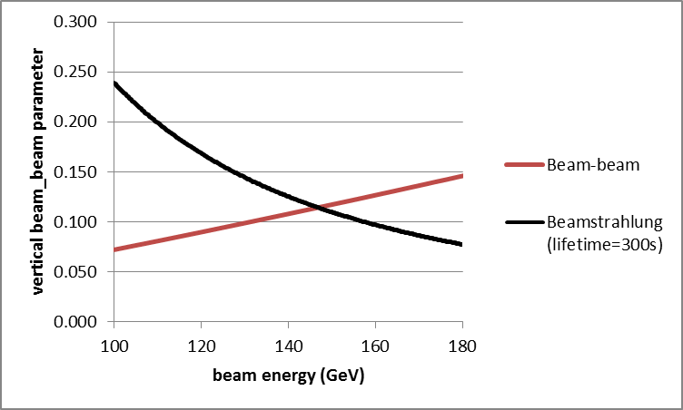
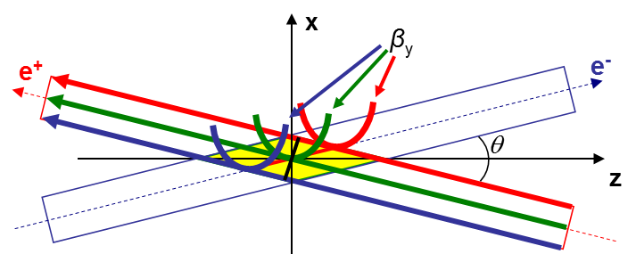
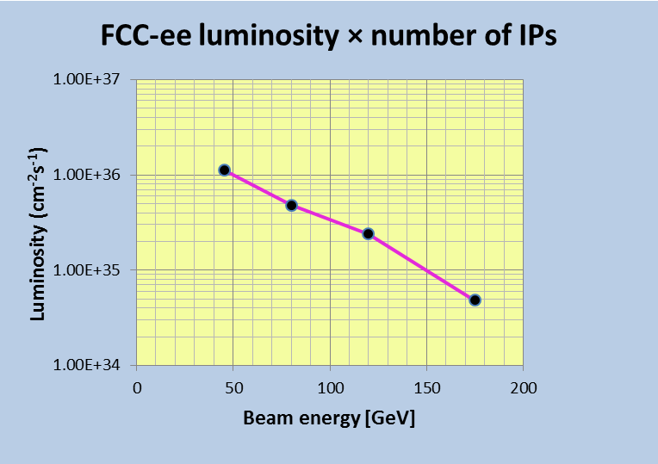
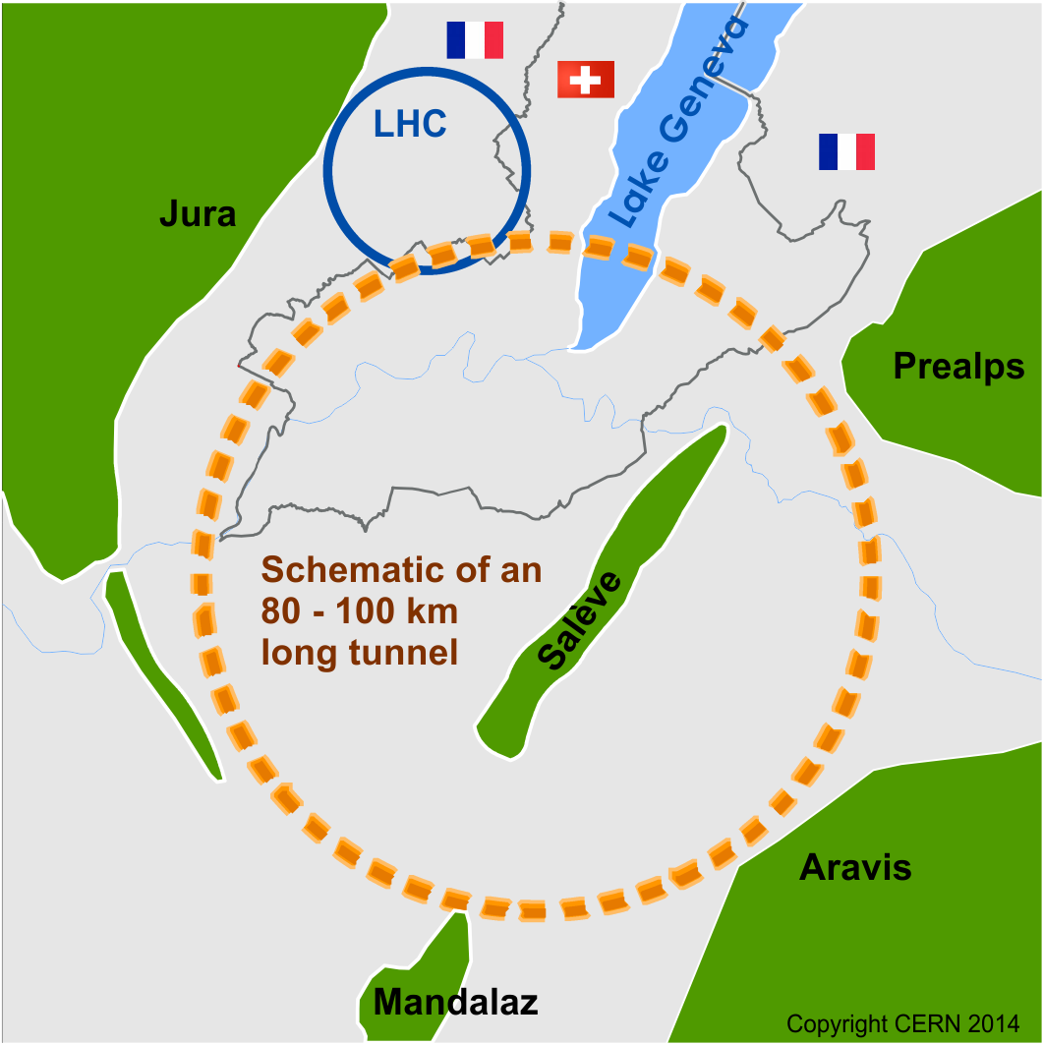

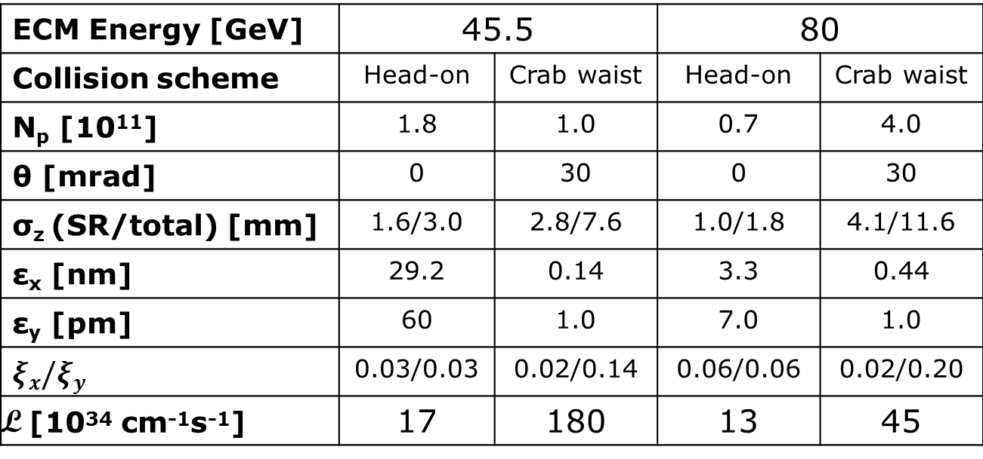
FCC-ee accelerator parameters, performance and limitations
M. Koratzinos, University of Geneva, on behalf of the FCC-ee design study
Abstract
CERN has recently launched the Future Circular Collider (FCC) study to deal with all aspects of an ambitious post-LHC possible programme. The emphasis of the study is on a 100 TeV proton collider to be housed in a 80-100 km new ring in the Geneva region. An electron machine will also be considered as a possible intermediate first step (FCC-ee). The study benefits from earlier work done in the context of TLEP and has already published a parameter table, to serve as the basis for the work to be done. The study aims to publish a conceptual design report at around 2018. The recent discovery of a light Higgs boson has opened up considerable interest in circular e⁺e⁻ Higgs factories around the world. FCC-ee is capable of very high luminosities in a wide centre-of-mass (E_{CM}) spectrum from 90 to 350 GeV. This allows the very precise study of the Z, W and H bosons as well as the top quark, allowing for meaningful precision tests of the closure of the Standard Model .
FCC-ee modes of operation
        Higgs factory mode: at 240GeV E_{cm} above the ZH threshold
        Top quark mode: at 350GeV, so that the Higgs can decay to ttbar
        WW threshold with transverse polarization at 160GeV E_{cm} : exquisite precision on the W mass
        Z pole running: repeat the whole of the LEP programme in a few minutes
        Z lineshape with transverse polarization: unprecedented precision on lineshape parameters
        Z running with longitudinal polarization: accurate asymmetry measurements
Join us!
Latest parameter list for FCC-ee at different energies
H
FCC-ACC-SPC-0004 EDMS no 1346082
t
The design study is under way and we need experts in all aspects of accelerator design (plus theory, plus experiments).
Number of subscribers to date: 430
 | Z | W | H | t
Circumference [km] | 100 | 100 | 100 | 100
Bending radius [km] | 11 | 11 | 11 | 11
Beam energy [GeV] | 45.5 | 80 | 120 | 175
Beam current [mA] | 1450 | 152 | 30 | 6.6
Bunches / beam | 16700 | 4490 | 1360 | 160
Bunch population [10¹¹] | 1.8 | 0.7 | 0.46 | 0.86
Transverse emittance ε Horizontal [nm] Vertical [pm] | 29.2 60 | 3.3 7 | 0.94 1.9 | 2 2
Momentum comp. [10⁻⁵] | 18 | 2 | 0.5 | 0.5
Betatron function at IP β* Horizontal [m] Vertical [mm] | 0.5 1 | 0.5 1 | 0.5 1 | 1 1
Beam size at IP σ* [μm] Horizontal Vertical | 121 0.25 | 26 0.13 | 22 0.044 | 45 0.045
Energy spread [%] Synchrotron radiation Total (including BS) | 0.04 0.06 | 0.07 0.09 | 0.10 0.14 | 0.14 0.16
Bunch length [mm] Synchrotron radiation Total | 1.64 2.56 | 1.01 1.49 | 0.81 1.17 | 1.16 1.27
Energy loss / turn [GeV] | 0.03 | 0.33 | 1.67 | 7.55
SR power / beam [MW] | 50 | 50 | 50 | 50
Total RF voltage [GV] | 2.5 | 4 | 5.5 | 11
RF frequency [MHz] | 800 | 800 | 800 | 800
Longitudinal damping time τ_{E} [turns] | 1320 | 243 | 72 | 23
Energy acceptance RF [%] | 2.7 | 7.2 | 11.2 | 7.1
Synchrotron tune Q_{s} | 0.65 | 0.21 | 0.096 | 0.10
Polarization time τ_{p} [min] | 11200 | 672 | 89 | 13
Hourglass factor H | 0.64 | 0.77 | 0.83 | 0.81
Luminosity/IP [10³⁴ cm⁻²s⁻¹] | 28.0 | 12.0 | 6.0 | 1.2
Beam-beam parameter Horizontal Vertical | 0.031 0.030 | 0.060 0.059 | 0.093 0.093 | 0.056 0.056
Luminosity lifetime [min] | 213 | 52 | 21 | 24
W
Z
Z
We have an aggressive time schedule: detailed technical study in time for the next European strategy update in 2018.
Z
Beamstrahlung: a limitation at high energies
Very rich scientific programme, testing not only the Higgs sector, but many crucial aspects of the Standard Model
Beamstrahlung limits the performance of a circular collider due to beam lifetimes becoming too short. Above a certain energy, it does not allow the machine to run at its theoretical beam-beam limit (red curve). For the FCC-ee parameters, with a momentum acceptance of 2% and beam lifetimes of 300 s (black curve) this crossover is above 120GeV, so only the tt running is affected.
A more ambitious scheme with great potential at low energies: crab-waist
The crab waist scheme promises large luminosity gains at beam energies of 45 and 80GeV. It avoids the hourglass effect and suppresses betatron coupling resonances allowing to achieve ξ_{y} ∼ 0.2
Major assumptions:
Total SR power dissipation 100MW
Bending radius 11 km
β*_{y} of 1 mm
ξ_{y} in the range 0.03 to 0.09
Very high luminosity is a trait of circular machines
FCC in the Geneva region:
The gain with respect to the baseline design at the Z is a factor of 10!
Very exciting
ECM Energy [GeV] | 45.5 |  | 80
Collision scheme | Head-on | Crab waist | Head-on | Crab waist
N_{p} [10¹¹] | 1.8 | 1.0 | 0.7 | 4.0
θ [mrad] | 0 | 30 | 0 | 30
σ_{z} (SR/total) [mm] | 1.6/3.0 | 2.8/7.6 | 1.0/1.8 | 4.1/11.6
ε_{x} [nm] | 29.2 | 0.14 | 3.3 | 0.44
ε_{y} [pm] | 60 | 1.0 | 7.0 | 1.0
$ξx/ξy$ | 0.03/0.03 | 0.02/0.14 | 0.06/0.06 | 0.02/0.20
L [10³⁴ cm⁻¹s⁻¹] | 17 | 180 | 13 | 45
Work in progress
Above is the total luminosity delivered to four experiments at different beam energies
Final tunnel circumference will depend on:
Physics
Geology
Minimization of cost
Please check out:
K. Ohmi et al., IPAC2014, THPRI003 & THPRI004
A. Bogomyagkov, E. Levichev, P. Piminov, IPAC2014, THPRI008

