Slide 1


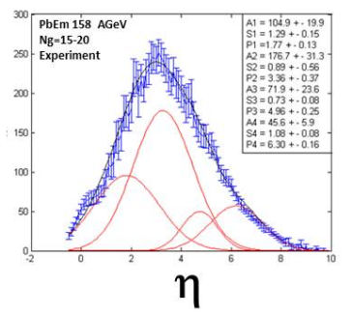
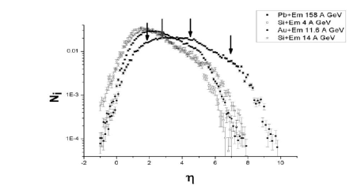
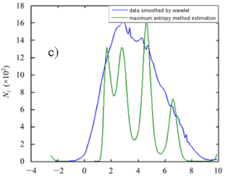
Pseudorapidity spectra of secondary particles
emitted in the relativistic nucleus-nucleus collisions
PoS(Baldin ISHEPP XXI)043
Sh. Khalilova, M. K. Suleymanov, B. Z. Belashev , S. Vokal, J. Vrláková , O. B. Abdinov , M. Ajaz , Ali Zaman, K. H. Khan
H.M. Abdullayev Institute of Physics NAS Baku, Azerbaijan
We discuss new results connected with more detail structure of the pseudorapidity spectra of charged relativistic particles with β > 0.7 produced in Si (at energy 4 A GeV and 14 A GeV), Au (at energy 11.6 A GeV) and Pb+Em (at energy 158 A GeV) reactions. The relativistic nucleus beams were obtained from AGS and SPS machines. The pseudorapidity spectra were analyzed using Maximum Entropy Methods. The number of fast target protons: g-particles are used to fix the centrality of collisions. Using the method we found some selected pseudorapidity values – nontrivial structure, the number of which depends on energy; increases from 2 to 4 with energy.
The stacks of NIKFI BR- 2 nuclear emulsions were irradiated horizontally by ²⁸Si beam at 4 and 14 A GeV , by ²⁰⁸Pb beam at 158 A GeV/c (EMU12 at the CERN SPS ) and by ¹⁹⁷Au beam at 11.6 A GeV=c (Experiment E863 at BNL AGS ). Secondary charged particles used in this study were classified into the (1) relativistic (shower) s-particles (Ns), fast singly charged particles with β>0.7. (2) fast target fragments, g-particles (Ng), with 0.23< β < 0.7. In this work we have analyzed 1322 Si+Em (at 4 AGeV) , 1093 Si+Em (at 14 AGeV), 628 Pb+Em and 1185 Au+Em collisions found by the along the track scanning.
Method:
Pseudorapidity distributions were considered in the framework of the
(i=1,…M) model, where s is the estimation of the z-distribution (smoothed distribution) of the η-spectra with the smoothed fluctuations, h is the blurring function, n is the additive noise, f is the estimation of the distribution which defines the structure of z-distribution and M is the number of steps in the histogram.
Results: The method could extract some selected values for η which are very close to observed visually ones.
The number of peaks increases with energy from 2 to 4.
The fourth peak observed in case PbEm (at 158 AGeV)-reactions for experimental events with a number of g particles N_{g}=15-20
For the last case the value of the P4=6.3±0.2, is in the stripping area of η. But N_{g}=15-20 which show that these are not stripping particles. So we support that the case may be connected with some special dynamics other than dynamics for 3 previous cases.
Experimental data:
COMSATS Institute of Information Technology
Park Road Shahzad Town, Islamabad, Pakistan
P. J. Šafárik University Košice, Slovakia
Institute of Geology, Karelian Research Center, Russian Academy of Sciences
shahla.ganbarov@cern.ch

