Slide 1


Slide 2

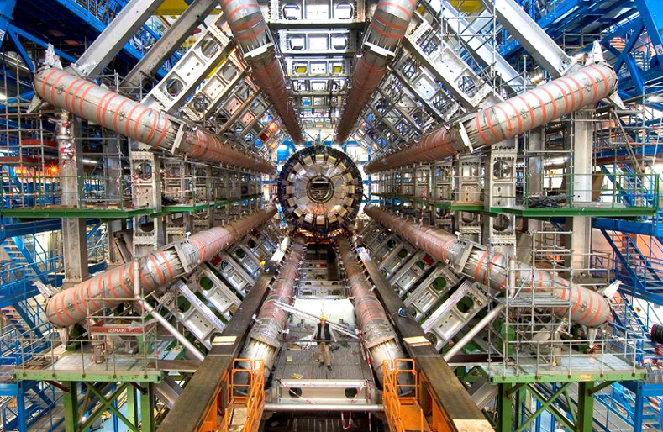
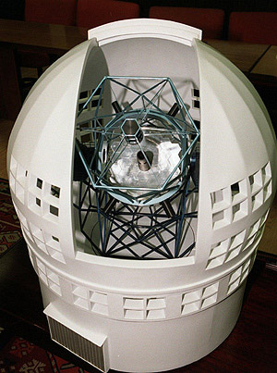
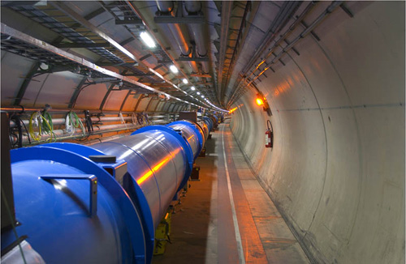
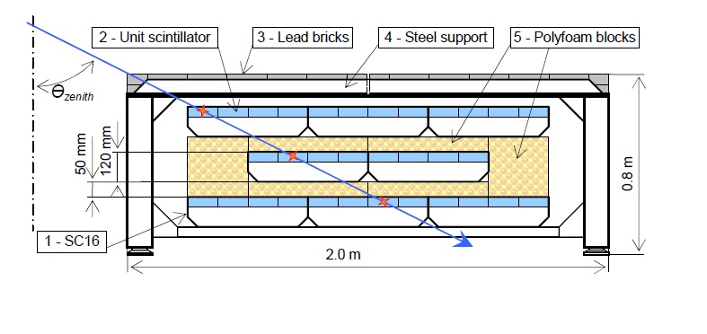
Objective: Coordination of the research in the frontier of Advanced Physics, from fundamental physics to applied physics.
Variety of instrumentation: accelerators, detectors, telescopes,…, in terrestial, underground, underwater, satellites, etc.
Funded by Generalitat Valenciana

Slide 3
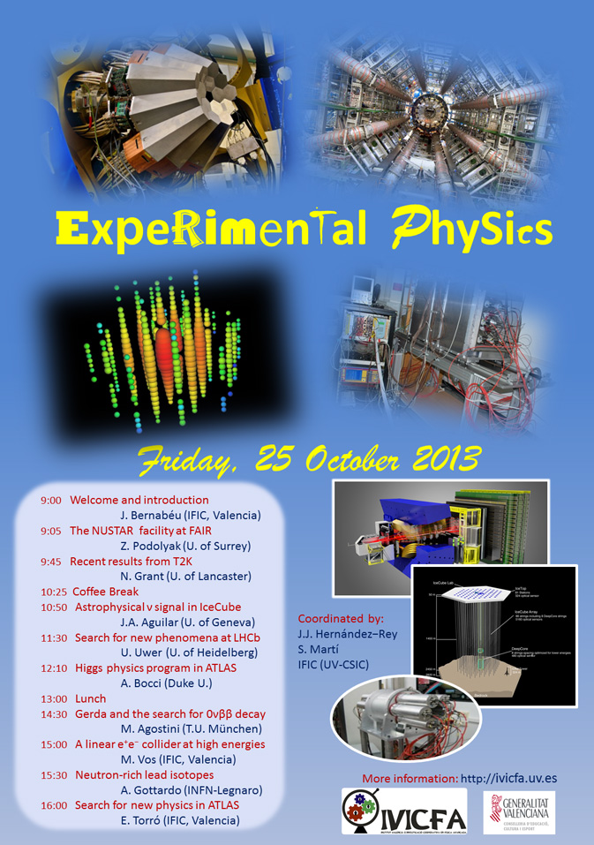

Slide 4






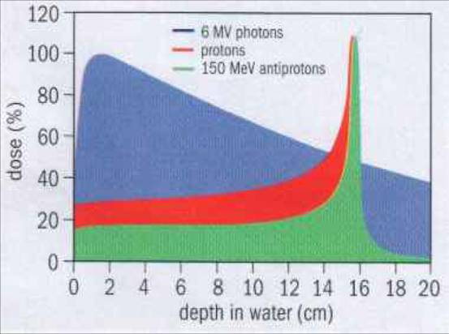
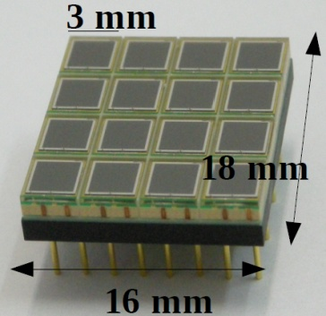
IFIMED
Research on Imaging and Accelerators applied to Medicine
ACTIVITY IN :
- Accelerators for Medical Physics
- Detectors
- Image Science
- e-Health
Coordinator
José Bernabéu - IFIC Valencia

Slide 5
Research on Imaging and Accelerators applied to Medicine
IFIMED
2006 IFIMED is recognized in the Map of ICTS of Spanish Government.
2007 approved in Conference of Presidents by Governments of Spain and Generalitat Valenciana.
2007 IFIMED joins ENLIGHT, European Platform for Medical Physics, participating in EU Projects: PARTNER, ENVISION, INTERVISION, COST,…
2010 The Technical Design Report approved by CAIS (Comisión Asesora de Infraestructuras Singulares)
2012 Modular development of the Facility using FEDER Funding with a collaboration between MINECO and University of Valencia.
2013 The Agreement between MINECO and the Unversity of Valencia approved by Council of Ministers.

